Slide 1
Lecture 38
CSE 331
Dec 4, 2024

Slide 2
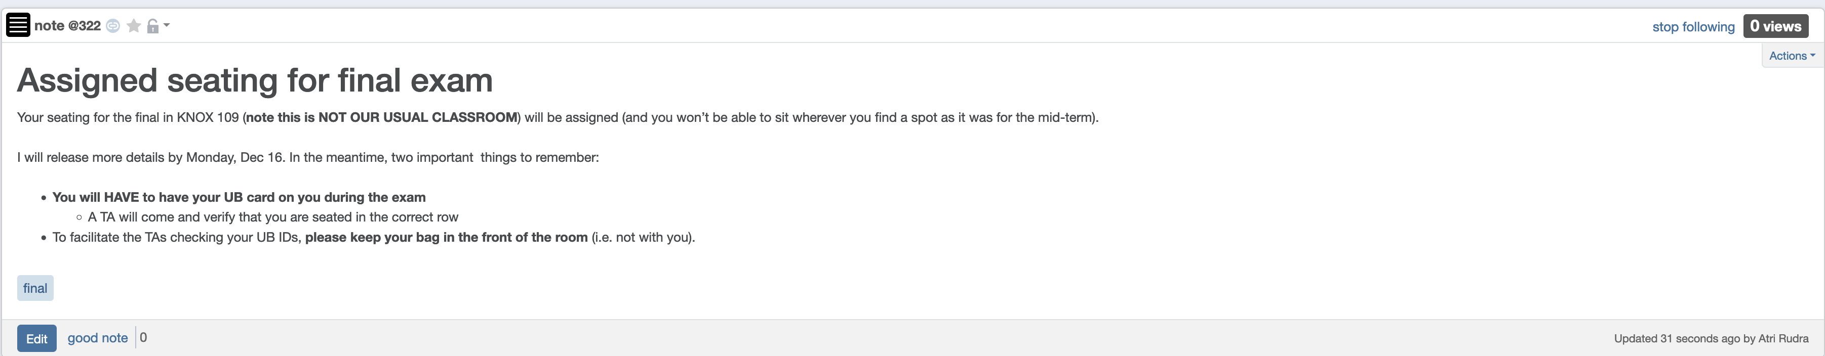
Bring UB card to final exam

Slide 3
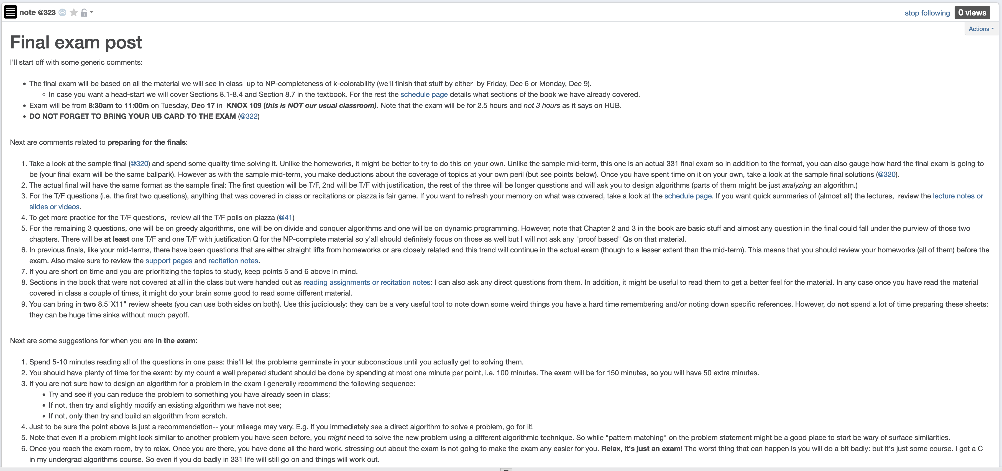
Final exam post

Slide 4
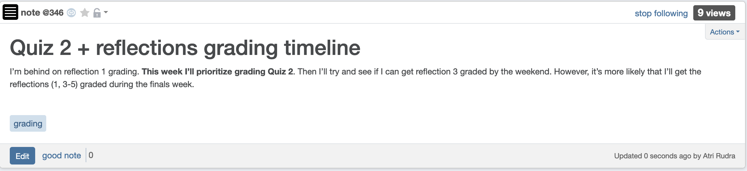
My grading timeline

Slide 5
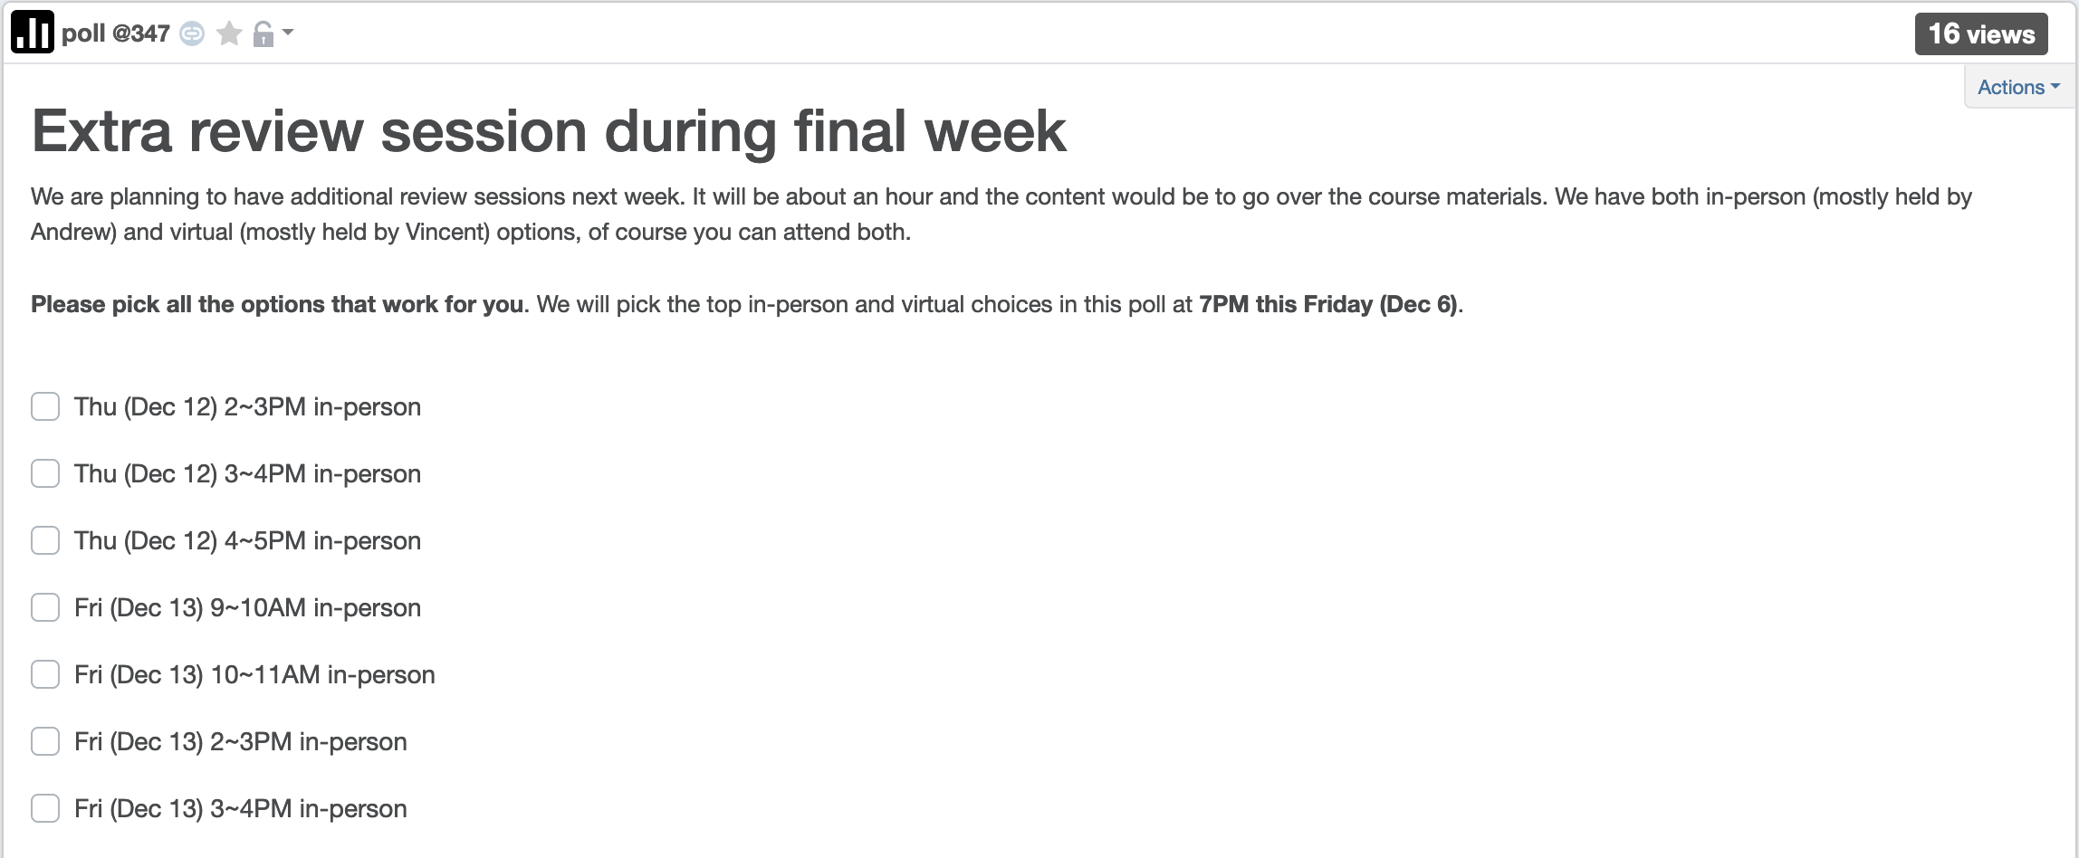
Extra review sessions

Slide 6

Questions?

Slide 7



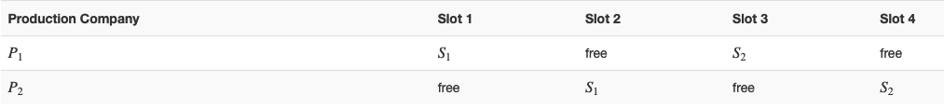
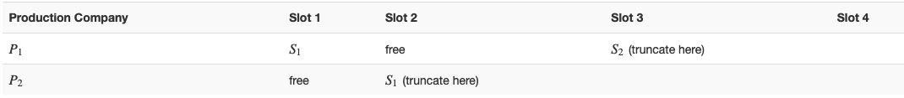






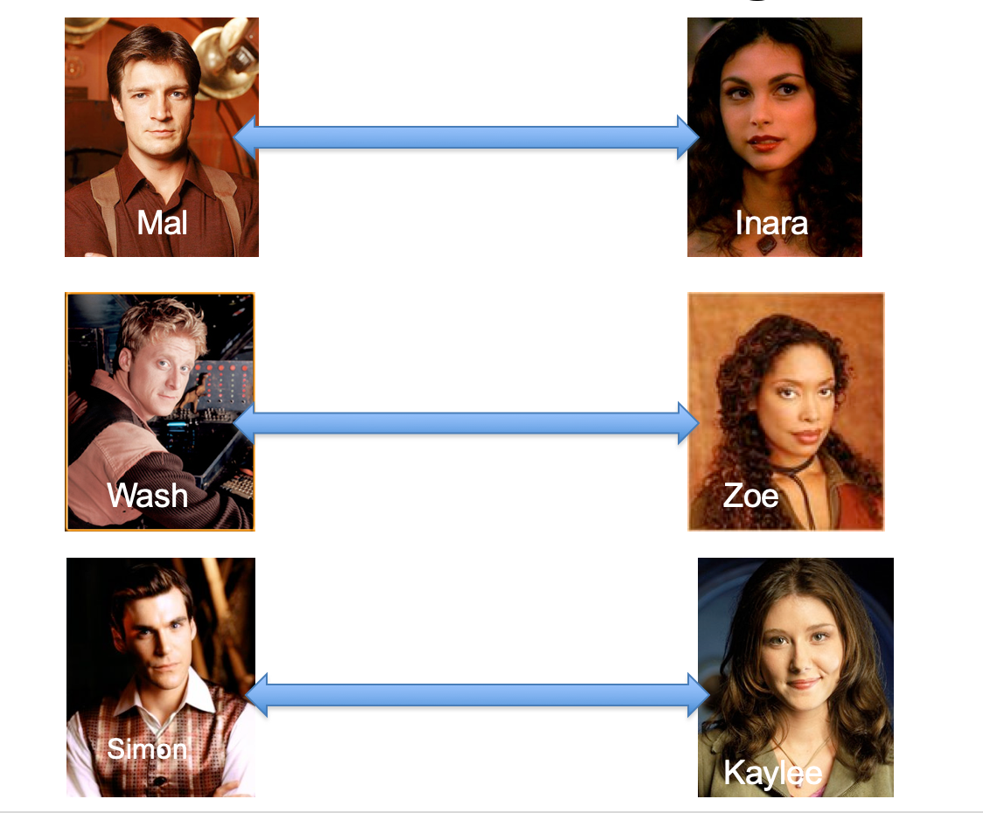
Poly time steps
Arbitrary Y instance
ANY algo for stable matching problem works!
Pre-process the input
Output for Y instance
All processing
is poly-time
Algo for X
Post-process the output

Slide 8



No poly time algo for Y
Poly time algo for X
Arbitrary Y instance
No poly time algo for X
Poly time algo for Y
Pre-process the input
Output for Y instance
All processing
is poly-time
Algo for X
Post-process the output

Slide 9

Independent Set (IS)
Input: Graph G = (V,E) and number k
Output: Yes iff G has an IS of size $≥$k

Slide 10
Today’s agenda
Define 3-SAT problem
Redux from 3-SAT to IS
Recap of NP-completeness

