Slide 1
Lecture 39
CSE 331
Dec 6, 2024

Slide 2
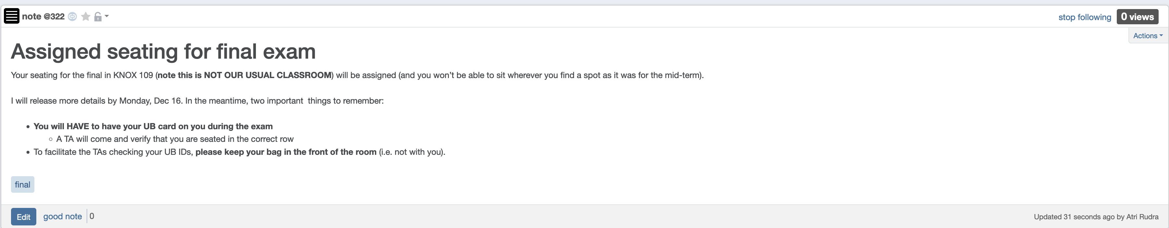
Bring UB card to final exam

Slide 3
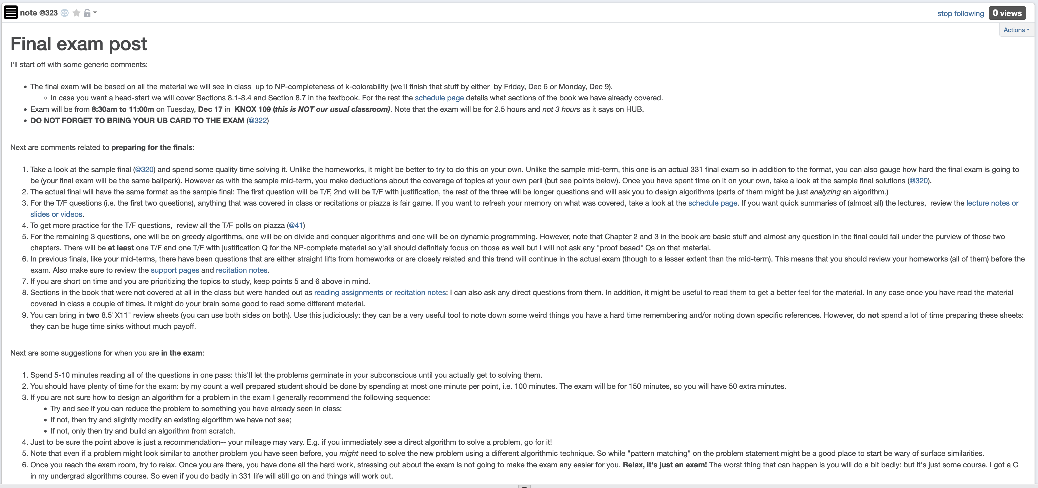
Final exam post

Slide 4
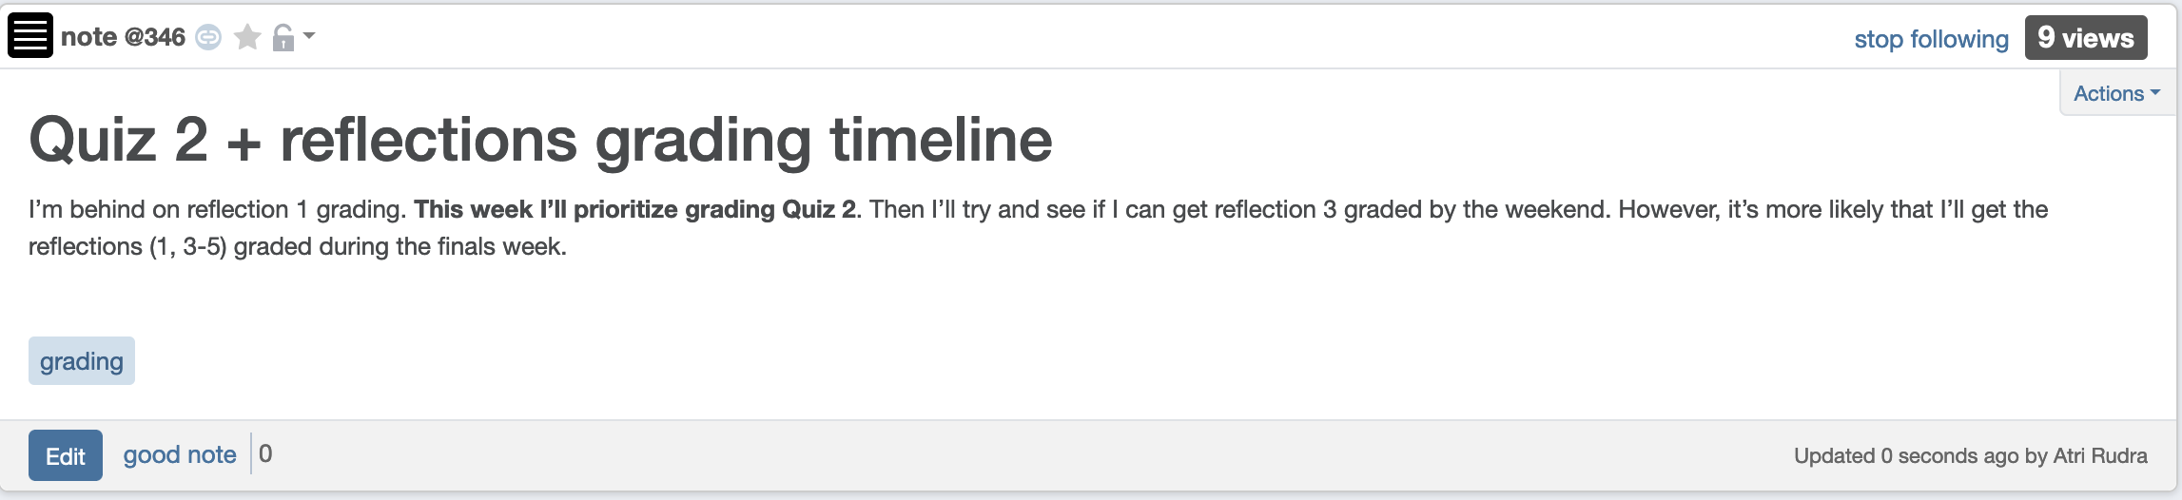
My grading timeline

Slide 5
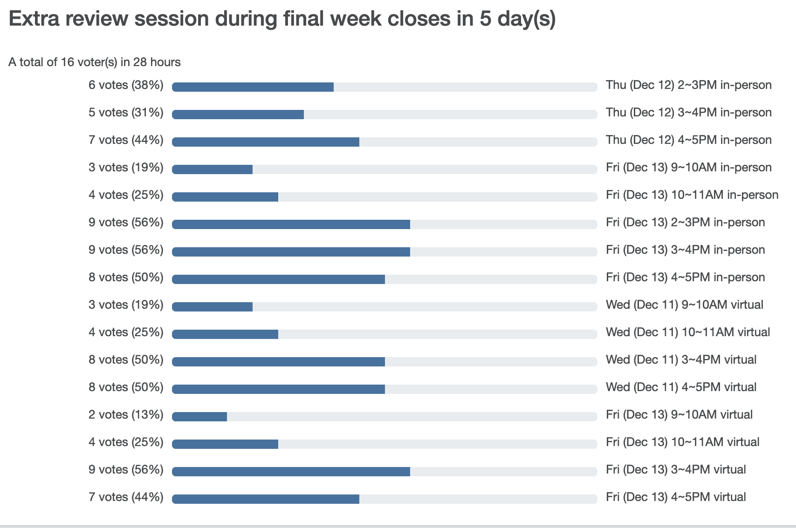
Extra review session next week!

Slide 6
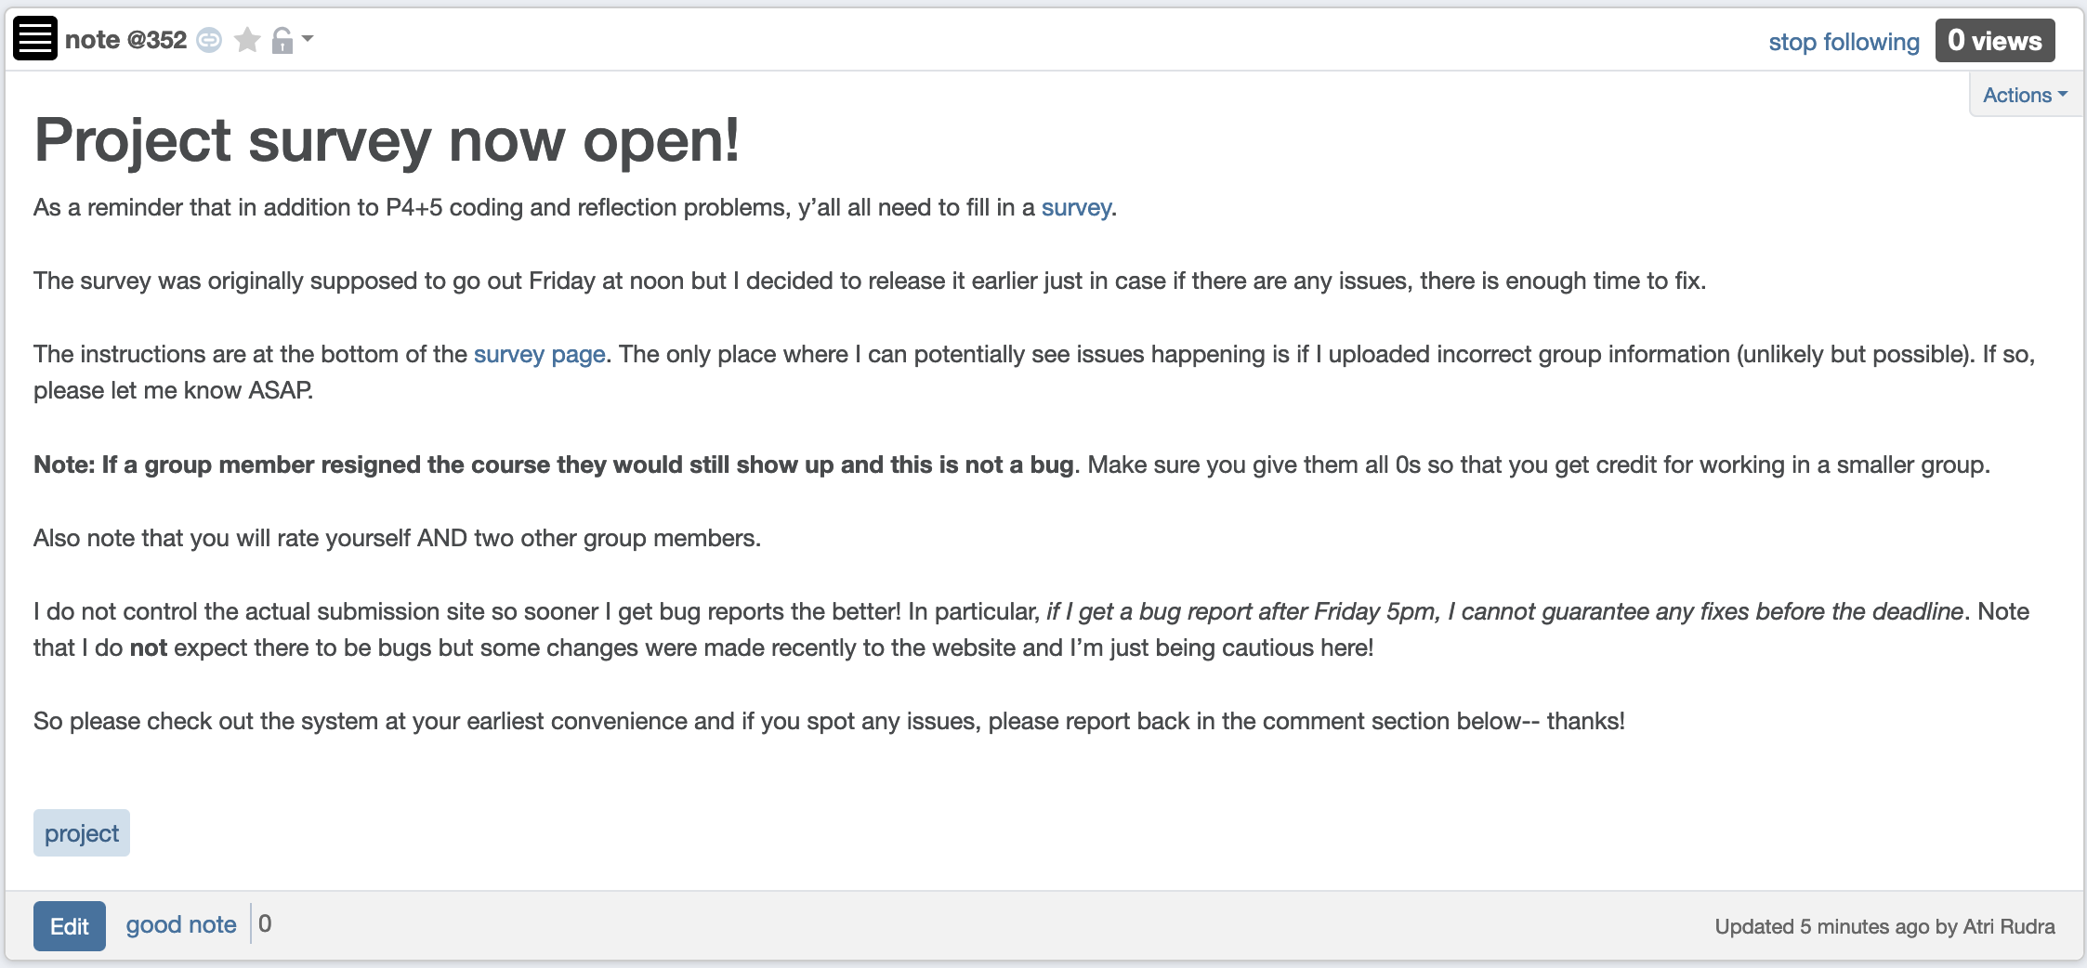
Project Survey Out!

Slide 7
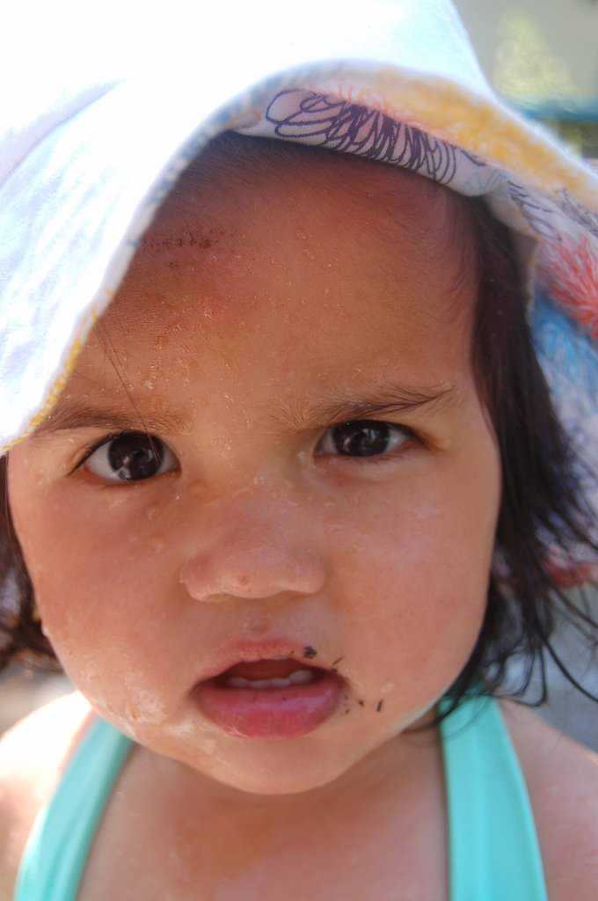
Questions?

Slide 8



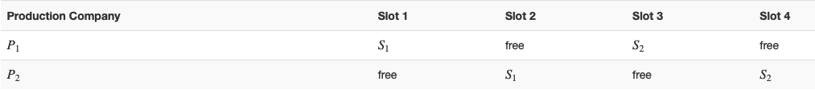
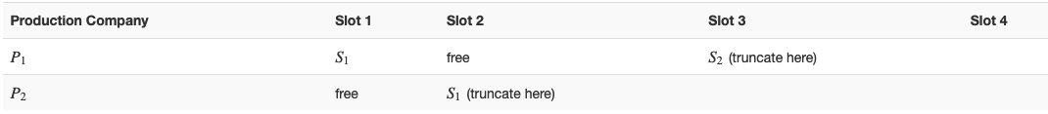



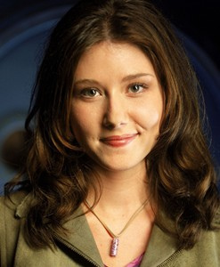
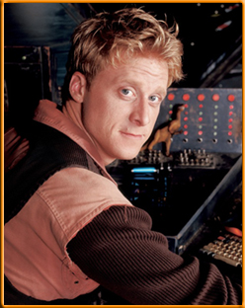

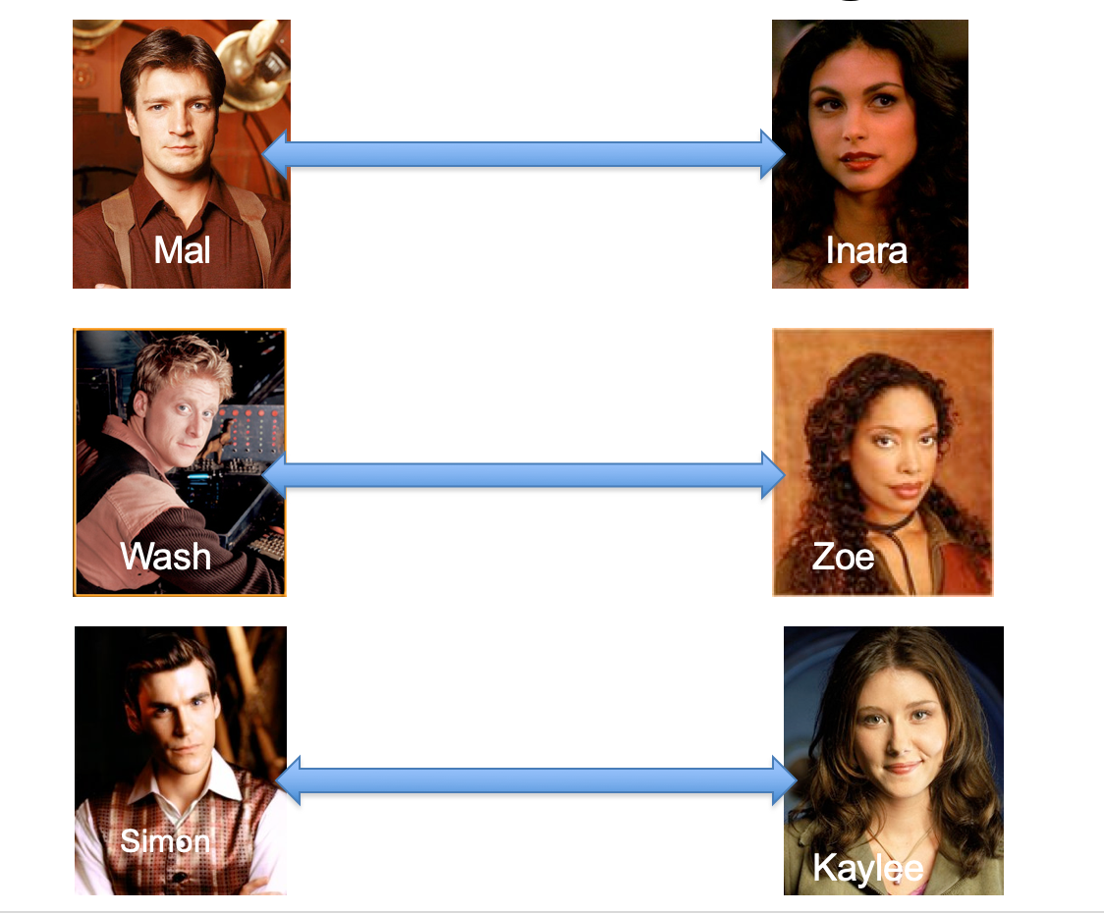
Poly time steps
Arbitrary Y instance
ANY algo for stable matching problem works!
Pre-process the input
Output for Y instance
All processing
is poly-time
Algo for X
Post-process the output

Slide 9



No poly time algo for Y
Poly time algo for X
Arbitrary Y instance
No poly time algo for X
Poly time algo for Y
Pre-process the input
Output for Y instance
All processing
is poly-time
Algo for X
Post-process the output

Slide 10

Independent Set (IS)
Input: Graph G = (V,E) and number k
Output: Yes iff G has an IS of size $≥$k

Slide 11

Vertex Cover (VC)
Input: Graph G = (V,E) and number k
Output: Yes iff G has a VC of size $≤$k

Slide 12

Arbitrary Y instance
AlgoIS (G,k)
G’ = G
Pre-process the input
Output for Y instance
k’ = n-k
b = AlgoVC(G’,k’)
Algo for X
return b
Post-process the output
(G,n-k)
Algo for VC
(G,k)

Slide 13

3-SAT problem
3-SAT formula (variables X₁,…,X_{n}) : C₁, …, C_{m}
Each clause C_{i} is t₁ OR t₂ OR t₃
Each t_{i} is X_{j} or !X_{j} for some j
Input: a 3-SAT formula $Φ$
Output: Yes/1 iff there exists a satisfying assignment for $Φ$

Slide 14
Questions?

Slide 15
Today’s agenda
Finish 3-SAT to IS reduction
k-colorability

