Slide 1
Lecture 4
CSE 331
Sep 4, 2024

Slide 2
Please do keep on asking Qs!
The only bad question is the one that is not asked!
Not just technical Qs but also on how the class is run

Slide 3

We’re not mind readers

Slide 4

If you need it, ask for help

Slide 5
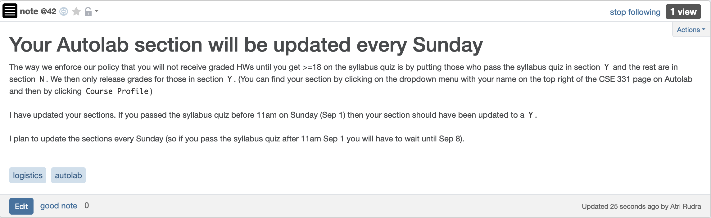
Syllabus Quiz (and sections)

Slide 6
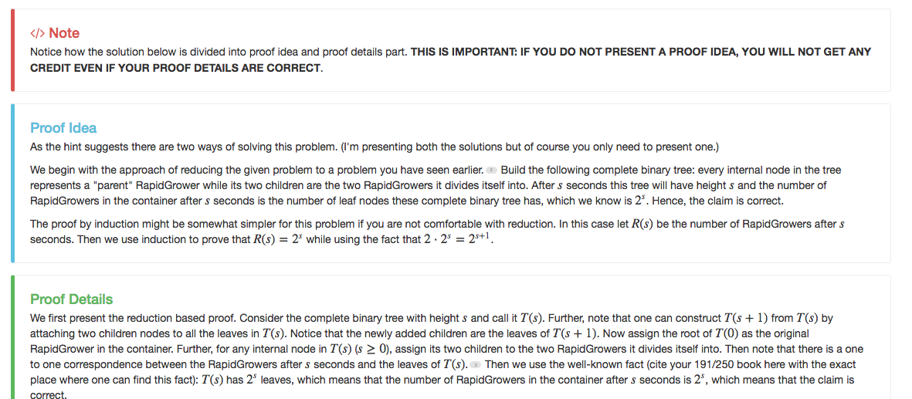
Separate Proof idea/proof details

Slide 7
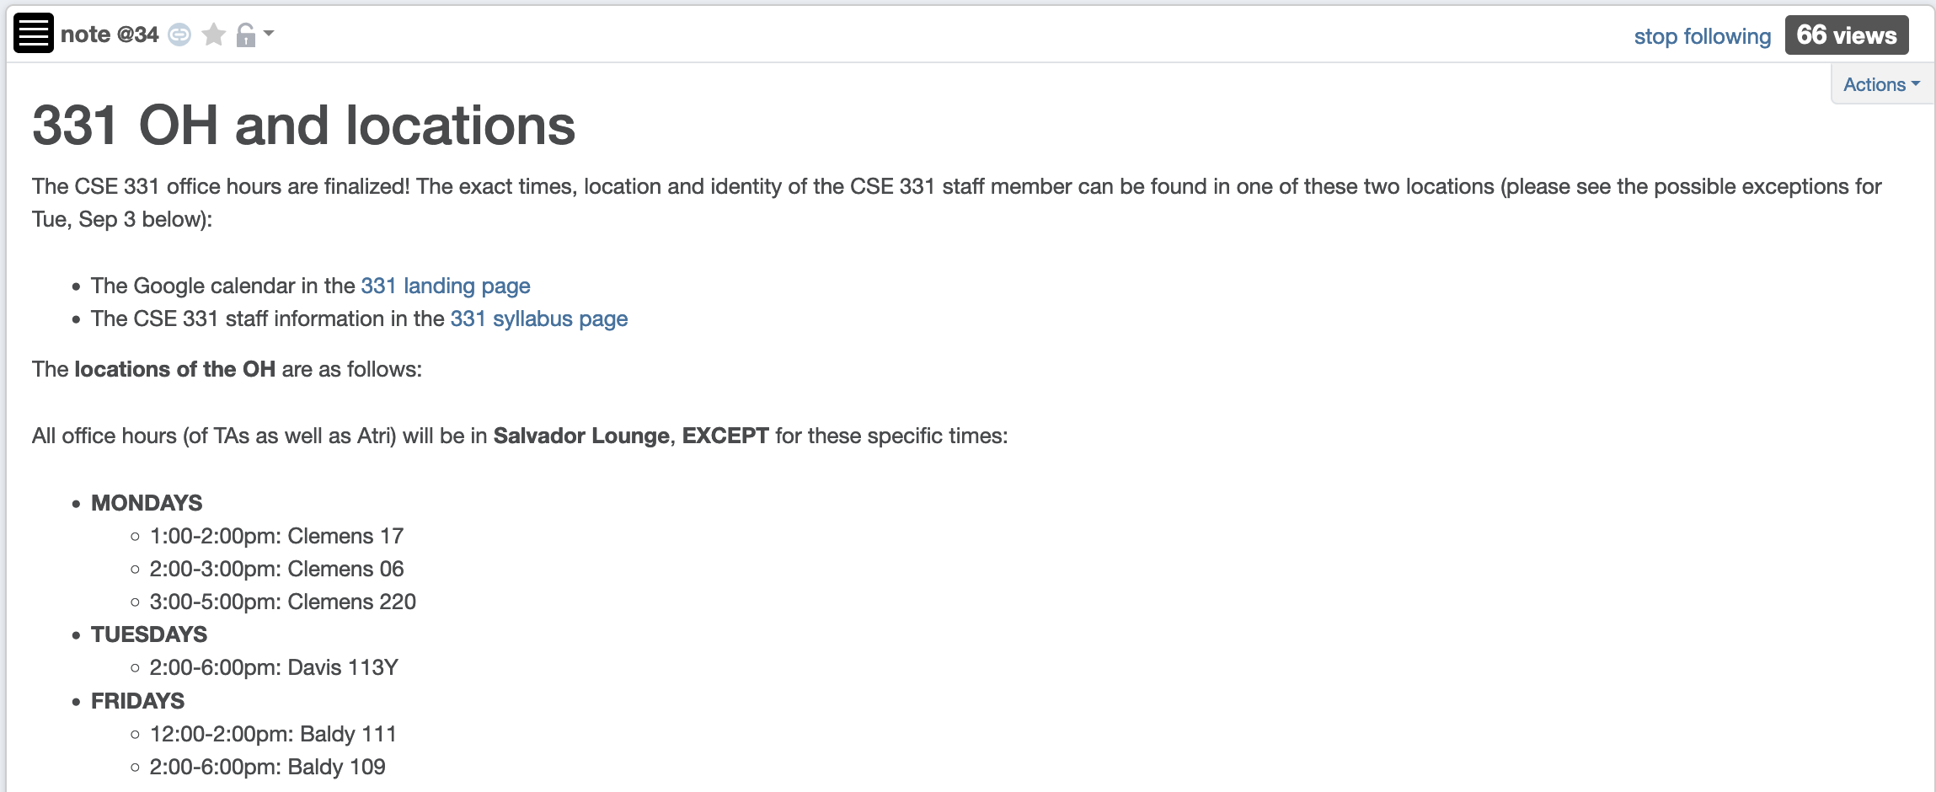
Office hours finalized
Come ask your proof related Questions!

Slide 8
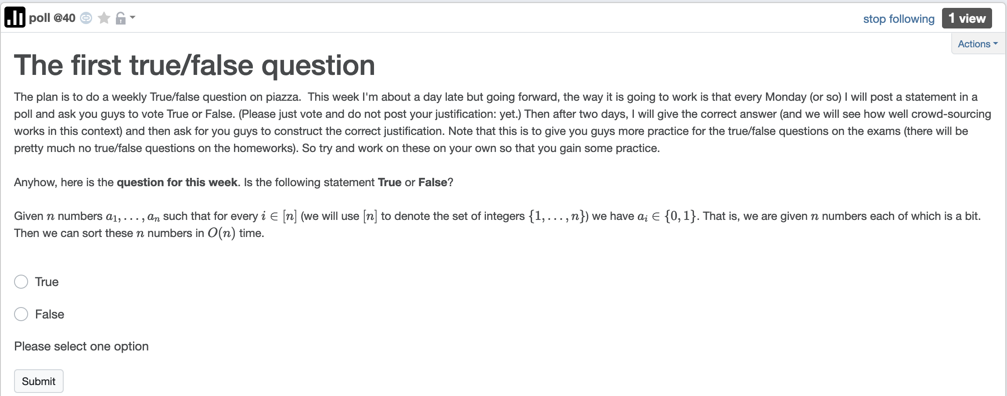
1st True/False poll

Slide 9
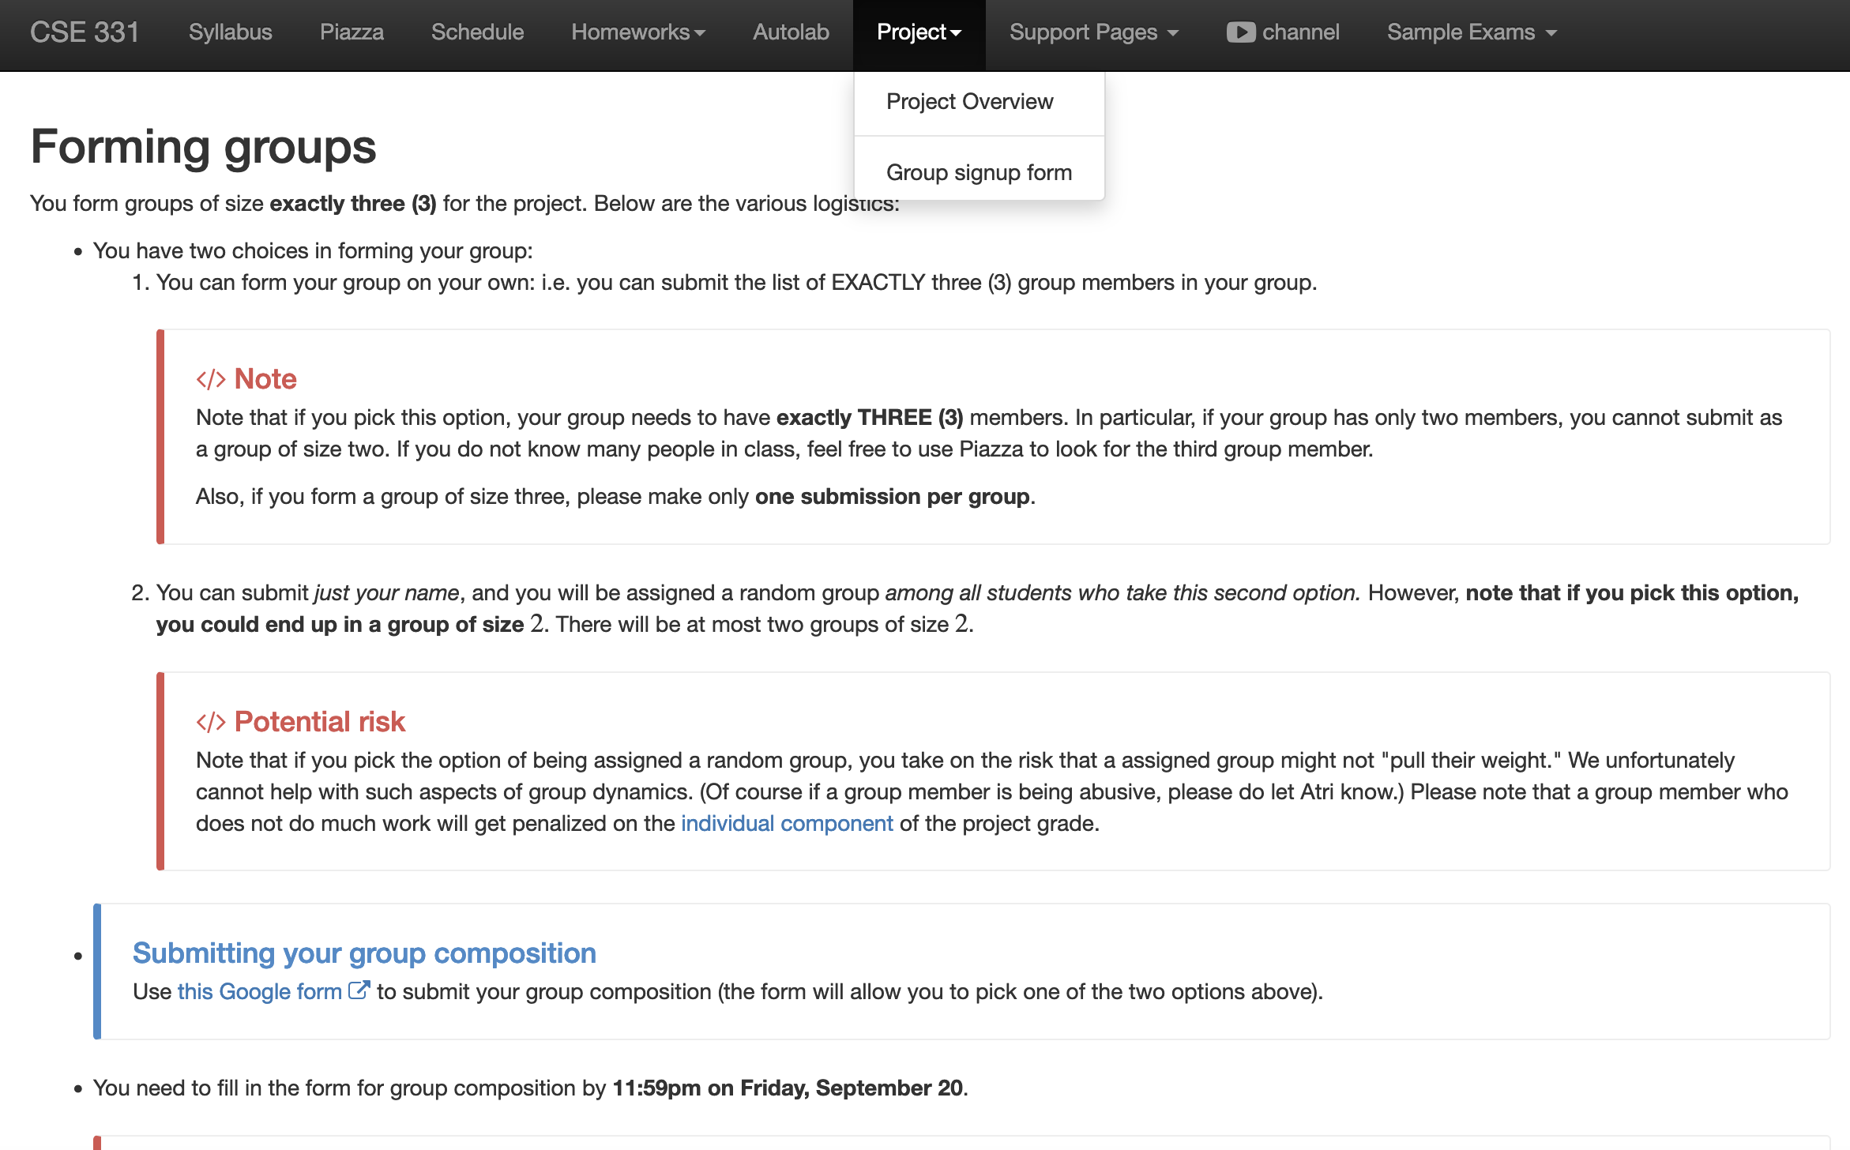
Register your project groups
Deadline: Friday, Sep 20, 11:59pm
If you miss this deadline then you will get a ZERO on the ENTIRE project

Slide 10
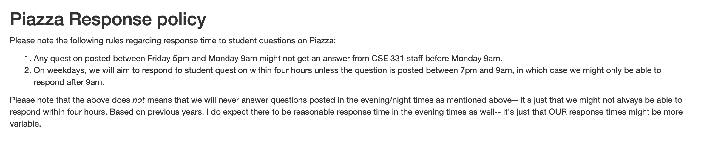
Piazza Response policy

Slide 11
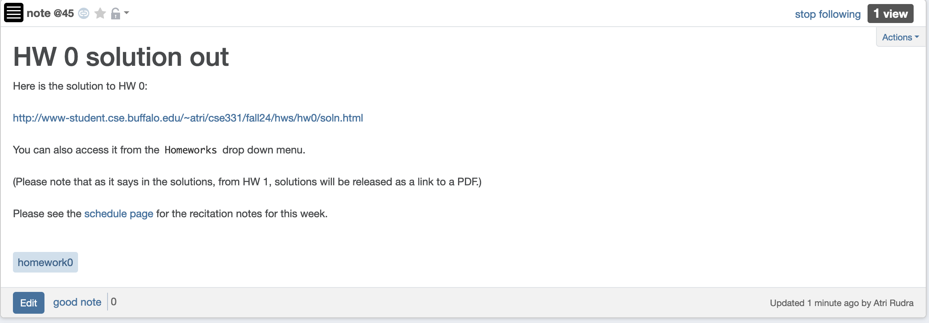
Solutions to HW 0 out

Slide 12
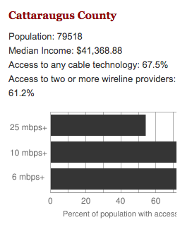
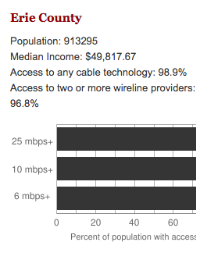
Make broadband more available
BOTH technical and societal issues
Say you are tasked to come up with the infrastructure

Slide 13
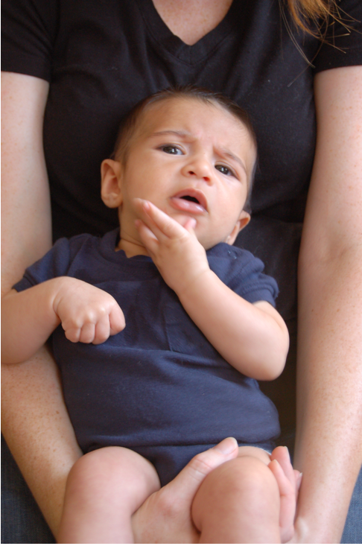
Questions/Comments?

Slide 14
Make broadband more available
Input requirements
Is Internet a right?
Environmental factors
Where are the customers located?
Security/Privacy
What are the bandwidth requirements?
Where is funding coming
from?
How is the input represented?
Income inequality in
population
What objective are we optimizing?
How should the connections be configured?
Get regulatory approval
Output requirements
Hire people
Get access to physical space
Problem Definition
Outreach
Where should we lay down the physical stuff?
What algorithm should be use to do this?
Algorithm Design
Implement the scheme
How should we do testing and maintenance?

Slide 15
Main Steps in Algorithm Design
Problem Statement
Real world problem
Problem Definition
Precise mathematical def
Algorithm
“Implementation”
Data Structures
Analysis
Correctness/Run time

Slide 16
Questions/Comments?

Slide 17

National Resident Matching

Slide 18

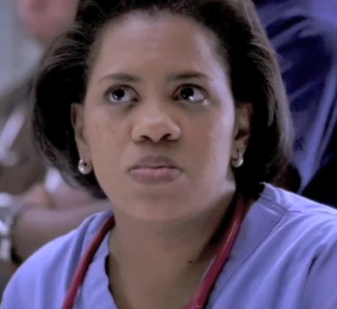




(Screen) Docs are coming to BUF
Buffalo General
Bailey (Grey’s Anatomy)
Millard Filmore (Gates Circle)
JD (Scrubs)
Millard Filmore (Suburban)

Slide 19
What can go wrong?

Slide 20
The situation is unstable!

Slide 21

What happens in real life
Preferences
Information
Preferences

Slide 22
NRMP plays matchmaker

Slide 23
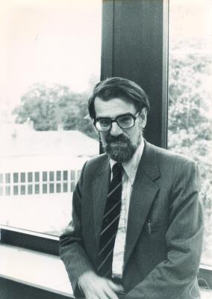
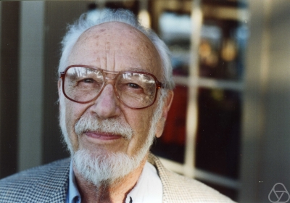
Stable Matching Problem
David Gale
Lloyd Shapley*

Slide 24
Questions/Comments?

Slide 25
Incorrect Proof Details: Q1(b) on HW0
Argument does not use ANYTHING about the problem statement!
Follows from part (a)
Let P(n) be the number of perfect matchings with n men and n women
Base case: P(1) = 1! = 1
This assumes number of perfect matchings only depends on n
Inductive hypothesis: Assume that P(n-1) = (n-1)!
Inductive step: Note that P(n) = n*P(n-1) = n*(n-1)! = n!
What are the issues with the above “proof”?

Slide 26
Incorrect Proof Details: Q1(b) on HW0
Needs justification
Claim 1: Number of perfect matchings is = number of permutations of
1…n
Claim 2: Number of permutations of 1…n is n!
Needs justification
Claims 1 + 2 prove the result
Follow from 191 (?)
What are the issues with the above proof?

Slide 27
Proof by contradiction for Q1(a)
Assume for contradiction there is an example where number of perfect
matchings depends on the identities of the men and women.
Let n =1 and consider two cases
(1) M = {BP} and W = {JA}
(2) M = {BBT} and W = {AJ}
You can only assume things about the example directly implied by it being a counter-example
In both cases the number of perfect matchings is 1 = 1!
There is NO contradiction
Hence contradiction.
What are the issues with the above proof?

Slide 28
Questions/Comments?

Slide 29
Matching Employers & Applicants
Input: Set of employers (E)
Set of applicants (A)
Preferences
Output: An assignment of applicants to employers that is “stable”
For every x in A and y in E such that x is not assigned to y, either
(i) y prefers every accepted applicant to x; or
(ii) x prefers her employer to y

