Slide 1
Lecture 40
CSE 331
Dec 9, 2024

Slide 2
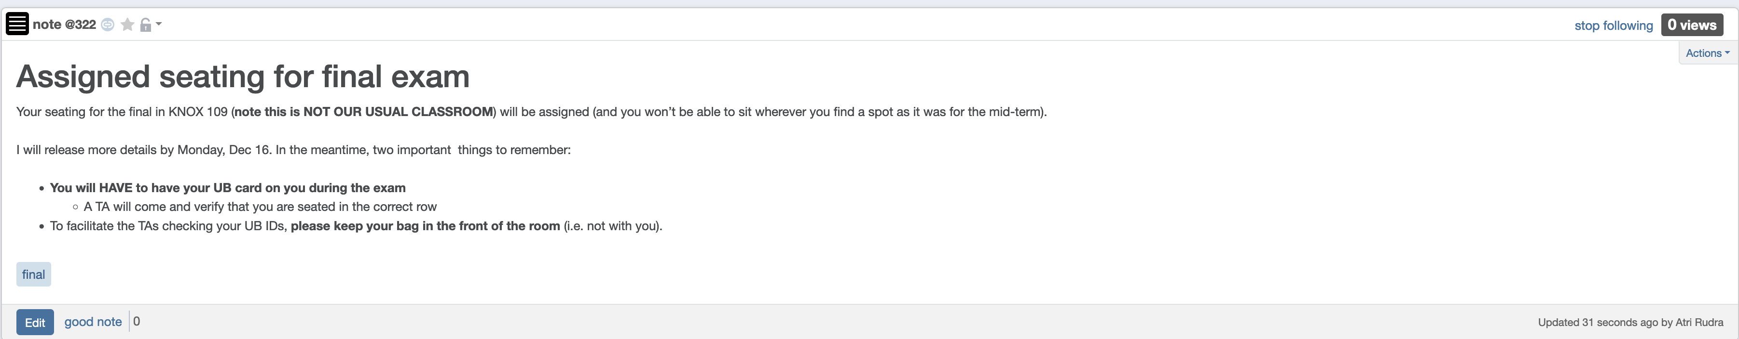
Bring UB card to final exam

Slide 3
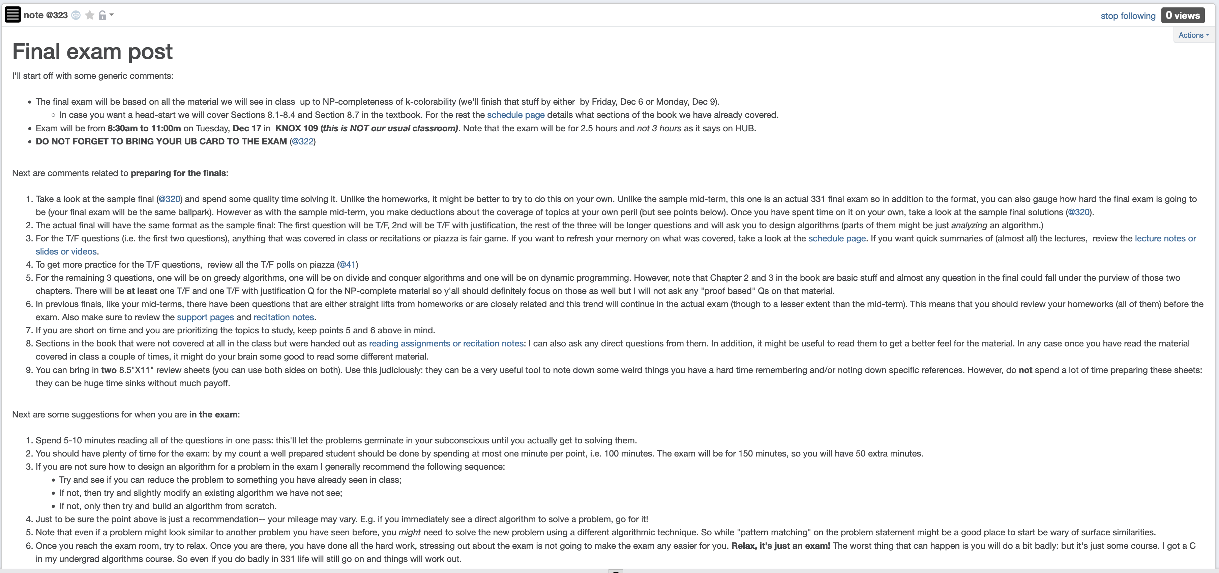
Final exam post

Slide 4
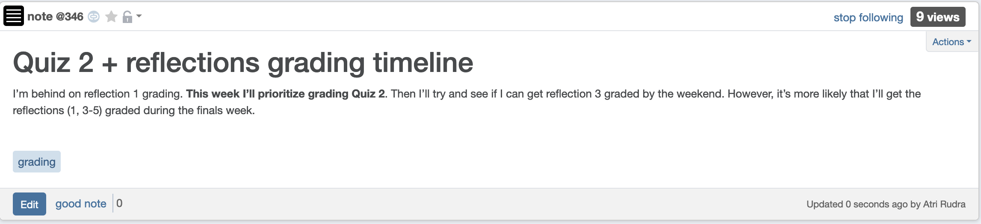
My grading timeline

Slide 5
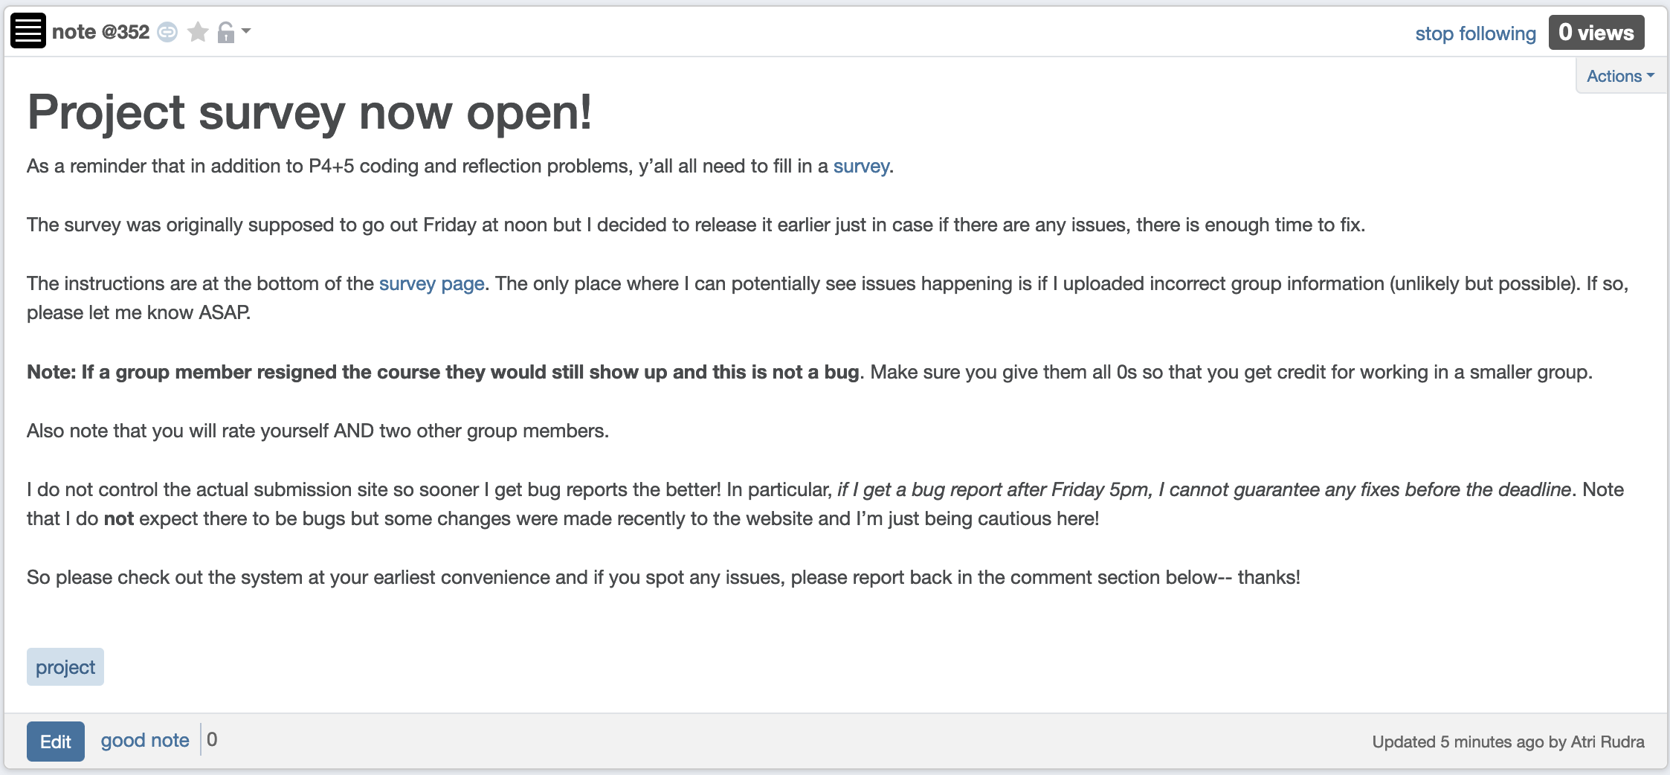
Project Survey Out!

Slide 6
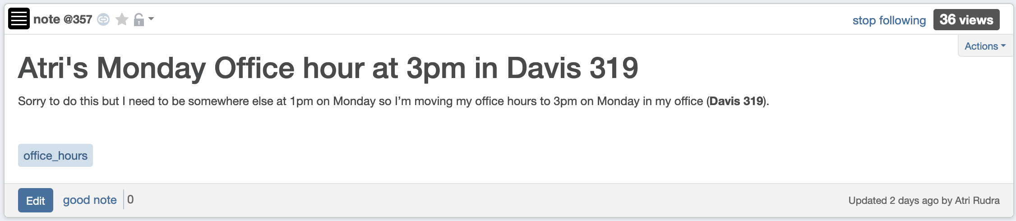
My office hour today at 3pm

Slide 7
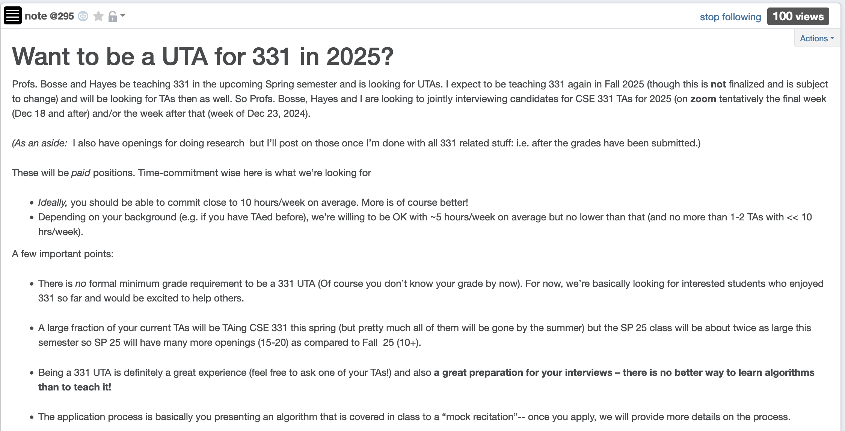
Consider applying for 331 TA!

Slide 8

Questions?

Slide 9

3-SAT problem
3-SAT formula (variables X₁,…,X_{n}) : C₁, …, C_{m}
Each clause C_{i} is t₁ OR t₂ OR t₃
Each t_{i} is X_{j} or !X_{j} for some j
Input: a 3-SAT formula $Φ$
Output: Yes/1 iff there exists a satisfying assignment for $Φ$
3-SAT is NP-Complete

Slide 10
3-coloring problem
Input: Graph G
Output: 1 if G is 3-colorable
3-coloring is in NP

Slide 11

Today’s agenda
3-SAT $≤$_{P} 3-coloring
What beyond CSE 331?

Slide 12
Questions?

Slide 13
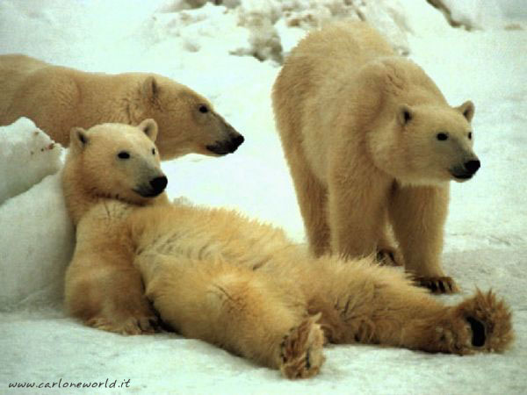
Now relax…

Slide 14
Halting Problem
Input: A program P and input I
Output: Yes if P terminates on I
No otherwise
Theorem: There is no algo A’ for Halting problem (as long as A’ terminates)

Slide 15
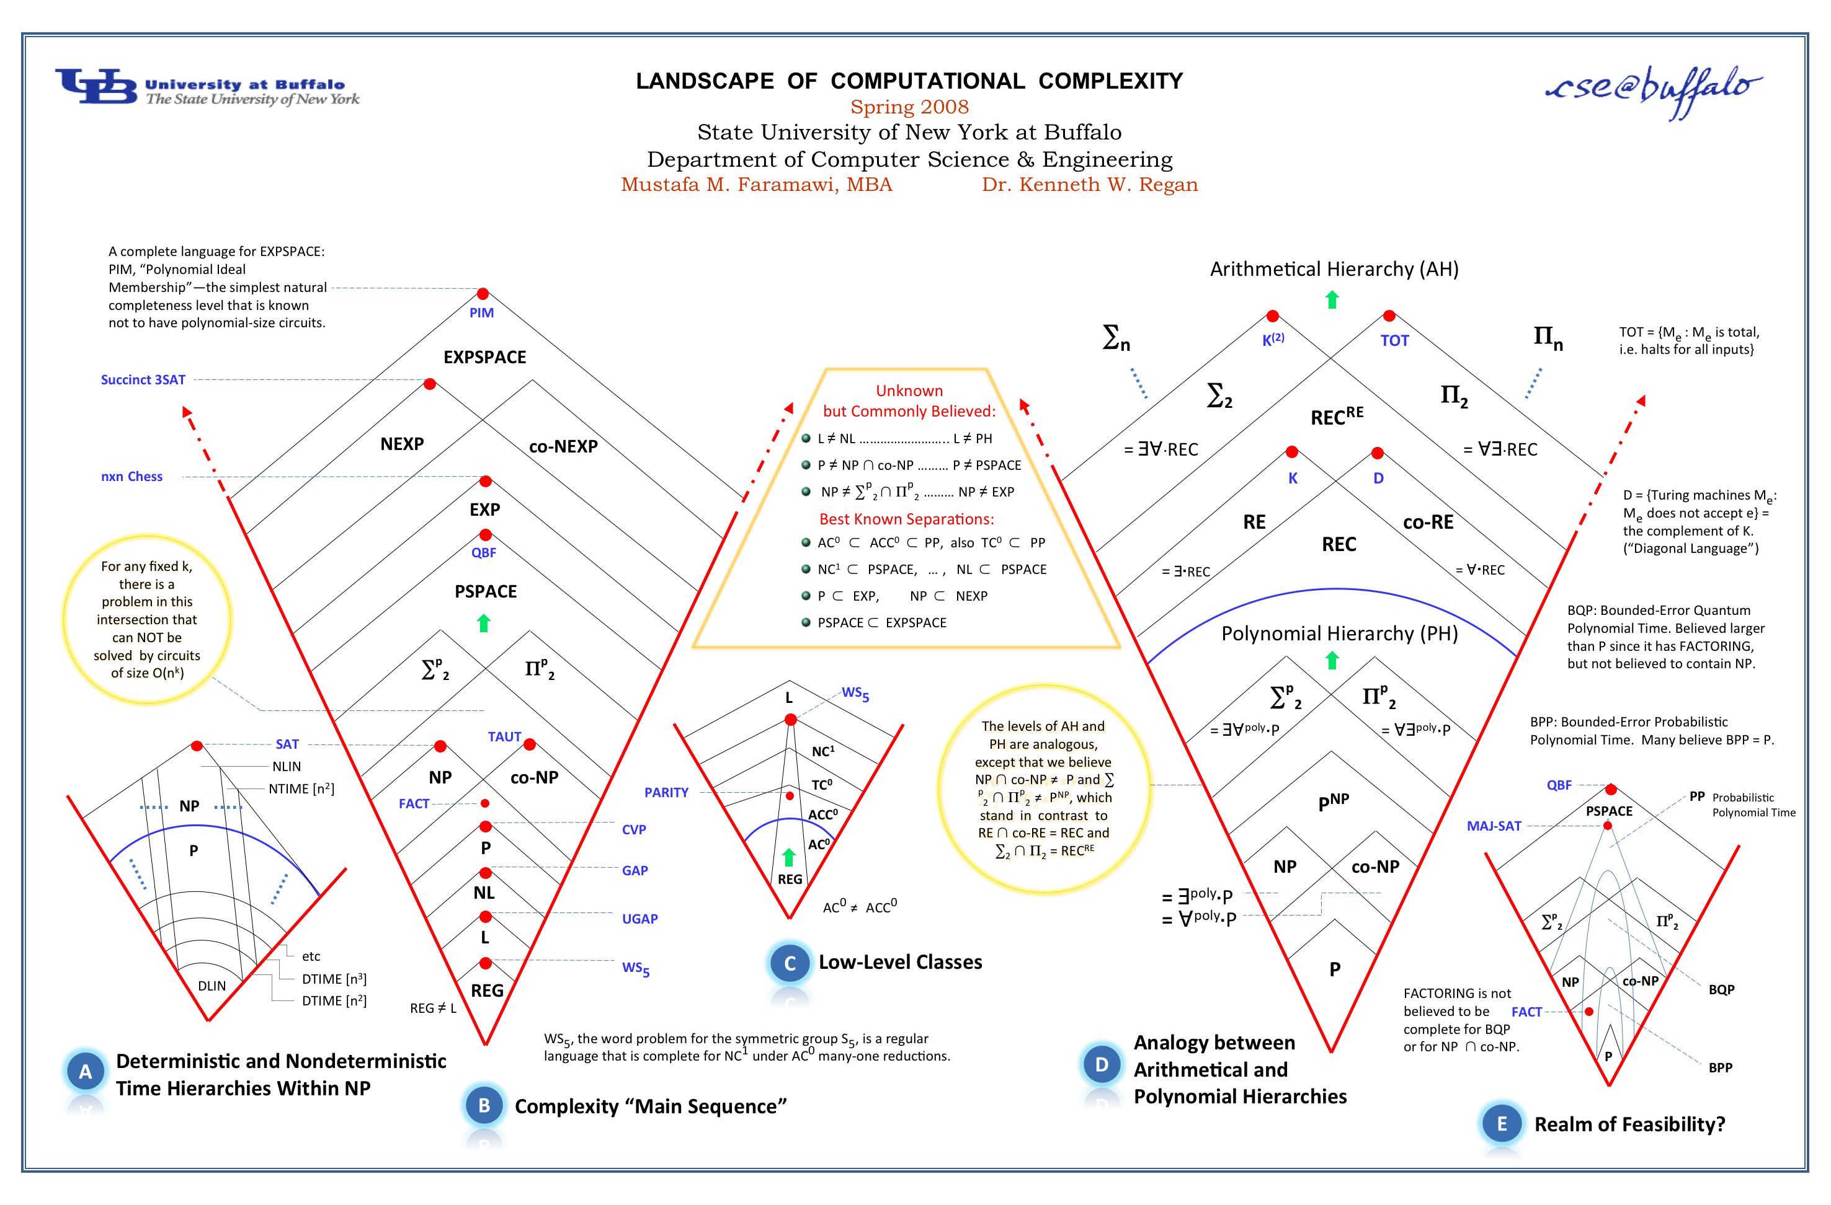
Anything > NP and < undecidability?

Slide 16
Questions?

Slide 17

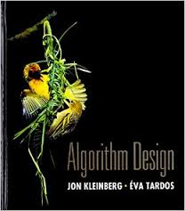
Randomized algorithms
What is different?
Algorithms can toss coins and make decisions
A Representative Problem
Hashing
http://calculator.mathcaptain.com/coin-toss-probability-calculator.html
Further Reading
CSE 432
Chapter 13 of the textbook

Slide 18
Approximation algorithms
Cool twist: NP-hardness of approximations!
What is different?
Algorithms can output a solution that is say 50% as good as the optimal
A Representative Problem
Vertex Cover
Further Reading
Chapter 12 of the textbook

Slide 19
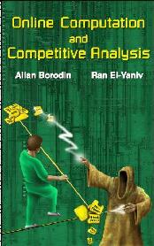
Online algorithms
What is different?
Algorithms have to make decisions before they see all the input
A Representative Problem
Secretary Problem
Further Reading

Slide 20
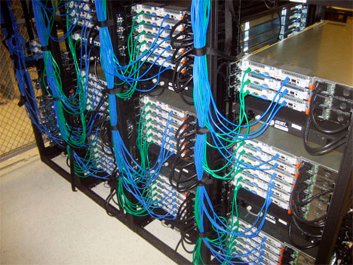
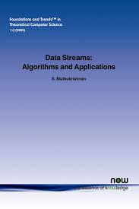
Data streaming algorithms
What is different?
https://www.flickr.com/photos/midom/2134991985/
One pass on the input with severely limited memory
A Representative Problem
Compute the top-10 source IP addresses
Further Reading

Slide 21
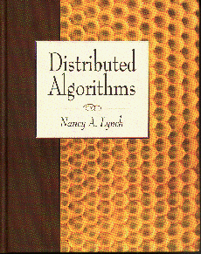
Distributed algorithms
What is different?
Input is distributed over a network
A Representative Problem
Consensus
Further Reading

Slide 22

Beyond-worst case analysis
What is different?
Analyze algorithms in a more instance specific way
A Representative Problem
Intersect two sorted sets
Further Reading
http://timroughgarden.org/f14/f14.html

Slide 23


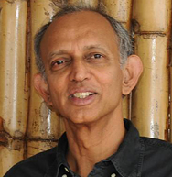
Algorithms for Data Science
What is different?
Algorithms for non-discrete inputs
A Representative Problem
Compute Eigenvalues
Further Reading
https://home.ttic.edu/~avrim/book.pdf

Slide 24
Algorithms and Society
What is different?
Measuring and correcting for harms caused by Algorithms
A Representative Problem
Bias in ML
CSE 440 in Spring 25: ML and Society

Slide 25
Q & A session
CSE 331 related Questions?
Any other Questions?

Slide 26


Whatever your impression of the 331
IT WAS
RIDING

Slide 27

Hopefully it was fun!

Slide 28

Thanks!
Except of course Reflections 4+5, survey and the final exam

