Slide 1
Lecture 5
CSE 331
Sep 6, 2024

Slide 2
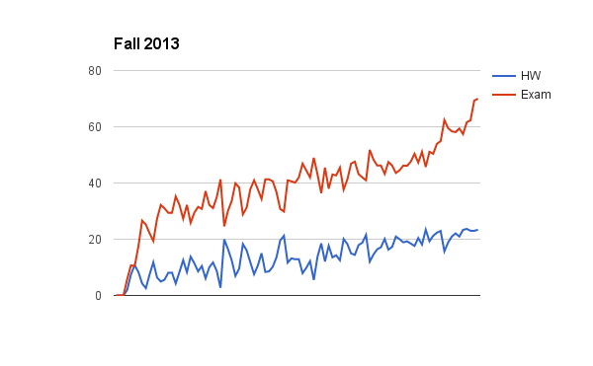
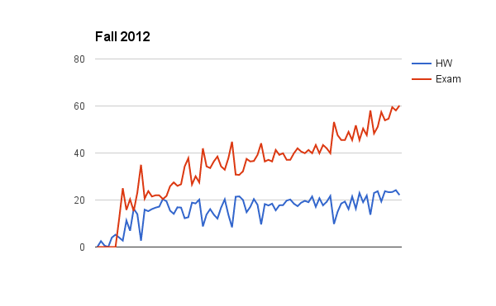
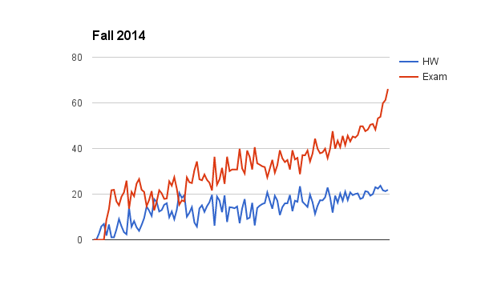
Can you guess the correlation?

Slide 3
Another comment
Discomfort with proofs
I will not cover proof basics in class anymore
Please read support pages and some utilize (next few) Office hours!

Slide 4
Lecture pace (until Fall 18)
Mid-term

Slide 5
Lecture pace
Mid-term

Slide 6
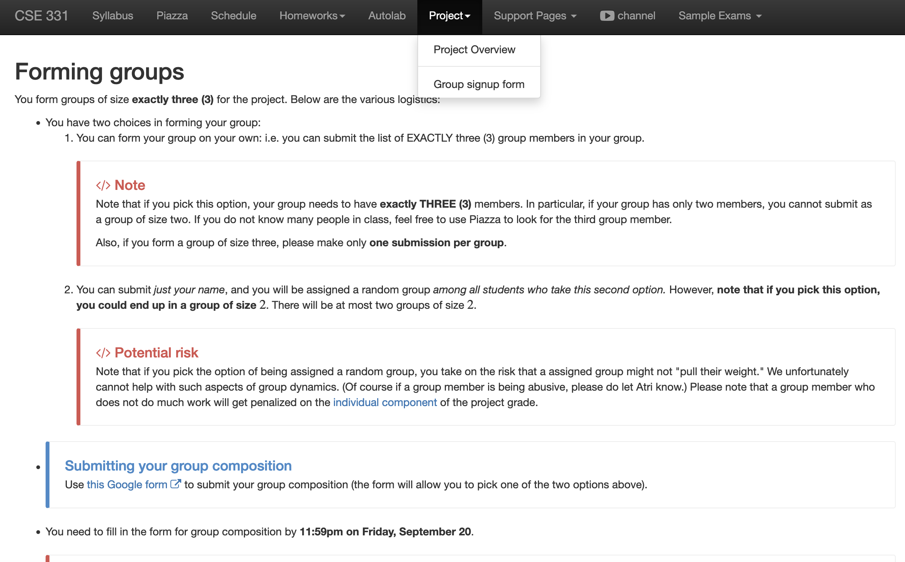
Register your project groups
Deadline: Friday, Sep 20, 11:59pm
If you miss this deadline then you will get a ZERO on the ENTIRE project

Slide 7
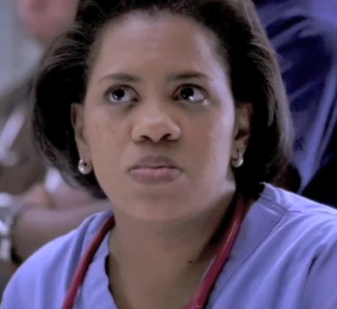

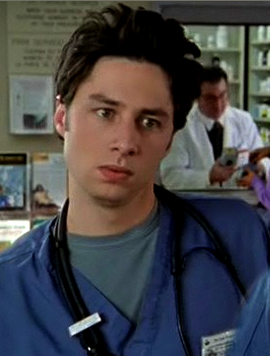

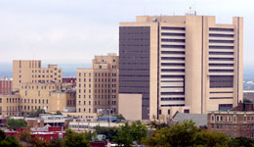
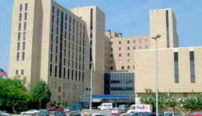

What happens in real life
Preferences
Information
Preferences

Slide 8
NRMP plays matchmaker

Slide 9
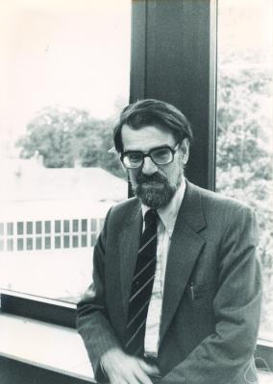
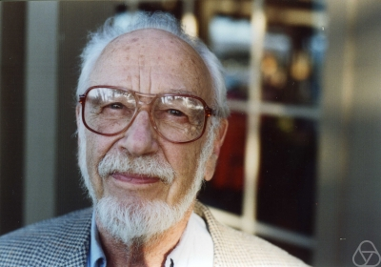
Stable Matching Problem
David Gale
Lloyd Shapley*

Slide 10
Matching Employers & Applicants
Input: Set of employers (E)
Set of applicants (A)
Preferences
Output: An assignment of applicants to employers that is “stable”
For every x in A and y in E such that x is not assigned to y, either
(i) y prefers every accepted applicant to x; or
(ii) x prefers her employer to y

Slide 11
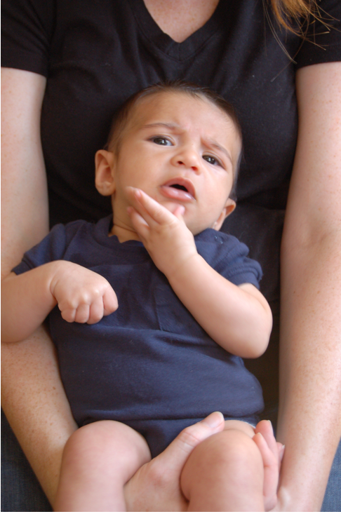
Questions/Comments?

Slide 12
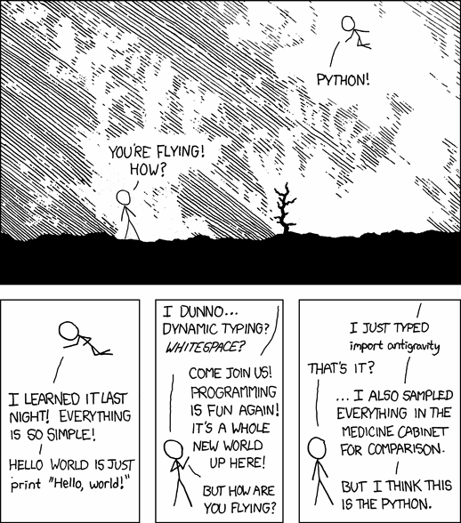
Simplicity is good
http://xkcd.com/353/

Slide 13
Questions to think about
1) How do we specify preferences?
Preference lists
2) Ratio of applicant vs employers
1:1
3) Formally what is an assignment?
(perfect) matching
4) Can an employer get assigned > 1 applicant?
NO
5) Can an applicant have > 1 job?
NO
6) How many employer/applicants in an applicants/employers preferences?
All of them
7) Can an employer have 0 assigned applicants?
NO
8) Can an applicant have 0 jobs?
NO

Slide 14
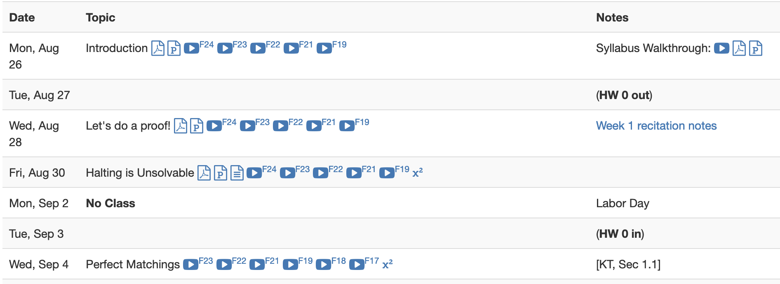
Lost in Notation….

Slide 15
Non-feminist reformulation
n men
Each with a preference list
n women
Match/marry them in a “stable” way

Slide 16

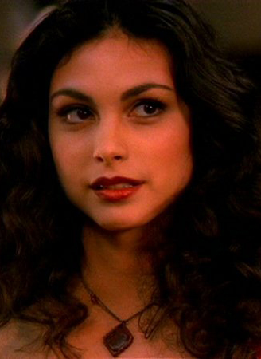

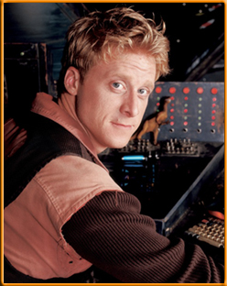
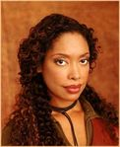

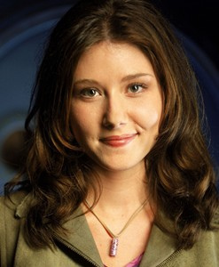
On matchings
Mal
Inara
Wash
Zoe
Simon
Kaylee

Slide 17
Is this a valid matching?
Mal
Inara
Wash
Zoe
Simon
Kaylee

Slide 18
Is this a valid matching?
Mal
Inara
Wash
Zoe
Simon
Kaylee

Slide 19
Is this a valid matching?
Mal
Inara
Wash
Zoe
Simon
Kaylee

Slide 20
Which one is a perfect matching?
Mal
Inara
Wash
Zoe
Simon
Kaylee

Slide 21
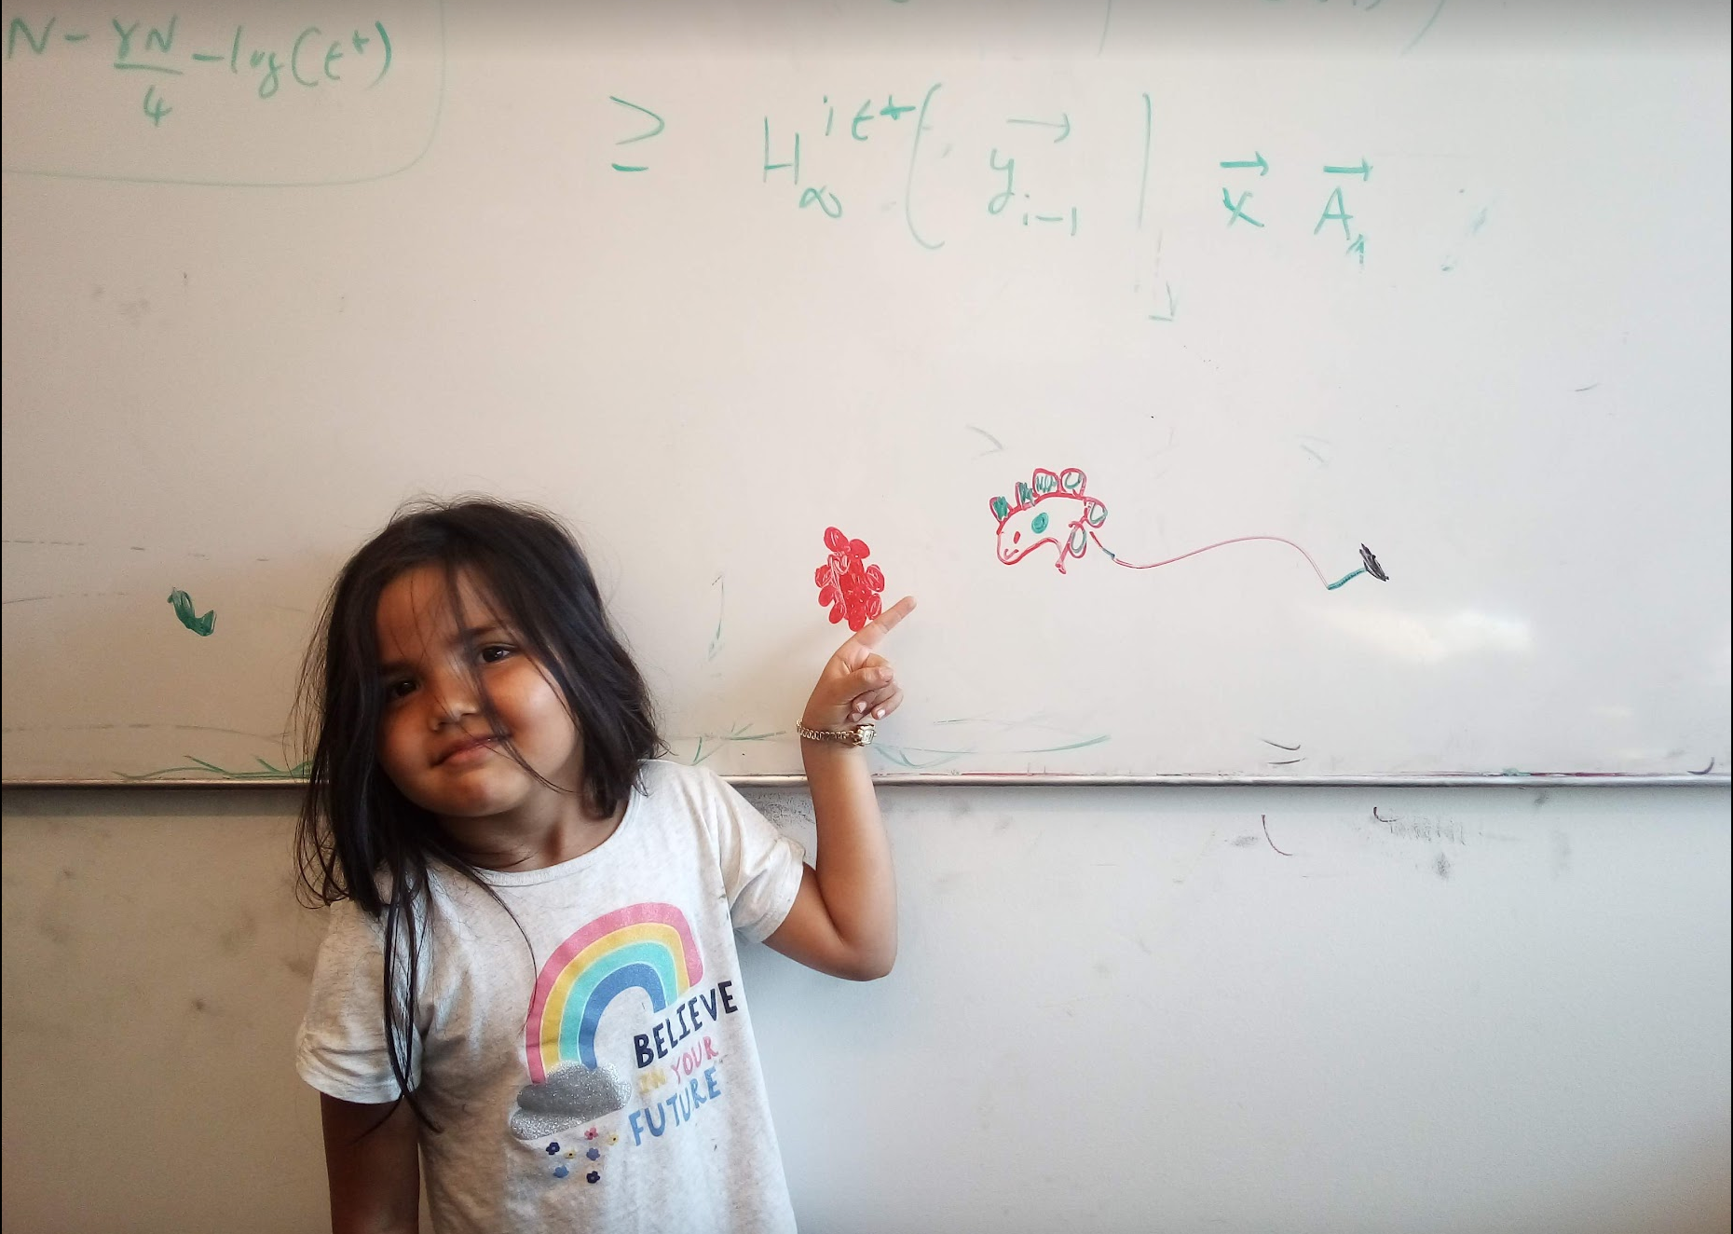
Questions/Comments?

Slide 22
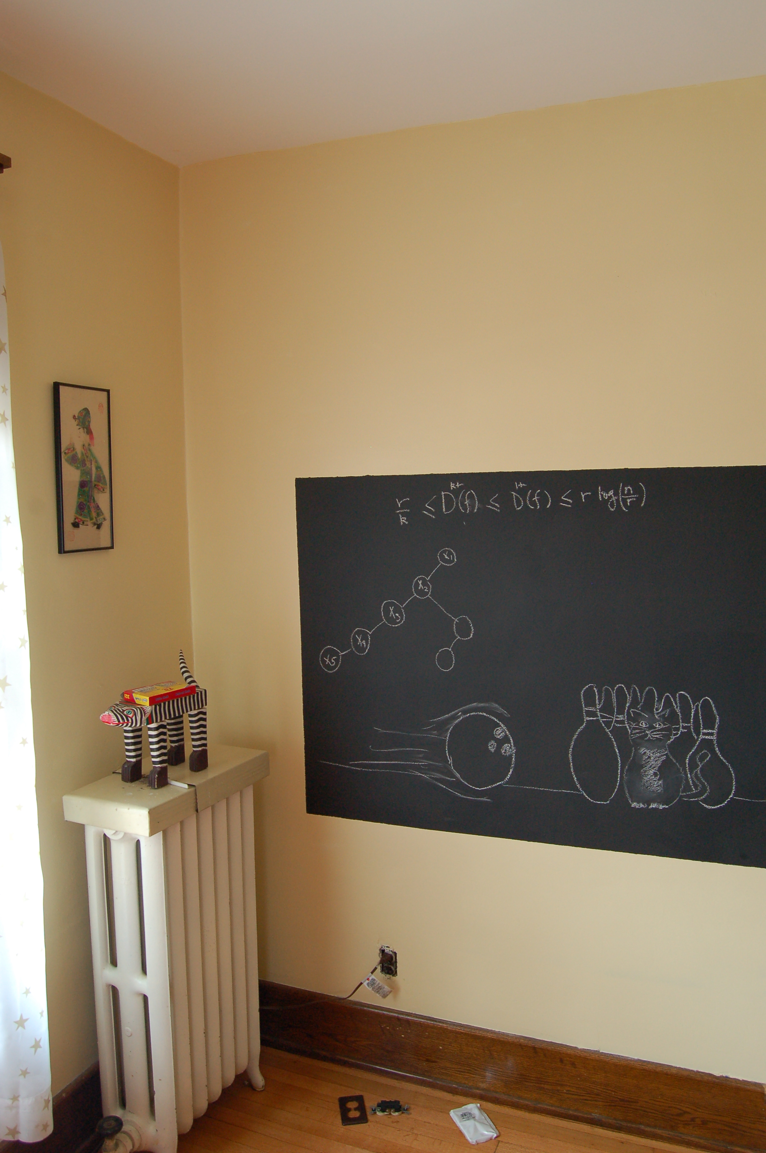
On to the board…

Slide 23
Preferences
Mal
Inara
Wash
Zoe
Simon
Kaylee

Slide 24
Instability
Mal
Inara
Wash
Zoe
Simon
Kaylee

Slide 25
Back to the board…

