Slide 1
Lecture 6
CSE 331
Sep 9, 2024

Slide 2
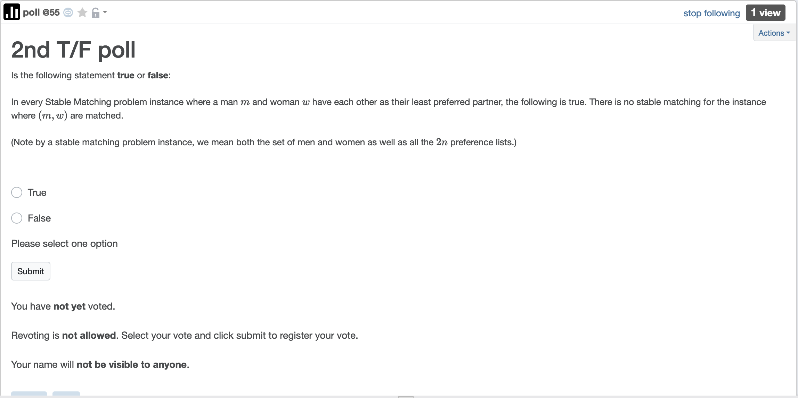
2nd T/F poll up

Slide 3
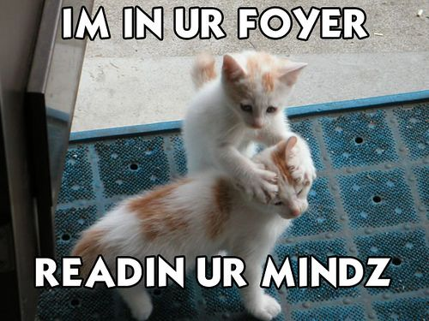
We’re not mind readers

Slide 4

If you need it, ask for help

Slide 5
NEVER apologize
for asking a question!!!

Slide 6
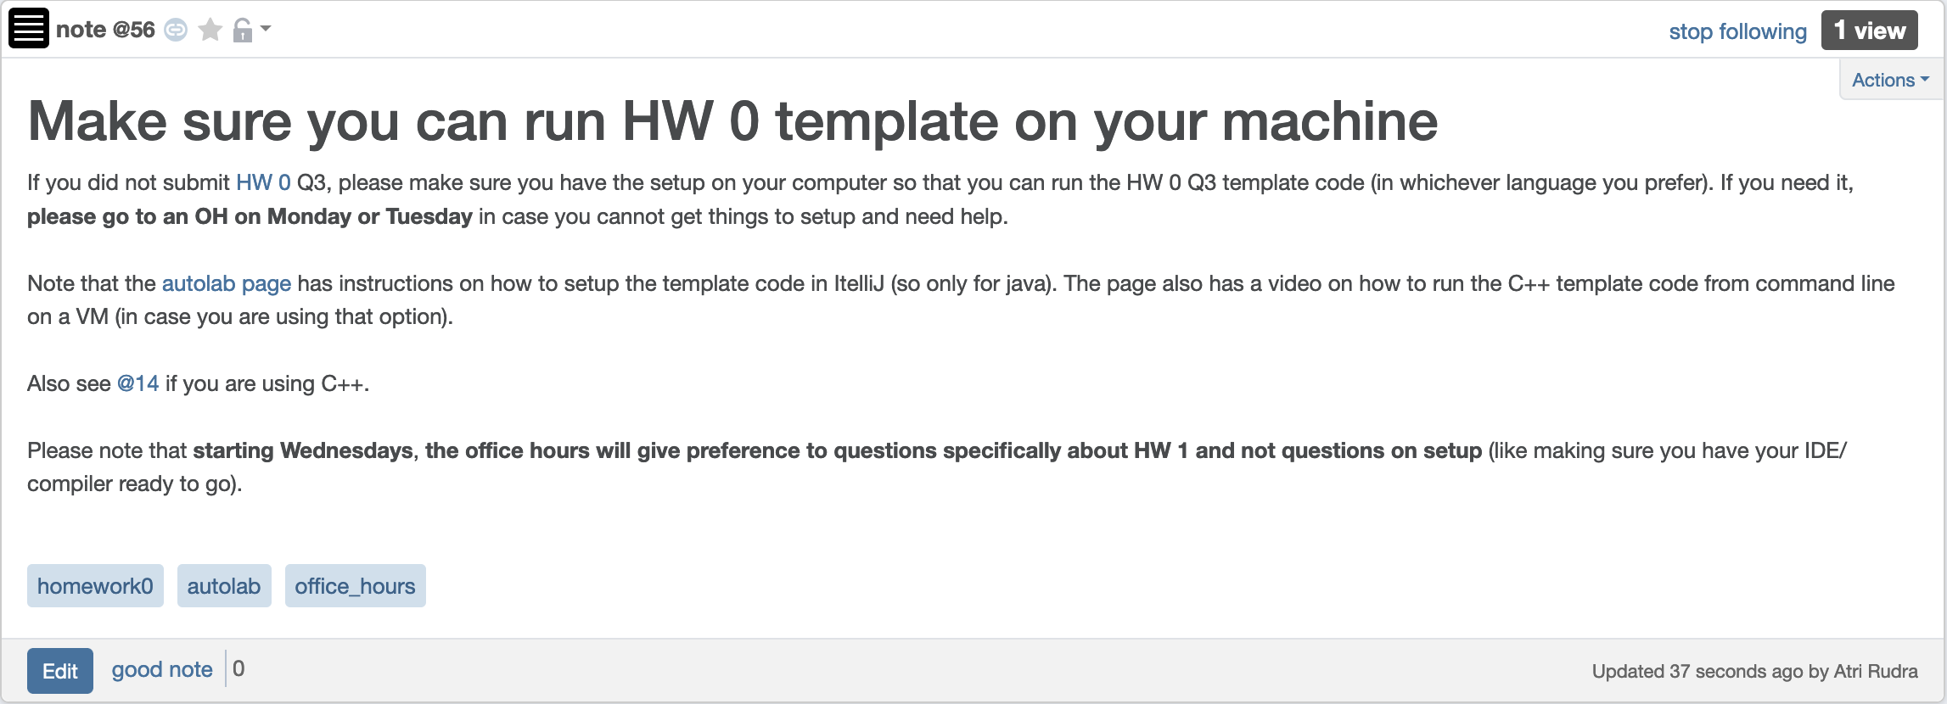
Make sure you can run HW0 code

Slide 7
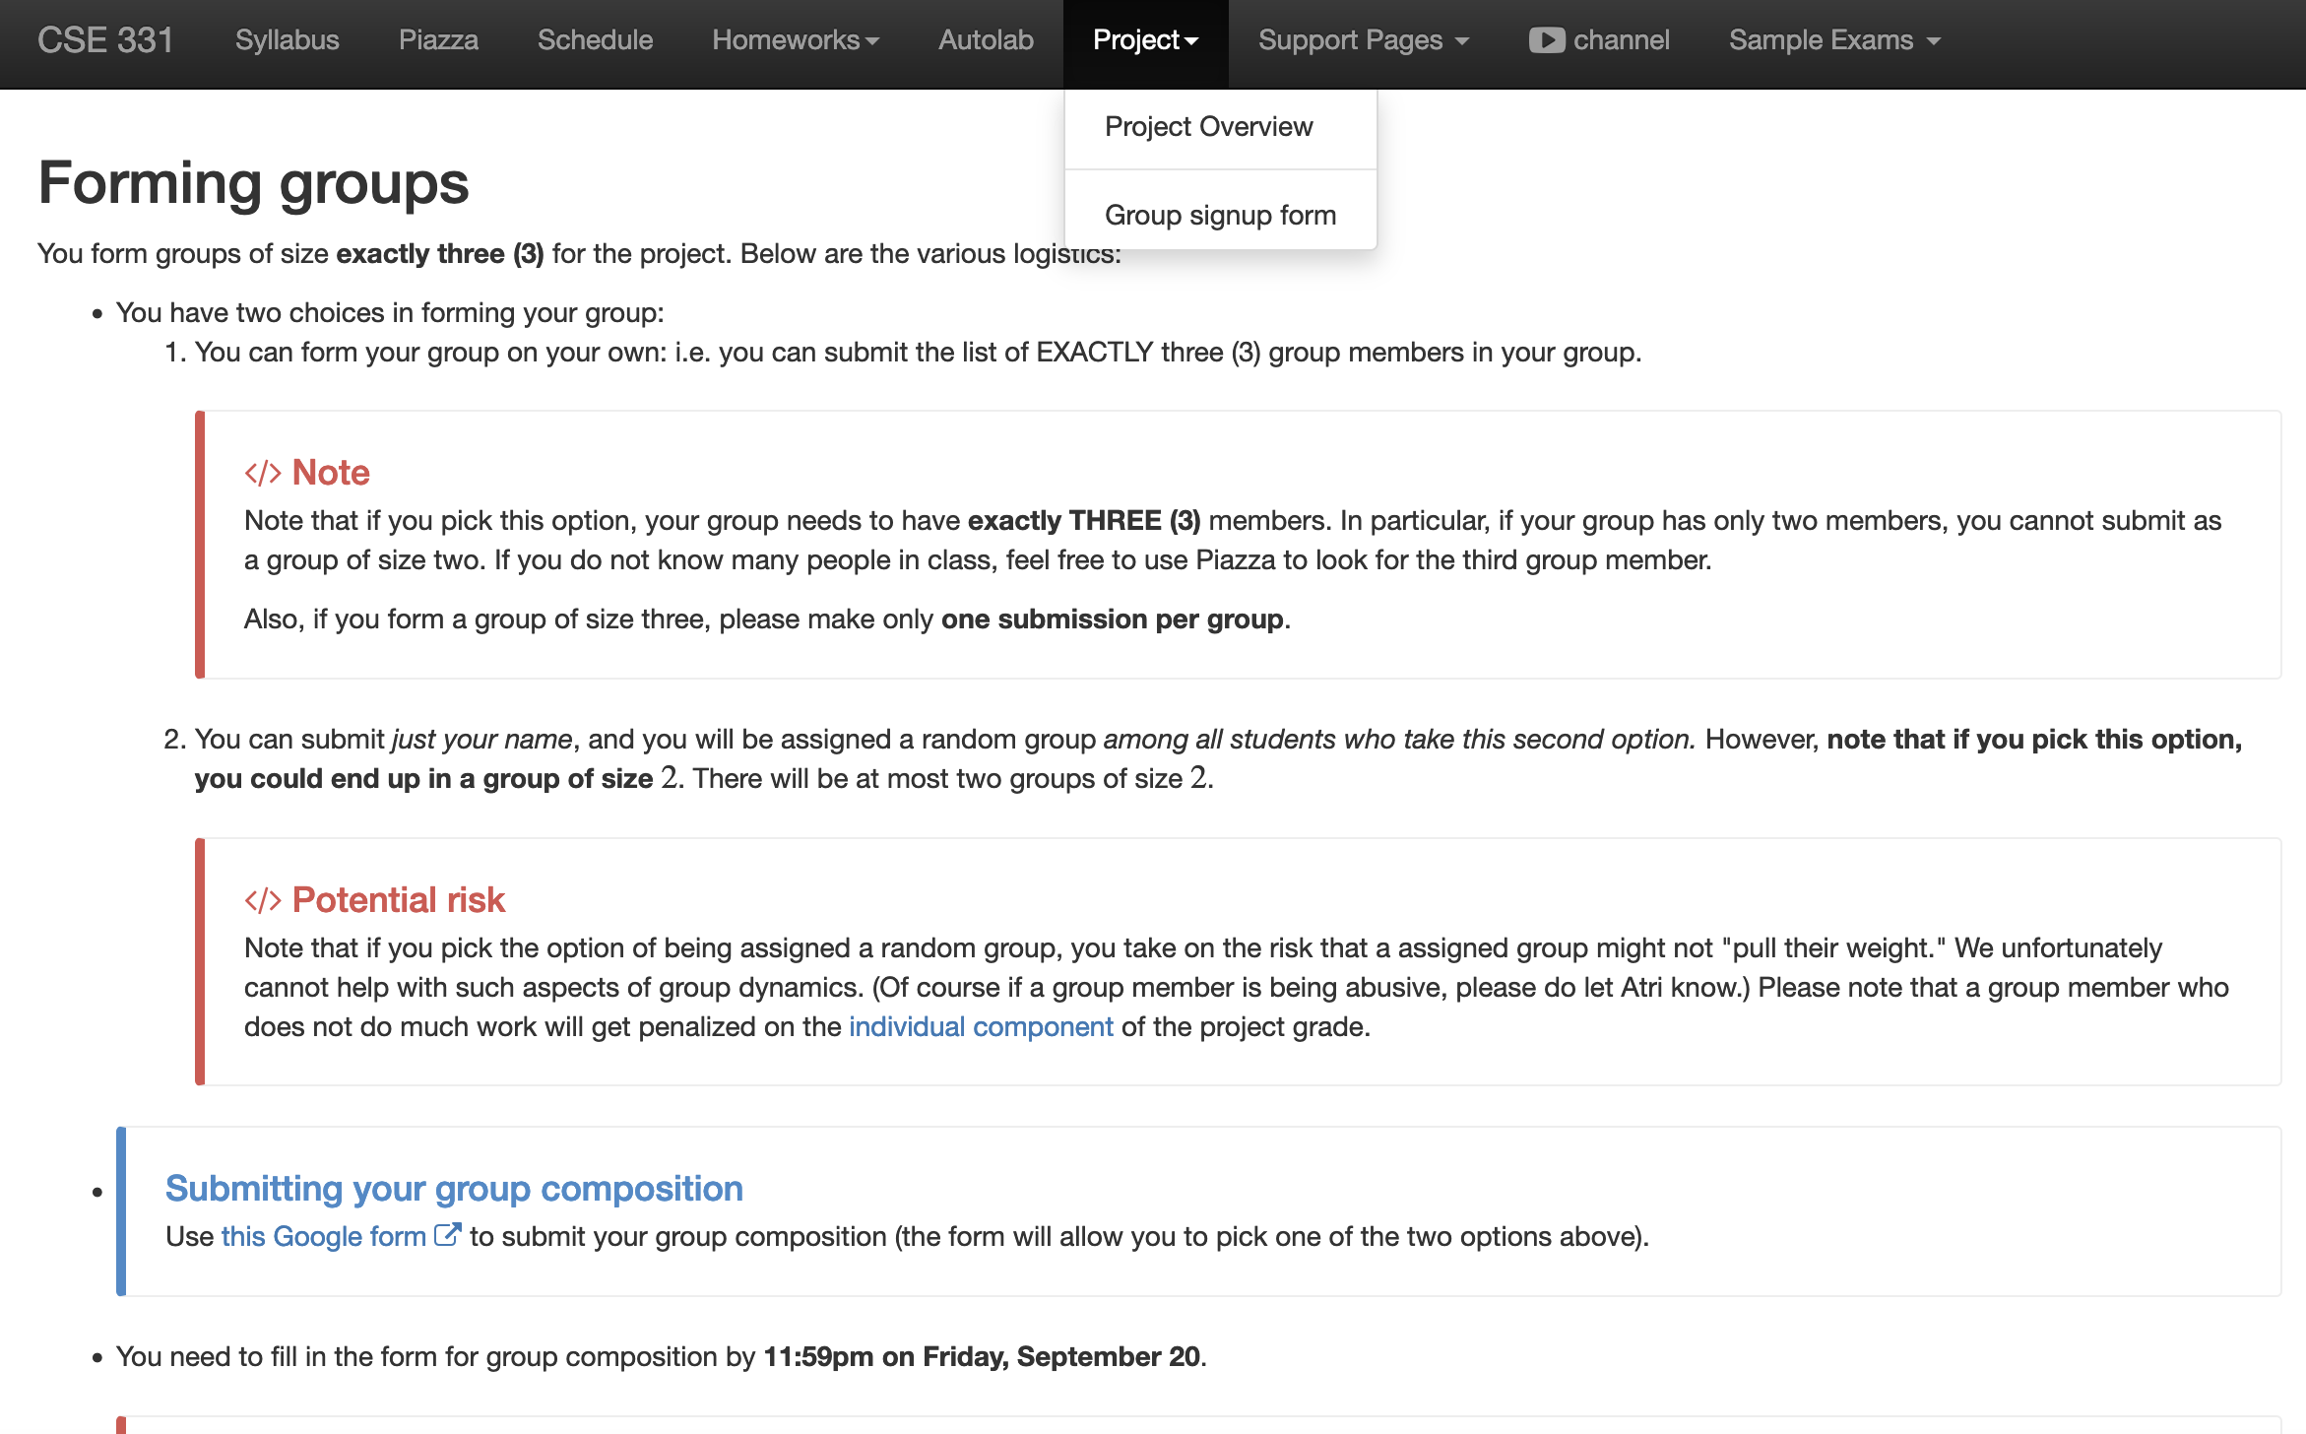
Register your project groups
Deadline: Friday, Sep 20, 11:59pm
If you miss this deadline then you will get a ZERO on the ENTIRE project

Slide 8
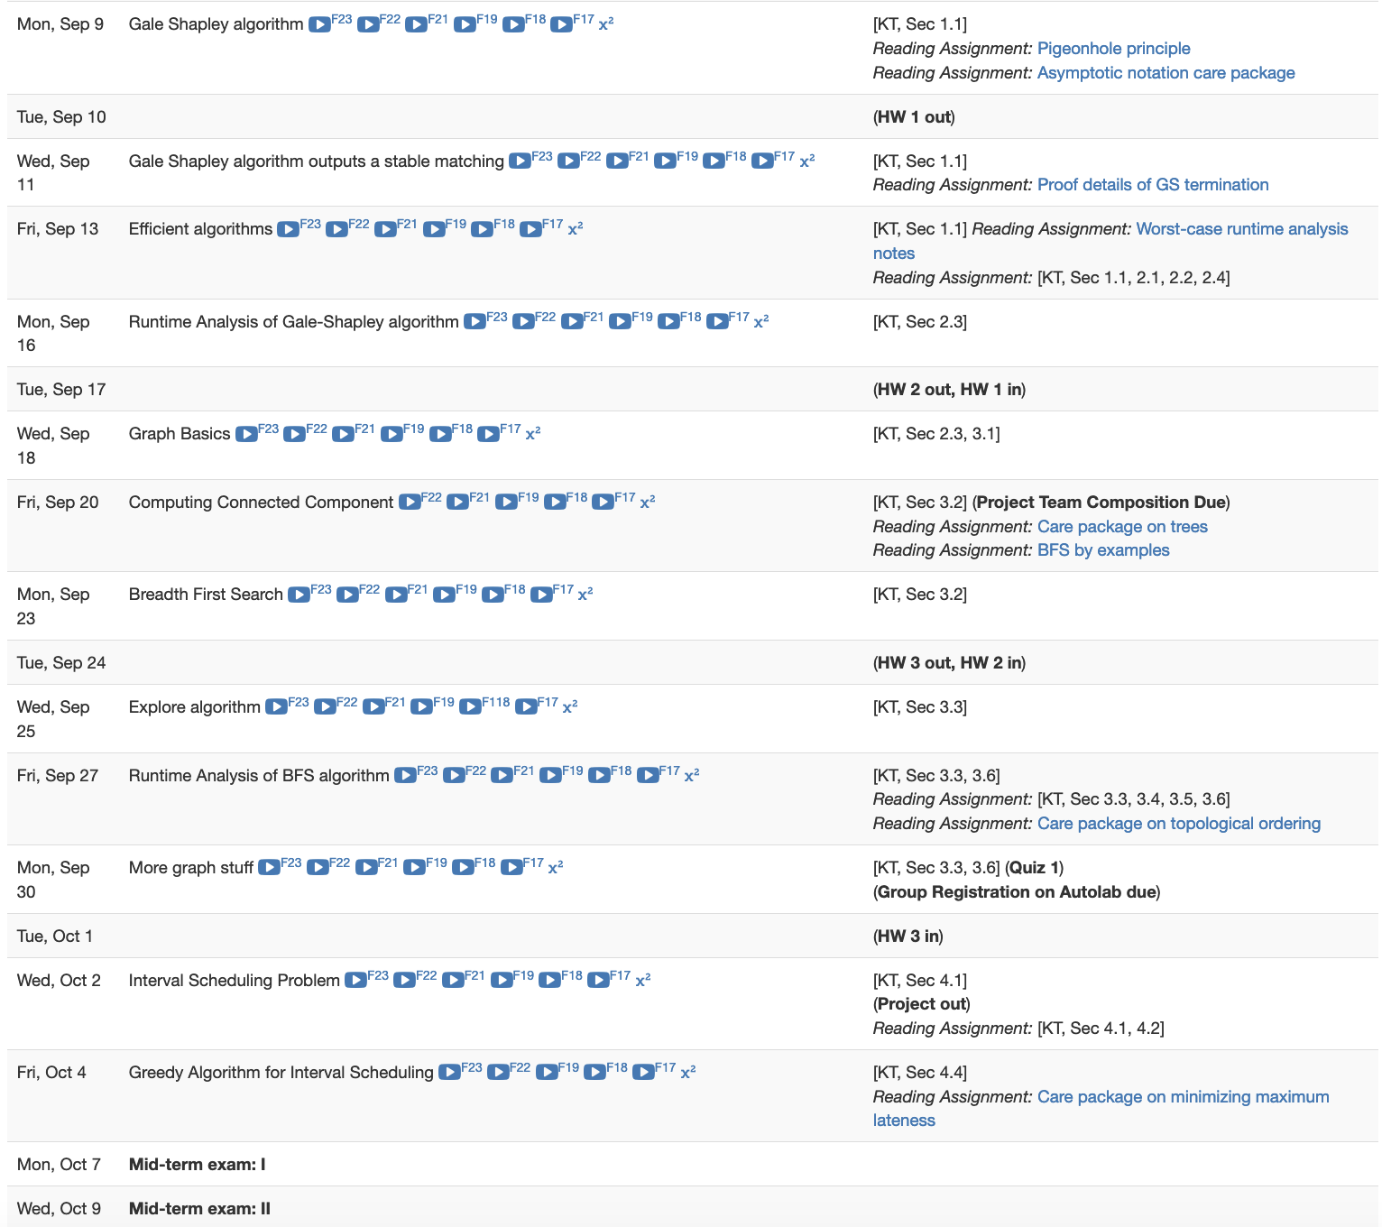
HW 1 gets released this Tue

Slide 9
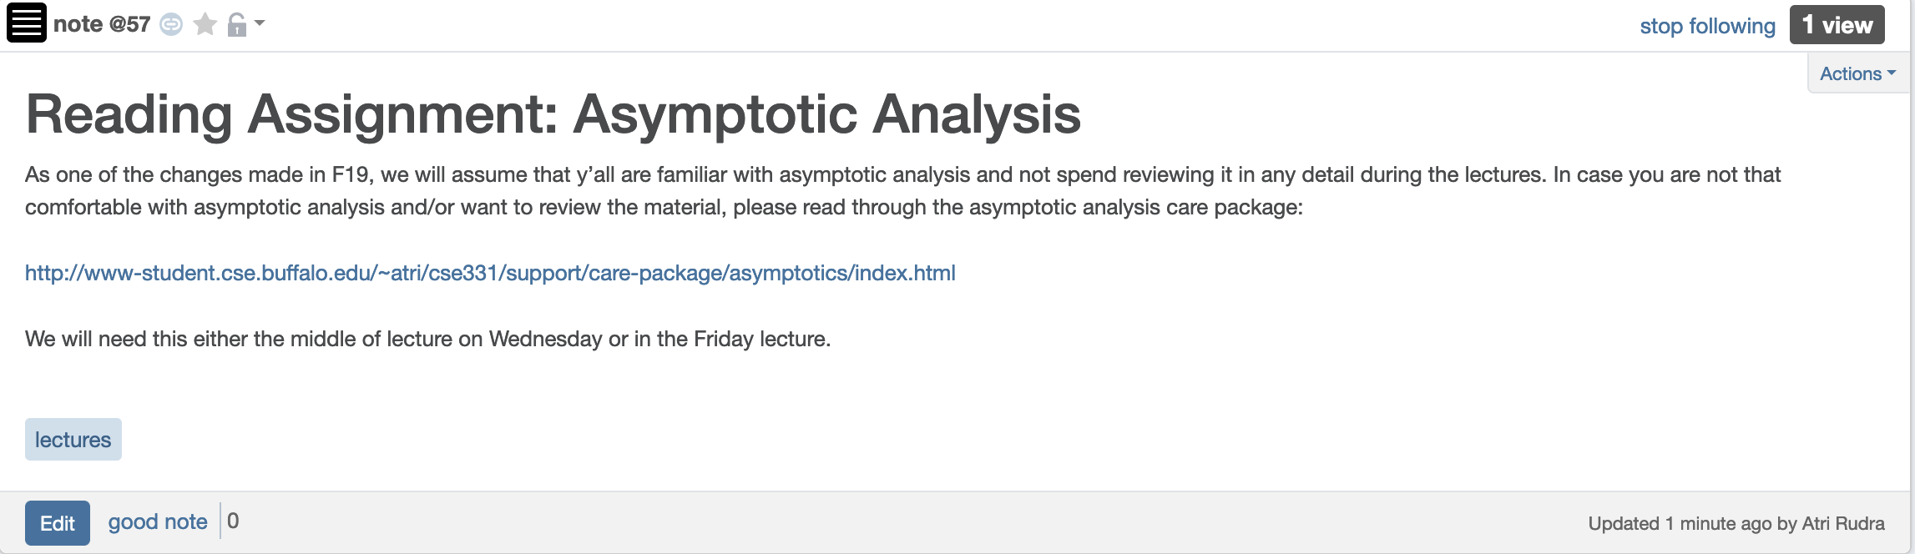
Reading Assignment - I

Slide 10
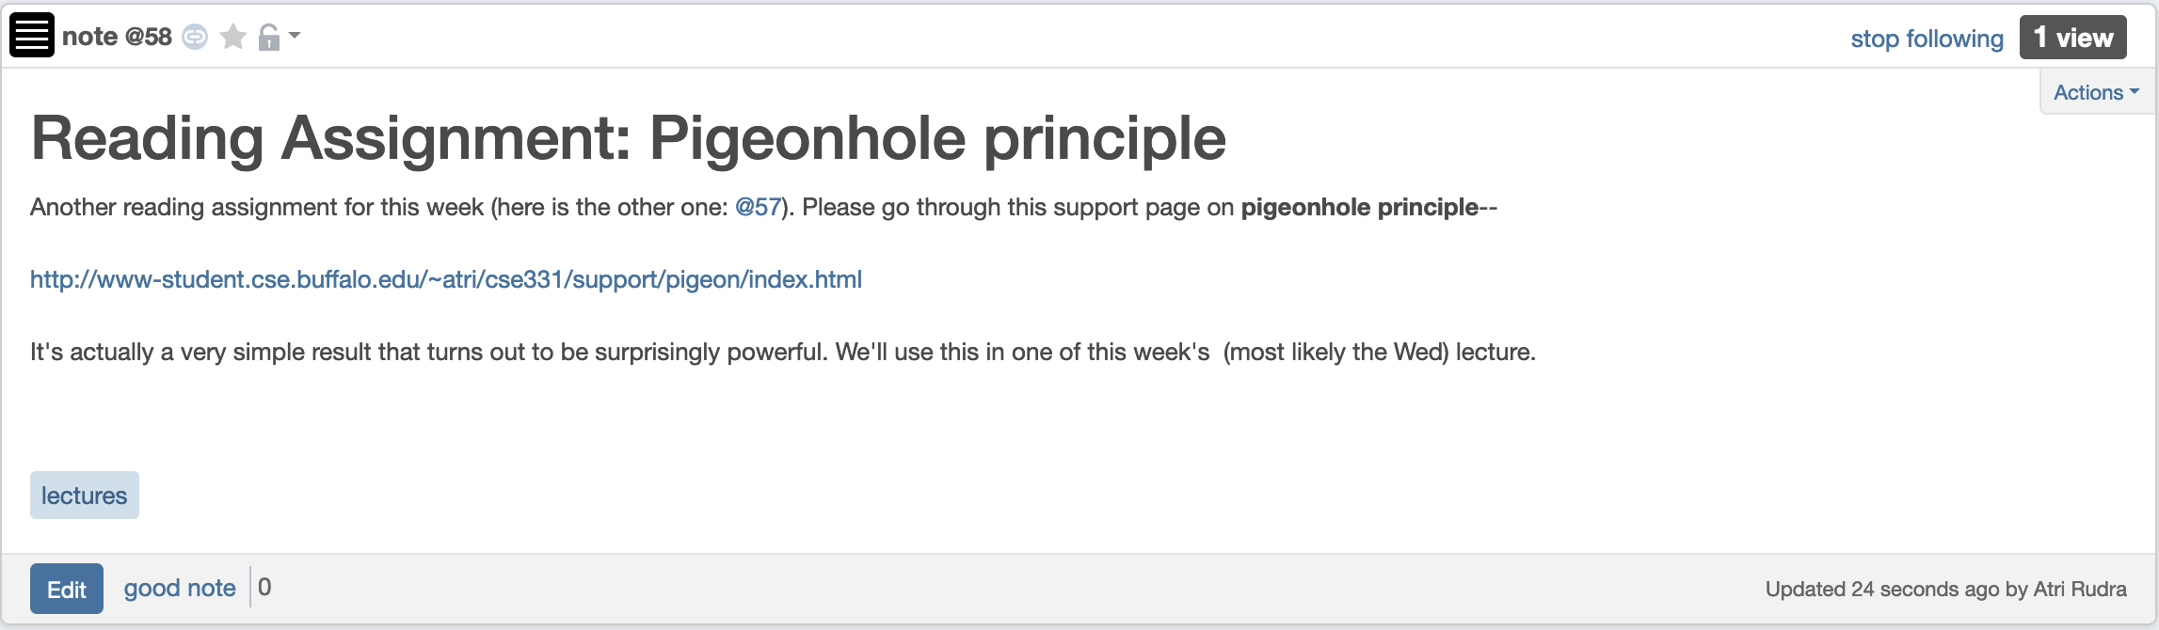
Reading Assignment - II

Slide 11
(Perfect) Matching
A matching S$⊆$ W$×$M satisfies the following properties:
S is a set of pairs (w,m) where w in W and m in M
exactly
(1) For every woman w in W, exist at most one m such that (w,m) in S
exactly
(2) For every man m in M, exist at most one w such that (w,m) in S
Perfect matching

Slide 12
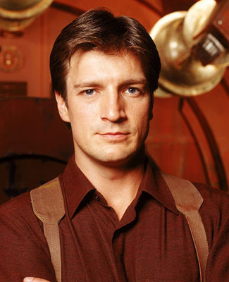


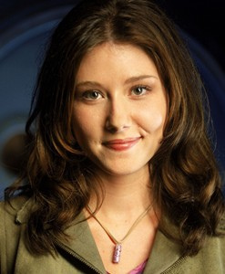
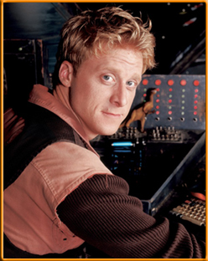
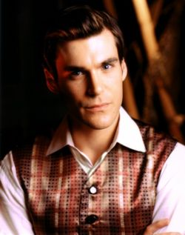
Preferences
Mal
Inara
Wash
Zoe
Simon
Kaylee

Slide 13
Instability
Mal
Inara
Wash
Zoe
Simon
Kaylee

Slide 14
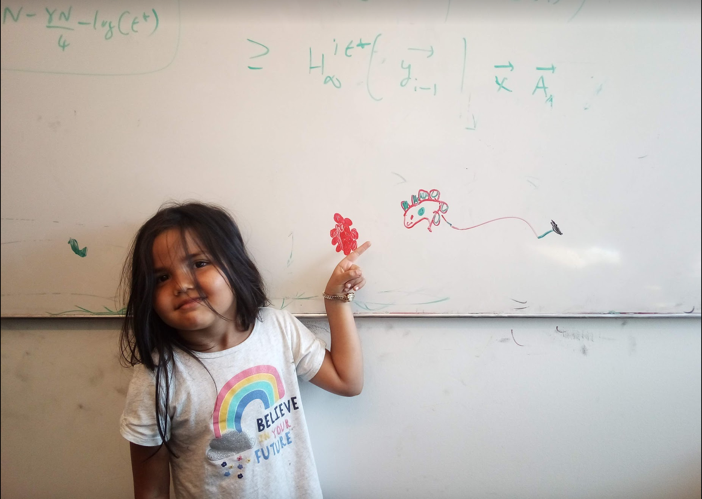
Questions/Comments?

Slide 15
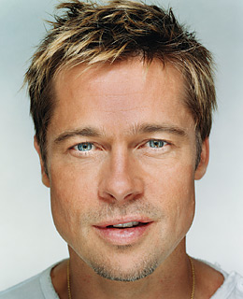
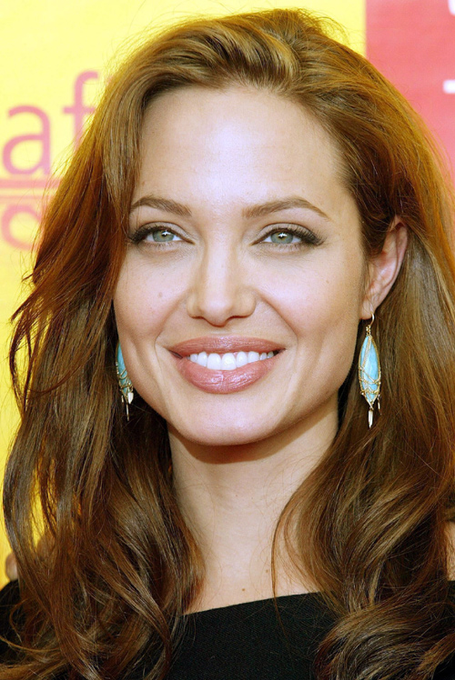
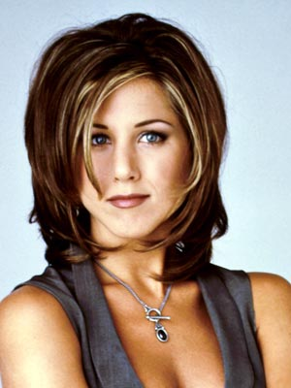
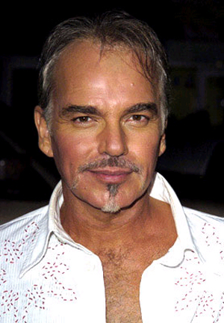
A stable matching
Even though BBT and JA are not very happy
Brad Pitt
Angelina Jolie
Billy Bob Thornton
Jennifer Aniston

Slide 16
Two stable matchings
Brad Pitt
Angelina Jolie
Billy Bob Thornton
Jennifer Aniston

Slide 17
Stable Matching problem
Input: M and W with preferences
Output: Stable Matching
Set of men M and women W
Preferences (ranking of potential spouses)
Matching (no polyandry/gamy in M X W)
Perfect Matching (everyone gets married)
m
w
Instablity
m’
w’
Stable matching = perfect matching+ no instablity

Slide 18
Questions/Comments?

Slide 19
Two Questions
Does a stable marriage always exist?
If one exists, how quickly can we
compute one?

Slide 20
Rest of today’s lecture
Naïve algorithm
Gale Shapley algorithm

Slide 21
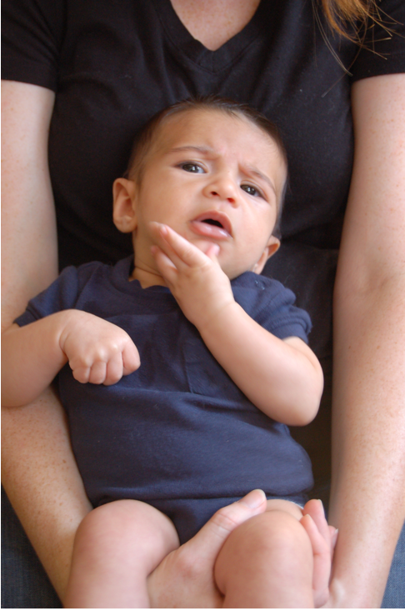
Questions/Comments?

Slide 22

Discuss: Naïve algorithm!

Slide 23
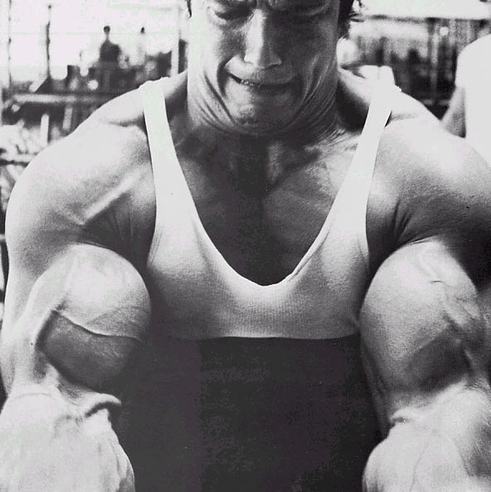
The naïve algorithm
Incremental algorithm to produce all n! prefect matchings?
Go through all possible perfect matchings S
If S is a stable matching
then Stop
n! matchings
Else move to the next perfect matching

Slide 24
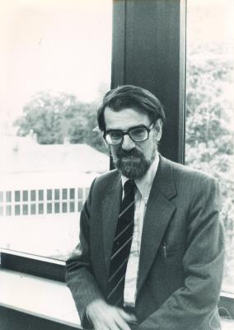
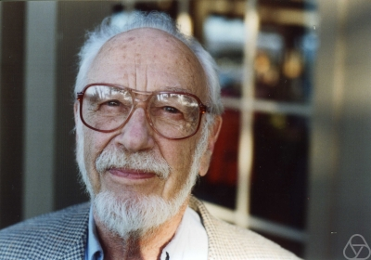
Gale-Shapley Algorithm
David Gale
Lloyd Shapley
O(n²) algorithm

Slide 25
Moral of the story…
>

Slide 26
Questions/Comments?

Slide 27
Rest of today’s agenda
Gale Shapley (GS) algorithm
Run of GS algorithm on an instance
Prove correctness of the GS algorithm

Slide 28
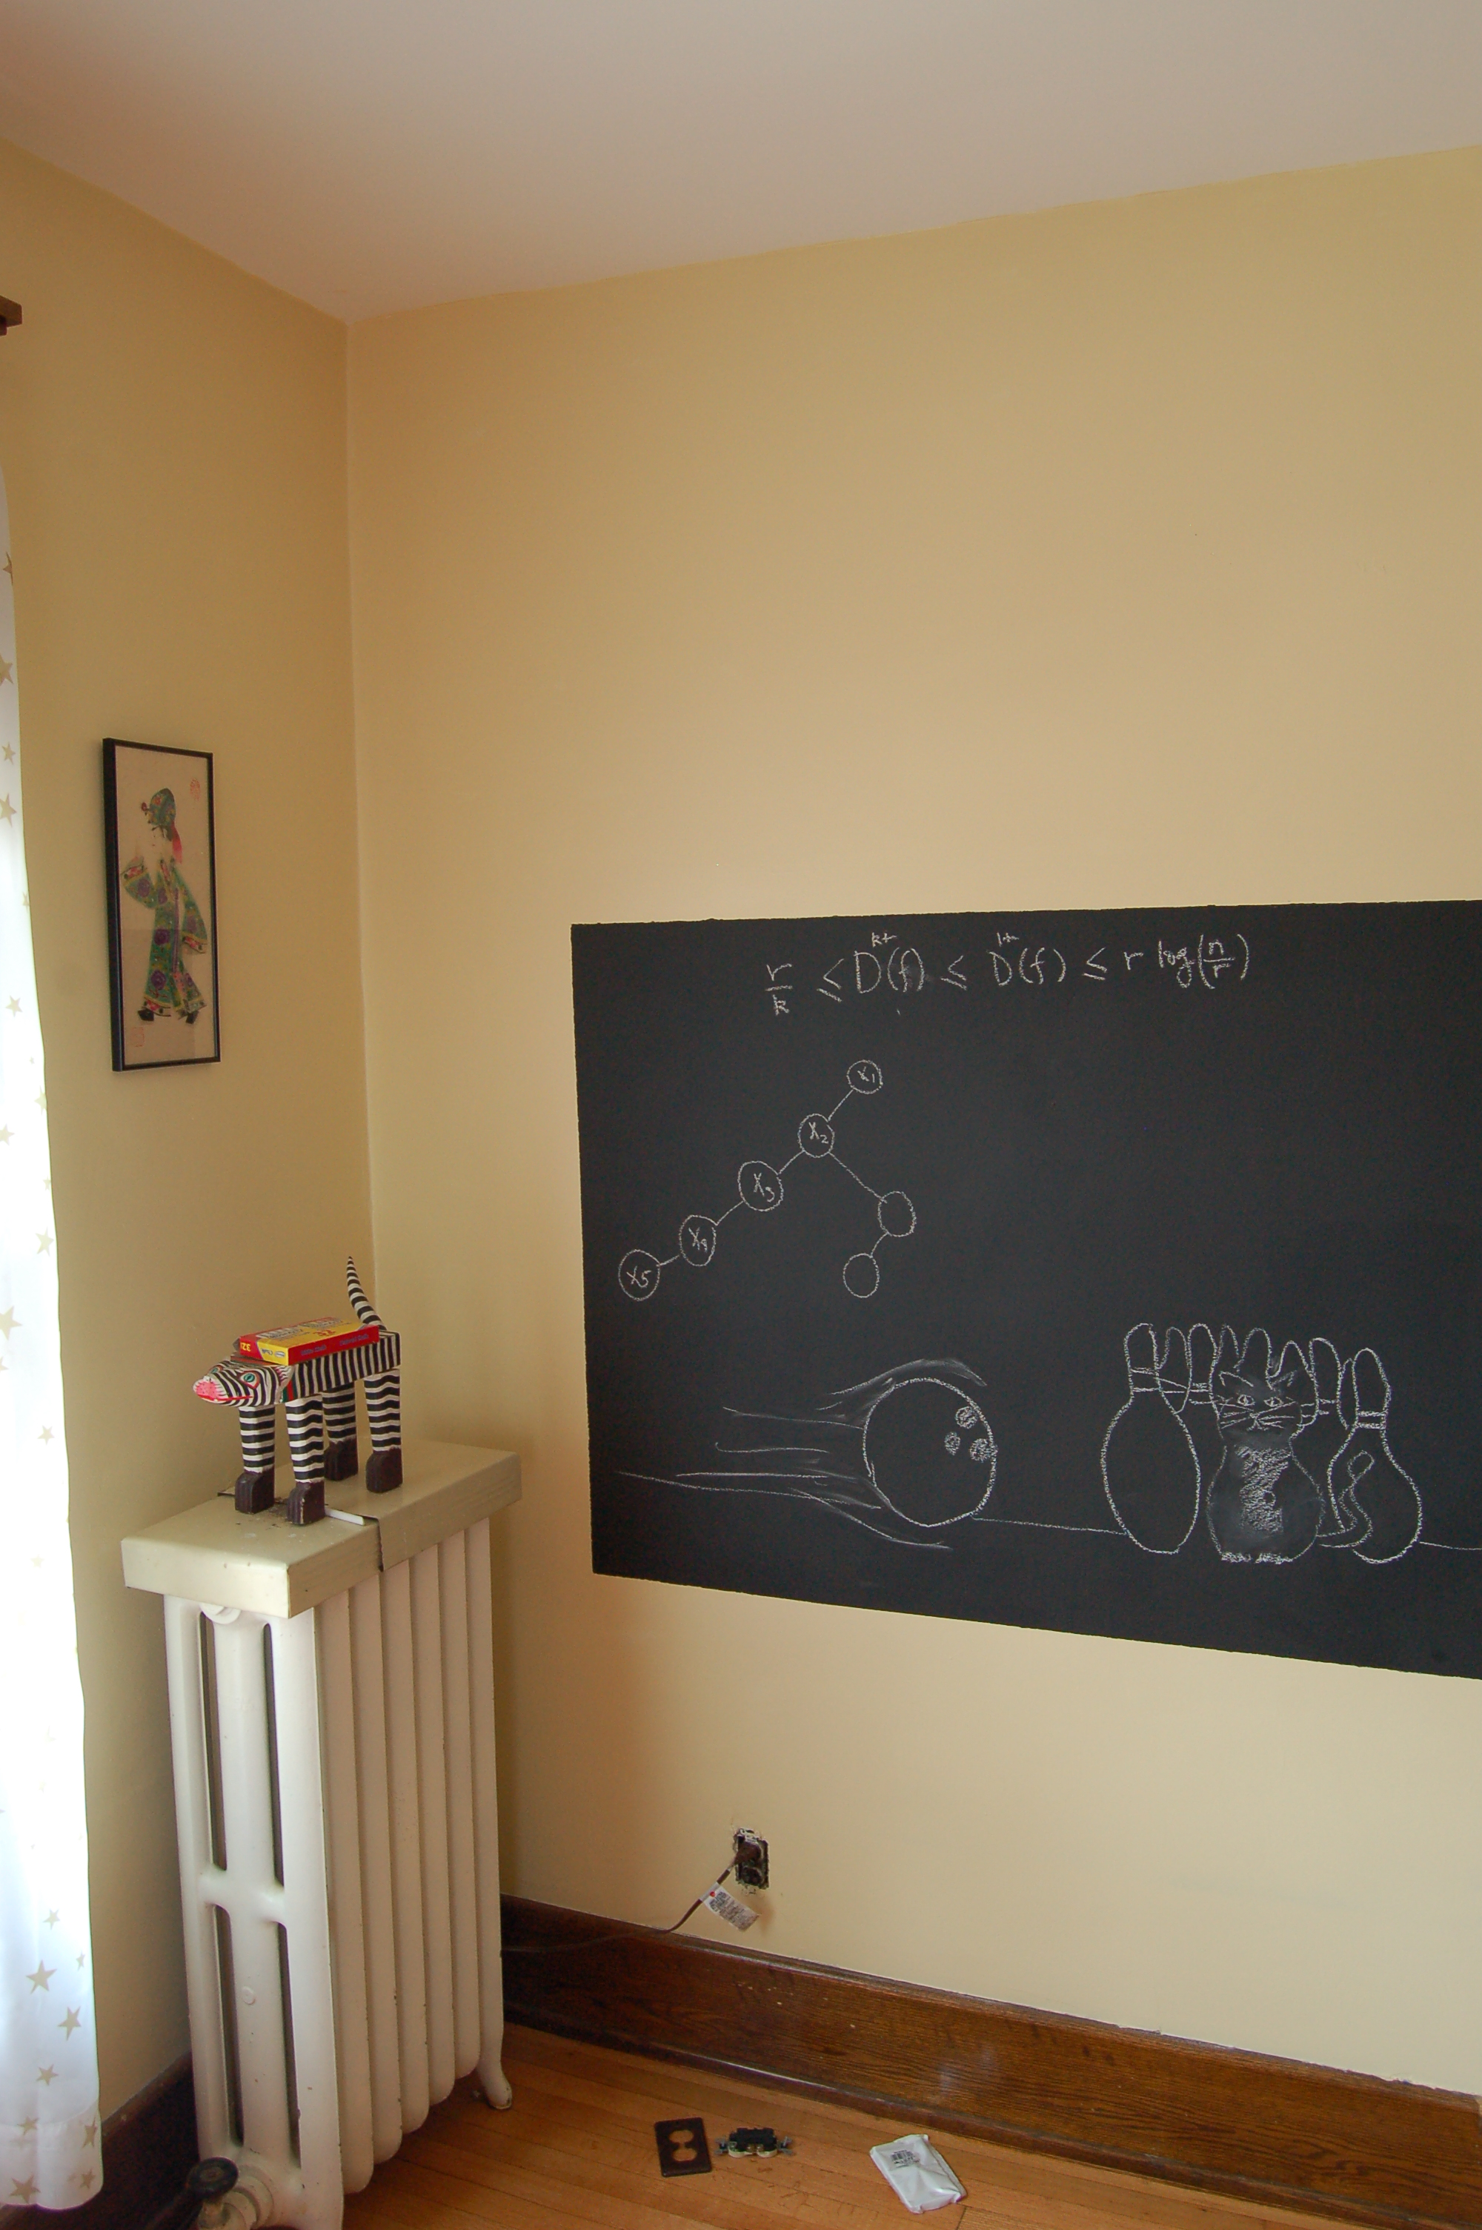
Back to the board…

