Slide 1
Lecture 7
CSE 331
Sep 11, 2024

Slide 2
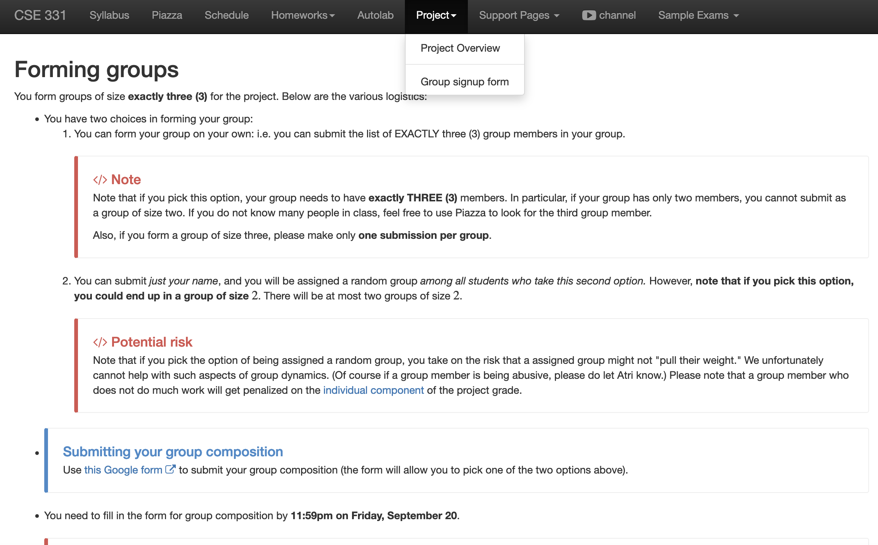
Register your project groups
Deadline: Friday, Sep 20, 11:59pm
If you miss this deadline then you will get a ZERO on the ENTIRE project

Slide 3
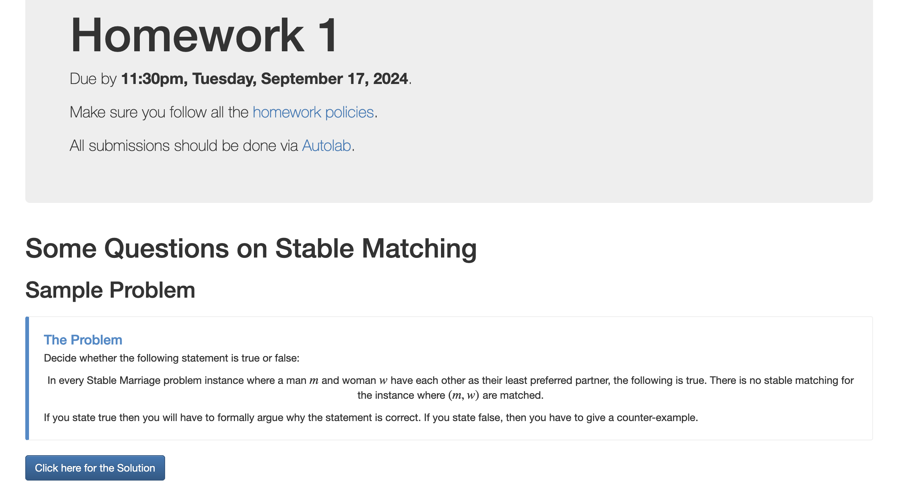
HW 1 is out!

Slide 4
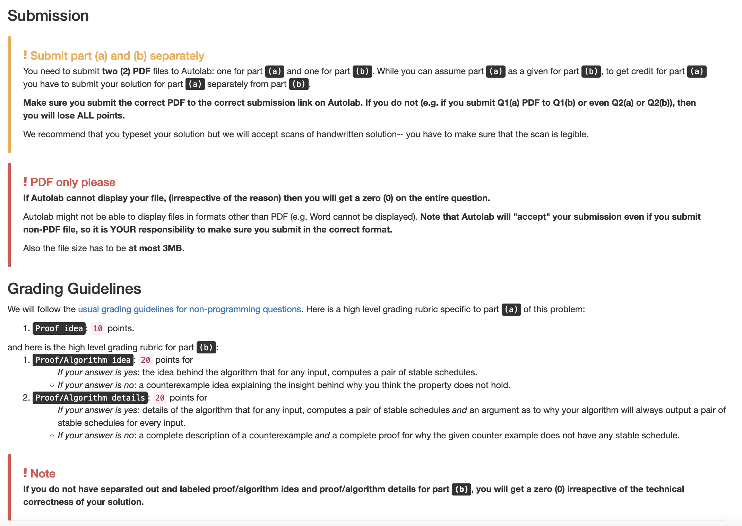
Submission requirements

Slide 5
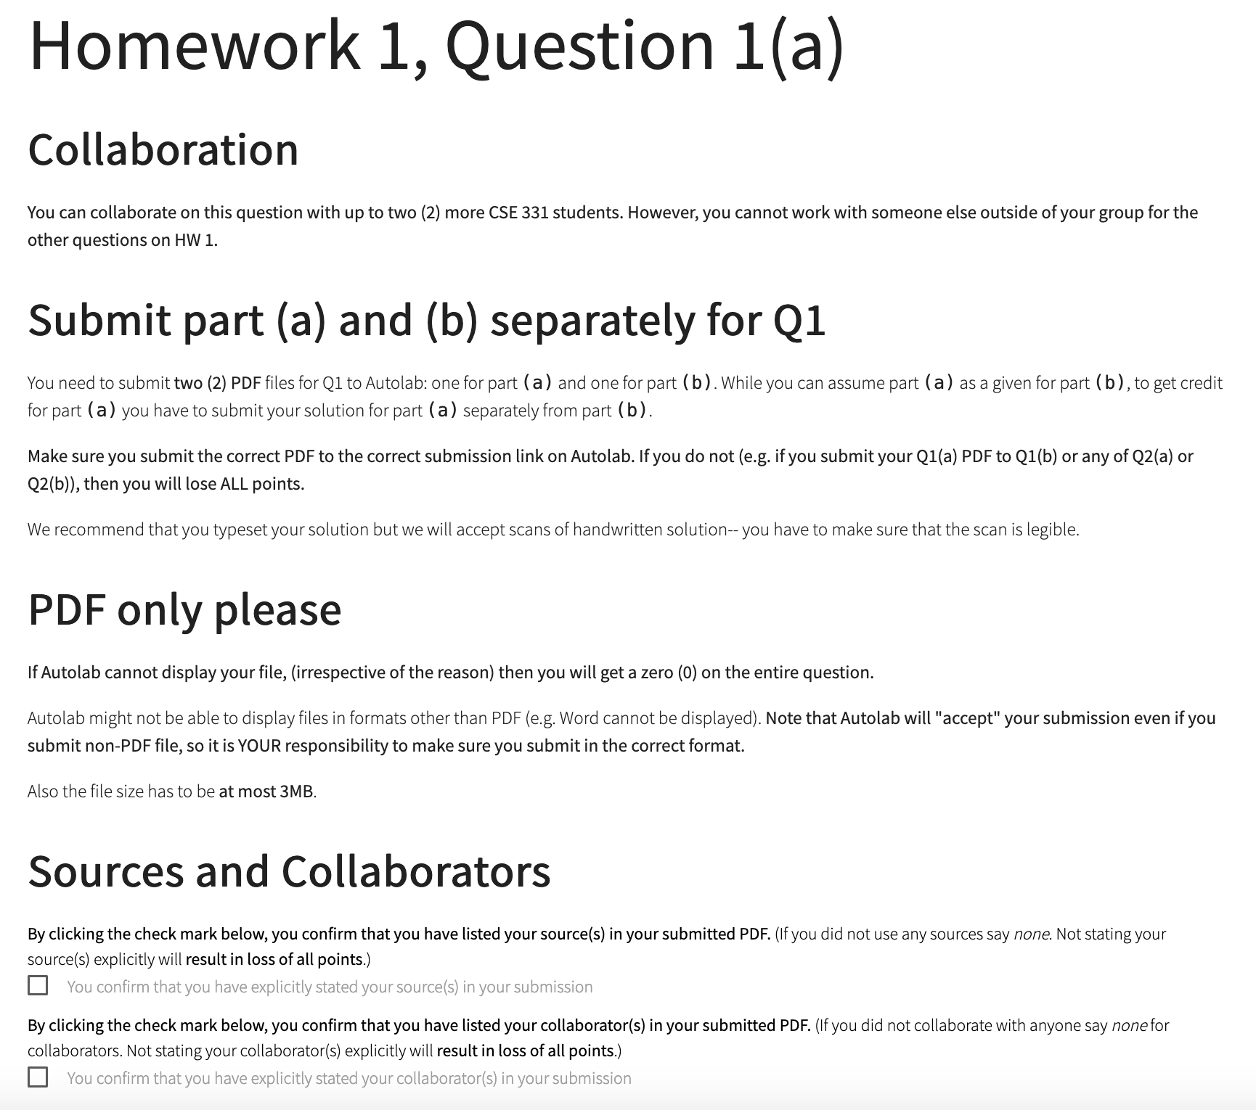
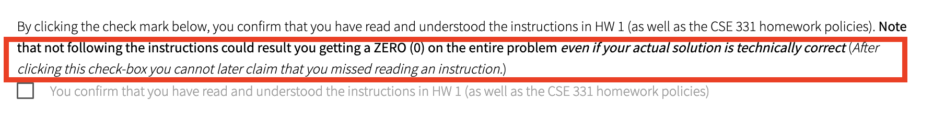
You need to confirm that you followed the requirements

Slide 6
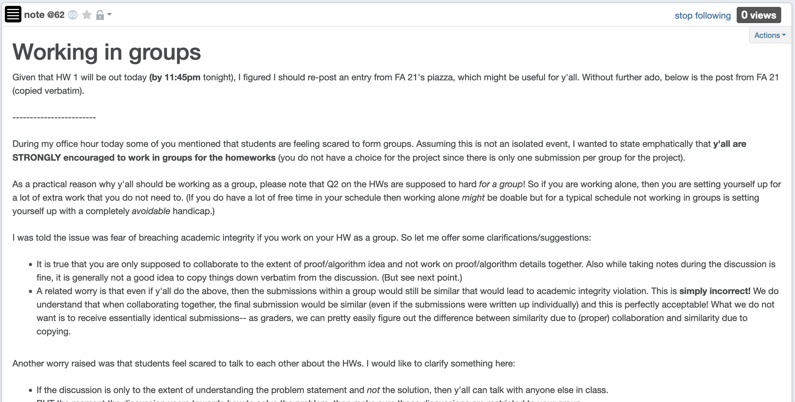
Working in groups

Slide 7

Just putting in time is not enough
You will be graded on what you submit and not how much time you spent
Be smart in how you spend your time
Please ask for help, get feedback if you get stuck!

Slide 8
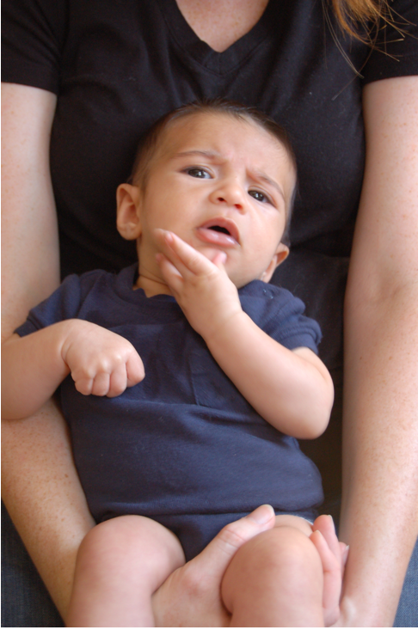
Questions/Comments?

Slide 9
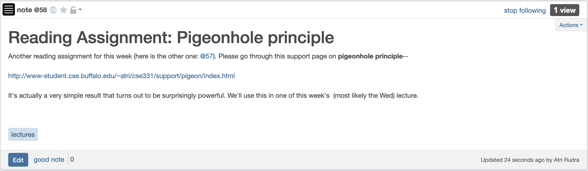
Read your reading assignment?

Slide 10
Gale-Shapley Algorithm
Intially all men and women are free
While there exists a free woman who can propose
Let w be such a woman and m be the best man she has not proposed to
w proposes to m
If m is free
(w,m) get engaged
Else (w’,m) are engaged
If m prefers w’ to w
w remains free
Else
(w,m) get engaged and w’ is free
Output the engaged pairs as the final output

Slide 11
Questions/Comments?

Slide 12
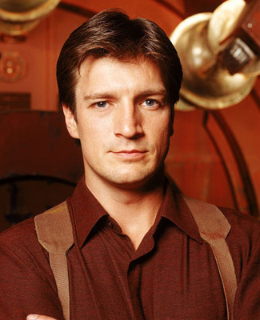
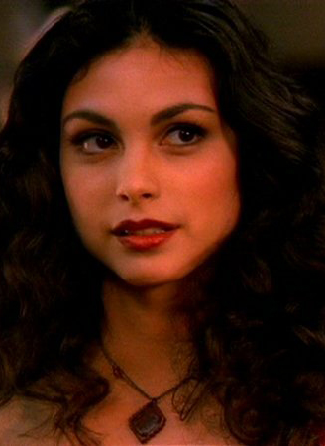
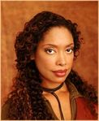
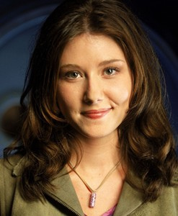
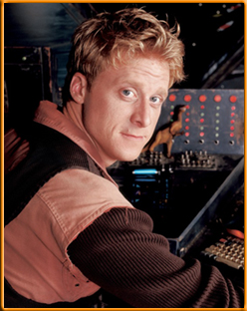
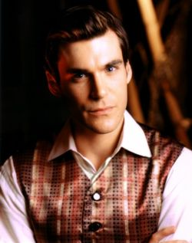
Preferences
Mal
Inara
Wash
Zoe
Simon
Kaylee

Slide 13
GS algorithm: Firefly Edition
Mal
Inara
Wash
Zoe
1
2
3
4
5
6
Simon
Kaylee
1
2
3
4
5
6

Slide 14
Observation 1
Intially all men and women are free
While there exists a free woman who can propose
Let w be such a woman and m be the best man she has not proposed to
w proposes to m
If m is free
(w,m) get engaged
Once a man gets engaged, he remains engaged (to “better” women)
Else (w’,m) are engaged
If m prefers w’ to w
w remains free
Else
(w,m) get engaged and w’ is free
Output the engaged pairs as the final output

Slide 15
Observation 2
Intially all men and women are free
While there exists a free woman who can propose
Let w be such a woman and m be the best man she has not proposed to
w proposes to m
If m is free
If w proposes to m after m’, then she prefers m’ to m
(w,m) get engaged
Else (w’,m) are engaged
If m prefers w’ to w
w remains free
Else
(w,m) get engaged and w’ is free
Output the set S of engaged pairs as the final output

Slide 16
Questions/Comments?

Slide 17
Why bother proving correctness?
Consider a variant where any free man or free woman can propose
Is this variant any different? Can you prove it?

Slide 18
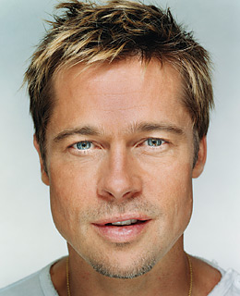
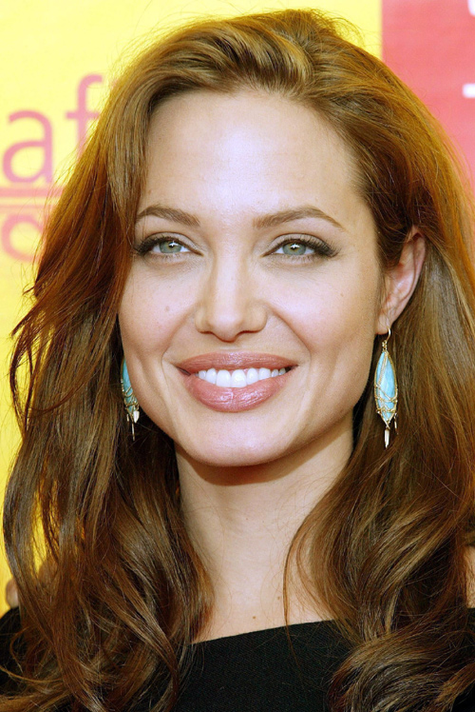
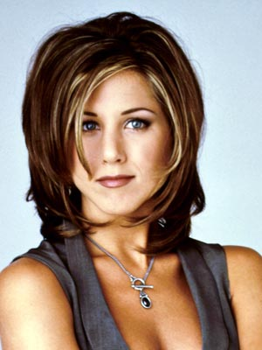
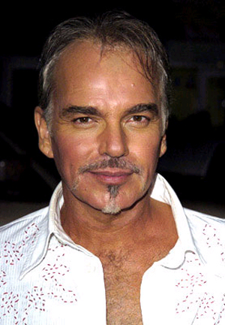
GS’ does not output a stable marriage
BP
AJ
BBT
JA

Slide 19
Questions/Comments?

Slide 20
Observation 1
Intially all men and women are free
While there exists a free woman who can propose
Let w be such a woman and m be the best man she has not proposed to
w proposes to m
If m is free
(w,m) get engaged
Once a man gets engaged, he remains engaged (to “better” women)
Else (w’,m) are engaged
If m prefers w’ to w
w remains free
Else
(w,m) get engaged and w’ is free
Output the engaged pairs as the final output

Slide 21
Observation 2
Intially all men and women are free
While there exists a free woman who can propose
Let w be such a woman and m be the best man she has not proposed to
w proposes to m
If m is free
If w proposes to m after m’, then she prefers m’ to m
(w,m) get engaged
Else (w’,m) are engaged
If m prefers w’ to w
w remains free
Else
(w,m) get engaged and w’ is free
Output the set S of engaged pairs as the final output

Slide 22
Questions/Comments?

Slide 23
Today’s lecture
GS algorithms always outputs a stable marriage

Slide 24
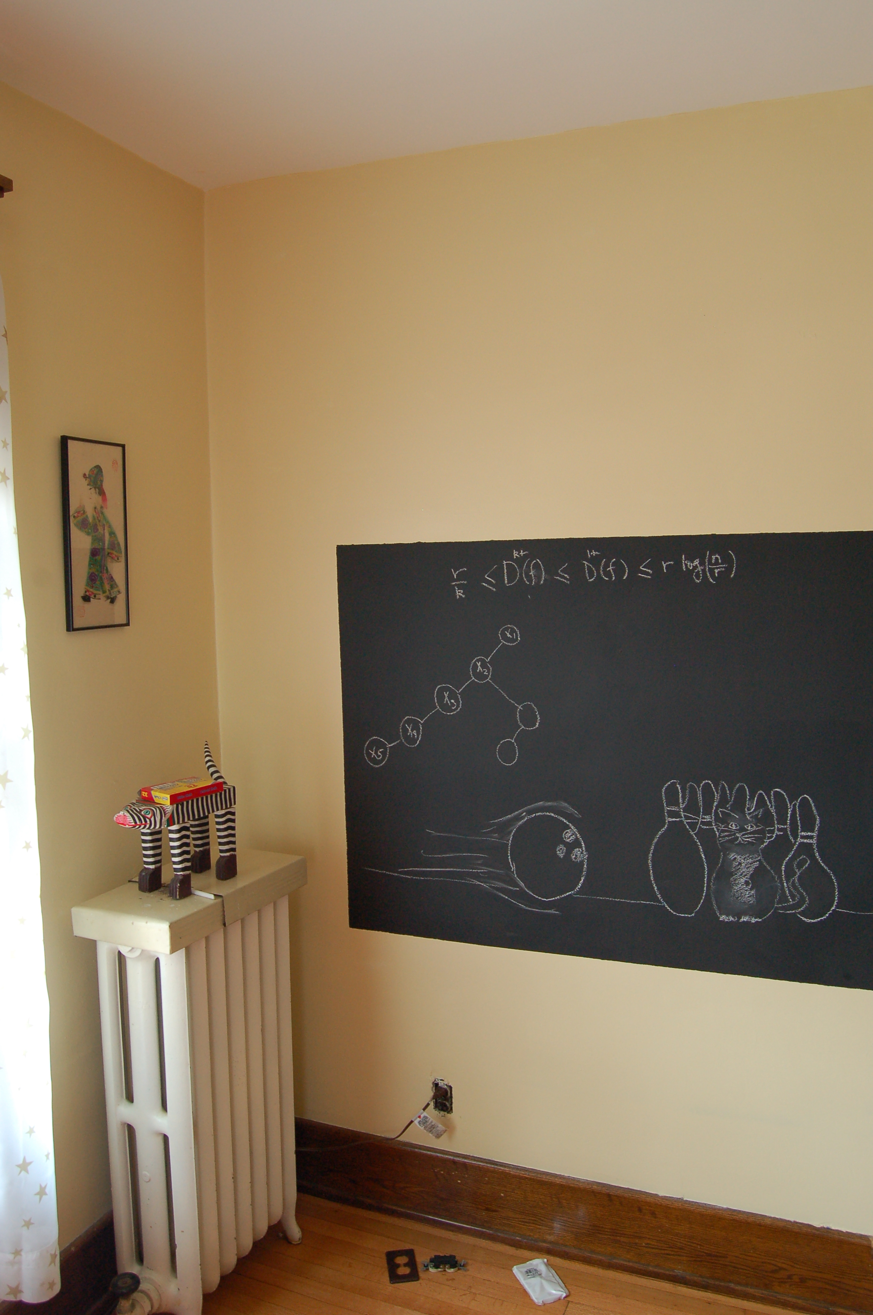
On to the board…

