Slide 1
Lecture 8
CSE 331
Sep 13, 2024

Slide 2

If you need it, ask for help

Slide 3
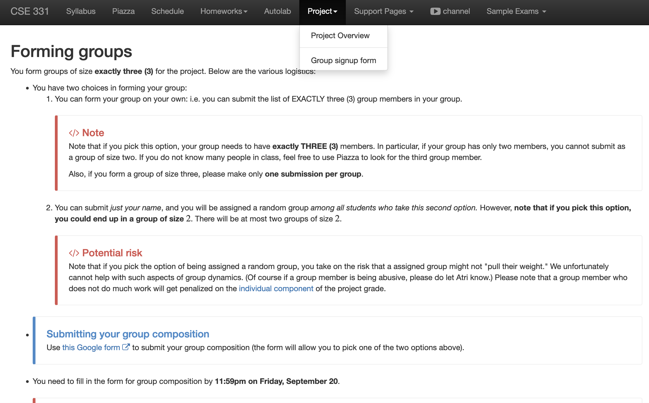
Register your project groups
Deadline: Friday, Sep 20, 11:59pm
If you miss this deadline then you will get a ZERO on the ENTIRE project

Slide 4
Your UBIT ID is
xyz if your email ID is xyz@buffalo.edu
NOT
xyz@buffalo.edu
Your UB person number

Slide 5
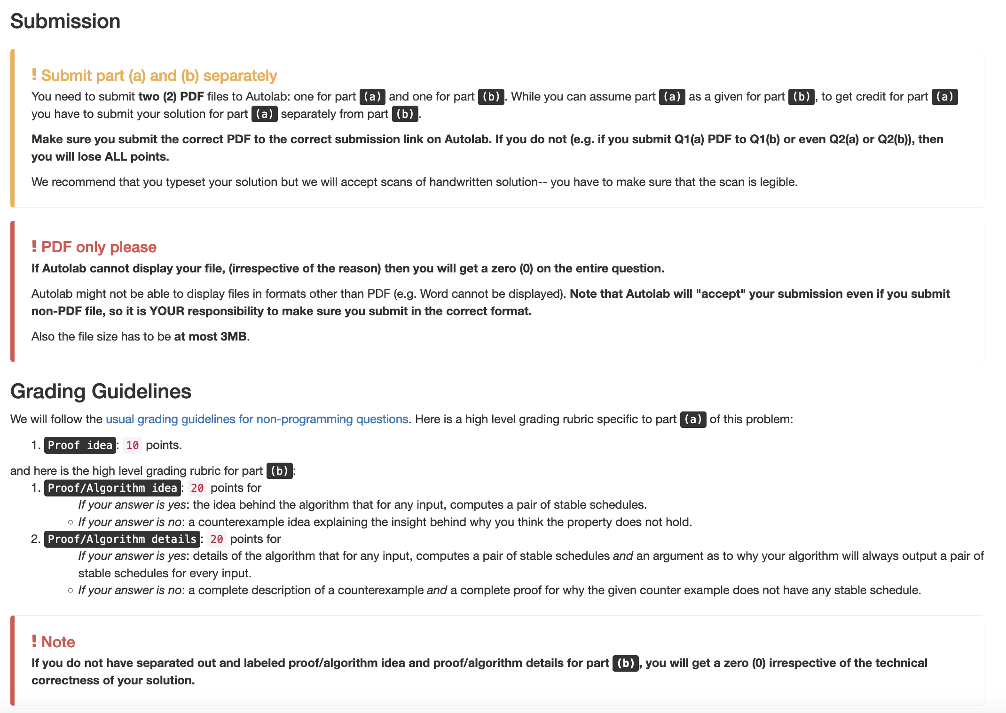
Submission requirements

Slide 6
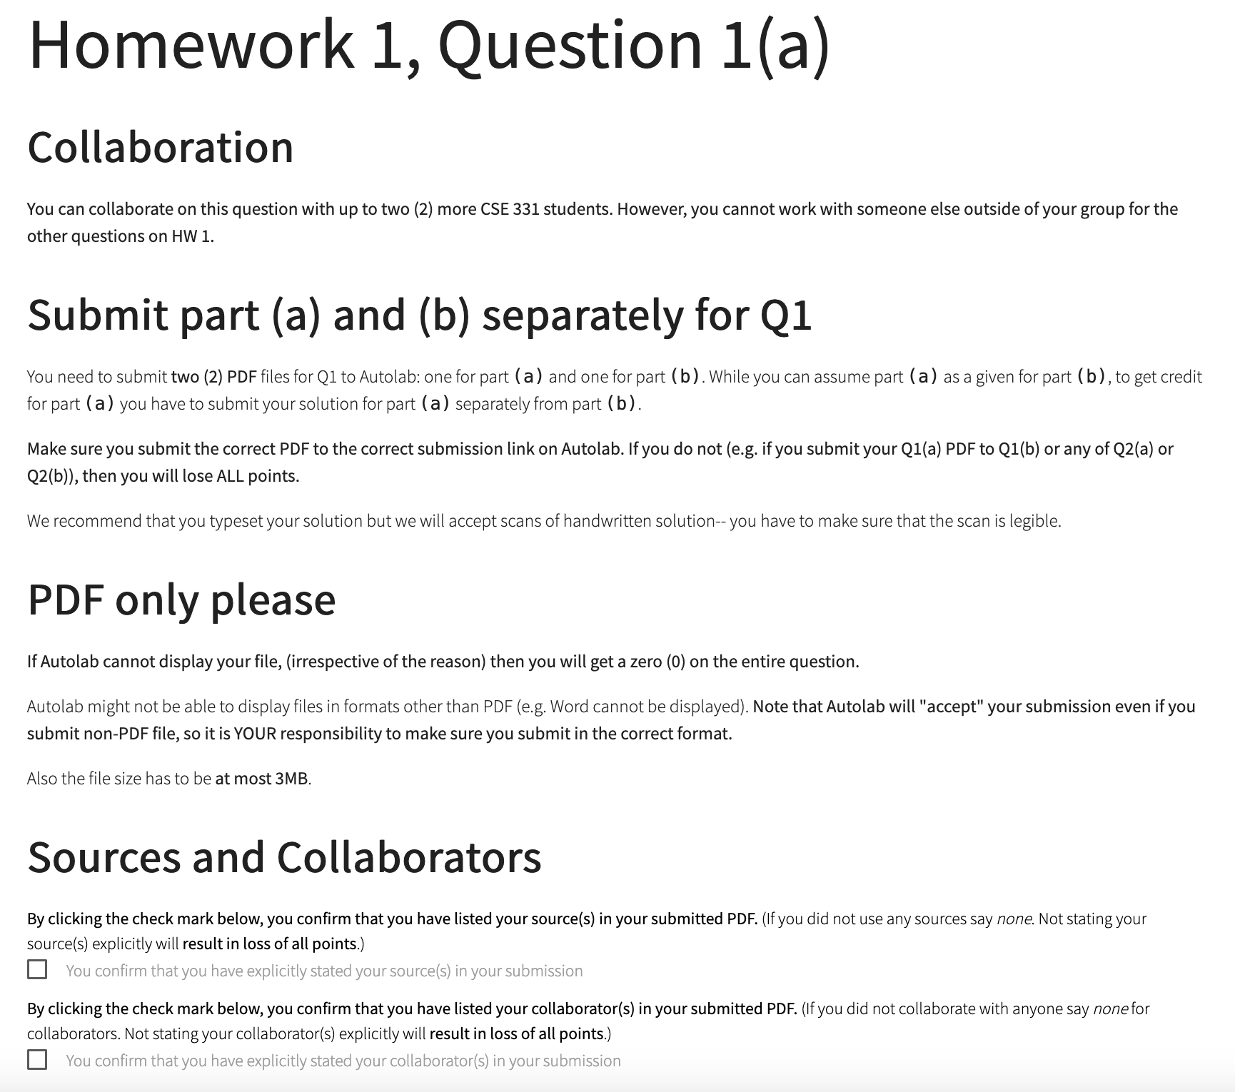
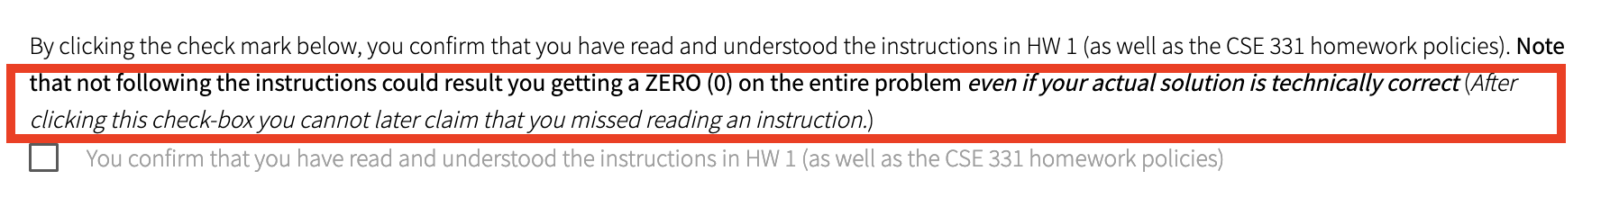
You need to confirm that you followed the requirements

Slide 7
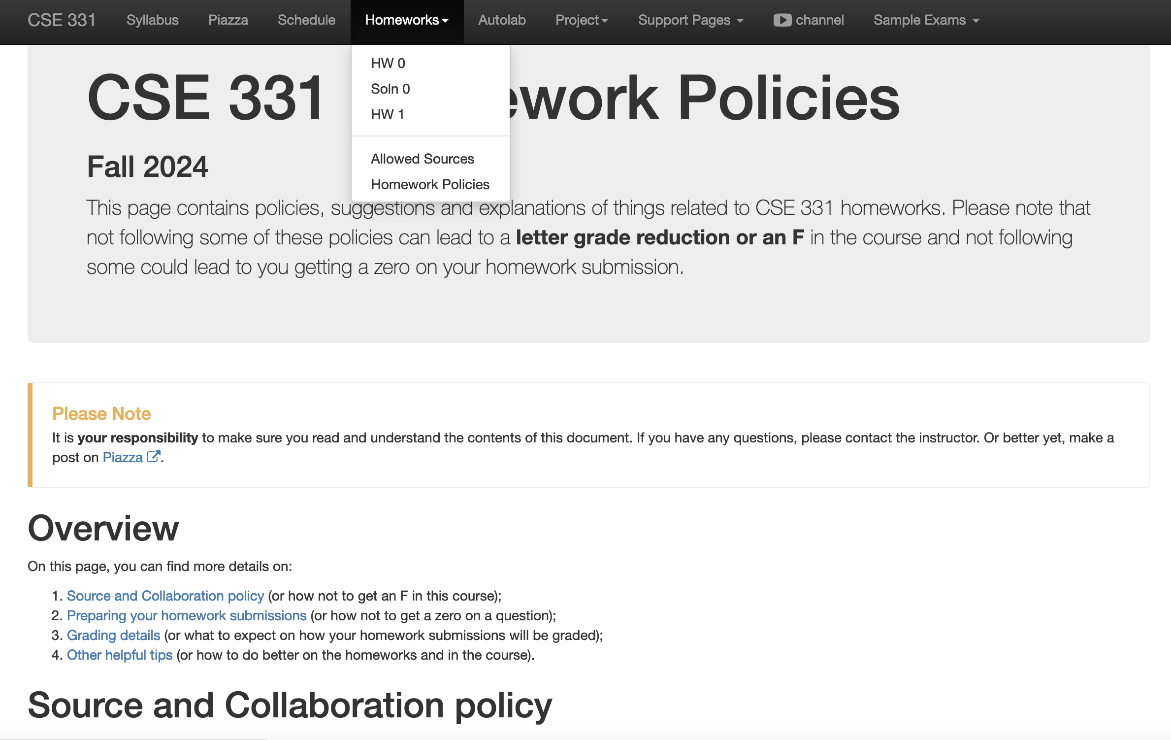
Review the HW policy doc!

Slide 8
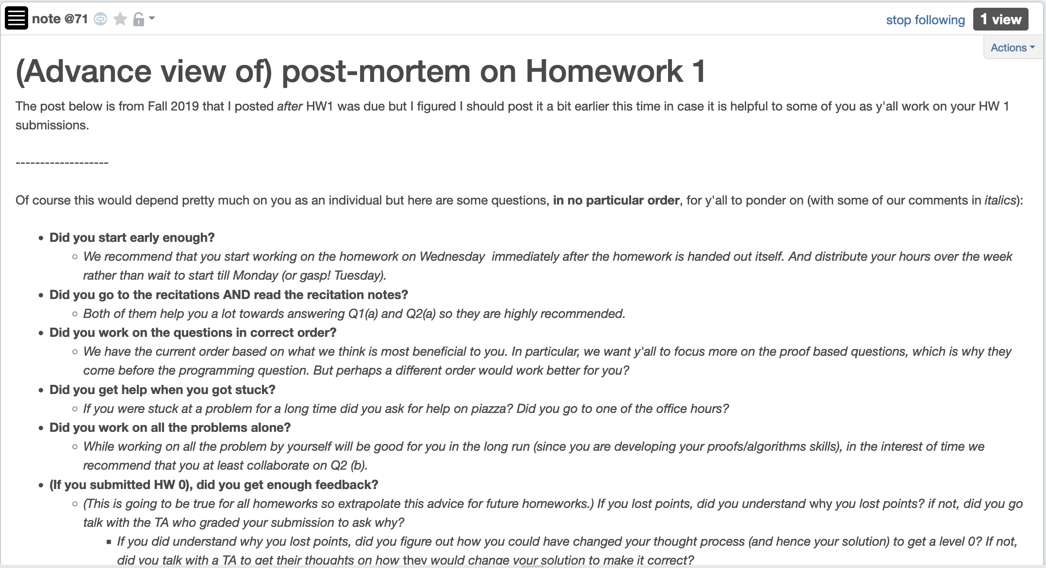
HW 1 (pre)post-mortem

Slide 9
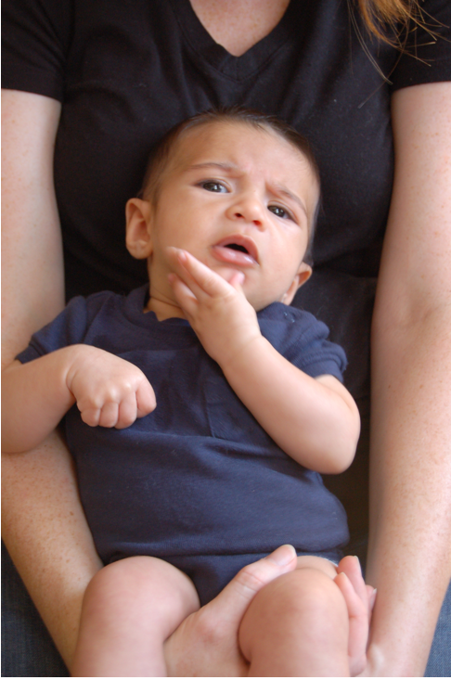
Questions/Comments?

Slide 10
Gale-Shapley Algorithm
Intially all men and women are free
While there exists a free woman who can propose
Let w be such a woman and m be the best man she has not proposed to
w proposes to m
If m is free
(w,m) get engaged
Else (w’,m) are engaged
If m prefers w’ to w
w remains free
Else
(w,m) get engaged and w’ is free
Output the engaged pairs as the final output

Slide 11
The Lemmas
Lemma 0: The GS algorithm has at most n² iterations
Lemma 1: S is a perfect matching
Lemma 2: S has no instability
Lemma 3: If at the end of an iteration, w is free then w has not proposed to
ALL men

Slide 12
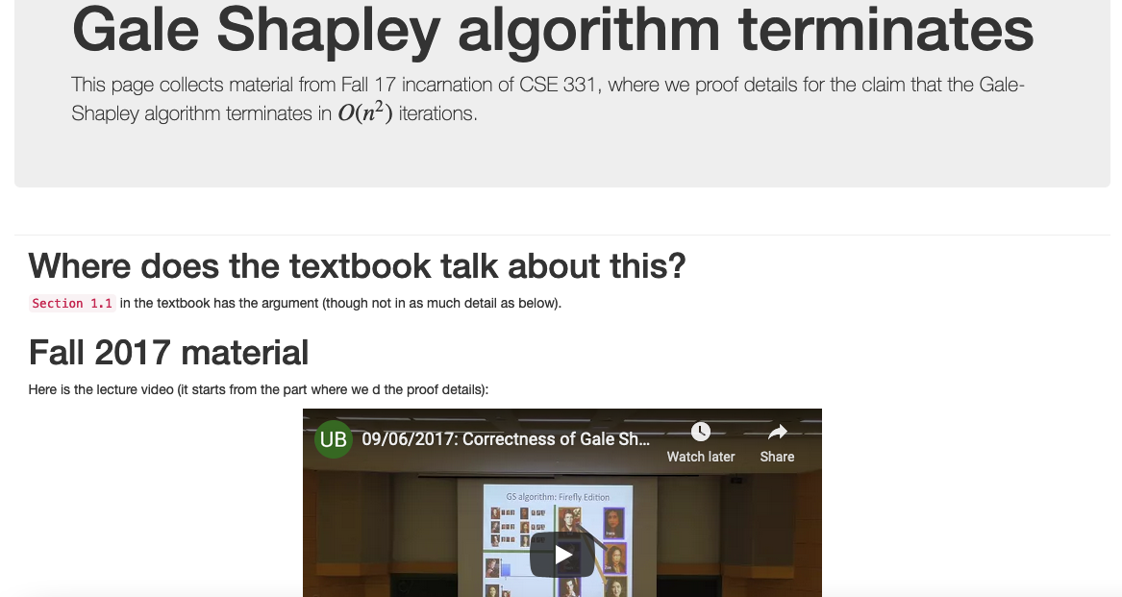
Proof Details of Lemma 0

Slide 13
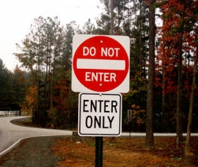
Proof technique de jour
Proof by contradiction
Assume the negation of what you want to prove
After some reasoning
Source: 4simpsons.wordpress.com

Slide 14
Two obervations
Obs 1: Once m is engaged he keeps getting
engaged to “better” women
Obs 2: If w proposes to m’ first and then to m
(or never proposes to m) then she
prefers m’ to m

Slide 15
Questions/Comments?

Slide 16
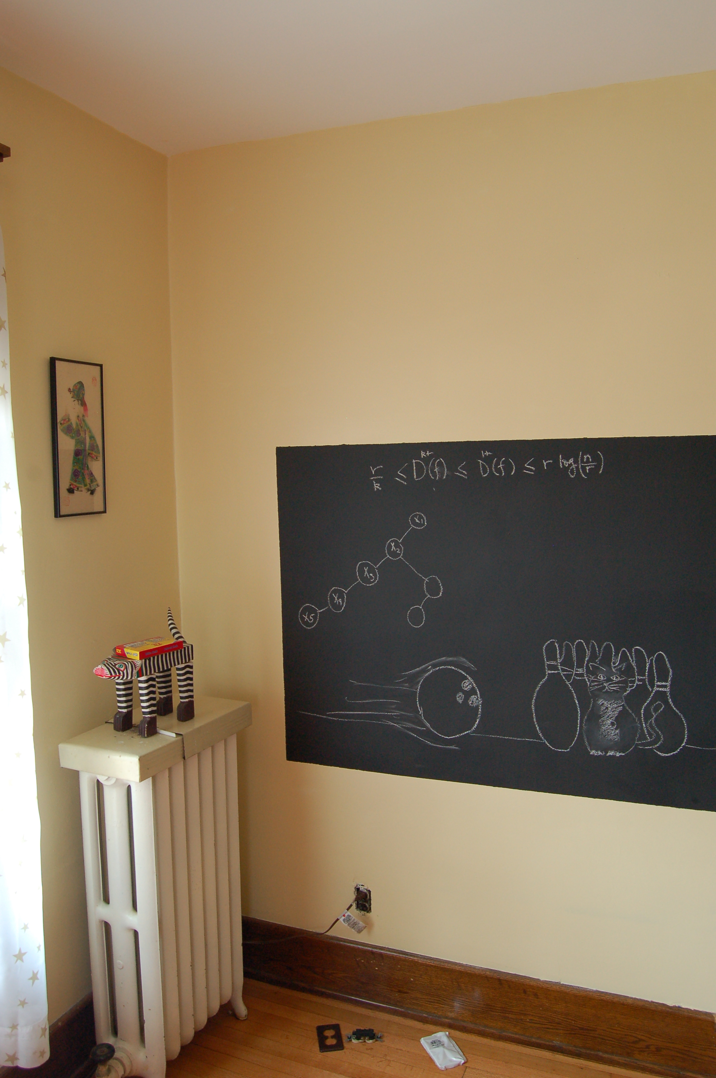
Pf. of Lemmas 1+3 on the board…

Slide 17
Proof of Lemma 2
By contradiction
w’ last proposed to m’
Assume there is an instability (w’,m)
m prefers w’ to w
m
w
w’ prefers m to m’
m’
w’

Slide 18

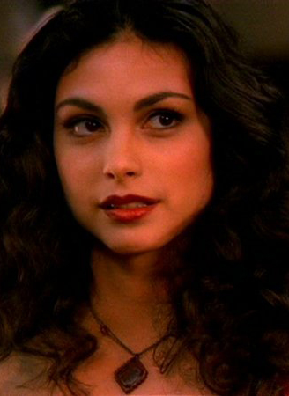
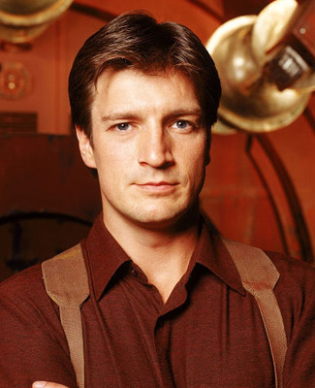
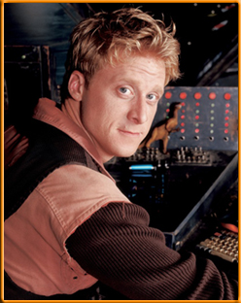
Contradiction by Case Analysis
Depending on whether w’ had proposed to m or not
Case 1: w’ never proposed to m
w’ prefers m’ to m
By Obs 2
m
Assumed w’ prefers m to m’
w’
Source: 4simpsons.wordpress.com

Slide 19
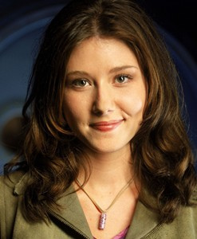

Case 2: w’ had proposed to m
w’
Case 2.1: m had accepted w’ proposal
m is finally engaged to w
m
Thus, m prefers w to w’
4simpsons.wordpress.com
By Obs 1
Case 2.2: m had rejected w’ proposal
m was engaged to w’’ (prefers w’’ to w’)
By Algo def
m is finally engaged to w (prefers w to w’’)
By Obs 1
m prefers w to w’
4simpsons.wordpress.com

Slide 20
Overall structure of case analysis
Did w’ propose to m?
Did m accept w’ proposal?
4simpsons.wordpress.com
4simpsons.wordpress.com
4simpsons.wordpress.com

Slide 21
Questions?

