Slide 1
Lecture 9
CSE 331
Sep 16, 2024

Slide 2
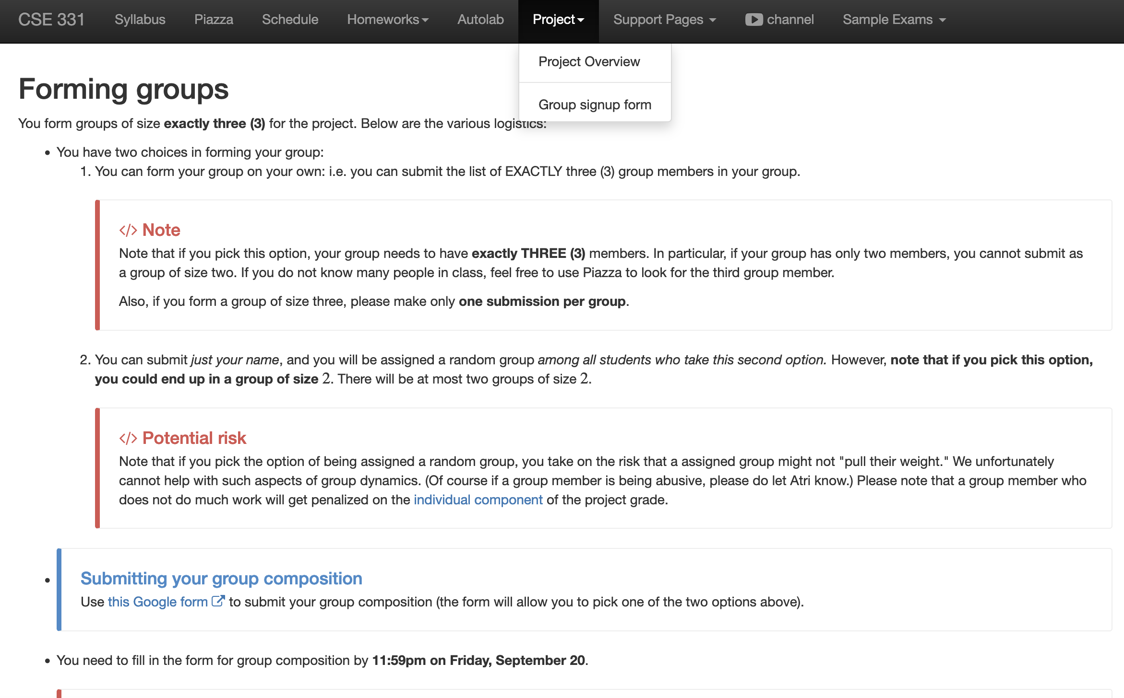
Register your project groups
Deadline: Friday, Sep 20, 11:59pm
If you miss this deadline then you will get a ZERO on the ENTIRE project

Slide 3
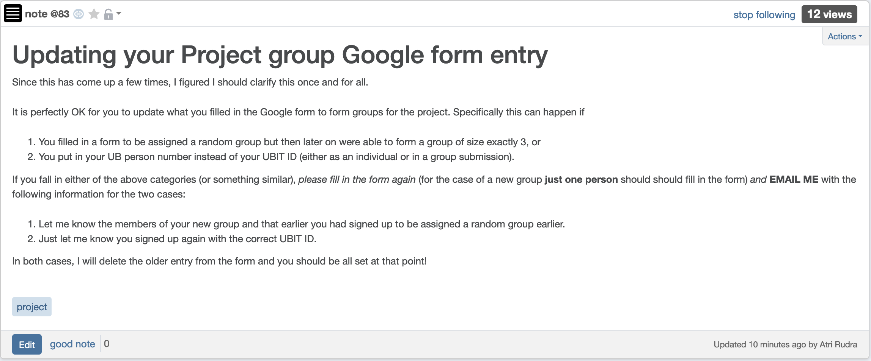
Updating your Google form entry

Slide 4
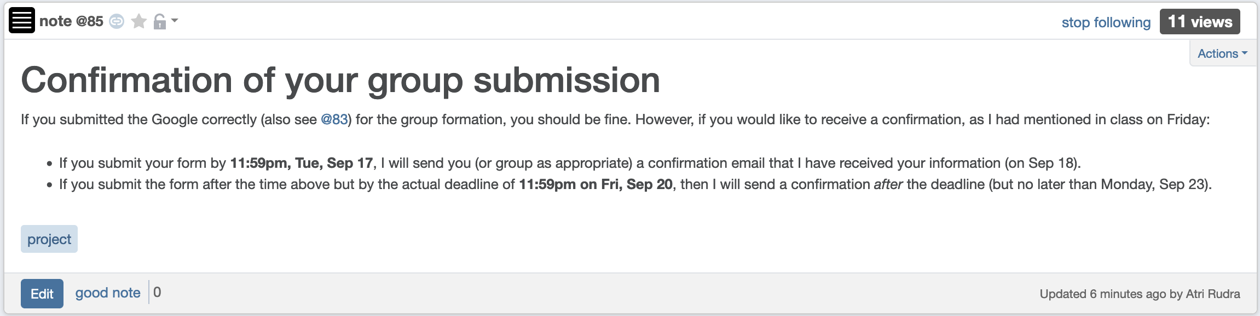
Confirmation of your group

Slide 5
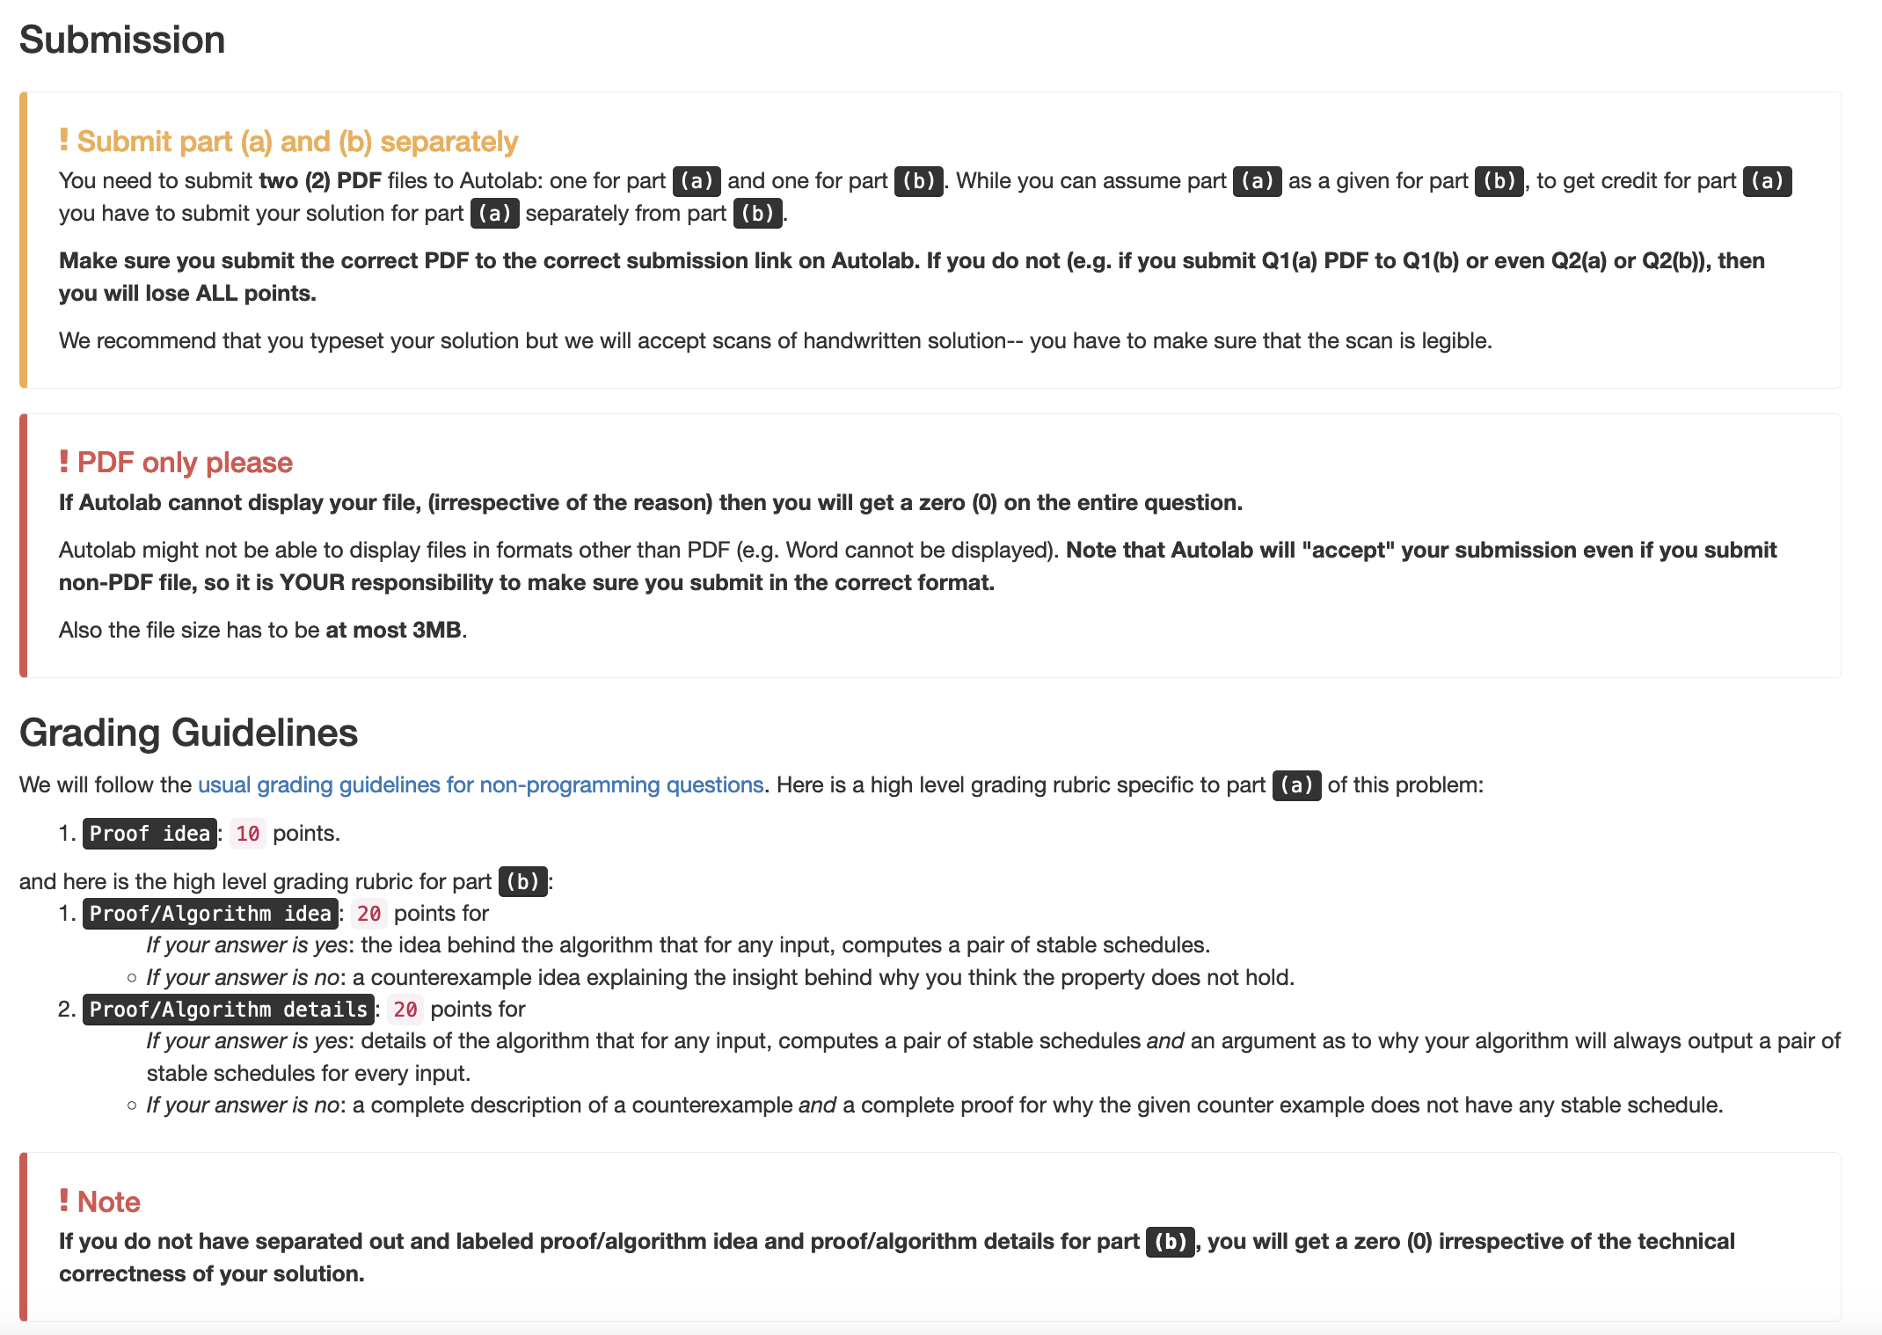
Submission requirements

Slide 6
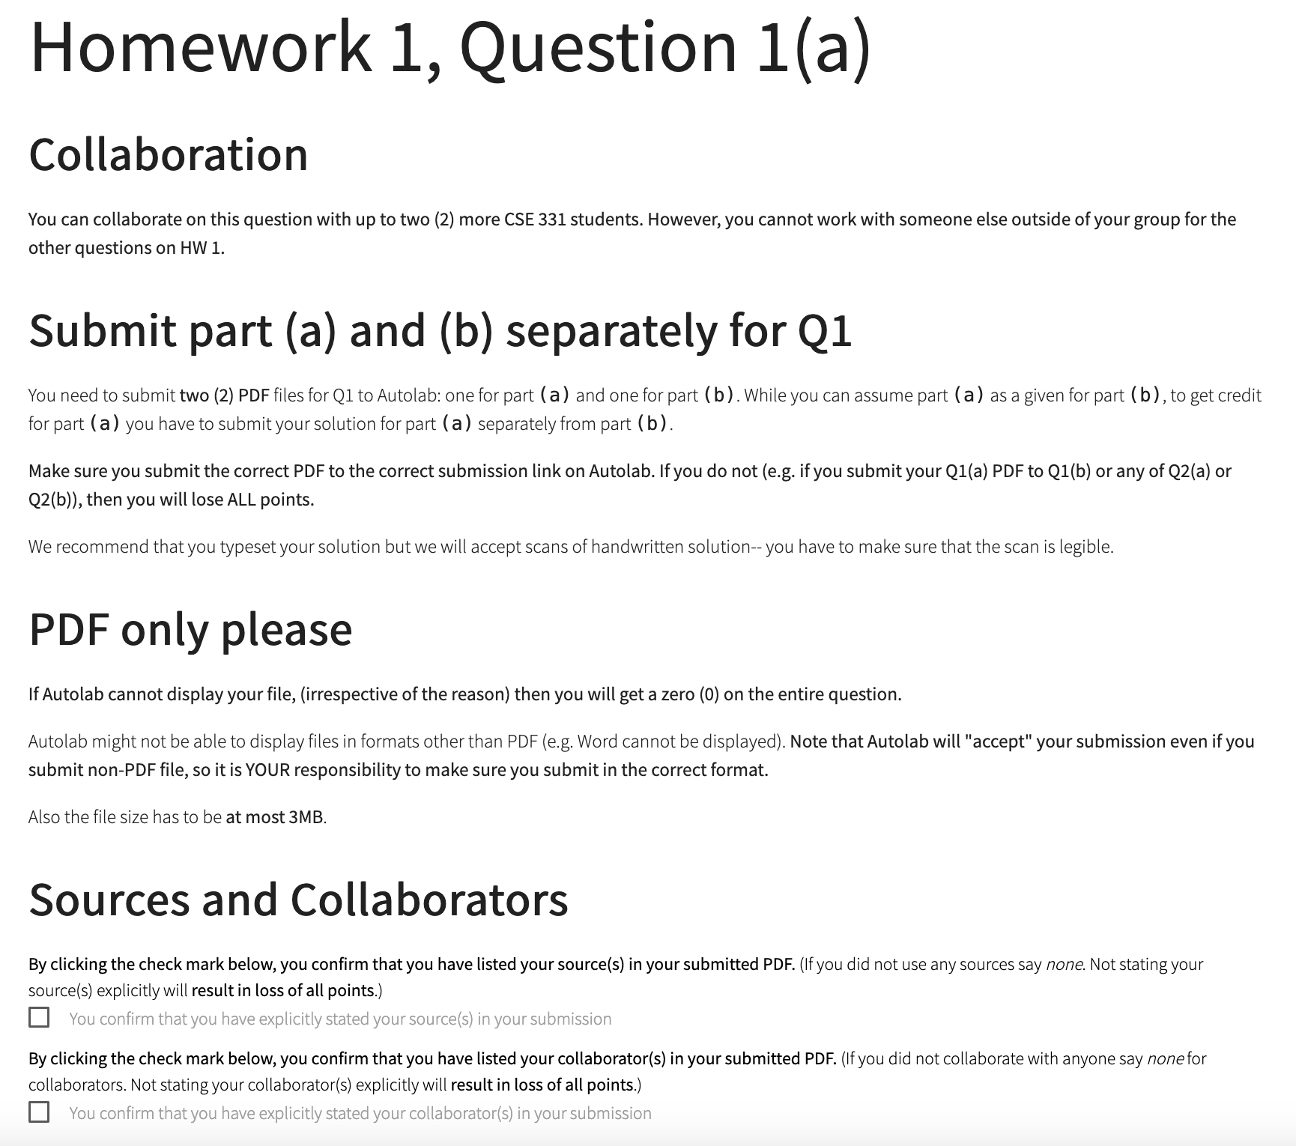
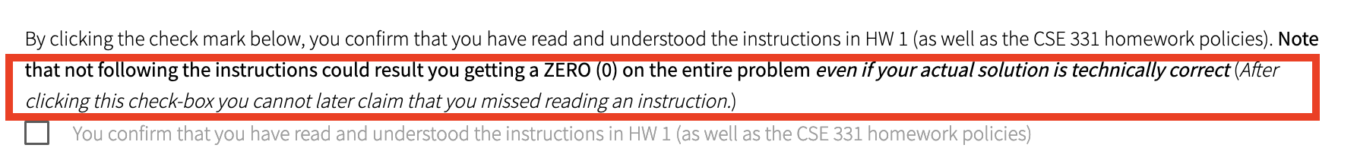
You need to confirm that you followed the requirements

Slide 7
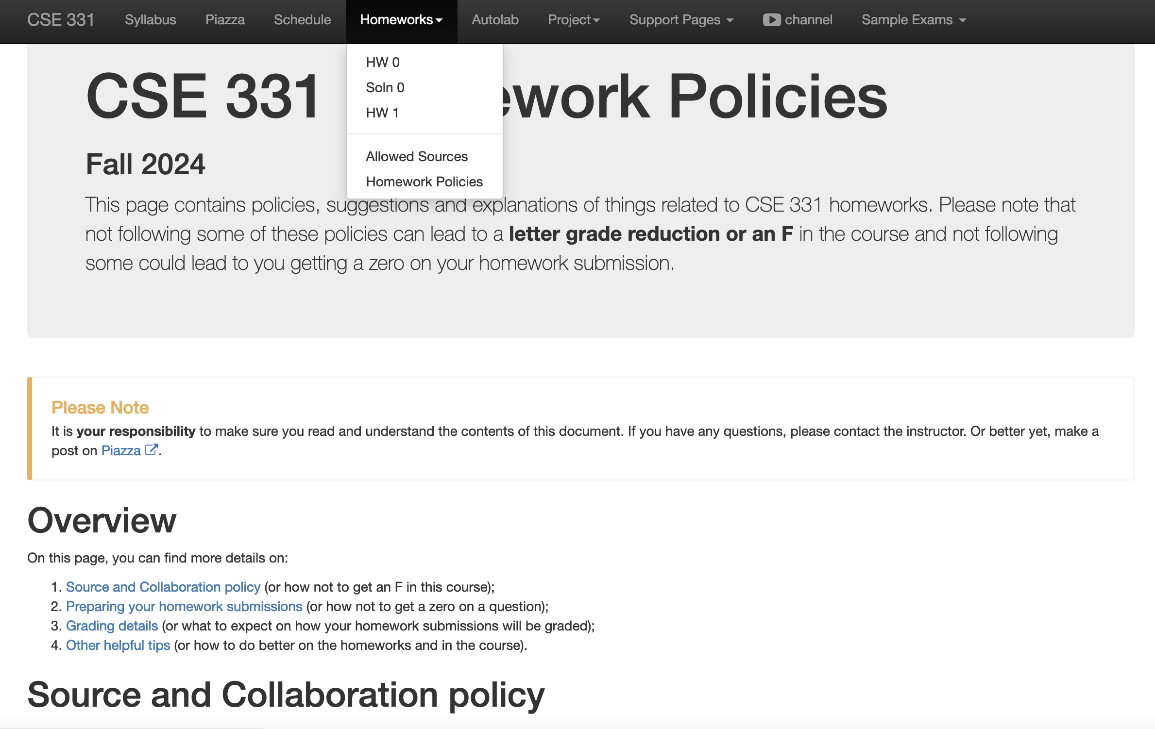
Review the HW policy doc!

Slide 8
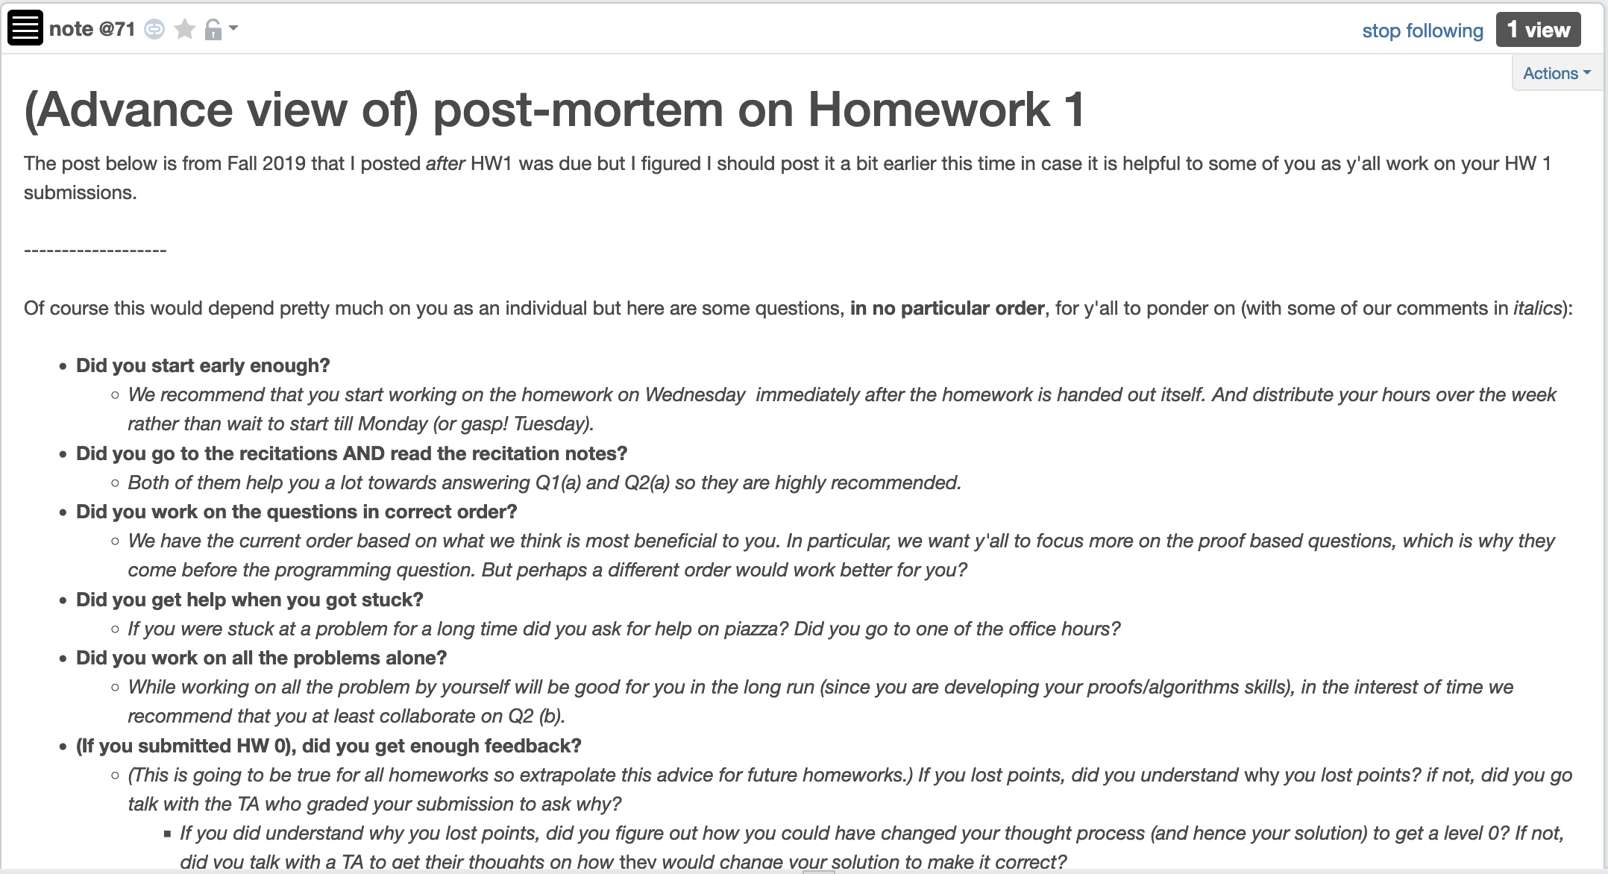
HW 1 (pre)post-mortem

Slide 9
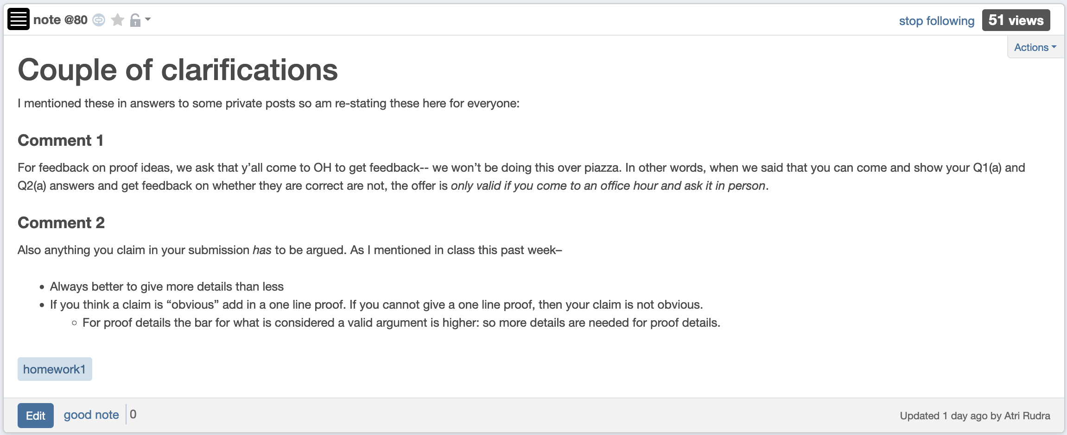
Feedback on Q1(a) and Q2(a)

Slide 10

If you need it, ask for help

Slide 11
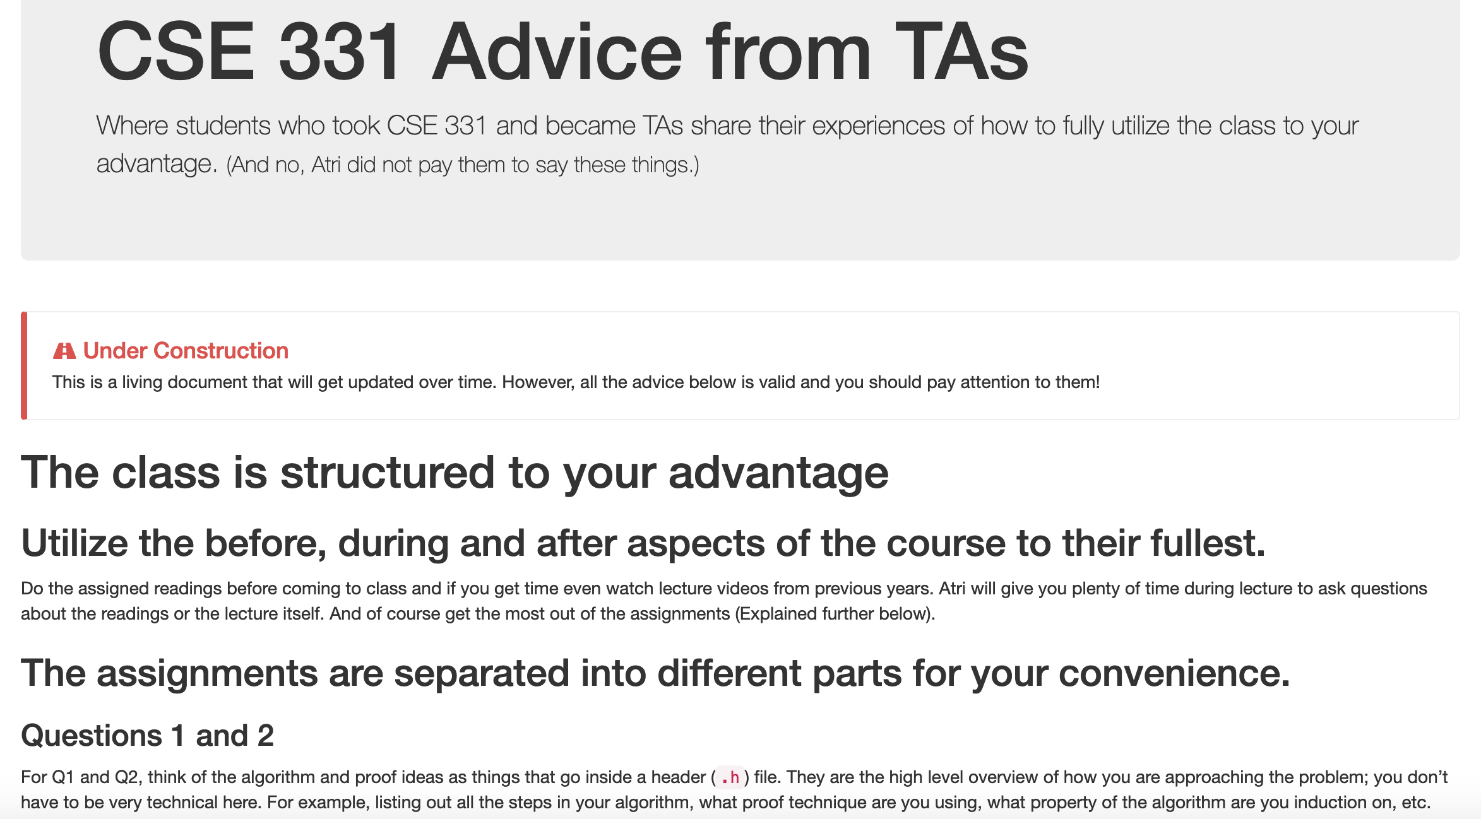
Advice from TAs

Slide 12
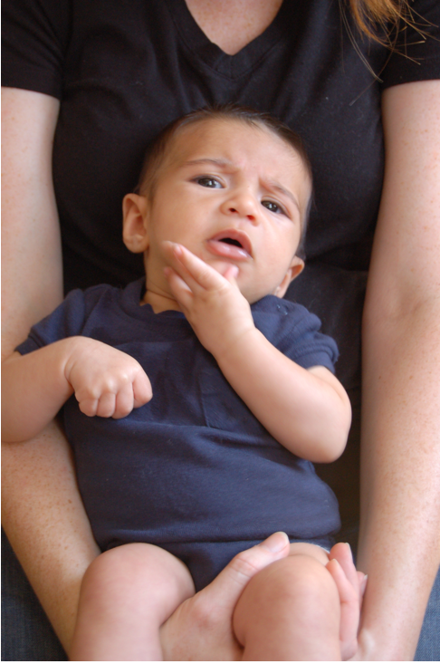
Questions/Comments?

Slide 13
Gale-Shapley Algorithm
Intially all men and women are free
While there exists a free woman who can propose
Let w be such a woman and m be the best man she has not proposed to
w proposes to m
If m is free
(w,m) get engaged
Else (w’,m) are engaged
If m prefers w’ to w
w remains free
Else
(w,m) get engaged and w’ is free
Output the engaged pairs as the final output

Slide 14
The Lemmas
Lemma 0: The GS algorithm has at most n² iterations
Lemma 1: S is a perfect matching
Lemma 2: S has no instability

Slide 15
Questions?

Slide 16

Question from end of Friday class
What is the size of an SMP input?
There are 2n preference lists
How many entries does each list have?
n
Total size = 2n$×$ n = 2n² = $Θ$(n²)

Slide 17
Questions?

Slide 18
Extensions
Fairness of the GS algorithm
Different executions of the GS algorithm

Slide 19





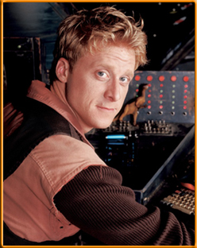

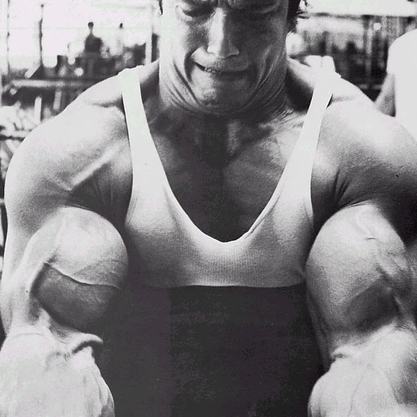
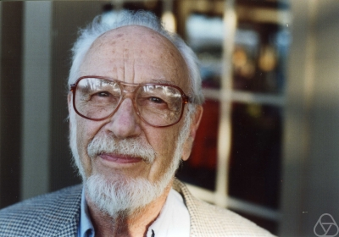
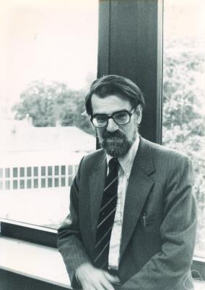

Main Steps in Algorithm Design
Problem Statement
Problem Definition
Algorithm
n!
“Implementation”
Analysis
Correctness Analysis

Slide 20



Definition of Efficiency
An algorithm is efficient if, when implemented, it runs quickly on real instances
Implemented where?
Platform independent definition
What are real instances?
Worst-case Inputs
N = 2n² for SMP
Efficient in terms of what?
Input size N

Slide 21
Definition-II
Analytically better than brute force
n!
How much better? By a factor of 2?

Slide 22
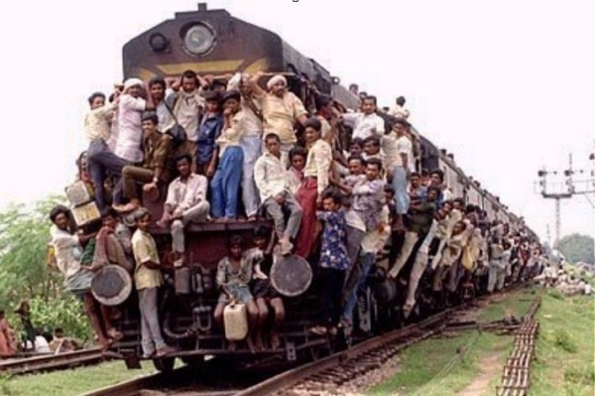
Definition-III
Should scale with input size
If N increases by a constant factor,
so should the measure
Polynomial running time
At most c.N^{d} steps (c>0, d>0 absolute constants)
Step: “primitive computational step”

Slide 23
More on polynomial time
Problem centric tractability
Can talk about problems that are not efficient!

Slide 24
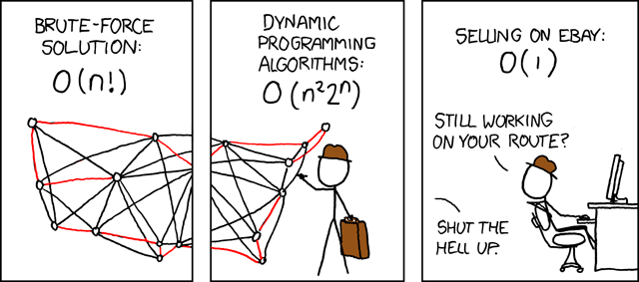
Asymptotic Analysis
Travelling Salesman Problem
(http://xkcd.com/399/)

Slide 25
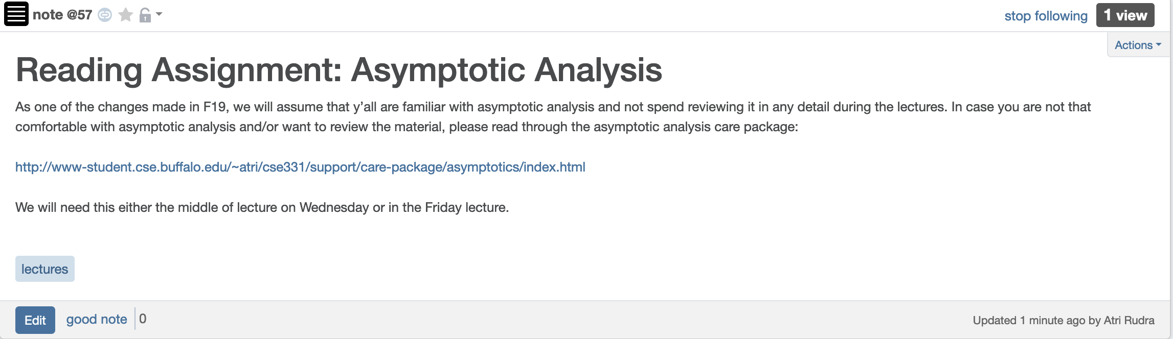
Reading Assignment for today

Slide 26
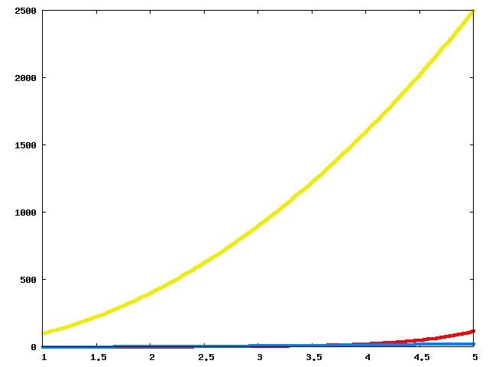
Which one is better?

Slide 27
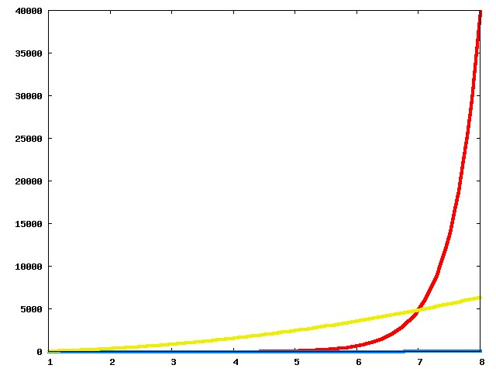
Now?

Slide 28
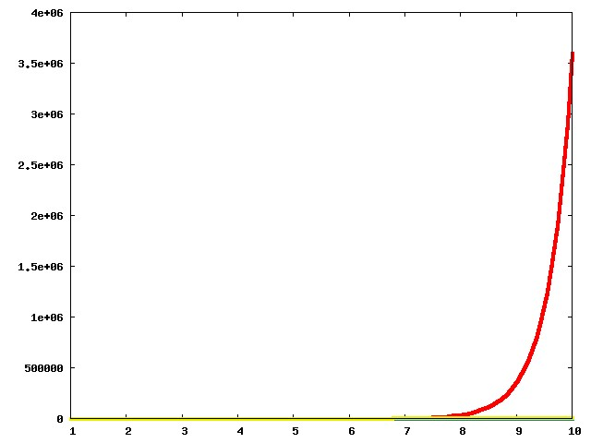
And now?

Slide 29
The actual run times
n!
100n²
Asymptotic View
n²

Slide 30
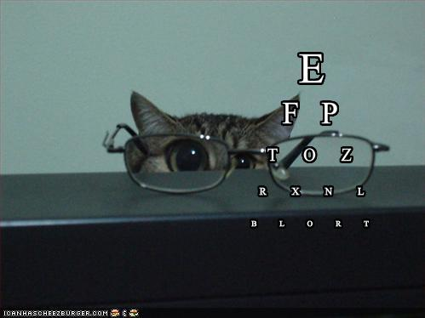
Asymptotic Notation
≤ is O with glasses
≥ is Ω with glasses
= is Θ with glasses

Slide 31
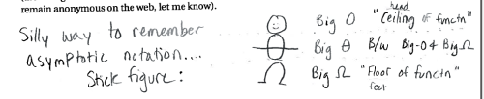
Another view
© Aleksandra Patrzalek, 2012

Slide 32
g(n) is O(f(n))
c*f(n) for some c>0
g(n)
n
n₀

Slide 33
g(n) is Ω(f(n))
g(n)
ε*f(n) for some ε>0
n
n₁

Slide 34
g(n) is Θ(f(n))
g(n)
ε*f(n) for some ε>0
n
n₁

Slide 35
Properties of O (and Ω)
Transitive
g is O(f) and f is O(h) then
g is O(h)
Step 1 // O(n) time
Step 2 // O(n) time
Additive
g is O(h) and f is O(h) then
g+f is O(h)
Overall: O(n) time
Multiplicative
g is O(h₁) and f is O(h₂) then
g*f is O(h₁*h₂)
Overall: O(n²) time
While (loop condition) // O(n²) iterations
Stuff happens // O(1) time

Slide 36
Questions?

Slide 37
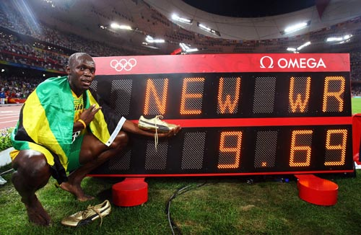
Rest of today’s agenda
O(n²) implementation of the Gale-Shapley algorithm
Some practice with run time analysis

Slide 38
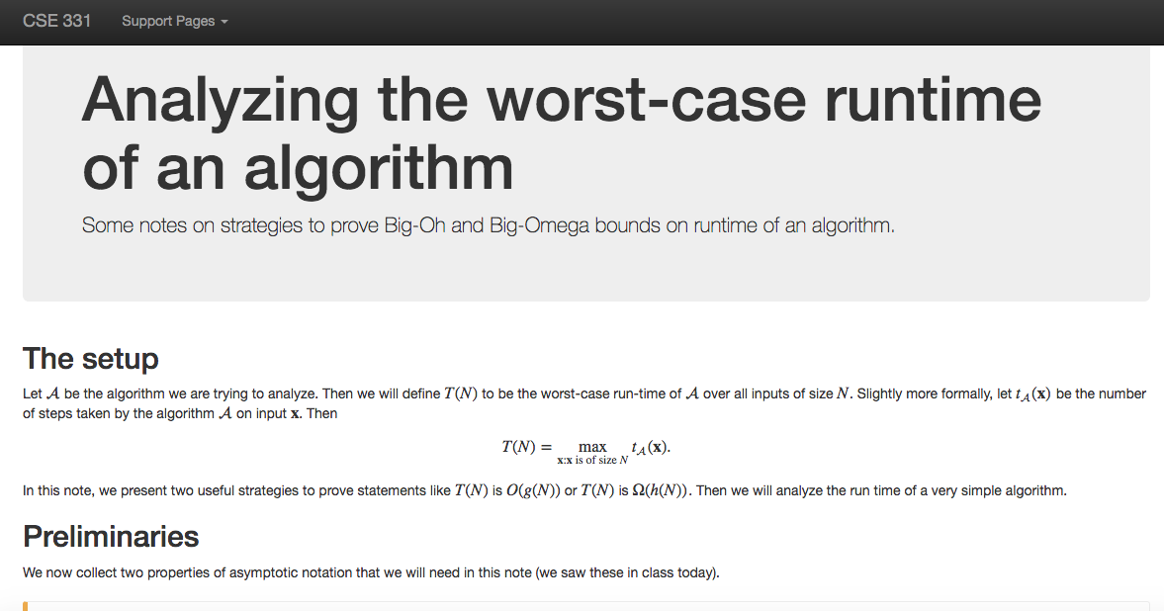
Another Reading Assignment

Slide 39
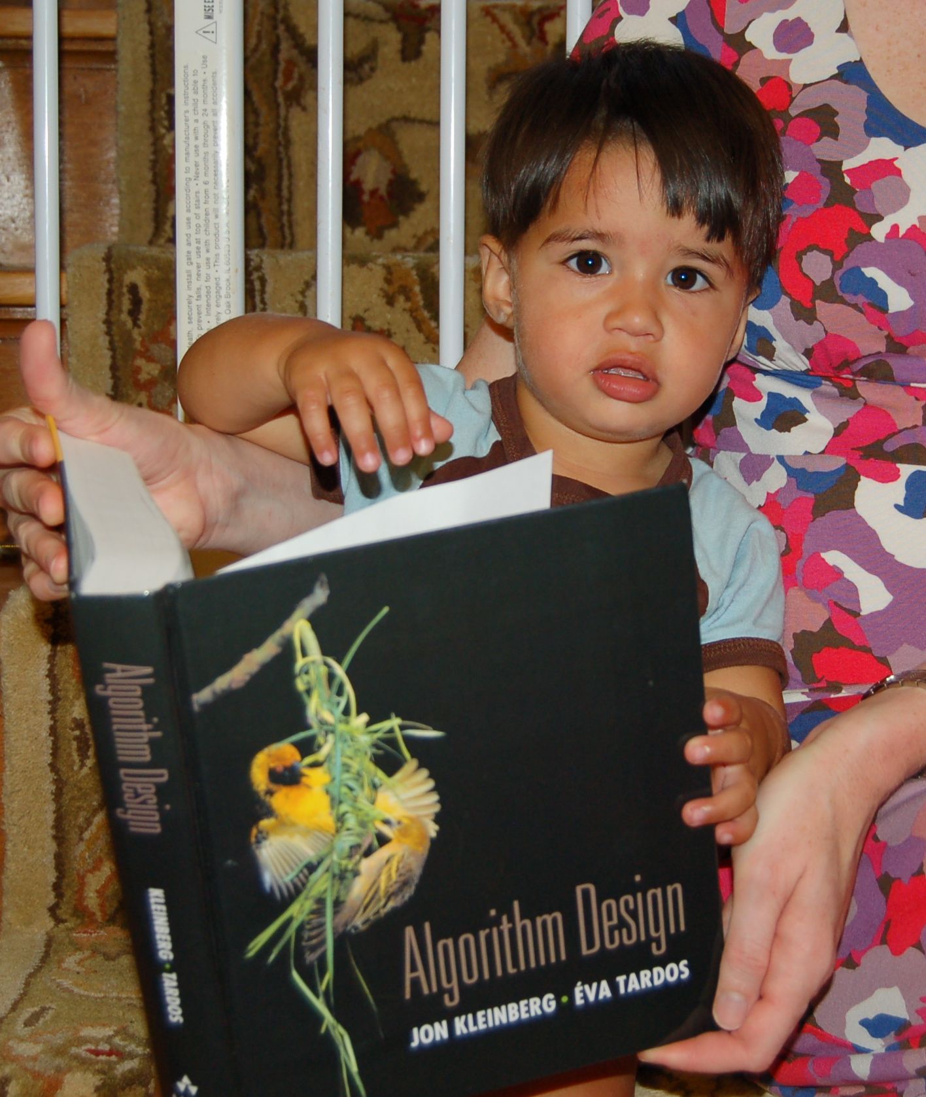
Reading Assignments
Sections 1.1, 1.2, 2.1, 2.2 and 2.4 in [KT]

Slide 40
Gale-Shapley Algorithm
At most n² iterations
Intially all men and women are free
While there exists a free woman who can propose
Let w be such a woman and m be the best man she has not proposed to
w proposes to m
O(1) time implementation
If m is free
(w,m) get engaged
Else (w’,m) are engaged
If m prefers w’ to w
w remains free
Else
(w,m) get engaged and w’ is free
Output the engaged pairs as the final output

Slide 41
Implementation Steps
(0) How to represent the input?
(1) How do we find a free woman w?
(2) How would w pick her best unproposed man m?
(3) How do we know who m is engaged to?
(4) How do we decide if m prefers w’ to w?

Slide 42
Overall running time
Init(1-4)
n² X ( Query/Update(1-4) )

Slide 43
Questions?

Slide 44
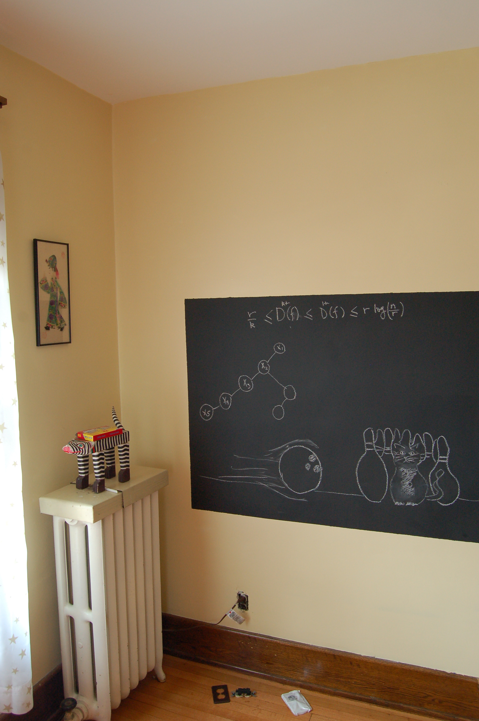
Rest on the board…

