Slide 1
TopOrd(G=(V,E))
If |V| = {u}, return u
Let w be a node with no incoming edges
Let G’ be G\{w}
Return w; TopOrd(G’)

Slide 2


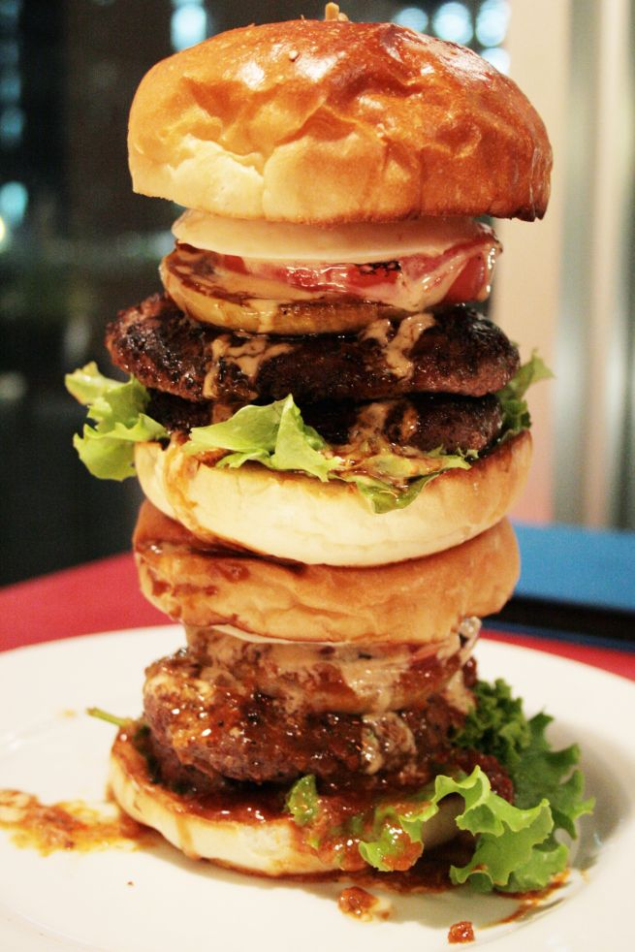
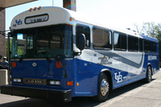
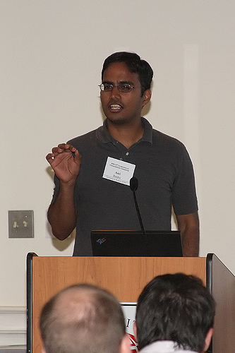
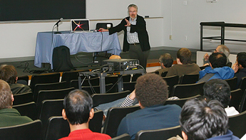
Run of TopOrd algorithm

