Slide 1
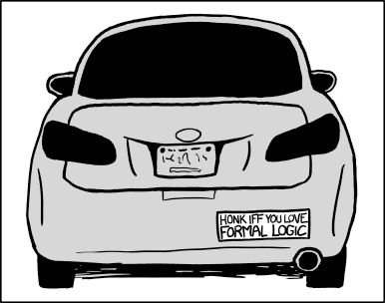
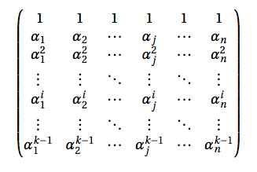
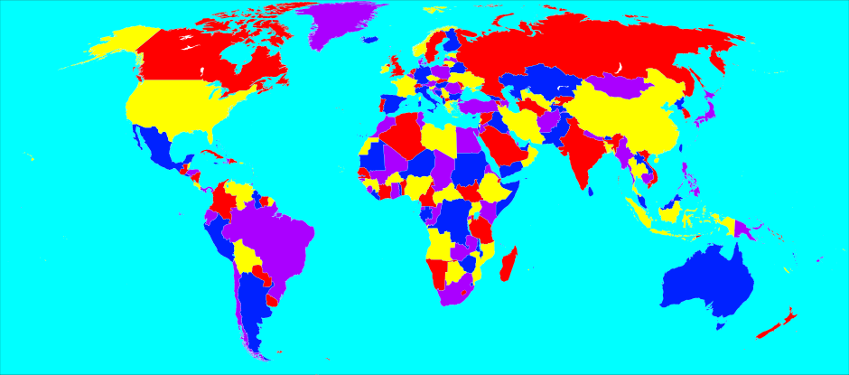
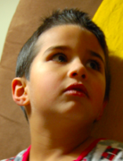
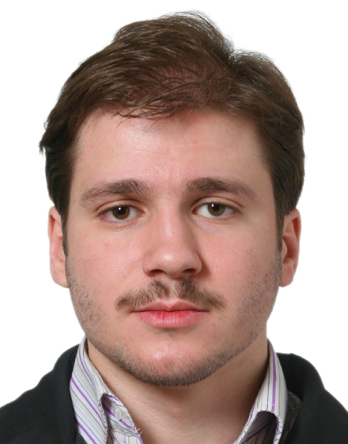
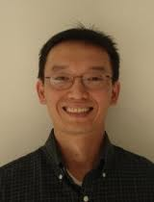
Answering FAQs
in CSPs, PGMs, Databases, Logic and Matrix Operations
Atri Rudra
Mahmoud
Abo Khamis
Hung
Ngo

Slide 2
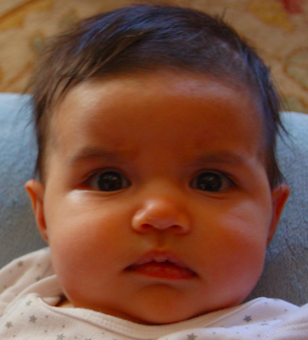
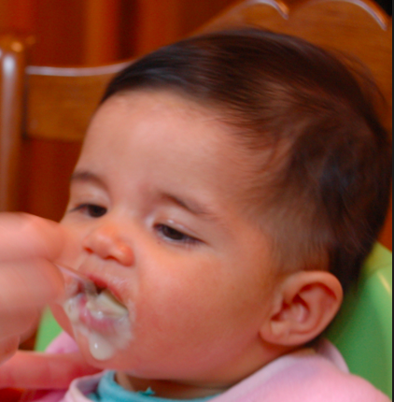
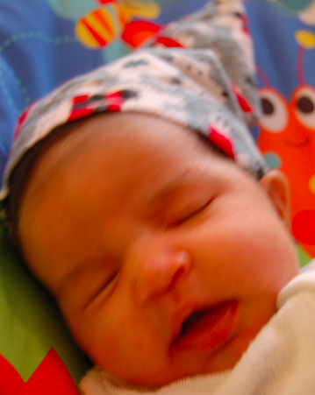
Probabilistic Graphical Models (PGMs)
http://ginaskokopelli.com/wp-content/uploads/2013/01/DiaperDealsLogo.jpg
D
E
H
f_{S|E}(s,e) = Pr[S=s|E=e]
S
S
E
f_{S|E}
Σ
1
1
0.8
φ (h) =
f_{H|D,S}(h,d,s) × f_{S|E}(s,e)
× f_{D|E}(d,e) × f_{E}(e)
1
0
0.3
d,s,e
0
1
0.2
0
0
0.7

Slide 3
Matrix vector multiplication
H
a_{0,0}
a_{0,2}
…..
a_{0,N-1}
b₀
b
X
Y
A
a_{N-1,0}
a_{N-1,1}
a_{N-1,N-1}
b_{N-1}
…..
A
b
φ (x) = Σ A(x,y)•b(y)
y

Slide 4
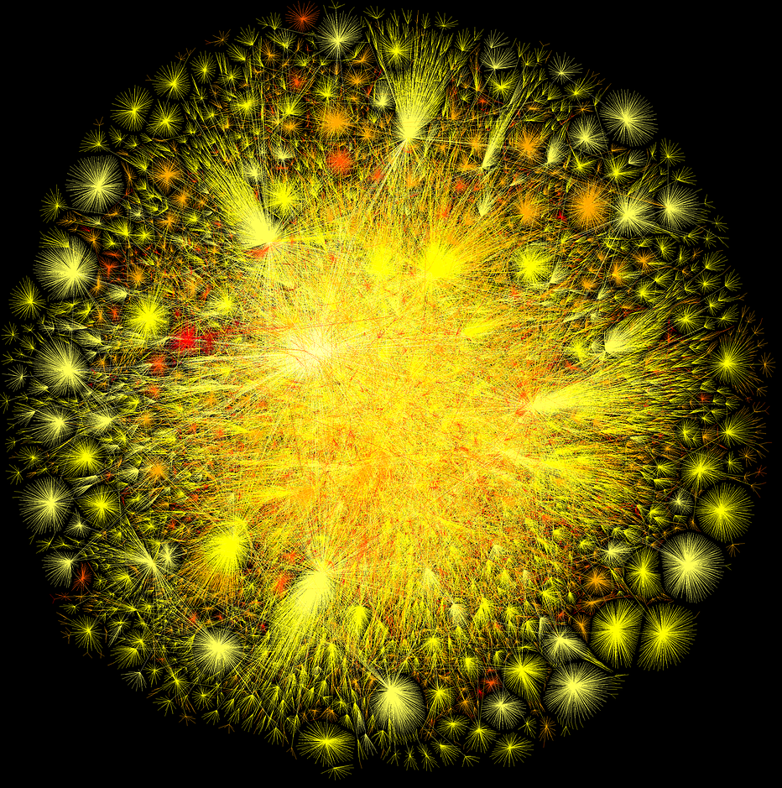
(Morally) Database joins
Input: A big (hypergraph) G = (V(G), E(G))
G
A small hypergraph H = (V, E )
Output: All copies of H in G
X₀
φ (x₀,x₁,x₂) = R(x₀,x₁)•S(x₁,x₂)•T(x₀,x₂)
R
T
H
R(x,y) = 1 if (x,y) in E(G) and x<y
X₁
X₂
= 0 otherwise
Encoding of the functions is crucial
S
S and T defined similarly

Slide 5
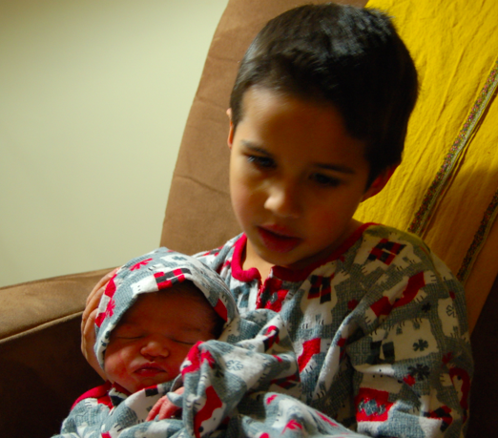
On FAQs
“Baby” FAQs

Slide 6
Baby FAQs
X₀
Variables V = {X₀, X₁, …, X_{n-1}}
R
T
Hypergraph H = (V, E )
X₁
X₂
S
Factors: for every e in E
f_{e}: Π _{i in e} Dom(X_{i}) ➔ D
0 ≤ r ≤ n
Aji
McEliece
There are r “free” variables
(D, ✜ ,✪ ) is a semi-ring*
Functional Aggregate Query
φ (x₀,…,x_{r-1}) = ✜ _{x ,..,x} ✪_{e in E} f_{e}(x_{e})
r
_{n-1}

Slide 7
Baby FAQs are very expressive
CSPs: ( {0,1}, OR, AND )
Logic
http://en.wikipedia.org/wiki/Four_color_theorem#/media/File:World_map_with_four_colours.svg
PGMs: ( R₊, +, × )
https://xkcd.com/1033/
Matrix Ops
Joins
φ (x₀,…,x_{r-1}) = ✜ _{x ,..,x} ✪_{e in E} f_{e}(x_{e})
r
_{n-1}

Slide 8
What do we show?
A single algorithm that solves the general FAQ problem
One algorithm to rule all the semi-rings
Faster algorithms for problems in PGMs and logic
Recovers best known results in other FAQ instances
Analysis is the technically challenging part

Slide 9
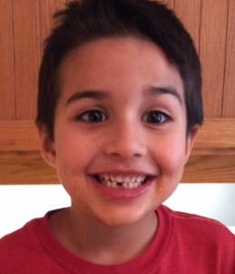
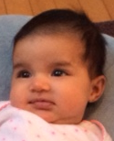
What is “grown up” FAQ?
_{(n-1)}
φ (x₀,…,x_{r-1}) = ✜ _{x} ....... ✜ _{x} ✪_{e in E} f_{e}(x_{e})
(f)
r
_{n-1}
Can handle # quantified conjunctive queries
For every i ≥ r
(i)
(i)
✜ = ✪
OR
(D, ✜ ,✪ ) is a semi-ring*
φ (x₀,…,x_{r-1}) = ✜ _{x ,..,x} ✪_{e in E} f_{e}(x_{e})
r
_{n-1}

Slide 10
How are functions represented?
Assume truth-table representation for now
Assume D = |Dom(X_{i})| for every i

Slide 11
Trivial algorithm for (baby) FAQs
Go through all D^{n} instantiations for (x₀,..,x_{n-1})
O(mnD^{n}) time
φ (x₀,…,x_{r-1}) = ✜ _{x ,..,x} ✪_{e in E} f_{e}(x_{e})
r
_{n-1}

Slide 12
Matrix vector multiplication-II
H
A•C•b
X
A
Y
Trivial FAQ algo: Θ(N³)
C
b
z
φ (x) = ΣΣ A(x,y)•C(y,z)•b(z)
y
z

Slide 13
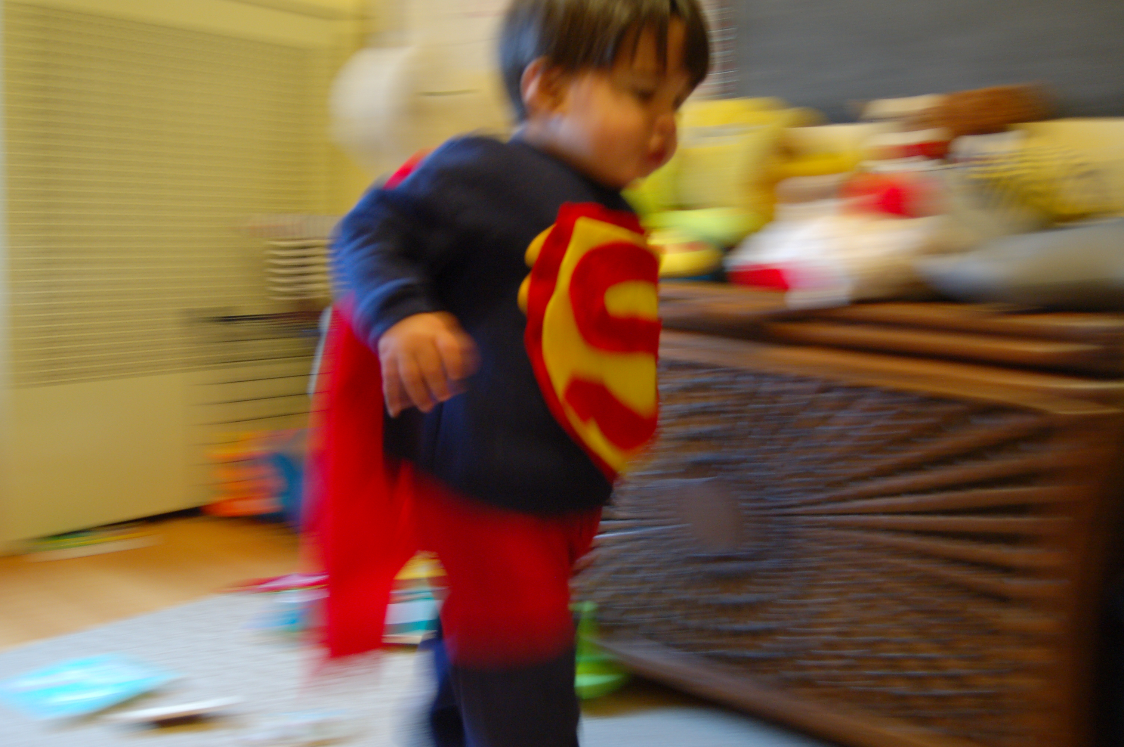
Let’s do it faster

Slide 14
The trivial O(N²) time algorithm
H
A•C•b
d
A
Σ_{y}Σ_{z} A(x,y)• C(y,z)• b(z)
X
Y
Y
Eliminate z
C
b
= Σ_{y} A(x,y)•[Σ_{z}C(y,z)• b(z)]
z
= Σ_{y} A(x,y)•d(y)
Eliminate y
φ (x) = ΣΣ A(x,y)•C(y,z)•b(z)
y
z

Slide 15
Going back to representations
φ (x₀,…,x_{r-1}) = ✜ _{x ,..,x} ✪_{e in E} f_{e}(x_{e})
r
_{n-1}
Listing representation:
Only list non-0 values of f_{e}(x_{e})
f_{e}(x_{e}) =0 determines the product
0
1
1
1
0
0
1
0
0

Slide 16
Let’s go back to joins …
CSPs: ( {0,1}, OR, AND )
Logic
http://en.wikipedia.org/wiki/Four_color_theorem#/media/File:World_map_with_four_colours.svg
PGMs: ( R₊, +, × )
https://xkcd.com/1033/
Matrix Ops
Joins
φ (x₀,…,x_{f-1}) = ✜ _{x ,..,x} ✪_{e in E} ψ_{e}(x_{e})
f
_{n-1}

Slide 17
… and run the previous algo
X₀
Ω(N²) output size (and hence time)
T
X₁
X₂
H
X₀
S
R
T
X₁
X₂
S
|R|=|S|=
|T|=N
φ (x₀,x₁,x₂) = R(x₀,x₁)•S(x₁,x₂)•T(x₀,x₂)

Slide 18
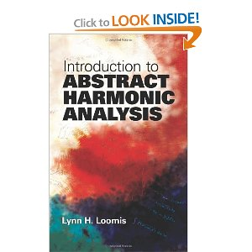
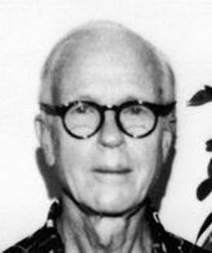
Is Ω(N²) time overall necessary?
X₂
N^{3/2}
|S| =N
|R|=N
Loomis
Whitney
X₀
H
X₀
|T|= N
R
T
X₁
X₁
X₂
φ (x₀,x₁,x₂) = R(x₀,x₁)•S(x₁,x₂)•T(x₀,x₂)
S

Slide 19
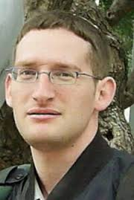
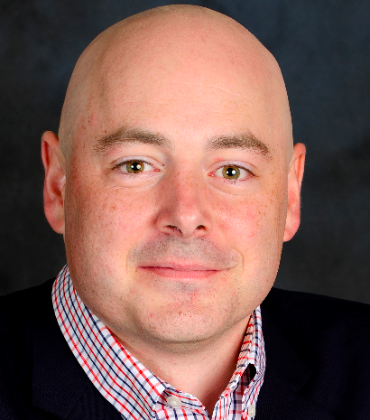
General Joins Result [PODS 12]
Attributes/Nodes: [n]
Ngo
Porat
Re
Provably worst-case optimal join algorithm
Relations/Hyperedges: e₁,…, e_{m} [n]
Factors/Tables/Projections: R₁ , … , R_{m}
φ (x₁,…,x_{n}) = Π _{j in [m]} R_{j}(x_{e} )
z₂
_{j}
z₁
1
z₁,..,z_{m} be a fractional cover
z₃
4
AGM bound: R₁^{z1}•…•R_{m}^{zm}
3
2
z₄
Our result: O(AGM + Input size)
5
Similar result later proven by folks at LogicBlox

Slide 20
Algorithm for FAQ
_{(n-1)}
φ (x₀,…,x_{r-1}) = ✜ _{x} ....... ✜ _{x} ✪_{e in E} f_{e}(x_{e})
(f)
r
_{n-1}
Eliminate variables in order σ = x_{n-1},..,x_{r}
H \x_{n-1}
x_{n-1}
H_{n-1}
Runtime is
max_{i} AGM^{σ}(H_{i})
Run* “join” algo on H_{n-1}
Recurse* on H \x_{n-1}

Slide 21
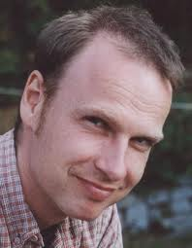
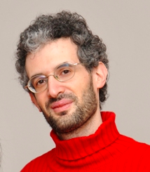
On the elimination ordering σ
Compute σ to minimize max_{i} AGM^{σ}(H_{i})
Joins problem: All σ are valid
Above leads to fhtw bound
Grohe
Marx
General FAQ problem: Not all σ might be valid
max_{a} Σ_{b} max_{c} Σ_{d} f_{A,B,C,D}(a,b,c,d)
≠
Σ_{b} max_{a} max_{c} Σ_{d} f_{A,B,C,D}(a,b,c,d)

Slide 22
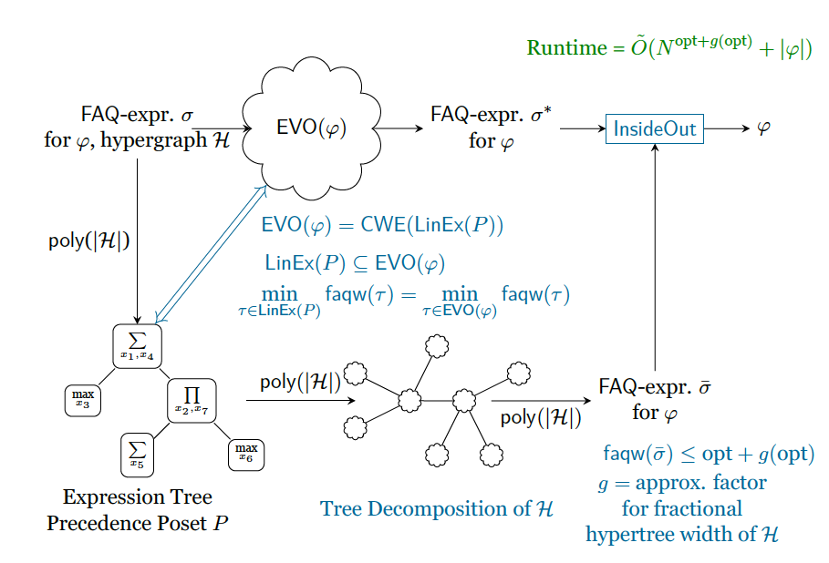
The obligatory (dense) slide

Slide 23
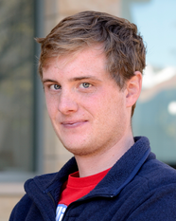
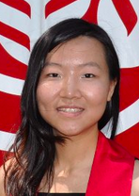
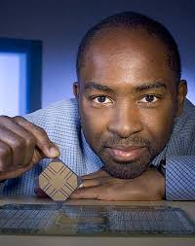
New algorithms perform well!
Worst-case optimal join algorithms implemented in a commercial DB system
>
With some engineering tricks can do much better!
10x faster
Aberger
Tu
Olukotun
Re

Slide 24
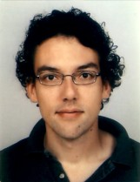
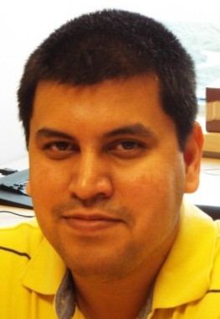
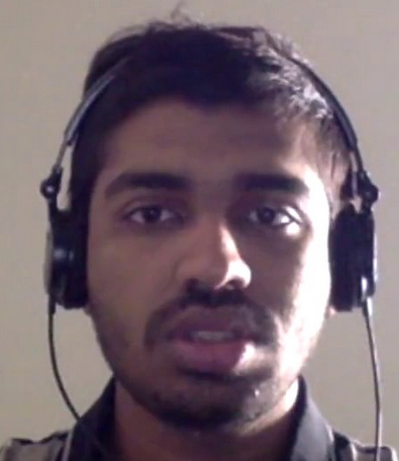
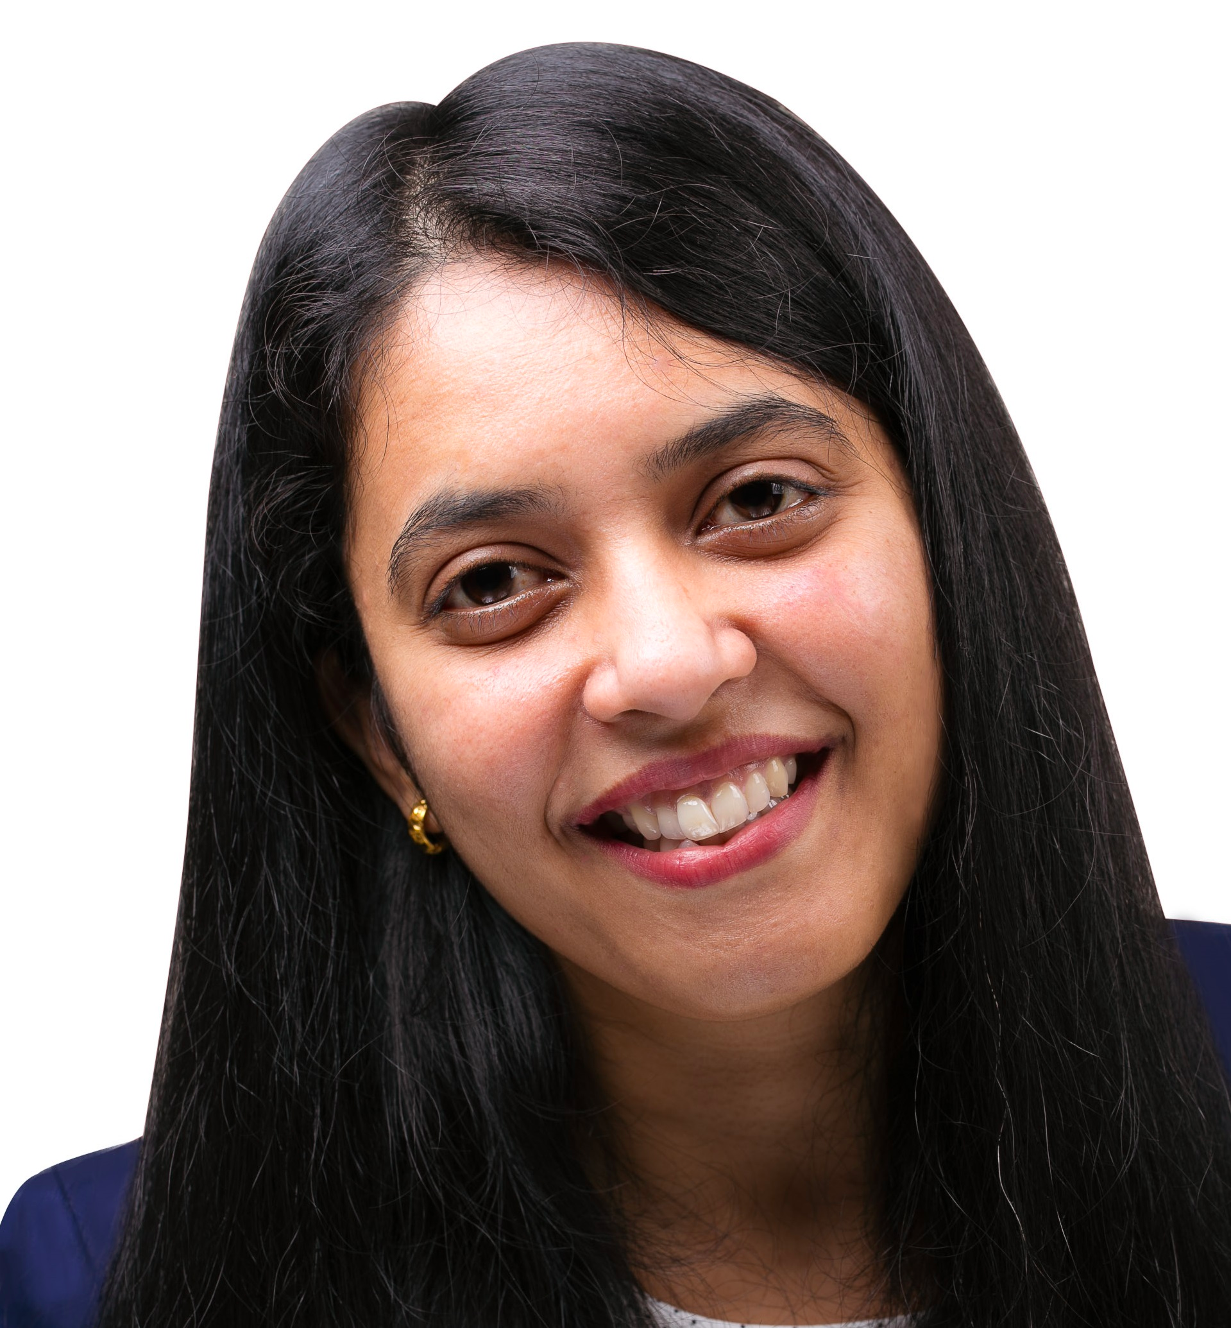
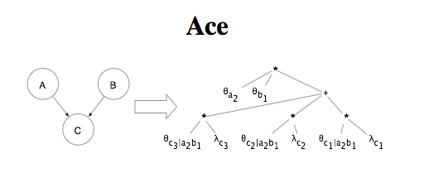
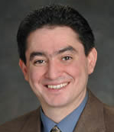
The FAQ algos are also fast
FAQ algorithm has been implemented in the LogicBlox system
Fast in-database ML implementations
Standalone prototype for exact inference in PGMs
Mooij
Up to 3x
faster*
>
Gogate
Dechter
Mani
Jayaraman
Shivram
Lamb
Re
Darwiche

Slide 25
Two open Questions
FAQ algorithms with beyond-worst case analysis
Such algorithms exist for joins
Abo Khamis
Ngo
Re
Approximate FAQ algorithms

Slide 26
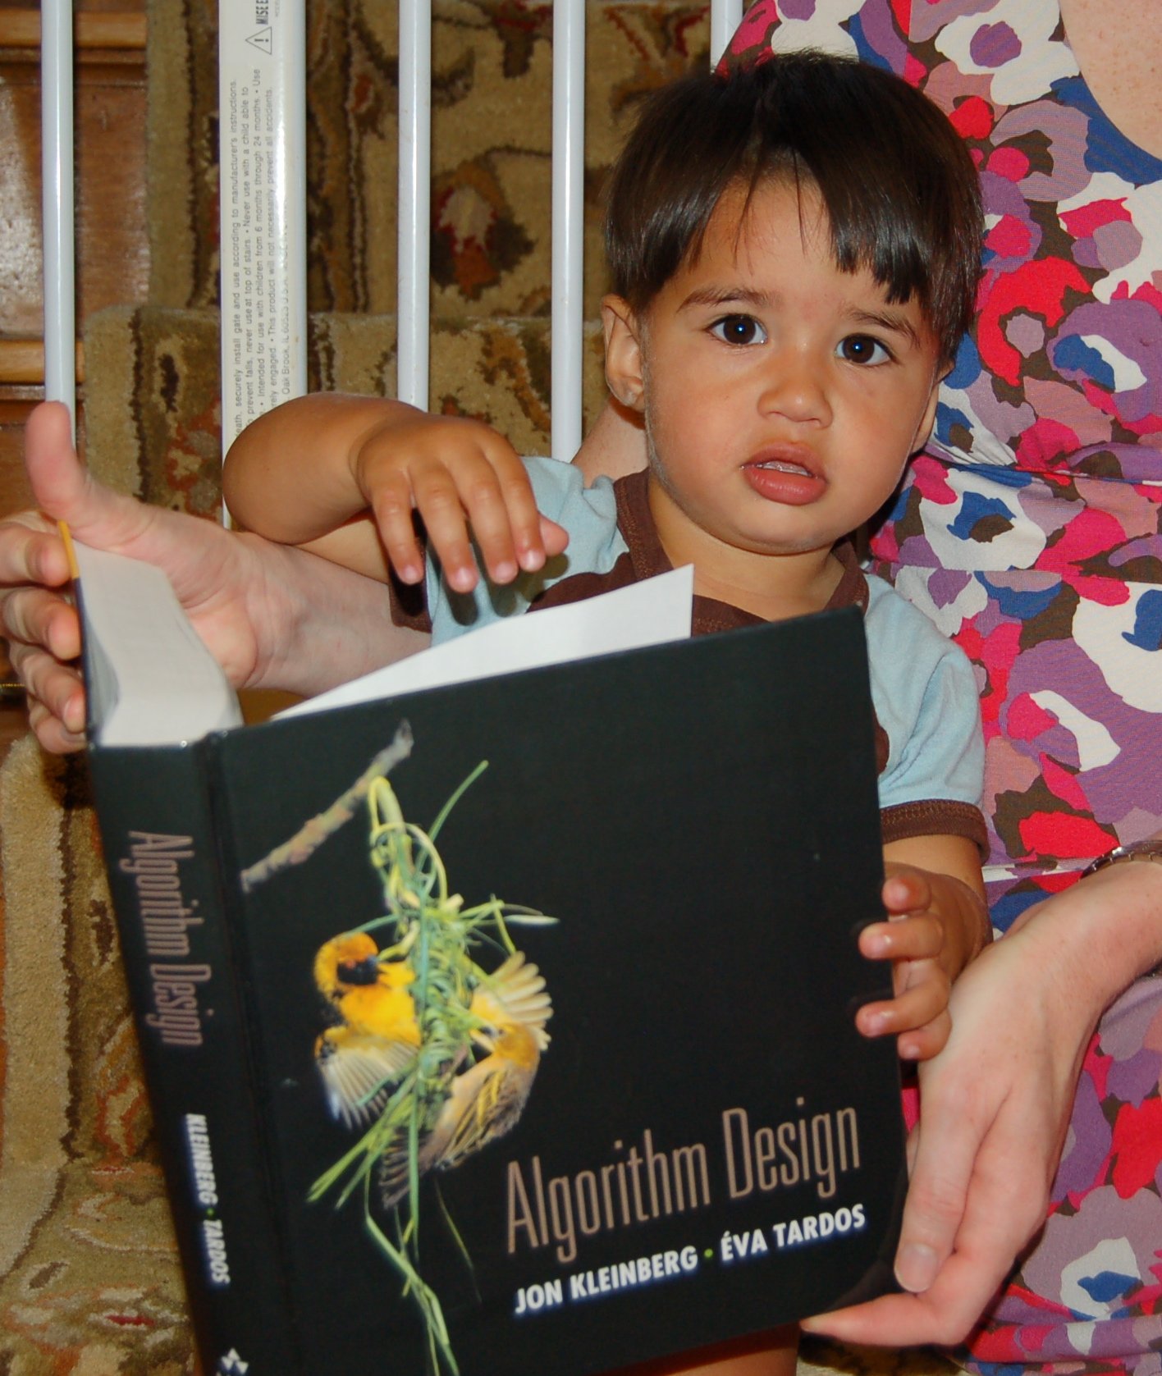
Further Reading

Slide 27
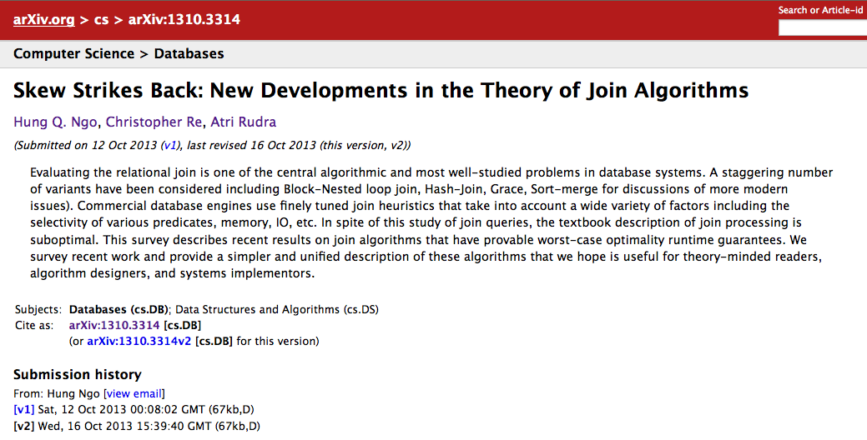
Worst-case optimal join algo
DO NOT READ THE PODS 12 PAPER

Slide 28
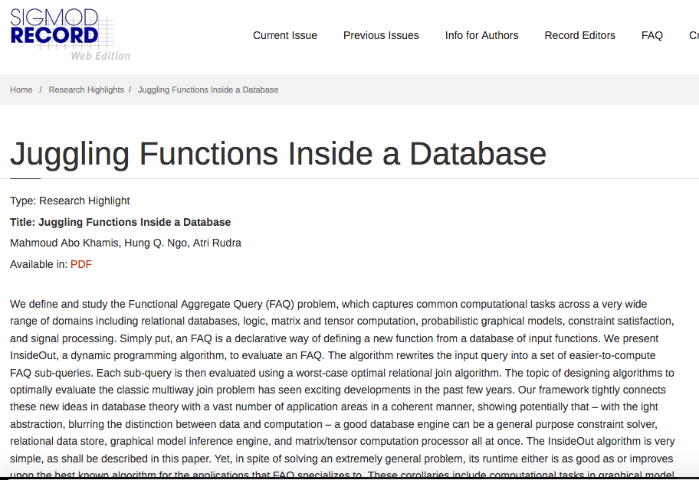
Read this version first for FAQ

Slide 29
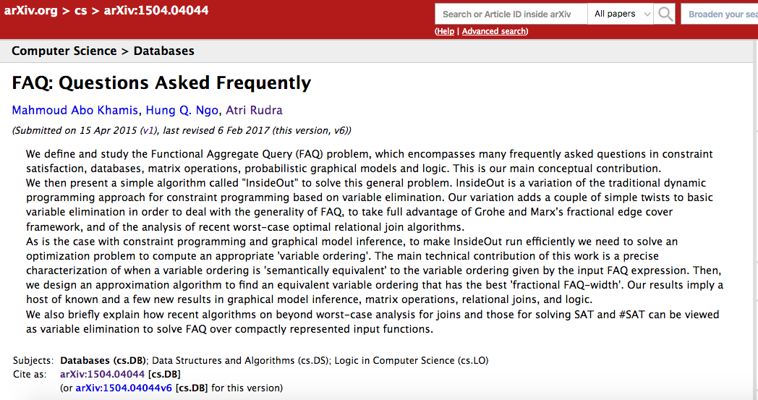
More on FAQs

Slide 30
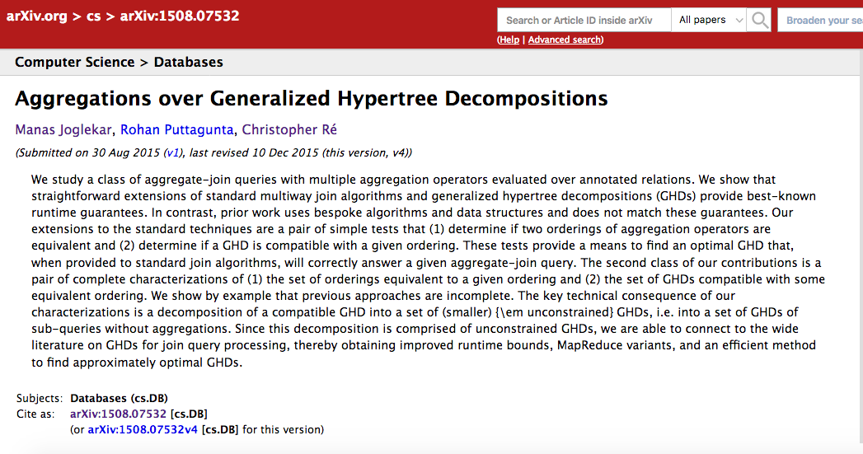
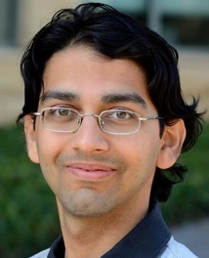
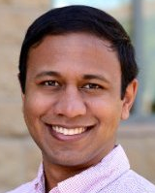
FAQ via hypertree decompositions
Joglekar
Puttagunta
Re

Slide 31
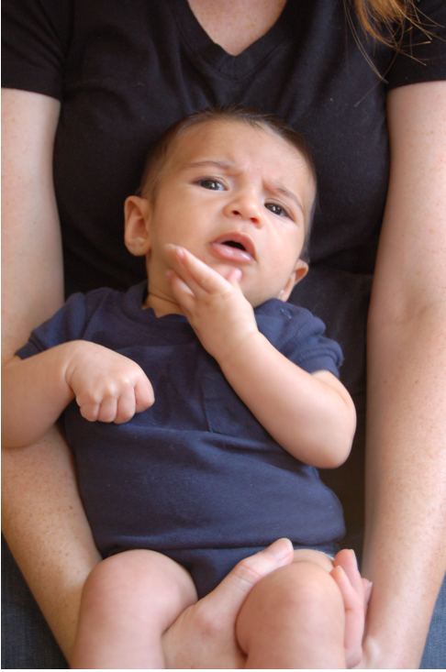
Questions?
Questions?

Slide 32
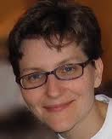
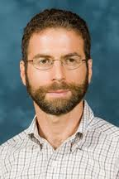
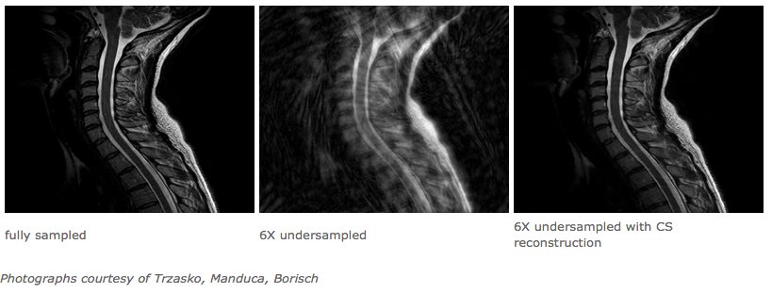
A brief history of this collaboration
L₂/L₂ foreach sparse recovery/compressed sensing
http://www-stat.stanford.edu/~candes/stats330/index.shtml

Slide 33
The key technical problem
Given the three projections, what is the largest size of the original set of points?

Slide 34
The key technical problem
Highly trivial: 4³ = 64
Still trivial: 4² = 16
Correct answer: 4^{1.5} = 8

Slide 35
The key technical problem
C
N^{3/2}
|T| =N
|S|=N
Loomis
Whitney
A
Algorithmic Loomis-Whitney?
|R|= N
B

Slide 36
An equivalent view
C
A
T
R
T
S
A
B
C
S
Output all (a,b,c) s.t. (a,b) in R, (b,c) in S and (c,a) in T
R
B

Slide 37
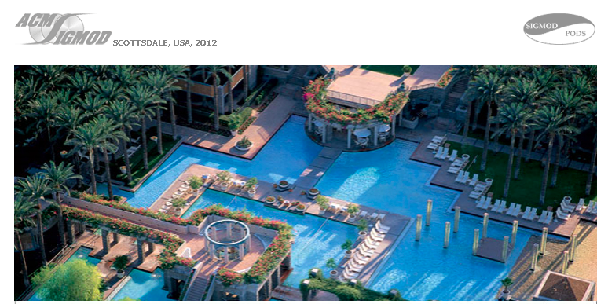
A conversation at PODS 12
All this join stuff should work for PGMs. Let’s do this!

Slide 38
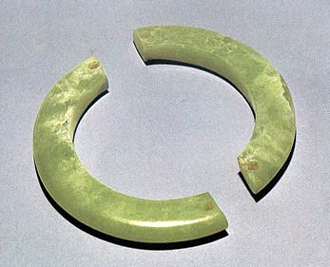
In case you were afraid to ask
What is a semi-ring*?
(D, ✜ ,✪ )
http://treasure.chinesecio.com/en/article/2010-01/19/content_102796.htm
( {0,1}, OR, AND )
(D, 0 , ✜ ) is a commutative monoid
(D, 1 , ✪ ) is a commutative* monoid
( {0,1}, +, × )
✪ distributes over ✜
( C, +, × )
0 ✪ x = 0

Slide 39
Discrete Fourier Transform
Intuition behind FFT
a_{0,0}
a_{0,2}
…..
a_{0,N-1}
b₁₀
N = p³
x = x₀ + x₁p + x₂p²
O(N^{4/3}) time FFT
y = y₀ + y₁p + y₂p²
x •y =
Σ x_{j} • y_{k} •p^{j+k}
( 0 ≤ j+k ≤ 4 )
a_{N-1,0}
a_{N-1,1}
…..
a_{N-1,N-1}
b_{N-1}
exp(2πi x•y/N) = Π exp (2πi x_{j}•y_{k}p^{j+k}/p³)
A
b
_{0 ≤ j+k ≤ 4}
= Π exp (2πi x_{j}•y_{k}p^{j+k}/p³)
a_{x,y} = exp(2πi x•y/N)
_{0 ≤ j+k ≤ 2}
= 1 for j+k ≥ 3
φ (x) = Σ ψ_{A}(x,y)•ψ_{b}(y)
y

Slide 40
Discrete Fourier Transform
N = p³
a_{x,y} = Π exp (2πi x_{j}•y_{k}p^{j+k}/p³)
a_{0,0}
a_{0,2}
a_{0,N-1}
b₁₀
…..
_{0 ≤ j+k ≤ 2}
X₀
Y₀
a_{N-1,0}
a_{N-1,1}
…..
a_{N-1,N-1}
b_{N-1}
H
X₁
Y₁
A
b
φ (x) = Σ ψ_{A}(x,y)•ψ_{b}(y)
X₂
Y₂
y
ψ_{j,k}(x_{j},y_{k}) = exp (2πi x_{j}•y_{k}p^{j+k}/p³)
φ (x₀,x₁,x₂) = Σ ψ_{b}(y₀,y₁,y₂) • Π ψ_{j,k}(x_{j},y_{k})
y₀,y₁,y₂
0 ≤ j+k ≤ 2

Slide 41
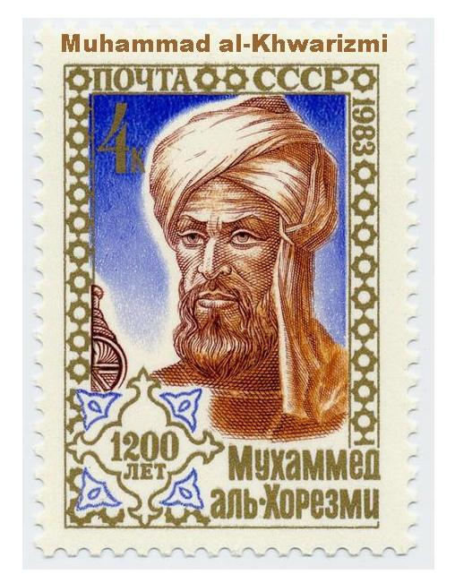
Algorithms for (baby) FAQs
φ (x₀,…,x_{f-1}) = ✜ _{x ,..,x} ✪_{e in E} ψ_{e}(x_{e})
f
_{n-1}
?

Slide 42
Matrix vector multiplication
H
a_{0,0}
a_{0,2}
…..
a_{0,N-1}
b₁₀
b
X
Y
A
a_{N-1,0}
a_{N-1,1}
a_{N-1,N-1}
b_{N-1}
…..
D=N
n=m=2
A
b
φ (x) = Σ ψ_{A}(x,y)•ψ_{b}(y)
Trivial algo runs in O(N²) time
y

Slide 43
Discrete Fourier Transform
N = p³
a_{x,y} = Π exp (2πi x_{j}•y_{k}p^{j+k}/p³)
_{0 ≤ j+k ≤ 2}
X₀
Y₀
H
X₁
Y₁
Trivial algo runs in O(p⁶) time
D=p
n=m=6
X₂
Y₂
φ (x₀,x₁,x₂) = Σ ψ_{b}(y₀,y₁,y₂) • Π ψ_{j,k}(x_{j},y_{k})
y₀,y₁,y₂
0 ≤ j+k ≤ 2

Slide 44
Faster than trivial algorithm

Slide 45
Fast(er) Fourier Transform
N = p³
a_{x,y} = Π exp (2πi x_{j}•y_{k}p^{j+k}/p³)
X₀
Y₀
_{0 ≤ j+k ≤ 2}
X₀
Y₀
Y₁
H
X₁
Y₁
Y₂
X₀,Y₀,Y₁,Y₂
O(p⁴)
X₂
Y₂
Σ Σ ψ_{0,0}•ψ_{1,0}•ψ_{2,0}•ψ_{0,1}•ψ_{1,1}• Σ ψ_{0,2}•ψ_{b}
Σ Σ Σ ψ_{0,0}•ψ_{1,0}•ψ_{2,0}•ψ_{0,1}•ψ_{1,1}•ψ_{0,2}•ψ_{b}
y₀
y₂
y₀
y₁
y₁
y₂
φ (x₀,x₁,x₂) = Σ ψ_{b}(y₀,y₁,y₂) • Π ψ_{j,k}(x_{j},y_{k})
y₀,y₁,y₂
0 ≤ j+k ≤ 2

Slide 46
Fast(er) Fourier Transform
N = p³
a_{x,y} = Π exp (2πi x_{j}•y_{k}p^{j+k}/p³)
X₀
Y₀
_{0 ≤ j+k ≤ 2}
X₀
Y₀
X₁
Y₁
H
X₁
Y₁
X₀,X₁,Y₀,Y₁
O(p⁴)
X₀,Y₀,Y₁,Y₂
O(p⁴)
X₂
Σ Σ ψ_{0,0}•ψ_{1,0}•ψ_{2,0}•ψ_{0,1}•ψ_{1,1}• Σ ψ_{0,2}•ψ_{b}
Σ ψ_{0,0}•ψ_{1,0}•ψ_{2,0}• Σ ψ_{0,1}•ψ_{1,1}• φ’(x₀,y₀,y₁)
Σ Σ ψ_{0,0}•ψ_{1,0}•ψ_{2,0}•ψ_{0,1}•ψ_{1,1}• φ’(x₀,y₀,y₁)
y₀
y₂
y₀
y₁
y₁
y₀
y₁
φ (x₀,x₁,x₂) = Σ ψ_{b}(y₀,y₁,y₂) • Π ψ_{j,k}(x_{j},y_{k})
y₀,y₁,y₂
0 ≤ j+k ≤ 2

Slide 47
Fast(er) Fourier Transform
N = p³
a_{x,y} = Π exp (2πi x_{j}•y_{k}p^{j+k}/p³)
Overall algo runs in O(p⁴) = O(N^{4/3}) time
_{0 ≤ j+k ≤ 2}
X₀
Y₀
X₀,X₁,X₂,Y₀
O(p⁴)
H
X₁
X₀,X₁,Y₀,Y₁
O(p⁴)
X₀,Y₀,Y₁,Y₂
O(p⁴)
Aji
McEliece
X₂
Σ ψ_{0,0}•ψ_{1,0}•ψ_{2,0}• φ’’(x₀,x₁,y₀)
Σ ψ_{0,0}•ψ_{1,0}•ψ_{2,0}• Σ ψ_{0,1}•ψ_{1,1}• φ’(x₀,y₀,y₁)
y₀
y₀
y₁
φ (x₀,x₁,x₂) = Σ ψ_{b}(y₀,y₁,y₂) • Π ψ_{j,k}(x_{j},y_{k})
y₀,y₁,y₂
0 ≤ j+k ≤ 2

Slide 48
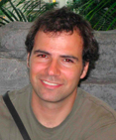
Bounding the output size
½
½
x
A
T
z
R
Atserias
Grohe
Marx
B
C
½
x + z ≥ 1
A
S
y
x + y ≥ 1
B
y + z ≥ 1
C
Highly trivial bound: R • S •T
x, y, z ≥ 0
Still trivial bound: R • S
AGM bound: R^{x} • S^{y} •T^{z}
Loomis-Whitney bound: R^{1/2} • S^{1/2} •T^{1/2}

Slide 49
?
Atserias
Grohe
Marx

Slide 50
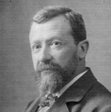
Same algorithm!
x + z ≥ 1
A
x + y ≥ 1
B
AGM bound: R^{x} • S^{y} •T^{z}
y + z ≥ 1
C
R
B
A
Σ_{c} min( R , d_{S}(c) •d_{T}(c) )
C
c
•
≤ Σ_{c} R^{x} • (d_{S}(c) •d_{T}(c) ) ^{1-x}
T
S
≤ R^{x}•Σ_{c} ( d_{S}(c) ^{y} •d_{T}(c) ^{z} )
≤ R^{x}•(Σ_{c} d_{S}(c)) ^{y}•(Σ_{c}d_{T}(c)) ^{z}
min(E,F) ≤ E^{x}•F^{1-x}
= R^{x}•S^{y}•T^{z}
Hölder

Slide 51
?
Loomis
Whitney

Slide 52
Algorithmic Loomis-Whitney
B
A
d_{S}(c)
d_{T}(c)
X₀
Loomis-Whitney bound: R^{1/2} • S^{1/2} •T^{1/2}
R
X₃
T
c
•
Goal: Count number of triangles
http://agilitrix.com/2011/03/red-pill-blue-pill/
X₁
X₂
ψ_{S}
ψ_{T}
S
ψ_{R}
X₁
X₀
There are R
choices for
edges in ψ_{R}
There are d_{S}(c)•d_{T}(c)
choices for pairs of
neighbors of c
X₃
c
•
ψ_{T}
ψ_{S}

Slide 53
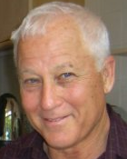
Algorithmic Loomis-Whitney
Loomis-Whitney bound: R^{1/2} • S^{1/2} •T^{1/2}
Run time of algo=
Σ_{c} min( R
,d_{S}(c)•d_{T}(c) )
Goal: Count number of triangles
ψ_{R}
Itai
Rodeh
X₁
X₀
There are R
choices for
edges in Ψ_{R}
There are d_{S}(c)•d_{T}(c)
choices for pairs of
neighbors of c
X₃
c
•
ψ_{T}
ψ_{S}
Make this choice for every c in X₃

Slide 54
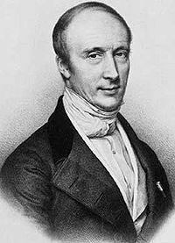
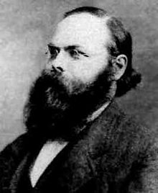
Analyzing the algorithm
Loomis Whitney bound: R^{½} • S^{½} •T^{½}
ψ_{R}
X₁
X₀
Σ_{c} min( R , d_{S}(c) •d_{T}(c) )
X₂
c
•
≤ Σ_{c} (R • d_{S}(c) •d_{T}(c) ) ^{½}
ψ_{T}
ψ_{S}
= R^{½}•Σ_{c} ( d_{S}(c) ^{½} •d_{T}(c) ^{½} )
≤ R^{½}•(Σ_{c} d_{S}(c)) ^{½}•(Σ_{c}d_{T}(c)) ^{½}
min(E,F) ≤ (E•F)^{½}
= R^{½}•S^{½}•T^{½}
Cauchy
Schwartz

Slide 55
Algorithm for FAQ
_{(n-1)}
φ (x₀,…,x_{f-1}) = ✜ _{x} ....... ✜ _{x} ✪_{e in E} ψ_{e}(x_{e})
(f)
f
_{n-1}
Run the “trivial” algorithm
Variable elimination algorithm
For each sub-problem run the “joins algorithm”
Obvious generalization of the NPRR algorithm
Grohe
Marx
The only ingenuity is in computing the “correct” variable ordering

Slide 56
Structure of H matters
A
B
All orderings are valid
C
D
max_{a} Σ_{b} max_{c} Σ_{d} f_{A,C}(a,c) •f_{B,D}(b,d)
General FAQ problem: Not all σ might be valid
max_{a} Σ_{b} max_{c} Σ_{d} f_{A,B,C,D}(a,b,c,d)
≠
Σ_{b} max_{a} max_{c} Σ_{d} f_{A,B,C,D}(a,b,c,d)

Slide 57
Minimize over valid σ
Compute σ to minimize max_{i} AGM^{σ}(H_{i})
Exactly characterize the set of valid σ
Approx for fhtw implies approx optimal valid σ
General FAQ problem: Not all σ might be valid
max_{a} Σ_{b} max_{c} Σ_{d} f_{A,B,C,D}(a,b,c,d)
≠
Σ_{b} max_{a} max_{c} Σ_{d} f_{A,B,C,D}(a,b,c,d)

Slide 58
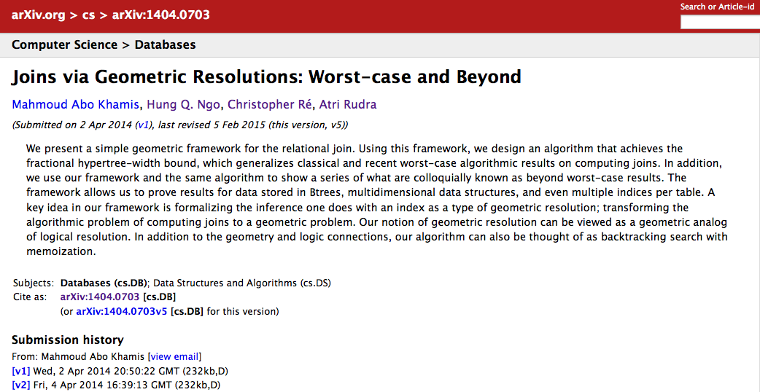
Joins and resolutions
Beyond worst-case analysis for join algorithms

Slide 59
Beyond worst-case analysis algorithms also perform great!

