Slide 1
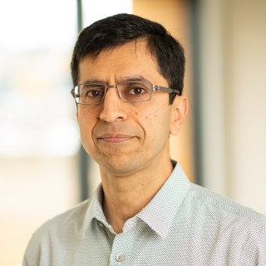
How Far Can LLMs Go? Computational Limits on the Underlying Neural Architectures
Ashish Sabharwal
Allen Institute for AI, Seattle
STOC-2024 Workshop on LLMs
William Merrill
Jackson Petty

Slide 2
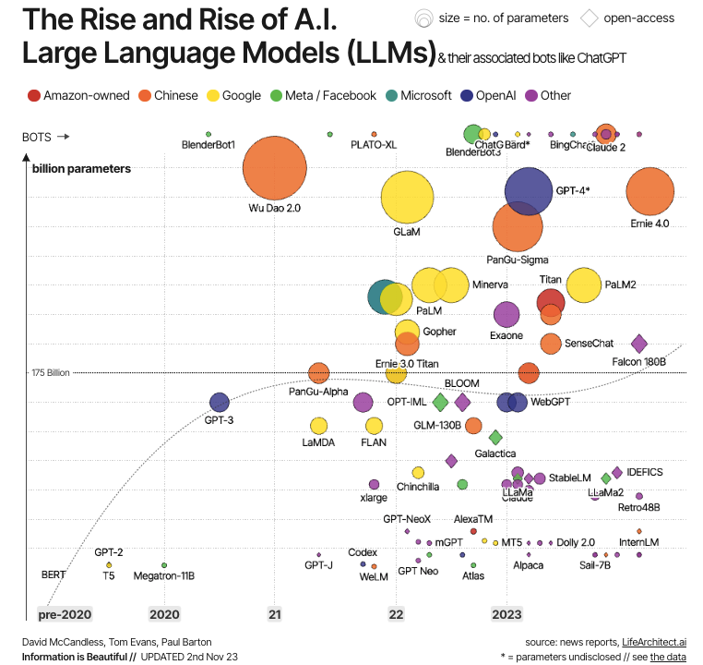
Large Language Models (LLMs)
Modern LLMs have amazing abilities
“Easily” solve problems that many in NLP, speech, & vision struggled with for years!
“… Verified traceable answers, secure, hallucination-free, LLM-agnostic, …”
Concerns about evolving into all-powerful “AGI”
Fascinating machines of Unprecedented Scale
100B+ parameters, 10s of TBs of data
Complex training (data curation, instruction tuning, RLHF, “human alignment”, …)
Ad on
Photo credit: https://www.linkedin.com/pulse/guide- large-language-models-how-work-yugank-aman-g1wif/
* https://archive.org/details/KQED_88_5 _FM_20231127_140000?start=6887

Slide 3
Large Language Models (LLMs)
Modern LLMs have amazing abilities
Fascinating machines of Unprecedented Scale
We understand very little about them
How exactly do they work? What can they do? What can they not?
Does it matter?
Basic scientific curiosity
Implications on trust, safety, and reliability
Photo credit: https://www.linkedin.com/pulse/guide- large-language-models-how-work-yugank-aman-g1wif/

Slide 4
How can we begin to “understand” LLMs?
I/O behavior => carefully design synthetic tasks, measure performance
Study training process => Gradient descent, approximations, …
Mechanistic interpretability => design ways to understand what individual components do (causally or otherwise), e.g., “attention heads”, MLP, etc.
Connect underlying architectures with known models of computation

Slide 5
This Talk in a Nutshell
We can understand fundamental capabilities – and limitations – of today’s LLMs by:
Studying the computational structure of the underlying neural architectures
Relating it to well-understood models of computation in TCS
Main Result:
Mainstream neural architectures behind modern LLMs (transformers and SSMs) can be expressed as simple classes of circuits, logic, and Turing machines
TC⁰ circuits, FOM[BIT] formulas, resource-bounded TMs

Slide 6
Roadmap
LLMs: Motivation for a formal study and the role of TCS
Background: Circuit complexity, Transformers
What can Transformers compute? What can they not?
Upper Bounds: Simple Threshold Circuits and Logic Formulas
Lower Bounds: Transcending TC⁰ Limit with Intermediate Generation
State Space Models (SSMs)
Similar Limits, different ways of transcending TC⁰
The Parallelism Tradeoff

Slide 7
Roadmap
LLMs: Motivation for a formal study and the role of TCS
Background: Circuit complexity, Transformers
What can Transformers compute? What can they not?
Upper Bounds: Simple Threshold Circuits and Logic Formulas
Lower Bounds: Transcending TC⁰ Limit with Intermediate Generation
State Space Models (SSMs)
Similar Limits, different ways of transcending TC⁰
The Parallelism Tradeoff

Slide 8
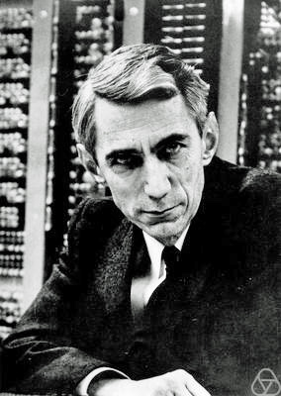
Background: Circuit Complexity
Directed acyclic computation graph
Input nodes represent bits (0/1)
Internal nodes: AND, OR, NOT
Output node (0/1)
Output
OR
=1
NOT
=1
AND
=1
Example: evaluate on x = 011
Shannon
x₁
x₂
x₃
Circuit Size = Number of non-input nodes (here 3)
= Runtime without parallelism
=0
=1
=1
Circuit Depth = Path length from any input to output (here 2)
= Runtime with (full) parallelism

Slide 9
Background: Circuit Complexity
Each individual circuit takes input strings of a fixed size – not interesting
Circuit family: sequence of circuits C₁, C₂, … for different input lengths
Defines a formal language
OR
NOT
AND
NOT
AND
x₁
x₁
x₂
x₁
x₂
x₃
C₁
C₂
C₃

Slide 10
Background: Circuit Complexity
Issue: Circuit families can have unintuitive and undesirable properties
E.g., can even solve some undecidable problems!
Uniform Circuit Families
Circuits C₁, C₂, …, C_{n}, … for different input sizes can’t be “too different” => the family must have “uniformity”!
A resource-bounded Turing machine, on input n, should be able to construct C_{n}
Will mainly consider log-space uniform (L-uniform) circuit families today, briefly also the stricter DLOGTIME-uniform

Slide 11
Background: Circuit Complexity
Classes of poly(n) size circuit families
AC⁰: unbounded fan-in, constant depth
TC⁰: AC⁰ + Majority gates
Majority, Parity, Arithmetic (division, iterated addition, iterated multiplication)
NC¹: binary fan-in, log n depth
State tracking (automata, S₅ word prob.), iterated (fixed-size) matrix multiplication
L: log-space Turing machines
Undirected s-t connectivity
P
L
LLMs
❓
NC¹
❓
TC⁰
AC⁰

Slide 12
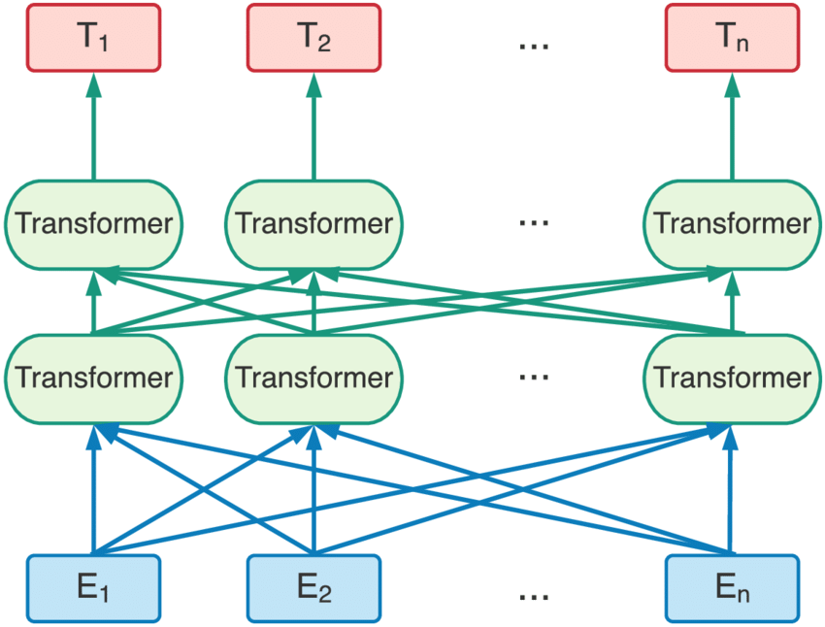
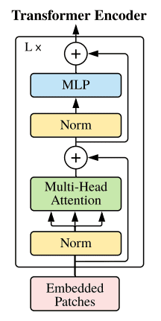
Transformers: The Architecture
A highly “uniform” architecture -- transformer “block” that repeats depth x n times
Local computation
Residual connections
Global computation (aggregation)
Layer normalization
Input + position embedding of “tokens”
* https://theaisummer.com/vision-transformer/

Slide 13
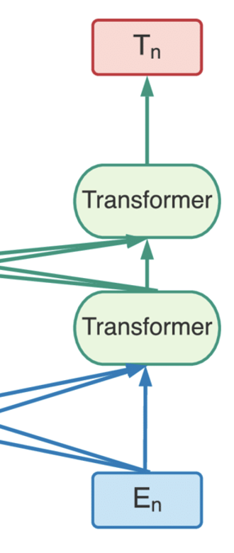
Transformers: The Architecture
Transformer Decoder: condition next output on past generation
Transformer Encoder
Output, e.g., 0/1, next token
₊₁
₊₂
₊₁
₊₂
Input + position embedding

Slide 14
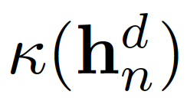
Transformers: A Formal Model (showing 1 layer)
* Layer Norm, Residual Connection, etc. not shown here
“Positional” embedding of input
Similarity function (scalar)
Value function
k-th Attention Head
Activation Block (feed-forward network / MLP)
Final Prediction on length-n input
* Notation from Merrill and S., NeurIPS-2023

Slide 15
Transformers: A Formal Model
A note on the data type
Mathematically, all vectors are in ℝ^{d}
Infinite-precision reals, however, aren’t realistic (too powerful, too!)
Fixed-precision isn’t enough to capture position embedding, uniform attention, …
Will use d-dimensional vectors of log(n) precision floats <m,e>
Semantics: <m,e> = m x 2e
Size: |m| + |e| = c log(n) bits

Slide 16
Roadmap
LLMs: Motivation for a formal study and the role of TCS
Background: Circuit complexity, Transformers
What can Transformers compute? What can they not?
Upper Bounds: Simple Threshold Circuits and Logic Formulas
Lower Bounds: Transcending TC⁰ Limit with Intermediate Generation
State Space Models (SSMs)
Similar Limits, different ways of transcending TC⁰
The Parallelism Tradeoff

Slide 17
Result #1: Transformers Are in L-Uniform TC⁰
Upper Bound (Merrill and S., TACL 2023)
Log-precision transformers can be simulated by poly-size, constant-depth, L-uniform threshold circuit families (TC⁰)
Proof overview: simulate each component of the transformer in TC⁰
Attention
Feedforward
Earlier results were less appealing:
Formal model too strong => Turing complete!
Formal model too weak => in AC⁰
Non-standard attention function
Non-uniformity as a crutch (e.g., crucial details “hidden” in position embeddings)

Slide 18
Result #1: Transformers Are in L-Uniform TC⁰
Attention: global (aggregation across all hidden states) but simple
a weighted average of Value vectors
weights = exp(Query_{i} Key^{T}_{j})
Multiplication, division, and iterated summation are in TC⁰
L-uniform constructions of individual components can be composed together
Feedforward: complex but local (function of one hidden state)
Any Boolean function of c log(n) bits is in L-uniform AC⁰ ⊊ TC⁰ (e.g., via DNF formulation)
O(log n) bits

Slide 19
Implications
Transformers as input-output computation machines are very impoverished!
Provably can’t solve a vast set of interesting computational problems exactly at scale
s-t connectivity, Boolean formula evaluation, network flow, SAT, relational reasoning, planning, …
P
L
NC¹
TC⁰
Log-precision transformers
AC⁰

Slide 20
Result #2: Transformers Operate in a Simple Logic!
Upper Bound (Merrill and S., NeurIPS 2023)
Every log-precision transformer can be expressed as an FOM[BIT] formula
* fixed-size formula, independent of n !
FOM[BIT]: first-order logic over strings with Majority quantifier and BIT predicate
variables = positions i, j, …
quantifiers = ∃, ∀, MAJ
predicates = value at i; i-th BIT of j

Slide 21
Result #2: Transformers Operate in a Simple Logic!
Upper Bound (Merrill and S., NeurIPS 2023)
Every log-precision transformer can be expressed as an FOM[BIT] formula
* fixed-size formula, independent of n !
Proof Idea:
Tighten L-uniformity to DLOGTIME-uniformity
Non-trivial and messy – log-time too little even to output a poly-size circuit, subcomponents being log-time uniform not necessarily enough
Leverage specific affine form + non-linearity of the feedforward function
Leverage known equivalence between FOM[BIT] and DLOGTIME-uniform TC⁰ [Barrington, Immerman, Straubing. 1990]

Slide 22
Roadmap
LLMs: Motivation for a formal study and the role of TCS
Background: Circuit complexity, Transformers
What can Transformers compute? What can they not?
Upper Bounds: Simple Threshold Circuits and Logic Formulas
Lower Bounds: Transcending TC⁰ Limit with Intermediate Generation
State Space Models (SSMs)
Similar Limits, different ways of transcending TC⁰
The Parallelism Tradeoff
Closing Remarks

Slide 23
Transcending TC⁰ with Intermediate Generation
x₁, x₂,…, x_{n}
z₁, z₂,…, z_{m}
y
Input
Intermediate generation
Output
Intermediate generation takes various forms in practice
Scratchpad, decomposition, chain of thought, …
Added computational power: next output is conditioned on past generations! z_{i+1} = f(x₁, …, x_{n}, z₁, …, z_{i}), y = f(x₁, …, x_{n}, z₁, …, z_{m}) => Depth of computational graph = ϴ(m)
CoT(m) = class of languages recognized by transformers with m steps of CoT

Slide 24
Result #3a: CoT(n) can Simulate Automata (in NC¹)
Lower Bound (Merrill and S., ICLR 2024)
Every finite state automata can be simulated by a log-precision transformer with n intermediate tokens
a
q₀
q₁
b
q₀
𝛿(q₀, a)
𝛿(q₁, b)
Track state via intermediate generation
“look up” input tokens (n nodes to the left) via Attention
FF
FF
FF
FF
Attn
Attn
Attn
Attn
No longer highly parallel! Computation graph depth = 𝚹(n)
x₁
x₂
x₃
x₃
1: a
2: b
3: q₀
4: q₁

Slide 25
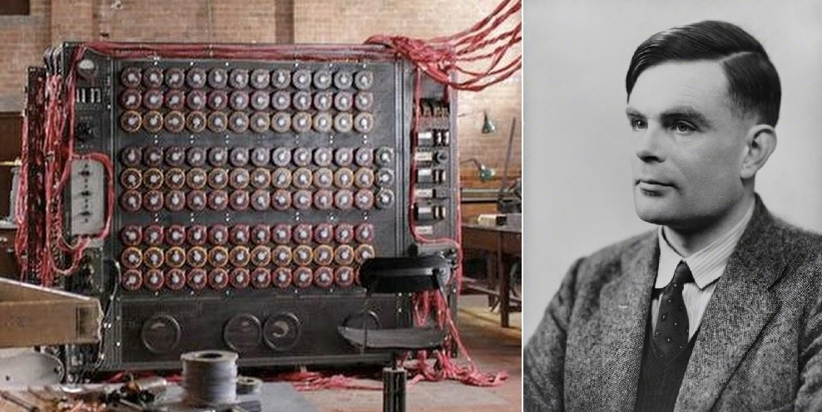
Result #3b: CoT can Simulate Turing Machines
Lower Bound (Merrill and S., ICLR 2024)
t(n) steps of any poly-time Turing machine can be simulated by a log-precision transformer with t(n) intermediate tokens
+ Upper Bounds
* multi-tape Turning machine, no random access

Slide 26
Result #3b: CoT can Simulate Turing Machines
Each step of CoT is a “basic” transformer computation on input size ≤ n + t(n) => in TC⁰ ⊆ Logspace = SPACE(log (n + t(n)))
Space is reusable! Reuse across CoT steps
Use t(n) space to write all intermediate output

Slide 27
Result #3b: CoT can Simulate Turing Machines
Challenge: Simulating free movement over tape and (re-)writing on it
Key idea: Reconstruct tape contents from the computation “trail” of Turing machine
Output “local” info at each CoT step: <new state, token written, direction ± 1>
Determine current head position p using Attention to aggregate direction
Determine tape contents at p by Attending to “most recent” write at p

Slide 28
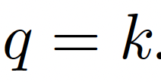
Layer-Norm Hash: A Useful Tool!
Technical difficulty: Transformers compute weighted averages, not direct sums!
Can’t actually compute head position p at node i; instead only have p/i
Need to match (via Attention) p/j with p/i computed independently at j and i !!
Solution: Use Layer-norm Hash
▶︎ Scale-invariant w.r.t i =>
▶︎ Dot-product iff
Allows comparing keys & queries even when computed at different positions!

Slide 29
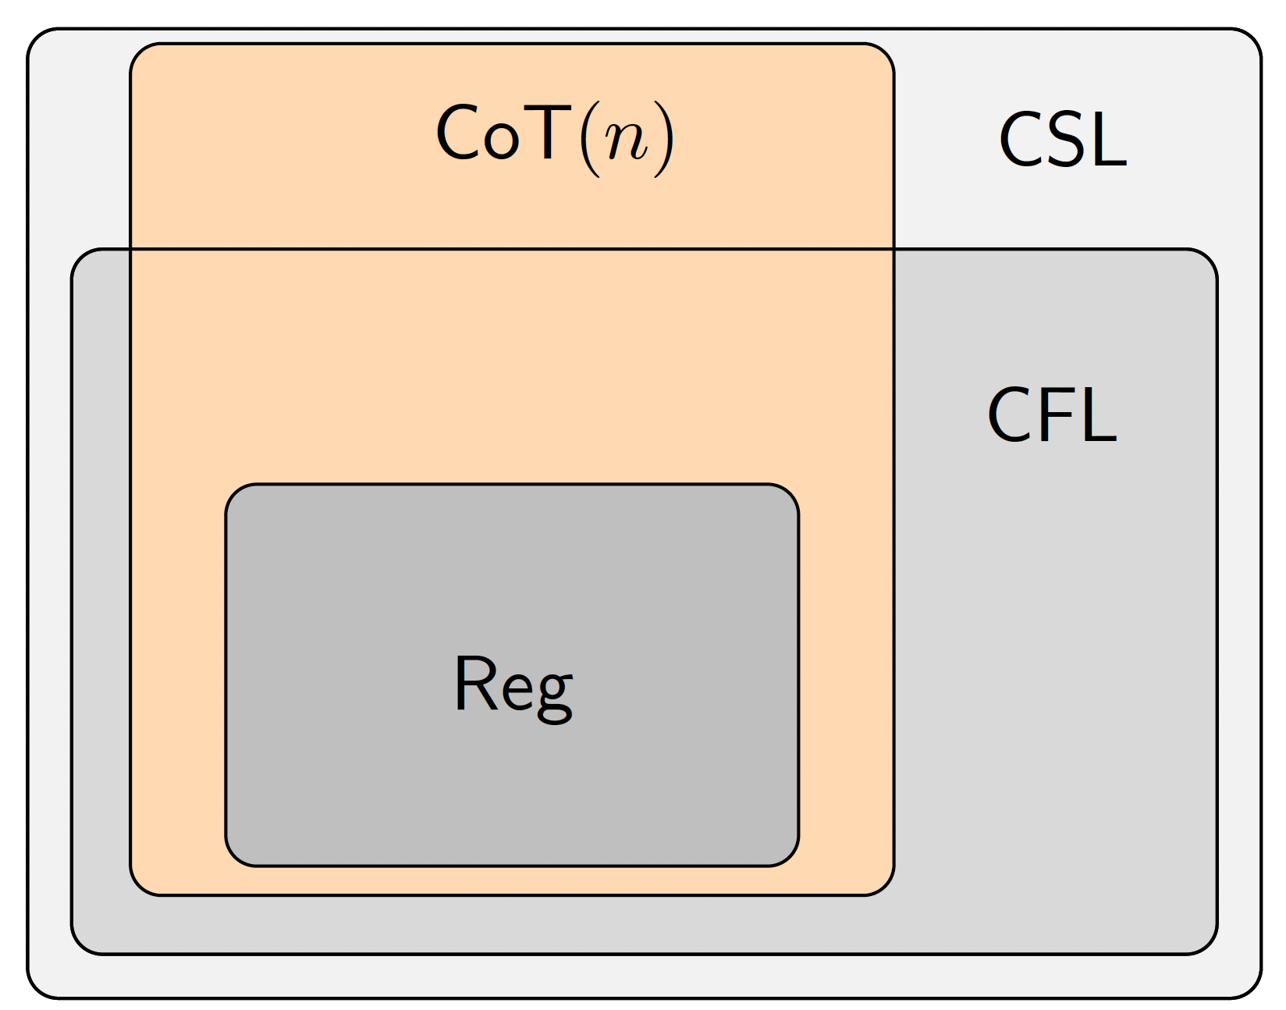
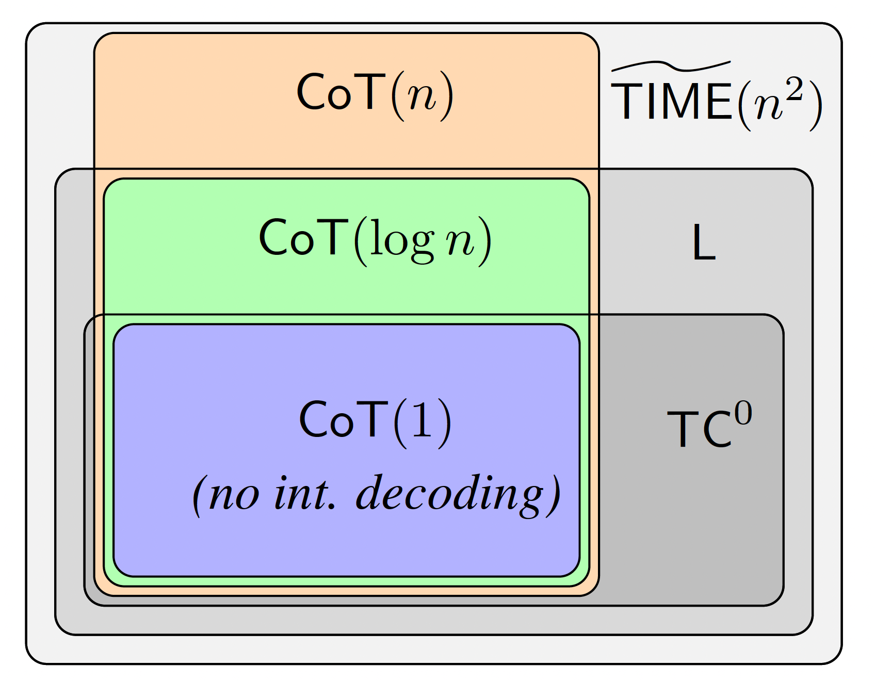
Summary & Implications
CoT(poly n) = P
Chomsky Hierarchy
* SPACE(n) ⊆ Context-sensitive langs. [Kuroda, 1964]

Slide 30
Roadmap
LLMs: Motivation for a formal study and the role of TCS
Background: Circuit complexity, Transformers
What can Transformers compute? What can they not?
Upper Bounds: Simple Threshold Circuits and Logic Formulas
Lower Bounds: Transcending TC⁰ Limit with Intermediate Generation
State Space Models (SSMs)
Similar Limits, different ways of transcending TC⁰
The Parallelism Tradeoff

Slide 31
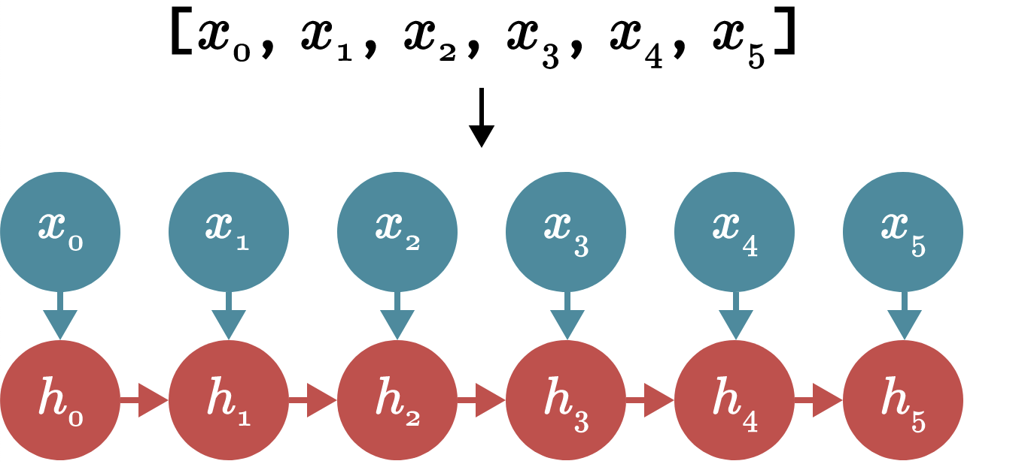
State Space Models (SSMs)
A Promising New Class of Architectures
Empirically successful at long-rage recall tasks
Reminiscent of RNNs but efficient due to parallelism and smart design & implementation!
Recurrent Form:
Convolutional Form:
y₅
* Figure credit: Jack Cook’s blog, Mamba: The Easy Way. https://jackcook.com/2024/02/23/mamba.html

Slide 32
Result #4: Large Classes of SSMs are in TC⁰
Upper Bound (Merrill and S., ICML 2024)
“Non-gated” SSMs (i.e., when A_{i} = some fixed A, e.g. S4) are in L-uniform TC⁰
Key observation: Reduces to (fixed size) matrix powering, which is in TC⁰ [Mereghetti & Palano, 2000]
Upper Bound (Merrill and S., ICML 2024)
“Diagonal” SSMs (i.e., when all A_{i} are diagonal, e.g. Mamba) are in L-uniform TC⁰
Key observation: Reduces to multiplication of diagonal matrices, which reduces to iterated product, which is in L-uniform TC⁰ [Hesse et al., 2002]
* extends also to SSMs where all A_{i} are simultaneously diagonalizable

Slide 33
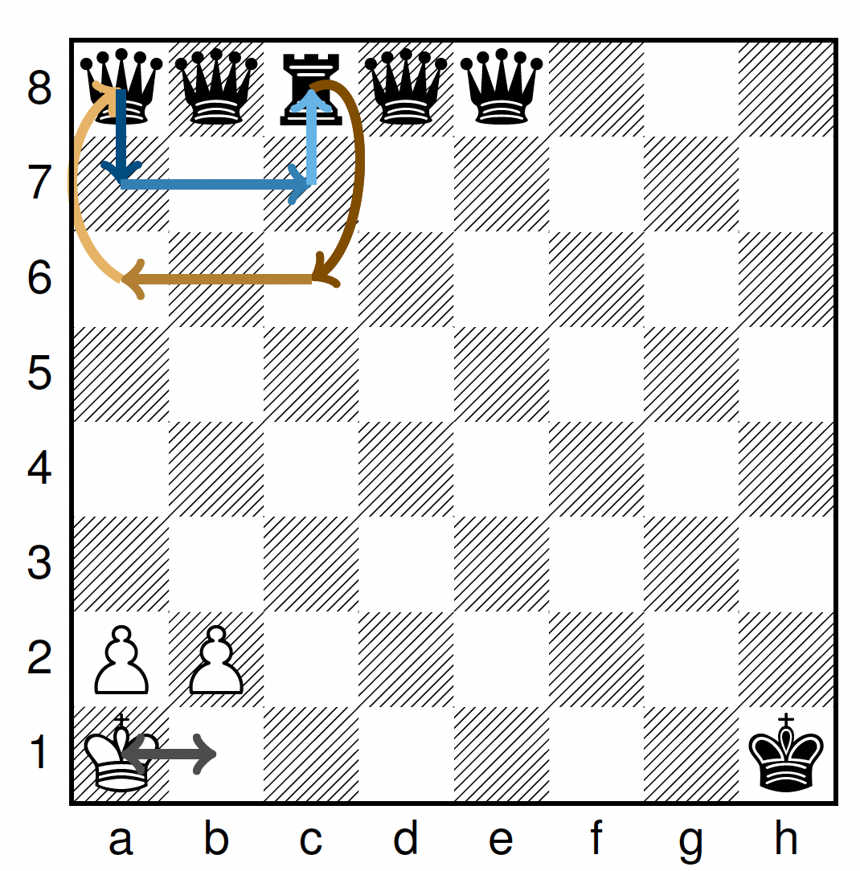
Implications
Large classes of SSMs are similarly limited as Transformers (to TC⁰)
Despite recurrent appearance, these SSMs cannot truly track state
Can’t solve hard (NC¹ complete) state tracking problems, e.g., the S₅ word problem
“The Illusion of State in State Space Models” [ICML-2024]
x, y = 0, 1
x = y - 1
y = 3 * x
Entity tracking in long narratives
Chess in UCI <src,tgt> notation
Code interpretation

Slide 34
Transcending TC⁰ with Input-Dependent Transitions
Lower Bound (Merrill and S., ICML 2024)
Non-diagonal, input-dependent SSMs (i.e., when A_{i} depends on x_{i}) can recognize any Regular language, including the S₅ word problem.
Key observation: Performs iterated (fixed size) matrix multiplication, which is NC¹-complete.
IDS4 Architecture
Also: Liquid S4 [Hasani et al, 2023]

Slide 35
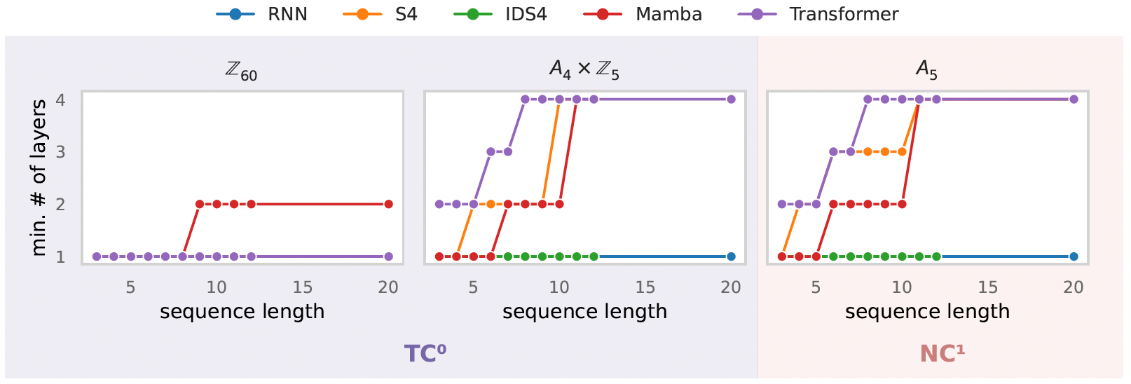
Empirical Validation + Additional Insights
“simple” tracking: commutative group
“mostly simple” tracking: solvable group
“hardest” tracking: non-solvable group

Slide 36
Roadmap
LLMs: Motivation for a formal study and the role of TCS
Background: Circuit complexity, Transformers
What can Transformers compute? What can they not?
Upper Bounds: Simple Threshold Circuits and Logic Formulas
Lower Bounds: Transcending TC⁰ Limit with Intermediate Generation
State Space Models (SSMs)
Similar Limits, different ways of transcending TC⁰
The Parallelism Tradeoff

Slide 37
The Parallelism Tradeoff
Transformers w/o intermediate generation (and SSMs w/o input-dep. transitions):
Can be trained at scale because they are fully parallelizable
Cannot solve problems outside TC⁰
Transformers with intermediate generation (and SSMs with input-dep. transitions) transcend TC⁰ but introduce sequentiality
Parallelism seems essential for scaled-up pretraining but appears to fundamentally limit expressive power

Slide 38
References
Transformers
The Parallelism Tradeoff: Limitations of Log-Precision Transformers. Merrill, S. TACL-2023
A Logic for Expressing Log-Precision Transformers. Merrill, Sabharwal. NeurIPS-2023
The Expressive Power of Transformers with Chain of Thought. Merrill, Sabharwal. ICLR-2024
State Space Models / SSMs
The Illusion of State in State-Space Models. Merrill, Petty, Sabharwal. ICML-2024
A Survey
What Formal Languages Can Transformers Express? A Survey. Strobl, Merrill, Weiss, Chiang, Angluin. TACL-2024

Slide 39
Closing Remarks
LLMs amazingly powerful, routinely used, yet poorly understood
Computational structure of their architectures reveals unexpected limitations
Also hints at possibilities to overcome limitations
TCS skills and curiosity about LLMs can be a powerful combination
Fascinating fundamental questions remain open!
Beyond exact asymptotic solutions – approximations, “typical” case
Learnability, role of data, effect of “alignment” with human values
In-context learning, “reflection” and retries, tool use (akin to SAT vs. SMT)

