Slide 1

Abstracting away the Deep Learning Mumbo-Jumbo (with Arithmetic Circuits)
TheoryFest@STOC 2024 workshop Tutorial
Atri Rudra
University at Buffalo

Slide 2


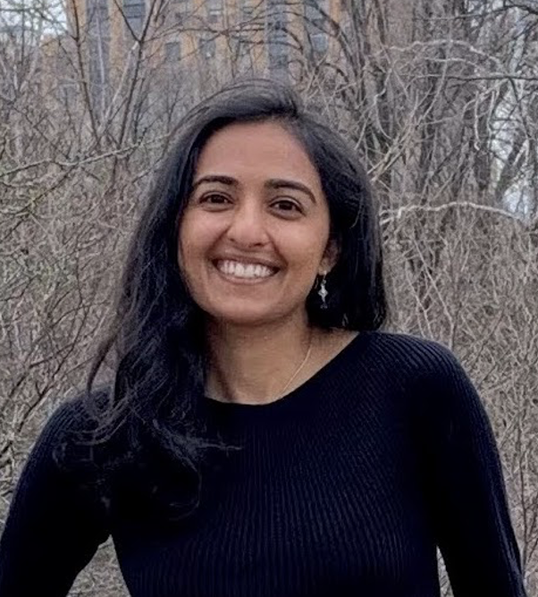
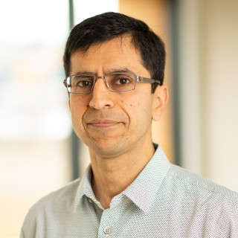
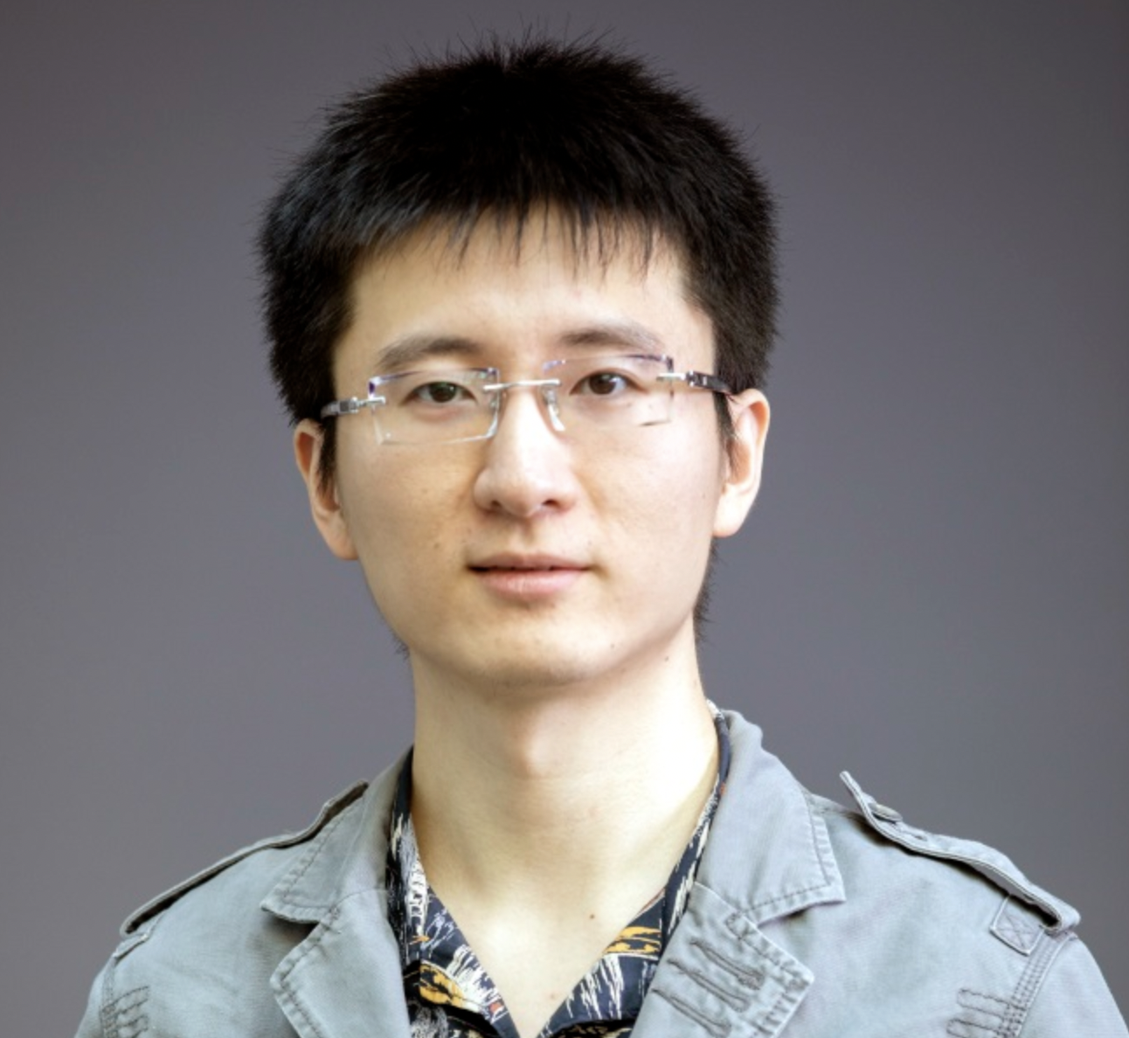
If you have a question on building systems…
Don’t ask me ☺
All of the other workshop speakers can better answer those questions
Jana
Dan
Simran
Ashish
Zeyuan

Slide 3

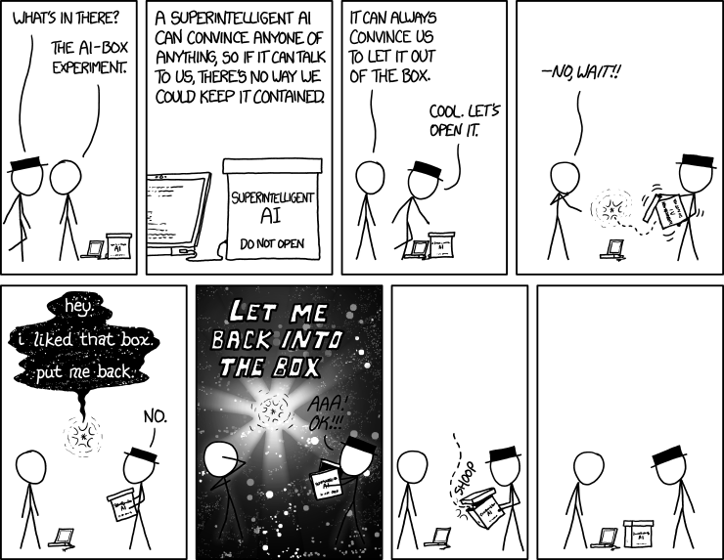
What this tutorial is NOT about... (part 1)
I have NO opinion on when AGI will be achieved….
I do think a lot of it is over-hyped…
https://xkcd.com/1450/

Slide 4
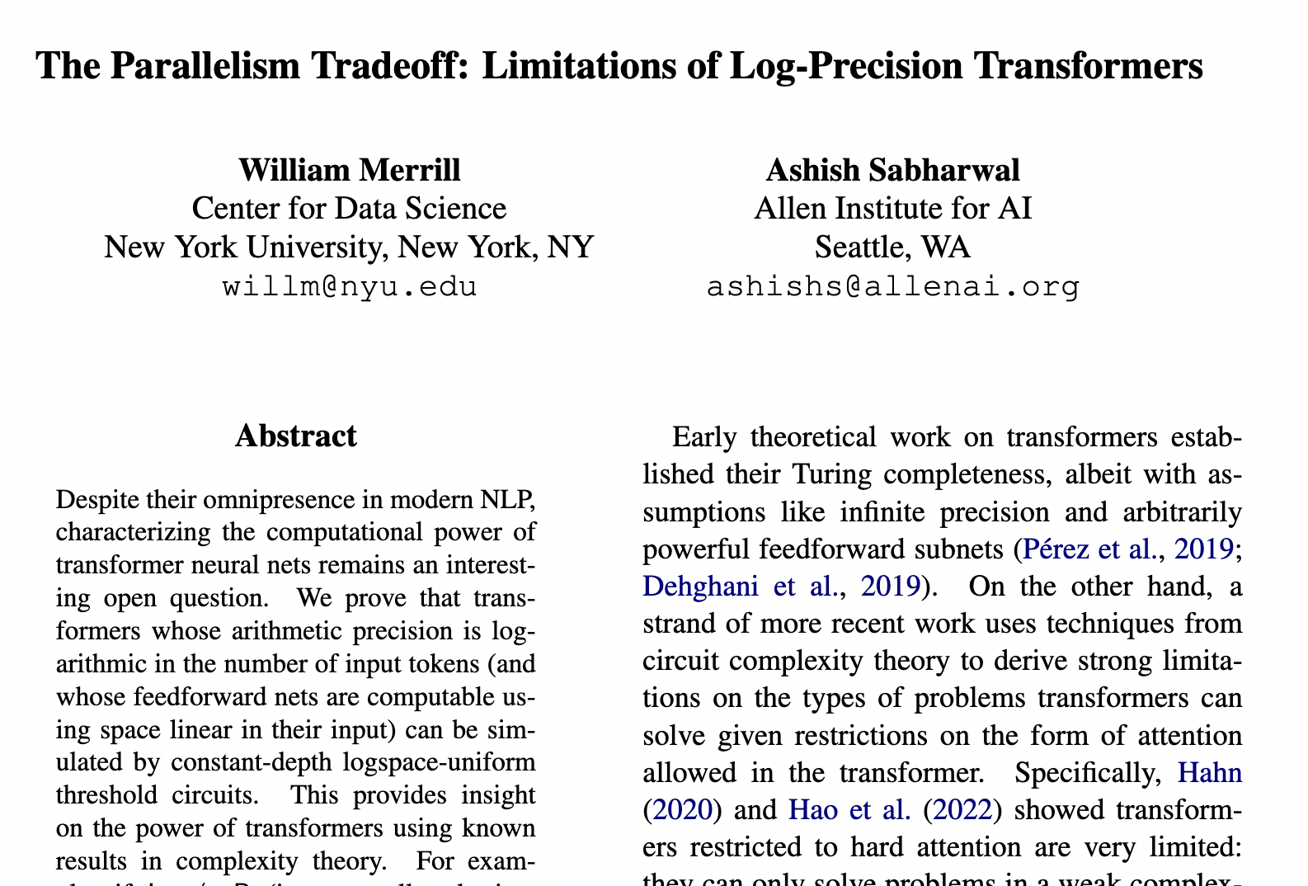
Having said that…
It is kind of ridiculous that TC⁰ circuits are causing all this hype.
Check out Ashish’s talk
on Wed!
Something very interesting is going on here!
TCS folks can (and should!) contribute

Slide 5

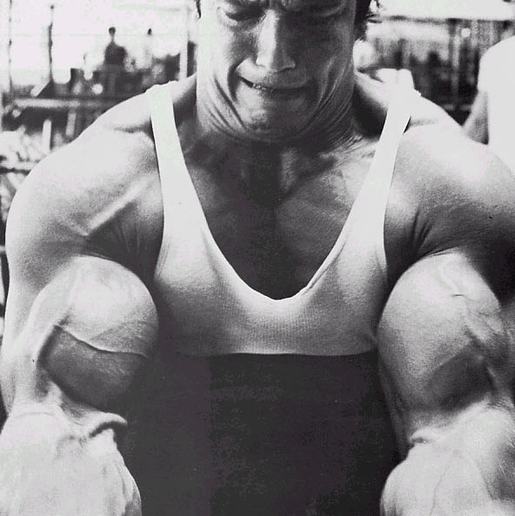
What this tutorial is not about… (part 2)
There is no “macho theory” here
“Macho Theory” credit:
Richard Ladner
Macho theory is needed to make progress

Slide 6
What this tutorial is not about… (part 3)
Not a comprehensive coverage of ALL related work
It’s very much biased by the kinds of things I have thought about

Slide 7
Overview of the rest of the talk
The setup, Assumption and Arithmetic Circuits
Transformers (Attention and MLP)
Replacing MLP
Replacing Attention

Slide 8
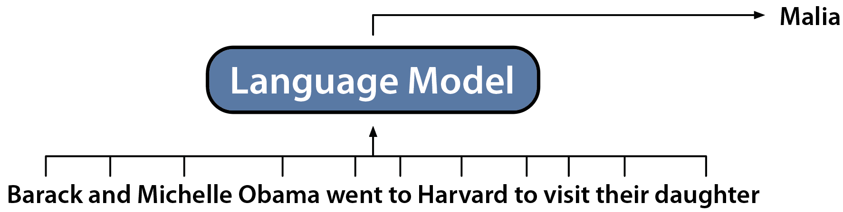
Reminder: Generative Language Models
Generative Language Models: Generate the Next Token
Slide by: Dan Fu

Slide 9
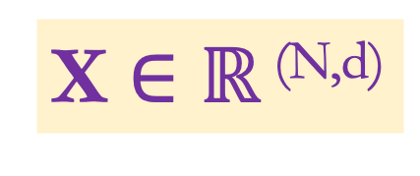
Input representation
Barak and Michelle Obama went to Harvard to visit their daughter
From now our input will be
Barak
and
X $∈$ $ℝ$ ^{(N,d)}
Michelle
Obama
went
to
N
Harvard
N : Sequence length
Input “embedding”
to
d : Hidden/model dimension
visit
their
daughter
d

Slide 10
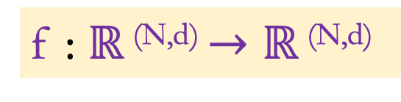
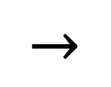
What (functions) do we want?
f : $ℝ$ ^{(N,d)} $→ℝ$ ^{(N,d)}
f
$$→$$
N
d

Slide 11
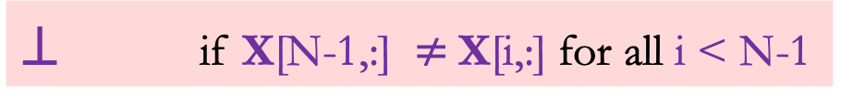

Our function for today: Associative Recall
$⊥$ if X[N-1,:] $≠$X[i,:] for all i < N-1
AR(X) =
X[i+1,:] if X[N-1,:]=X[i,:] for some i< N-1
N
$$⊥$$
d

Slide 12
But you said the output has to be a matrix!
$⊥$ if X[N-1,:] $≠$X[i,:] for all i < N-1
AR(X) =
X[i+1,:] if X[N-1,:]=X[i,:] for some i< N-1
Check out Simran’s talk
Tomorrow!
Multi-Query Associate Recall
Simran is on the faculty job market this coming year!

Slide 13
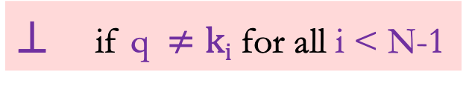
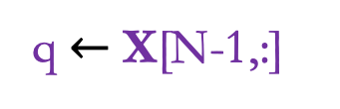
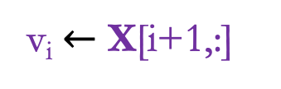
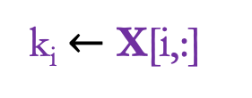
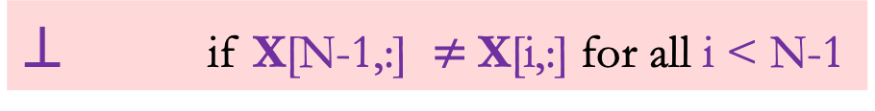
Associative Recall = Key Value Store problem
k_{i} $←$ X[i,:]
$⊥$ if X[N-1,:] $≠$X[i,:] for all i < N-1
v_{i} $←$ X[i+1,:]
q $←$ X[N-1,:]
AR(X) =
X[i+1,:] if X[N-1,:]=X[i,:] for some i< N-1
Input: (k₁,v₁), …. ,(k_{n-1},v_{n-1}) ; q
$⊥$ if q $≠ki$ for all i < N-1
Output:
v_{i} if q = k_{i} for some i < N-1

Slide 14
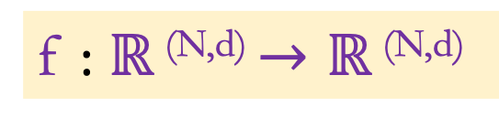
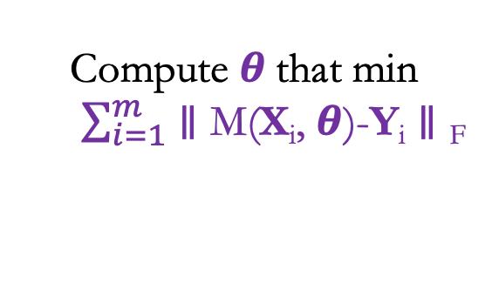
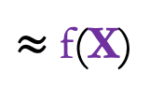
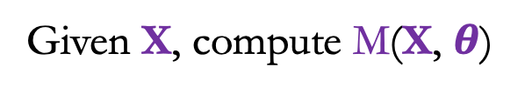
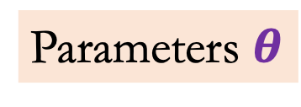
Backing up: Training and Inference
f : $ℝ$ ^{(N,d)} $→ℝ$ ^{(N,d)}
Inference
fixed
Model (M)
Given X, compute M(X, $θ$)
$≈$f(X)
Parameters $θ$
Training
Given (X₁,Y₁), … , (X_{m},Y_{m})
Input X
Compute $θ$that min
$\sum_{i=1}^{m}{∥\text{M}\text{(}\text{X}\text{i}\text{,} θ\text{)−}\text{Y}\text{i}∥\text{F}}$
fixed

Slide 15
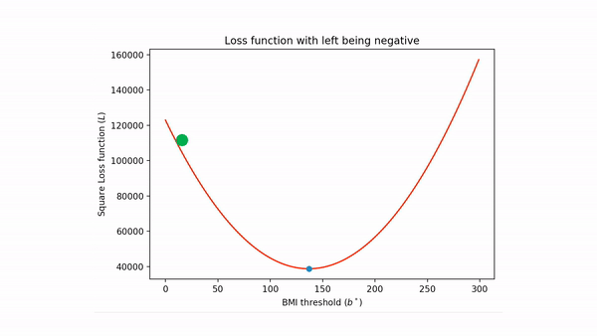
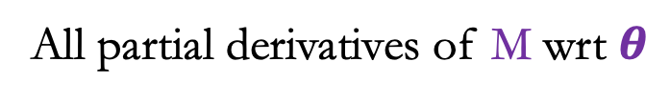
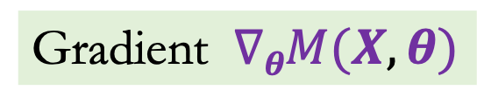
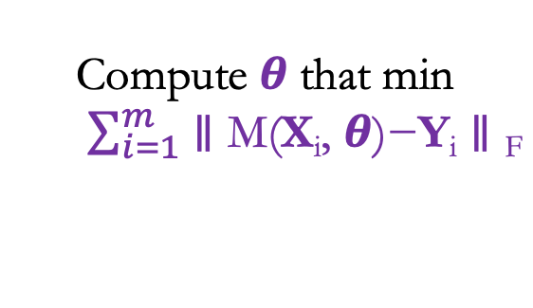

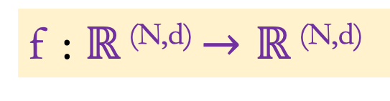
Assumption 1: Training = Gradient Descent
f : $ℝ$ ^{(N,d)} $→ℝ$ ^{(N,d)}
Model (M)
Parameters $θ$
Given (X₁,Y₁), … , (X_{m},Y_{m})
Input X
Compute $θ$that min
$\sum_{i=1}^{m}{∥\text{M}\text{(}\text{X}\text{i}\text{,} θ\text{)−}\text{Y}\text{i}∥\text{F}}$
Gradient $∇θM(X,θ)$
fixed
All partial derivatives of M wrt $θ$

Slide 16
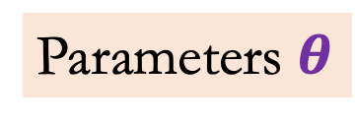
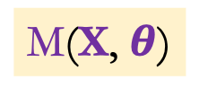

Simplification 1: Arithmetic Circuits
Our notion of efficiency = number of arithmetic operations
Models = Arithmetic Circuits
M(X, $θ$)
Model (M)
Arithmetic
Circuit
Parameters $θ$
Input X
X
$$θ$$

Slide 17
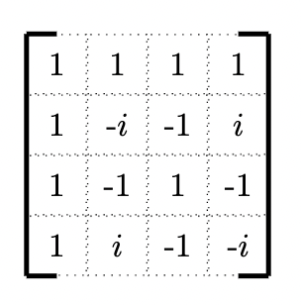
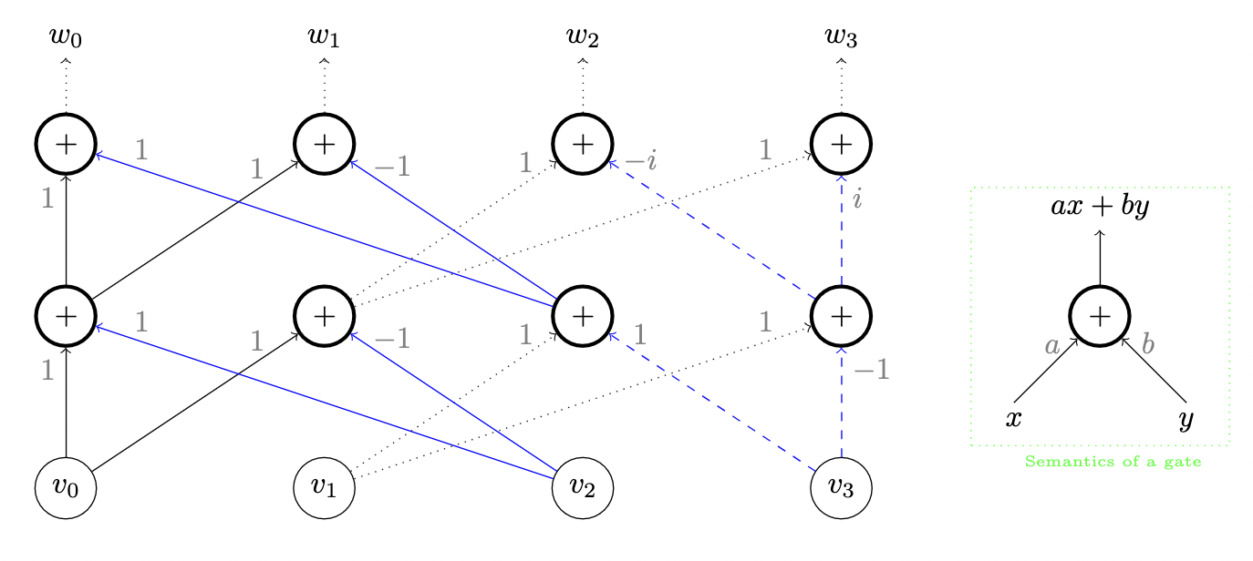
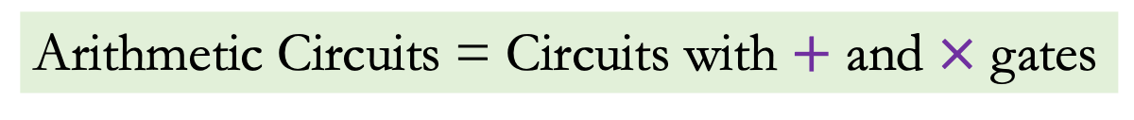

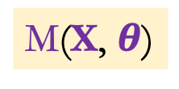

Arithmetic Circuits
w =
$∙$v
Arithmetic Circuits = Circuits with $+$ and $×$ gates
DFT of order 4
M(X, $θ$)
Arithmetic
Circuit
X
$$θ$$
(Linear) Arithmetic circuit for DFT of order 4

Slide 18
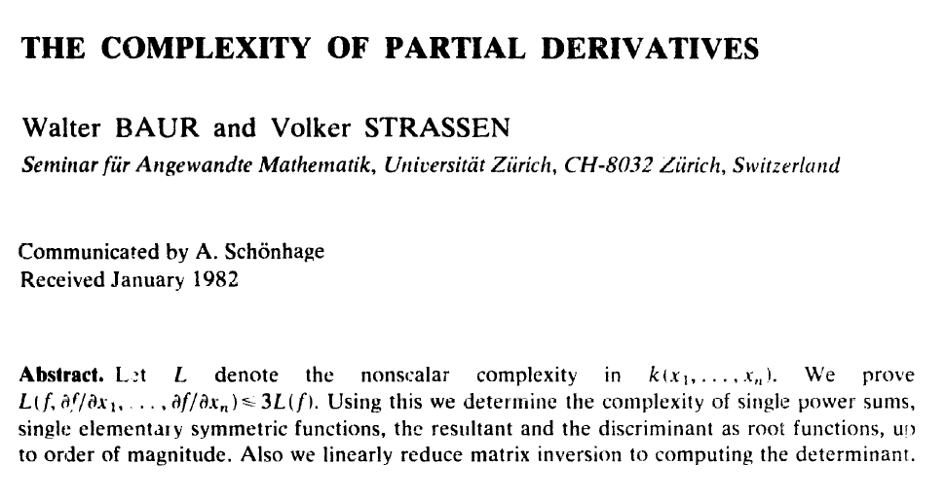
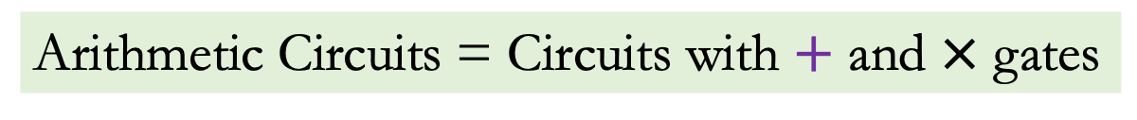
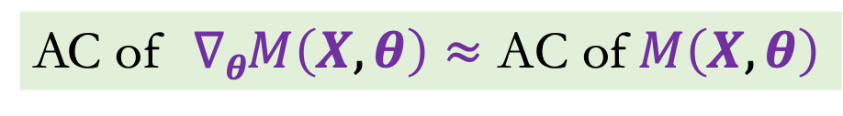
Arithmetic Circuits: what we gain
Arithmetic Circuits = Circuits with $+$ and $×$ gates
M(X, $θ$)
Arithmetic
Circuit
Proof is via the “Back propagation” algorithm
X
$$θ$$
AC of $∇θM\left(X,θ\right)≈\text{AC} \text{of} M\left(X,θ\right)$

Slide 19
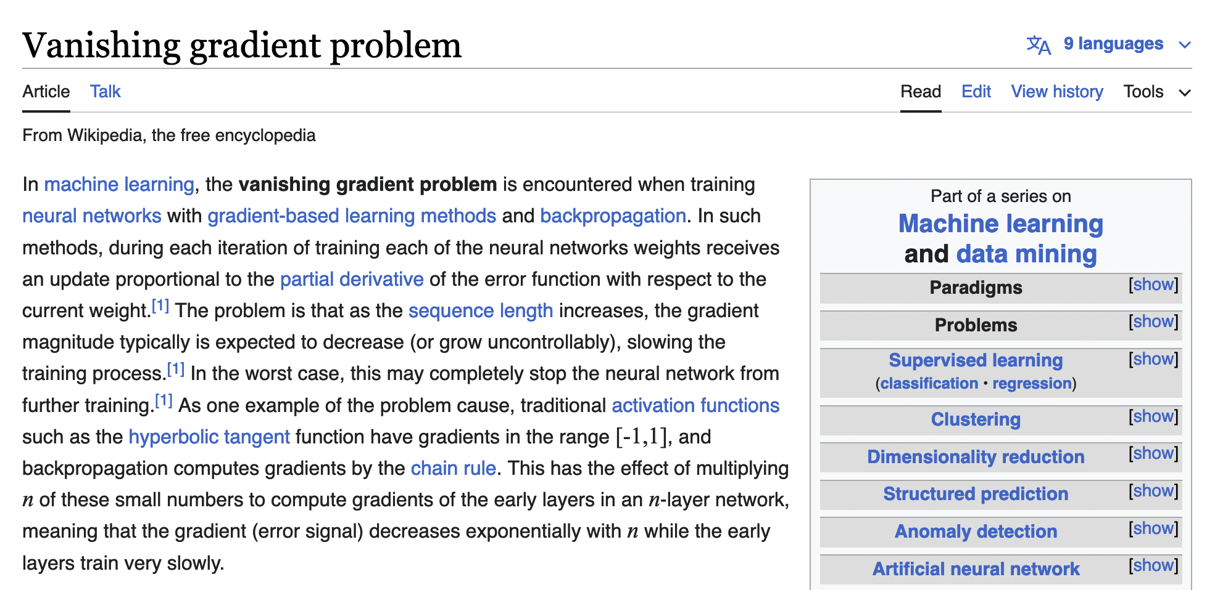
Arithmetic Circuits: what we lose
Arithmetic Circuits = Circuits with $+$ and $×$ gates
Arithmetic circuits = polynomials
M(X, $θ$)
Cannot represent all models exactly
Arithmetic
Circuit
Ignores numerical stability issues
X
$$θ$$

Slide 20
Overview of the rest of the talk
The setup, Assumption and Arithmetic Circuits
Transformers (Attention and MLP)
Replacing MLP
Replacing Attention

Slide 21
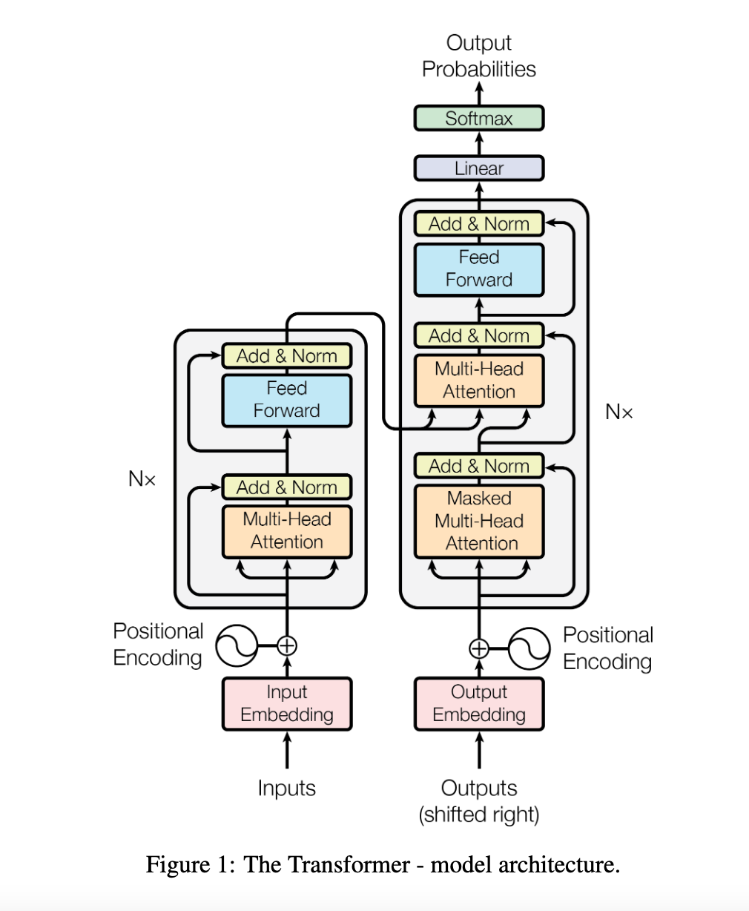
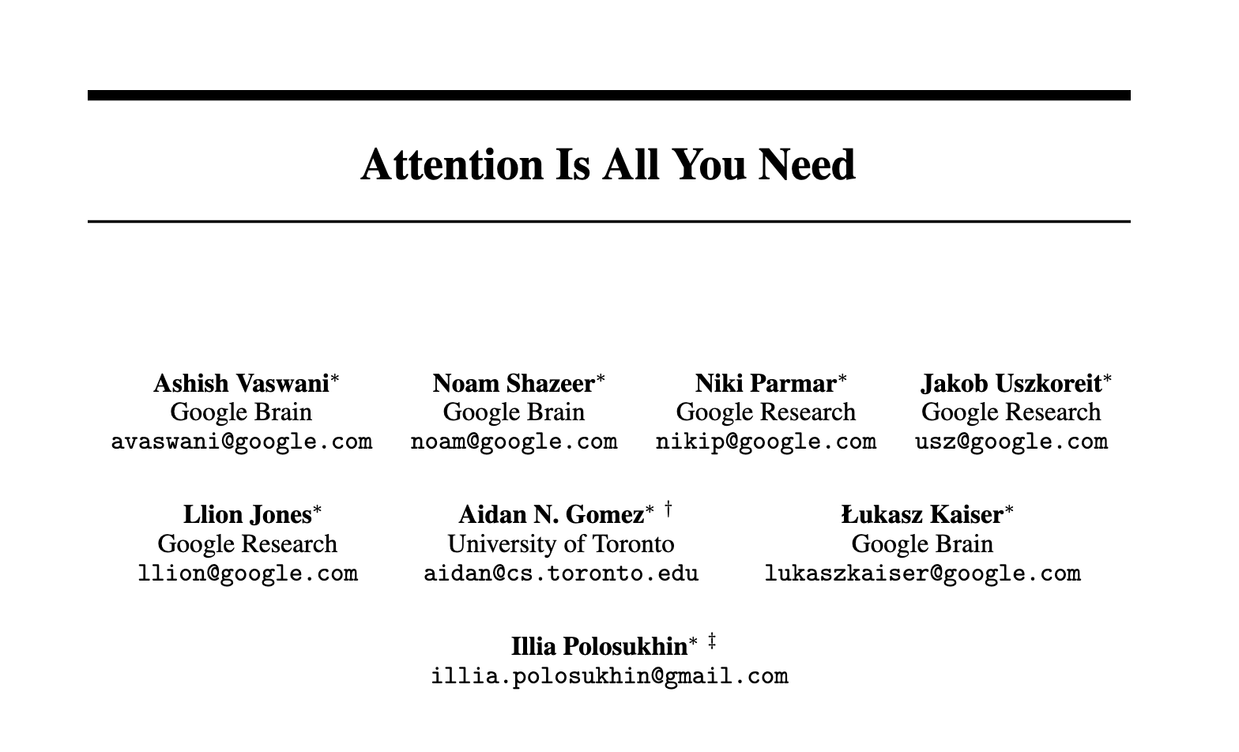
Transformers (and Attention) are the norm..
Focus on these

Slide 22
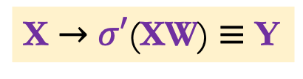
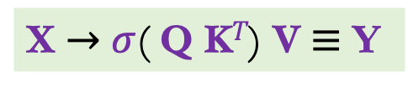


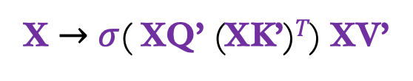
Two most important parts of each layer
Only “mixes” the hidden dimension
Feedforward layer/MLP
X $→$ $σ′$(XW) $≡$ Y
X $∈$ $ℝ$^{(N , d)}, W $∈$ $ℝ$^{(d , d)}
Only “mixes” the sequence length
Attention layer
exp
X $→$ $σ$( XQ’ (XK’)$T$) XV’
X $∈$ $ℝ$^{(N , d)}, Q’, K’, V’ $∈$ $ℝ$ ^{(d , d)}
X $→$ $σ$( Q K$T$) V $≡$ Y
Positional Encodings
Permutation invariant

Slide 23
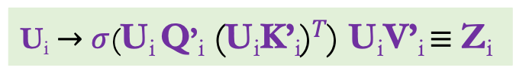

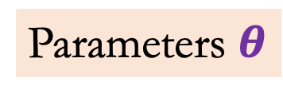
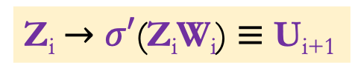
Our Simplified Transformer Model
Y
MLP L
Parameters $θ$
Attention L
Q’_{i} ; K’_{i} ; V’_{i} ; W_{i}
MLP i
Z_{i} $→$ $σ′$(Z_{i}W_{i}) $≡$ U_{i+1}
1 $≤$ i $≤$L
Attention i
U_{i} $→$ $σ$(U_{i} Q’_{i} (U_{i}K’_{i})$T$) U_{i}V’_{i} $≡$ Z_{i}
MLP 1
Attention 1
X=U₀

Slide 24
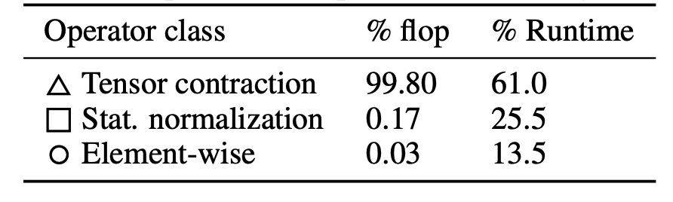


But why focus on these two operations?
$$×$$
W
d
Q
K^{T}
V
N
X
d
d
$$σ$$
N
N
N
d
d
d
Ivanov et al., A Case Study on Optimizing Transformers. MLSys 21.
Notes:
[Karan]
What does "sparsity" mean in ML? Replace dense with sparse.
[Neel] You lose steam in the middle, I'm unsure why youre telling me this.
What are things I should try to understand, and what are things I should ignore.
Need to succinctly articulate your research style.
What you're doing: looking at effieincy by understanidng "how computers work" and understanding "foundabmental mathematics for efficinecy".
[Sarah] blurry fig, slide number small.
Title: what's question. The answer is "matmul".
Floating text.
Enough text to help understanding.

Slide 25
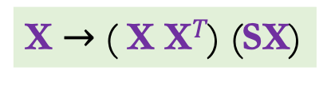
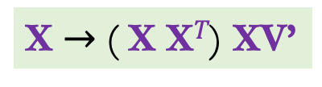
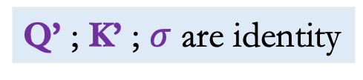
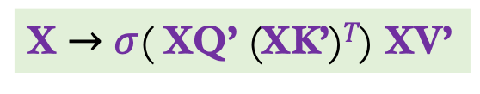
Associative Recall in 1 layer of Attention*
* Modulo some assumptions
$⊥$ if X[N-1,:] $≠$X[i,:] for all i < N-1
X uses 1-hot encoding
AR(X) =
X[i+1,:] if X[N-1,:]=X[i,:] for some i< N-1
i
j
X $→$ $σ$( XQ’ (XK’)$T$) XV’
Q’ ; K’ ; $σ$ are identity
X $→$ ( X X$T$) XV’
XV’ is X shifted up by 1
X $→$ ( X X$T$) (SX)

Slide 26
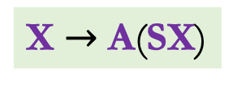


Associative Recall in 1 layer of Attention*
* Modulo some assumptions
$⊥$ if X[N-1,:] $≠$X[i,:] for all i < N-1
X uses 1-hot encoding
AR(X) =
X[i+1,:] if X[N-1,:]=X[i,:] for some i< N-1
i
j
j
A = X X$T$
i
i
X $→$ ( X X$T$) (SX)
X $→$ A(SX)
j
A[i,j] = 1 iff
i
=
j

Slide 27




Associative Recall in 1 layer of Attention*
$⊥$ if X[N-1,:] $≠$X[i,:] for all i < N-1
* Modulo some assumptions
AR(X) =
X uses 1-hot encoding
X[i+1,:] if X[N-1,:]=X[i,:] for some i< N-1
i
A
j
A = X X$T$
i
$$×$$
X[i+1,:]
i
$$=$$
N-1
0
N-1
X[i+1,:]
✅
i
SX
j
X $→$ A(SX)
A[i,j] = 1 iff
i
=
j
At most one i that matches N-1

Slide 28
Two follow up comments
Transformers end up solving may more than language problems
Check out Zeyaun’s talk
on Wed
Why would gradient descent learn a Transformer model like this?
Macho theory is most likely needed to make progress

Slide 29



Is there anything that Transformers cannot do?
Run in sub-quadratic time!
MLP
Attention
Feedforward/MLP layer is $Ω$(d²) time and space
X
X $→$ $σ′$(XW) $≡$ Y
$$×$$
W
d
N
X
d
d

Slide 30



Attention is $Ω$(N²) time in the worst case
Q
K^{T}
V
d
$$σ$$
N
N
N
N² entries
d
d

Slide 31


Why does quadratic bottleneck matter? -I

Slide 32




Why does quadratic bottleneck matter? -II
Compute budget of B
N $≈\sqrt{B}$
d $≈\sqrt{B}$

Slide 33
Overview of the rest of the talk
The setup, Assumption and Arithmetic Circuits
Transformers (Attention and MLP)
Replacing MLP
Replacing Attention

Slide 34


Not all operations are created equal
2. Data moved to compute units & SRAM for computation
1. Inputs start out in HBM (GPU memory)
3. Output written back to HBM
Blogpost: Horace He, Making Deep Learning Go Brrrr From First Principles.
Slide by: Tri Dao

Slide 35
Bit more on hardware
Atomic operations happen on a block matrix
Matrix mults of two blocks is O(1) time
Want to utilize many parallel computes
Want to avoid accessing slow memory

Slide 36


Simplification 2: Focus on matrix vect mult
X $→$ $σ′$(XW) $≡$ Y
w_{0,0}
w_{0,2}
…..
w_{0,d-1}
x₀
y₀
$$×$$
W
d
N
X
w_{d-1,0}
w_{d-1,1}
…..
w_{d-1,d-1}
x_{d-1}
y_{d-1}
d
W
x
y
d
Θ(d²) time and space in worst-case
Get this down to O(d)

Slide 37




But wait, we have gathered more requirements..
W comes from a “structured” class of matrices
At a minimum, we would like to replace generic Wx with
Expressive class of matrices
Differentiable (to run GD)
Toeplitz, Fourier, sin/cosine transform …
Gradient $∇θM(X,θ)$
Matrix vect. mult. with small arithmetic circuit
Hardware aligned algorithms

Slide 38

Any suggestions on structured matrices?
Sparse matrices
Low rank matrices
Q
K^{T}
o(d²) arithmetic ops
✅
✅
Expressive
❌
❌
Differentiable
❌
✅
HW aligned
❌
✅

Slide 39
Since o(d²) arithmetic ops is a requirement
Pretty much all efficient transform have small arithmetic circuits
Toeplitz, Fourier, sin/cosine transform …
Can we use any matrix class with small (size+depth) arithmetic circuit?
Differentiable
o(d²) arithmetic ops
✅
Small arithmetic circuits
Expressive
✅
Differentiable
❌
HW aligned
❌

Slide 40

Differentiable superset of small arithmetic ckt?
Why would this even be possible?
w =
$∙$v
DFT of order 4
(Linear) Arithmetic circuit for DFT of order 4

Slide 41







Small arithmetic ckt $≡$ prod. of sparse matrices
Wx
w_{0,0}
w_{0,2}
…..
w_{0,d-1}
x₀
y₀
$𝒞$_{W}
Size s
has
Depth $∆$
w_{d-1,0}
w_{d-1,1}
…..
w_{d-1,d-1}
x_{d-1}
y_{d-1}
W
x
y
X
Fig by: Tri Dao
W =
$$×$$
….
$$×$$
W₁
W₂
W$∆−1$
W$∆$

Slide 42

Small arithmetic ckt $≡$ prod. of sparse matrices
Wx
w_{0,0}
w_{0,2}
…..
w_{0,d-1}
x₀
y₀
$𝒞$_{W}
Size s
has
w_{d-1,0}
w_{d-1,1}
w_{d-1,d-1}
x_{d-1}
y_{d-1}
Depth $∆$
…..
W
x
y
X
Sum of nnz(W_{i}) $≈$ s
Fig by: Tri Dao
W =
$$×$$
….
$$×$$
Better ref?
W₁
W₂
W$∆−1$
W$∆$
De Sa, Gu et al., SODA 2018

Slide 43
Is product of sparse matrices the answer?
o(d²) arithmetic ops
✅
Expressive
✅
Differentiable
❌
❌
HW aligned
Fig by: Tri Dao
$$×$$
….
$$×$$
W₁
W₂
W$∆−1$
W$∆$

Slide 44
FFT is always the answer
Sparse AND Structured
Fig by: Tri Dao
$$×$$
….
$$×$$
W₁
W₂
W$∆−1$
W$∆$

Slide 45


Butterfly Matrices: Fixed Sparsity Inspired by FFT
…
We can compose butterfly matrices:
Butterfly matrices:
Fixed sparsity patterns
Expressive: Can represent any fast matrix almost optimally (Dao et al., ICLR 20)
$\tilde{O}$(s$∆$) arithmetic ops
✅
Expressive
✅
Differentiable
✅
[Beneš, 65; Parker, 95; Matthieu & LeCun, 14; Li et al., 15, De Sa et al., 18, Dao et al., 19]
HW aligned
❌
Slide by: Tri Dao

Slide 46


Block-sparsity for Hardware-Efficiency
Fixed “bit-reversal” permutations
FFT with base $\sqrt{N}$
Monarch
Slide by: Tri Dao
Block-diagonal leverages efficient block-matrix-multiply on GPUs

Slide 47
Monarch Matrices: Efficient and Expressive
Outstanding Paper runner-up, (Dao, …, Grogan, Liu, Rao,… ICML 2022)
o(d²) arithmetic ops
✅
Expressive
✅
Differentiable
✅
HW aligned
✅
Check out Dan’s talk
Tomorrow!
Slide by: Tri Dao

Slide 48
Overview of the rest of the talk
The setup, Assumption and Arithmetic Circuits
Transformers (Attention and MLP)
Replacing MLP
Replacing Attention

Slide 49
Going back to Transformer Model
Y
MLP L
Attention is still quadratic!
Attention L
MLP i
Z_{i} $→$ $σ′$(Z_{i}W_{i}) $≡$ U_{i+1}
Attention i
U_{i} $→$ $σ$(U_{i} Q’_{i} (U_{i}K’_{i})$T$) U_{i}V’_{i} $≡$ Z_{i}
MLP 1
Attention 1
X=U₀

Slide 50

Flash Attention [Dao, Fu et al. 2022]
Q
K^{T}
V
d
$$σ$$
N
N
N
d
d
Want to avoid accessing slow memory
With apologies to
Flash Attention avoids unnecessary writes to slow memory!
Tri
Dan
Notes:
[Karan]
What does "sparsity" mean in ML? Replace dense with sparse.
[Neel] You lose steam in the middle, I'm unsure why youre telling me this.
What are things I should try to understand, and what are things I should ignore.
Need to succinctly articulate your research style.
What you're doing: looking at effieincy by understanidng "how computers work" and understanding "foundabmental mathematics for efficinecy".
[Sarah] blurry fig, slide number small.
Title: what's question. The answer is "matmul".
Floating text.
Enough text to help understanding.

Slide 51





Linear Attention
O(d²N)
$$φ\left(Q\right), φ\left(K\right)∈ℝ\text{ (}\text{N}\text{, }\text{f}\text{)}$$
$e^{QKT} ≈$ $φ\left(Q\right)φ\left(K\right)T$
Q
K^{T}
V
d
Compute $φ\left(Q\right)φ\left(K\right)T$V
$$exp$$
N
N
N
d
d
Check out Simran’s talk
tomorrow

Slide 52






State Space Models
s_{i} = As_{i-1} + bx_{i}
Input: x₁, x₂, …. $∈ℝ$
A $∈ℝ$^{(m,m)}
Output: y₁, y₂, …. $∈ℝ$
y_{i} = c^{T}s_{i} + dx_{i}
s_{i},b,c $∈ℝ$^{m}

Slide 53




(Linear) State Space Models
Isys will be on
Post doc job market
next year!
Albert
Isys
s_{i} = As_{i-1} + bx_{i}
Input: x₁, x₂, …. $∈ℝ$
A $∈ℝ$^{(m,m)}
Output: y₁, y₂, …. $∈ℝ$
y_{i} = c^{T}s_{i} + dx_{i}
s_{i},b,c $∈ℝ$^{m}

Slide 54

Carefully crafted A gives S4
s_{i} = As_{i-1} + bx_{i}
Input: x₁, x₂, …. $∈ℝ$
A $∈ℝ$^{(m,m)}
Output: y₁, y₂, …. $∈ℝ$
y_{i} = c^{T}s_{i} + dx_{i}
s_{i},b,c $∈ℝ$^{m}

Slide 55



Making parameters depend on input as well
Tri
Albert
s_{i} = A_{i}s_{i-1} + b_{i}x_{i}
Input: x₁, x₂, …. $∈ℝ$
A_{i} $∈ℝ$^{(m,m)}
Output: y₁, y₂, …. $∈ℝ$
y_{i} = c_{i}^{T}s_{i} + dx_{i}
s_{i},b_{i},c_{i} $∈ℝ$^{m}

Slide 56
I’ll leave you with one open question…
Can we prove something about convergence of Gradient Descent for these new models?
Please?

Slide 57






A big thanks to my collaborators!
Simran Arora
Beidi Chen
Chris Re
Tri Dao
Sabri Eyuboglu
Isys Johnson
Jessica Grogan
Amit Blonder, Matt Eichhron, Alex Liu Aniruddh Rao, Aman Timalsina
Dan Fu
Albert Gu
+ many others

