Slide 1
Statistical Models and Machine Learning Algorithms
B. Ramamurthy

Slide 2
Review of Last Class
R and RStudio
Data science process
    RealDirect sales data
Predictive analytics:
  Linear regression- statistical method
    Simple but powerful and popular
    Twitter vs CDC Ebola data
  K-means clustering machine learning algorithm
    Application: customer segmentation
  K-NN classification machine learning algorithm
    Prediction of a class through training and learning

Slide 3
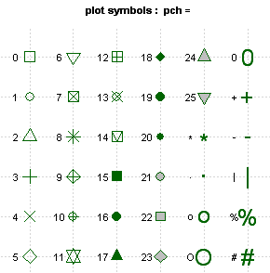
What is in pch?

Slide 4
Topics for today
7 steps in the data science process: 6 of them illustrated using real data
Data strategy from Chapter 2: Realdirect case study
  Micro level data-strategy
  Importing data Excel
  We will do EDA on two sets of data: Brooklyn and Manhattan sales data
Algorithms from Chapter 3 and their significance and application to real data
  Linear regression
  K-nearest neighbor (k-nn)
  K-means
More hands-on lab work using several data sets and complete end-to-end problem solving in data analysis

Slide 5
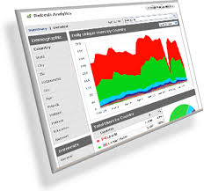
Transforming data into analytics➔ Strategies/decisions
Vertical domain
Probability-Statistics-Stochastic
Randomness,
Uncertainty
Machine learning algorithms
Food services data
Results
Decisions
Diagnosis
Strategies
Horizontal domain
Social/ media data/ web data

Slide 6

The Data Science Process (contd.)
4
Exploratory data analysis
1
Raw data collected
Data is processed
3
2
Data is cleaned
Machine learning algorithms;
Statistical models
5
Build data products
7
Communication
Visualization
Report Findings
6
Make decisions
Micro-level data strategy

Slide 7
The Seven Steps
Collect data
Prepare data
Clean data
EDA
Visualize + understand
Fit Models/apply algorithms + analyze + predict + understand (deeper) + visualize
Build data products

Slide 8

EDA to Data Product
Fit model
Build data tool
EDA
Extract parameters
Deploy on the cloud
Use it

Slide 9
Today’s Lab
We will illustrate the three algorithms using simple exercises
You may need to install several packages within R Studio, as and when needed
We will also explore 6 of the 7 steps in the data science process using two applications

Slide 10
Plots, Graphs and Models
Plots, graphs, maps provide the ability to visualize data and the results of model fitting
Models provide you parameters that you can use to
  Get a deeper understanding of the data characteristics
  Build data tools based on the parameter so that you automate the analysis
Algorithms drive the model (fitting) of your data
For example,
  if your guess is a linear relationship for the data, then use linear regression;
  if you want to see clusters in your data you can use K-means;
  if you want to classify the data into classes then you may want to use K-NN

Slide 11
Algorithms
Three types of algorithms:
  Data munging or data engineering or data wrangling: mapping raw and dirty data to a format that is usable in tools for analysis.
    By some estimates (NYT) this is about 50% of a data scientists time.
    Start-ups to do this kind of work: re-package data and sell it.
  Optimization algorithms for parameter estimation: Least squares, Newton’s methods, Stochastic gradients descent
    R has many functions readily available do to this
    Example: lsfit(x, y, … tolerance = 1e-07,…)
  Machine Learning algorithms
    Used to predict, classify and cluster

Slide 12
Linear Regression
Vey simple, easy to understand
Expresses the relationship between two variables/attributes
You assume a linear relationship between an outcome variable (dependent variable, response variable/ label) and the predictor(s) (independent variables, features, explanatory variables)
  Examples: company sales vs money spent on ads
  Number of friends vs time spent on social media

Slide 13
Linear regression (contd)
y = f(x) where y = β₀ + β₁ x
For this revenue table you can see y = 25x
How about this head(data1)?
Not so obvious
Need to “fit the model”
Subscribers x | Revenue y
5 | 125
10 | 250
15 | 375
20 | 500
7 | 276
3 | 43
4 | 83
6 | 136
10 | 417

Slide 14
Fitting the model
Least squares method to improve the fit
We will now look at R exercise for linear regression and extract the parameters
Fitted model can be evaluated and can be refined or updated.
Many variations of linear regression exists and can be used as the need arises for these.

Slide 15
Multiple Regression
Regression with multiple predictors
y = β0+ β1.x1 + β2.x2+.. + Є
We are considering data table/frame of one dependent variable y, and multiple independent variables.
Model fitting using R.
model<- lm(y ~ x0+x1+x2)
model <-lm(y ~ x0+x1+x2*x3) where predictors x2 and x3 have interaction between them.
Example: y :
price of oil ~
x1= # full oil storage tanks, x2= #half tanks, x3= #empty tanks

Slide 16
Synthetic data
You can generate synthetic data to explore, learn and/or hypothesize and evaluate a certain model
Usually the generating functions for random number is “r” followed by distribution function.
Examples:
  runif(10,0.0,100.0) # generate 10 numbers between 0.0 and 100.0 : uniform distribution
  rpois(100,56)# generate 100 numbers with mean of 56 according to Poisson distribution
  rnorm(100,mean=56,sd=9) # generate 100 numbers with mean 56, std.dev 9, according to Normal distribution

Slide 17
Synthetic Data
Generate 30 random numbers in a given range.
  x<-sample(0:100, 30)
Non-numerical data:
  sts<- sample(state.name,12)
  Try this twice and observe the randomness
You can set seed to avoid pseudo randomness
  set.seed(5)
You can also save the synthetic data generated for later use in another experiment by using the command:
  write.csv(data6, “mydata.csv”, row.names=FALSE)

Slide 18
Machine Learning Methods
Learning: three major categories of algorithms
  Unsupervised
  Supervised
  Semi-supervised
Another categorization: generative vs discriminative
Clustering: putting items together in clusters
  Given a collection of items, bin them into groups with similar characteristics.
  K-means
Classification: label a set of items based on prior knowledge of classes
  Given a collection of items, label them according to their properties
  K-NN : semi-supervised
  Training set, test set, unlabeled data➔ labeled data

Slide 19
K-means
K-means is unsupervised: no prior knowledge of the “right answer”
Goal of the algorithm is to determine the definition of the right answer by finding clusters of data
Kind of data: social data, survey data, medical data, SAT scores, customer data
Assume data {age, gender, income, state, household, size}, your goal is to segment the users.
Lets understand k-means using an example.

Slide 20
K-means Algorithm
Choose the number of clusters k (by some requirement)
The centers (centroids/means) are initialized to some value (by some strategy)
Choosing centroid itself can be special step/algorithm; it can be random.
Then the algorithm proceeds in two steps:
  Reassign all the points in the data to the closest centroid thus creating clusters around the centroid
  Recalculate the centroid based on this assignment
The above reassign-recalculate process continues until there is no change in centroid values, or points stop switching clusters.
Input data will have to be in a table/matrix with each column representing a (influencing) feature

Slide 21
Theory Behind K-means
K-means searches for the minimum sum of squares assignment;
It minimizes unnormalized variance (=total_SS) by assigning points to cluster centers.
In order for k-means to converge, two conditions are considered:
  Re-assigning points reduces the sum of squares
  Re-computing the mean reduces the sum of squares
As there is only finite number of combinations, you cannot infinitely reduce this value and the algorithm must converge at some point to a local optimum.
Good measure of convergence: between_SS/total_SS

Slide 22
K-means Theory (contd.)
Functional principal component analysis
K-means algorithm is not distance based; it minimizes the variances to arrive a cluster.
That’s why the axes are labeled by the discriminating component value.

Slide 23
Lets examine an example
{Age, income range, education, skills, social, paid work}
Lets take just the age { 23, 25, 24, 23, 21, 31, 32, 30,31, 30, 37, 35, 38, 37, 39, 42, 43, 45, 43, 45}
Classify this data using K-means
Lets assume K = 3 or 3 groups
Give me a guess of the centroids?

Slide 24
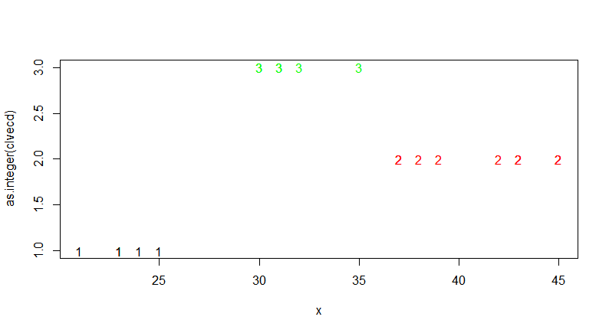
Results for K=3

Slide 25
R code
age<-c(23, 25, 24, 23, 21, 31, 32, 30,31, 30, 37, 35, 38, 37, 39, 42, 43, 45, 43, 45)
clust<-kmeans(age,centers=3)
plotcluster(age,clust$cluster)

Slide 26
Discussion on K-means
We discussed the problem with a small data set.
Obviously the R code given in the previous slide is same irrespective of the size
Typically for really big-data and also for building a data tool,
  We will take the parameters from the K-means model fitted or generated by R code and
  Write a program that can automate the K-means clustering
Kmeans(x, centers, iter.max=10, algorithm=c(“Hattigan-wong”, “Lyoyd”, “Forgy”, “MacQueen”))

Slide 27
R Data sets
Anderson’s Iris dataset is a very popular dataset available with R package
The iris data set gives the measurements in centimeters of the variables sepal length and width and petal length and width, respectively, for 50 flowers from each of 3 species of iris. The species are Iris setosa , versicolor, and virginica (coded 1, 2 and 3 respectively, some times)

Slide 28
K-means application: Customer Segmentation
Clustering (& classification) are important data analysis methods for customer segmentation for understanding your customers and target your business practices.
Ex: Obama’s election 2008: 230 M voters, 59% voted, 2.2 M (between 18-29), 66% voted for Obama, 1.5M; in some states like Indiana this accounted for the small 1% margin! Election that was won by computing and social media.

Slide 29
K-NN
Semi-supervised ML
You know the “right answers” or at least data that is “labeled”: training set
Set of objects have been classified or labeled (training set)
Another set of objects are yet to be labeled or classified (test set)
Your goal is to automate the processes of labeling the test set.
Intuition behind k-NN is to consider most similar items --- similarity defined by their attributes, look at the existing label and assign the object a label.

Slide 30
K-NN Classification
A set of objects have been classified or labeled in some way
Other similar objects with unknown class need to be labeled / classified
Goal of a classification algorithm (K-NN) is to automatically label these objects
NN stands for nearest neighbor
How do you determine the closeness? Euclidian distance; color, shape or similar features.

Slide 31
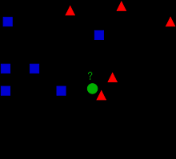
Example²
Label1
Label2
What is class of
unknown item
indicated by green
circle?
K = 3
K =5

Slide 32
Intuition (K = 3)
Label1
Label2
What is class of
unknown object
indicated by green
circle?
K = 3
The unknown object gets 2 votes and 1 vote➔ label of unclassified object is

Slide 33
Intuition (K = 5)
Label1
Label2
What is the class of
unknown object
indicated by green
circle?
K = 5
The unknown object gets 2 votes and 3 votes → label of unknown object is

Slide 34
Discussion on K-NN
How do you select K, the number of voters/objects with known labels?
Three phases: training, test and classification/labeling of actual data
Lets generate some synthetic data and experiment with K-NN.

Slide 35
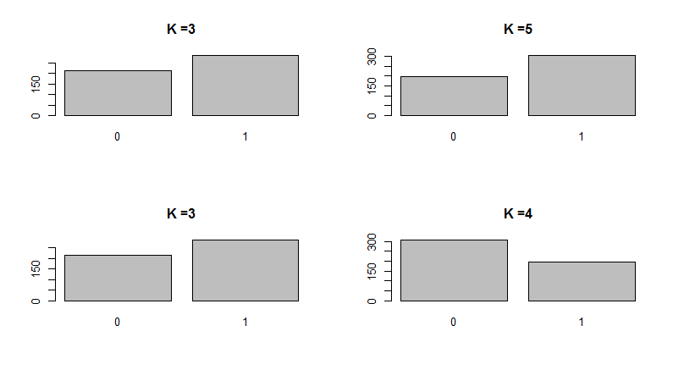
Different Values of K

Slide 36
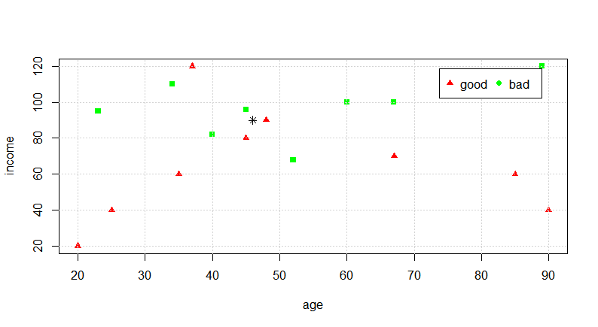
K-NN application: Credit Rating
Predict credit rating as “good” or “bad” based on a set of known data

Slide 37
R code for the previous example
age<-c(25,35,45,20,37,48,67,90,85) # good rating
income<-c(40,60,80,20,120,90,70,40,60)
plot(income~age, pch=17, col="red")
xn<-c(52,23,40,60,48,33,67,89,34,45) #bad rating
yn<-c(68,95,82,100,220,150,100,120,110,96)
points(yn~xn,pch=15, col="green")
grid(nx=NULL,ny=NULL)
x<-46 # predict the rating of this customer
y<-90
points(y~x, pch=8)
legend("topright", inset=.05, pch=c(17,19),c("good","bad"), col=c("red","green"), horiz=TRUE)

Slide 38
Application of the K-NN process
Decide on your similarity or distance metric
Split the original data into training and test data
Pick an evaluation metric (misclassification rate is a good one)
Run k-NN a few and check the evaluation metric
Optimize k by picking one with the best evaluation measure
Once k is chosen, create the new test data with no labels and predict the “class” for the test data

Slide 39
Discussion
How to apply these methods and techniques to data problems at your work? See exercises at the end of the lab handout.
When you launch on a data analytics project here are some of the questions to ask:
  What are the basic variables?
  What are underlying processes?
  What influences what?
  What are the predictors?
  What causes what?
  What do you want to know?: This needs a domain expert

Slide 40
Summary
We covered 3 of the 10 top data mining algorithms
We studied:
Linear regression
Clustering algorithm K-means
Classification algorithm K-NN
Powerful methods for predicting and discovering intelligence
R /Rstudio provides convenient functions to model your datasets for these algorithms

Slide 41
References
N. Harris, Visualizing K-means Clustering, http://www.naftaliharris.com/blog/visualizing-k-means-clustering/, 2014.
Example figure, http://en.wikipedia.org/wiki/K-nearest_neighbors_algorithm, 2014
R Nutshell online version of the book: http://web.udl.es/Biomath/Bioestadistica/R/Manuals/r_in_a_nutshell.pdf

