Slide 1
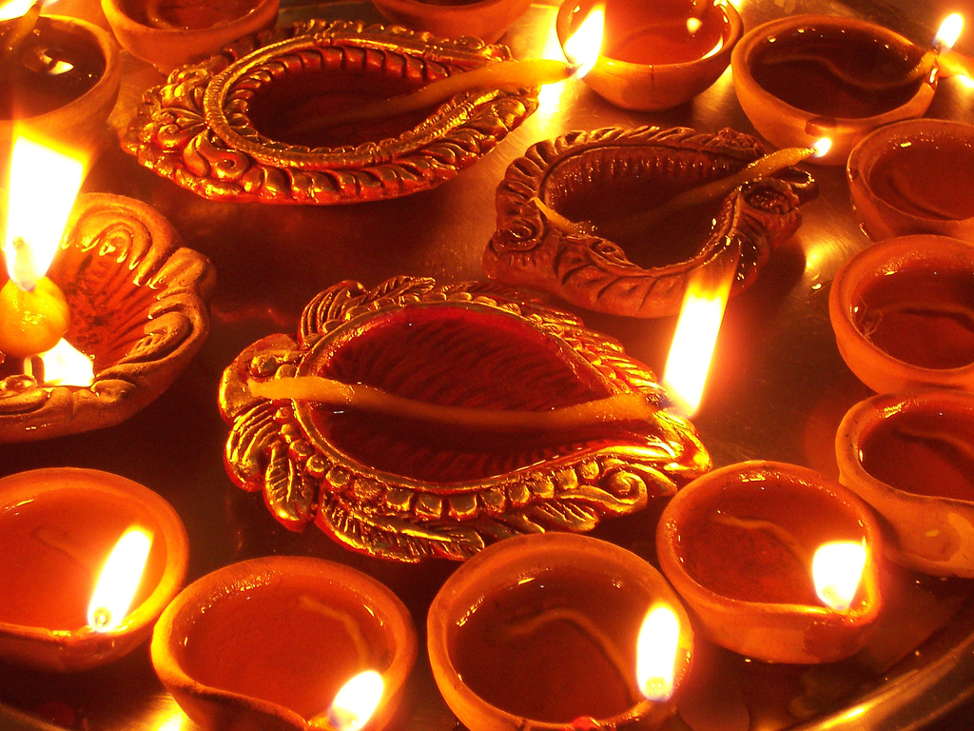
Deepa Mehta’s
1947: Earth
Presented by Nainita Madurai

Slide 2

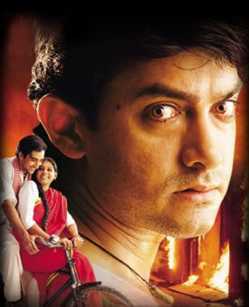
Background Information
Directed by Deepa Mehta
Starring Amir Khan, Nandita Das, Rahul Khanna and Maia Sethna
Depicts the partition of India and Pakistan after Indepedence
Not like most Bollywood films

Slide 3
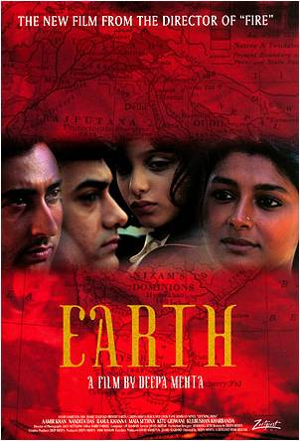
Basic Plot
Narrated by young girl, Lenny, living in Lahore
The movie centers on a group of friends of all different religions
After the partition, violence erupts and some individuals in the group change
Lenny sees the ultimately tragic affect that the partition has on the group as well as her innocence

Slide 4
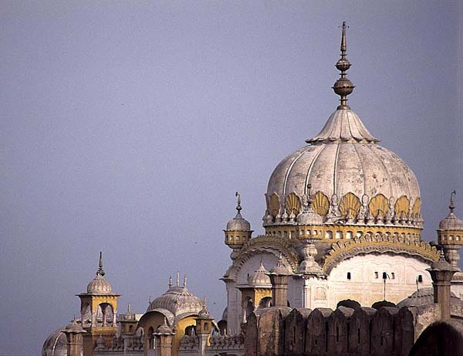
Setting
Lahore is a city in the Punjab province, on the border of India and Pakistan
Before the partition, different religions lived their together peacefully
After the partition there was a mass migration across the border and Lahore became an overwhelming Muslim city

Slide 5
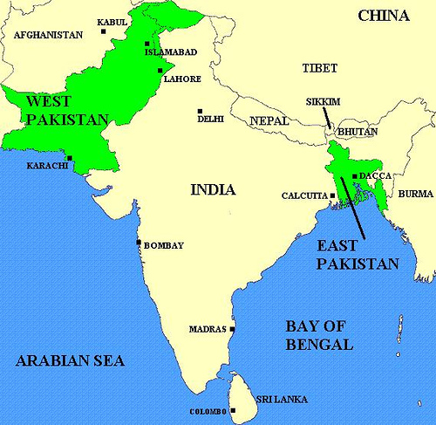

Slide 6
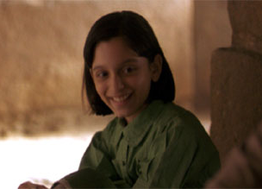
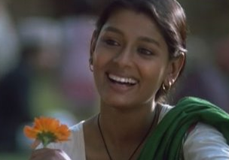
Characters
Lenny is the daughter of a wealthy, Parsi family
Lenny is a very innocent, pampered girl
She shares a close bond with Shanta
Shanta is the beautiful Hindu woman in the group
She is very protective of Lenny
Loved by Dil and Hassan

Slide 7
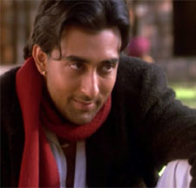
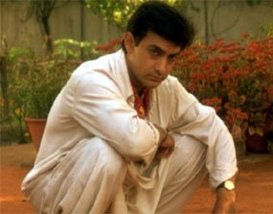
Characters Continued
Kind, shy Muslim man in love with Shanta
Remains loyal to his friends and helps them when they need it
Dil, or Ice-Candy Man, shows how people changed
At first, he is full of life and happiness
Becomes vengeful and full of hatred

Slide 8
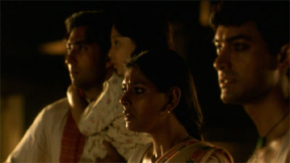
Continuation of Plot…
After losing his sisters, Dil asks Shanta to marry him believing that she is the only one who can control his anger and thirst for revenge
Shanta declines his proposal and goes to Hassan
The next day Hassan is found dead and Shanta is taken away by mob of Muslims

Slide 9
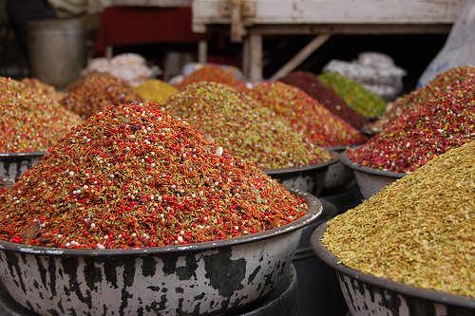
Outside connections
The characters are parallel to those in The Home and the World
Shanta, Hassan, and Dil : Bimala, Nikhil, and Sandip, respectfully
In Chatterjee’s book he talks about how the mob is uncontrollable and it is very easy to become part of the mobocracy
Gandhi’s ideals were what they needed but he was not even mentioned in the movie

Slide 10



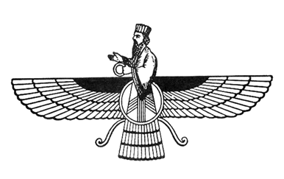
Religious Conflict
In Lahore before partition, all religions lived together peacefully as “brothers”
Parsi’s are neutral and don’t choose sides
The film portrays unbiased view, all sides are committing atrocities
Film hinted at the idea that Britain instigated the religious conflicts by carving
up India

Slide 11
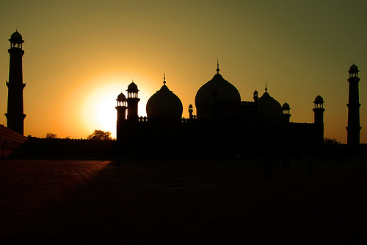
Corruption of Nationalism
Spurs the question: why did these people turn on one another?
What united the people against the British is now tearing them apart
Nationalism has been corrupted by religious extremism

Slide 12

Symbolism
Gardener cuts flowers and is told off by the butler who says: “It’s a sin to cut flowers after sunset, they’re sleeping. Just as well, imagine they’re pain if they were awake.”
In the zoo there is a lion that Lenny is afraid of and Shanta soothes her by saying: “The cage is so strong that even one hundred lions can’t break it

Slide 13
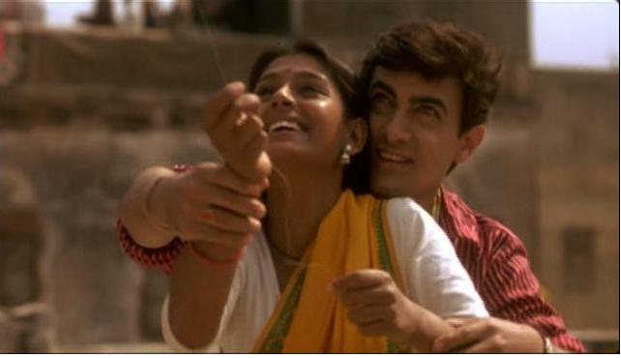
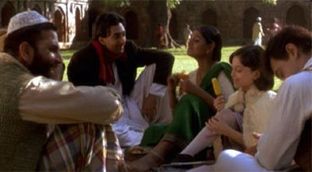
Symbolism Continued
Kite-flying scene in which another kite comes to cut Dil’s kite, but gets cut instead
Foreshadows Dil’s part in violence
The group of friends represents Lahore (all different religions)
In the end, the group is torn apart

Slide 14

Film Nuances
The earthy tones in the movie represented looming danger
The tones were also in reference to the title of the film: Earth
The title is Earth because people were literally fighting over land
The film score, by A.R. Rahman was incredible and really captured the scenes well

Slide 15
Reviews
It was well received and most critics say that it depicted an accurate portrayal of the brutalities that occurred during the partition
Stephen Holden of the NYTimes says: “‘Earth’ is a powerful and disturbing reminder of how a civilization can suddenly crack under certain pressures.”

Slide 16
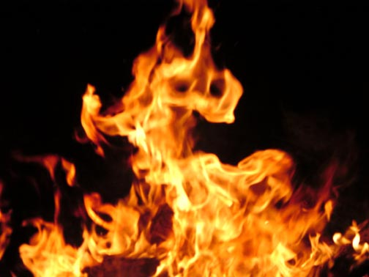
Conclusion
The movie is true to what actually happened
The Sikh mob and train massacre
Atrocities that caused immense bloodshed occurred often
Not a nationalistic movie for India
In the end, the movie proved that love and innocence were not strong enough to survive

Slide 17
Sources
Dir. Deepa Mehta. Perf. Amir Khan, Maia Sethna, Nandita Das, and Rahul Khanna,. DVD. Cracking the Earth Films Inc., 1998.
"Earth." Internet Movie Database. 20 Mar. 2009 <http://www.imdb.com/title/tt0150433/>.
"Earth, politics, and the politics of life." Rev. of Earth. Weblog post. TheBollywoodFan. 22 Aug. 2008. 20 Mar. 2009 <http://thebollywoodfan.blogspot.com/2008/08/earth-politics-and-politics-of-life.html>.
Holden, Stephen. "India Torn Apart, as a Child Sees It." Rev. of Earth. The New York Times. 10 Sept. 1999. The New York Times. 20 Mar. 2009 <http://movies.nytimes.com/movie/review?_r=2&res=9A01E2D6143DF933A2575AC0A96F958260>.
"1947 EARTH." Cinemas online. 22 Mar. 2009 <http://www.cinemas-online.co.uk/films/1947earth.fhtml>.

