Slide 1
Depression
Presentation by Francoise Adan, M.D.

Slide 2
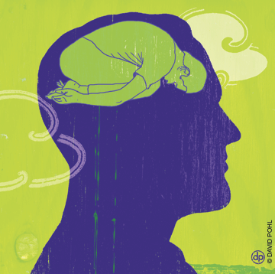
What is it?
Medical illness
Affects MIND & BODY

Slide 3
What is it not?
Not something to be ashamed of
Not a character flaw
Not something that you “snap out of”
Not feeling sad or blue
Not grief (numbness, bargaining, anger, despair, reorganization)

Slide 4
Frequency
1 in 5 people suffer during lifetime
Equal opportunity illness
At least 50% suffering do NOT get adequate treatment

Slide 5
Symptoms
Mood: sad, empty
Sleep: heavy sleeping or sleeplessness
Loss of interest or pleasure
Fatigue, low energy

Slide 6
Symptoms cont.
Decreased concentration, difficulties making decisions, diminished memory
Appetite: may increase or decrease --> weight change
Psychomotor: agitation, slow down
Guilt: worthlessness, helplessness
Suicide: thoughts of and preoccupation with death

Slide 7
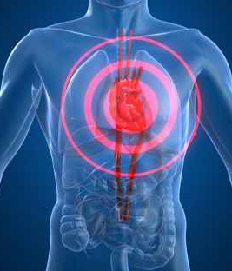
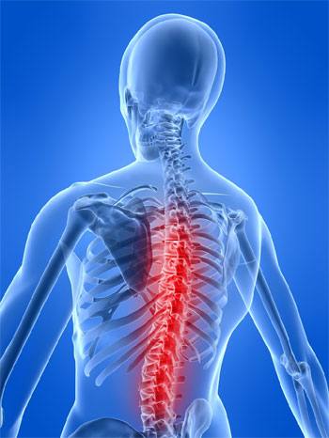
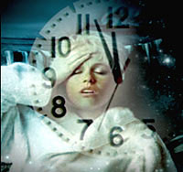
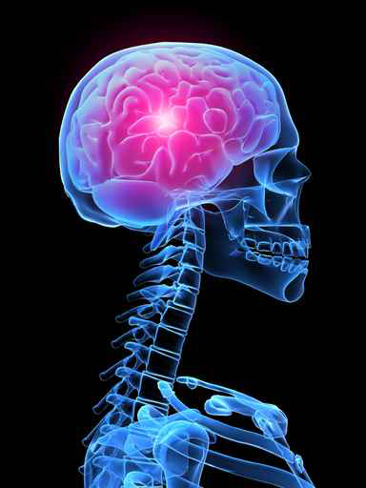
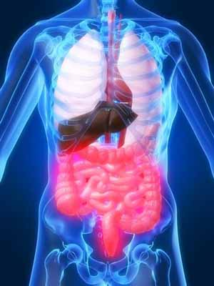
Physical Complaints
Chronic Pain 34-43%
Chest Pain 61%
Insomnia 51%
Irritable Bowel Syndrome
70.94%
Headaches 40%

Slide 8
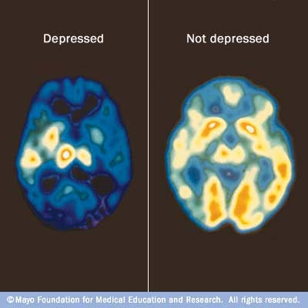
Mind-Body Connection

Slide 9

When to Ask for Help?
2 weeks of symptoms
When symptoms affect life (work, school, personal, etc.)
Suicidal thoughts

Slide 10
Types of Depressive Disorders
Major Depression
Single
Recurrent
Dysthymia
Seasonal Affective Disorder
Bipolar Affective Disorder
Substance Induced Depression
Due to a general medical condition

Slide 11
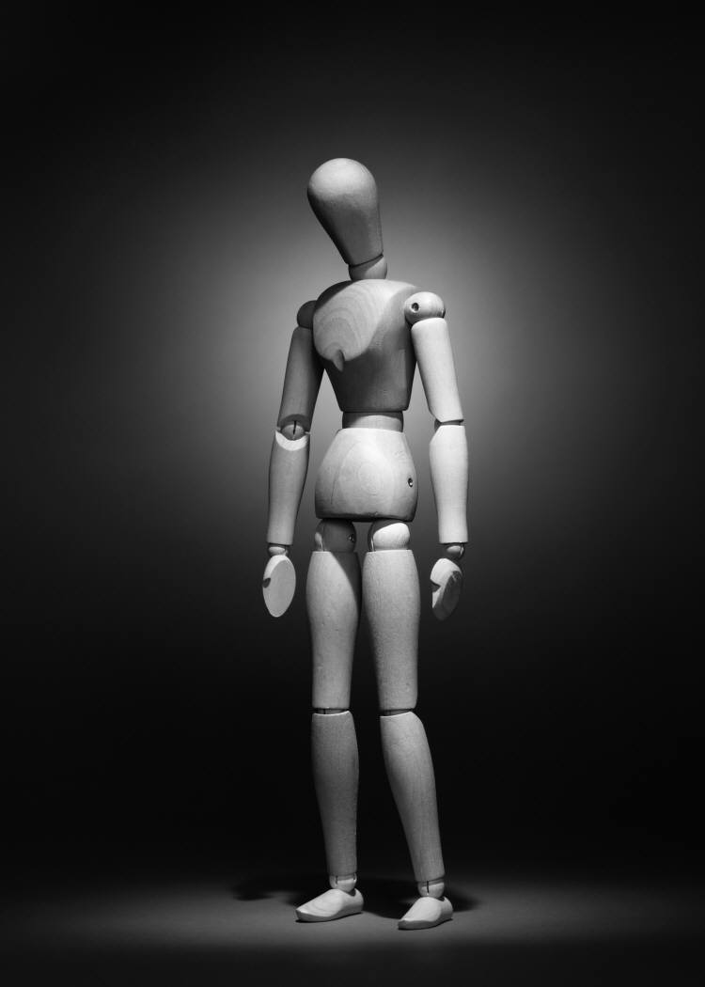
Risk Factors
Family history
Prior history
Female gender
Life stressors
bereavement
Personality traits
Death of a loved one

Slide 12
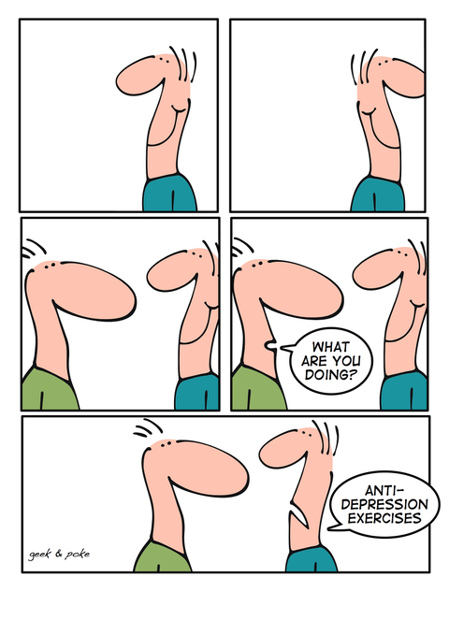
Treatment Options
Goals:
Reduce/eliminate symptoms
Restore function
Prevent relapse and recurrence
Rx:
Pharmacotherapy
Psychotherapy
Stress Management

Slide 13
When Someone You Know Is Depressed...
LISTEN
LEARN
Do NOT judge
Do NOT take it personally
ENCOURAGE
Take care of yourself

Slide 14
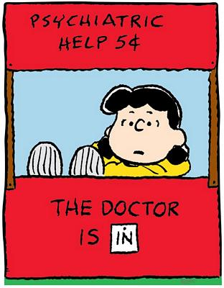
University Hospitals
Case Medical Center
Francoise Adan, M.D.
Mood Disorders Program
10524 Euclid Ave, 12th Floor
Cleveland, OH 44106
Phone: 216-844-2400
Fax: 216-844-2877
Email: Francoise.Adan@UHhospitals.org

Slide 15
Questions?

Slide 16
True or False?
T/F Clinical depression is the most common serious brain disease in the U.S.
T/F People of all ages, backgrounds, lifestyles, and nationalities suffer from major clinical depression
T/F 80% of those properly treated for clinical depression show an improvement in their symptoms generally within 4 to 6 weeks
T/F More people die from suicide than from homicide
T/F Pyschotropic drugs are the only way to treat clinical depression

Slide 17
True or False?
T/F Men do not suffer from clinical depression
T/F Clinical depression costs the U.S. more than $45 billion annually
T/F Sad events are the chief cause of clinical depression
T/F There is nothing that family and friends can do to help a victim of clinical depression
T/F Clinically depressed children, women, and men can be highly successful and productive

Slide 18
More Risk Factors for Suicide
Hopelessness
Male gender
Caucasian race
Advanced age
History of attempts
Medical illness
History of substance abuse
Psychotic symptoms
Living alone
Insomnia
Anxiety

Slide 19
Symptoms of Abnormal Neurotransmitter Function
DOPAMINE | NOREPINEPHRINE | SEROTONIN
Decreased ability to experience pleasure | Low energy and lethargy | Obsessive-compulsive behavior
Decreased motivation | Decreased alertness
Decreased attention
Cognitive slowing

Slide 20
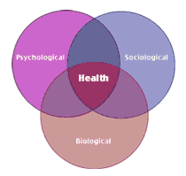
Biopsychosocial Model
Biology
genetic predisposition
“you have a chemical imbalance”
Psychology
defense mechanisms, memories, cognitions, beliefs, and life experiences
“what you think determines what you feel”
Social Stressors
relationships, finances, job, loss
“idealized self vs. reality”

