Slide 1
0/1 KNAPSACK PROBLEM
CSE 633 – Parallel Algorithms
Prof. Russ Miller
Student Name: Lakshya Rawal
UB Person Number: 50459636

Slide 2
Outline
Problem Statement
Applications
Brute Force Solution
Sequential Algorithm
Parallel Approach
Results
To Do
References

Slide 3
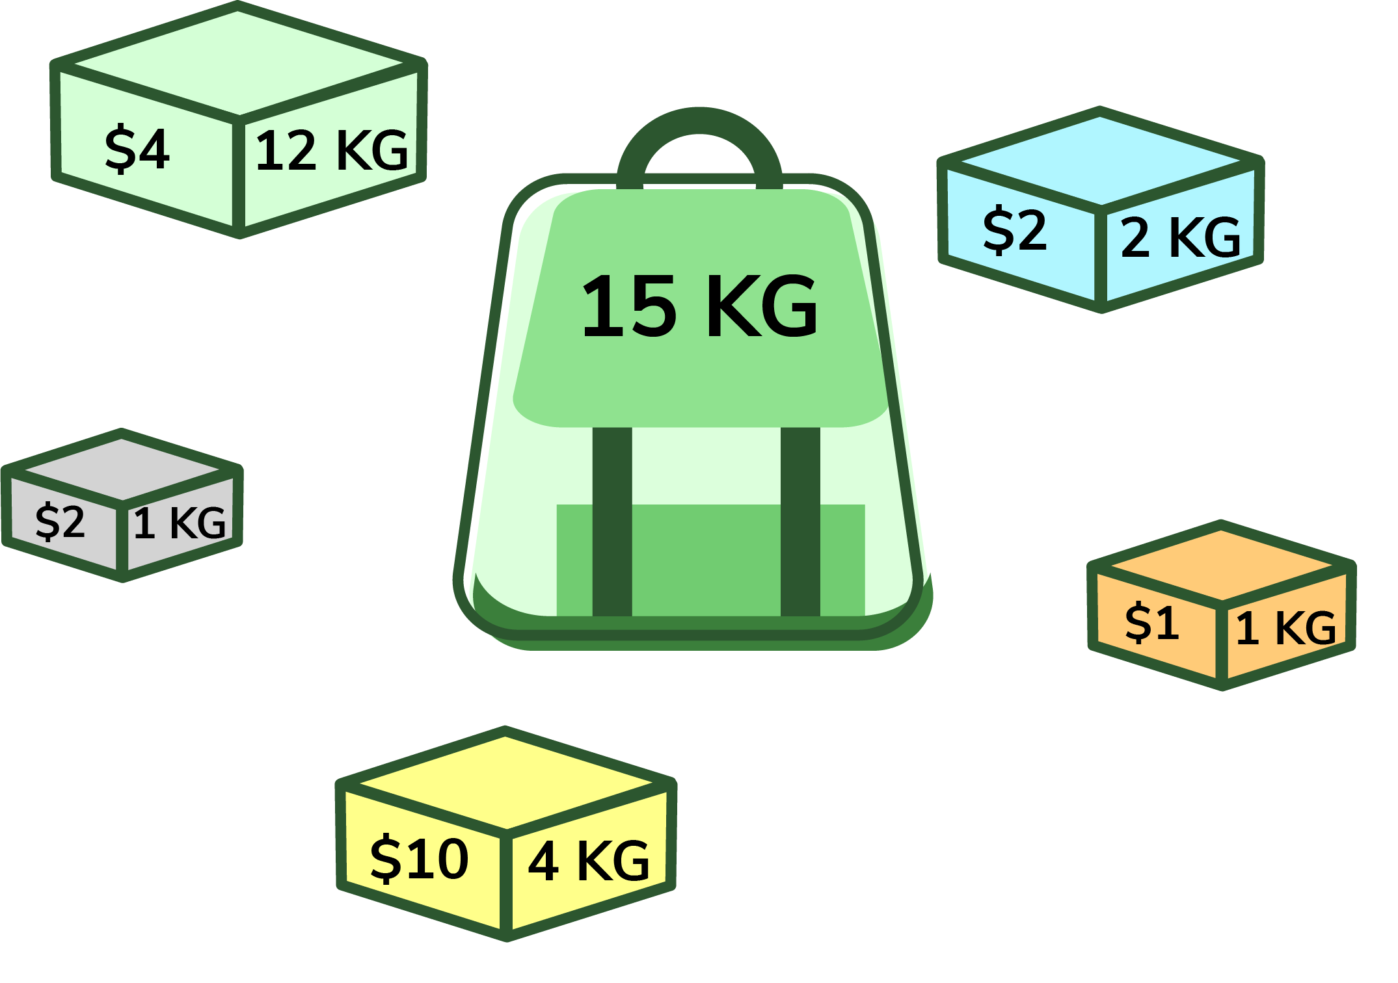
Problem Statement
We are given N items where each item has some weight and value associated with it. We are also given a bag with capacity W, [i.e., the bag can hold at most W weight in it]. The target is to put the items into the bag such that the sum of values associated with them is the maximum possible.
Applications
Finding the least wasteful way to cut raw materials
Selection of investments and portfolios, selection of assets for asset-backed securitization
Generating keys for the Merkle–Hellman and other knapsack cryptosystems.

Slide 4
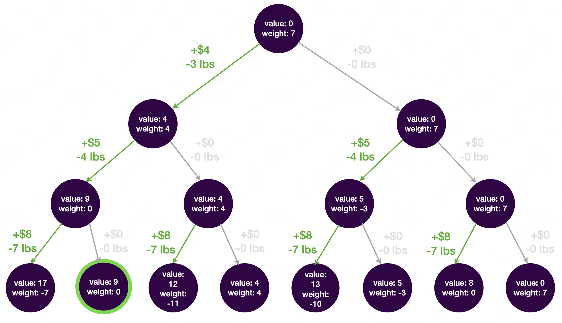
Brute Force Solution
This solution is brute-force because it evaluates the total weight and value of all possible subsets, then selects the subset with the highest value that is still under the weight limit.
Time complexity: $O(2^{n})$, due to the double the number of calls at each level
Auxiliary space: $O(1)$ , no additional storage is needed.

Slide 5
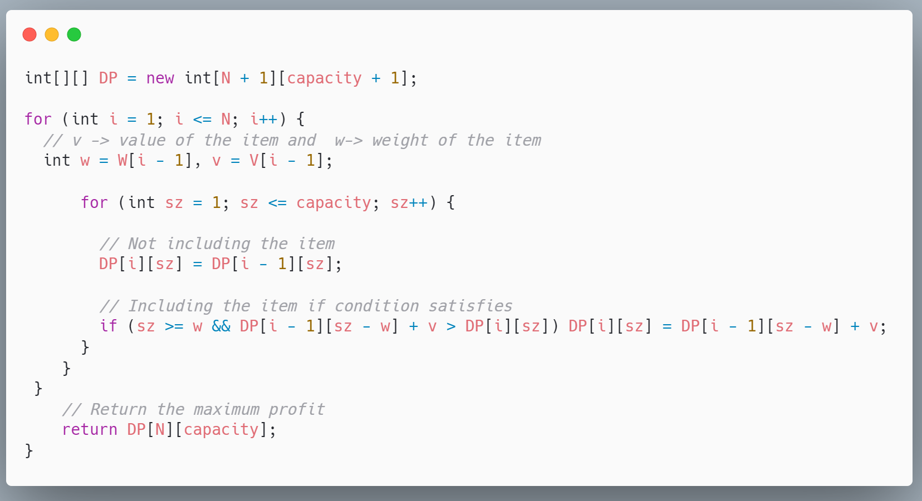
Sequential Algorithm: Dynamic Programming
Dynamic programming generates solution to knapsack problem in $O(n^{2})$ time, a time controlled by the number of items and the maximum capacity in the problem.

Slide 6
Sequential Algorithm
Time complexity: $O(N∗W)$, where we create a matrix of number of items and each capacity
Auxiliary space: $O(N∗W)$ , storage is needed to store the previous results.
V/W | 0 | 1 | 2 | 3 | 4 | 5 | 6 | 7
0 | 0 | 0 | 0 | 0 | 0 | 0 | 0 | 0
2/3 | 0 | 0 | 0 | 2 | 2 | 2 | 2 | 2
2/1 | 0 | 2 | 2 | 2 | 4 | 4 | 4 | 4
4/3 | 0 | 2 | 2 | 4 | 6 | 6 | 6 | 8
5/4 | 0 | 2 | 2 | 4 | 6 | 7 | 7 | 9
3/2 | 0 | 2 | 3 | 5 | 6 | 7 | 9 | 10
Max Value: 10
Items Included: 3/2, 5/4, 2/1

Slide 7
Parallel Algorithm
Approach: Dividing columns between processors
P Processors are assigned W/P columns which they compute independently
P1 starts for the first column and fills up every nth column. If the condition is satisfied that it needs the value from another column it will call for the value using MPI_RECV.
The Processor then uses MPI_ISEND to send all its calculated values to other processors in the columns they might need it.
This value is then updated with the current value which is the value of the current item it is processing.
V/W | 0 | 1 | 2 | 3 | 4 | 5 | 6 | 7
0 | 0 | 0 | 0 | 0 | 0 | 0 | 0 | 0
2/3 | 0 | 0 | 0 | 2 | 2 | 2 | 2 | 2
2/1 | 0 | 2 | 2 | 2 | 4 | 4 | 4 | 4
4/3 | 0 | 2 | 2 | 4 | 6 | 6 | 6 | 8
5/4 | 0 | 2 | 2 | 4 | 6 | 7 | 7 | 9
3/2 | 0 | 2 | 3 | 5 | 6 | 7 | 9 | 10
P1 P2 P3 P1 P2 P3 P1 P2 …

Slide 8
Experiment Results
This table depicts the run time of parallel algorithm in milliseconds with the increase in maximum weight and number of items in the knapsack problem

Slide 9
Graph and Analysis
We see a gradual decrease in run time of this algorithm as we increase the number of nodes in this approach as more processors are responsible for fewer columns.

Slide 10
Speedup vs Nodes
When comparing this parallel approach to a sequential algorithm we were able speedup for decent input sizes whereas there are signs of diminishing returns after 64 processors.
Note: Speedup was calculated using the formula: Tseq / Tparallel

Slide 11
To Do
Identify opportunity areas using MPI + OpenMP hybrid approach which is more popular for solving np hard problems
Understand the use of CUDA in solving np complete problems considering the Integration of GPU Based Parallel Computing in this problem

Slide 12
References
https://ubccr.freshdesk.com/support/solutions/articles/13000026245-tutorials-workshops-and-training-documents
https://docs.ccr.buffalo.edu/en/latest/
https://www.geeksforgeeks.org/0-1-knapsack-problem-dp-10/
https://www.educative.io/blog/0-1-knapsack-problem-dynamic-solution
https://en.wikipedia.org/wiki/Knapsack_problem

