Slide 1
PARALLELIZED CONVOLUTION

Slide 2
Convolution
Convolution is a mathematical operation on two functions
A function derived from two given functions by integration that expresses how the shape of one is modified by the other.
The Mathematical expression for basic two dimensional convolution is

Slide 3
Convolution

Slide 4
Applications
Image Processing
Electrical Engineering (Communication signal processing)
Statistics
Differential equations

Slide 5
Matrix Convolution

Slide 6
Sequential solution
The kernel matrix is padded over the input matrix and the overlapping pixels are computed and this operation is continued for all the pixels of input matrix.
The complexity is similar to matrix multiplication where the computation involves huge no of multiplications and additions.

Slide 7
Parallel solution
Input Matrix is stored in a single node
Kernel matrix is broadcasted to all the other processors
Input Matrix node distributes chunks of input matrix to all the other processors
All the processors sends the partially computed result to a single final node
Because of independent convolutions, distributed parallelism can be implemented

Slide 8
The Input size
1024 x 1024 image – input
90 x 90 kernel

Slide 9
Running Time

Slide 10
No of Processors vs Speedup

Slide 11
Running Time

Slide 12
Running Time
No of Processors allotted | Processors Requested | Running Time (seconds) | Analysis
80 | 160 | 92.12
80 | 135 | 87.34
80 | 115 | 83.98
80 | 90 | 79.63
80 | 80 | 76.38 | Best Running Time
52 | 96 | 90.54
52 | 84 | 87.91
52 | 75 | 82.25
52 | 63 | 76.54
52 | 52 | 73.68 | Best Running Time

Slide 13
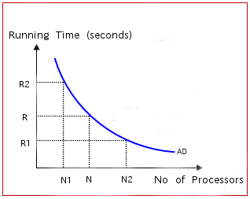
Running Time

Slide 14
Choosing optimum N from the graph?
xy=constant
x+y=minimum
x y cost
1 64 64
2 32 64 8+8=16 - which is the minimum among
4 16 64 all x+y combinations. so choosing N (no
8 8 64 of processors) at this point will give fairly
16 4 64 best cost for a given input
32 2 64
64 1 64

Slide 15
Optimum N?
The optimum no of nodes for the approximate no of multiplications can be calculated.
example : 1024 x 1024 image – input
90 x 90 kernel
- 1024 x 1024 x 90 x 90 = ~ 8 billion operations

Slide 16
Difficulties
Communication overhead
Large no of multiplications
- (~8 billion Multiplications and additions) for 90 x 90 kernel
- (~6.5 billion Multiplications and additions) for 80 x 80 kernel
Filtering the input matrix

Slide 17
References
www.scribd.com/doc/58013724/10-MPI-programmes
http://heather.cs.ucdavis.edu/~matloff/mpi.html
Miller, Russ, and Laurence Boxer. Algorithms, sequential &
parallel: A unified approach.

Slide 18
Questions ?

