Slide 1
CSE 199: Internet, Computing, and Society

Slide 2
Welcome, everyone to CSE 199!
We are so happy you’re here! (All 70-ish of 280-ish of you!)
This week’s lecture plan:
  199 Intro (Today)
  TA Panel (Sections A and B), Academic Advising (C and D)
In recitation:
  Attendance
  Class Icebreakers
  Group Icebreakers

Slide 3
“Why am I taking this course?”
Because you [kind of] have to. Every UB student has to take (and pass) a 199 course. We’re happy you’re with us!
Because it will help you build skills to succeed. We’ll cover things like time management and violating academic integrity
Because you will see different sides of computer science and engineering. From AI to hardware, we’ll cover many (but not all) areas of a big field
Because it will help you get a job. This is not a “technical course.” But the #1 thing we hear from potential employers who don’t hire you is “they don’t have the ‘other important skills’”

Slide 4

The “other important skills”
https://www.naceweb.org/uploadedFiles/files/2021/resources/nace-career-readiness-competencies-revised-apr-2021.pdf
Notes:
Mention here that technology is only one. And you can feel free to add your own thoughts. We’ll come back to these throughout the semester, hopefully (TBD on how we do that)

Slide 5
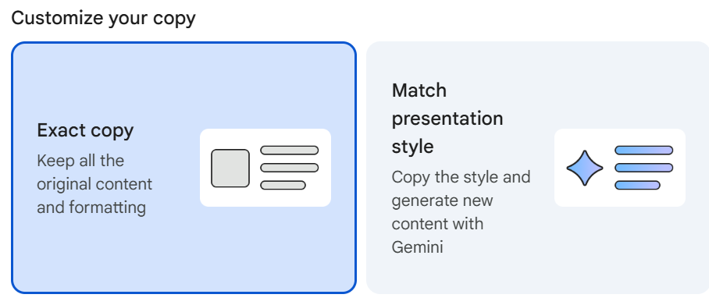
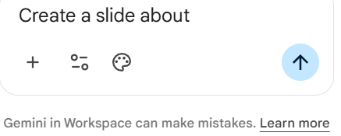
Not Yet Important Skills
AI was in-my-face the moment I started editing this…

Slide 6
What CSE 199 is
An attendance-heavy class. If you show up and participate, it is somewhat challenging to not get an A
“90% of life is just showing up”---Not Yogi Berra
A low workload class. You should expect to spend around an hour per week outside of class on CSE 199. Do not expect your other CSE classes to be the same.
A group-intensive class. You will do groupwork in CSE 199, just like in the real world. This is a skill, you will not get a job without it. So we’re practicing it here
A presentation-heavy class. See above - you will develop this skill.

Slide 7
What CSE 199 is not
A class that everyone passes. Last semester, around 3% of the class failed. Do not expect to pass the course if you do not participate.
A class you can cheat in. Last year, around 8% of the class was charged with a violation of academic integrity. This can go on your permanent record. More on this later.
A place to judge others. You are at UB to learn. Do not judge others who haven’t yet been given the chance to learn what you have learned.

Slide 8




The basic setup of CSE 199
Section A
Section B
Section C
Section D
There are 4 lecture sections. Lectures meet twice a week, on Mondays and Wednesdays.
You’ll have me for the first 6 weeks, then leaders rotate 3 weeks each

Slide 9

The basic setup of CSE 199
Recitation B2
Recitation B4 (it isn’t 1-3 always. Don’t ask us why, we don’t know)
Recitation B1
Each lecture has three recitation sections. You are in one of them! Your recitation is on Thursday or Friday. We’ll come back to these in a minute!

Slide 10
The basic setup of CSE 199
Check HUB to see when and where your recitation is!
Recitation B2
Recitation B4 (it isn’t 1-3 always. Don’t ask us why, we don’t know)
Recitation B1
Each lecture has three recitation sections. You are in one of them! Your recitation is on Thursday or Friday. We’ll come back to these in a minute!

Slide 11
The basic setup of CSE 199
No. You cannot attend a different lecture/recitation and still get credit.
Recitation B2
Recitation B4 (it isn’t 1-3 always. Don’t ask us why, we don’t know)
Recitation B1
Each lecture has three recitation sections. You are in one of them! Your recitation is on Thursday or Friday. We’ll come back to these in a minute!

Slide 12
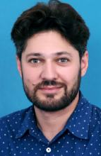
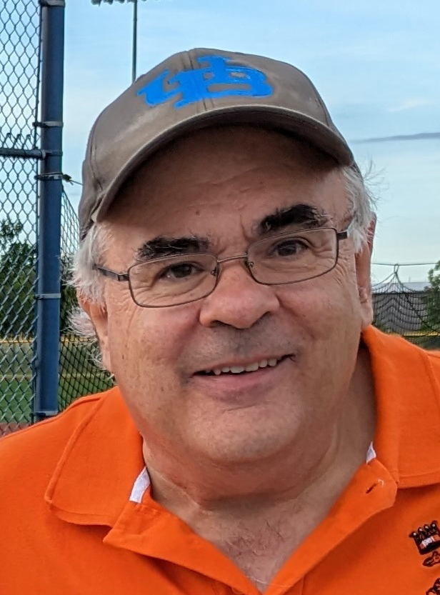
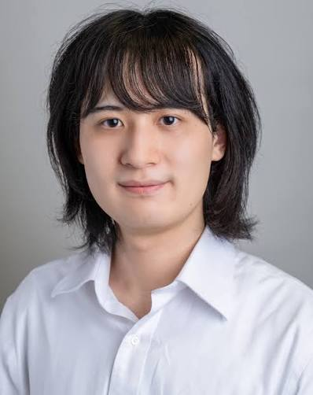
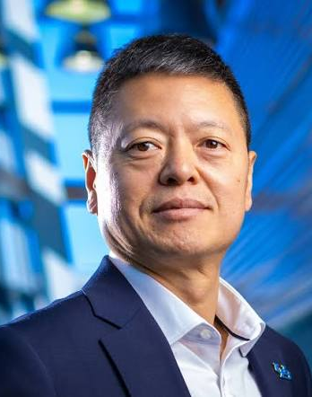
Embedded Computing
Data and Society and AI
AI-Generated Media and Digital Trust
Data Management
199 has 5 modules; 1 intro (first three weeks) and 4 content modules (3 weeks each).
Content modules are taught by different professors

Slide 13




Week 1
Recitation 1 (Th or Fr)
Lecture 1 (M)
Lecture 2 (W)
Week 2
Homework
(due Weds, 11:59PM)
Recitation 2 (Th or Fr)
Lecture 1 (M)
Lecture 2 (W)
Week 3
Recitation 3 (Th or Fr)
Lecture 1 (M)
Lecture 2 (W)
Each (content) module is three weeks long, and has 6 lectures, 1 HW, and 3 recitations

Slide 14

Each lecture gets each module for 3 weeks (ordering depends on which lecture you’re in) Every 3 weeks, your lecture prof. changes!

Slide 15
Your recitation instructors and TAs will not change!

Slide 16
You will be assigned a group in recitation. You cannot change this group. That is how the real world is, too. We are aiming to force you to get used to it

Slide 17
Your Teaching Assistants (TAs)
They are also undergraduate students just as you are!
You can also be a UTA (Undergraduate Teaching Assistant)!
If interested, please talk to an instructor or a TA during the semester.
Paid position (do it for course credit instead, too)
It is important to understand that for this course, they are not your fellow students. They are part of the teaching staff, so approach them appropriately.

Slide 18
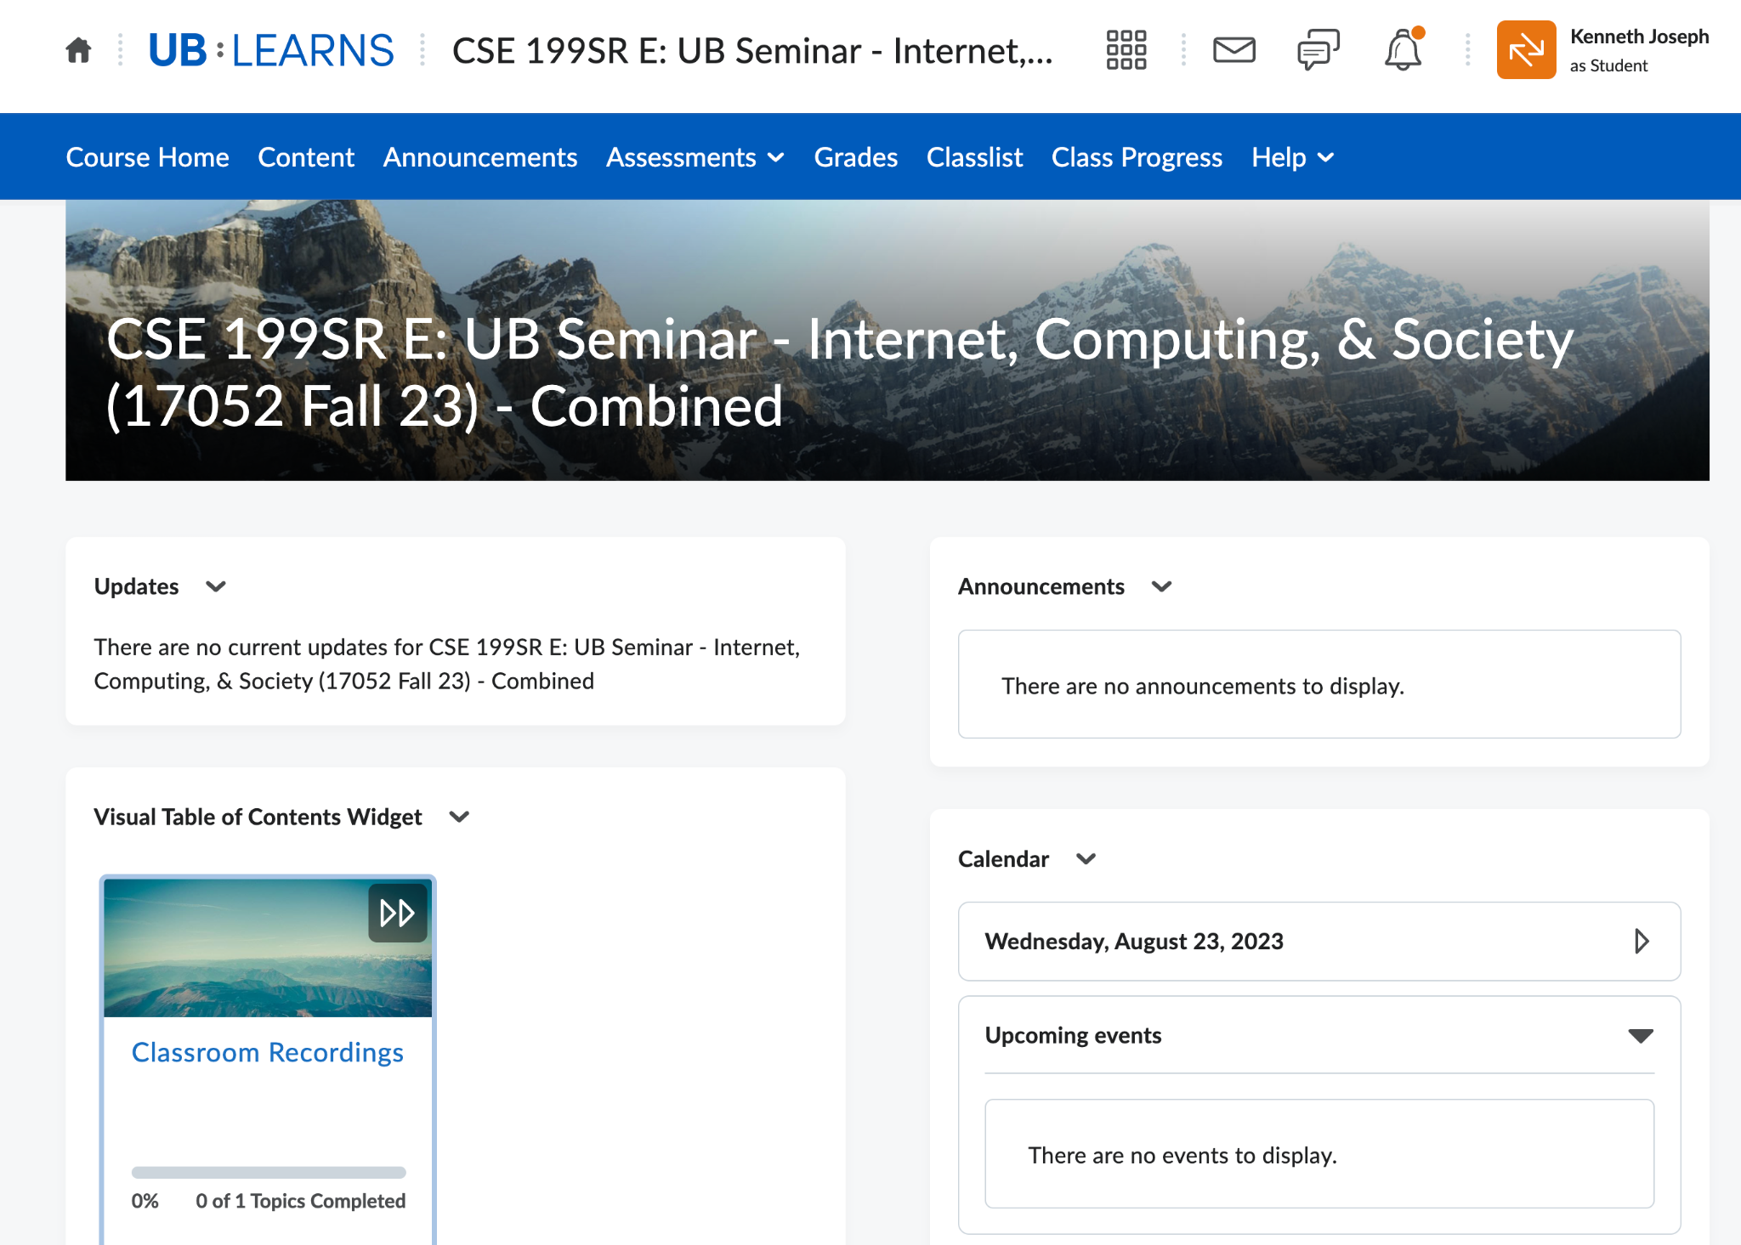
UBLearns -> Place you go to submit stuff and check your grades
You are responsible for all UBLearns announcement content. Turn on notifications!

Slide 19
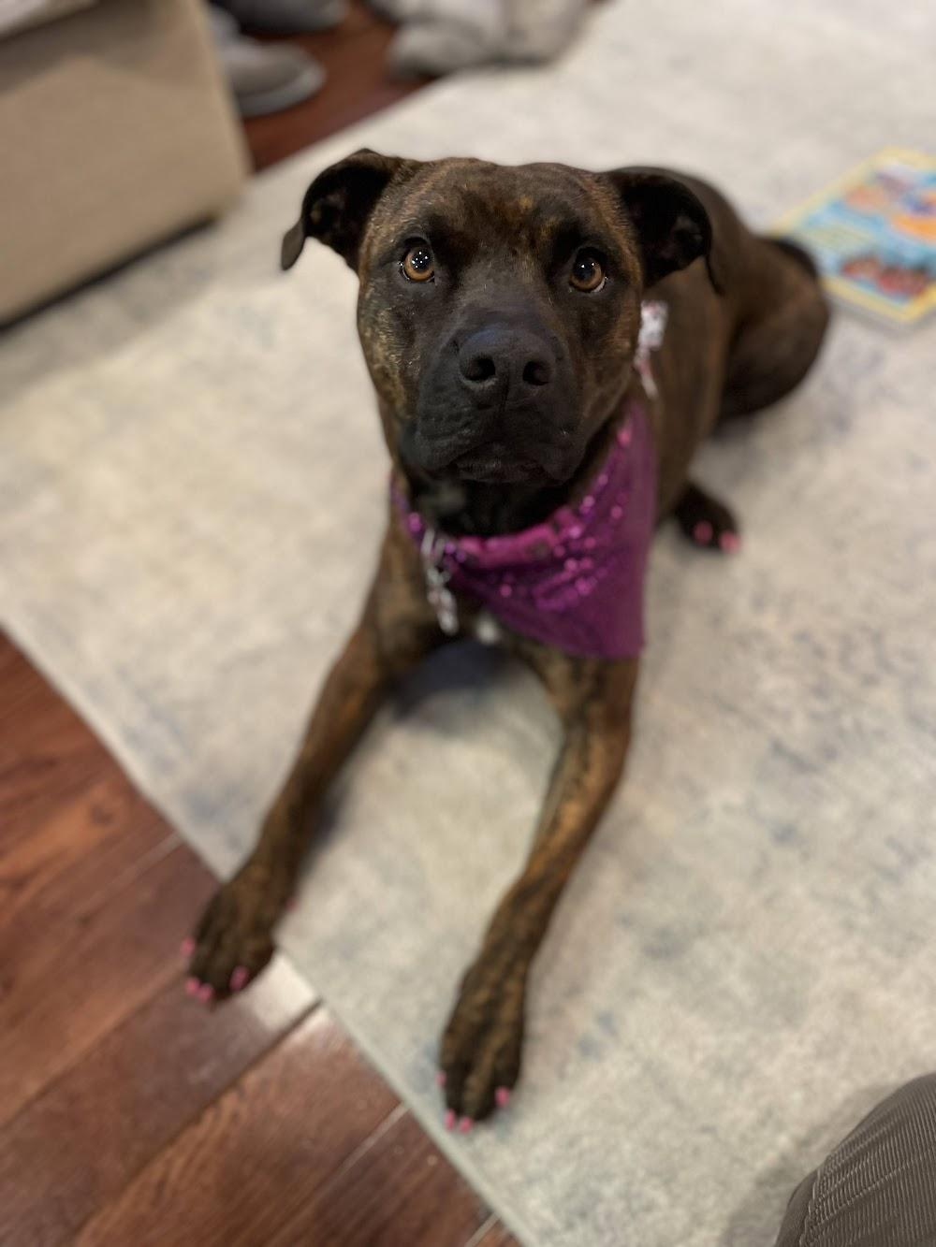
Josie, Kenny’s dog --->
Questions?!

Slide 20
Detailed Logistics, Part 1
Lecture and recitation attendance is mandatory!
  We will take lecture attendance and measure participation with TopHat (more later).
  Recitation attendance will be done by TAs
Module HWs are due certain Wednesdays at 11:59PM, and must be submitted to UBLearns as PDF

Slide 21

Details, Part 2 - Attendance
We will take attendance now, to show you the process.
We are using TopHat for attendance, and to ask questions periodically during class to confirm your understanding. Sign up before next lecture! You do NOT have to pay for TopHat! You can sign in via SSO, look to UBLearns announcements for details!
For future lectures, attendance information:
Will be put up before class starts
Must be entered in the first ten minutes of class. You must arrive within the first ten minutes, or be counted absent!
For every 3 lectures or recitations that you miss, we will downgrade your letter grade by one (e.g., A to A-, then to B+, etc.).
Notes:
Instructors should bring up the TopHat section at this point and start attendance, so students can see the six-digit code and students with TopHat accounts can enroll and sign in. Don’t expect the entire class to sign in today, and let them know that’s OK.

Slide 22
Details, Part 3 - Grading
Grading will generally use the following scheme:
0 pts: No submission or no attendance
1 pt: Clearly no effort for the assignment/activity
2 pts: Partial effort
3 pts: Full effort
(Leniently following Bill Rapaport’s scheme: https://www.cse.buffalo.edu/~rapaport/howigrade.html)

Slide 23
Grading, cont.
Absolute based on total points earned (not curved)
A: 92.0% -100.00% A-: 88.0% - 91.9%
B+: 84.0% - 87.9% B: 80.0% - 83.9% B-: 76.0% - 79.9%
C+: 72.0% - 75.9% C: 66.0% - 71.9% C-: 62.0% - 65.9%
D+: 58.0% - 61.9% D: 50.0% - 57.9%
F: 49.9% or below
Footnote: UB does not have A+ grade, but you can see its ghost here.

Slide 24
Details, Part 4 –Recitation
The structure of recitations is the same each week:
  Enter and sit with your group (you’ll find this out on Thurs/Friday!)
  Open up the recitation assignment (on the course website!)
  Wait for any instructions
  Create a shared Doc/Slide deck and begin working
  With 7 minutes left:
    Fill out the Weekly Reflection in UBLearns
    One group member submits your recitation work

Slide 25
Recitation – Weekly Reflections
We want to better understand your experience during recitations and how that changes over the semester.
What you’ll do:
  Complete an anonymous few Likert scale* responses about your group work experience
  Answer 1-3 non-anonymized responses about your semester. Questions might include:
    How is CSE 115 going?
    What did you like least about this recitation?
    How can we make CSE 199 better?
    …
*On a scale of 0-to-10, rate how familiar you are with Likert scales.

Slide 26
Details, Part 5 – 2026 CSE Cohort Survey
What?
Three 10-15 minute-surveys at the beginning, middle, and end of the semester that you can complete anywhere.
Anonymous to the CSE-199 teaching team and all UB faculty. We will never be able to associate responses to an individual student.
Completing the surveys will count toward your grade!
If >80% of your section finishes all 3 surveys, you all get BONUS POINTS
Why?
To learn about your goals for the future, what motivated you to pursue CSE, and what challenges you foresee in the coming years.
To create a welcoming environment for everyone in CSE.

Slide 27
Details, Part 6 – Academic Integrity
Academic Integrity (AI) is very important to the University process! (Also called AH for Academic Honesty.)
In this course, your deliverables are largely:
Assignments
In-class participation and attendance
Falsifying your attendance, helping another to falsify their attendance, sharing TopHat quiz answers, copying from others for assignments, etc., are all AI violations.

Slide 28
Academic Integrity, cont.
AI violations will result in receiving at most a B- in this course. There will be no exceptions. Can result in an F.
Even before GenAI, 10-12 students per year were punished for AI violations in CSE 199. Now that number is higher. Note also that people have failed from this course because:
They shared a TopHat attendance code with someone who was not in class
They copied someone else’s homework
…

Slide 29
Academic Integrity, cont.
This year, we are trying something new!
We will require (or at least, assign as homework) the academic integrity course on UBLearns.
We will also have folks from UB’s Academic Integrity Office come to lecture!
Details are in your UBLearns announcements!

Slide 30
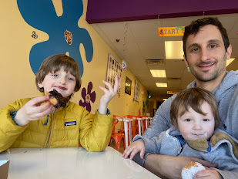
The most important part about AI!
If you’re having trouble, contact course staff. We’re here to help!
If the faculty make you nervous, contact the TAs!
But faculty shouldn’t make you nervous! We want you to succeed. You failing is bad for you, but it is also bad for us.
< not scary
Unintimidating >

Slide 31

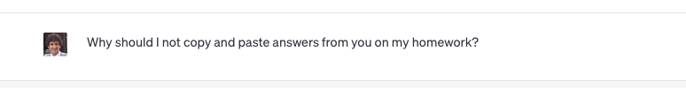
(The other) AI, continued.

Slide 32
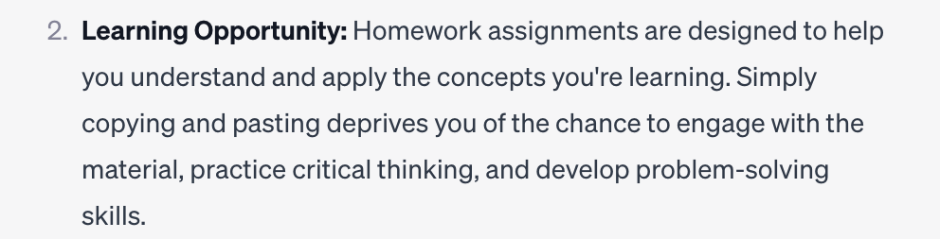
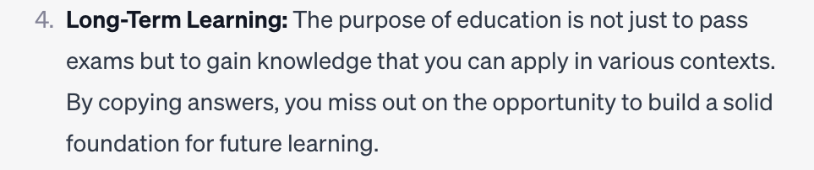
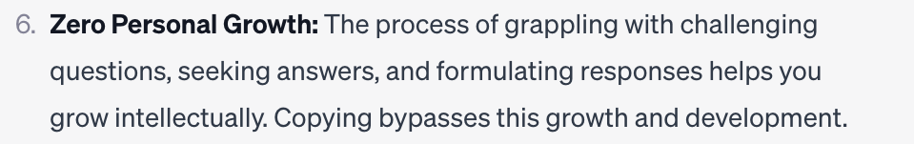
Why are we worried about this?
Because our job is to train you to go out in the world and do great things. How well we train you reflects on you, your peers, UB as a whole, and us.
And you will not learn by copy/pasting from GPT

Slide 33
(The other) AI, continued.
In short:
Most of you are in a major where many of the faculty are actively developing technologies that use and/or help improve LLMs. We love technology! We think there are great uses of it!
But our first priority is that you learn. And you will not learn by copy/pasting from an LLM.

Slide 34
Please, please don’t cheat
If you cheat, and we catch you, we will make sure it goes on your record, even though we are not scary or mean and we really hate doing it. There will be no exceptions.

Slide 35
Details, Part 7– Days with No Class
The UB Academic calendar is now very strange (don’t blame us!). We will not have class on the following days:
  September 7th (Labor Day)
  October 12th (Fall Break)
  November 25th (Thanksgiving Break…although you may have other classes on this day! Check with your instructors!)
  December 7th

Slide 36
Questions?!

Slide 37

Your Four Current TODOs
You have four immediate TODOs
  Get access to TopHat (by WEDNESDAY)
    You will get a UBLearns announcement TONIGHT with instructions on how to do so
    It is also in the syllabus!

Slide 38
Your Four Current TODOs
You have three immediate TODOs
  Get access to TopHat (by WEDNESDAY)
  Complete the first CSE Cohort Study (due Sept 1st, next TUESDAY)
    You’ll get information on how to do this on Wednesday
    It is also detailed in UBLearns, under assignments!

Slide 39
Your Four Current TODOs
You have three immediate TODOs
  Get access to TopHat (by WEDNESDAY)
  Complete the first CSE Cohort Study (due Sept 1st, next TUESDAY)
  Complete your 8 Hours without the Internet Assignment (due Sept 1st, next TUESDAY)
    … details on next slide…and on UBLearns

Slide 40
8 Hours without the Internet
For your first assignment (due next TUESDAY), you must:
Go 8 hours without using the Internet
Make a slide deck that includes:
  A journal of your time without the ‘net (Slide 1)
  A slide you’ll present to the class in Recitation 2 (Slide 2)
  A slide with a link to your Powerpoint that is accessible by the TAs
Your instructor will now show you how to access the assignment via the website & UBLearns
Notes:
Atri Q: Does this have to be continuous 8 hours? And do students have to be awake :)?
Kenny A: Yes and Yes (You should maybe show them the assignment on the website at this point)

Slide 41
Your Four Current TODOs
You have four immediate TODOs
  Get access to TopHat (by WEDNESDAY)
  Complete the first CSE Cohort Study (due Sept 1st, next TUESDAY)
  Complete your 8 Hours without the Internet Assignment (due NEXT TUESDAY)
  Complete the Academic Integrity module on UBLearns (due 9/8)
    You will get a UBLearns announcement with instructions on how to do so, it is also an assignment in UBLearns

Slide 42
Questions?!

Slide 43
A common question, answered!
Why does this course have such a weird structure?
We want to expose you to different topics in CSE!
  One day you will have to choose electives; this will help.
  One day you will have to work or do research across subdisciplines of CSE; this will help.
We want to expose you to different teaching styles
  You will encounter these (and other styles!) later
  Learn what works for you, and how to get what you can out of what doesn’t.

Slide 44
E.g.
I can be very fast
and
i n c h o a t e l y s e s q u i p e d a l i a n.

Slide 45
E.g. (cont’d)
…but I tend to recapitulate in shorter terms.
“Majority-of-3 is more robust than 1.”
(Related to a principle of longer speeches, which may-or-may- not apply to your short recitation presentations…)
Feel welcome to ask questions during my lectures.

Slide 46
A Little About Me
At UB CS(E) since Fall 1989 (no Internet then!)
Main research is Computational Complexity Theory
  …which embraces Quantum Computing.
  Teaching CSE439 on QC from my own joint textbook.
Second research is on Human Decision Making (At Chess)
  Used by FIDE to arbitrate cheating accusations.
  Will draw on for examples but not as main topic.
  Currently trying to carry over methodology to LLM detection.
  International Master (not Grandmaster) at chess.
My materials are (also) at https://cse.buffalo.edu/~regan/cse199/
  They are being updated to emphasize AI a lot more.

Slide 47
General Learning Outcomes
Learning from different styles of instruction
Collaboration in activities
Understanding how to handle various lab/recitation/seminar/lecture type activities
Attention to detail (please read instructions carefully!)
Exposure to many concepts you may encounter throughout life, or studying various areas of STEM+C

Slide 48
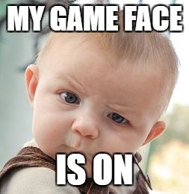
Yay! See you Wednesday

