Slide 1
CSE 199: Internet, Computing, and Society

Slide 2
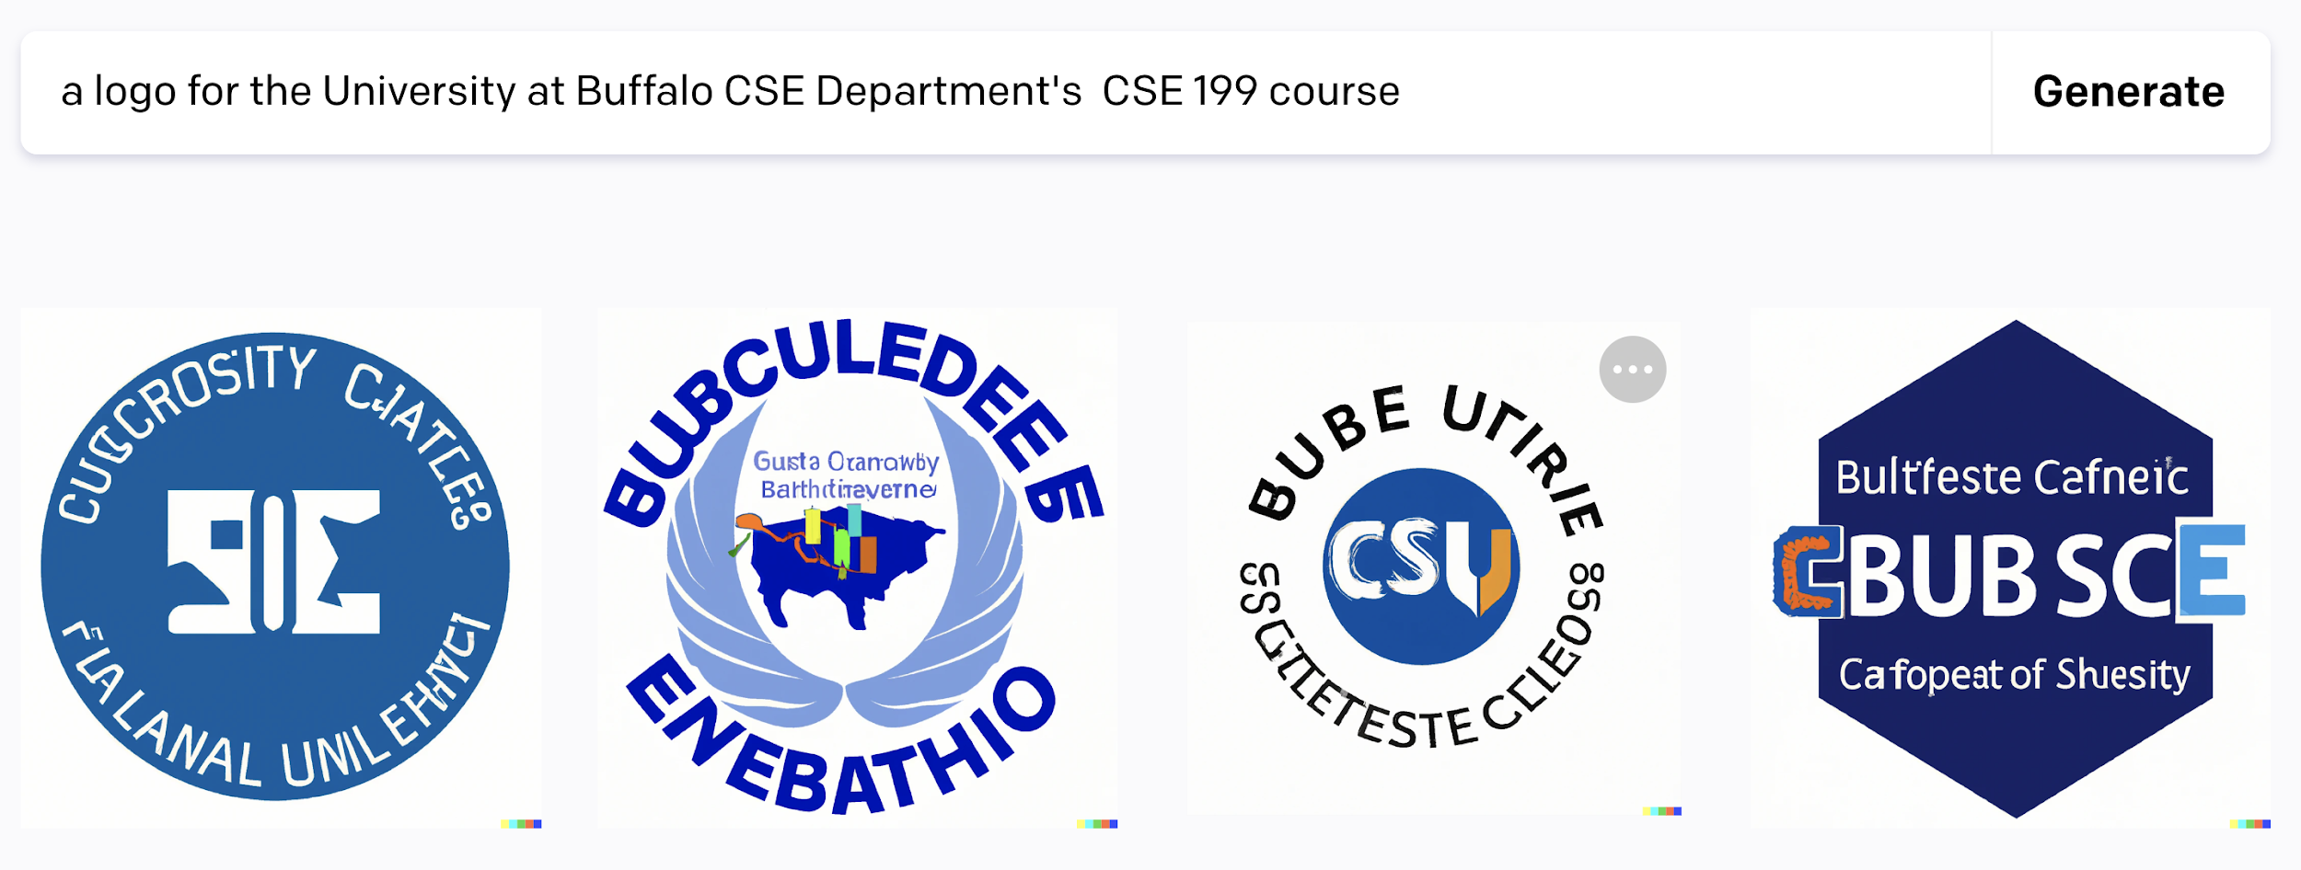
[Don’t ask Artificial Intelligence for logos…]

Slide 3
Welcome, everyone to CSE 199!
We are so happy you’re here! (All 700+ of you!)
This week’s lecture plan:
199 Intro
CSE Intro (CSE = Computer Science and Engineering!)
Some friendly competition
In recitation:
Attendance
Icebreakers
TA presentation on “things to know to succeed at UB”

Slide 4
Introducing Myself
Kenneth W. Regan: https://cse.buffalo.edu/~regan/
Web folder for my unit: https://cse.buffalo.edu/~regan/cse199/
Main research: Computational Complexity Theory, including:
The “P Versus NP” question.
Quantum Computing. Textbook with Richard J. Lipton.
Blog Gödel’s Lost Letter and P=NP founded by Lipton.
Other Research: “Human Decision Making (At Chess)”:
Statistical predictive model of move choice in terms of rating
Used to arbitrate accusations of cheating with computers.
The Hans Niemann case was largely settled---this morning!

Slide 5
The basic setup of CSE 199
Section A
Section B
Section C
Section D
Section E
Section F
There are 6 lecture sections. Lectures meet twice a week, on Mondays and Wednesdays

Slide 6
The basic setup of CSE 199
Recitation A1
Recitation A3
Recitation A5
Recitation A2
Recitation A4
Each lecture has 4 or 5 recitation sections. You are in one of them! Your recitation is on Thursday or Friday. We’ll come back to these in a minute!

Slide 7
The basic setup of CSE 199
Check HUB to see when and where your recitation is!
Each lecture has 5 recitation sections. You are in one of them! Your recitation is on Thursday or Friday. We’ll come back to these in a minute!
Notes:
Atri: Is this an activity where we pause and let students do this or we expect them to do them later?
Kenny: I think later

Slide 8
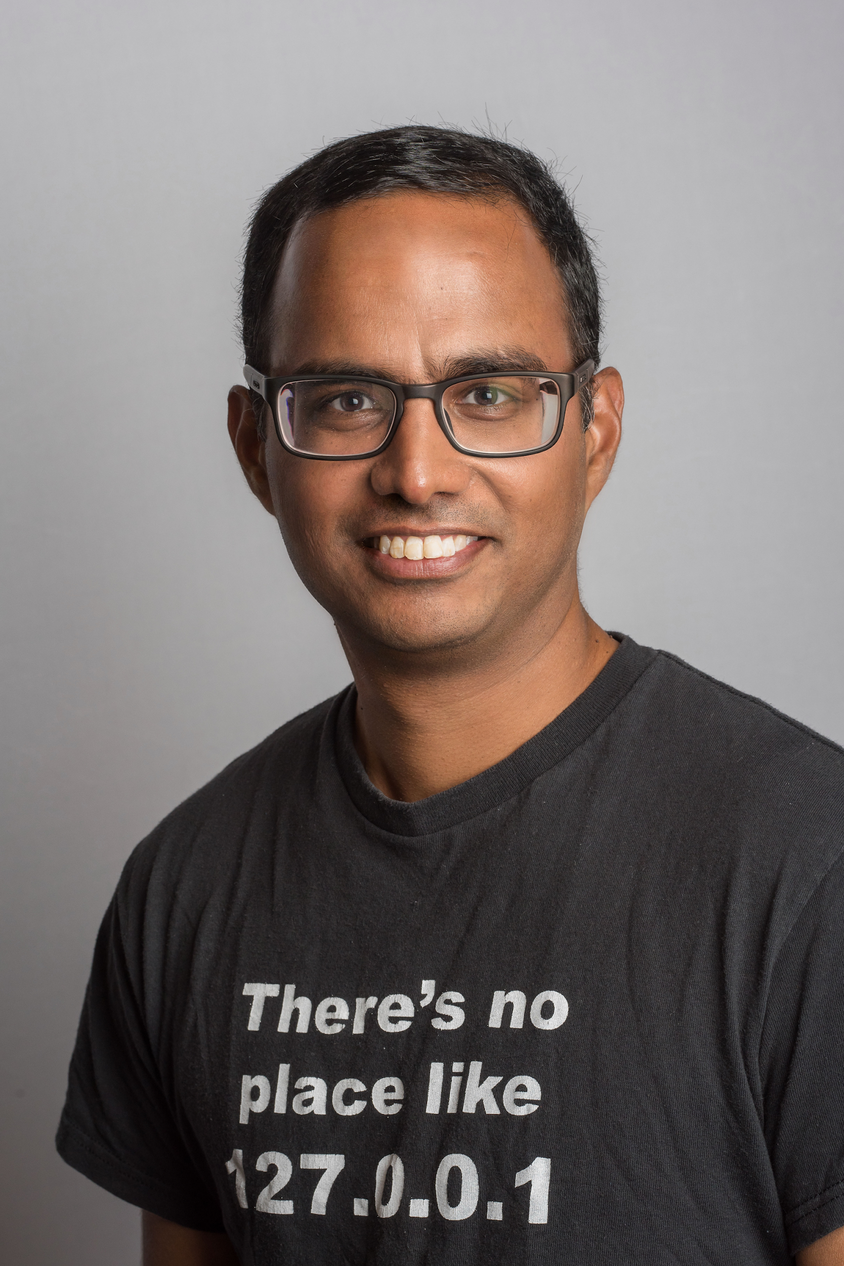
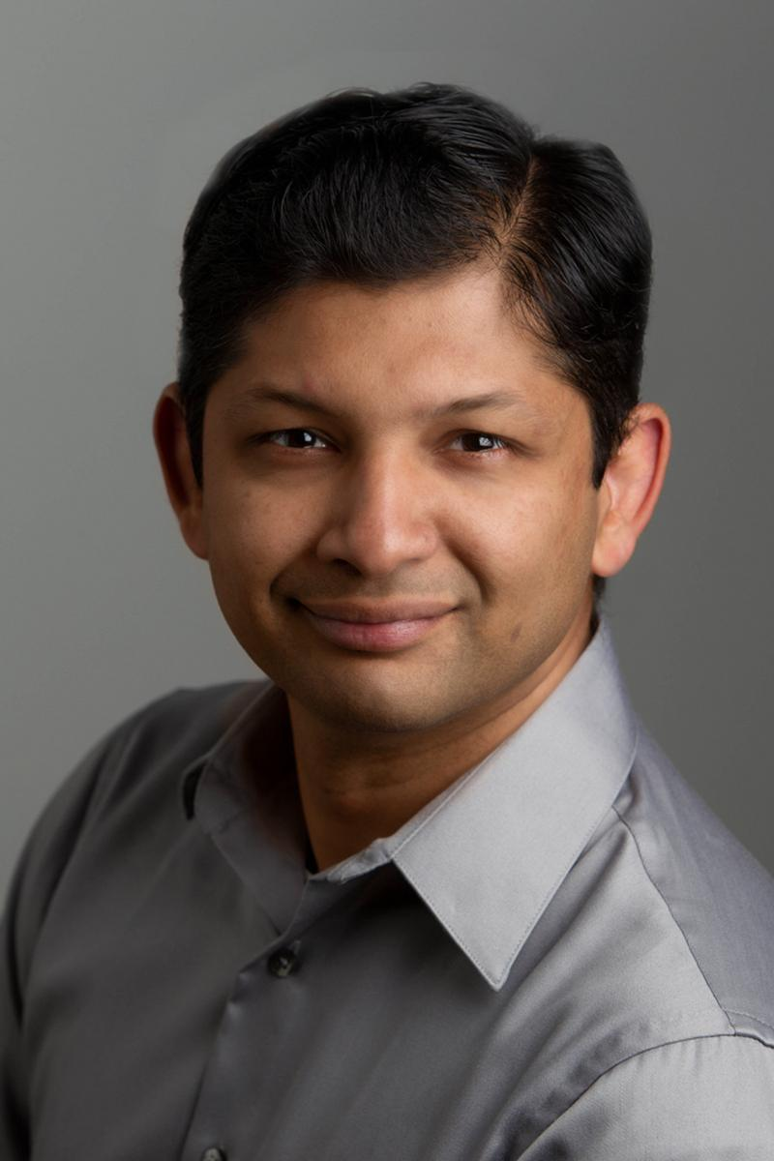
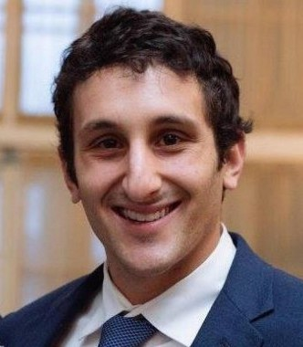
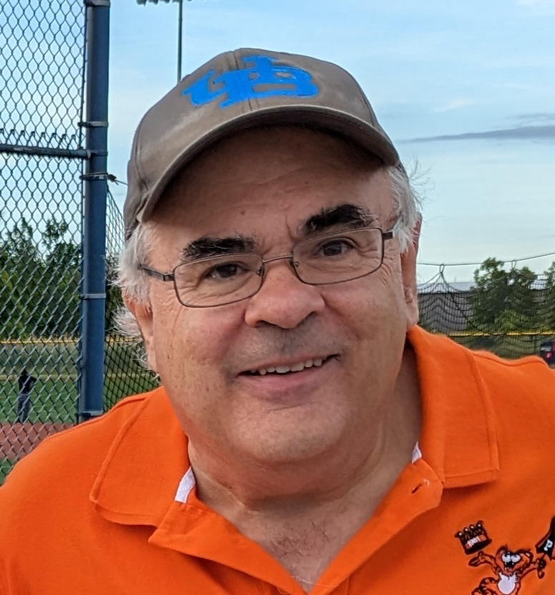
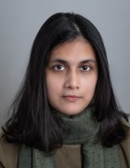
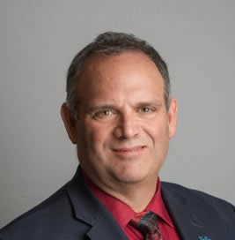
Internet and Data
Data Mining
Misinformation
Abstraction
Robotics
Societal Computing
199 has 7 modules; 1 intro (first two weeks) and 6 content. Content modules are taught by different professors

Slide 9
Lecture 1
(Monday)
Lecture 2
(Wednesday)
HW 1 (due Weds, 11:59PM, no exceptions)
Recitation 1 (Th or Fr)
Lecture 3
(Monday)
Lecture 4
(Wednesday)
HW 2 (due Weds, 11:59PM, no exceptions)
Recitation 2 (Th or Fr)
Each (content) module is two weeks long, and has 4 lectures, 2 HWs, and 2 recitations

Slide 10
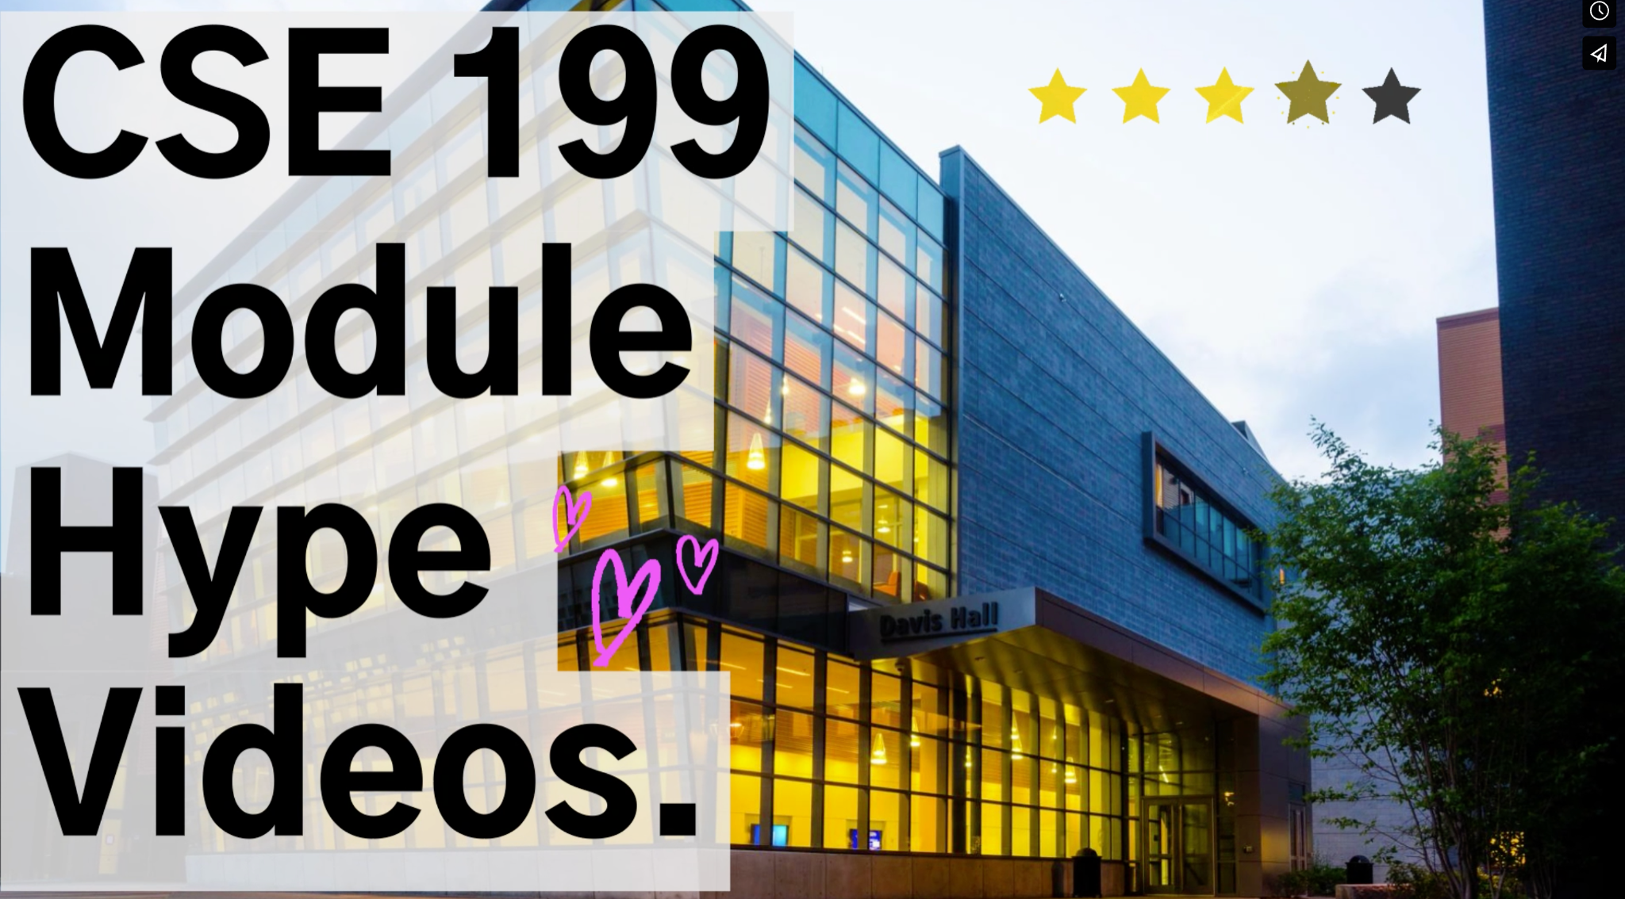
https://vimeo.com/user139951706/199hype?share=copy
https://vimeo.com/user139951706/199hype

Slide 11
Data Mining
Societal Computing
Robotics
Internet and Data
Misinformation
Abstraction
Module:
Each lecture gets each module for 2 weeks (ordering depends on which lecture you’re in) Every 2 weeks, your lecture prof. changes!

Slide 12
Your recitation instructors and TAs will not change!

Slide 13
Your Teaching Assistants (TAs)
They are also undergraduate students just as you are!
You can also be a UTA (Undergraduate Teaching Assistant)!
If interested, please talk to an instructor or a TA during the semester.
Paid position (unpaid if you want to)
It is important to understand that for this course, they are not your fellow students. They are part of the teaching staff, so approach them appropriately.
Notes:
Have the TAs come up and introduce themselves.

Slide 14
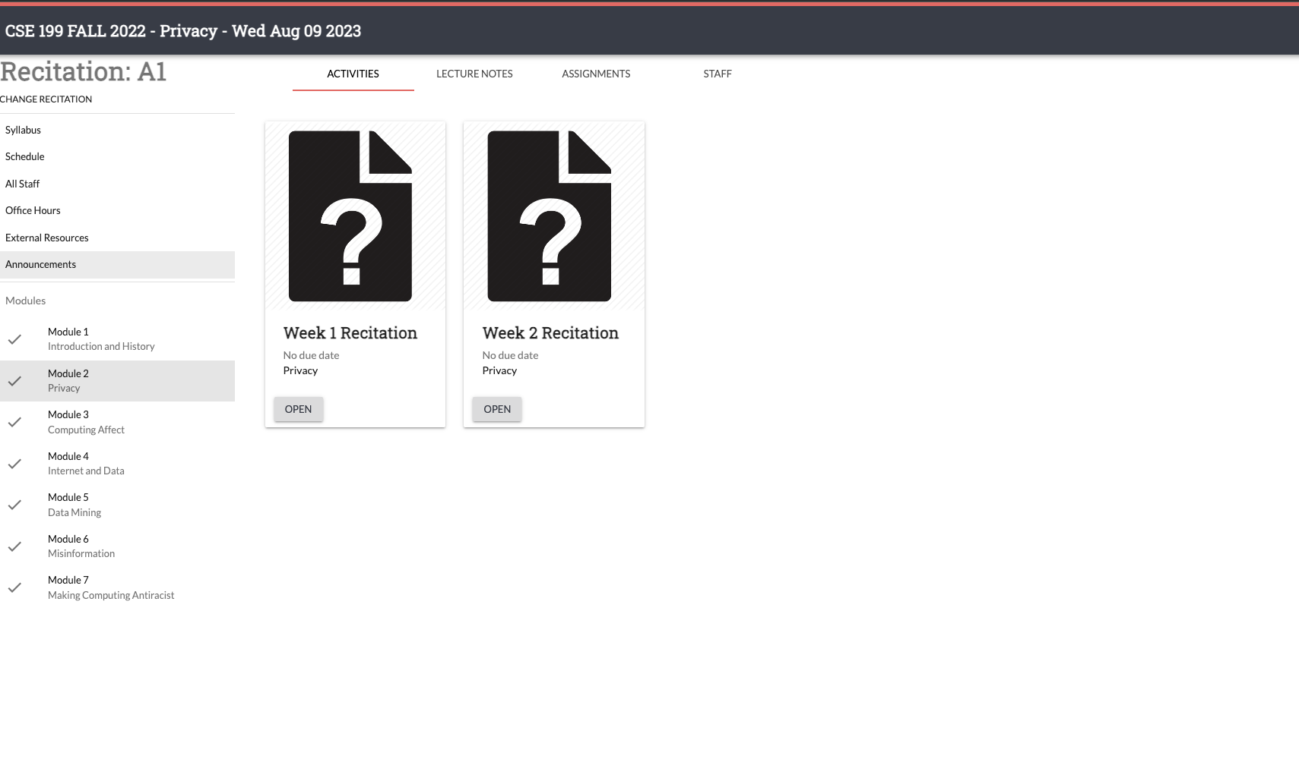
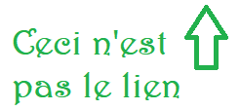
https://cse.buffalo.edu/cse199
If this sounds confusing, make sure to return to these slides! This setup is also how our course website is structured. We’ll now review the website!
Notes:
Atri Q: Are there particular things on the website that we should cover?
Kenny A: Just showing them the basics (where the syllabus is, how to select a recitation, etc). Sorry, hard to make this specific, so I think just basically showing it to them is the right thing to do

Slide 15
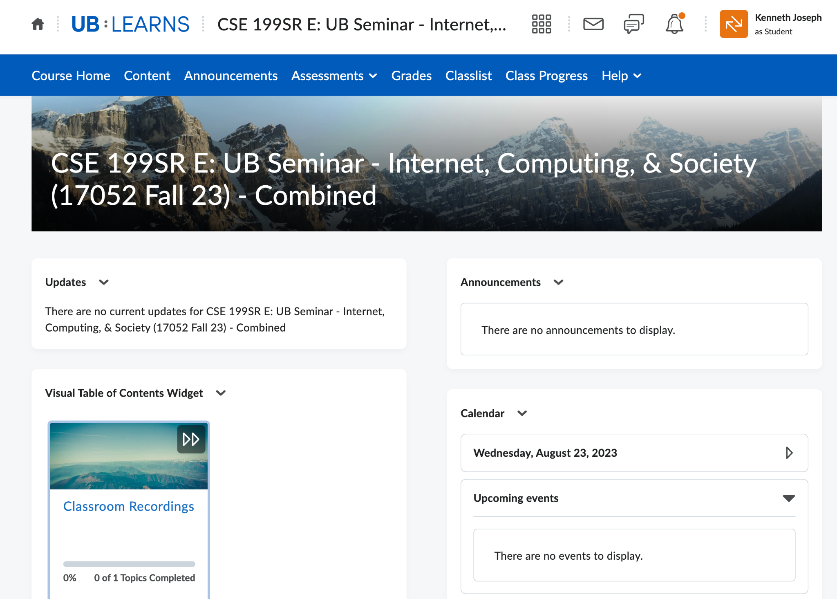
Course website -> Place you go to remember things and find assignments
Brightspace
UBLearns -> Place you go to submit stuff and check your grades
Notes:
Atri Q: At this point, do we ask students to go and check out UB Learns as well and/or should we do a review/walkthrough as well?
Kenny A: No to both. I think showing them around might confuse more than anything b/c I'm not 100% you can see exactly what they do, even in the "View as Student", for combined classes. And 2) they won't know blackboard so best to let it be

Slide 16
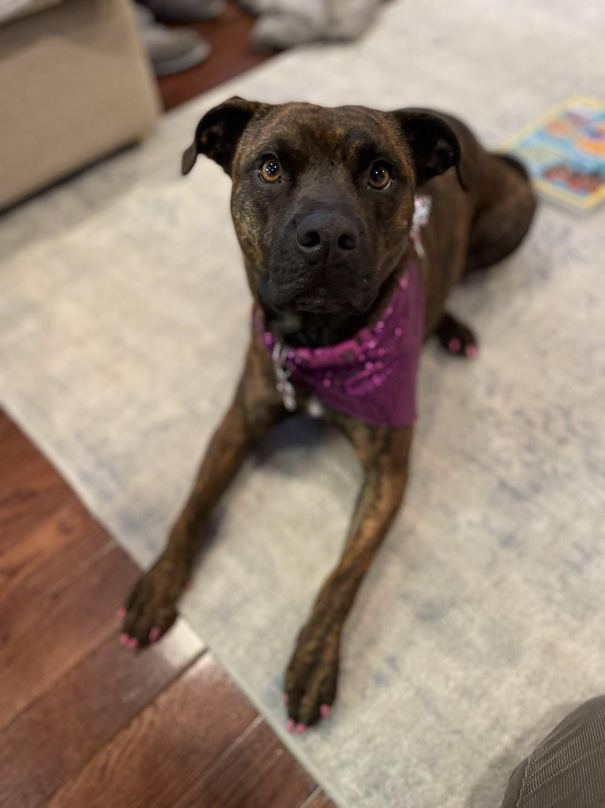
Josie, Kenny’s dog --->
Questions?!

Slide 17
Detailed Logistics, Part 1
Lecture and recitation attendance is mandatory!
We will take lecture attendance and measure participation with TopHat (more later).
Recitation attendance will be done by TAs
Module HWs are due Wednesday at 11:59PM, and must be submitted to UBLearns as PDF

Slide 18
Details, Part 2 - Attendance
We will take attendance now, to show you the process.
We are using TopHat for attendance, and to ask questions periodically during class to confirm your understanding. Sign up before next lecture! You must get a subscription to TopHat, the free trial will expire before class, and will cause you trouble.
For future lectures, attendance information:
Will be put up before class starts
Must be entered in the first ten minutes of class. You must arrive within the first ten minutes, or be counted absent!
For every 3 lectures or recitations that you miss, we will downgrade your letter grade by one (e.g., A to A-, then to B+, etc.).
Notes:
Instructors should bring up the TopHat section at this point and start attendance, so students can see the six-digit code and students with TopHat accounts can enroll and sign in. Don’t expect the entire class to sign in today, and let them know that’s OK.

Slide 19
Details, Part 3 - Grading
Grading will generally use the following scheme:
0 pts: No submission or no attendance
1 pt: Clearly no effort for the assignment/activity
2 pts: Partial effort
3 pts: Full effort
(Following Bill Rapaport’s scheme: https://www.cse.buffalo.edu/~rapaport/howigrade.html)
KWR: My unit uses 0-9, then maps {8,9} to 3, {5,6,7} to 2, etc.

Slide 20
Grading, cont.
Absolute based on total points earned (not curved)
A: 92.0% -100.00% A-: 88.0% - 91.9%
B+: 84.0% - 87.9% B: 80.0% - 83.9% B-: 76.0% - 79.9%
C+: 72.0% - 75.9% C: 66.0% - 71.9% C-: 62.0% - 65.9%
D+: 58.0% - 61.9% D: 50.0% - 57.9%
F: 49.9% or below

Slide 21
Details, Part 4 –Recitation
The structure of recitations is the same each week:
Enter and sit with your group (you’ll find this out on Friday!)
Open up the recitation assignment (on the course website!)
Wait for any instructions
Create a shared Doc/Slide deck and begin working
With 7 minutes left:
Fill out the Weekly Reflection in UBLearns
One group member submits your recitation work

Slide 22
Recitation – Weekly Reflections
We want to better understand your experience during recitations and how that changes over the course of the semester
What you’ll do:
Complete an anonymous few Likert scale responses about your group work experience
Answer 1-3 non-anonymized responses about your semester. Questions might include:
How is CSE 115 going?
What did you like least about this recitation?
How can we make CSE 199 better?
…

Slide 23
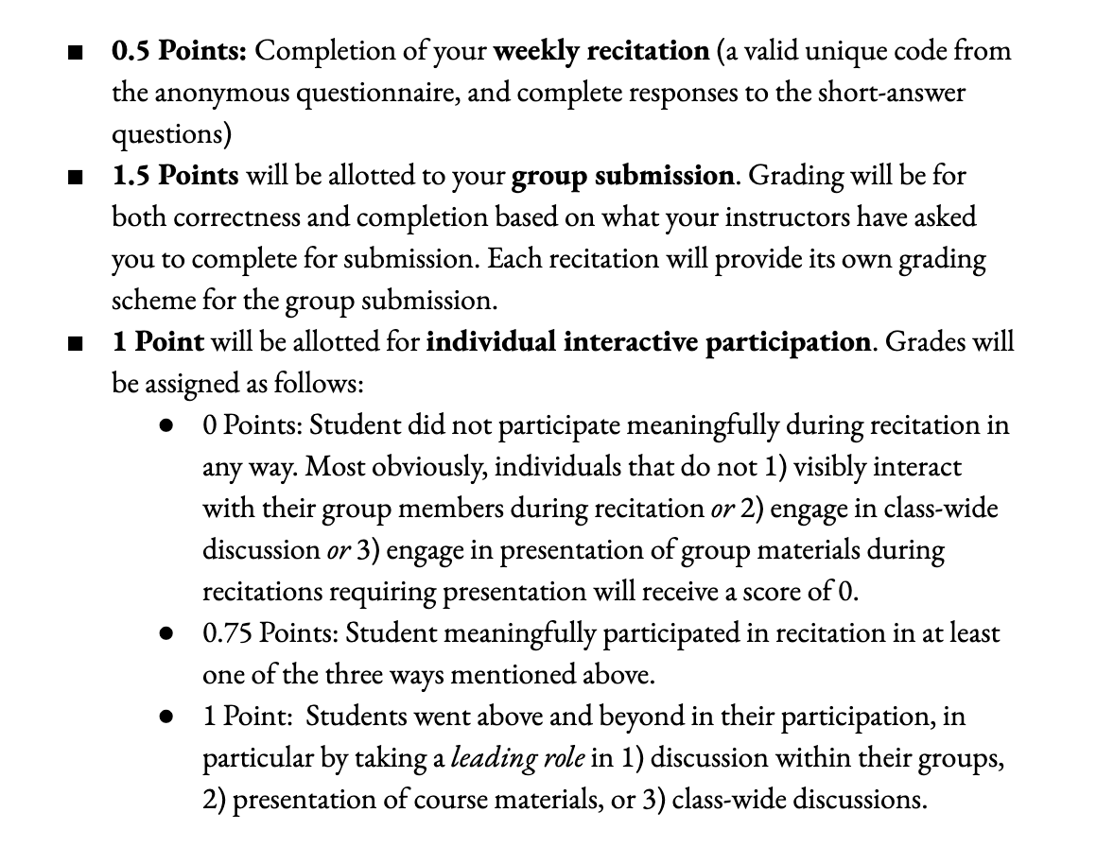
Details, Part 4 –Recitation
Recitation grading: details in the syllabus, but we’ll cover them briefly here as well…

Slide 24
Details, Part 5 – 2023 CSE Cohort Survey
What?
Three 10-15 minute-surveys at the beginning, middle, and end of the semester that you can complete anywhere.
Anonymous to the CSE-199 teaching team and all UB faculty. We will never be able to associate responses to an individual student.
Completing the surveys will count toward your grade!
If >80% of your section finishes all 3 surveys, you all get BONUS POINTS
Why?
To learn about your goals for the future, what motivated you to pursue CSE, and what challenges you foresee in the coming years.
To create a welcoming environment for everyone in CSE.

Slide 25
Details, Part 6 – Academic Integrity
Academic Integrity (AI) is very important to the University process!
In this course, your deliverables are largely:
Assignments
In-class participation and attendance
Falsifying your attendance, helping another to falsify their attendance, sharing TopHat quiz answers, copying from others for assignments, etc. are all AI violations.

Slide 26
Academic Integrity, cont.
AI violations will result in failing this course. There will be no exceptions.
On average, around 10-12 students are punished for AI violations in CSE 199 every year. People have failed from this course because:
They shared a TopHat attendance code with someone who was not in class
They copied someone else’s homework
…

Slide 27
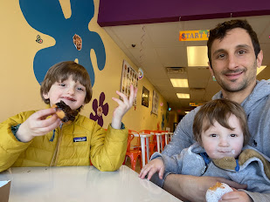
The most important part about AI!
If you’re having trouble, contact course staff. We’re here to help!
If the faculty make you nervous, contact the TAs!
But faculty shouldn’t make you nervous! We want you to succeed. You failing is bad for you, but it is also bad for us.
< not scary
Unintimidating >

Slide 28
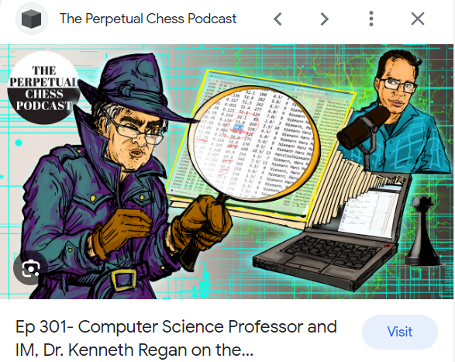
Very scary..

Slide 29
(The other) AI, continued.
Academic integrity violation records will be kept by the university.
You will likely lose your scholarship if you have one.
Future employers can request academic integrity records (e.g., law enforcement, certain government sectors, etc.)
Medical and law schools often request academic integrity records.

Slide 30
(The other) AI, continued.

Slide 31
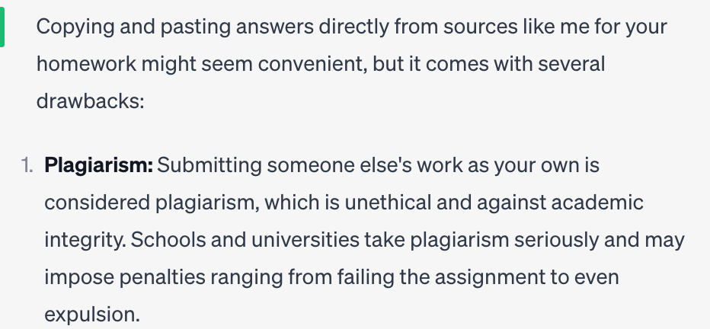
(The other) AI, continued.
Several times throughout this class (and your majors!) we will directly ask you to engage with Large Language Models (LLMs). But if you use an LLM to do your homework, and we catch you, this is plagiarism.
If you’re not sure, ask.

Slide 32
Why will we fail you?
Because our job is to train you to go out in the world and do great things. How well we train you reflects on you, your peers, UB as a whole, and us.
And you will not learn by copy/pasting from GPT

Slide 33
(The other) AI, continued.
In short:
Most of you are in a major where many of the faculty are actively developing technologies that use and/or help improve LLMs. We love technology! We think there are great uses of it!
But our first priority is that you learn. And you will not learn by copy/pasting from an LLM.

Slide 34
Please, please don’t cheat
If you cheat, and we catch you, we will fail you, even though we are not scary or mean and we really hate doing it. There will be no exceptions.

Slide 35
Details, Part 7–Fall Break
UB has instituted a new Fall Break, on 10/9-10/10
We will obviously not have lecture on 10/9. Otherwise,
You will be assigned homework the week prior, due the following week, to watch a video of the lecture that will be canceled.
Your professor will ask the relevant TopHat questions on 10/11
Nothing else will change
”But it is a break!”
Yes, we agree. However, the way this class has been structured, there is no plausible alternative
And, this way, no class the last Monday of the semester!

Slide 36
I’m NOT a CS OR a CE Major!! WTH!
Most of these slides have been targeted at folks who intend to major in CS or CE
If this is not you, do not worry:
You are not alone (~10-15% of the class)
We will help you (please make sure your recitation instructors know you’re not CSE)
Hey, maybe you’ll change your mind :) !

Slide 37
Questions?!

Slide 38
Your Three Current TODOs
You have three TODOs
Get access to TopHat (by WEDNESDAY)
You will get an email TONIGHT with instructions on how to do so
As an incentive, we’ll play a quiz game on Wednesday in lecture
Bonus points will be given to the Recitation Section with the MOST CORRECT ANSWERS (per lecture)
TopHat costs $$, if this is a problem, email the Head Instructor:
Professor Joseph: kjoseph@buffalo.edu

Slide 39
Your Three Current TODOs
You have three immediate TODOs
Get access to TopHat (by WEDNESDAY)
Complete the first CSE Cohort Study (due NEXT Weds.)
You’ll get information on how to do this on Wednesday

Slide 40
Your Three Current TODOs
You have three immediate TODOs
Get access to TopHat (by WEDNESDAY)
Complete the first CSE Cohort Study (due NEXT Weds.)
Complete your 8 Hours without the Internet Assignment (due NEXT TUESDAY)
… details on next slide…

Slide 41
8 Hours without the Internet
For your first assignment (due next TUESDAY), you must:
Go 8 hours without using the Internet
Make a slide deck that includes:
A journal of your time without the ‘net (Slide 1)
A slide you’ll present to the class in Recitation 2 (Slide 2)
A slide with a link to your Powerpoint that is accessible by the TAs
Your instructor will now show you how to access the assignment via the website & Brightspace
Note: this is the only thing you’ll have due on a Tuesday. All assignments will typically be due Wednesday (TAs need time to create the slides!)
Notes:
Atri Q: Does this have to be continuous 8 hours? And do students have to be awake :)?
Kenny A: Yes and Yes (You should maybe show them the assignment on the website at this point)

Slide 42
8 Hours without the Internet
We’ll now show you how to access your 8 hours without the Internet Assignment on the Course Website!
Notes:
Atri Q: Does this have to be continuous 8 hours? And do students have to be awake :)?
Kenny A: Yes and Yes (You should maybe show them the assignment on the website at this point)

Slide 43
Questions?!

Slide 44
A common question, answered!
Why does this course have such a weird structure?
We want to expose you to different topics in CSE!
One day you will have to choose electives; this will help
One day you will have to work or do research across subdisciplines of CSE; this will help.
We want to expose you to different teaching styles
You will encounter these (and other styles!) later
Learn what works for you, and how to get what you can out of what doesn’t

Slide 45
General Learning Outcomes
Learning from different styles of instruction
Collaboration in activities
Understanding how to handle various lab/recitation/seminar/lecture type activities
Attention to detail (please read instructions carefully!)
Exposure to many concepts you may encounter throughout life, or studying various areas of STEM+C

Slide 46
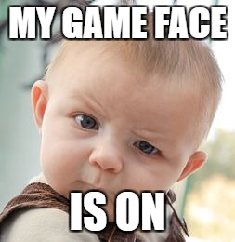
Yay! See you Wednesday for our TopHat CSE Trivia Competition!

