Slide 1
Career Design Center
259 Capen Hall
jobs@buffalo.edu
buffalo.edu/career.html
Notes:
Professor Julia Latorre <jmtalari@buffalo.edu>

Slide 2
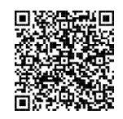
CSE 199 Section A - Please scan QR code to check in

Slide 3
Career Design Center
Resources & Services

Slide 4
Resources & Services
Individual Career Coaching Appointments
Bullseye powered by Handshake
Internship & job postings
Part-time On & Off campus jobs
Practice Interviews
Interstride
Career Communities
Career Design STUDIO
Focus 2 Career Assessment
Digital Challenge Cards

Slide 5
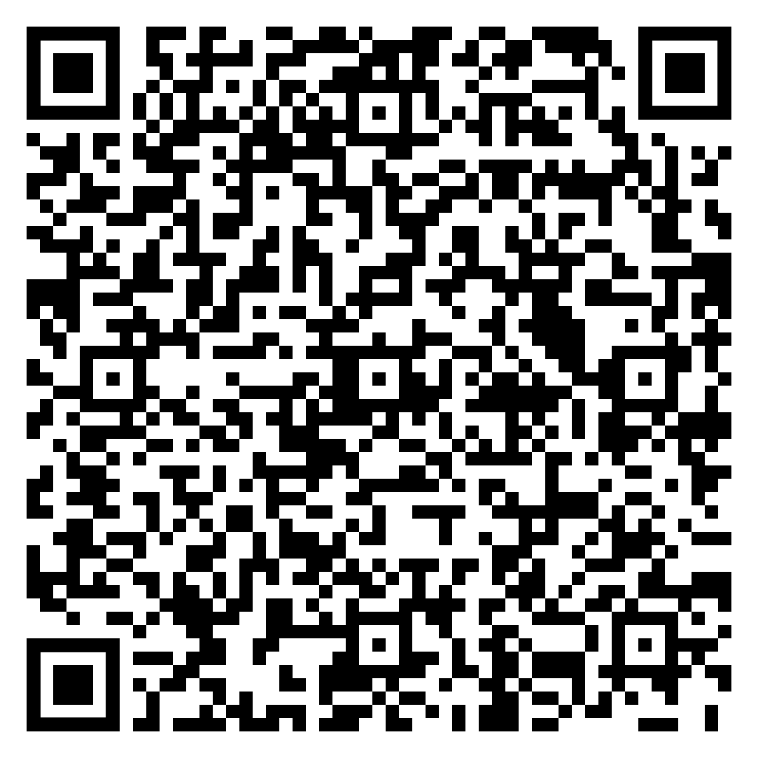
Start where you are.
Whether you’re searching for your major, a job/internship, skills to build or trying to imagine your life after college?
We’re with you every step of the way.
You Talk.
We Listen.
Book Online.
buffalo.edu/career/appointments
Notes:
One on one meeting
60 or 30 minute long appointments available depending upon topic.
To schedule your Career Coaching appointment log on to “Bullseye powered by Handshake”
Appointments are available Video (Zoom), Phone or In-person.

Slide 6
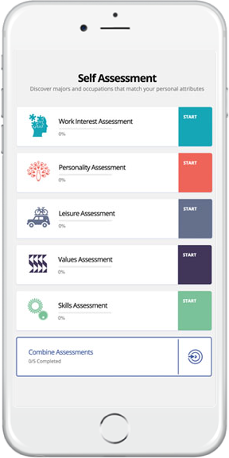
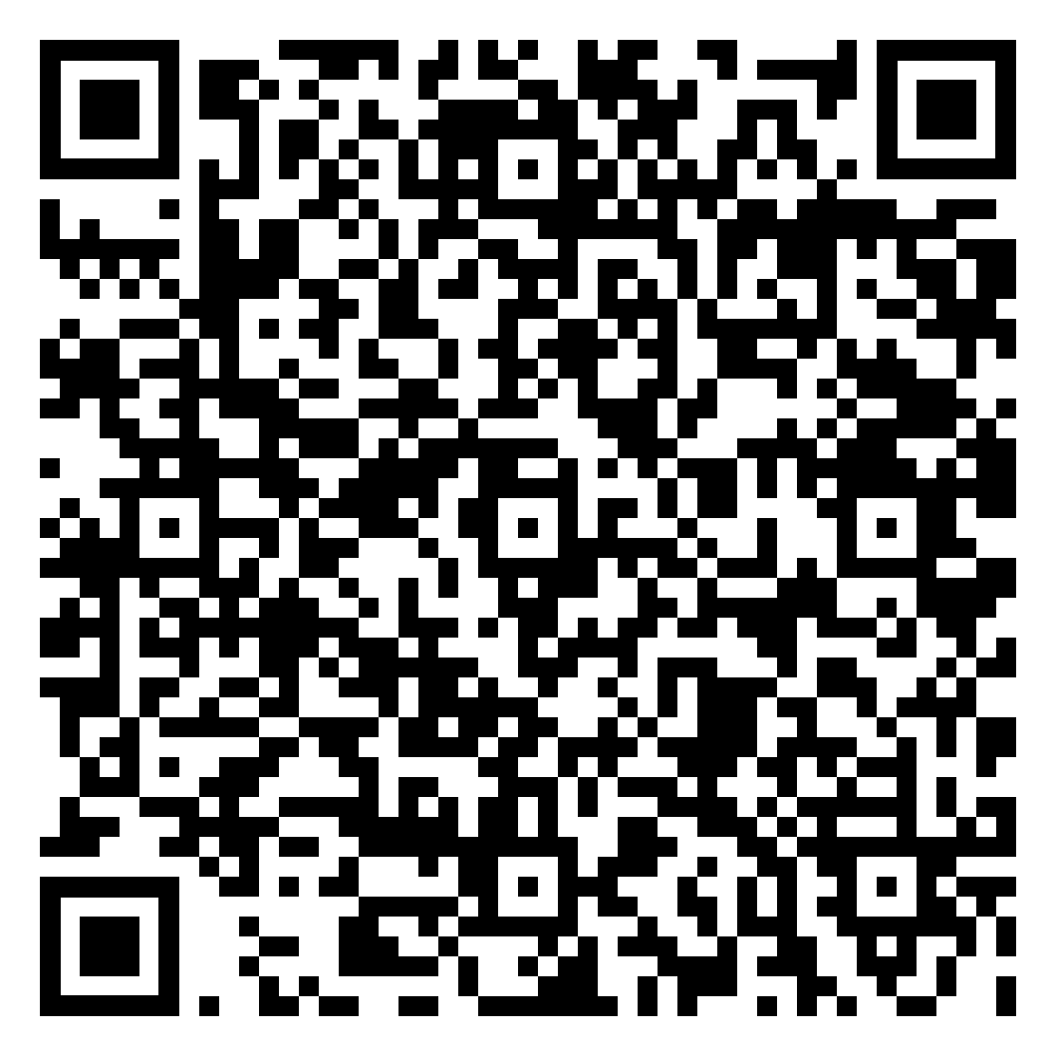
What interests you?
Figure out what your interests are and how it all connects to a major and career with Focus 2.
Just answer simple questions about your hobbies, skills, values and work interests. Then Focus2 gets to work and matches your results with major and career options.
Register a new account using your UB email address and the access code: ubbulls.

Slide 7
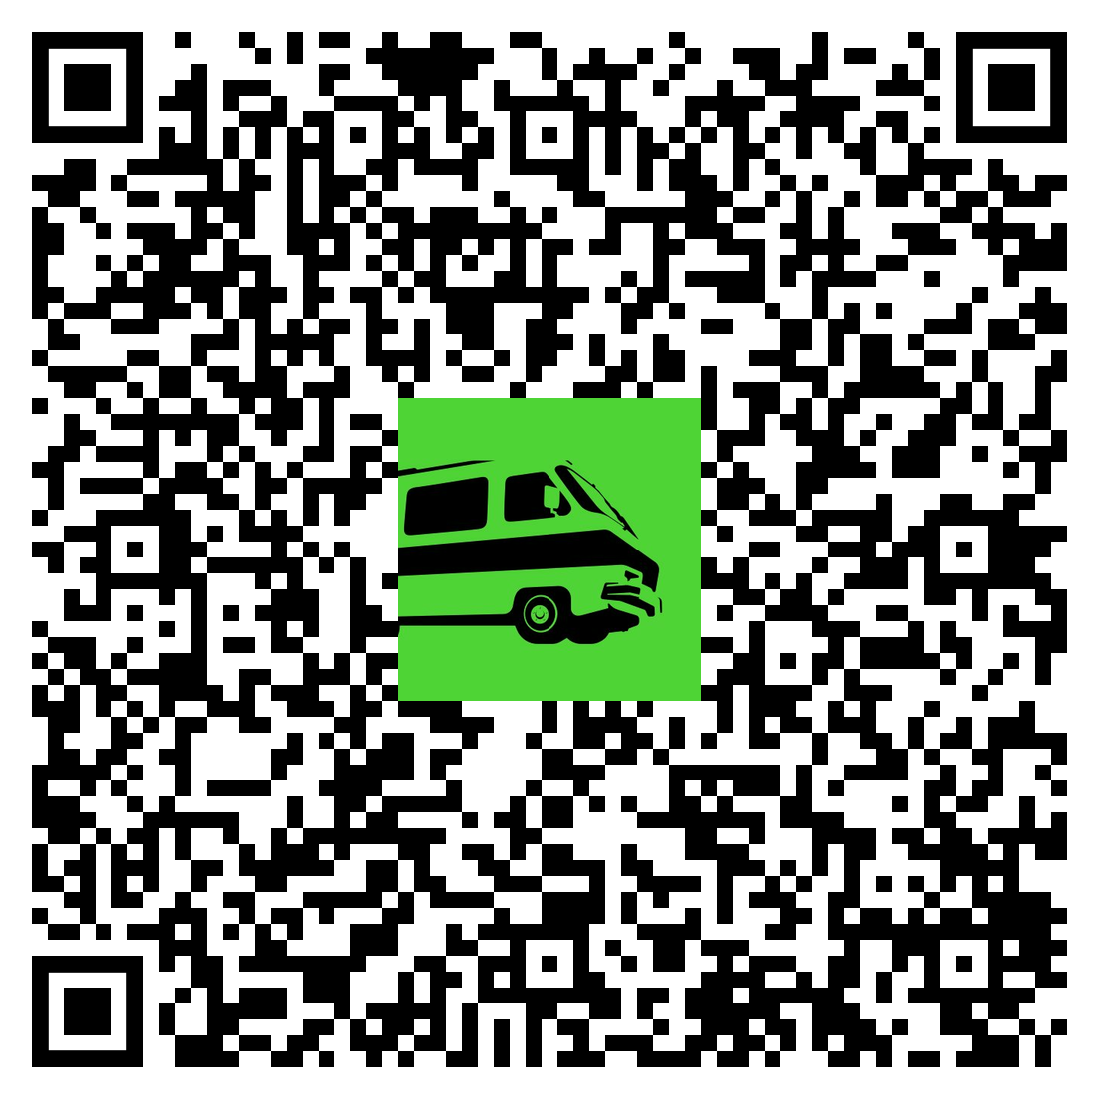
Helping you find your path
Learn how to get full access to Roadtrip Nation.
Roadtrip Nation has full-length documentaries and series, interviews, exclusive web clips, podcasts, and self and career exploration courses.

Slide 8
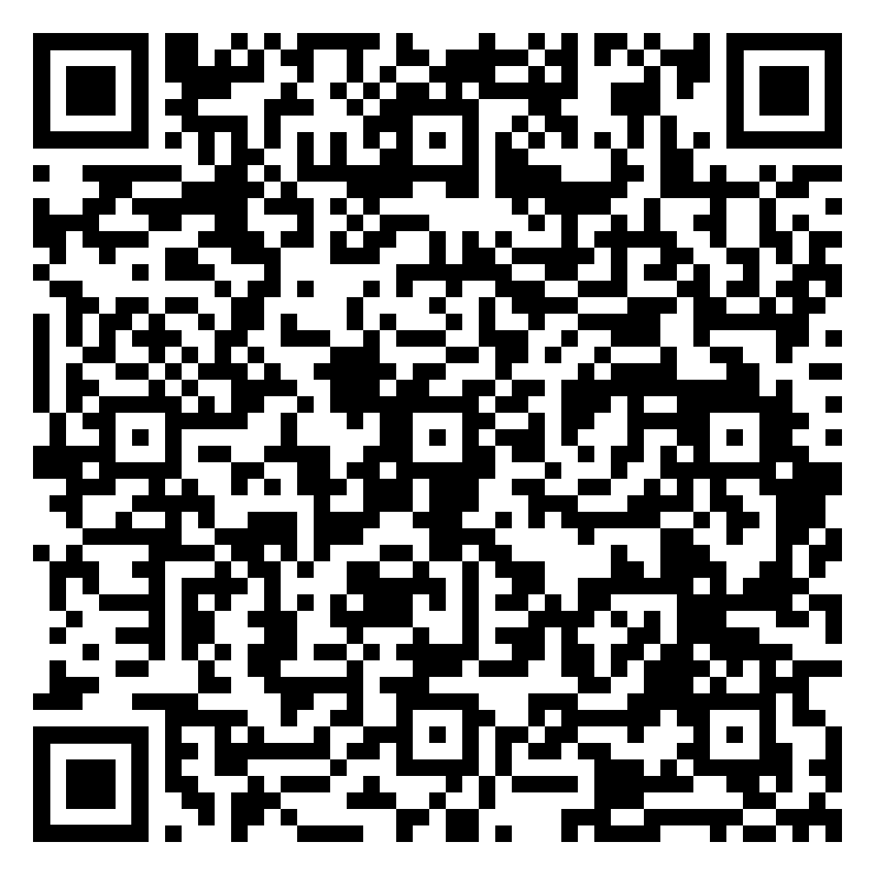
Are you up for the Challenge?
Challenge yourself to think outside of what you already know when exploring majors or careers.
The Digital Challenge cards will help you think about problems you want to solve based on what interests you.
Use this QR to learn more and to access the Digital Challenge Cards.
bit.ly/3MVKRv7

Slide 9
Bullseye powered by Handshake
Job & internship posting system
Event – Career Fairs, workshops, Employer information sessions, networking events, and much more!
Connect - Opportunity to connect to alumni, UB students and students in the Handshake community
5x – How much you increase your chance of being contacted by an employer if you complete your profile in Bullseye powered by Handshake!
Join a Career Community!

Slide 10
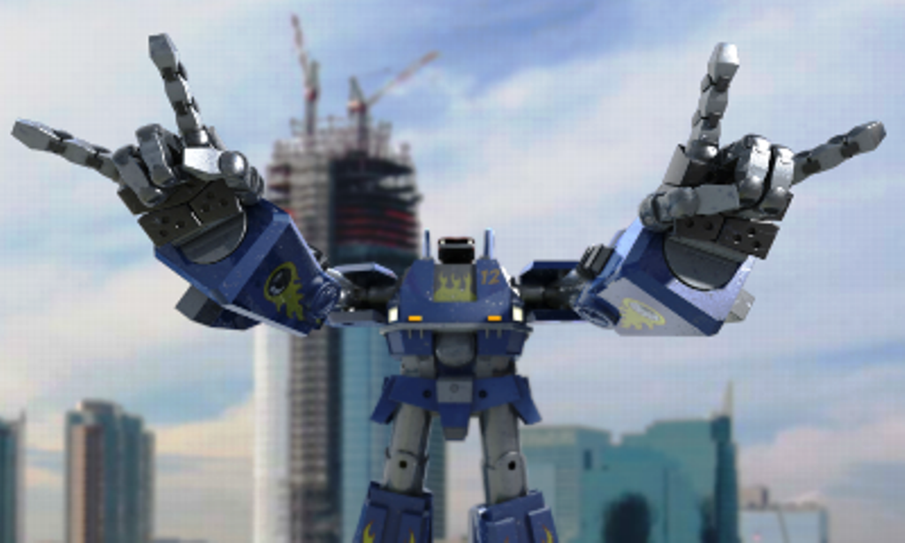
job + Internship Fair
Is Coming

Slide 11
STEAM Job & Internship Fair
October 3, 2023
12:30pm - 4:30pm
Alumni Arena

Slide 12
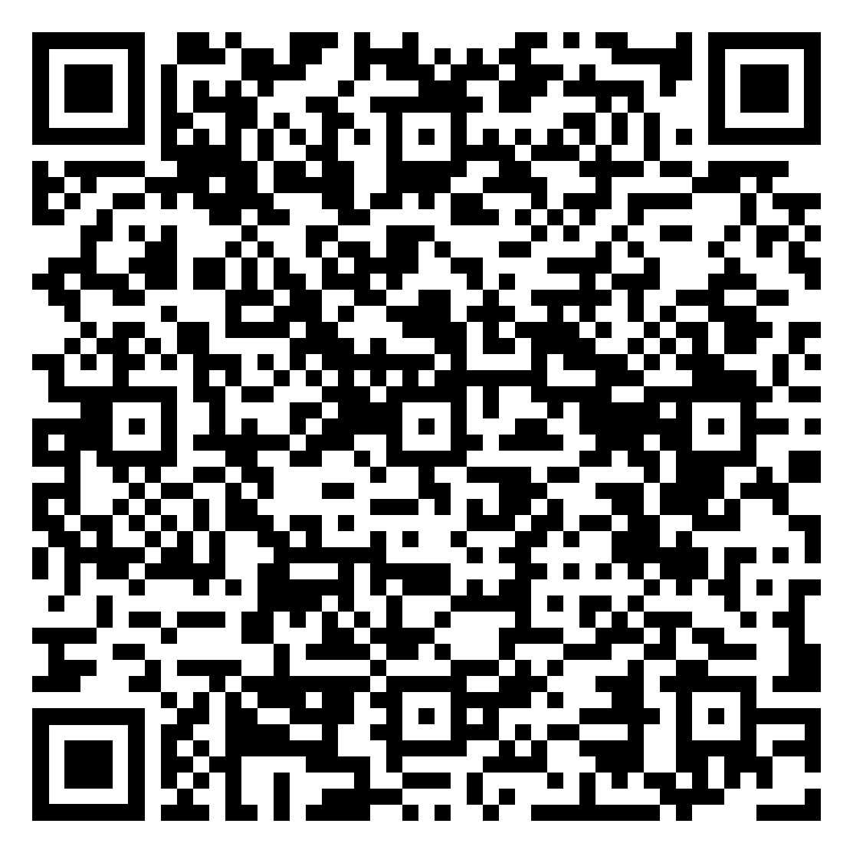
Unlock your instant resume review in 15-seconds or less
Use this QR code for your 1 out of 10 resume reviews + get to green status.
Introducing VMock, an algorithm-based online resume review platform:
Bullet by bullet feedback that’s personalized to you!
Green, yellow, or red scoring, showing you where your resume is strong and where it needs more attention.
Formatting tips to get your resume looking clean and sharp.
+Plus, it’s available 24/7
https://www.vmock.com/unibuffalo
You’ll need to sign in to Bullseye powered by Handshake with your UBIT name and password to get access.
Notes:
To access Vmock – Bullseye powered by Handshake, click on Career Center, click on Resources, find the Vmock resource.
Only available to SEAS – Sept & Oct.
Will become available to all majors across campus on a rolling basis.

Slide 13
ASPIRE – LinkedIn Profile Review
Use this QR code for your 1 out of 10 resume reviews + get to green status.
Introducing Aspire, a new feature inside Vmock:
Section by section feedback that’s personalized to you!
Green, yellow, or red scoring, showing you where your profile is strong and where it needs more attention.
Skills Gaps Snapshot
+Plus, it’s available 24/7
https://www.vmock.com/unibuffalo
You’ll need to sign in to Bullseye powered by Handshake with your UBIT name and password to get access.
Notes:
To access Vmock – Bullseye powered by Handshake, click on Career Center, click on Resources, find the Vmock resource.
Only available to SEAS – Sept & Oct.
Will become available to all majors across campus on a rolling basis.

Slide 14
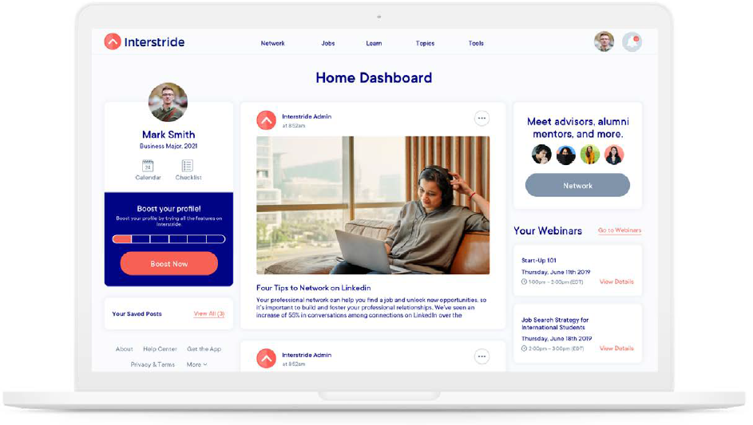
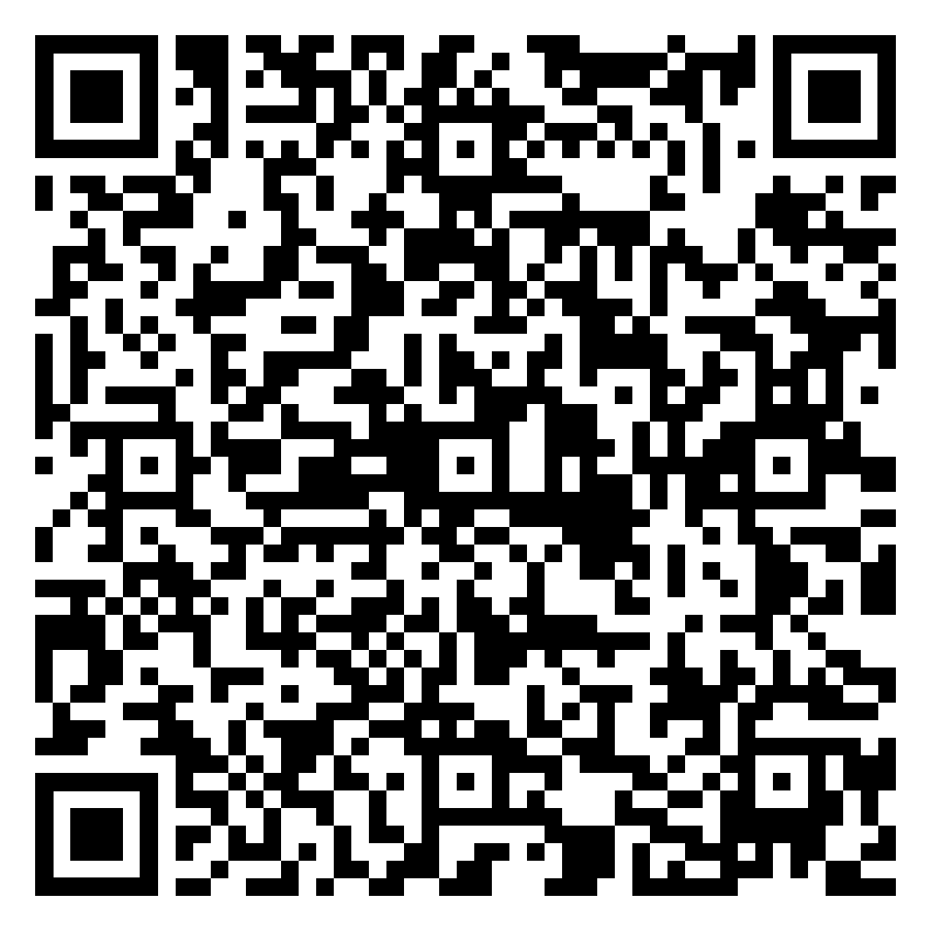
Interstride – The one-stop-shop for all things international.
Interstride is an online tool designed to support international students or students wishing to work abroad in their global job search!
With Interstride, get access to:
US and global opportunities
Visa and immigration support
Productivity tools, webinars and resources
+Plus, it’s available 24/7
Use this QR to learn more and to access Interstride.

Slide 15
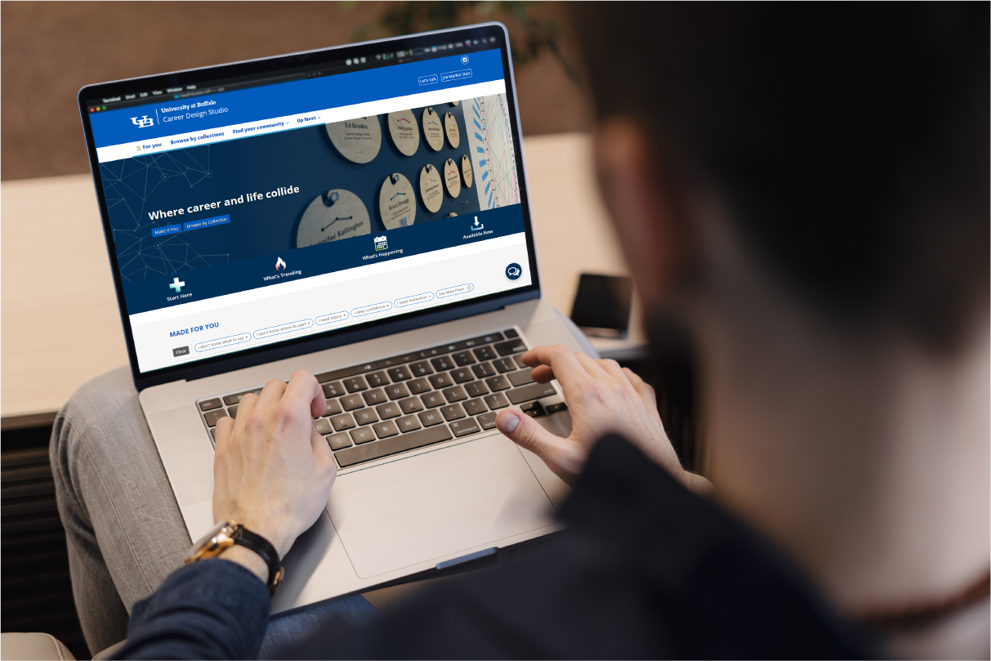
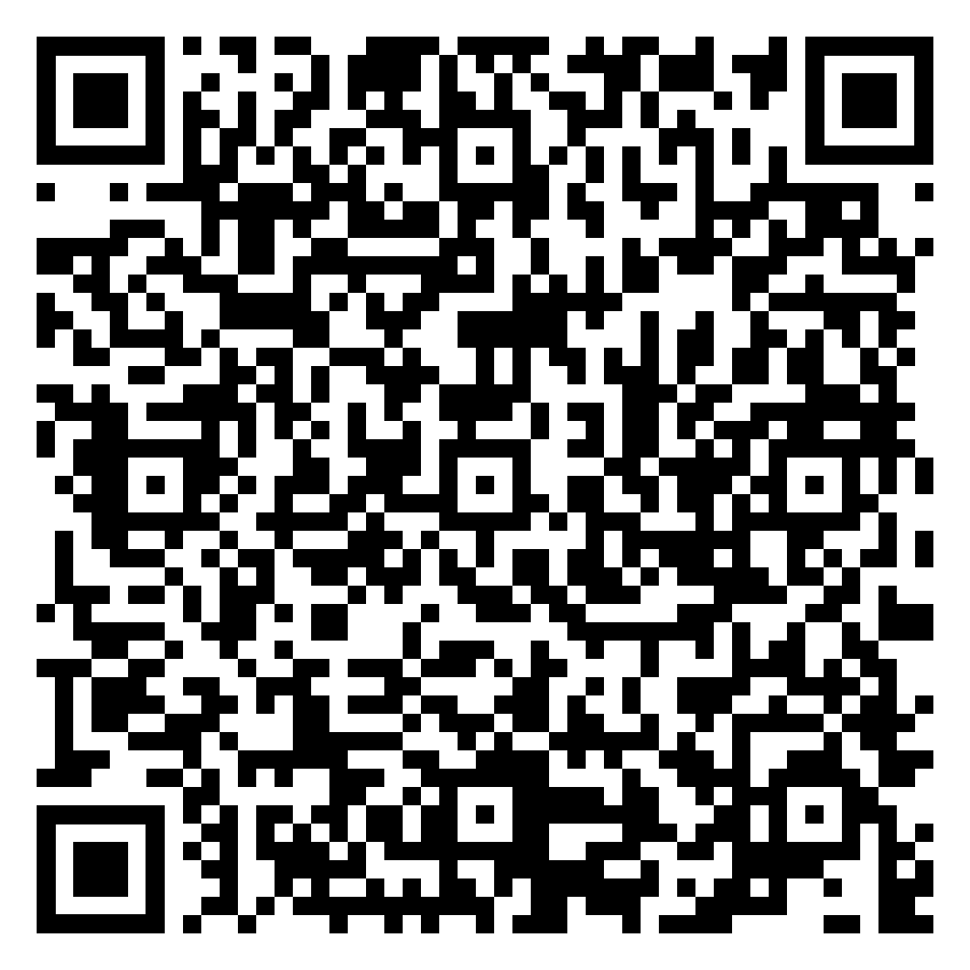
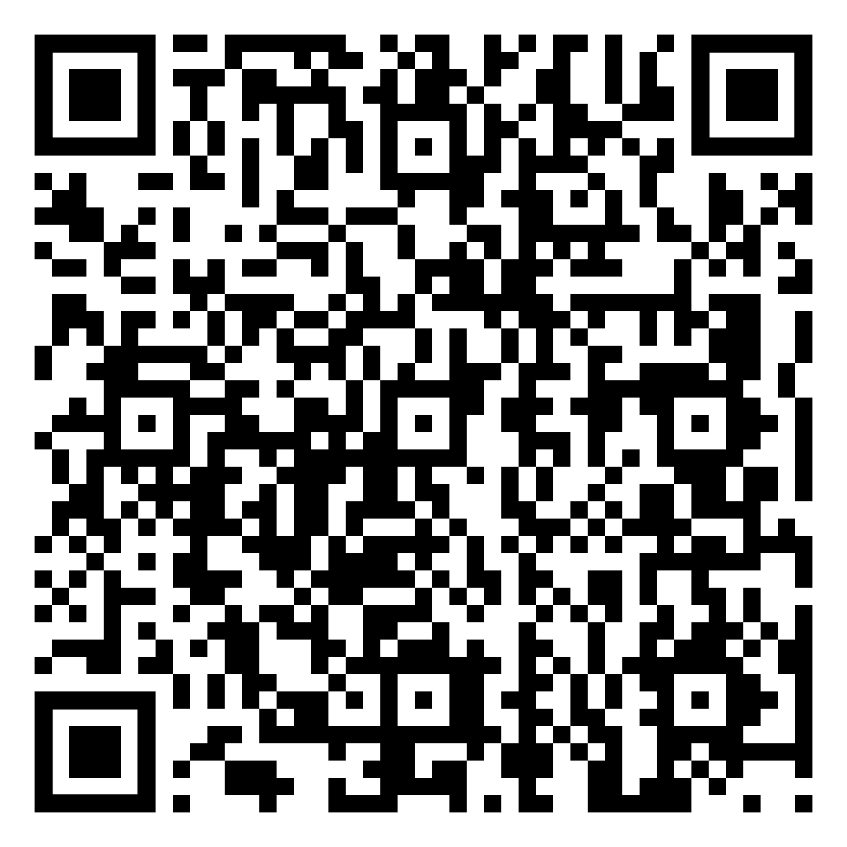
Career Design Studio
Where career and life collide.
No matter where you're at on your career design journey, the Career Design Studio can help you find your way forward.
Things you might find:
What’s trending
Career Community toolkits full of people, events, blogs, resources, podcasts and playlists
List of employers hiring now for internships, on-campus job, part-time and full-time jobs
buffalo.edu/career/collections

Slide 16
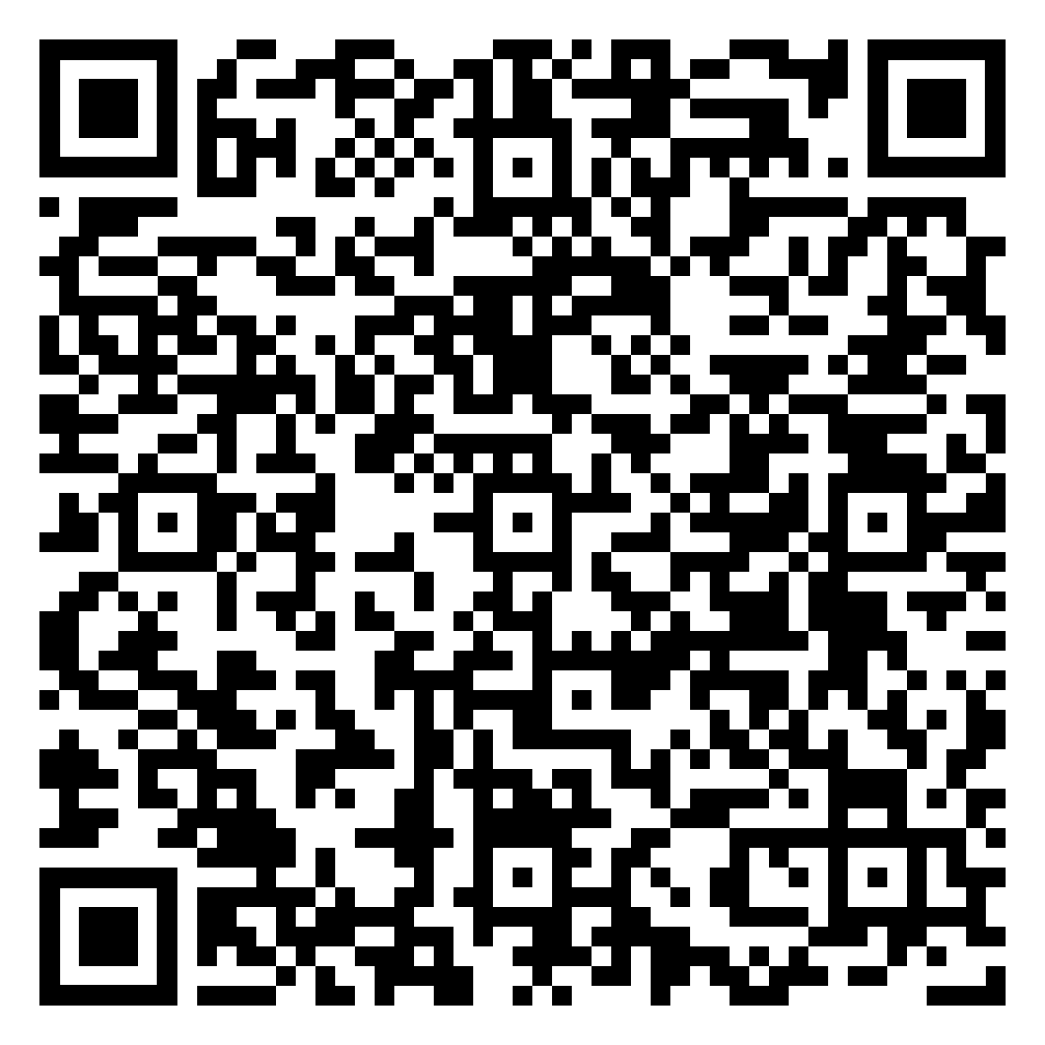
Six Career Communities to follow
Arts, Design, Entertainment + Communications
Data, Analytics, Technology + Engineering
Government, Law, International Affairs + Policy
Healthcare, Public Health, Life + Lab Sciences
Management, Sales, Consulting + Finance
Nonprofit, Education + Social Impact
Find a community (or two) that fits you. There's no limit to how many communities you can join + you can change your mind at any time.
Notes:
You can join 1 or many Career Communities regardless of your major!
As a part of a Career Community you will get to Explore, Learn & Connect!
Benefits of Joining a Career Community
Community. Connection. & Tools.
Community designed by you--Personally led by your Career Community Guide, supported by a network of like-minded community members, UB alumni and mentors sharing advice, inspiration, motivation and ideas for your career journey.
Exclusive invitations to events, job + internship opportunities -- career community only events to connect with UB alumni and employers with the next best job + internship opportunities.
Career + life design tools for every step of the way---A toolkit to help students (like you!), including what’s trending in the job market, blogs, videos, articles, podcasts and recommendations on what to try so you can easily discover how your major can lead to more opportunities.

Slide 17
Next Steps

Slide 18
Next Action Steps
Log into Bullseye powered by Handshake & complete your profile!
Check out the Career Design STUDIO
Visit the office – 259 Capen Hall, Career Design Center

Slide 19
Questions?

Slide 20
Contact Us!
Career Design Center
Monday - Friday | 8:30 a.m. - 5 p.m.
259 Capen Hall, North Campus
Phone: 716-645-2231
You Talk. We Listen. Book online.
buffalo.edu/career/appointments
Use this QR code to book a career design appointment or chat with Virtual Vic about your career questions 24/7.

Slide 21
Career Design Center
Chat to Virtual Vic 24/7 too.

