Slide 1
CSE 199: Internet, Computing, and Society

Slide 2
Welcome, everyone to CSE 199!
We are so happy you’re here! (All 700+ of you!)
This week’s lecture plan:
199 Intro (Today)
UB CSE Alumni Panel (Wednesday)
In recitation:
Attendance
Class Icebreakers
Group Icebreakers

Slide 3
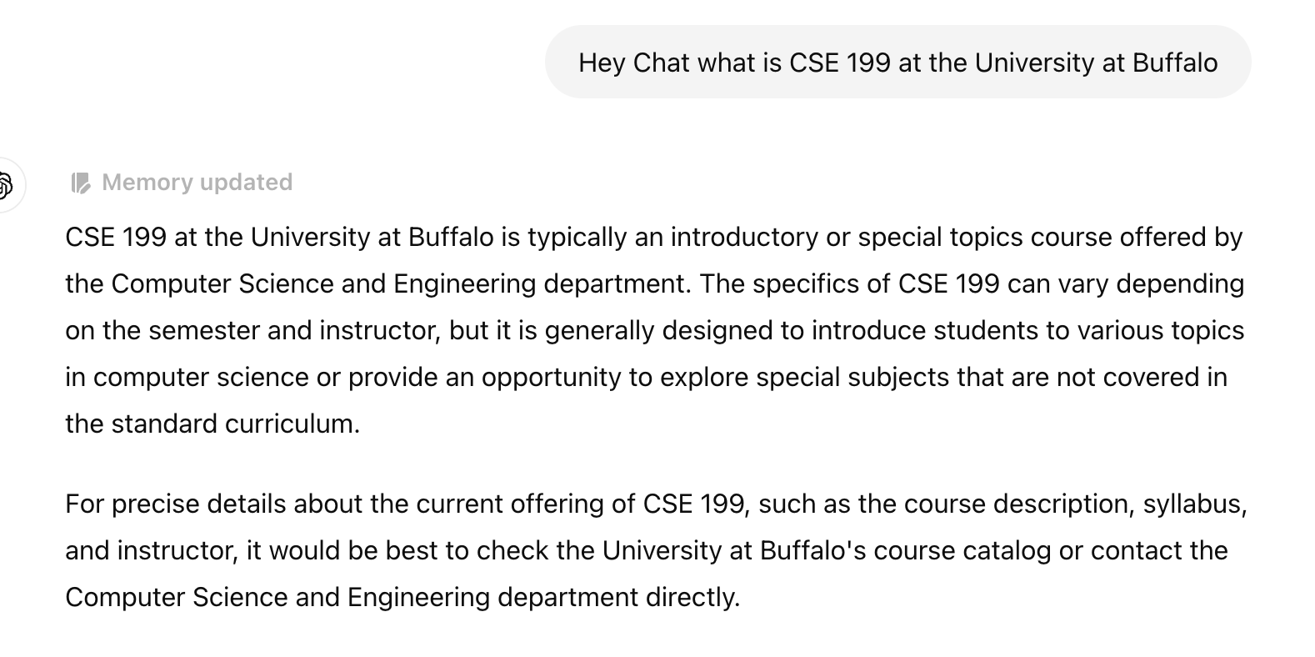
[this is wrong. ]

Slide 4
“Why am I taking this course?”
Because you [kind of] have to. Every UB student has to take (and pass) a 199 course. We’re happy you’re with us!
Because it will help you build skills to succeed in CSE. We’ll cover things like time management and violating academic integrity
Because you will see different sides of computer science and engineering. From AI to Ethics, we’ll cover many (but not all) areas of a big field
Because it will help you get a job. This is not a “technical course.” But the #1 thing we hear from potential employers who don’t hire you is “they don’t have the ‘other important skills’”

Slide 5
The “other important skills”
https://www.naceweb.org/uploadedFiles/files/2021/resources/nace-career-readiness-competencies-revised-apr-2021.pdf
Notes:
Mention here that technology is only one. And you can feel free to add your own thoughts. We’ll come back to these throughout the semester, hopefully (TBD on how we do that)

Slide 6
What CSE 199 is
An attendance-heavy class. If you show up and participate, it is somewhat challenging to not get an A
A low workload class. You should expect to spend around an hour per week outside of class on CSE 199. Do not expect your other CSE classes to be the same.
A group-intensive class. You will do groupwork in CSE 199, just like in the real world. This is a skill, you will not get a job without it. So we’re practicing it here
A presentation-heavy class. See above - you need to develop this skill.

Slide 7
What CSE 199 is not
A class that everyone passes. Last semester, around 3% of the class failed. Do not expect to pass the course if you do not participate.
A class you can cheat in. Last semester, around 8% of the class was charged with a violation of academic integrity. This can go on your permanent record. More on this later.
A place to judge others. You are at UB to learn. Do not judge others who haven’t yet been given the chance to learn what you have learned.

Slide 8
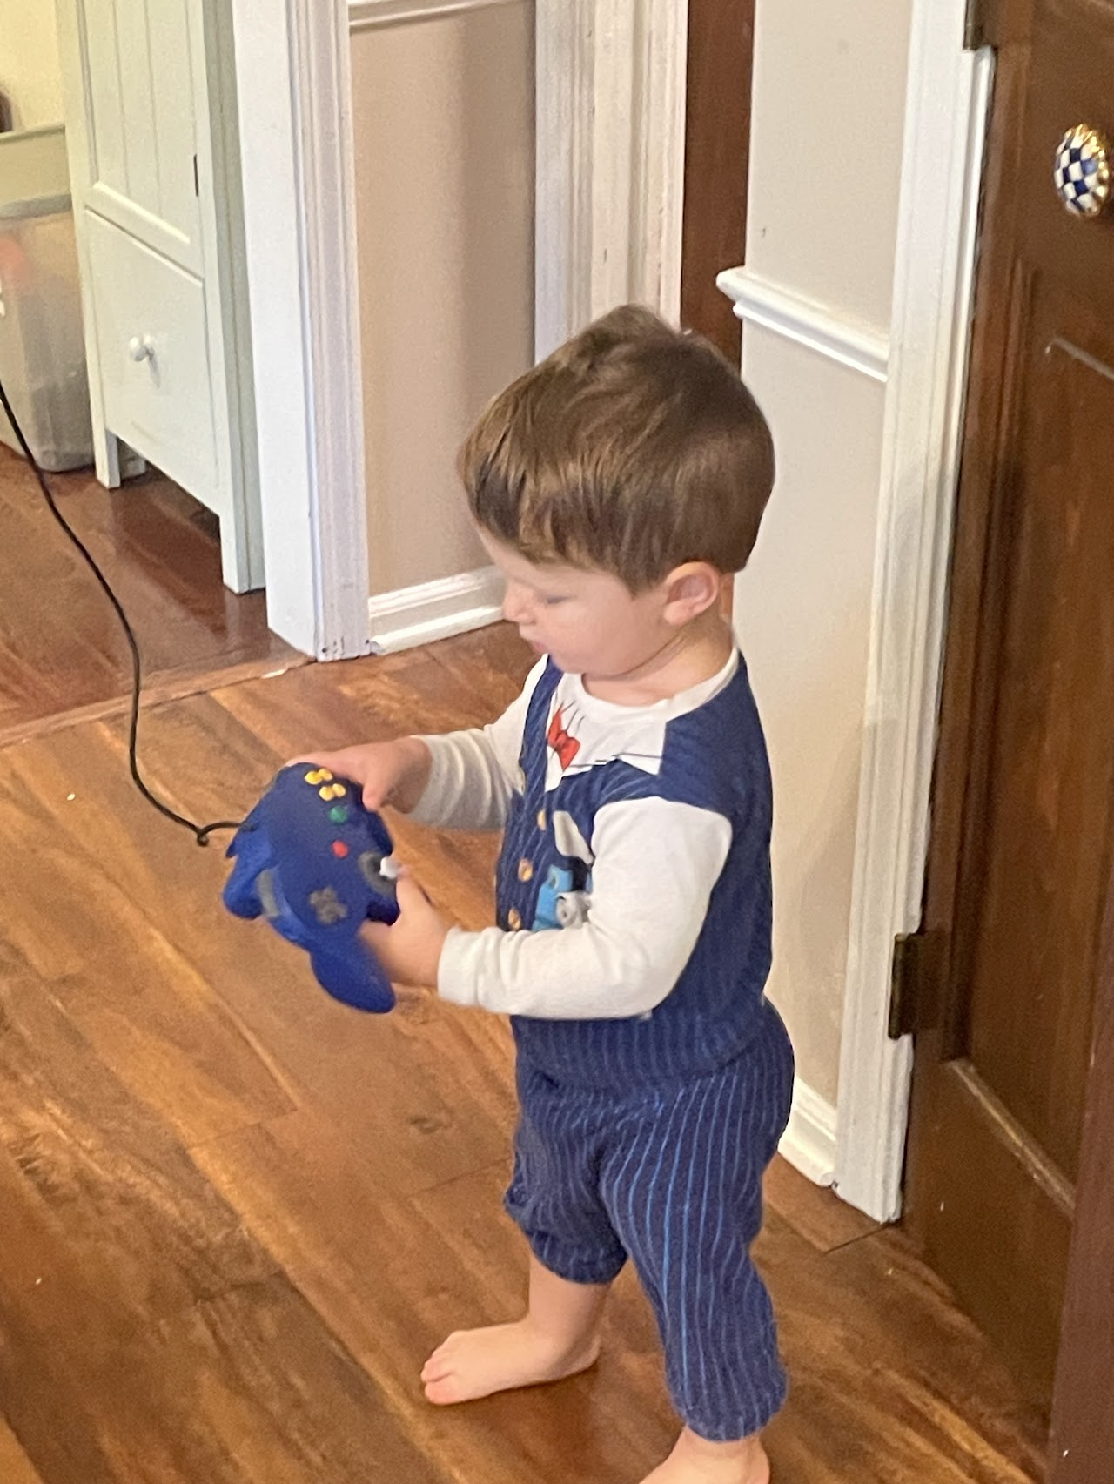
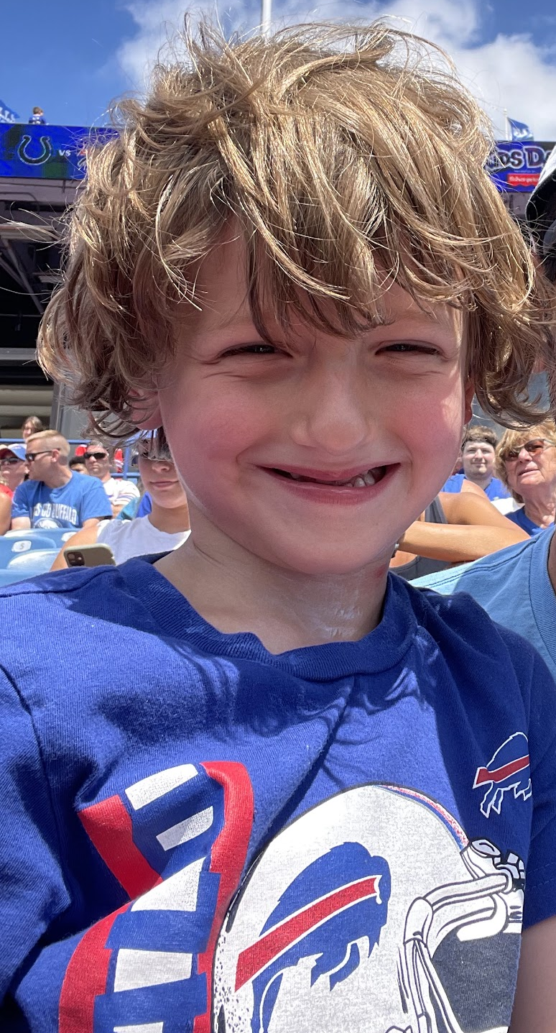
Who am I? Personal
I am a native of Buffalo, NY. I can tell you where to find the best food and beverages
Most days, when not in the office, I’m hanging with these dudes

Slide 9
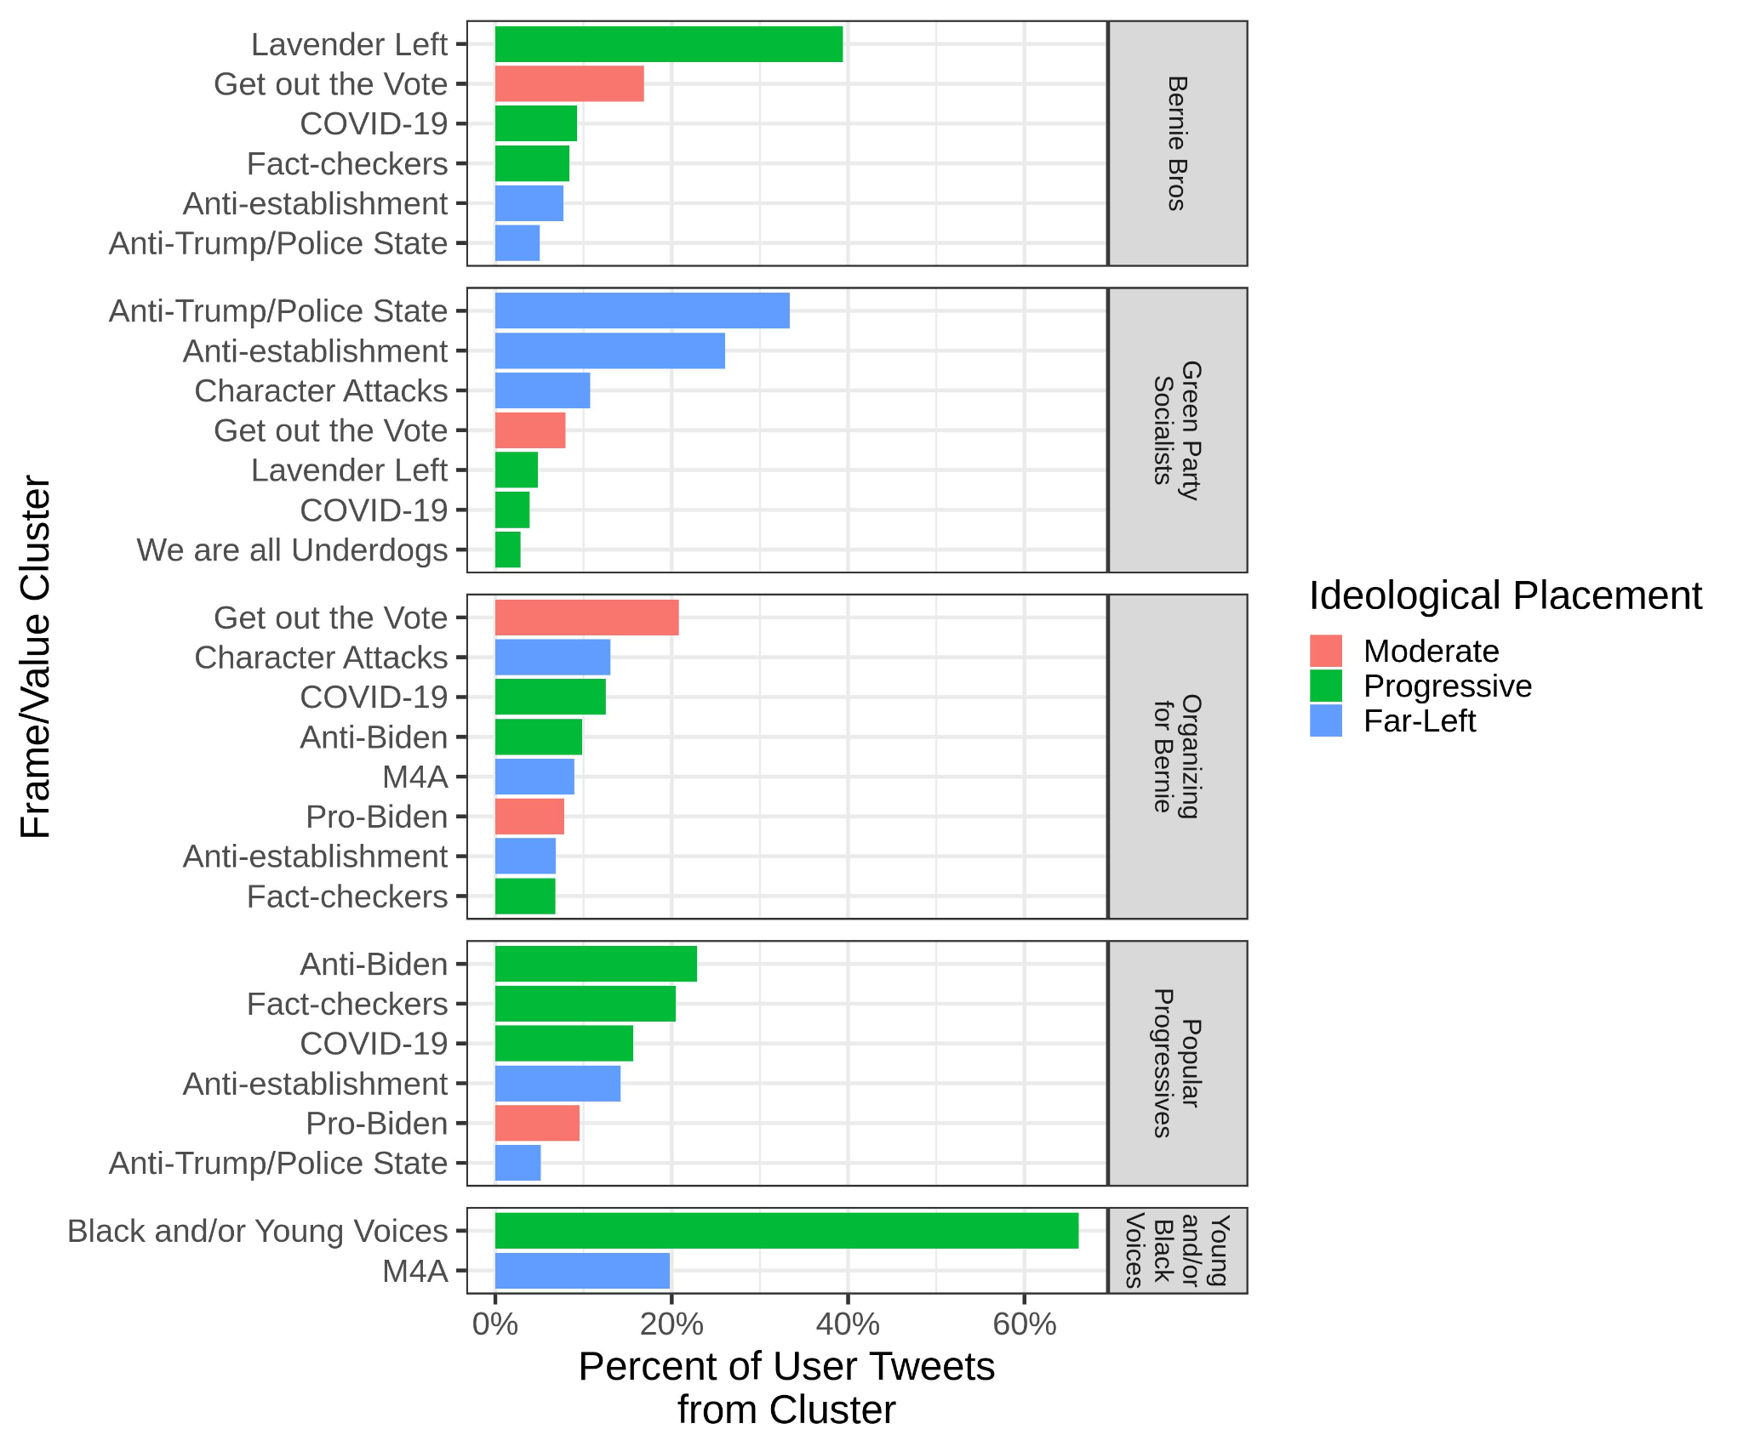
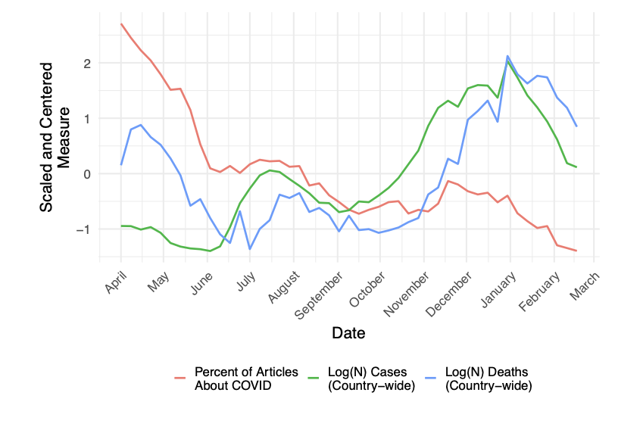
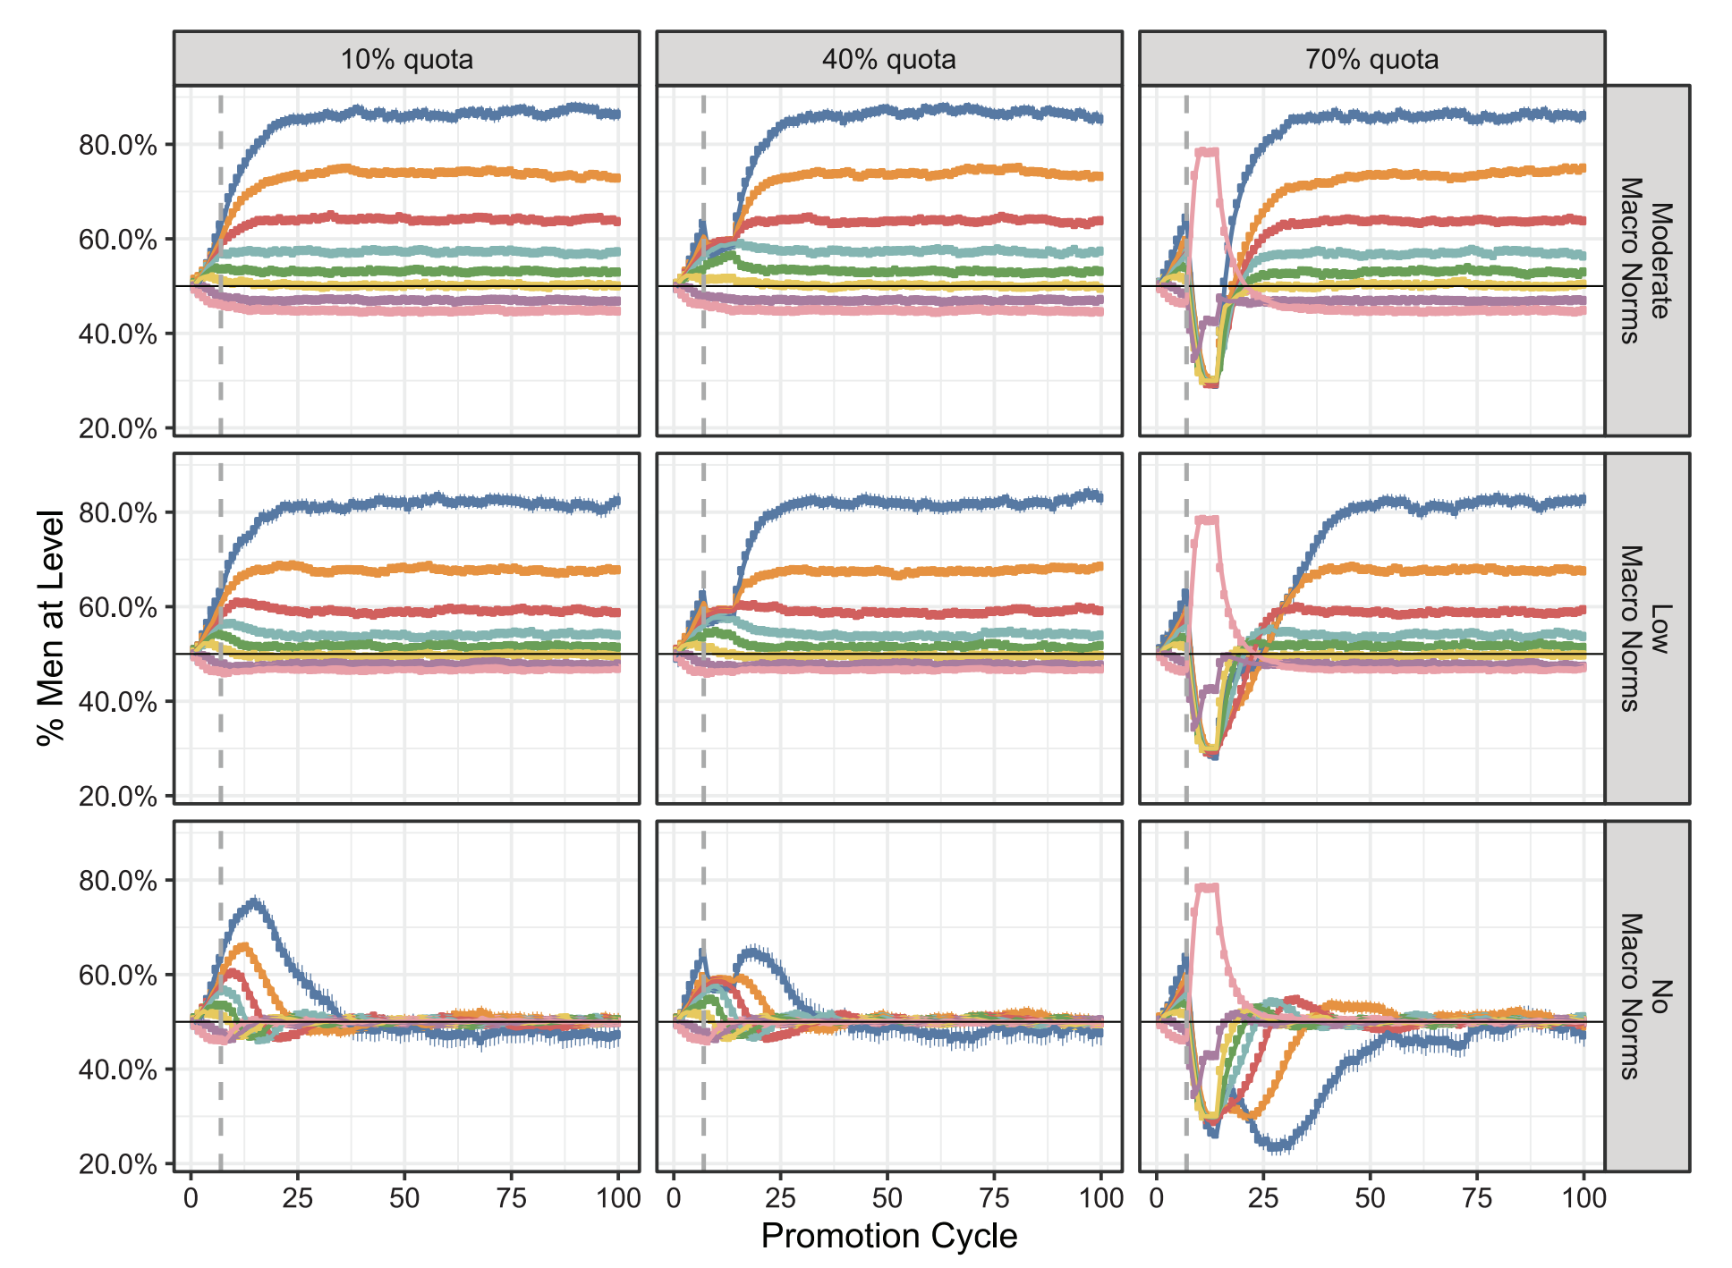
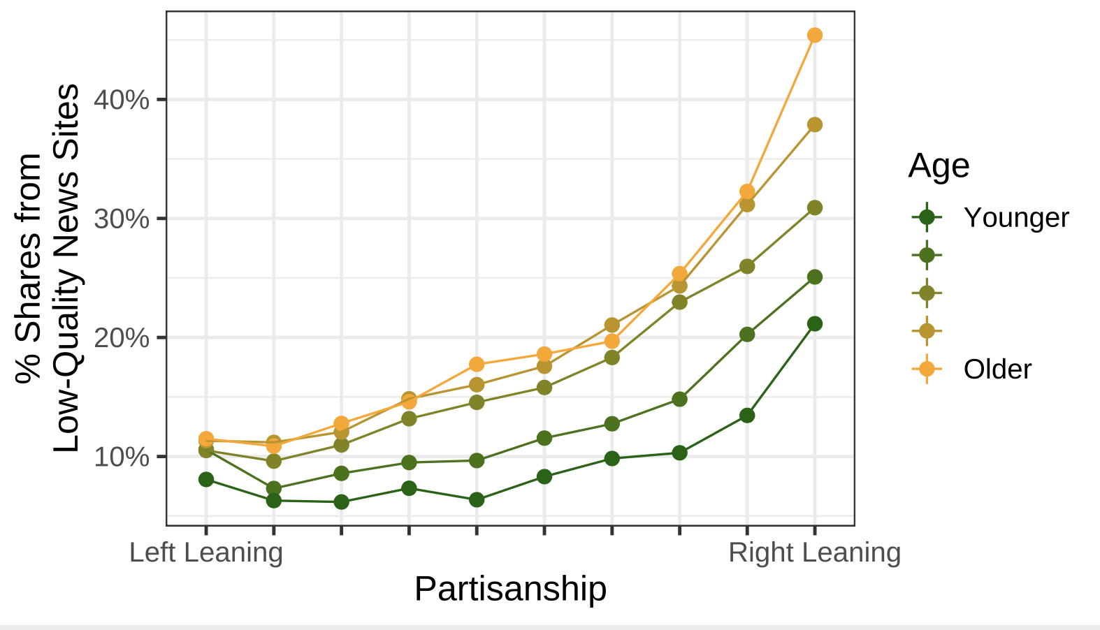
Who am I? Research
Most of my time in the office is spent doing research
My research focuses on measuring and modeling sociotechnical systems to characterize and reduce social inequality

Slide 10
The basic setup of CSE 199
Section B
Section D
Section E
Section F
There are 4 lecture sections. Lectures meet twice a week, on Mondays and Wednesdays.
Do not ask us why it isn’t A-E. We don’t know. Blame someone else.

Slide 11
The basic setup of CSE 199
Recitation B1
Recitation B3
Recitation B5
Recitation B2
Recitation B4
Recitation B6
Each lecture has 6 recitation sections. You are in one of them! Your recitation is on Thursday or Friday. We’ll come back to these in a minute!

Slide 12
The basic setup of CSE 199
Check HUB to see when and where your recitation is!
Recitation B1
Recitation B3
Recitation B5
Recitation B2
Recitation B4
Recitation B6
Each lecture has 6 recitation sections. You are in one of them! Your recitation is on Thursday or Friday. We’ll come back to these in a minute!

Slide 13
The basic setup of CSE 199
No. You cannot attend a different lecture/recitation and still get credit.
Recitation B1
Recitation B3
Recitation B5
Recitation B2
Recitation B4
Recitation B6
Each lecture has 6 recitation sections. You are in one of them! Your recitation is on Thursday or Friday. We’ll come back to these in a minute!

Slide 14
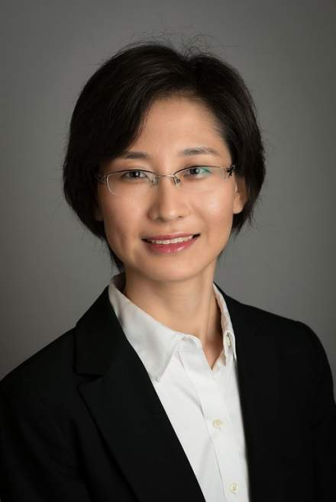
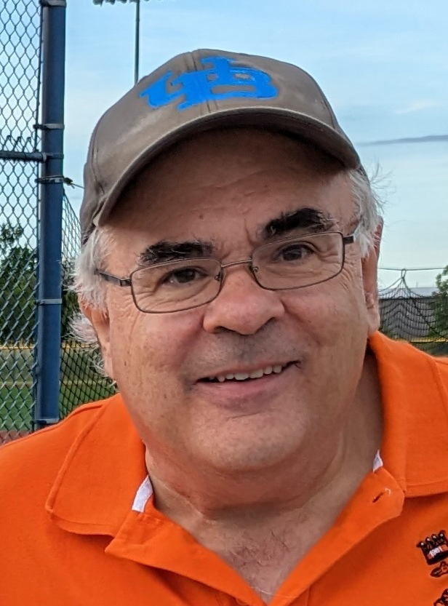
AI and Healthcare
Data and Society
Human- Computer Interaction
Ethics and Computing
199 has 5 modules; 1 intro (first two weeks) and 6 content modules (3 weeks each).
Content modules are taught by different professors

Slide 15
Week 1
“Activity” Recitation 1 (Th or Fr)
Lecture 1 (M)
Lecture 2 (W)
Week 2
Individual Homework
(due Weds, 11:59PM)
“Activity” Recitation 2 (Th or Fr)
Lecture 1 (M)
Lecture 2 (W)
Week 3
Group Homework
(due Weds, 11:59PM)
“Project” Recitation 3 (Th or Fr)
Lecture 1 (M)
Lecture 2 (W)
Each (content) module is three weeks long, and has 6 lectures, 1 individual HW, 1 Group HW, and 3 recitations

Slide 16
https://vimeo.com/user139951706/199hype?share=copy
https://vimeo.com/user139951706/cse199hype?share=copy

Slide 17
Each lecture gets each module for 3 weeks (ordering depends on which lecture you’re in) Every 3 weeks, your lecture prof. changes!

Slide 18
Your recitation instructors and TAs will not change!

Slide 19
You will be assigned a group in recitation. You cannot change this group. That is how the real world is, too. We are aiming to force you to get used to it

Slide 20
Your Teaching Assistants (TAs)
They are also undergraduate students just as you are!
You can also be a UTA (Undergraduate Teaching Assistant)!
If interested, please talk to an instructor or a TA during the semester.
Paid position (unpaid if you want to)
It is important to understand that for this course, they are not your fellow students. They are part of the teaching staff, so approach them appropriately.

Slide 21
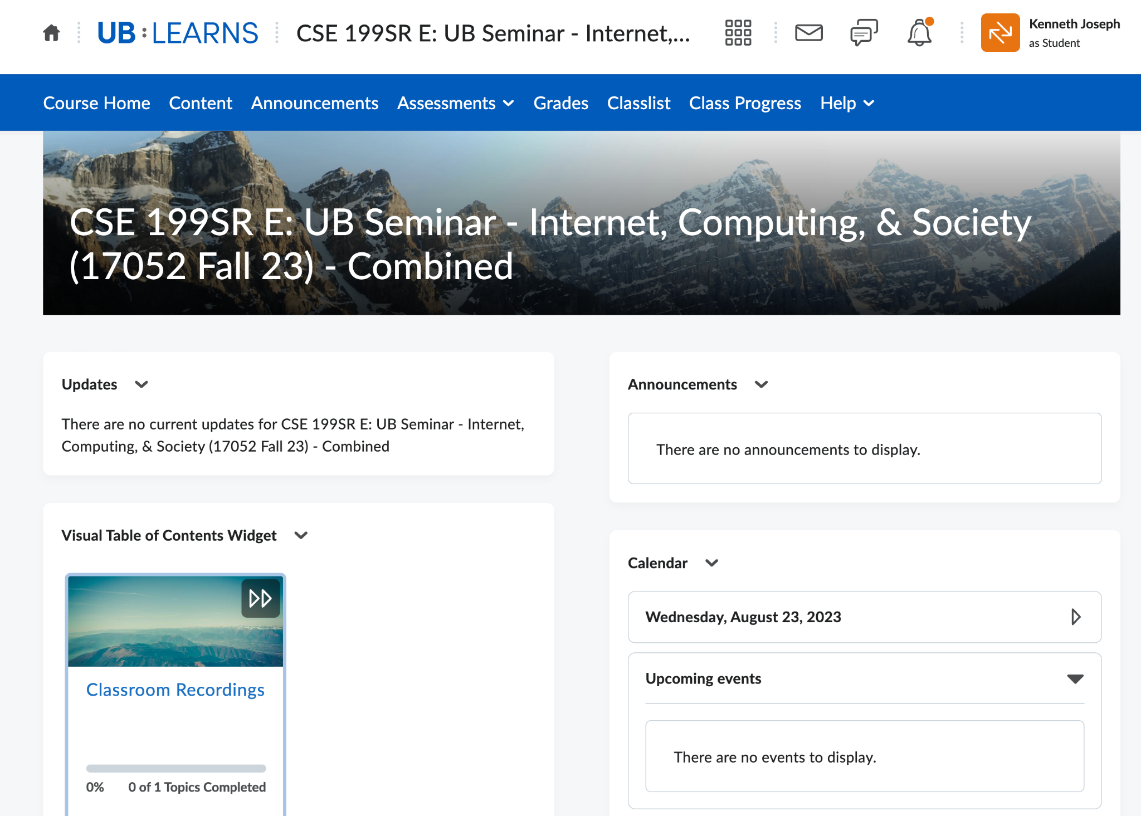
UBLearns -> Place you go to submit stuff and check your grades
You are responsible for all UBLearns announcement content. Turn on notifications!

Slide 22
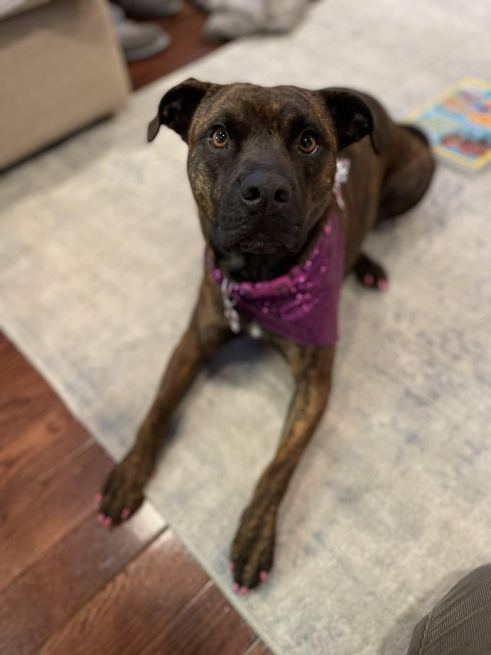
Josie, Kenny’s dog --->
Questions?!

Slide 23
Detailed Logistics, Part 1
Lecture and recitation attendance is mandatory!
We will take lecture attendance and measure participation with TopHat (more later).
Recitation attendance will be done by TAs
Module HWs are due Wednesday at 11:59PM, and must be submitted to UBLearns as PDF

Slide 24
Details, Part 2 - Attendance
We will take attendance now, to show you the process.
We are using TopHat for attendance, and to ask questions periodically during class to confirm your understanding. Sign up before next lecture! You must get a subscription to TopHat, the free trial will expire before class, and will cause you trouble.
For future lectures, attendance information:
Will be put up before class starts
Must be entered in the first ten minutes of class. You must arrive within the first ten minutes, or be counted absent!
For every 3 lectures or recitations that you miss, we will downgrade your letter grade by one (e.g., A to A-, then to B+, etc.).
Notes:
Instructors should bring up the TopHat section at this point and start attendance, so students can see the six-digit code and students with TopHat accounts can enroll and sign in. Don’t expect the entire class to sign in today, and let them know that’s OK.

Slide 25
Details, Part 3 - Grading
Grading will generally use the following scheme:
0 pts: No submission or no attendance
1 pt: Clearly no effort for the assignment/activity
2 pts: Partial effort
3 pts: Full effort
(Following Bill Rapaport’s scheme: https://www.cse.buffalo.edu/~rapaport/howigrade.html)

Slide 26
Grading, cont.
Absolute based on total points earned (not curved)
A: 92.0% -100.00% A-: 88.0% - 91.9%
B+: 84.0% - 87.9% B: 80.0% - 83.9% B-: 76.0% - 79.9%
C+: 72.0% - 75.9% C: 66.0% - 71.9% C-: 62.0% - 65.9%
D+: 58.0% - 61.9% D: 50.0% - 57.9%
F: 49.9% or below

Slide 27
Details, Part 4 –Recitation
The structure of recitations is the same each week:
Enter and sit with your group (you’ll find this out on Thurs/Friday!)
Open up the recitation assignment (on the course website!)
Wait for any instructions
Create a shared Doc/Slide deck and begin working
With 7 minutes left:
Fill out the Weekly Reflection in UBLearns
One group member submits your recitation work

Slide 28
Recitation – Weekly Reflections
We want to better understand your experience during recitations and how that changes over the course of the semester
What you’ll do:
Complete an anonymous few Likert scale responses about your group work experience
Answer 1-3 non-anonymized responses about your semester. Questions might include:
How is CSE 115 going?
What did you like least about this recitation?
How can we make CSE 199 better?
…

Slide 29
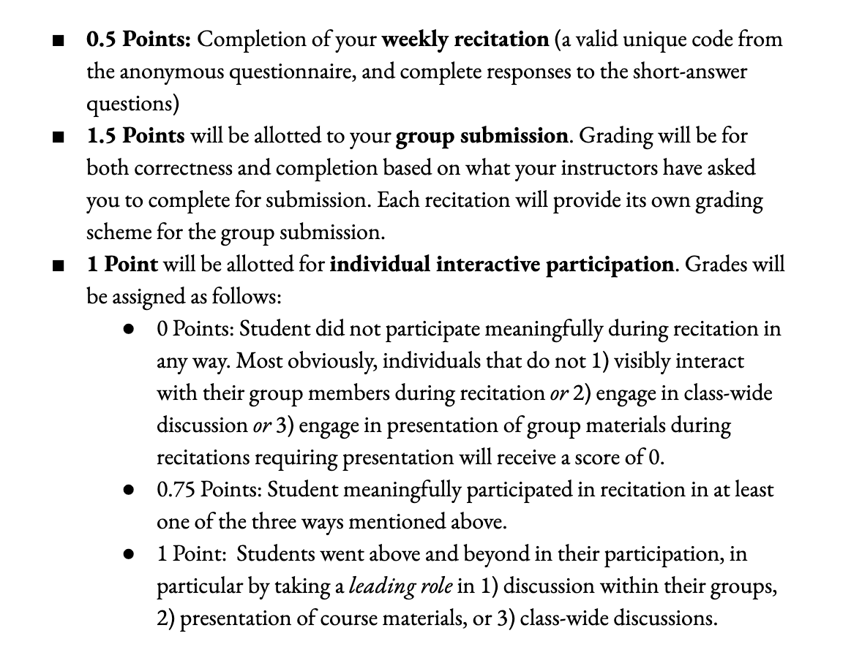
Details, Part 4 –Recitation
Recitation grading: details in the syllabus, but we’ll cover them briefly here as well…

Slide 30
Details, Part 5 – 2023 CSE Cohort Survey
What?
Three 10-15 minute-surveys at the beginning, middle, and end of the semester that you can complete anywhere.
Anonymous to the CSE-199 teaching team and all UB faculty. We will never be able to associate responses to an individual student.
Completing the surveys will count toward your grade!
If >80% of your section finishes all 3 surveys, you all get BONUS POINTS
Why?
To learn about your goals for the future, what motivated you to pursue CSE, and what challenges you foresee in the coming years.
To create a welcoming environment for everyone in CSE.

Slide 31
Details, Part 6 – Academic Integrity
Academic Integrity (AI) is very important to the University process!
In this course, your deliverables are largely:
Assignments
In-class participation and attendance
Falsifying your attendance, helping another to falsify their attendance, sharing TopHat quiz answers, copying from others for assignments, etc. are all AI violations.

Slide 32
Academic Integrity, cont.
AI violations will result in receiving at most a B- in this course. There will be no exceptions.
On average, around 10-12 students are punished for AI violations in CSE 199 every year. Last year, because of GPT, it was quadruple that number. People have failed from this course because:
They shared a TopHat attendance code with someone who was not in class
They copied someone else’s homework
…

Slide 33
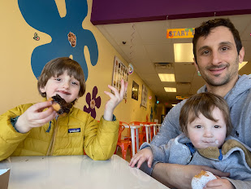
The most important part about AI!
If you’re having trouble, contact course staff. We’re here to help!
If the faculty make you nervous, contact the TAs!
But faculty shouldn’t make you nervous! We want you to succeed. You failing is bad for you, but it is also bad for us.
< not scary
Unintimidating >

Slide 34
(The other) AI, continued.
Academic integrity violation records will be kept by the university.
You will likely lose your scholarship if you have one.
Future employers can request academic integrity records (e.g., law enforcement, certain government sectors, etc.)
Medical and law schools often request academic integrity records.

Slide 35
(The other) AI, continued.

Slide 36
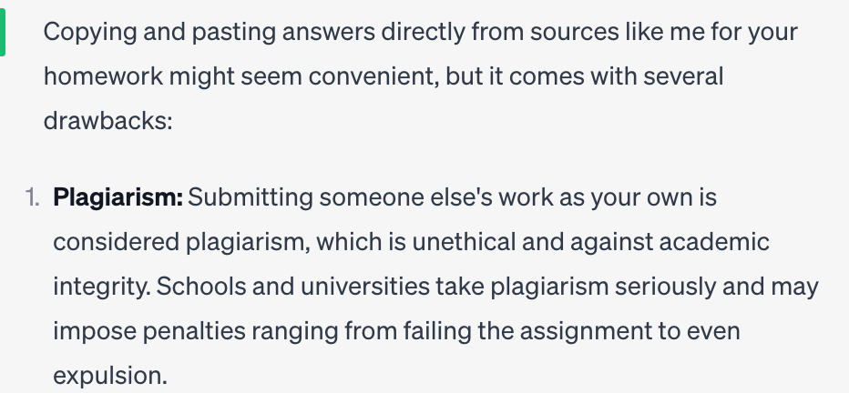
(The other) AI, continued.
Several times throughout this class (and your majors!) we will directly ask you to engage with Large Language Models (LLMs). But if you use an LLM to do your homework, and we catch you, this is plagiarism.
If you’re not sure, ask.

Slide 37
Why will we make sure we catch you?
Because our job is to train you to go out in the world and do great things. How well we train you reflects on you, your peers, UB as a whole, and us.
And you will not learn by copy/pasting from GPT

Slide 38
(The other) AI, continued.
In short:
Most of you are in a major where many of the faculty are actively developing technologies that use and/or help improve LLMs. We love technology! We think there are great uses of it!
But our first priority is that you learn. And you will not learn by copy/pasting from an LLM.

Slide 39
Please, please don’t cheat
If you cheat, and we catch you, we will make sure it goes on your record, even though we are not scary or mean and we really hate doing it. There will be no exceptions.

Slide 40
Details, Part 7–Fall Break
UB has instituted a new Fall Break, on 10/14-10/15
We will obviously not have lecture on 10/14. Otherwise, nothing else will change

Slide 41
Questions?!

Slide 42
Your Three Current TODOs
You have three TODOs
Get access to TopHat (by WEDNESDAY)
You will get an email TONIGHT with instructions on how to do so
TopHat costs $$, if this is a problem, email the Head Instructor:
Professor Joseph: kjoseph@buffalo.edu

Slide 43
Your Three Current TODOs
You have three immediate TODOs
Get access to TopHat (by WEDNESDAY)
Complete the first CSE Cohort Study (due NEXT Weds.)
You’ll get information on how to do this on Wednesday

Slide 44
Your Three Current TODOs
You have three immediate TODOs
Get access to TopHat (by WEDNESDAY)
Complete the first CSE Cohort Study (due NEXT Weds.)
Complete your 8 Hours without the Internet Assignment (due NEXT TUESDAY)
… details on next slide…

Slide 45
8 Hours without the Internet
For your first assignment (due next TUESDAY), you must:
Go 8 hours without using the Internet
Make a slide deck that includes:
A journal of your time without the ‘net (Slide 1)
A slide you’ll present to the class in Recitation 2 (Slide 2)
A slide with a link to your Powerpoint that is accessible by the TAs
Your instructor will now show you how to access the assignment via the website & Brightspace
Note: this is the only thing you’ll have due on a Tuesday. All assignments will typically be due Wednesday (TAs need time to create the slides!)
Notes:
Atri Q: Does this have to be continuous 8 hours? And do students have to be awake :)?
Kenny A: Yes and Yes (You should maybe show them the assignment on the website at this point)

Slide 46
Questions?!

Slide 47
A common question, answered!
Why does this course have such a weird structure?
We want to expose you to different topics in CSE!
One day you will have to choose electives; this will help
One day you will have to work or do research across subdisciplines of CSE; this will help.
We want to expose you to different teaching styles
You will encounter these (and other styles!) later
Learn what works for you, and how to get what you can out of what doesn’t

Slide 48
General Learning Outcomes
Learning from different styles of instruction
Collaboration in activities
Understanding how to handle various lab/recitation/seminar/lecture type activities
Attention to detail (please read instructions carefully!)
Exposure to many concepts you may encounter throughout life, or studying various areas of STEM+C

Slide 49
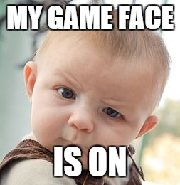
Yay! See you Wednesday for our Alumni Panels

