Slide 1
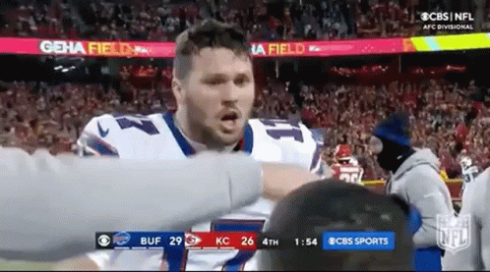
Lecture 2: Game Time!

Slide 2
Today
Submit your attendance on TopHat (now)
TopHat Quiz Game!
But first: announcements and reminders

Slide 3
Emails
All emails (in any course, but especially 199) should include:
  Your name
  Your person #
  The course number 199
  Your Recitation Section (e.g. A1 / F1)
If your emails do not contain this information, you will not receive a response
Regardless, give faculty two working days (M-F 9-5) to respond to emails before checking back!

Slide 4

Your Four Current TODOs
Get access to TopHat (by WEDNESDAY)
Complete the first CSE Cohort Study (due TUESDAY)
Complete your 8 Hours without the Internet Assignment (due TUESDAY)
Complete the Academic Integrity module on UBLearns (due 9/8)
Instructions on how to complete all of these are on UBLearns in announcements and are assigned as Assignments

Slide 5
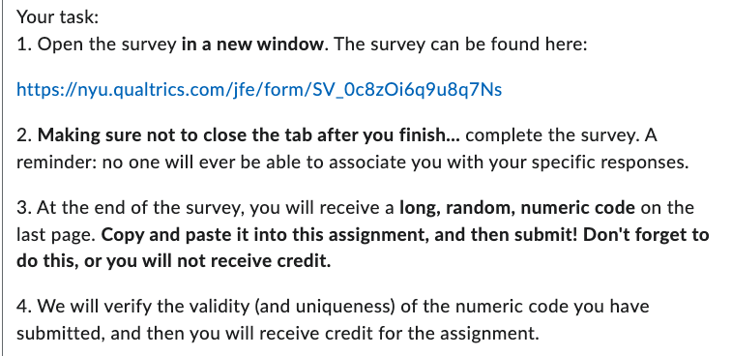
Cohort Survey Details
Go to UBLearns
Find the “2026 CSE Cohort Survey 1” assignment
Follow the directions
Directions you will see on UBLearns

Slide 6
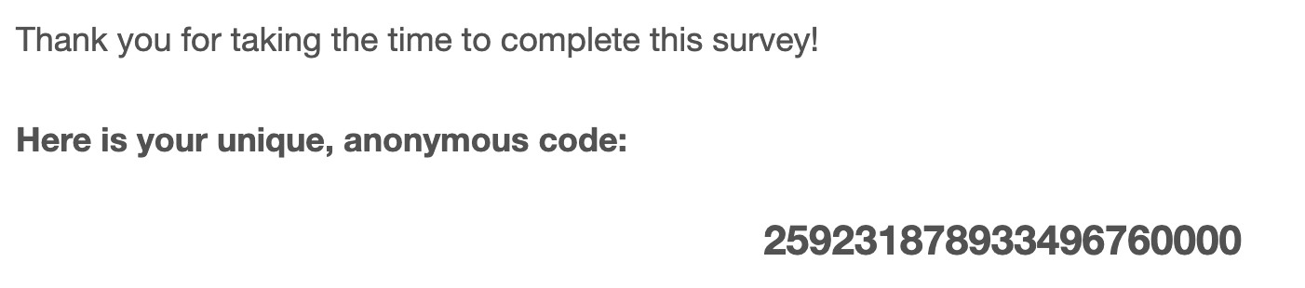
Cohort Survey Details: What your code will look like
The codes are 20ish digits long. You need a valid and unique one to obtain credit.
(Fun game: What are the odds you could guess a valid code?!)

Slide 7
Some reminders
Slides from Monday are up on the course website
Regularly check your own email!
Regularly check UBLearns announcements and turn on notifications!
Remember that your grades will not immediately appear for HW submissions, TAs have to grade them

Slide 8
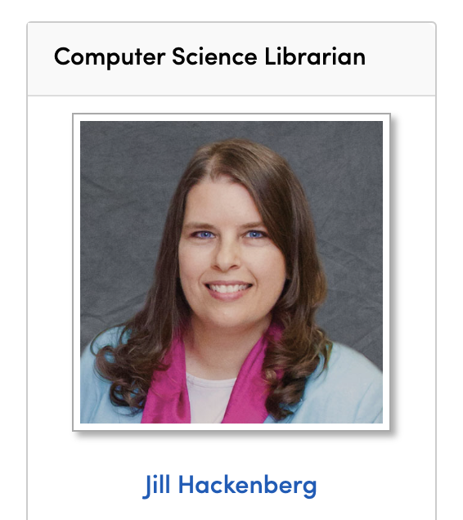
Some additional resources
Libraries still exist, and they can be incredibly useful!
Our librarian is Jill Hackenberg
See what she can do for you here:
https://research.lib.buffalo.edu/cs/library-intro

Slide 9
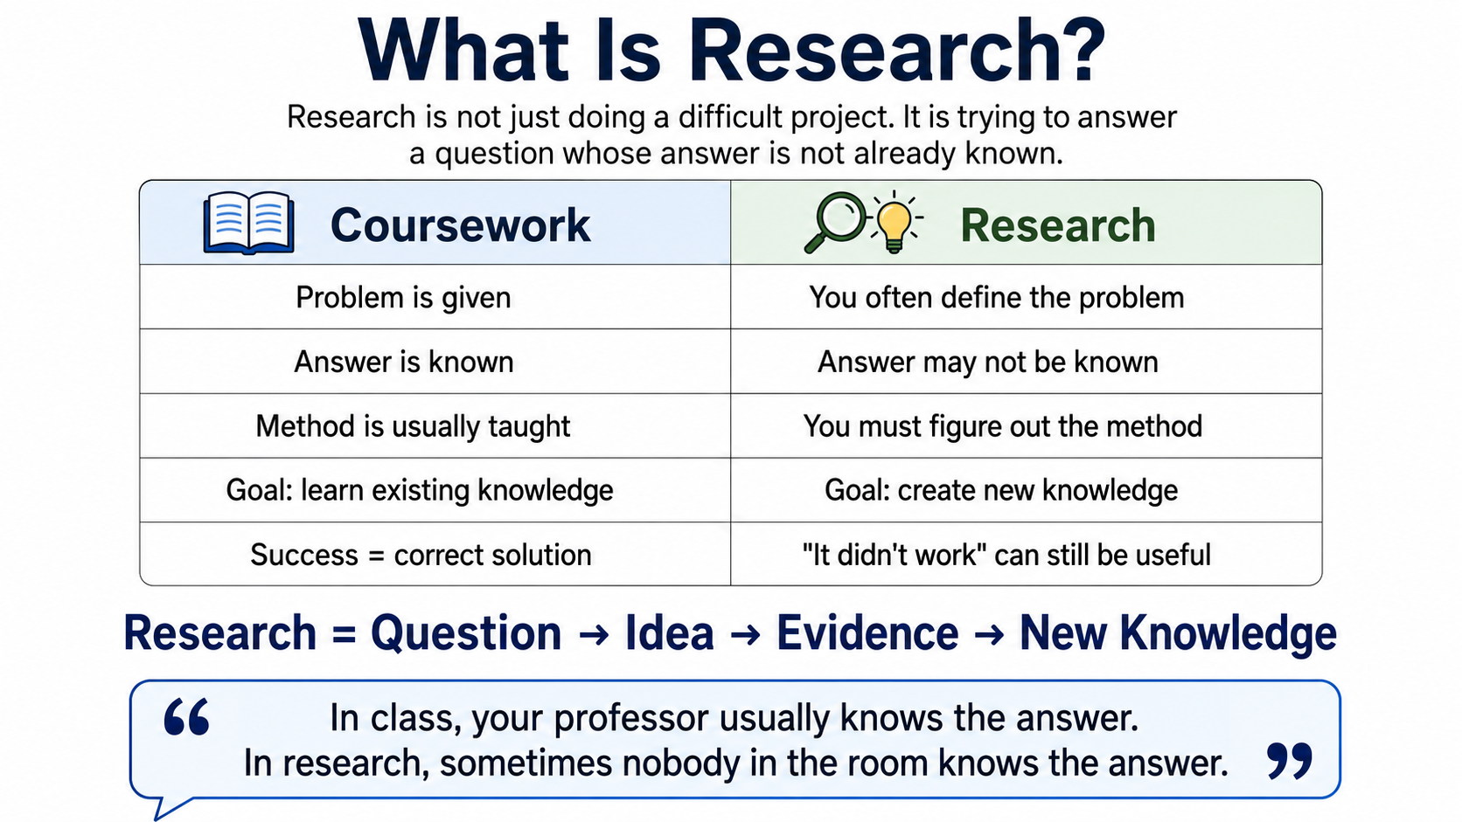

Slide 10
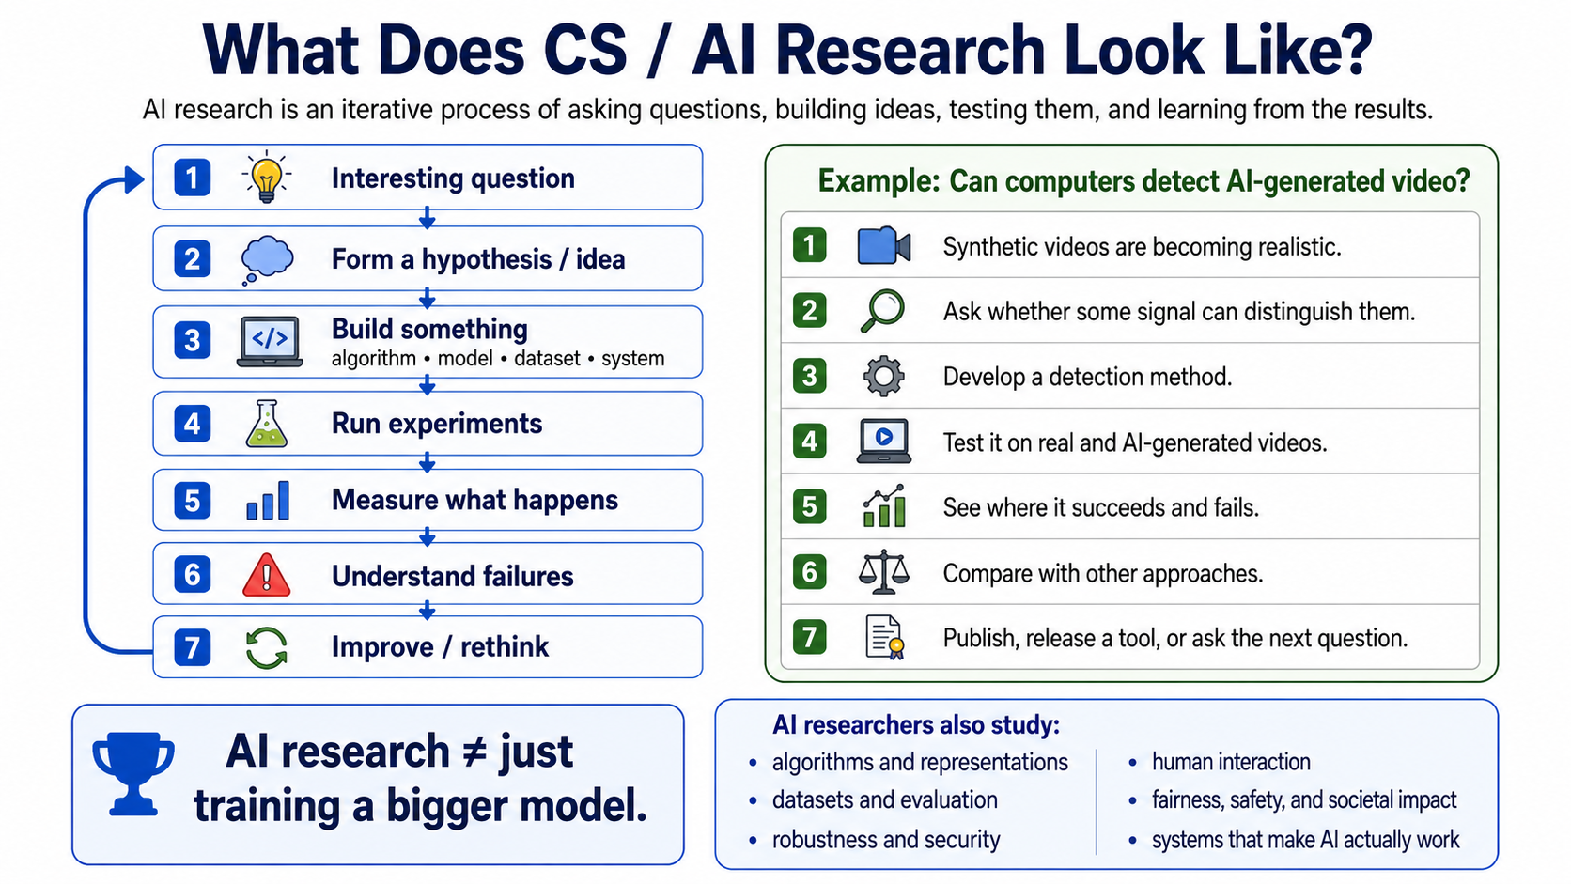

Slide 11
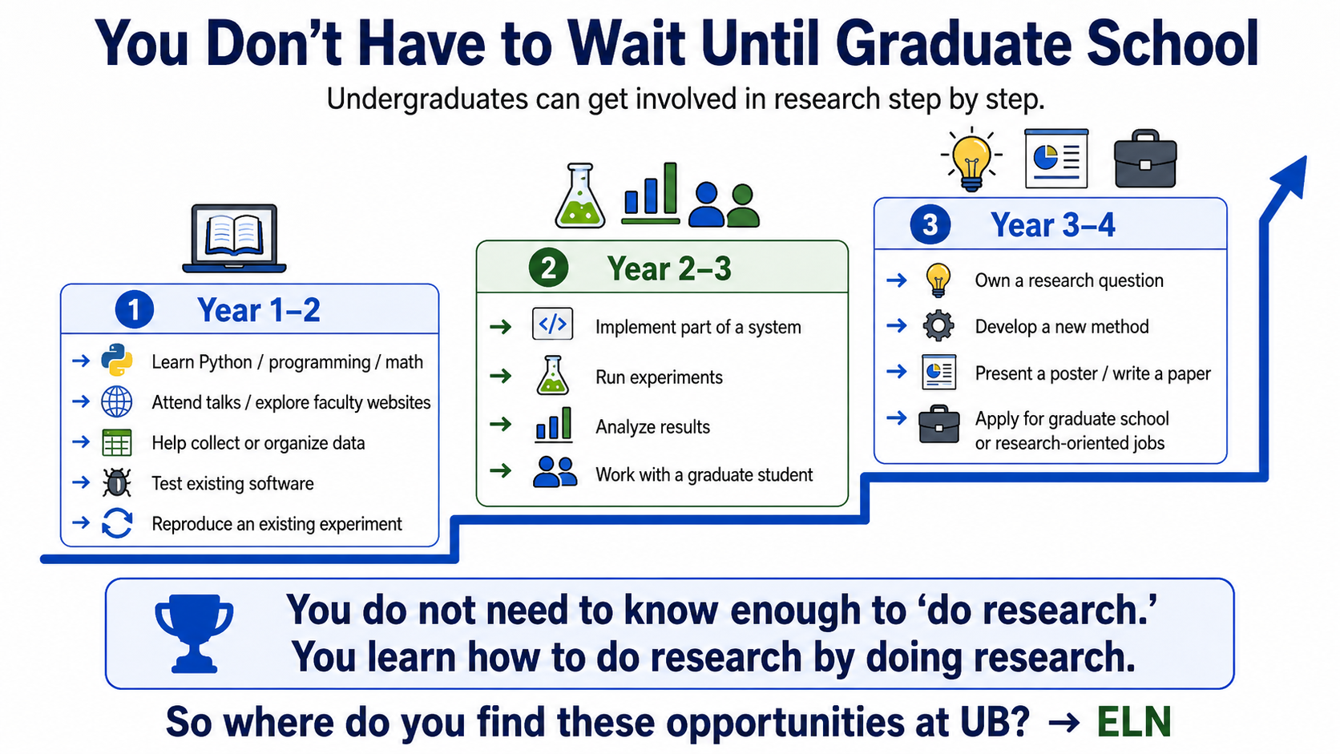

Slide 12
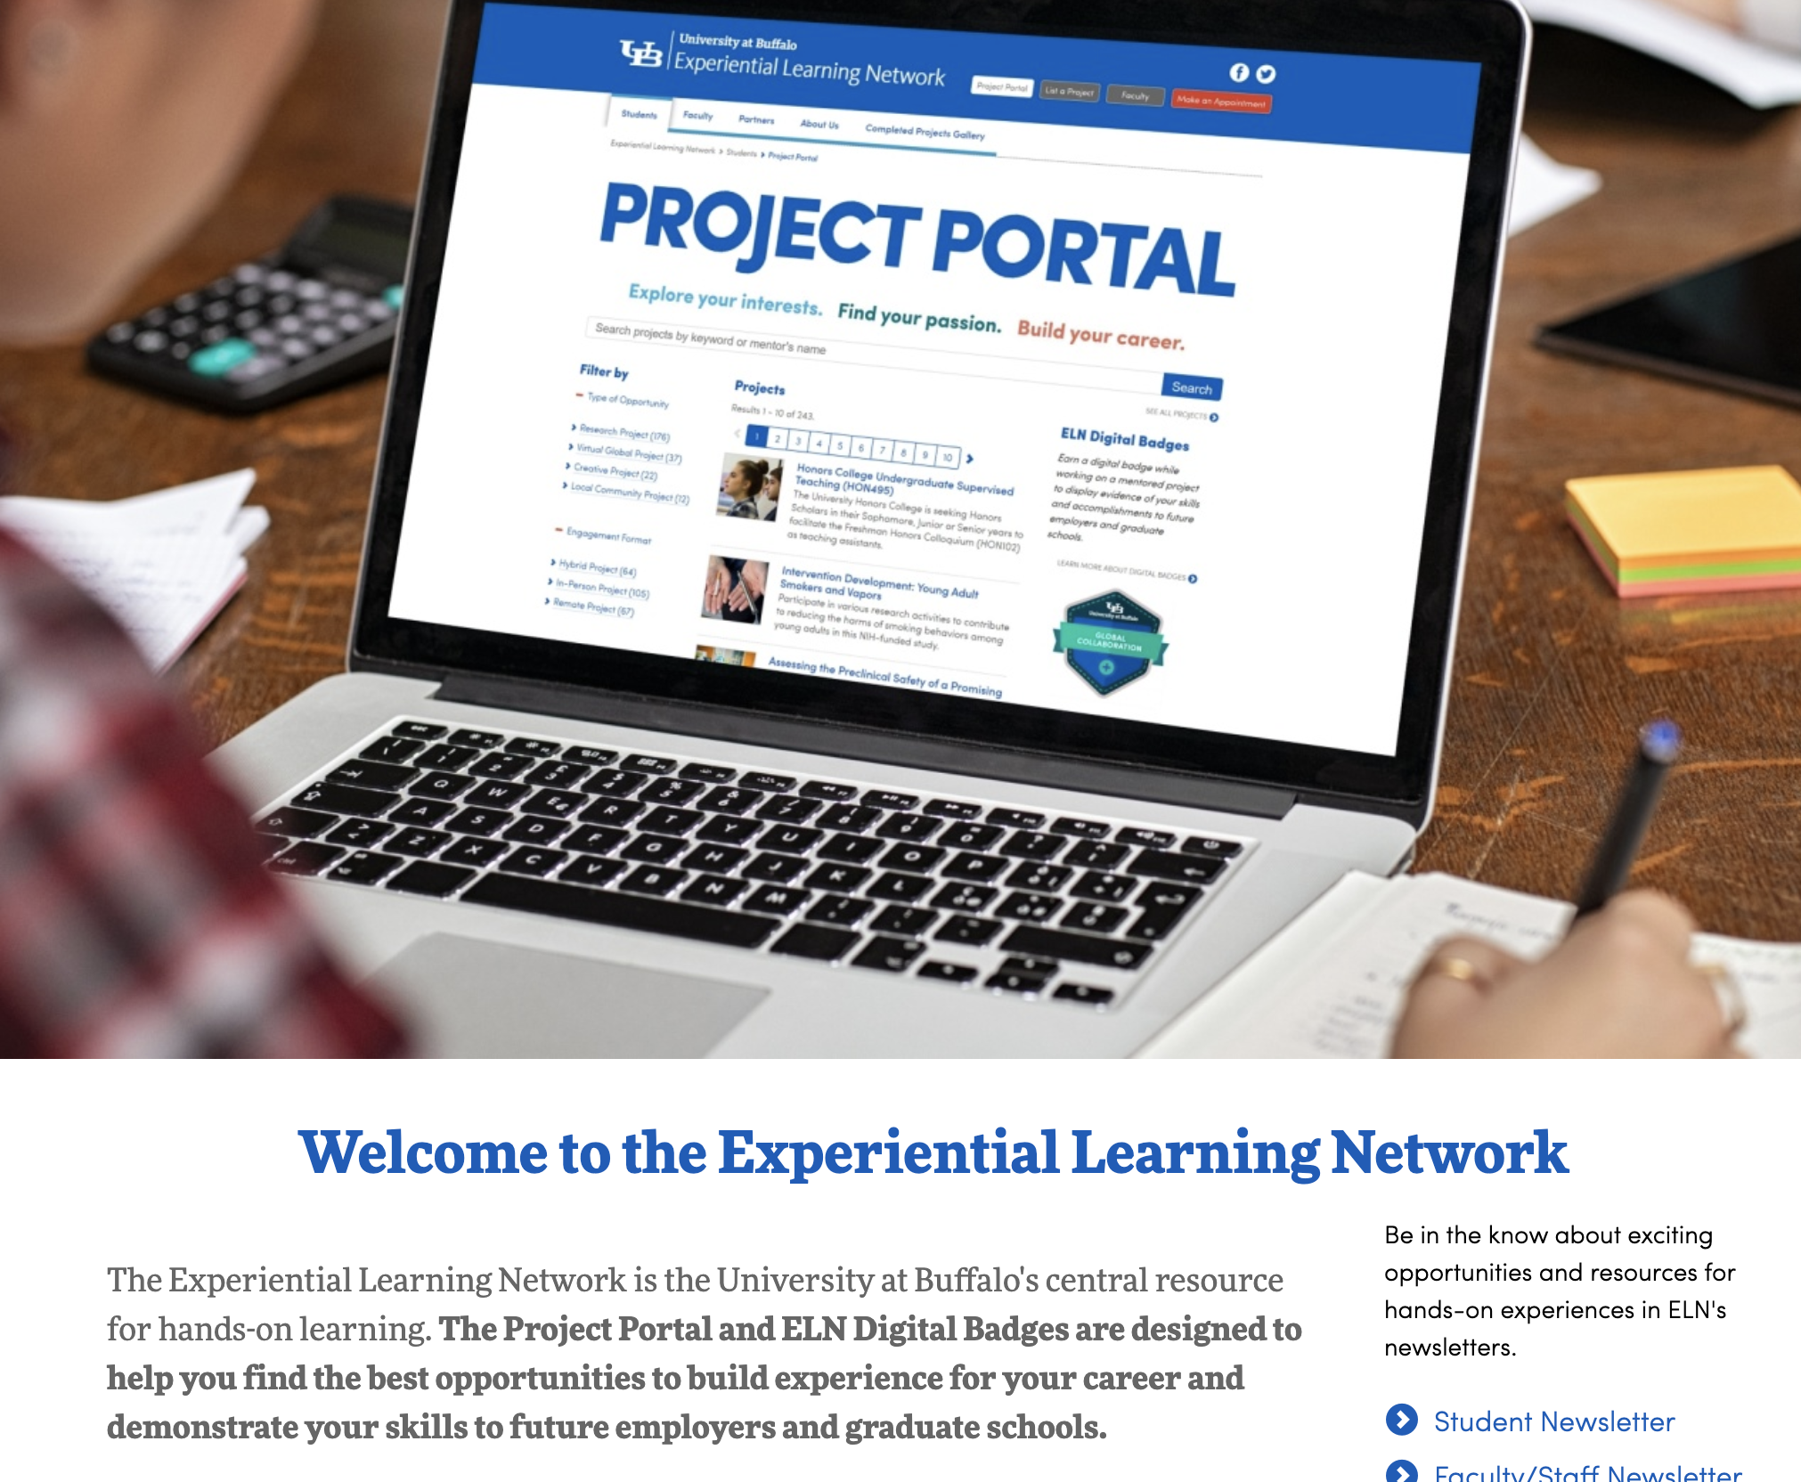
Additional Resources - ELN
The Experiential Learning Network at UB is a place to find projects (with CSE faculty and others) to work on to advance your skills in your chosen field!
https://www.buffalo.edu/eln.html

Slide 13

Game time!

Slide 14
Rules of the Game
The Recitation Section with the most correct answers will receive 2 bonus points
You absolutely may discuss with your neighbors… but remember, if they’re not in the same section, you’re competing against each other :)
If you do not have TopHat, for some reason, you can help someone in your own section!
We’ll now give you two minutes to get situated!

Slide 15
The questions
The quiz game will have questions about:
  The CSE 199 Syllabus
  Your instructors
  General CSE trivia
  The CS and CEN majors at UB
  The CSE Department
  General UB Trivia

