Slide 1
Lecture 2: Game Time!

Slide 2
Today
Submit your attendance on TopHat (now)
Panel with UB CSE Alumni!
But first: announcements and reminders

Slide 3
Emails
All emails (in any course, but especially 199) should include:
Your name
Your person #
Your Recitation Section (e.g. A1 / F1)
If your emails do not contain this information, you will not receive a response
Regardless, give faculty two working days (M-F 9-5) to respond to emails before checking back!

Slide 4
Your Three TODOs this week
You have three TODOs
Get access to TopHat (Today)
Reminder: This needs to be done through UBLearns
Complete your 8 Hours without the Internet Assignment (Already assigned, due NEXT TUESDAY)
Complete the first CSE Cohort Study (already assigned, due next Wednesday)

Slide 5
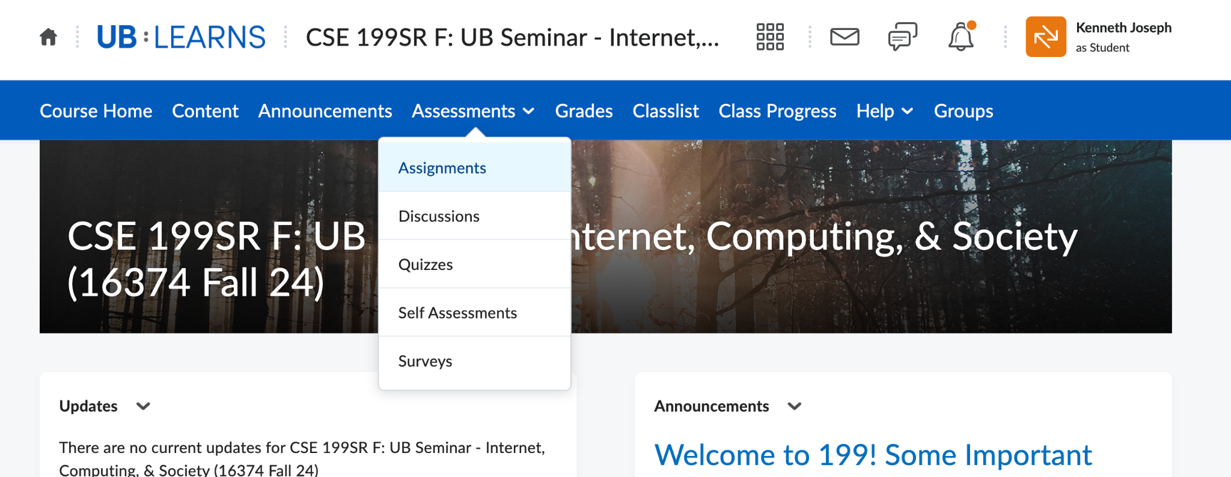
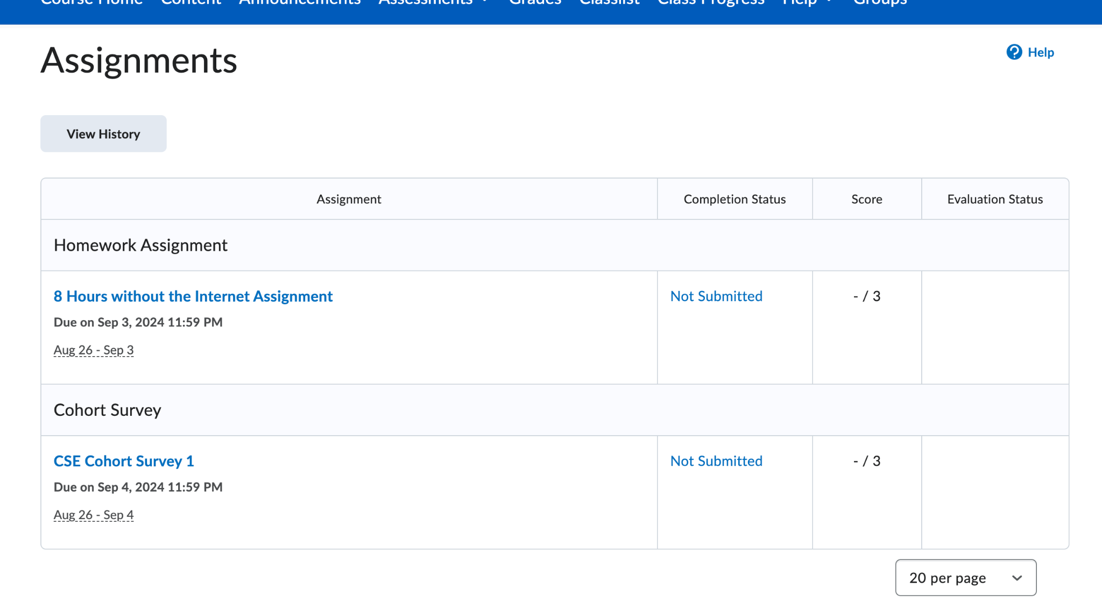
Where to find the 8 hours assignment

Slide 6
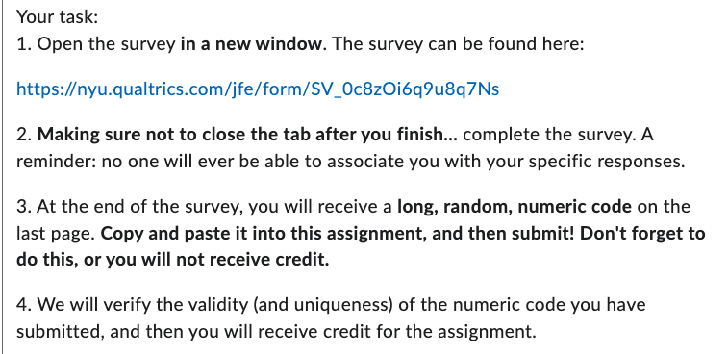
Cohort Survey Details
Go to UBLearns
Find the “CSE Cohort Survey 1” assignment
Follow the directions
Directions you will see on UBLearns

Slide 7
Cohort Survey Details: What your code will look like
The codes are 20ish digits long. You need a valid and unique one to obtain credit.
(Fun game: What are the odds you could guess a valid code?!)
Notes:
The odds of correctly guessing a 20-digit code are 1 in 10^{20}, which is a 1 in 100,000,000,000,000,000,000 chance.
This probability is extremely low, making it almost impossible to guess the correct 20-digit code by chance.

Slide 8
Your Three TODOs this week
You have three TODOs
Get access to TopHat (Today)
Complete your 8 Hours without the Internet Assignment (Already assigned, due NEXT TUESDAY - Not Wednesday)
Complete the first CSE Cohort Study (Assigned via UBLearns tomorrow at 7pm, due Wednesday)

Slide 9
Some reminders
Please:
Regularly check your own email
Turn UBLearns notifications on
Remember that your grades will not immediately appear for HW submissions, TAs have to grade them

Slide 10
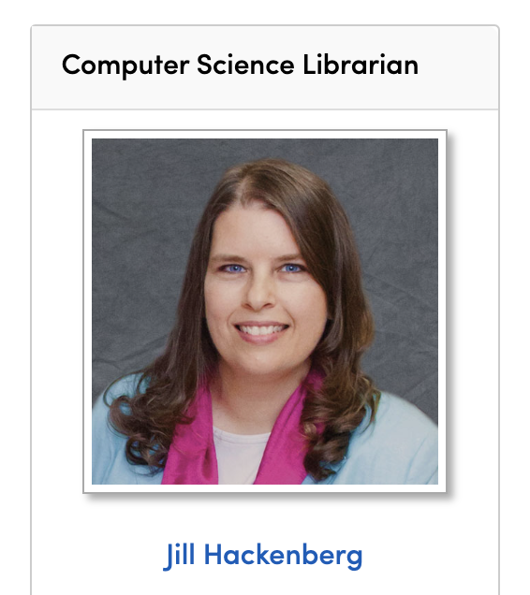
Some additional resources
Libraries still exist, and they can be incredibly useful!
Our librarian is Jill Hackenberg
See what she can do for you here:
https://research.lib.buffalo.edu/cs/library-intro

Slide 11
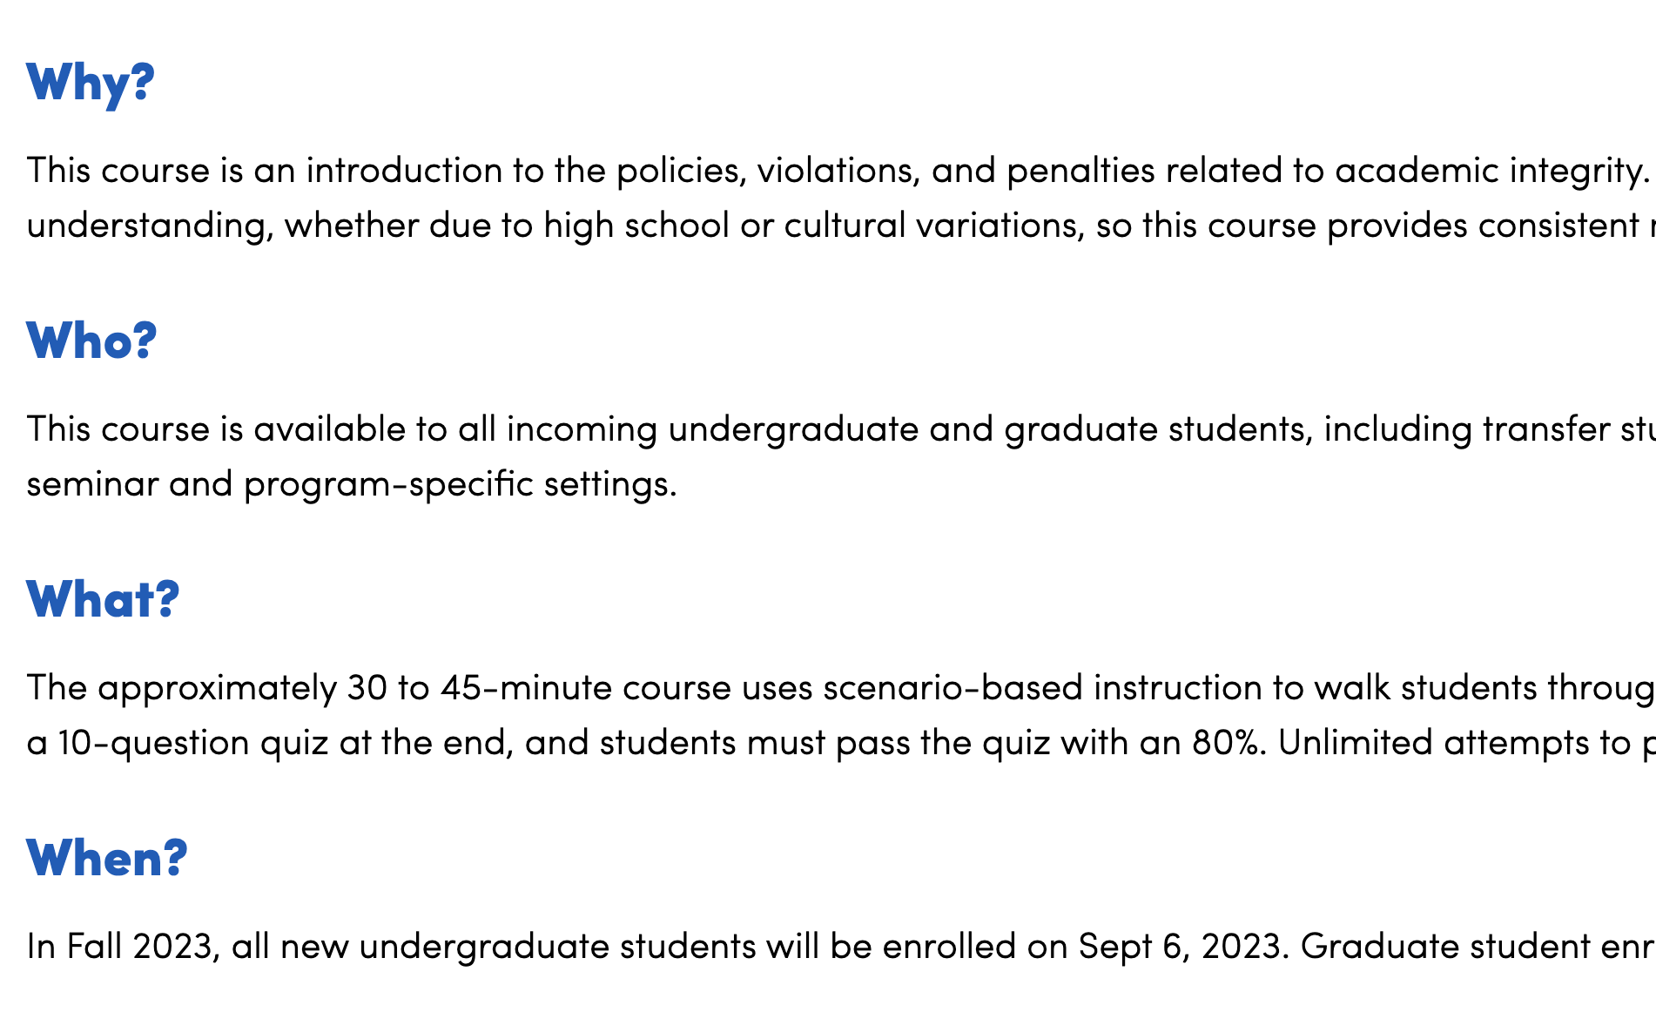
Some additional resources - AI
Consider taking the “Academic Integrity at UB” course (available on Brightspace)
Particularly if you are new to the U.S. education system, this is likely to be helpful!
https://www.buffalo.edu/academic-integrity/resources/Academic-Integrity-at-UB.html

Slide 12
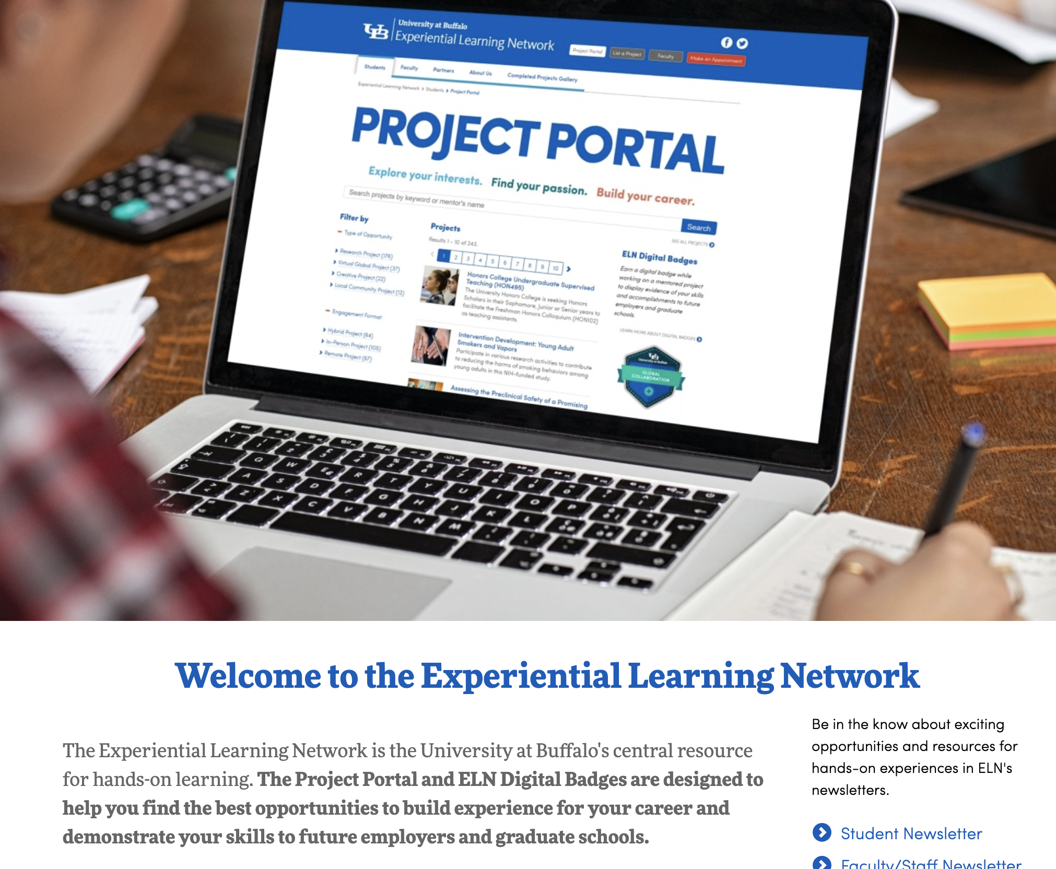
Additional Resources - ELN
The Experiential Learning Network at UB is a place to find projects (with CSE faculty and others) to work on to advance your skills in your chosen field!
https://www.buffalo.edu/eln.html

Slide 13
Alumni Panel!

