Slide 1
CSE 707 SEMINAR
Cybersecurity Attacks in Vehicular Sensors
Paper by - Zeinab El-Rewini, Karthikeyan Sadatsharan, Niroop Sugunaraj,
Daisy Flora Selvaraj, Siby Jose Plathottam, and Prakash Ranganathan
Presentation by - Sai Saran Putta, Sarthak Jain, and Shrishti Karkera under the supervision of Prof. Shambhu Upadhyaya
Notes:
https://docs.google.com/presentation/d/e/2PACX-1vQvmymgwoCt2CChCWPEpJqnzeKVNBRRuA5L4jDDlOElOVpg3BTv9MDR1z776OX8BloqyfFihORCeV3T/pub?start=true&loop=false&delayms=20000

Slide 2
Overview
Introduction
The Sensing Layer
Environment Sensors
Vehicle Dynamics Sensors
Future Outlook
Conclusion
Notes:
We will start with a brief introduction about vehicular sensors, various usecases that require sensors. Then we will see what kind of challenges that are arising with the use of these sensors. Then we ll briefly touch upon the three-tier automated vehicle architecture.
in the second section, we ll study the sensing layer. here we ll see different types of sensors especially VD and env sensors. What kind of attacks are possible on each types and differect vectors through which these attacks are carried out. at the end of this section, we ll define the safety
In third section we will study some crucial environmental sensors, potential threats and their counter measures
In fourth we ill see some VD sensors, threats and counter measures
In fifth section, we wll go through some futuristic technologies that csn be used to secure vehicular networks
In the end, we ll conclude the presentation.

Slide 3
Introduction
Vehicles are becoming more autonomous day by day.
Why do we need sensors in vehicles?
Automatic headlights, automatic windshield wipers, adaptive cruise control, lane assist etc.
Notes:
we are rapidly approaching an age where vehicles are becoming more and more autonomous. When we think about autonomous vehicles, a very few vehicles to our mind like teslas. But if you think about it, modern vehicles are all autonomous to a certain degree. Even the cars back home in india. Many cars now have automatic headlights, windshield wipers, adaptive cruise control, lane assist etc. Tesla has taken this leaps ahead with their full self driving capability. How is it being acheived? with the help of sensors.
for each usecase, there are bunch of sensors which identify the trigger and relay it to car control system. which then activates the required functionality.

Slide 4
Introduction
Cyber physical systems:
High degree of coupling, cohesiveness and interaction between physical systems and digital systems
Makes it vulnerable to cyber attacks which compromise the physical systems
Notes:
Modern verhicles are increasingly becoming cyber physical systems. modern vehicles contain 60 to 100 sensors.
CPS are integrated systems that combine physical processes with computing and communication components. acts as bridge between physical world and digital world enabling seamless interactions between physical processes and computer systems
they are becoming more vulnerable to cyber attacks. By attacking the cyber components, physical components get compromised.

Slide 5
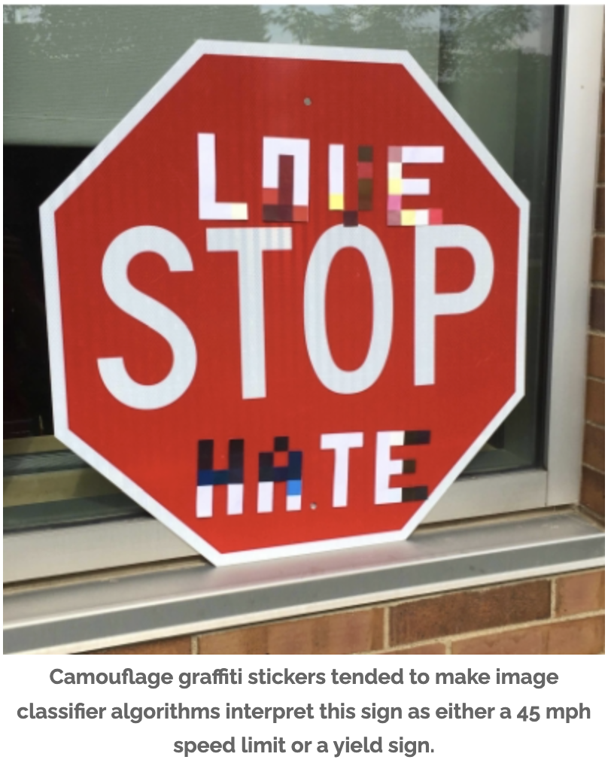
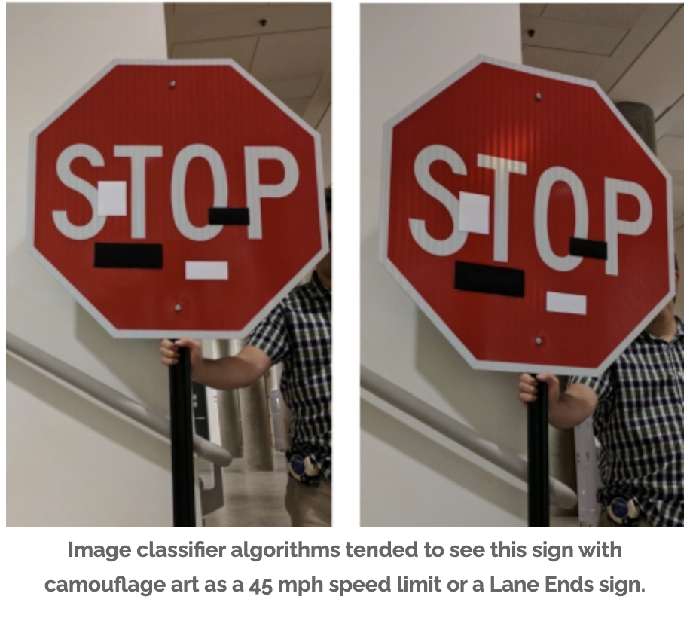
Introduction
Vulnerabilities
Threats are increasing with increasing
usage of sensors.
Data is less as OEMs fix them
immediately.
Robust Physical-World Attacks on Deep Learning Visual Classification, 2018, https://arxiv.org/pdf/1707.08945.pdf
Notes:
Autonomous vehicles perceive the world through sensors. Sensors monitors roadways, recognize street signs, identify collision threats
Humans can make correct judgements by drawing upon their experiences when these perceptions are prevented or misleading
Michigan university research
The research in this area is very difficult as there is no sufficient data. Because OEMs fix these issues as & when they happen through OTA updates.

Slide 6
Introduction
Other vulnerabilities:
Sensors are not the only weak points.
OTA updates : malicious updates by hackers
Roadside infrastructure: personal data can be stolen from cloud when vehicle connects to unsafe roadside networks.
Supply chain must be secured too.

Slide 7
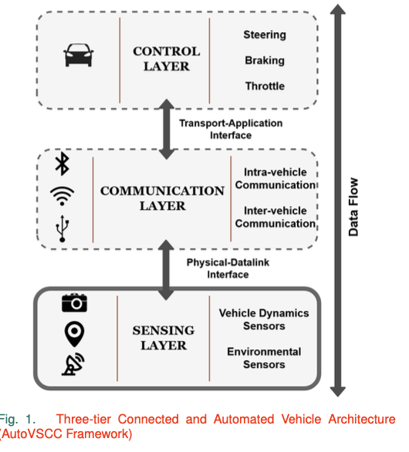
Introduction
Three-Tier Framework for Automotive Systems
Threats to sensing layer:
Jamming the GPS, eavesdropping on TPMS etc
Threats to comms layer:
Sending wrong messages, taking control of
vehicle through infotainment system.

Slide 8
The Sensing Layer
Crucial for smooth operation of vehicle
Eg: distance sensors allow adaptive cruise control to safely increase the speed.
Contains 60 - 100 sensors. Expected to rise to 200 in near future.
Types of sensors based on functionality:
Safety
Diagnostic
Convenience
Environment monitoring

Slide 9
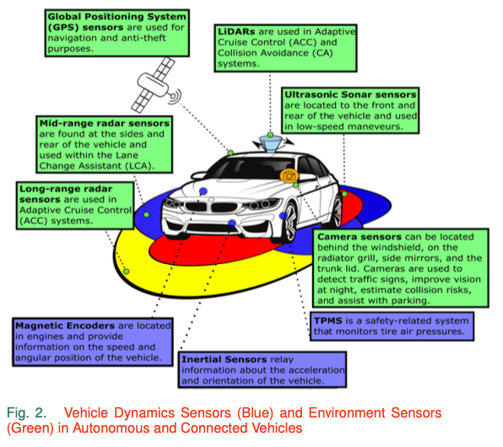
The Sensing Layer
Classification:
Vehicle dynamics sensors.
Environment sensors.
Another Classification:
Passive sensors
Active sensors

Slide 10
The Sensing Layer
Attack vectors:
Vulnerable to both physical and remote attacks
Physical mode: physical damage is done to sensors.requires access to sensors.
Remote mode: roadside, front/back/side, scenery attack.

Slide 11
The Sensing Layer
Various attack vectors

Slide 12
The Sensing Layer
Security Requirements:
Availability: Sensor data must be available for the smooth operation of vehicle.
Authorization: Only authorized sensors should collect and distribute information.
Confidentiality: Unauthorized sensors should not access/decrypt sensor data.
Freshness: Data should be collected frequently to maintain freshness.
Integrity: sensor information must not be tampered.

Slide 13
LiDAR
Light Imaging Detection and Ranging (LiDAR) systems rely on laser scanning techniques to generate a three-dimensional mapping of their surroundings.
A single laser pulse may generate several echoes if the pulse is not completely stopped when reaching an object. The LiDAR can then calculate its distance to the obstacle using the speed of light and the time between pulse transmission and reception of the echo
Types of LiDAR:
Solid State LiDARs
Scanning LiDARs
Applications Of LiDAR: Adaptive Cruise Control (ACC) and Collision Avoidance systems
Notes:
magnetic encoders,
inertial sensors,
Tire Pressure Monitoring Systems (TPMSs)

Slide 14
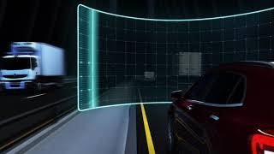

Slide 15
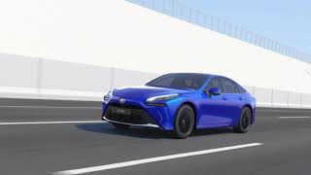
Notes:
magnetic encoders,
inertial sensors,
Tire Pressure Monitoring Systems (TPMSs)

Slide 16
Attacks on LiDAR sensors
• Replay Attack:
Attackers can receive and record signals sent by the LiDAR. At a later point in time, the attackers can conduct a replay attack by sending the recorded signals back to the LiDAR in order to cause the LiDAR to map non-existent objects
• Relay Attack:
Replay attacks can be extended in order to carry out a relay attack, which can disrupt the LiDAR’s ability to accurately gauge the distances of nearby objects. During a relay attack, attackers receive LiDAR signals and transmit those signals to a receiver in a different location. The second receiver can then send the signals back to the LiDAR leading to an incorrect map location of nearby objects.
• Spoofing Attack :
Spoofing attacks cause LiDARs to detect non-existent objects.
Notes:
magnetic encoders,
inertial sensors,
Tire Pressure Monitoring Systems (TPMSs)

Slide 18
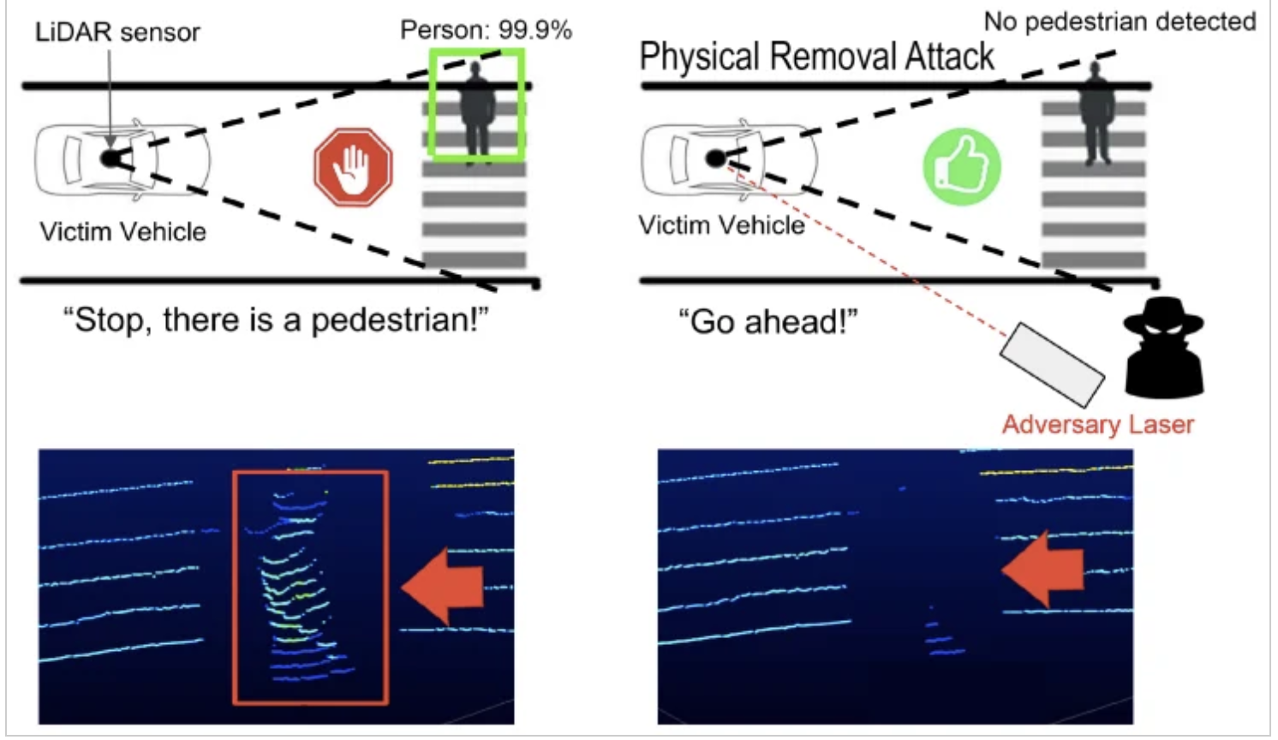
Attacks on LiDAR sensors
• Blinding Attack:
Blinding attacks are carried by injecting a light source of the same wavelength as the LiDAR’s pulses. The external light source will cause the LiDAR to experience saturation, which would effectively deny its services to the vehicle. LiDARs transmit infrared light pulses, so the attacker’s light source must have to be infrared light. As infrared light is not detectable by the human eye, blinding attacks can occur without the vehicle’s occupants’ knowledge.
Notes:
magnetic encoders,
inertial sensors,
Tire Pressure Monitoring Systems (TPMSs)

Slide 19
Attacks on LiDAR sensors
• Jamming Attack:
This type of Attack directly emits light back at the scanner unit on the vehicle that uses the same frequency band as the laser. The author in points out a low-cost, off-the-shelf system using a Raspberry Pi and a low-power laser to jam the LiDAR sensor of a vehicle.
• Denial-of-Service Attack:
Attackers can conduct denial of service attacks on LiDARS by injecting an enormous number of fake objects created using by jamming or spoofing. If the number of injected objects is larger than the maximum number of objects that a LiDAR can track, then the system becomes unstable.
Notes:
magnetic encoders,
inertial sensors,
Tire Pressure Monitoring Systems (TPMSs)

Slide 20
Countermeasures
An approach that guards against spoofing is modulating the LiDAR laser with side-channel information, thereby preventing attackers from injecting false reflection signals since they do not know the side channel’s secret key. It superimposes authentication fingerprint onto light wave itself. In the proposed method, amplification of laser output is directly modulated by power side-channel information leaked from a cryptographic device.
Notes:
magnetic encoders,
inertial sensors,
Tire Pressure Monitoring Systems (TPMSs)

Slide 21
Countermeasures
LiDARS could utilize signals of different wavelengths so that the attacker will have difficulty in targeting multiple wavelengths simultaneously.
LiDARs could incorporate random probing by varying the time interval between laser pulses. This will prevent attackers from being able to predict when they should inject fake pulses so that the pulses are reached within the interval.
Shorten the pulse period to lower the attack window. Denial-of-service attacks can be prevented by increasing the number of objects that are tracked at one time by the LiDAR sensor.
Notes:
magnetic encoders,
inertial sensors,
Tire Pressure Monitoring Systems (TPMSs)

Slide 22
Ultrasonic Sensor
Ultrasonic sensors can detect nearby obstacles and calculate their distance to the vehicle. The sensor emits an ultrasonic signal to detect nearby objects, which, upon reaching an obstacle, will be reflected back to the sensor. The time between the transmission of the signal and the reception of the reflected signal can then be used to calculate the distance of the obstacle to the vehicle.
Applications:
Ultrasonic sensors are often used to assist drivers in conducting tasks that are typically at very low speed (e.g., parking)
Notes:
magnetic encoders,
inertial sensors,
Tire Pressure Monitoring Systems (TPMSs)

Slide 23
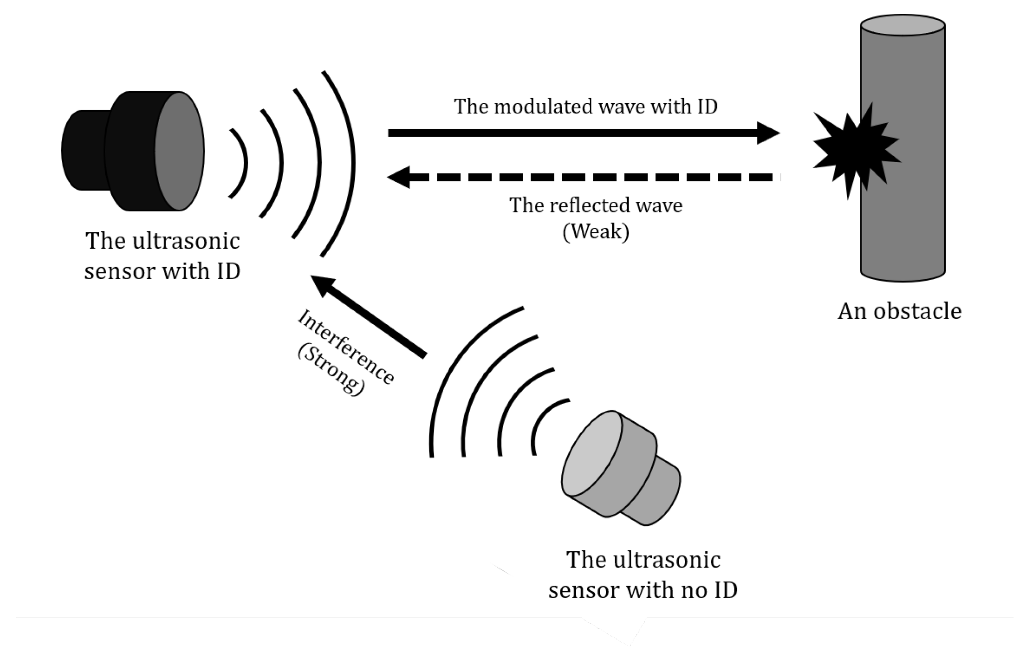
Attacks on Ultrasonic sensors
• Sensor Interference Attack: Attackers can conduct sensor interference attacks to interfere with the legitimate sensor’s measurements by placing their own ultrasonic sensors opposite to a vehicle’s ultrasonic sensors. When two sensors are placed opposite to each other, each sensor will receive the other sensor’s signals in addition to its own reflected signals.
Notes:
magnetic encoders,
inertial sensors,
Tire Pressure Monitoring Systems (TPMSs)

Slide 24
Attacks on Ultrasonic sensors
• Blind Spot Exploitation Attack:
Vehicle’s ultrasonic sensors cannot detect very thin objects in their blind spot region. Attackers can take advantage of this vulnerability by placing a thin object in a reversing vehicle’s blind spot so that the vehicle can collide with the object.
• Cloaking Attack :
Attackers conduct cloaking attacks in order to conceal the presence of nearby objects from the ultrasonic sensor . To conduct a cloaking attack, attackers can simply place sound-absorbent materials around obstacles so that the sensor does not detect them.
• Physical Tampering Attack:
Attackers can physically tamper with an ultrasonic sensor’s receiver and transmitter by covering them with scotch tape. Attackers can use this technique to cause ultrasonic sensor failure.
Notes:
magnetic encoders,
inertial sensors,
Tire Pressure Monitoring Systems (TPMSs)

Slide 25
Attacks on Ultrasonic sensors
• Acoustic Cancellation Attack:
Acoustic cancellation attacks can be used to eliminate legitimate ultrasonic signals. Attackers can cause an ultrasonic signal’s phase to become zero by transmitting an illegitimate signal with a phase opposite to the legitimate signal.
• Spoofing Attack:
During spoofing attacks, attackers direct ultrasonic signals toward an ultrasonic sensor. The false signals may be able to reach the ultrasonic sensor before the legitimate, reflected signals emitted from the sensor itself and thus may falsely perceive a non-existent object.
• Jamming Attack:
Jamming attacks occur when an attacker continually sends ultrasound pulses in the direction of an ultrasonic sensor. The sensor is then overwhelmed and unable to accurately gauge the vehicle’s distance to nearby objects
Notes:
magnetic encoders,
inertial sensors,
Tire Pressure Monitoring Systems (TPMSs)

Slide 26
Countermeasures
To counter blind spot exploitation, sensor interference, and cloaking attacks, sensor fusion and backup cameras can be used in order to verify the legitimacy and accuracy of ultrasonic sensor measurements.
Physical Shift Authentication (PSA) is one defense against simple spoofing, random spoofing, advanced spoofing, and jamming attacks. PSA randomizes the waveforms of the ultrasonic signal. The reflected signals will only be accepted if they correlate to the randomized waveform. The ultrasonic signal frequency is also continually changed to prevent jamming attacks.
Notes:
magnetic encoders,
inertial sensors,
Tire Pressure Monitoring Systems (TPMSs)

Slide 27
Camera
Within automated vehicles, cameras are necessary so that the vehicular system can identify its surroundings.
Applications Of Camera: These sensors are used for purposes such as detecting traffic signs, identifying hard-to-see objects during the night-time, showing drivers nearby obstacles while they are parking, avoiding collisions by using sensor data to track nearby objects and checking the validity of information gained from other sensors.
Notes:
magnetic encoders,
inertial sensors,
Tire Pressure Monitoring Systems (TPMSs)

Slide 28
Attacks on Camera sensors
• Blinding Attack:
Blinding attacks disable the functionality of the vehicle’s camera sensors. A strong laser beam focused at the camera leads to higher tonal values, and the attacker exploits this phenomenon to conceal the camera feed, causing complete blindness to the vehicular sensory inputs. This may lead to vehicle distortion or even emergency braking.
• Auto-Control Attack:
Auto-control attacks also target camera sensors. Attackers continually direct bursts of light at the camera in an attempt to manipulate the auto controls so that the image cannot stabilize. This type of attack can generally only be implemented in what [30] terms as a front/rear/side attack.
Notes:
magnetic encoders,
inertial sensors,
Tire Pressure Monitoring Systems (TPMSs)

Slide 29
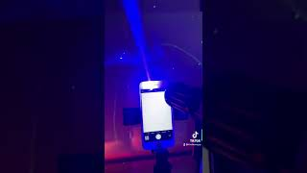

Slide 30
Countermeasures
To guard against blinding and auto-control attacks on cameras. Incorporating multiple cameras with the same view and near-infrared light filters capable of eliminating infrared light interference during daylight hours can be helpful.
The use of photochromic lenses, which can filter certain wavelengths of light.
Notes:
magnetic encoders,
inertial sensors,
Tire Pressure Monitoring Systems (TPMSs)

Slide 31
Radar
Radio Detection and Ranging (Radar) sensors emit electromagnetic signals and gauge the distance of nearby objects by determining the time elapsed from the moment the signal is sent to the moment the signal is detected by the radar’s receiver. Most radar sensors today operate within the millimeter wave (mmW) frequency band.
Applications Of Radar: Long-range radar sensors are used in Adaptive Cruise Control (ACC),
mid-range radar sensors are used as part of Lane Change Assistants (LCA),
and short-range radar sensors are used to alert drivers of potential obstacles while they are parking their cars
Notes:
magnetic encoders,
inertial sensors,
Tire Pressure Monitoring Systems (TPMSs)

Slide 32
Attacks on Radar sensors
• Jamming Attack:
During jamming attacks, attackers can jam radar sensors with a signal that is a part of the same frequency band .
• Spoofing/Relay Attack:
Spoofing/Relay attacks occur when malicious actors falsify signals and continually retransmitting a previous legitimate signal. Attackers can use a Digital Radio Frequency Memory (DRFM) repeater to store a signal, create a digital duplicate, and then continually retransmit the duplicate so that the radar will consider it to be a legitimate signal.
Notes:
magnetic encoders,
inertial sensors,
Tire Pressure Monitoring Systems (TPMSs)

Slide 33
Countermeasures
Filtering method that combats DRFM signals and would prevent both jamming and spoofing/relay attacks carried out using a DRFM repeater.
A hybrid filter that uses the modified Kalman filter and a Chi-squared detector to detect false data that is injected at random points and minimize the impact this data will have on radar sensor inputs.
Notes:
magnetic encoders,
inertial sensors,
Tire Pressure Monitoring Systems (TPMSs)

Slide 34
GPS
GPS is a system of 30+ navigation satellites circling Earth. We know where they are because they constantly send out signals. A GPS receiver in your phone listens for these signals. Once the receiver calculates its distance from four or more GPS satellites, it can figure out where you are.
However, since these receivers do not authenticate or encrypt signals and since the spreading codes used within GPS are public knowledge since GPS is an open standard with a transparent architecture, GPS communication is vulnerable to attack. As automated vehicles depend upon GPS, considers attacks on GPS systems within automated vehicles to be, along with attacks on the camera sensor, the highest priority in terms of automated vehicle cybersecurity.
Applications Of GPS: Connected and automated vehicles utilize the Global Positioning System (GPS) to obtain their location identity and geographic location
Notes:
magnetic encoders,
inertial sensors,
Tire Pressure Monitoring Systems (TPMSs)

Slide 36
Attacks on GPS sensors
• Jamming Attack:
During a GPS jamming attack, GPS sensor signals are jammed to prevent locating the vehicle. GPS jamming is one of the simplest attacks as GPS jammers are cheap and widely available. If enough radio noise is added to the GPS signal at the operating frequency (e.g., 1575.42 MHz), the receiver in the vehicle cannot distinguish the authentic signal.
• Spoofing Attack:
Spoofing attacks occur when an attacker takes advantage of GPS signals’ low power and supplies a false GPS signal with higher signal strength to overpower the original signal and compromise data integrity.
Attackers can either tamper with the GPS receiver so that it computes false locations and times or transmit data to interrupt the GPS receiver as it attempts to communicate with GPS satellites, thereby preventing the receiver from locating its position. Spoofing attacks can be used as a first step in conducting additional attacks, including replay and tunnel attacks.
Notes:
magnetic encoders,
inertial sensors,
Tire Pressure Monitoring Systems (TPMSs)

Slide 37
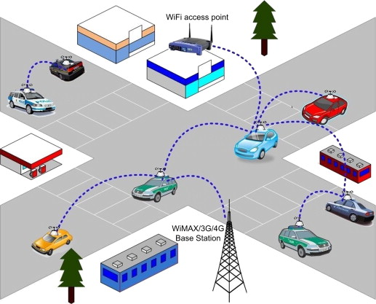
Attacks on GPS sensors
• Black Hole Attack:
In a black hole attack, an attacker deliberately causes the loss of information that was supposed to be forwarded from one vehicle to another.
This type of attack occurs within self-organized Vehicular Ad hoc NETworks (VANETs)
Notes:
magnetic encoders,
inertial sensors,
Tire Pressure Monitoring Systems (TPMSs)

Slide 38
Countermeasures
To combat GPS jamming attacks, incorporating inertial sensor measurements in the case of jamming attacks. To develop Receiver Autonomous Integrity Monitoring (RAIM) detection using measurements from both the GPS and the vehicle’s Inertial Navigation System (INS), which is comprised of inertial sensors.
The use of a secondary source or hybrid navigation system for GPS signals such as the European Union’s Galileo or India’s Indian Regional Navigation Satellite System (IRNSS) also called as NAVIC. To defend against GPS spoofing attacks,
The use of validation mechanisms such as monitoring GPS signals to ensure that any relative changes are within a threshold is a countermeasures for GPS spoofing, includes
Notes:
magnetic encoders,
inertial sensors,
Tire Pressure Monitoring Systems (TPMSs)

Slide 39
Countermeasures
As for black hole attacks, building multiple routes to the destination node. Road-Side Units (RSUs) and associated transportation infrastructure can aid in detecting black hole attacks.
Notes:
magnetic encoders,
inertial sensors,
Tire Pressure Monitoring Systems (TPMSs)

Slide 40
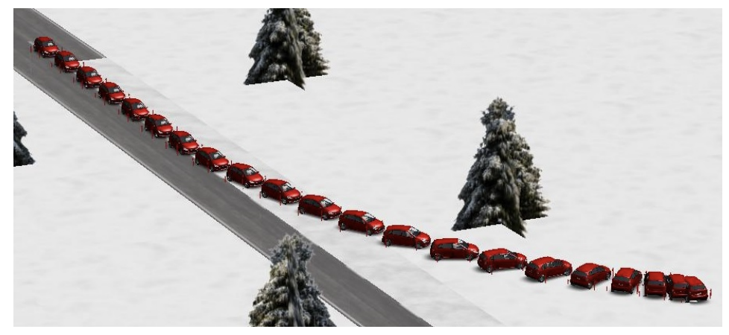
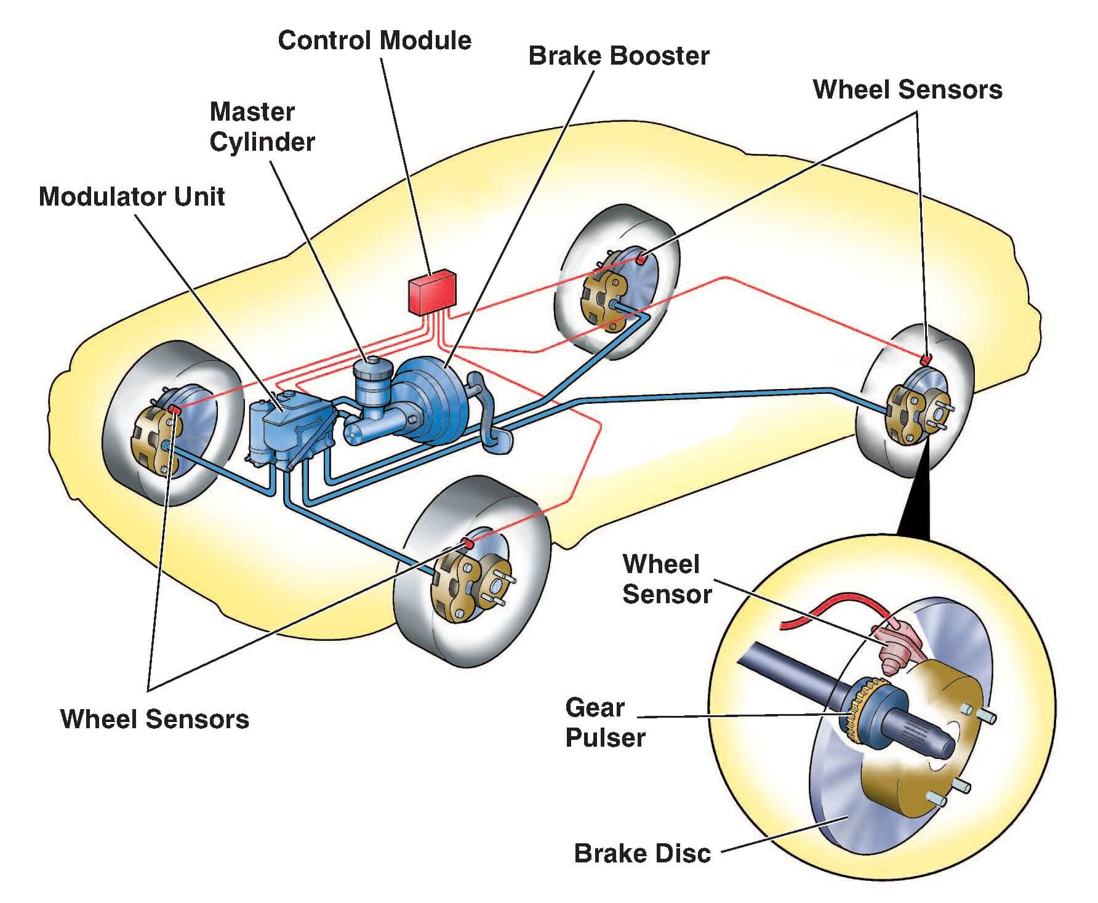
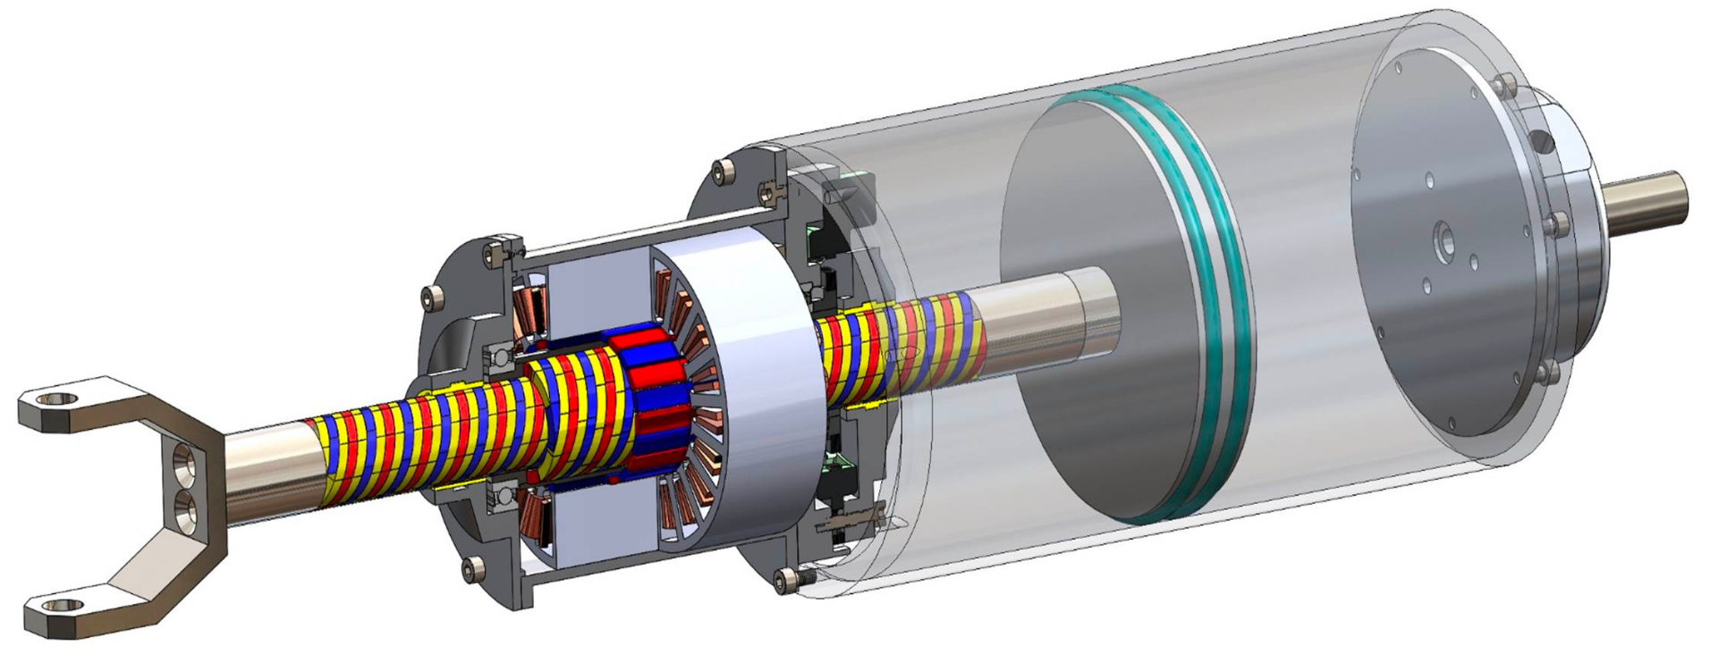
Attacks on Vehicle Dynamic Sensors
Magnetic Encoders
measure the angular velocity of a vehicle gear or wheel
Disruption attack
Spoofing attack
magnetic actuator
Notes:
Resource Allocation in Finance: In portfolio optimization, investors face a similar problem when selecting a combination of stocks or assets to maximize their return while staying within their budget or risk constraints.
Inventory Management: Businesses must decide which products to stock in limited shelf space or warehouse capacity while maximizing profits. Each item corresponds to a product with a weight (space it occupies) and a value (profit it generates).
Production Planning: Manufacturers must decide which parts or materials to include in a limited-capacity production line to maximize output or minimize production costs.
Data Compression: In data compression algorithms like Huffman coding, a similar problem arises when deciding which characters or symbols to include in a compressed representation to minimize the storage space while preserving data integrity.
Resource Scheduling: In project management, allocating resources to tasks while considering their duration and resource requirements can be viewed as a knapsack-like problem.
Network Design: When designing communication networks, engineers may need to select which network components (routers, switches, cables) to include to maximize performance while staying within budget and physical space constraints.
Subset Selection: In machine learning feature selection, the knapsack problem can be used to select a subset of features (variables) that maximize predictive accuracy while minimizing complexity.
Traveling Salesman Problem: In some variations of the Traveling Salesman Problem, where a salesman must visit a set of cities once and return to the starting city while minimizing travel costs, the knapsack problem can be used to optimize the selection of cities to visit.
Resource Management in Cloud Computing: When allocating virtual machines or containers to physical servers in a data center, cloud providers need to make decisions that maximize resource utilization and minimize operational costs.
Robotic Path Planning: In robotics, robots may need to select objects to pick up or carry while considering their weight and value, making it a variation of the knapsack problem.

Slide 41
Attacks on Vehicle Dynamic Sensors
Countermeasures
PyCRA (Physical Challenge-Response Authentication) - secure magnetic encoders or inductive active sensors
Y. Shoukry, P. Martin, Y. Yona, S. Diggavi, and M. Srivastava, “PyCRA: physical challenge-response authentication for active sensors under spoofing attacks,” in CCS ’15 Proceedings of the 22nd ACM SIGSAC Conference on Computer and Communications Security, 2015, pp. 1004–1015.
Notes:
Resource Allocation in Finance: In portfolio optimization, investors face a similar problem when selecting a combination of stocks or assets to maximize their return while staying within their budget or risk constraints.
Inventory Management: Businesses must decide which products to stock in limited shelf space or warehouse capacity while maximizing profits. Each item corresponds to a product with a weight (space it occupies) and a value (profit it generates).
Production Planning: Manufacturers must decide which parts or materials to include in a limited-capacity production line to maximize output or minimize production costs.
Data Compression: In data compression algorithms like Huffman coding, a similar problem arises when deciding which characters or symbols to include in a compressed representation to minimize the storage space while preserving data integrity.
Resource Scheduling: In project management, allocating resources to tasks while considering their duration and resource requirements can be viewed as a knapsack-like problem.
Network Design: When designing communication networks, engineers may need to select which network components (routers, switches, cables) to include to maximize performance while staying within budget and physical space constraints.
Subset Selection: In machine learning feature selection, the knapsack problem can be used to select a subset of features (variables) that maximize predictive accuracy while minimizing complexity.
Traveling Salesman Problem: In some variations of the Traveling Salesman Problem, where a salesman must visit a set of cities once and return to the starting city while minimizing travel costs, the knapsack problem can be used to optimize the selection of cities to visit.
Resource Management in Cloud Computing: When allocating virtual machines or containers to physical servers in a data center, cloud providers need to make decisions that maximize resource utilization and minimize operational costs.
Robotic Path Planning: In robotics, robots may need to select objects to pick up or carry while considering their weight and value, making it a variation of the knapsack problem.

Slide 42
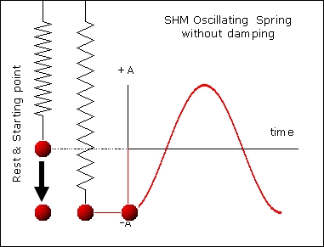
Attacks on Vehicle Dynamic Sensors
MEMS Inertial Sensors
measure the acceleration of an object and rotation rate wrt a given axis
Miniaturized mechanical sensing structure
Similar to mass-spring
Vulnerable to acoustic resonance
Attacks
Spoofing attack
Acoustic attack
Side swing attack
Switching attack
Notes:
Resource Allocation in Finance: In portfolio optimization, investors face a similar problem when selecting a combination of stocks or assets to maximize their return while staying within their budget or risk constraints.
Inventory Management: Businesses must decide which products to stock in limited shelf space or warehouse capacity while maximizing profits. Each item corresponds to a product with a weight (space it occupies) and a value (profit it generates).
Production Planning: Manufacturers must decide which parts or materials to include in a limited-capacity production line to maximize output or minimize production costs.
Data Compression: In data compression algorithms like Huffman coding, a similar problem arises when deciding which characters or symbols to include in a compressed representation to minimize the storage space while preserving data integrity.
Resource Scheduling: In project management, allocating resources to tasks while considering their duration and resource requirements can be viewed as a knapsack-like problem.
Network Design: When designing communication networks, engineers may need to select which network components (routers, switches, cables) to include to maximize performance while staying within budget and physical space constraints.
Subset Selection: In machine learning feature selection, the knapsack problem can be used to select a subset of features (variables) that maximize predictive accuracy while minimizing complexity.
Traveling Salesman Problem: In some variations of the Traveling Salesman Problem, where a salesman must visit a set of cities once and return to the starting city while minimizing travel costs, the knapsack problem can be used to optimize the selection of cities to visit.
Resource Management in Cloud Computing: When allocating virtual machines or containers to physical servers in a data center, cloud providers need to make decisions that maximize resource utilization and minimize operational costs.
Robotic Path Planning: In robotics, robots may need to select objects to pick up or carry while considering their weight and value, making it a variation of the knapsack problem.

Slide 43
Attacks on Vehicle Dynamic Sensors
Countermeasures
Physical barrier against the noise - differential comparator, tuning the resonant frequency
Hardware design solutions - low-pass filter, acoustic dampening material, secure amplifier
Notes:
Resource Allocation in Finance: In portfolio optimization, investors face a similar problem when selecting a combination of stocks or assets to maximize their return while staying within their budget or risk constraints.
Inventory Management: Businesses must decide which products to stock in limited shelf space or warehouse capacity while maximizing profits. Each item corresponds to a product with a weight (space it occupies) and a value (profit it generates).
Production Planning: Manufacturers must decide which parts or materials to include in a limited-capacity production line to maximize output or minimize production costs.
Data Compression: In data compression algorithms like Huffman coding, a similar problem arises when deciding which characters or symbols to include in a compressed representation to minimize the storage space while preserving data integrity.
Resource Scheduling: In project management, allocating resources to tasks while considering their duration and resource requirements can be viewed as a knapsack-like problem.
Network Design: When designing communication networks, engineers may need to select which network components (routers, switches, cables) to include to maximize performance while staying within budget and physical space constraints.
Subset Selection: In machine learning feature selection, the knapsack problem can be used to select a subset of features (variables) that maximize predictive accuracy while minimizing complexity.
Traveling Salesman Problem: In some variations of the Traveling Salesman Problem, where a salesman must visit a set of cities once and return to the starting city while minimizing travel costs, the knapsack problem can be used to optimize the selection of cities to visit.
Resource Management in Cloud Computing: When allocating virtual machines or containers to physical servers in a data center, cloud providers need to make decisions that maximize resource utilization and minimize operational costs.
Robotic Path Planning: In robotics, robots may need to select objects to pick up or carry while considering their weight and value, making it a variation of the knapsack problem.

Slide 44
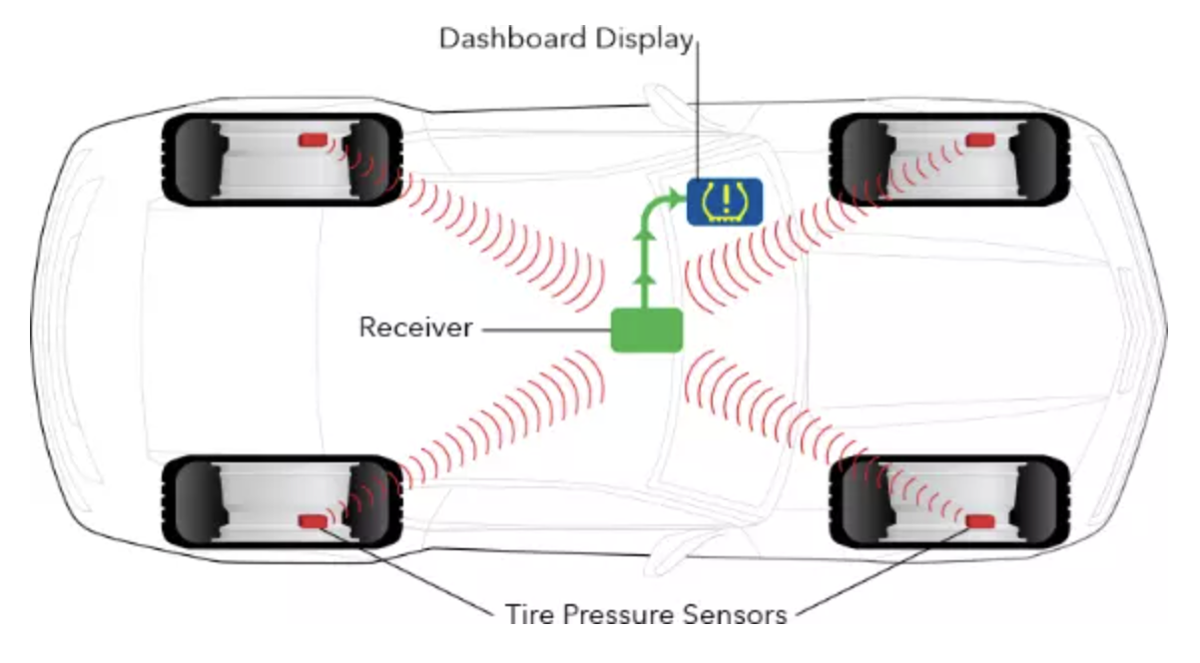
Attacks on Vehicle Dynamic Sensors
Tire Pressure Monitoring System (TPMS)
Reverse Engineering Attack
Spoofing Attack
Eavesdropping Attack
Sensor ID
Sensor ID
Sensor ID
Sensor ID
Notes:
Figure 1 shows the result of an attack in a series of time-lapsed images. In this simulation, the car is proceeding in a straight line when it encounters a patch of ice and begins to apply the brakes. The vehicle begins to skid at some point, but the driver retains control thanks to the ABS. Shortly after the brakes are applied, the right, rear ABS sensor is spoofed such that it reports a slower speed, allowing the car to skid uncontrollably off the road. Work reported in [Shoukry et al. 2013] has shown a physical implementation of such an attack.

Slide 45
Attacks on Vehicle Dynamic Sensors
Countermeasures
Incorporate basic error checking, also use a conducive packet structure
Linear-Feedback Shift Register (LFSR)-based encryption and anonymity techniques - to shield the sensor IDs
Static code analysis tools in the ECU software
Notes:
Figure 1 shows the result of an attack in a series of time-lapsed images. In this simulation, the car is proceeding in a straight line when it encounters a patch of ice and begins to apply the brakes. The vehicle begins to skid at some point, but the driver retains control thanks to the ABS. Shortly after the brakes are applied, the right, rear ABS sensor is spoofed such that it reports a slower speed, allowing the car to skid uncontrollably off the road. Work reported in [Shoukry et al. 2013] has shown a physical implementation of such an attack.

Slide 46
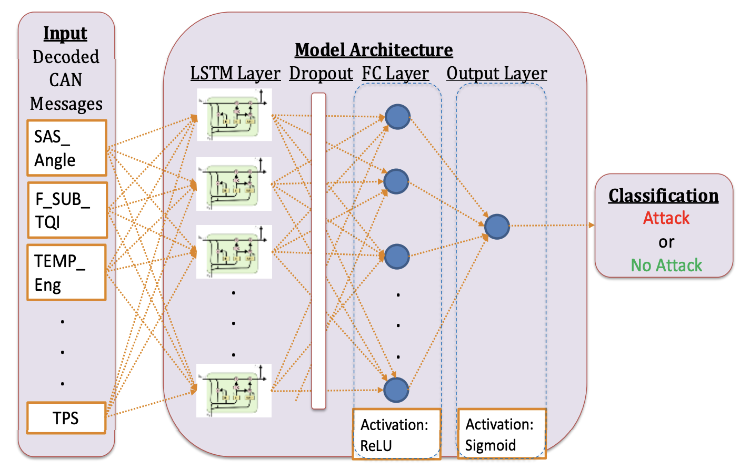
Future Outlook
Machine Learning based solutions
Deep Neural Networks
Convolutional Neural Nets
Tiny ML for low resource systems
Z. Khan, M. Chowdhury, M. Islam, C.-Y. Huang, and M. Rahman, “Long short-term memory neural networks for false information attack detection in software-defined in-vehicle network,” 2019
Notes:
Figure 1 shows the result of an attack in a series of time-lapsed images. In this simulation, the car is proceeding in a straight line when it encounters a patch of ice and begins to apply the brakes. The vehicle begins to skid at some point, but the driver retains control thanks to the ABS. Shortly after the brakes are applied, the right, rear ABS sensor is spoofed such that it reports a slower speed, allowing the car to skid uncontrollably off the road. Work reported in [Shoukry et al. 2013] has shown a physical implementation of such an attack.

Slide 47
Future Outlook
Blockchain based solutions
Features: Immutability, Distributed Network, security(encryption), anonymity(no personal information is used).
Inter-vehicle Networks V2X:
OTA updates can be delivered through blockchain.
Intra-vehicle Networks V2V:
Traffic updates like collisions, congestions can be shared among other vehicles through blockchain.
Notes:
Another technology that has the potential to revolutionize the network security of vehicles
The salient features of bc are listed in the slide
What kind of applications that blockchain has in vehicle networks.

Slide 48
Conclusion
Offers a timely review of potential cyber attacks on autonomous vehicles.
Specifically, how sensing layer can be targeted by malicious attackers.
Studied crucial sensors, potential threats and their countermeasures.
Authors predict that automotive industry will soon adopt disruptive technologies like AI/ML and Blockchain to enhance security and safety of vehicular networks

Slide 49
References
Z. El-Rewini, K. Sadatsharan, N. Sugunaraj, D. F. Selvaraj, S. J. Plathottam, and P. Ranganathan,“Cybersecurity attacks in vehicular sensors,” IEEE Sensors J., vol. 20, no. 22, pp. 13752–13767, Nov. 2020. <https://www.osti.gov/servlets/purl/1763654>
Z. Khan, M. Chowdhury, M. Islam, C.-Y. Huang, and M. Rahman, “Long short-term memory neural networks for false information attack detection in software-defined in-vehicle network,” 2019
Y. Shoukry, P. Martin, Y. Yona, S. Diggavi, and M. Srivastava, “PyCRA: physical challenge-response authentication for active sensors under spoofing attacks,” in CCS ’15 Proceedings of the 22nd ACM SIGSAC Conference on Computer and Communications Security, 2015, pp. 1004–1015.
https://www.youtube.com/watch?v=n3S8Io0kZZs&t=79s
https://www.allaboutcircuits.com/news/researchers-blind-and-deceive-lidar-in-autonomous-vehicles/
https://youtube.com/watch?v=ijryAVZXROk
https://ieeexplore.ieee.org/document/8590946
https://ipvm.com/reports/lasers-cameras
https://www.youtube.com/watch?v=hYuvmwzqmsY&t=5s
Notes:
Figure 1 shows the result of an attack in a series of time-lapsed images. In this simulation, the car is proceeding in a straight line when it encounters a patch of ice and begins to apply the brakes. The vehicle begins to skid at some point, but the driver retains control thanks to the ABS. Shortly after the brakes are applied, the right, rear ABS sensor is spoofed such that it reports a slower speed, allowing the car to skid uncontrollably off the road. Work reported in [Shoukry et al. 2013] has shown a physical implementation of such an attack.

Slide 50
Thank you
Hope you found it interesting!

