Slide 1
HEALTHGUARD
A Machine Learning-Based Security Framework for Smart Healthcare Systems
Paper By - AKM Iqtidar Newaz†, Amit Kumar Sikder†, Mohammad Ashiqur Rahman††, and A. Selcuk Uluagac†
CSE 707 Seminar
Group 1 – Aishwarya Mehta & Kajol .

Slide 2
OVERVIEW
INTRODUCTION
RELATED WORK
BACKGROUND
SYSTEM OVERVIEW
PERFORMANCE EVALUATION
WORKING CODE (Our Contribution)
CONCLUSION
RECENT TRENDS (Our Contribution)
CITATIONS

Slide 3
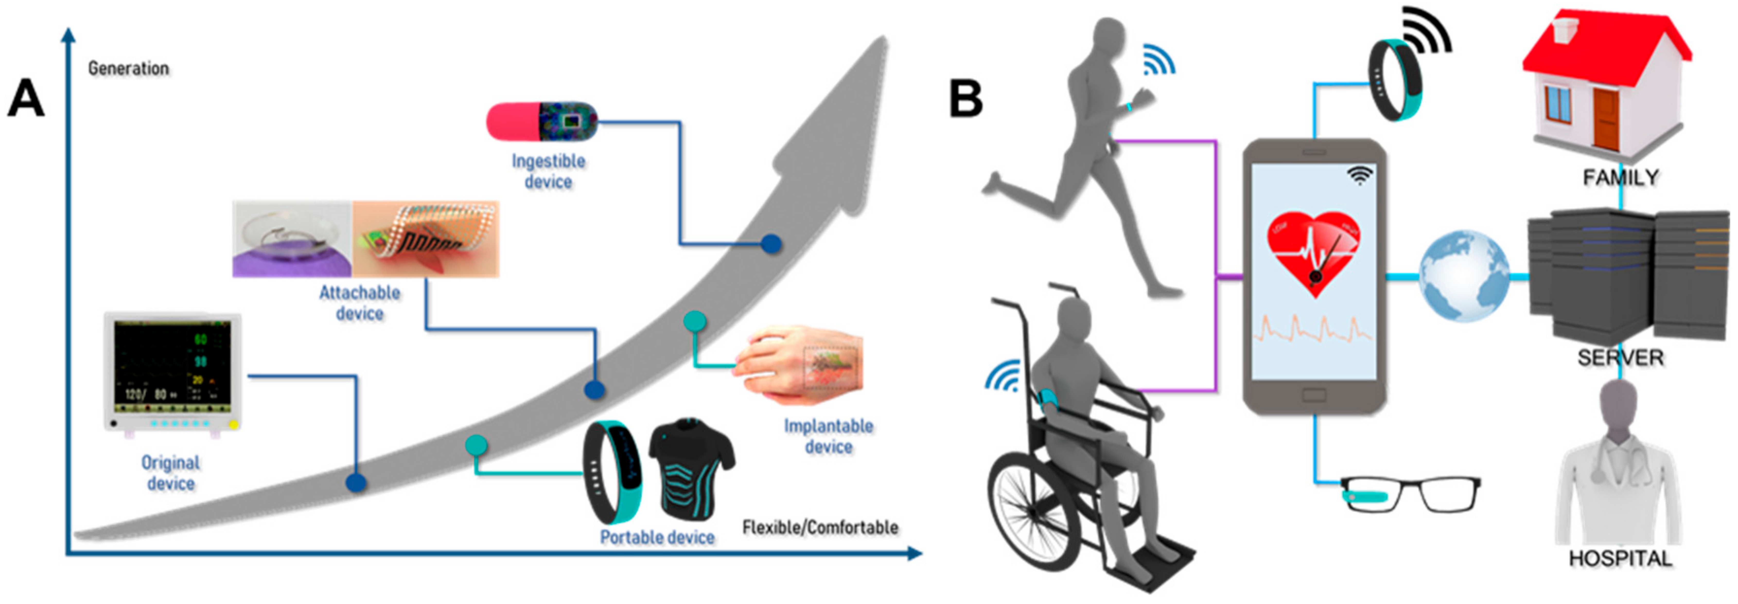
INTRODUCTION
The global healthcare market is predicted to reach a staggering $53.65 billion by 2025 due to a rapidly aging population and rising healthcare costs, establishing an urgent requirement for a more efficient healthcare system.
Progress through Technological Advancements
Innovations in medical technology have enabled the development of advanced diagnostic tools and treatments and have facilitated the creation of devices that enhance patient life quality, presenting a promising future for healthcare delivery.
Pervasiveness of Smart Healthcare Systems
SHSs, fortified with high-precision medical sensors and Internet-of-Things (IoT) applications, have permeated our daily lives, not only being confined to clinical settings but also enabling constant health monitoring through wearables and implantable devices.

Slide 4
CYBERSECURITY CHALLENGES WITHIN SHS
SHS brings about innovative solutions for healthcare management, but it inadvertently introduces a plethora of cybersecurity threats that could jeopardize patient safety and data security.
Ensuring a secure, private, and user-friendly environment within SHS is paramount due to potential catastrophic repercussions from any breach or malfunction, necessitating proactive and aggressive measures.
Instances such as pacemaker hacks and attacks on implantable devices highlight real and present dangers within healthcare cybersecurity, emphasizing the criticality of safeguarding against potential threats.
.

Slide 5
HEALTHGUARD : PARADIGM SHIFT IN SHS SECURITY
HealthGuard emerges as a beacon of hope, providing a novel, machine learning-based security framework that promises to safeguard SHS against malicious activities by closely monitoring and correlating various vital signs from connected devices.
The framework meticulously observes each device in an SHS, correlating vital signs from diverse devices to comprehend the overall status of a patient, thereby using these correlations to distinguish between normal and disease-affected activities, enhancing its predictive and protective capabilities.
Comprehensive training of HealthGuard was accomplished using data from nine databases, concerning eight different devices and twelve benign activities, ensuring a robust, well-rounded model.
With a commendable accuracy of 91% and an F1-score of 90%, HealthGuard has demonstrated its capability to adeptly identify and counteract threats within SHS, ensuring reliable and secure healthcare delivery through technological means.

Slide 6
SECURITY VULNERABILITIES
Smart Healthcare Systems (SHS) play a crucial role in real-time monitoring and treatment, but their increasing functional complexity poses unprecedented challenges.
Security threats to SHS can be classified into four main categories: hardware, software, side-channel, and radio attacks.
Major Concerns:
Significant concern arises from hardware Trojan attacks on integrated circuits (ICs), particularly as most ICs are manufactured in outsourced facilities.
The threat of EM radiation looms large, with the potential for the recovery of internal information from medical devices.
EMI injection into an implantable cardiac defibrillator’s leads can disrupt pacing signals, significantly affecting normal device function.
Real-world Incidents:
"In 2016, Hollywood Presbyterian Medical Center faced a ransomware attack, resulting in a ten-day network shutdown until a ransom of $17,000 was paid.”
"Security researchers reported a 'crash attack' on St. Jude Medical Maerlines Cardiac Implantable Electronic Devices (CIEDs), causing a loss of radio connectivity."

Slide 7
EXISITNG SOLUTIONS SHORTCOMINGS
Overview of Current Solutions
REBEL: A mechanism proposed to detect delay anomalies in Hardware Trojans (HTs) to counter hardware-based threats.
NFC and RFID Implementation: Using NFC and RFID channels for short-range communication to prevent unauthorized access and secure data transmission between devices in SHS.
Sensor-Based Security: The security framework proposed relies on sensors located on wearable devices.
Critiquing Present Solutions
Gaps in Comprehensive Protection: Despite these available solutions, a comprehensive, centralized solution that can protect SHS from a wide array of malicious threats is conspicuously absent.
Limitations in Current Approaches: Existing solutions exhibit limitations in offering a holistic, robust, and scalable security framework capable of safeguarding SHS against diverse threats.

Slide 8
HEALTHGUARD APPROACH
Detection Approach: HealthGuard focuses on interconnected body functions rather than just sensors on wearable devices.
Machine Learning-Based Framework: HealthGuard is a machine learning-based data-driven security framework that doesn't require a user identification unit for medical devices.
Processing Overhead: HealthGuard avoids the processing complexity overhead on the sensor node for collecting data from different devices.
Comprehensive Threat Detection: HealthGuard can detect threats in SHS, making it a robust solution compared to threat-specific existing solutions.

Slide 9
CONNECTED SMART HEALTHCARE SYSTEMS
Definition: SHS involves medical devices equipped with physical sensors for real-time data collection from patients and their surroundings, making autonomous decisions to enhance treatments.
Components: Comprises wearables, wireless devices, implantable devices, etc., and utilizes wired or wireless technology (Bluetooth, ZigBee) for data sharing between patients and healthcare providers.
Data Processing: Vital signs collected by devices are transmitted as network packets to a Central Data Processing Unit (CDPU). The CDPU monitors patient conditions, alerts physicians in emergencies, and may suggest treatment changes autonomously.

Slide 10
INTERCONNECTED BODY FUNCTION
Interconnection: Different organs' functions in the human body are interconnected. Changes in one organ's behavior can impact the overall body condition.
Feature for Anomaly Detection: Recognizes abnormal behavior by understanding the interconnection of body functions. For instance, changes in heart rate may affect other organs, serving as a feature for anomaly detection.

Slide 11
ANALYSIS OF ANOMALOUS BEHAVIOUR
Anomaly Behavior Analysis: Defines normal behavior in a system to identify abnormal behavior. Challenges include establishing a ground truth with low false positives.
Proposed Solution: Proposes anomaly behavior analysis based on patients' health conditions and activities. Ground truth is established by observing day-to-day user activities and vital signs for specific diseases.
Detection Method: Analyzes ongoing human body activities, distinguishing between benign and malicious activities based on vital signs from connected devices.
Considerations: Considers both regular and disease-affected scenarios by observing user activities and usage patterns to build the ground truth for HealthGuard, the proposed security framework.

Slide 12
PROBLEM SCOPE
Introduction to the Use Case Scenario:
Patient (P) admitted to the hospital with chest pain.
Smart Healthcare System (SHS) set up with ECG, pulse oximeter, and EEG monitoring.
System programmed to alert physicians and administer medicine for sudden heart rate changes.
Key Questions Addressed by HealthGuard:
Is the alert from one device benign or malicious?
Is the alert due to a disease?
Is there any outside influence on vital signs?
Is an automatic decision (e.g., medicine dosage change) benign?
HealthGuard's Role:
Observes each device and determines overall system status by connecting different vital signs.
Verifies patient status by cross-checking related vital signs.
Identifies decisions made under outside influence and alerts physicians to prevent erroneous treatment

Slide 13
THREAT MODEL AND ATTACK SCENARIOS
Malicious Device Behavior Considered:
Unauthorized user changing device states leading to abnormal SHS functionality.
Categories of Threats:
Threat 1 - False Data Injection: Malicious attacker injects forged data to change the patient's physical condition.
Threat 2 - Tampered Device Attack: Malicious app installed on a medical device prevents it from entering sleep mode.
Threat 3 - Denial of Service (DoS) Attack: Attacker physically tampers with a medical device to make it temporarily unavailable.
Scope Exclusions:
Passive attacks such as eavesdropping or information leakage considered out of HealthGuard's scope.
Assumes data collected from the SHS are not compromised.

Slide 14
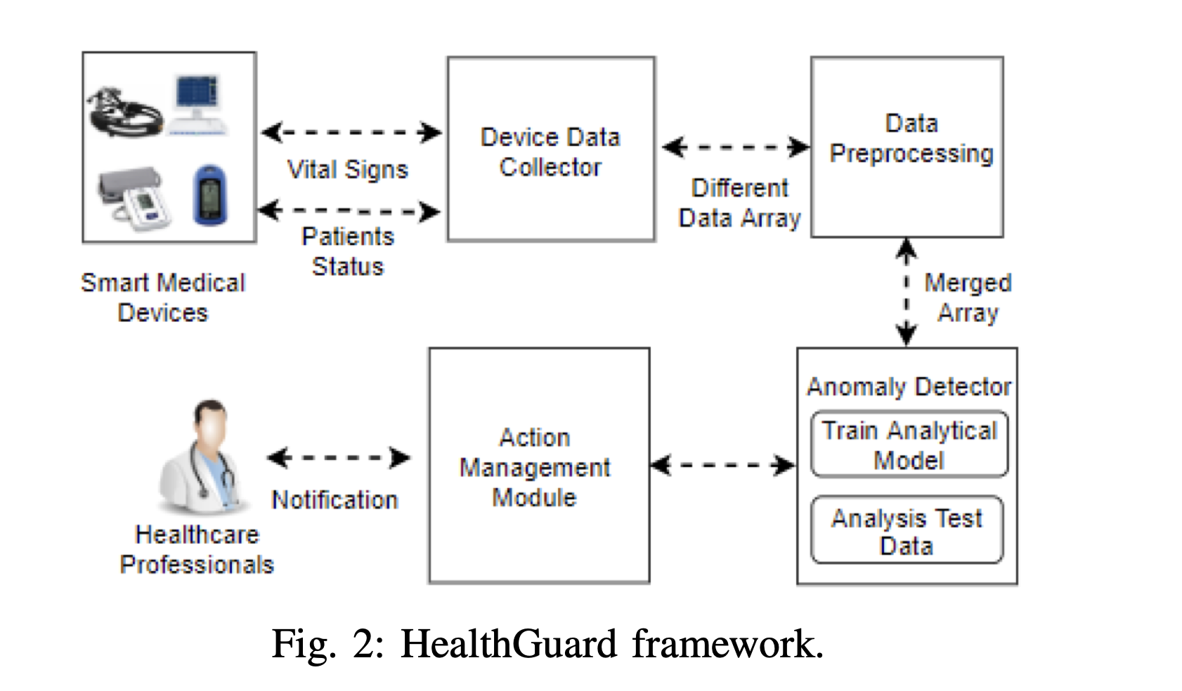
SYSTEM OVERVIEW
Malicious Device Behavior Considered:
Unauthorized user changing device states leading to abnormal SHS functionality.
Categories of Threats:
Threat 1 - False Data Injection: Malicious attacker injects forged data to change

Slide 15
A.DATA COLLECTOR MODULE
Role & Importance:
Primarily responsible for accumulating data from various smart medical devices within a Smart Healthcare System (SHS).
Ensures a comprehensive collection of patients' vital signs and status, forming the foundation for subsequent modules.
Process and Equation
Collects data from each device symbolized by E = {D1,D2,D3,D4……Dn}
Accrues varied data, from heart rate to blood oxygen levels, across numerous medical devices, ensuring a comprehensive view of patient health.
Significance:
Centralizes data from multiple devices, offering a holistic view of a patient’s health and ensuring that subsequent analyses are comprehensive and robust.

Slide 16
B.DATA PREPROCESSING MODULE
Functionality: Manages the refined and raw data from the Data Collector, ensuring it is suitably processed and prepped for analysis.
Data Merging : Integrates the disparate data points from different devices, harmonizing them into a singular data array, denoted as Data Array, S = {S1,S2,S3,S4….Sn}
Data Sampling : Adapts data from devices with diverse sampling rates into a consistent per-minute data representation.
Significance: Guarantees that the data fed into the anomaly detector is congruent and reflective of the overall patient status.

Slide 17
C. ANOMALY DETECTOR MODULE
Aim: Utilizes machine learning algorithms to discern any anomalies or malicious activities within the SHS.
Machine Learning Algorithms Explored:
Artificial Neural Network (ANN): Deploys the Multi-Layer Perceptron algorithm, appreciating its prowess in managing multiclass supervised learning scenarios.
Decision Tree (DT): Leverages the hierarchical data structure to deal with hierarchical patterns in data, offering insights into attribute relationships and decision paths.
Random Forest (RF): An ensemble approach that utilizes multiple decision trees, enhancing prediction accuracy and stability, especially pertinent for multiclass classification.
K-Nearest Neighbor (KNN): Offers swift training times and is adept at managing multiclass datasets by assessing the proximity of data points in the feature space.
Implementation Choice: Algorithms were chosen based on quick computation and ease of implementation, considering the critical and time-sensitive nature of healthcare data.

Slide 18
D. ACTION MANAGEMENT MODULE
Objective: To activate responsive actions when the anomaly detector identifies potential malicious activities.
Actions:
Alert Mechanism: Notifies healthcare professionals of potential threats, ensuring immediate action to safeguard both the SHS and the patient.
Autonomous Decision Mitigation: Scrutinizes and, if necessary, halts autonomous decisions made by the system that might be triggered by malicious activities.
Significance: Ensures that detected anomalies don’t result in deleterious consequences and that healthcare professionals can intervene timely to secure the SHS and patient health.

Slide 19
PERFORMANCE EVALUATION
A. Performance Evaluation Questions
RQ1: Differentiation between incidents on normal and disease-affected users.
RQ2: Proficiency in detecting various malicious attacks in SHS.
RQ3: Influence of the number of devices on HealthGuard’s performance.
RQ4: Impact of the quantity of attacks on HealthGuard’s effectiveness.
B. Data Utilization and Simulated Threats
Dataset Composition: 20,000 instances (17,000 healthy/disease-affected, 3,000 simulated attack data).
Data Division: 70% for training, 30% (plus malicious data) for testing.
Simulated Threat Scenarios: False data injection, disabling device sleep mode, and impeding smart medical device operation.
C. Training Environment and Methodology
Data Origin: Eight smart medical devices, covering diverse vital signs and conditions.
Disease Scenarios: Five disease scenarios like high blood pressure, abnormal oxygen level, etc., with corresponding devices and thresholds identified.
User Activities: Seven activities, e.g., exercise, stress, etc., with specific vital sign alterations logged.
Machine Learning: Utilization of collected data to train HealthGuard on recognizing normal and disease-affected states.

Slide 20
PERFORMANCE EVALUATION
D. Performance Metrics Employed
Accuracy: Degree of veracity of predictions.
Precision: Proportion of true positives in positive identifications.
Recall: Proportion of true positives identified.
F1-Score: Harmonic mean of precision and recall.
E. Evaluation Against Disease and Normal States
Objective: Discerning HealthGuard’s adeptness in identifying benign activities.
Outcomes: Varied accuracy and F1 scores (90%-93%) across algorithms, with Decision Tree (DT) yielding the highest accuracy and F1 score (93%).
F. Evaluation Across Attack Scenarios
Scope: Assessing efficacy against three threats (tampered device, DoS, false data injection).
Findings: Artificial Neural Network (ANN) rendered the highest accuracy and F1 score (91% and 89% respectively), demonstrating a balanced performance in identifying malicious activities.
G. Evaluation Considering Device Numbers
Focus: Understanding the effect of device count on HealthGuard.
Conclusion: Accuracy and F1 score diminish with reduced device numbers, but ANN consistently outperforms other algorithms. More devices contribute to easier event detection due to additional vital sign data.

Slide 21
OBSERVATION
Consistent Performance: HealthGuard demonstrates robust performance across varied scenarios, affirming its comprehensive security framework for SHS.
Algorithm Efficiency: While ANN generally provides optimal performance, specific scenarios may benefit from other algorithms like DT, highlighting the importance of algorithm selection based on context.
Resilience against Threats: Noteworthy performance in detecting multiple simultaneous threats underscores HealthGuard’s viability as a security framework in real-world, multifaceted SHS environments.
Adaptability: The ability to perform effectively across different numbers of devices and varied user states (normal and disease-affected) indicates adaptability, a critical attribute for a healthcare security system.

Slide 22
WORKING CODE
The code demonstrates how to use a trained machine learning model to predict whether given vital sign samples are benign or malicious, with specific examples of a benign sample and a malicious sample, along with printing the corresponding predictions.
LINK TO THE CODE

Slide 23
CONCLUSION
Bridging the Healthcare Security Gap:
In the backdrop of escalating advancements and subsequent cybersecurity challenges in Smart Healthcare Systems (SHS), HealthGuard emerges as a pivotal, machine-learning-based framework. It ensures a robust, proactive security layer, meticulously safeguarding the comprehensive health data ecosystem from numerous cybersecurity threats and vulnerabilities.
Holistic and Inclusive Approach:
HealthGuard brings to the table a capability that spans across varied medical environments, safeguarding both healthy and disease-affected data flows within the system. It encompasses the entirety of a SHS, ensuring the preservation of data integrity and seamless operational functionality amidst the diverse and nuanced data integrations present.
Highly Efficient in Threat Mitigation:
Boasting a remarkable 91% accuracy in detecting diverse cyber-attacks, HealthGuard stands as a reliable fortress against potential threats in SHS. Its proficiency in identifying, analyzing, and negating malicious activities ensures that healthcare services operate smoothly and patient data remains shielded from unauthorized access and malicious breaches.
Harnessing Machine Learning for Enhanced Security:
Leveraging the potent capabilities of ML algorithms, HealthGuard not only identifies but adeptly prevents potential cyber threats, ensuring that SHSs are not just secure, but also resilient against future threats. It effectively balances security needs with the ongoing advancements in healthcare technology, promising a future where technology and security go hand in hand.

Slide 24
RECENT TRENDS
Emergence of 5G Technology:
The advent of 5G technology has transformed wireless networks, especially in healthcare. With significantly increased data speeds and low-latency connections, 5G enables seamless real-time monitoring in Smart Healthcare Systems (SHS). For example, in emergency situations, where quick transmission of vital signs data is crucial, 5G facilitates rapid and reliable communication between medical devices and the SHS.
Video
Notes:
University Hospitals Birmingham (UHT)

Slide 25
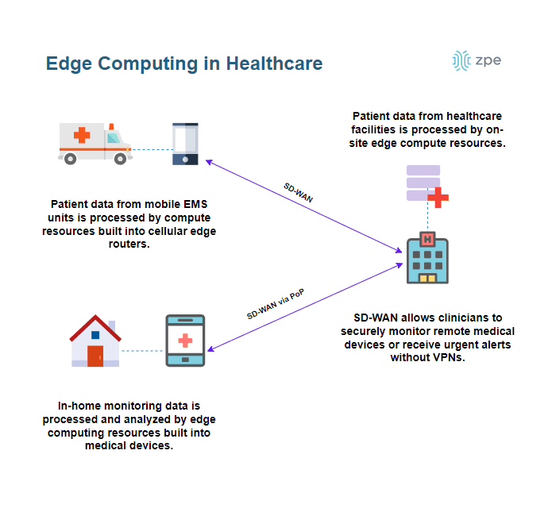
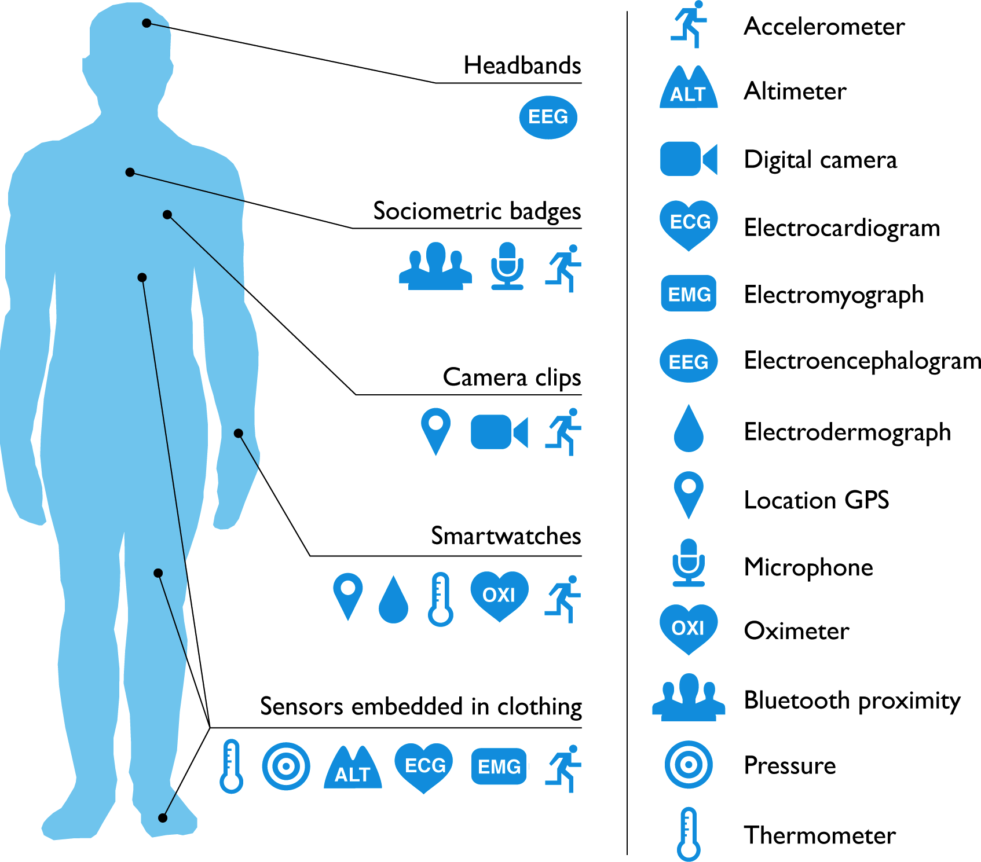
Edge Computing in Healthcare
Edge computing integrates health monitors into Smart Healthcare Systems, allowing real-time data processing. In scenarios like glucose monitoring, swift local analysis at the edge triggers immediate actions, enhancing healthcare efficiency. Seamless data transfer to devices, like insulin pumps, ensures timely interventions, minimizing processing delays.

Slide 26
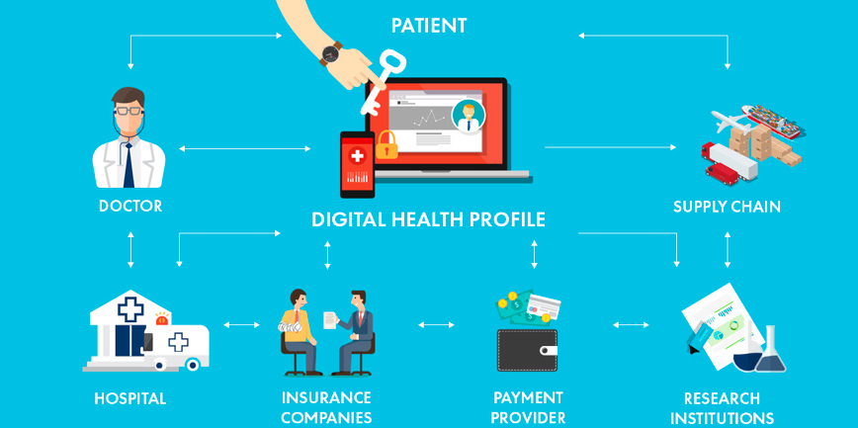
Blockchain for Data Integrity:
Blockchain technology is revolutionizing data integrity and security in healthcare. By creating a decentralized and tamper-proof ledger, blockchain ensures the integrity of health data. In a real-world scenario, patient records stored on a blockchain would be resistant to unauthorized alterations, providing a transparent and secure way to manage medical information.

Slide 27
CITATIONS
[1] A. I. Newaz, A. K. Sikder, M. A. Rahman and A. S. Uluagac, "HealthGuard: A Machine Learning-Based Security Framework for Smart Healthcare Systems," 2019 Sixth International Conference on Social Networks Analysis, Management and Security (SNAMS), Granada, Spain, 2019, pp. 389-396, doi: 10.1109/SNAMS.2019.8931716
[2] A. Bordia, S. Verma, and K. Srivastava, “Effect of garlic (allium sativum) on blood lipids, blood sugar, fibrinogen and fibrinolytic activity in patients with coronary artery disease,” Prostaglandins, leukotrienes and
essential fatty acids, vol. 58, no. 4, pp. 257–263, 1998.
[3] “Splitting the data into training and evaluation data,”https://docs.aws.amazon.com/machine-learning/latest/dg/
splitting-the-data-into-training-and-evaluation-data.html/.
[4] https://www.ncbi.nlm.nih.gov/pmc/articles/PMC6996619/
[5]https://blog.marketresearch.com/5-key-healthcare-industry-trends-to-watch#:~:text=According%20to%20the%20latest%20market,increase%20in%20value%2Dbased%20care.

