Slide 1
CSE 707: Wireless network security One Key to Rule Them All: Secure Group Pairing for Heterogeneous IoT Devices by habiba Farrukh* , Muslum Ozgur Ozmen* , Faik Kerem Ors, and Z. Berkay Celik
Presentors:
Sai Abhilash Kondepati
Pavithra Nallamothu

Slide 2
oVERVIEW
Introduction
IoT Devices Communication
Design Requirements & Challenges
Types of Attacks
IoTCupid – Secure Group Pairing System
Implementation
Evaluation
Limitations

Slide 3
Introduction

Slide 4
Internet of Things (IoT)
The networking capability that allows information to be sent to and received from objects and devices (such as fixtures and home appliances) using the Internet

Slide 5
Types of IoT Devices
IoT devices can be broadly categorized into two main types
1. Instant Monitoring IoT Devices
Designed to capture data or events at specific, discrete moments in time. They are typically triggered by specific conditions or user actions.
Examples: Smart Cameras, Environmental Sensors, Smart Doorbells
2. Continuous monitoring devices :
Designed to collect and transmit data constantly or at predefined intervals. They provide a continuous stream of information.
Examples: Health wearables, Smart Home Thermostats, Industrial Sensors

Slide 6
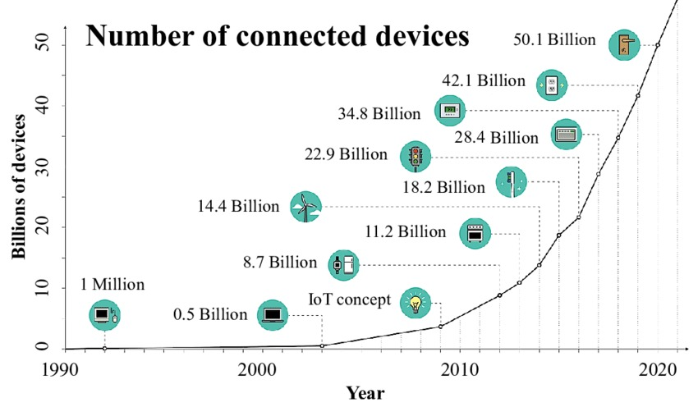
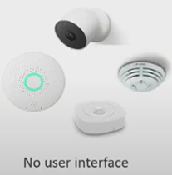
IoT Devices Communication
Secure Communication channels need to be established between devices to protect against from attacks like man in the middle, eavesdropping etc…

Slide 7
Context-based pairing systems
These systems leverage common physical context to sense common events for establishing a secure symmetric key
Limitation: Only works for Homogeneous Devices
Both Microphones recording same Sounds

Slide 8
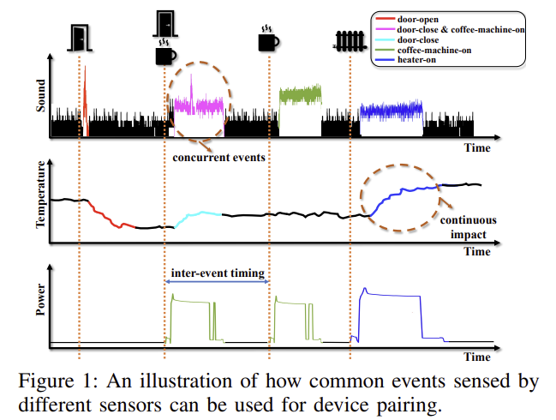
Context-based pairing for Heterogeneous IoT devices
Recent work, Perceptio [ S&P’19], leverages inter-event timing as evidence of co-presence

Slide 9
Context-based pairing for Heterogeneous IoT devices
Limitations:
While this approach supports heterogeneous sensing types without human intervention, it suffers from four fundamental limitations:
Takes several hours or a few days for pairing
Limited to sensors that only sense instant physical quantities
Impaired by concurrent events
Can pair solely two sensors at a time

Slide 10
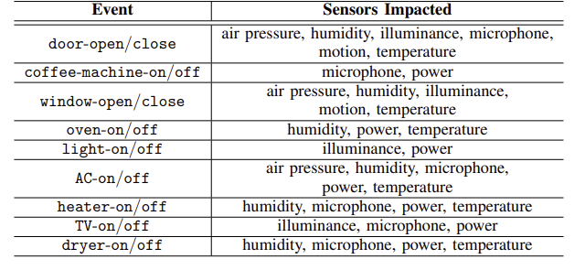
Context-based pairing for Heterogeneous IoT devices
Commonly occurring events in IoT environments and the sensors impacted by these events.

Slide 11
Design Requirements & Challenges
1) Short Pairing Time
Existing works require many inter-event timings to provide sufficient entropy for the shared keys to be cryptographically secure
2) Pairing Continuously Influenced Sensors
Prior pairing systems only consider sensors that are instantly influenced by an event. Yet, in real environments, many sensors measure continuous physical quantities

Slide 12
Design Requirements & Challenges
3)Concurrent Events
Existing pairing schemes mainly evaluate scenarios where a device only senses a single event per time period.
However, in practical scenarios, multiple events occur simultaneously and produce an overlapping influence on the sensors
4)Deriving Group Keys
In decentralized IoT protocols, devices need to broadcast their states to invoke their event-triggered automations.
Previous decentralized pairing schemes establish individual keys among pairs of devices. When a device needs to broadcast a message, it individually encrypts it with all shared keys and then sends the ciphertexts, causing linear computation.

Slide 13
Types of Attacks
IoT devices are vulnerable to various types of cyber security attacks. Here are some of
the most common types of IoT attacks
1) Eavesdropping attack
2) Man-in-the-middle attack
3)Brute-force attack
4)Denial of key exchange

Slide 14
Types of Attacks : Eavesdropping attack
Attacker places malicious devices outside the IoT environment’s physical boundary to pair them with legitimate devices. Devices can be
(a) embedded with off-the-shelf sensors with similar capabilities as the legitimate devices
(b) equipped with higher-end sensors that are more powerful and expensive compared to the legitimate devices.

Slide 15
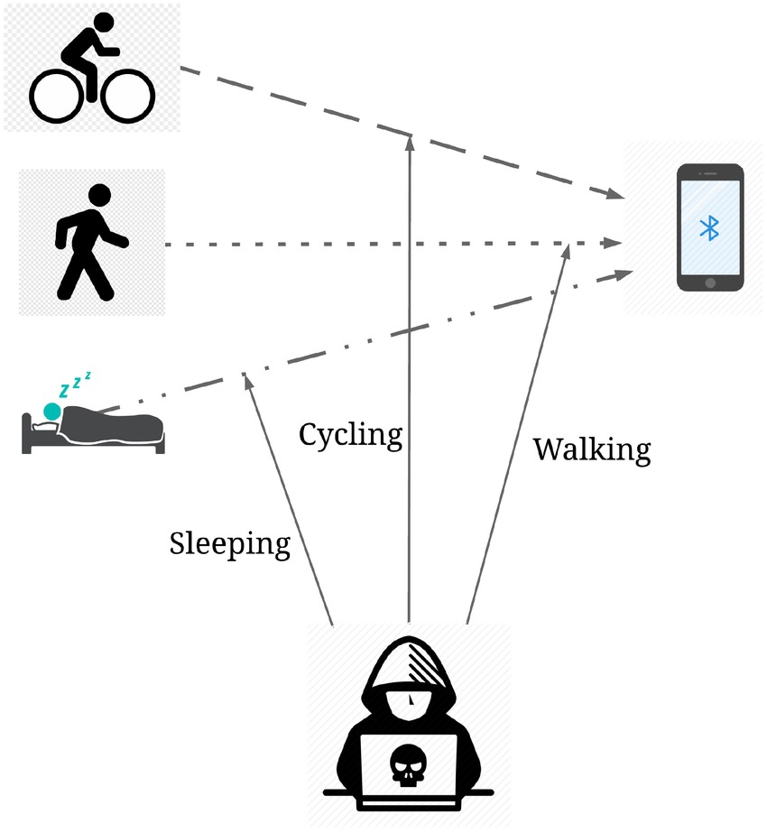
Types of Attacks : Man-in-the-middle attack
A intercepts the messages between legitimate devices and attempts to establish keys with them.

Slide 16
Types of Attacks : Brute-force attack
Attacker tries every possible evidence to derive the cryptographic keys used by legitimate devices. There are two ways.
1. Online attacks: Attacker joins the key establishment process and guesses the evidence.
2. Offline attacks: Attacker eavesdrops on the communication between the legitimate devices and attempts to crack the established key after pairing.

Slide 17
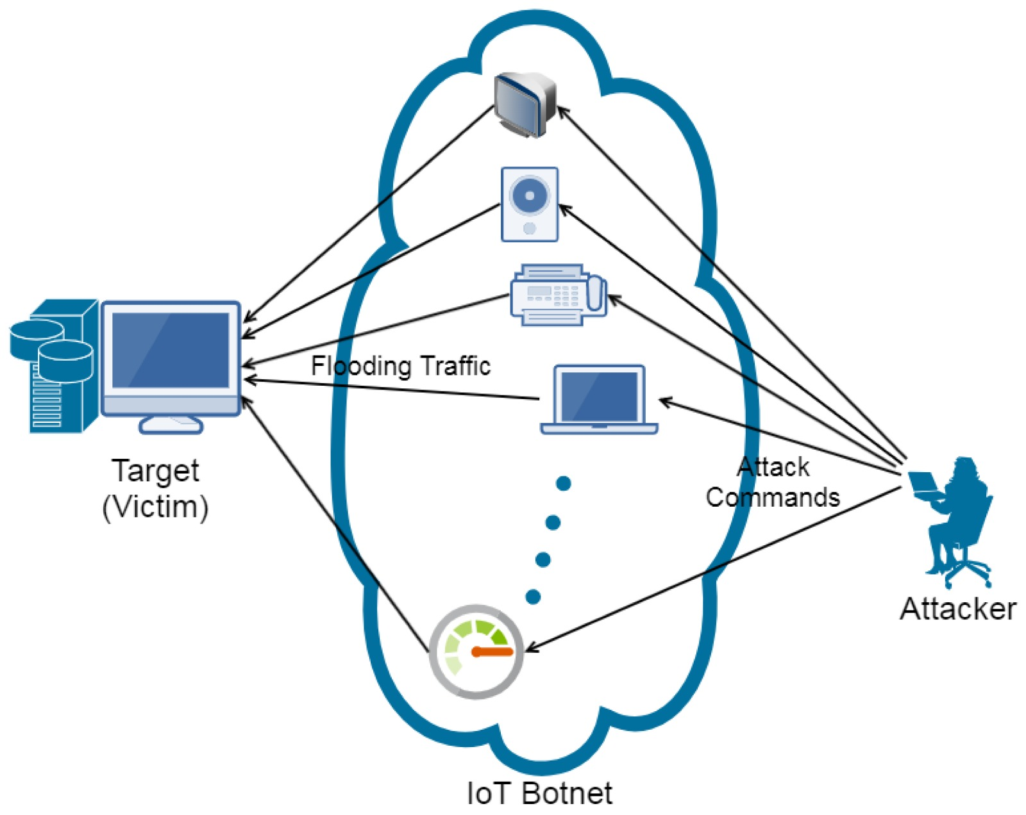
Types of Attacks : Denial of key exchange
Attacker participates in group key establishment with random evidences to prevent legitimate devices from establishing a key.

Slide 18
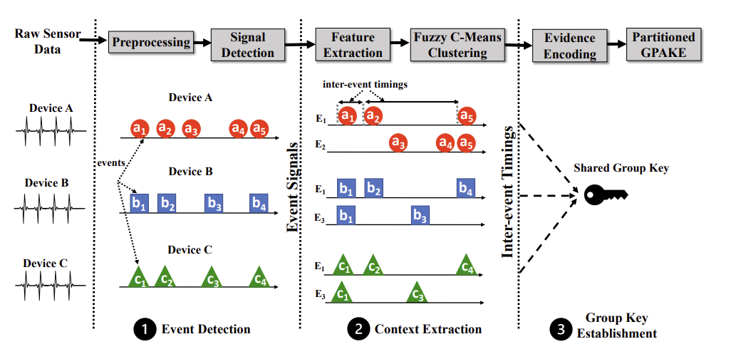
IoTCupid
IoTCupid is a secure group pairing system for heterogeneous devices

Slide 19
Event Detection
Events – Users routine activities that influence different sensors Ex: Opening door, making coffee,….
Operates on each sensor’s raw time-series data
1. IOTCUPID’s first pre-process the sensor data for signal smoothing and noise reduction.
2. Performs threshold-based signal detection to separate the events
impact on sensor data from noise.
The approach works for both instantly and continuously influenced sensors

Slide 20
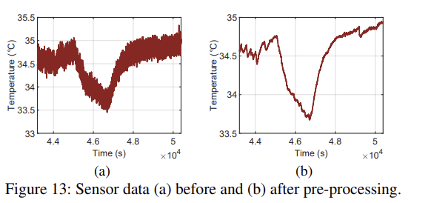
Event Detection : Pre-processing
Normalize the sensor readings to eliminate these fluctuations’ impact and capture the transient changes caused by events.
Apply a smoothing filter by computing sensor data’s exponentially weighted moving average (EWMA) to reduce noise.

Slide 21
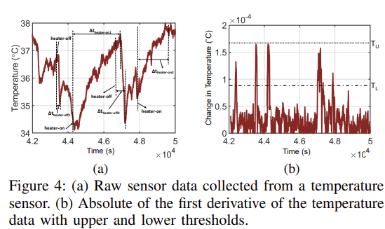
Event Signal Detection
A threshold-based approach to distinguish events influence on sensor readings from background noise.
A lower threshold, TL, to identify peaks in the sensor readings that distinguish events impact from background noise, and an upper threshold, TU, to remove high amplitude noise signals.

Slide 22
Event Detection

Slide 23
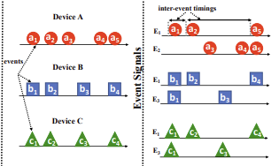
Context Extraction
IOTCUPID extracts distinctive time-series features from the signals each sensor has detected. It then extends to group independent and concurrent signals into different events.

Slide 24
Event Clustering
We cluster the detected signals into different events to extract their inter-event timings. This is because each device can sense multiple event types, and the devices do not know the type of detected signals. We use temporal features extracted from the detected signals to cluster similar events via a fuzzy clustering algorithm, without any prior information about the event types
Deriving Temporal Sensor Features
It extracts time-domain features (F) such as min, max, mean, and median from the signals corresponding to each event.
And normalizes the selected features and perform dimensionality reduction through principal component analysis (PCA) to select a subset of features, Fmin, which is used to differentiate event types

Slide 25
Fuzzy C-Means Event Clustering
In real IoT deployments, multiple events may occur simultaneously and produce an overlapping signal on the devices.
Fuzzy C-Means partitions signal into c fuzzy event clusters, where c is an input. Each signal corresponding to an event is assigned a degree of membership to each of the c clusters.
For a given signal (e), the degree of its membership (uej) in cluster j is determined by
$uej=\frac{1}{\sum_{k=1}^{c}{{\left(\frac{dej }{dek}\right)}^{\frac{2}{m−1}}}}$where dej represents the Euclidean distance between the cluster j’s centroid and signal e’s feature vector.
Context Evidence Generation uses the inter-event timings for all events sensed by a device

Slide 26
Comparison of Event clustering through K-Means and Fuzzy C-Means algorithms

Slide 27
Establishing Group Keys from Evidences
After devices extract inter-event timings, they use the timings as evidence to authenticate each other and establish group keys.
A group key is shared between the devices that sense the same event type, and all devices in the group can securely communicate using a single key.
Challenges:
The groups must be generated dynamically based on the devices that sense the same event.
The group key establishment protocol must support device addition and removal.

Slide 28
Fuzzy Commitment
Group Diffie-Hellman
Once individual keys are derived through a standard pairing protocol, devices use a Group Diffie-Hellman protocol to derive group keys. The protocol is used to create a shared secret key that can be used for secure group communication.
Must run over secure communication channels to prevent Man-in-the-Middle (MitM) attacks.
Group keys can be built on error-correcting codes and enable verifying two evidences even when they have small differences (e.g., Hamming distance less than a threshold).
Group keys derived using similar evidences.
Vulnerable to offline brute force key guessing attack.

Slide 29
Group PAKE (GPAKE)
There are two approaches to protect against brute force key guessing attacks.
1) A large number of evidences (i.e., inter-event timings) can be used to derive the keys. Yet, this approach sacrifices efficiency since it may take a long time to derive a large number of evidences.
2) Password-Authenticated Key Exchange (PAKE) schemes have been proposed to prevent offline brute-force attacks.
Group PAKE is a cryptographic protocol that enables multiple devices to securely derive a shared encryption key based on a common password or passphrase. This shared key is used for secure communication among the devices. Possibility of Denial of Key Exchange Attack:

Slide 30
Partitioned GPAKE
Partitioned GPAKE. The partitioned GPAKE scheme runs on each subset of devices sensing the same events to generate a group key.
Partitioned GPAKE is implemented over an Elliptic curve to offer compact key sizes and fast computations. A re-initiation-based key management scheme is used to support device additions and removals.
Key Management: The added devices re-initiate IoTCupid and extract inter-event timings to prove their legitimacy to the existing devices

Slide 31
Design Space Exploration

Slide 33
Implementation
Python 3.9.12
We implement partitioned GPAKE on the FourQ elliptic curve which offers 128- bit security with fast computations
Libraries - blake2 as the hash function and ChaCha-Poly as the authenticated encryption due to their efficiency. We leverage the portable libraries of FourQ, blake2 and ChaChaPoly to implement our protocol in C. We implement the communication rounds with the zeromq library

Slide 34
Evaluation

Slide 35
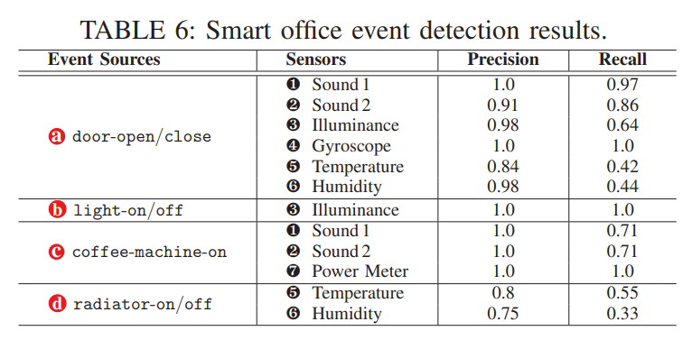
Evaluation: Results

Slide 36
Evaluation: Results (Distance)

Slide 37
Evaluation: Results (No. of events)

Slide 38
Evaluation : Performance
Event detection & Extraction : 20.08 secs on average when window size is 2 mins
Group key establishment overhead
- with 4 event types & 20 devices : 39.04 ± 13.78ms
- with 10 event types & 5 devices : 20.77 ± 7.32 ms
Memory Usage: Around 93.75 KB for each device when 100 devices sensing 10 different event types
Encryption & Communication Cost: when done for 32-byte message 100 times – it takes 0.21 ± 0.005ms

Slide 39
Evaluation : Comparision
Comapred all devices paired with IoTCupid – only 63% of them paired using Perceptio.
IoTCupid(32-bit entropy) is 4x faster than Perceptio(128-bit entropy – fuzzy commitment). 54% faster pairing with IoTCupid.
For secure communication cost, IoTCupid incurs constant overhea, whereas Perceptio's cost linearly increased because of indicidual keys. For instance broadcasting a message to 50 devices took 0.21ms in IoTCupid, while Perceptio took 6.73ms.

Slide 40
Limitations
Handling mismatches in inter-event timings.
Deployment considerations
Resourceful attackers
Pairing in large spaces
Impact of environmental noise
Rarely/Regularly occurring events

Slide 41
Conclusion
IotCupid is a secure group pairing system for heterogeneous IoT devices that accurately derives context to establish group keys.
Pairs instant and continuously influenced devices.
Achieves a faster pairing time.
Resilient to Man in the middle attack and eavesdropping attack.
Supports dynamic device addition and removal.
Supports group to group communication.

Slide 42
References
H. Farrukh, M. O. Ozmen, F. Kerem Ors and Z. B. Celik, "One Key to Rule Them All: Secure Group Pairing for Heterogeneous IoT Devices," 2023 IEEE Symposium on Security and Privacy (SP), San Francisco, CA, USA, 2023
One Key to Rule Them All: Secure Group Pairing for Heterogeneous IoT Devices
P. Han, A. J. Chung, M. K. Sinha, M. Harishankar, S. Pan, H. Y. Noh, P. Zhang, and P. Tague, “Do you feel what i hear? enabling autonomous IoT device pairing using different sensor types,” in IEEE Symposium on Security and Privacy (S&P), 2018.

Slide 43
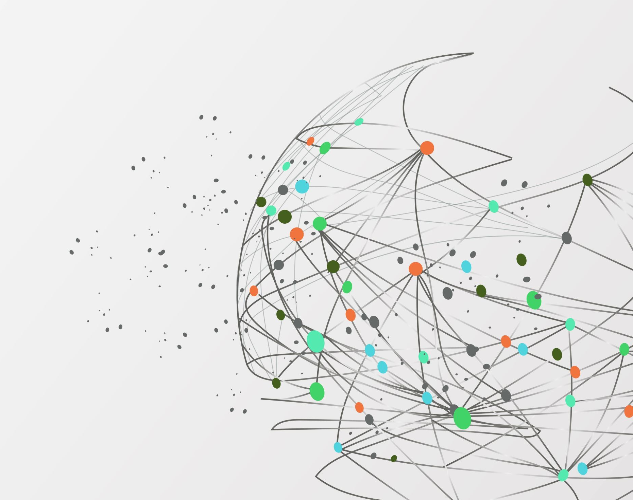
Thank you!!

