Slide 1

University at buffalo
CSE 707 seminar
“Analyzing the Usability of Popular Smartphone Password Managers”
Paper by -
Sunyoung Seiler-Hwang, Patricia Arias-Cabarcos, Andrés Marín, Florina Almenares, Daniel Díaz-Sánchez, Christian Becker
Presented by –
Anurag Lingabathina and Rahul Nimbalkar under the supervision of
Prof. Shambhu Upadhyaya
Notes:
Today, where we untangle the messy, and often frustrating, web of passwords in our daily lives.
many of us here use forgot password feature, its regular for me.
We're not here to dive deep into sophisticated algorithms, encryption techniques, or cyber-attack statistics.
Our paper is basically on survey conducted on popular smartphone managers.
we will go from basics

Slide 2
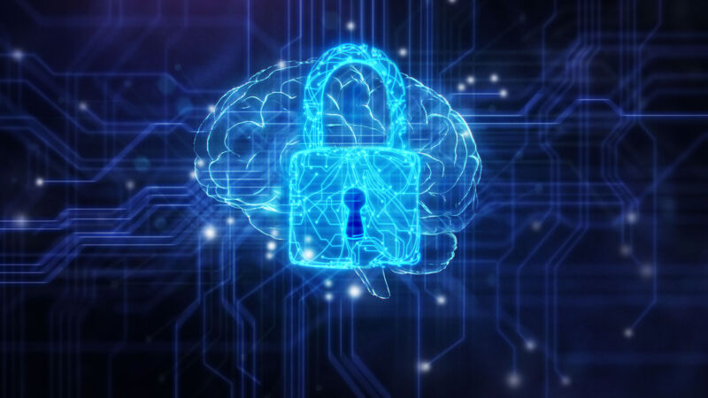
Who all ???
Everyone has an account for Google, Facebook, Twitter, LinkedIn, Outlook/Hotmail, Dropbox... the list goes on.
Unfortunately, most of us use either one password or a group of passwords (Three or Four) for all of our major accounts.
That's dangerous !!!
Notes:
No, we’re here to talk about us, the everyday users, and the tiny secret codes, our passwords, that are sprinkled throughout our digital lives.

Slide 3
Latest 2023 Cyber Crime Statistics
2021
1 in 3 American internet users had their accounts breached in 2021.
2022
Nearly 1 billion emails were exposed in a single year, affecting 1 in 5 internet users in 2022.
2022
Data breaches cost businesses an average of $4.35 million in 2022.
2022
Around 236.1 million ransomware attacks occurred globally in the first half of 2022.
2022
It’s predicted that cyber crime cost the global economy around $7 trillion in 2022, and this number is expected to rise to $10.5 trillion by 2025.
Notes:
2022 has been quite a ride in the online world, hasn’t it?
We’ve seen some cheeky cyber activities, with passwords often playing a surprising role in the drama! And guess what?
Let’s peek into the stats and see what tales they have to tell, shall we?

Slide 4

Introduction
Notes:
guys! In a world that's increasingly digitized, our day starts and ends with passwords.
From unlocking our phones in the morning to checking our emails, accessing our bank accounts, or simply scrolling through social media - passwords are our constant companions, whether we like them or not. They're like the keys to our digital homes, aren’t they?
You know those secret codes we punch in to check our emails, or log into apps? That's right – Passwords! Think of them as digital handshakes, letting the online world know it's really you. Cool, right? Let's chat more about them!

Slide 5
Why Password ?
Passwords are the keys to accessing your computer, bank account and almost everything you do online .
In other words passwords are the primary means of authenticating a user
Notes:
authentication being the process of verifying who somebody is

Slide 6
COMMON MISTAKES
MISTAKES | EXAMPLES | RISK EVALUATION
USING COMMON PASSWORDS | 123456 12345 123456789 password iloveyou the six letters on any row of a keyboard. For example, the first six letters on the top row of the keyboard "qwerty" | Too risky. These are most criminal’s first guesses, so don't use them.
Notes:
Ever used "password123" or your birthday as your password? Or maybe you've got that one password for EVERYTHING? Oops! We all slip up sometimes.
Let's chat about those little password oopsies we make daily

Slide 7
COMMON MISTAKES
MISTAKES | EXAMPLES | RISK EVALUATION
Using a Password that is based on personal data | ”puppy" ”DOB" ”29JAN" " Ethan" ”surname” “tripathi” | Too risky: anyone who knows you can easily guess this information.

Slide 8
COMMON MISTAKES
MISTAKES | EXAMPLES | RISK EVALUATION
Using a short password | JOHN12 Jimh2345 Hala34222 YesorNo12 | The shorter the password, the more opportunities and guessing it
Notes:
Short passwords can be like rolling out the red carpet for hackers.

Slide 9
COMMON MISTAKES
MISTAKES | EXAMPLES | RISK EVALUATION
Using the same password everywhere | Using one password If this password is on every site or online service | Too risky: compromised, or someone finds it, the rest of your accounts including your sensitive information are at risk.
Notes:
A short password might be easy to remember, but for criminals the it’s a open door, it's also a golden ticket for them.

Slide 10
COMMON MISTAKES
MISTAKES | EXAMPLES | RISK EVALUATION
Writing your password(s) down. | Writing your password down on a post it note stuck to your monitor, keyboard or anywhere. | Very high risk, especially in corporate environments. Anyone who physically gets the piece of paper or sticky note that contains your password can log into your account.
Notes:
this seemingly innocent act can be a high-stakes gamble in the corporate arena, which can get you down from the company, writing frustrated emails to you boss these might happen

Slide 11
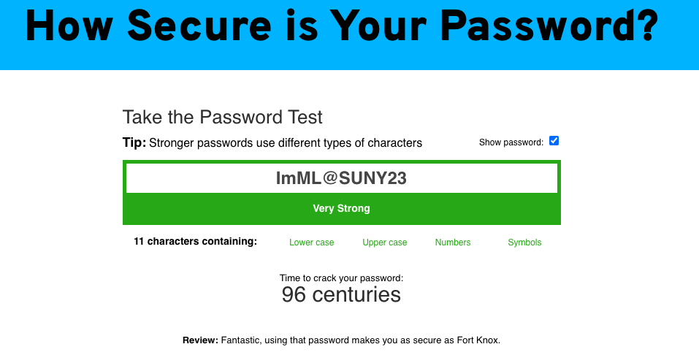
What to do ??
Think of a phrase you can remember
Come up with a phrase and use a character from each word.
Use capitals where appropriate
Example
"I met my love at SUNY in 2023"
The password could be: ImML@SUNY23
Notes:
How to avoid these password blunders together,

Slide 12


Regional language-based password
Example 1:
Shloka: "Aum Bhur Bhuvah Swah”
Example 2:
Shloka: "Yada Yada Hi Dharmasya”
Example 3:
Shloka: "Guru$BrahmaVishnu”
Example 4:
Shloka: "Sarve Bhavantu Sukhinah"
Notes:
As professor said during initial classes
Using sankskrit shlokas, everyone here is a Indian, we came across many shlokas in our childhood, so we can use those to keep us safe as well

Slide 13
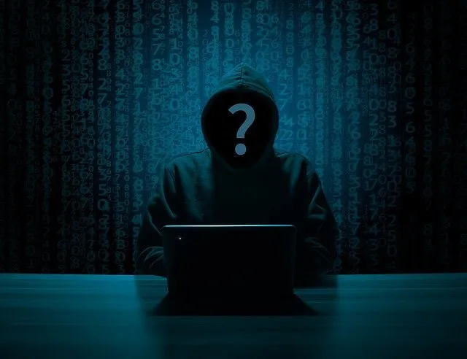
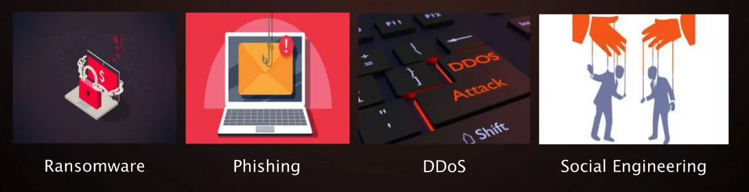
Attacking
Brute Force Attack
Dictionary Attack
Phishing
Credential Stuffing
Rainbow Table Attack
Keylogger Attack
Man-in-the-Middle Attack
Notes:
let’s embark on a slightly darker face of cyber world.
Attacks! They come in all shapes and sizes, from sneaky phishing emails to brute force attacks trying to bash through our digital walls.
It's like a virtual heist, where our precious data is the treassure they’re after.

Slide 14
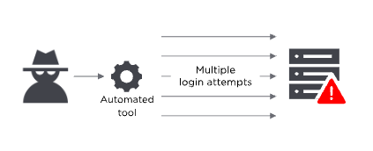
Bruteforce
attack
If a password is equivalent to using a key to open a door, a brute force attack is using a battering ram. A hacker can try 2.18 billion password/username combinations in 22 seconds, and if your password is simple, your account could be in the crosshairs.
Notes:
Coming to brute force its like --
Imagine a burglar trying every single key on his keyring to break into a house –
that's essentially what this attack is in the digital realm.
It's about making countless attempts,

Slide 15
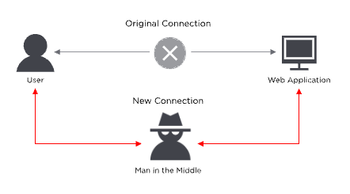
Man in the middle attack
Man-in-the middle (MitM) attacks are when a hacker or compromised system sits in between two uncompromised people or systems and deciphers the information they're passing to each other, including passwords
Case: In 2017, Equifax removed its apps from the App Store and Google Play store because they were passing sensitive data over insecure channels where hackers could have stolen customer information.
Notes:
. Picture this: you’re in a classroom, secretly passing a love letter to your crush.
Suddenly, the class prankster intercepts it, reads it, maybe even changes a few words, and then passes it along as if nothing happened! In the digital world, hackers do the same,

Slide 16
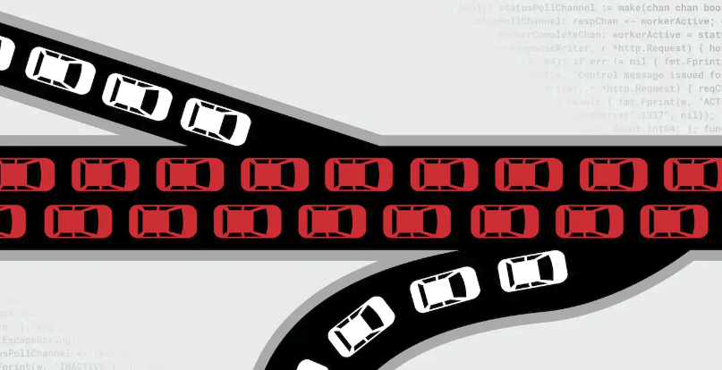
DDoS is an acronym for Distributed Denial of Service
It is a malicious attempt to disrupt normal traffic of a server that is targeted
This could result in servers being clogged with traffic
It would slow down speeds or "crash" the server(s) altogether
This is a costly form of attack, that could cost a company/organization millions (if not billions) of dollars* resolved quickly
DDOS ATTACKS
Notes:
Picture a busy highway, cars zooming smoothly, when suddenly, a flood of vehicles appears from nowhere, causing a massive, chaotic traffic jam!, preventing legitimate users from getting where they need to go. It's a mess,

Slide 17
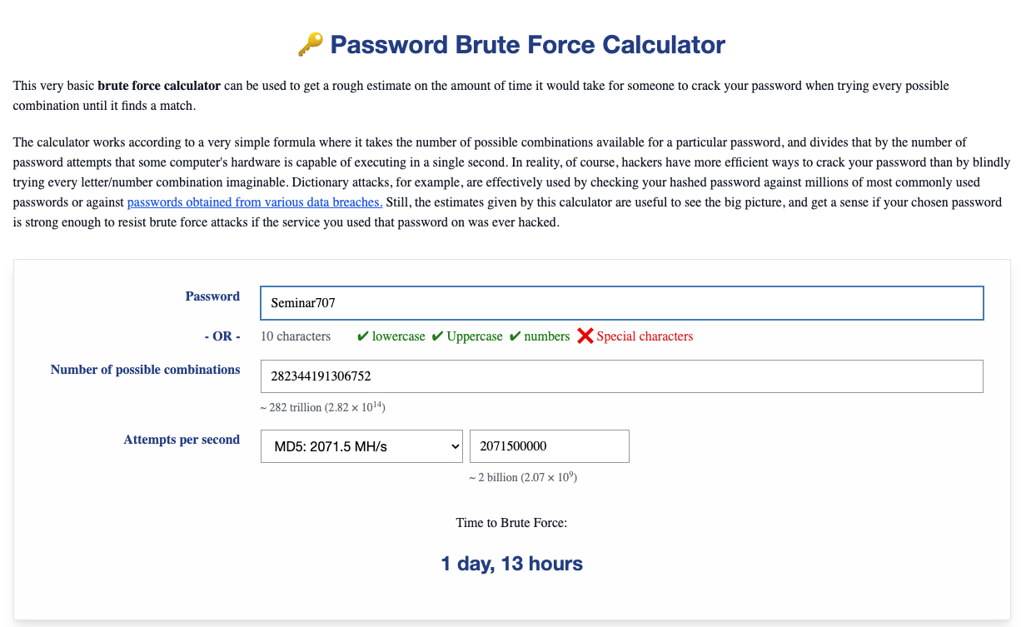
Notes:
A Brute Force Calculator does just that – it gives us a peek into how long it might take for a brute force attack to crack a password. It's like estimating the time before the digital lock is picked

Slide 18
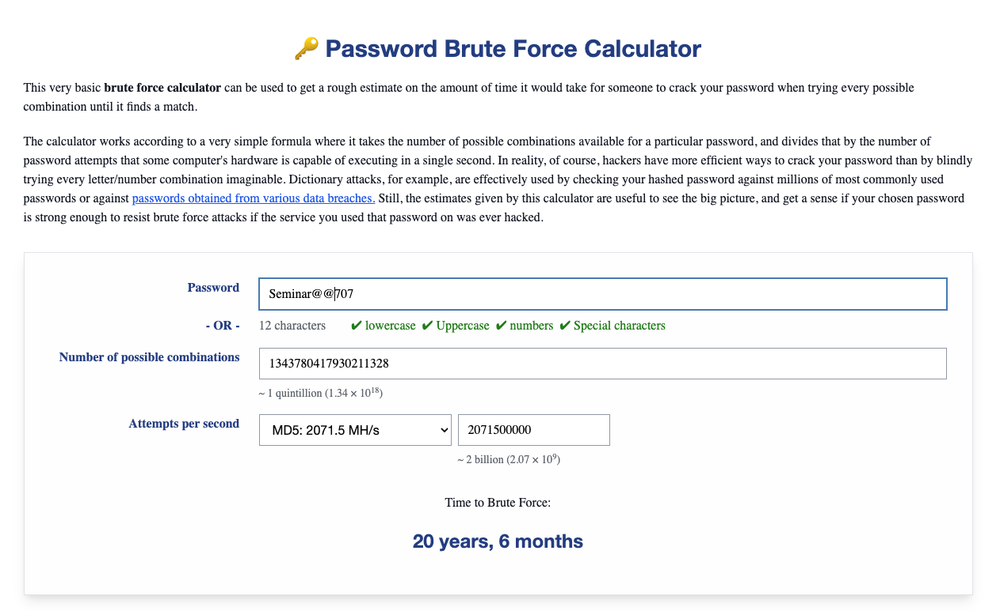

Slide 19
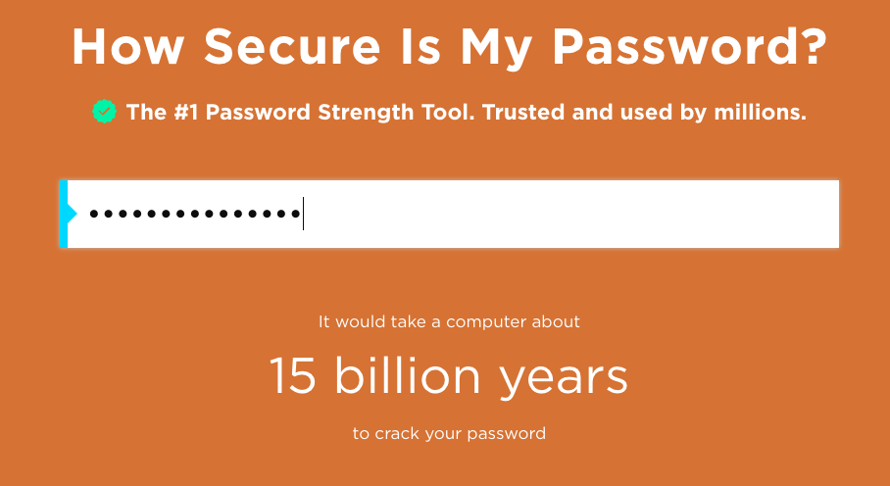
USING YOUR FAVOURITE PHRASE
Password: Ilovegroot3000!

Slide 20

Not possible
You don't want to use the same password with all your on-line accounts, but it is also impossible for you to remember dozens of passwords.

Slide 21
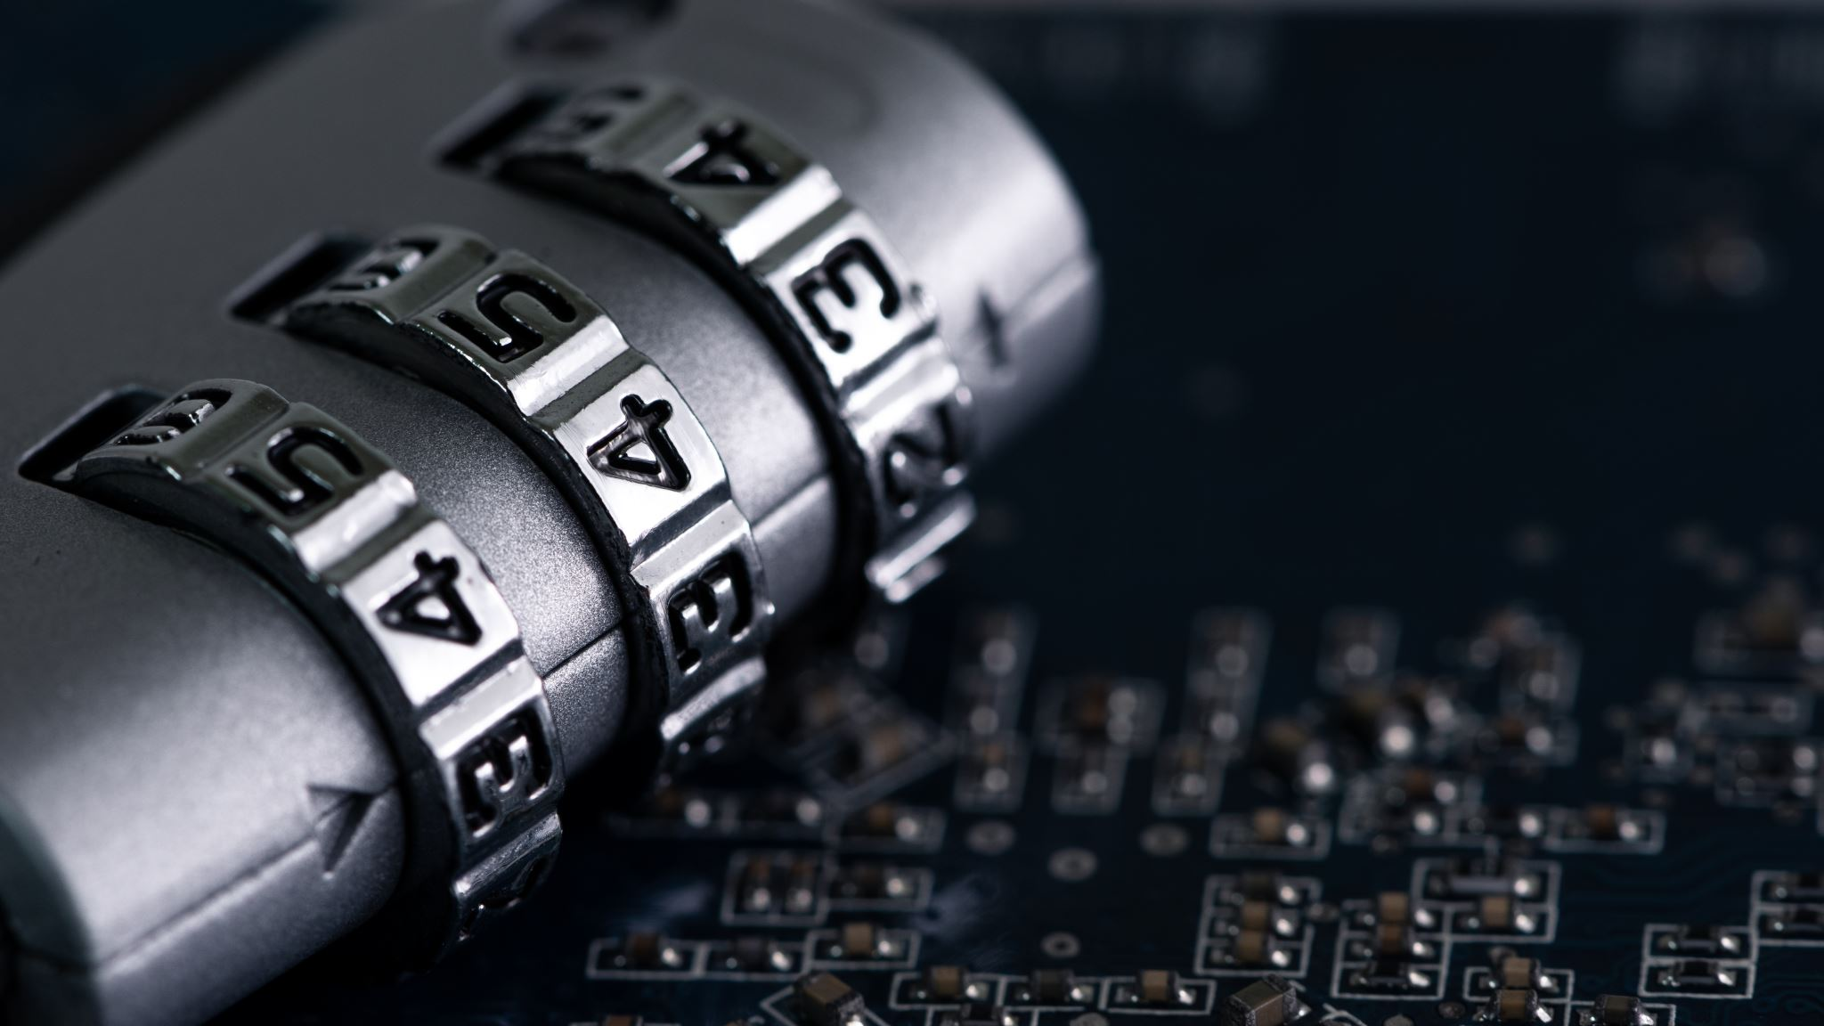
Is there a solution ???
Notes:
Is there any solution to these digital potholes, ensuring our journey through the online world is smooth and secure.
safeguarding us from these cyber troubles.

Slide 22
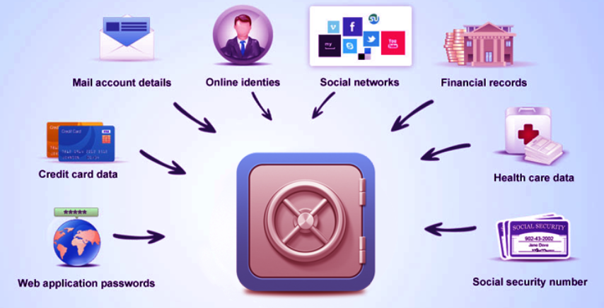
Is there a solution ???
Yes
Password Manager
Notes:
imagine having a digital safe where all your passwords are stored securely and recalled in a snap –
welcome to the world of Password Managers! Let's dive into this digital vault and see how it might be a game-changer in our online journeys.

Slide 23
what is pm ???
Password managers, also known as vaults,
Provide a convenient solution for safeguarding and managing login information across various online platforms and devices.
Low adoption rate:
  Despite the availability of these services, which are typically free and seamlessly integrated with existing devices, a considerable people still prefer traditional methods such as memorization, saved files, and even handwritten lists for handling their login credentials.
Notes:
Password managers, or vaults, are like digital safes for your login information.
They make it easy to keep track of your usernames and passwords for different websites and apps on your computer and phone.
Surprisingly, not many people use these handy tools, even though they are often free and work smoothly with the devices you already use.
Instead, many folks still rely on old-fashioned methods like trying to remember everything, saving passwords in files, or even writing them down on paper.

Slide 24
Password manager
Definition:
A software that securely manages and stores your usernames and passwords, acting as a secure vault for all your digital keys.
Pain Point Addressed:
Tackle the challenges of remembering multiple passwords and avoiding the risky practice of using the same password across various platforms.
Enhanced Security and Convenience:
Generate strong, unique passwords and access them through a single, secure master password, enhancing both security and user convenience.
Notes:
Definition: It's like a safe for your online passwords, keeping them safe and organized.
Pain Point Addressed: Helps you deal with the difficulty of remembering lots of passwords and the danger of using the same one everywhere.
Enhanced Security and Convenience: It creates strong, different passwords for you and lets you access them with just one secure password, making things safer and easier. It also offers extra protection with two-factor authentication and updates your passwords automatically for better online security.

Slide 25
RESEARCH PAPER METHODOLOGY
Gap in Existing Research
Objective of the Study
Selection of PMs
Criteria for Selection
Methodology for Usability Study
Notes:
Despite the increasing importance of these tools in managing digital security,
no prior work has concentrated on understanding their usability.
To bridge this gap, we undertook a user study dedicated to evaluating this specific subset of managers.
To address this gap, we carefully selected a sample of four popular password managers known for their wide user adoption and support on the two leading mobile operating systems, Android and iOS.
Our selection criteria were based on factors such as user recommendations and the number of downloads from the Android Market and Apple Store.
4.chosen password managers for this study are 1Password [1], Dashlane [17], Keeper [32], and LastPass [36].
5. In the study, which was conducted on October 22, 2018, on MTurk, participants were offered a $7.9 compensation. There were minimal participation restrictions; participants needed to be at least 18 years old and possess an Android or iOS smartphone. Each individual could only participate once. Within three days, 110 responses were collected. After filtering out 30 surveys that were either hasty or not completed within the expected time, 80 responses were retained for analysis.
On average, participants took about 58 minutes to complete the survey, with a median session duration of 44 minutes.

Slide 26
research work conducted on the usability of mobile password managers.
Here are the main contributions:
Empirical Study on Mobile Password Managers
Quantitative and Qualitative Evaluation
Use of Standard Evaluation Tools
Notes:
Point 1 What is Empirical study?
An empirical study is a research method that involves the collection of data or evidence through observation or experimentation. The goal of an empirical study is to gather factual and objective information to answer specific research questions.
Point 2
We used a model called PACMAD [23] to create a survey, focusing on mobile app usability. This survey included questions that asked for people's opinions (qualitative) and also used a standard rating scale called System Usability Scale (SUS) [15] to get numerical scores (quantitative).
Point 3
the research also uses the System Usability Scale (SUS), a standard tool for quantitatively measuring usability. By using SUS, the research can provide objective scores

Slide 27
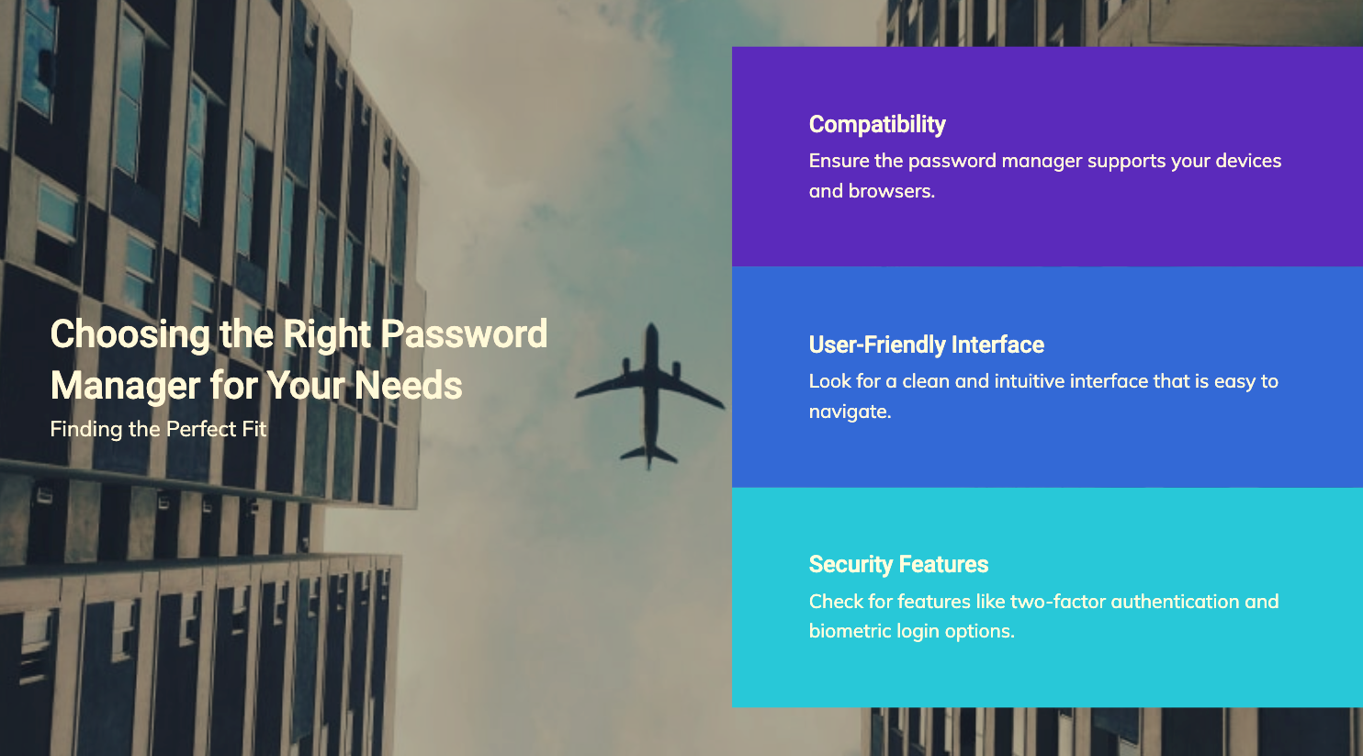
Selection of a right Password manager
Notes:
Compatibility
Cross-Platform Support: Ensure the password manager works on your various devices and operating systems, including Windows, macOS, Android, and iOS.
Browser Integration: Look for a manager that seamlessly integrates with your preferred web browsers like Chrome, Firefox, or Safari.
Cloud Sync: Choose a password manager that syncs your passwords securely across all your devices through cloud services
User-Friendly Interface:
Cross-Platform Support: Ensure the password manager works on your various devices and operating systems, including Windows, macOS, Android, and iOS.
Browser Integration: Look for a manager that seamlessly integrates with your preferred web browsers like Chrome, Firefox, or Safari.
Cloud Sync: Choose a password manager that syncs your passwords securely across all your devices through cloud services
Security Features:
End-to-End Encryption: Ensure your passwords are encrypted with strong, end-to-end encryption methods to protect your data.
Two-Factor Authentication (2FA): Choose a manager that supports 2FA for an additional layer of security.
Secure Notes and Data Storage: Look for the ability to store secure notes and sensitive information beyond passwords.
Biometric Authentication: Some password managers offer biometric login options (e.g., fingerprint or facial recognition) for added security.

Slide 28
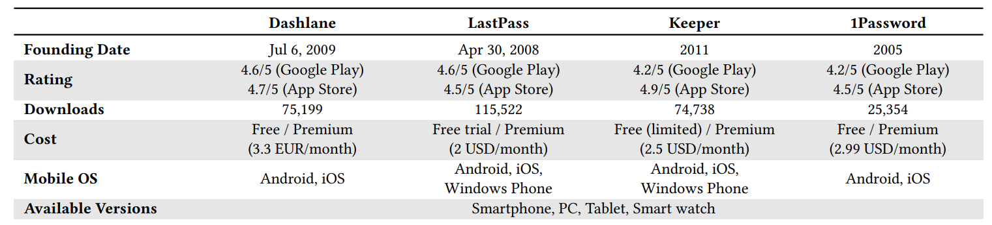
Password managers considered for the paper study
Research conducted up to 2018
Notes:
four popular managers for the two most widely used mobile operating systems, Android and iOS. We made our choices based on their recommendations and the number of downloads they have on the Android market and Apple store.

Slide 29
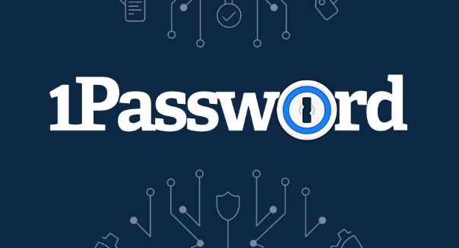
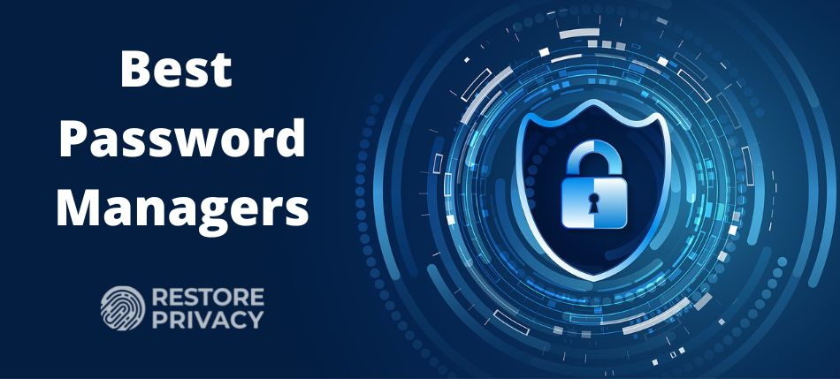
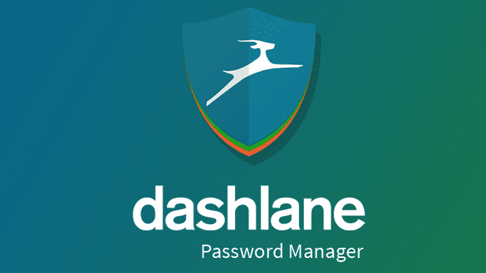
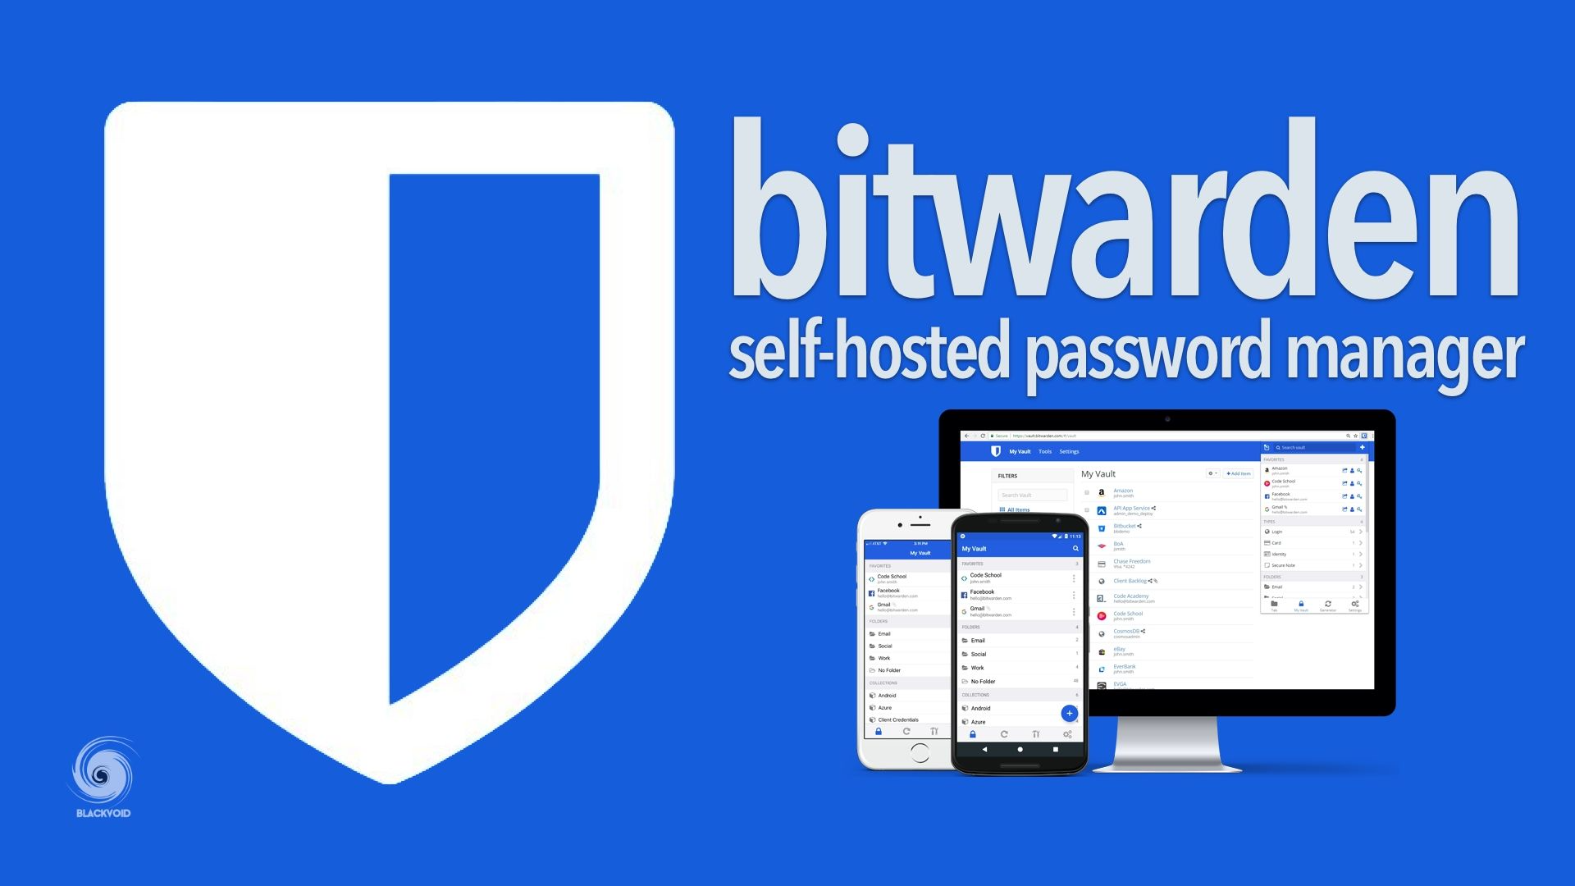
Password managers
REPORT BASED UNTIL Mar—2023

Slide 30
preferences
Choose 1password if: You want a user-friendly interface with solid security and various plans.
Choose Bitwarden if: You prefer an open-source option, plan to self-host, or want a more budget-friendly premium option.
Choose Dashlane if: You’re looking for a polished user interface, and dark web monitoring.
Notes:
1password – user friendly
Bitwarden – open source
Dashlane – better UI

Slide 31
Best Password manager
Rank | Password manager | Users count (millions) | Created
1 | Bitwarden | 40+ | 2016
2 | 1Password | 20+ | 2006
3 | Dashlane | 15+ | 2008
4 | NordPass | 10+ | 2014
5 | Keeper | 5+ | 2011
Notes:
Here's a list of password managers based on user counts and their creation years:
Bitwarden: Created in 2016, with over 40 million users.
1Password: Established in 2006, boasting 20+ million users.
Dashlane: Founded in 2008, with more than 15 million users.
NordPass: Originated in 2014, and has 10+ million users.
Keeper: Created in 2011, with over 5 million users.

Slide 32
Differences
Features | 1password | Bitwarden | Dashlane
Security | AES-256 bit encryption, PBKDF2 SHA-256 | AES-256 bit encryption, Open Source | AES-256 bit encryption,
Pricing | Easy to use, family plans, advanced security features | Free version available, competitively priced premium plans | Limited free version, pricier premium plans
User Interface | User-friendly | Clean but slightly technical | Intuitive and visually appealing
Open Source | No | Yes | No
Extra Features | Security challenge, dark web monitoring, emergency access | Extensive import/export options, self-hosting | dark web monitoring
Notes:
AES: AES stands for Advanced Encryption Standard. It is a symmetric encryption algorithm, which means the same key is used for both encryption and decryption.
256-bit: This refers to the key length used in the encryption process. AES 256-bit encryption
-more difficult for unauthorized parties to crack.
All three password managers use strong encryption standards, Bitwarden is known for its open-source nature, which allows security experts to review its code for vulnerabilities. This transparency is a point in Bitwarden's favor for security-conscious users.
Bitwarden offers a free, open-source version with paid premium features, making it a cost-effective option.1Password and Dashlane are subscription-based services. Dashlane offers a limited free version, but most features are available in the premium subscription. 1Password primarily operates on a subscription model.
Bitwarden is clean but tech oriented bcez of customizations

Slide 33
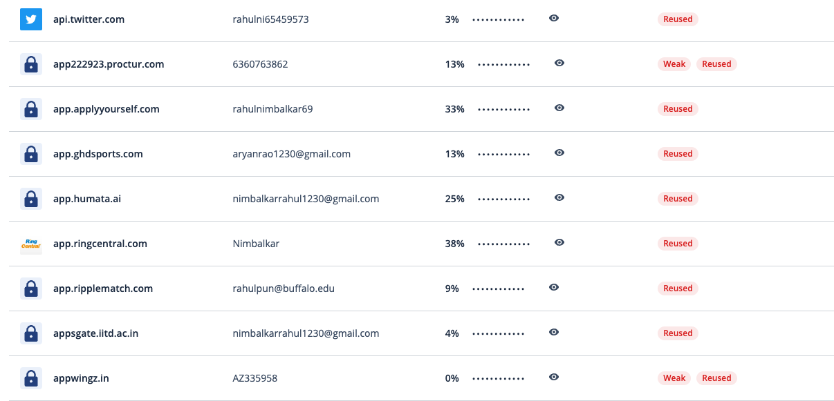
Extra features in pm
Notes:
Here is a screenshot of LastPass, showcasing the credentials of website and their password strength and risk levels.

Slide 34
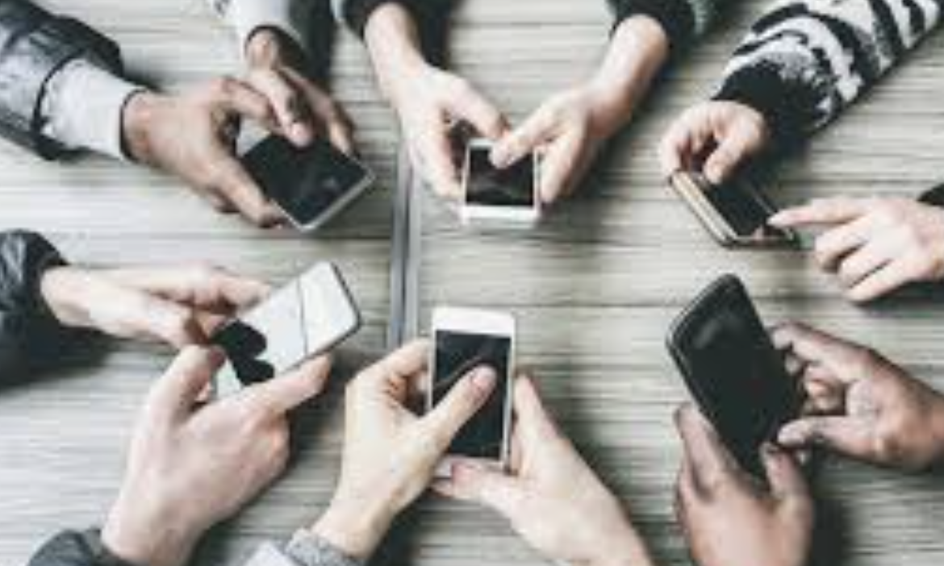

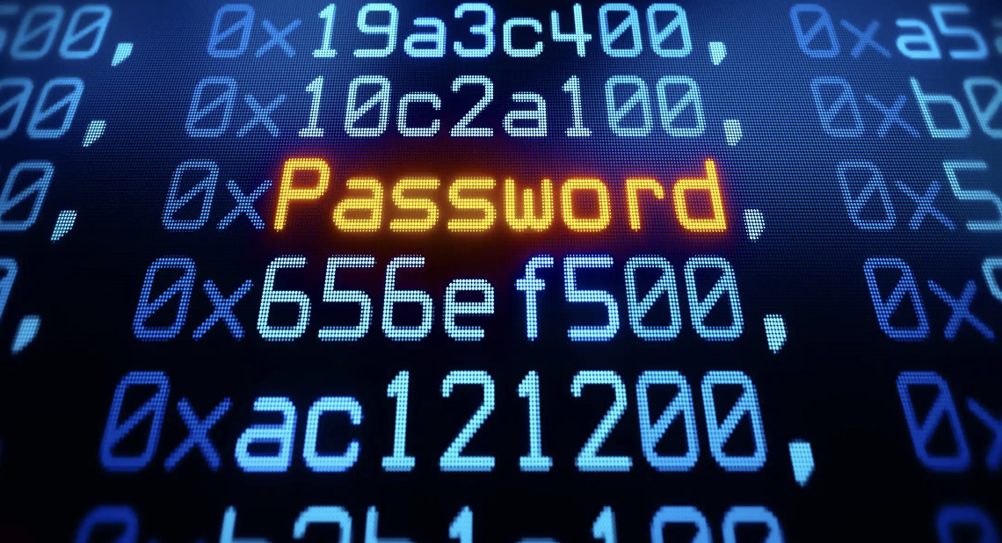
What it should include
(Multifactor authentication)
Something you know -- password
Something you have – mobile or authenticator
Something you are – fingerprint or face-id
(ANY TWO minimum)

Slide 35
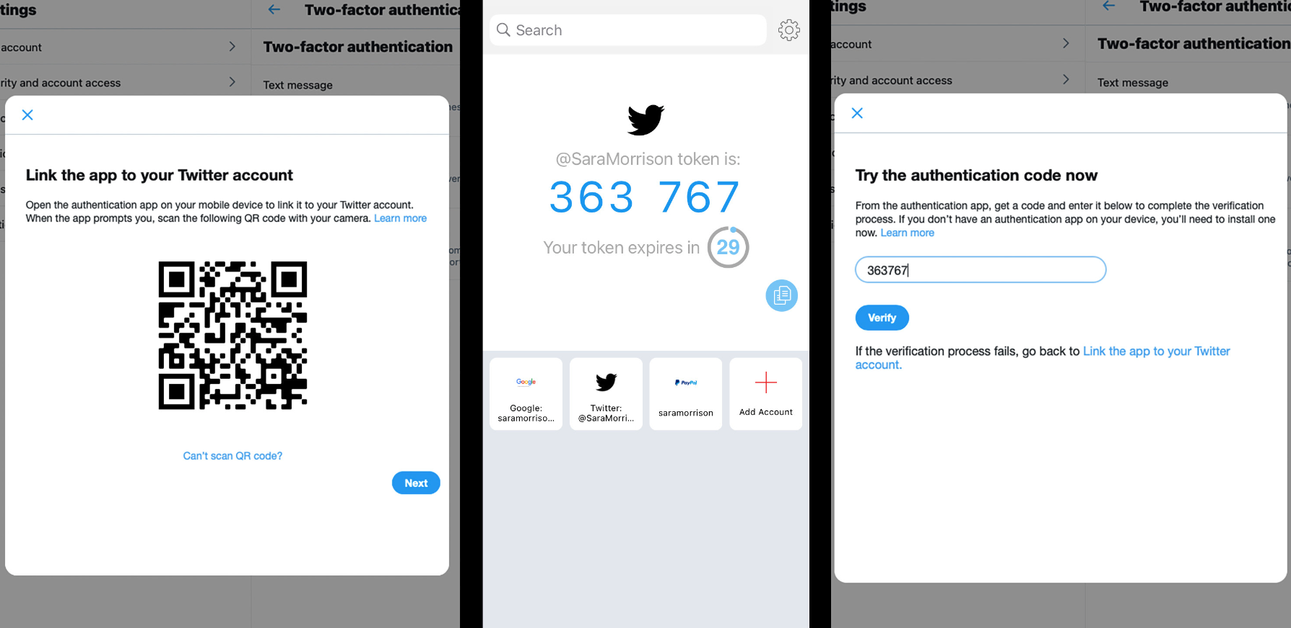
Google authenticator
Google Authenticator is a two-factor authentication app that provides an additional layer of security by generating time-sensitive codes (valid for a min) used to verify a user's identity when logging into various services and accounts.

Slide 36
study design of paper
Design and methodology of a study that evaluates the usability of four mobile password managers (PMs) using both qualitative and quantitative methods.
Structure
Participant Recruitment
Evaluation Framework
Notes:
Structure
The study is divided into three parts:
Pre-study Questionnaire: Collects demographic data and information about participants' previous knowledge of PMs.
After-task Questionnaire Measures usability attributes and usage of PMs after each task.
Post-Study Questionnaire: Obtains a quantitative SUS score assigned by participants
**************************
Participant Recruitment
Participants were recruited through Amazon Mechanical Turk (MTurk), with the requirement that they should not select a PM they were already using.
****************************
Evaluation Framework
The study evaluates PMs both qualitatively and quantitatively.
- Quantitative analysis relies on the System Usability Scale (SUS), a widely used and validated tool to measure usability.
The PACMAD (People At the Center of Mobile Application Development) usability model is also used, assessing PMs against seven attributes: Effectiveness, Efficiency, Satisfaction, Learnability, Memorability, Errors, and Cognitive Load.

Slide 37
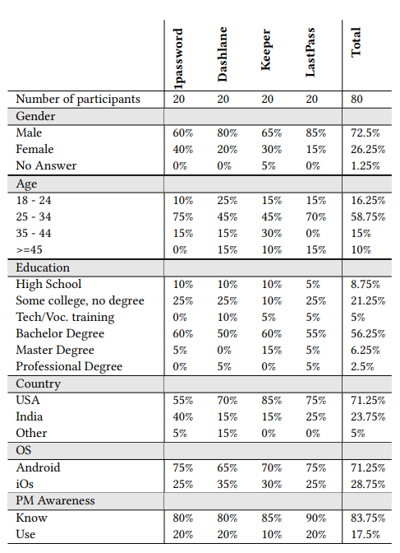
Demographics of participants in the usability study
Gender Distribution
Age Distribution
Education Levels
Geographic Distribution
Operating System Preferences:
Awareness and Adoption of Password Managers
Notes:
Gender Distribution: The participant group is not balanced in terms of gender, with 72.5% males, 26.25% females, and 1.25% preferring not to answer.
Age Distribution: The participants' ages range from 18 to over 45 years old, with a skew towards younger users (75% are younger than 35). This age distribution is typical in usable security research.
Education Levels: The participants have diverse educational backgrounds, with 8.75% having a high school degree or equivalent, 5% receiving technical or vocational training, 21.25% having some college education, 56.25% holding a college degree, and 8.75% having a graduate degree.
Geographic Distribution: Most participants (95%) are from the USA or India, with the remaining 5% from other countries like Italy, Mexico, Sweden, and Germany.
Operating System Preferences: 71.25% of the participants primarily use Android, while the remaining percentage prefers iOS.
Awareness and Adoption of Password Managers: While 83.75% of respondents claimed to know what a password manager is, only 17.5% reported actually using one. Participants mentioned using both browser-based password managers (28.6%) and third-party applications (71.4%), including options not analyzed in the study (e.g., Roboform, KeePass, Sticky Password, Kaspersky). Notably, some participants (6.25%) indicated they wouldn't continue using the tested password manager because their passwords were already stored by their browser or iPhone, indicating varying understandings of what constitutes a password manager.

Slide 38
Tasks Design
The study's questionnaire is designed around seven tasks that mimic common actions users perform with password managers (PMs) on smartphones:
1.Initialization
2.Account Migration
3.Login
4.Account Creation and Usage
5.Interaction with Apps
6.Password Change
7.Security Settings
Notes:
Initialization: Install and set up the password manager app on your device.
Account Migration: Save an existing web account and its password in the password manager.
Login: Log in to a website using the password manager's stored password.
Account Creation and Usage: Create a new web account on your smartphone, save the account and password in the password manager, and log in to the website.
Interaction with Native Apps: Download the mobile app of a website and log in using the password manager.
Password Change: Change the password of an account using the password manager's password generator and then log in with the new password.
Security Settings: Adjust the security settings of the password manager according to your preferences.

Slide 39
FRAMEWORK CONSIDERED
SUS scores –
SYSTEM USABILITY SCORES
PACMAD model –
“PEOPLE AT THE CENTRE OF MOBILE APPLICATION DEVELOPMENT”

Slide 40
SUS scores
The System Usability Scale (SUS) score is a widely used questionnaire-based method for evaluating the usability of a product or system, typically software or websites.
It has since become a standard tool in the field of usability and user experience (UX) research. The SUS score is used to assess how user-friendly and intuitive a system is from the perspective of its users.
Here's how the SUS score works:
Questionnaire
Scoring
Interpretation
Qualitative Insights
Pros: Quick and Easy, Comparative,
Cons: Subjectivity, Limited Detail, Context Matters
Notes:
SUS is a simple measure that tells us how user-friendly and easy to use a product or system is, typically on a scale from 0 to 100, with higher scores indicating better usability.

Slide 41
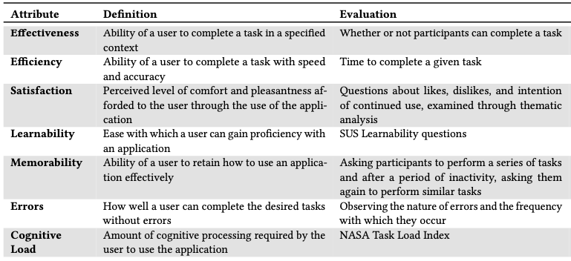
PACMAD Attributes
PACMAD model, a tool specifically oriented to evaluate the usability of mobile applications. Besides qualitative questions, PMs are also quantitatively evaluated through the standard System Usability Scale (SUS), which allows for objective comparison with other authentication alternatives.
Notes:
The PACMAD model is like a tool that helps check how easy it is to use mobile apps. We ask people questions and also use a scale called SUS to compare how good it is compared to other security methods.

Slide 42
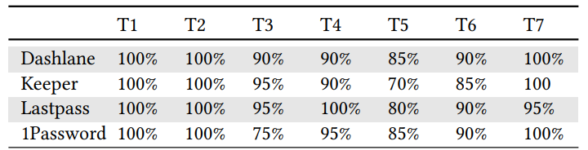
Tasks design to draw results on pacmad
The effectiveness of all four mobile password managers (PMs) was generally high, with an average success rate of above 90% across all tasks. However, Task 5, which involved downloading a native app and logging in using a stored password, had the lowest success rate.
Fig. Effectiveness of PMs measured as the success rate in completing each of the seven tested tasks (T1-T7).
Notes:
Reason behind dip in task 5, This was likely because participants expected the PM's auto-fill feature to work seamlessly with native applications, but it required granting system-level permissions or realizing that auto-fill might not work for every app.

Slide 43
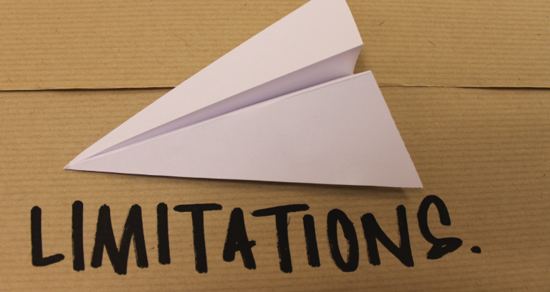
Paper Limitations
Sample Bias –
Informed Consent
Participant Interest
Artificial Testing Environment
Limited Selection of PMs -- 4
Long-term Usage Insights
Notes:
1. **Sample Bias**: The study acknowledges that the participant sample recruited from MTurk may not be entirely representative of the general population. MTurk users are often "WEIRD" (coming from Western, Educated, Industrialized, Rich, and Democratic countries), and the demographics of the study still skewed towards the United States and India. This limits the diversity of backgrounds and experiences in the sample.
2. **Informed Consent**: The study openly disclosed its purpose to participants to obtain fully informed consent. However, this transparency can introduce bias, as participants might alter their behavior and responses to align with what they think the experimenters expect.
3. **Participant Interest**: Participants who chose to take part in the study might have a higher level of interest or familiarity with password managers (PMs). This could exclude the perspectives of users who are not interested in PMs but may still have valuable insights.
4. **Artificial Testing Environment**: Participants tested the mobile PMs based on instructions in an artificial setting, which may not fully reflect real-life PM usage. There could be differences between test results and actual user experiences.
6. **Limited Selection of PMs**: The study analyzed a reduced set of mobile PMs chosen based on popularity. This may not provide a comprehensive view of the entire mobile PM market, as different versions and implementations can affect usability perceptions.
7. **Long-term Usage Insights**: The study did not explore long-term usage of PMs. Field studies tracking participants over an extended period in their everyday use could reveal usability issues that only arise with continued use.
Despite these limitations, the study aims to contribute to the understanding of smartphone PM usability. It recognizes the need for more diverse participant samples, longer-term studies, and broader coverage of PM applications and versions to gain a more comprehensive view of PM usability.

Slide 44
ongoing expansion
Increasing Cybersecurity Threats:
The surge in cyber-attacks and data breaches drives a growing demand for secure password management solutions to protect sensitive data and online identities.
Digital Transformation:
The ongoing global shift towards digital platforms across various sectors, such as banking, healthcare, and retail, necessitates robust password management to secure numerous online accounts.
Consumer Awareness:
Rising awareness among consumers regarding the importance of robust cybersecurity practices, including secure password management, fuels the adoption of password managers.
Regulatory Compliance:
Stricter data protection regulations worldwide compel businesses to adopt secure password management solutions like password managers to comply with data security and user privacy norms.
Notes:
Increasing Cybersecurity Threats: With more cyber-attacks and data breaches happening, there's a bigger need for tools that help keep our passwords and online information safe.
Digital Transformation: As the world becomes more digital, like with online banking and healthcare, we need strong ways to manage our passwords and protect our online accounts.
Consumer Awareness: People are realizing how important it is to be safe online. They're using password managers to help keep their information secure.
Regulatory Compliance: There are now stricter rules about protecting data. To follow these rules, businesses are using password managers to make sure they're keeping data and user information safe.

Slide 45
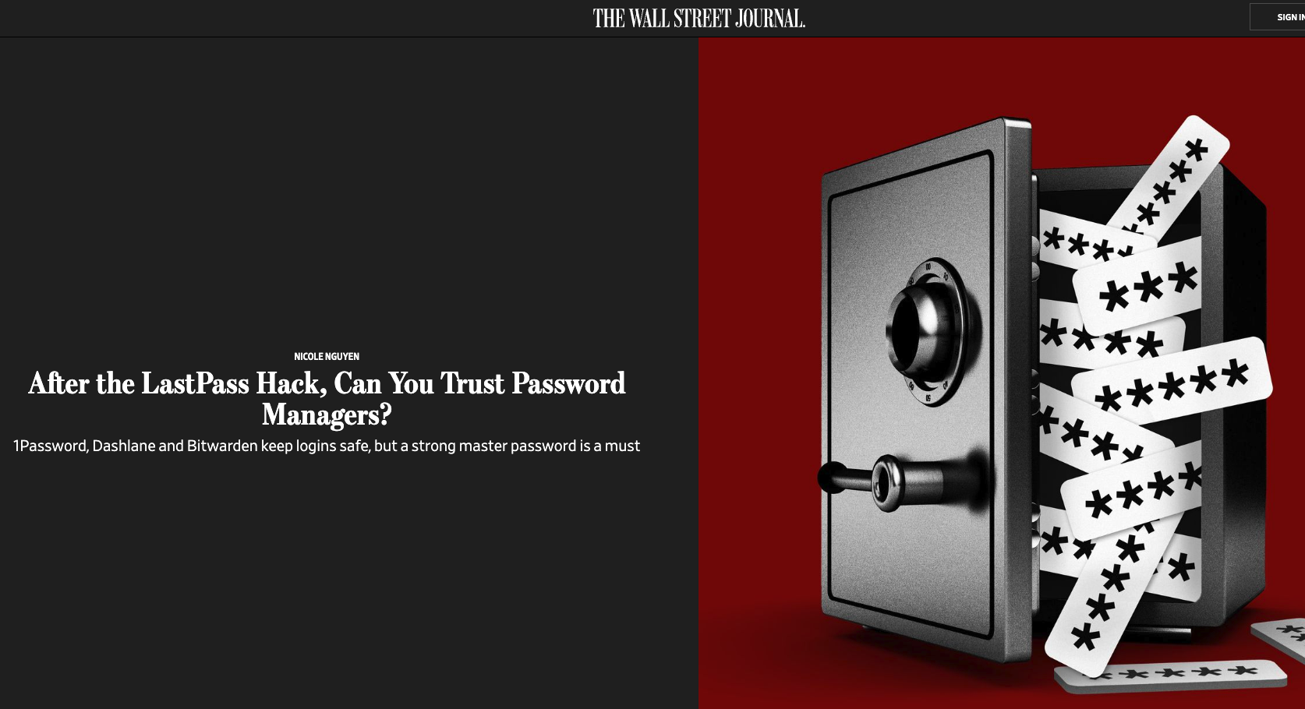
Breaches ??
Notes:
So, we've lauded the Password Manager as our digital
superhero, but what happens when even the mightiest guardians face threats? Yep, we're talking about breaches into these virtual vaults.
Let’s navigate through the incidents, understand the cracks

Slide 46
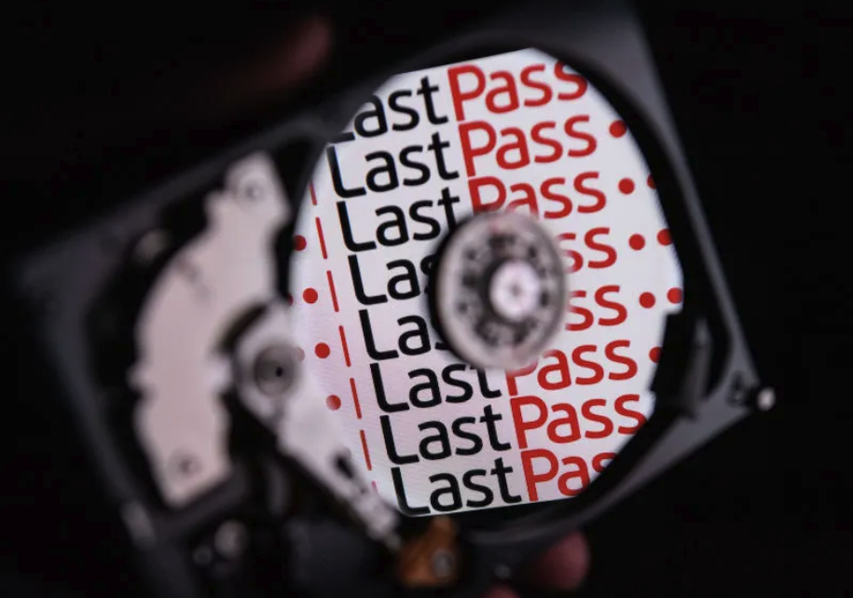
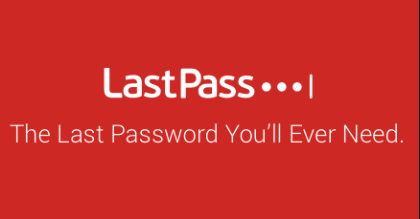
Lastpass hacked
August 25, 2022: LastPass detects “unauthorized” access
September 15, 2022:
LastPass says no customer data or passwords compromised
Hackers were unable to get these decryption keys because they were not stored anywhere by LastPass.
That customers’ most sensitive data — such as (most) email addresses and passwords — were encrypted using a
Zero-knowledge method.
That means they were encrypted with a key derived from each user’s master password and unknown to LastPass. When the hackers stole LastPass data,
Notes:
The incident, much like the Titanic’s descent into the abyss, left the digital community in stunned silence, questioning the infallibility of even the most robust security systems.
Today, let’s rewind to August 25, 2022, a day that sent a shiver down the digital world’s spine: LastPass detected unauthorized access.
where despite a breach, the data within remained untouched and secure. Fast forward to September 15, 2022, and LastPass assured us: no customer data or passwords were compromised! How so? Our digital treasures - email addresses, passwords, and more - were encrypted using a method akin to a secret language, known only to the user and indecipherable to intruders.
This Zero-knowledge encryption meant that even though hackers infiltrated the vault, the treasures within, encrypted with a key born from each user’s master password, remained elusive and intact.

Slide 47
Zero knowledge method
User-Centric Encryption: Sensitive data is encrypted using a key derived from the user's credentials, ensuring only the user can decrypt the information.
Zero Knowledge Principle: The service provider does not have access to the decryption key, maintaining ignorance ("zero knowledge") of the user’s actual data.
Security in Breaches: In the event of a data breach, attackers only access encrypted data, which is unreadable without the decryption key.
Enhanced Privacy: The approach ensures user data is secure and private, safeguarding it against unauthorized access and breaches.
Notes:
Let's chat about a fascinating concept today: the Zero-Knowledge Method. Imagine having a secret, something so precious that even the box where you keep it doesn’t know what’s inside.
This is the marvel of Zero-Knowledge encryption! It ensures our digital secrets, like passwords, are locked away in a box, encrypted with a special key that only we possess.
Even the box (in our case, LastPass) is clueless about the contents!
Imagine you have a diary filled with your deepest secrets, and it's locked with a key that only you possess. Now, think of a trusted friend as your service provider. Here’s the catch: your friend is the guardian of your diary, but they don’t have the key to open it. They can hold the diary, move it around, and keep it safe for you, but the contents inside remain an enigma to them. Even in your absence, your secrets are secure because your friend operates on the Zero Knowledge Principle - they're completely clueless about the diary's contents.

Slide 48
What happens if pm is breached
In most cases, getting hacked doesn’t result in all your accounts and passwords falling into the wrong hands. This is because password managers are locally encrypted.
As such, if a hacker breaches your password manager, they can only see encrypted information.
The hacker won’t be able to decipher your data.
Notes:
Today, we’ll dive into the potential consequences and ripple effects of a password manager breach, uncovering the digital chaos that may ensue.
So, if a hacker does manage to break in,
all they find is a puzzle without a solution. It's like having a safe inside a safe, and even if someone cracks the outer shell, the inner one remains impenetrable.
In simple terms, the hacker can't decipher your data.
It’s a bit like finding a jigsaw puzzle with no picture on the box. The pieces are there, but they won't reveal the full picture without the right key.

Slide 49
what kind of encryption they use
(inside data protection)
Most password managers use 256-bit AES encryption, which is a military-grade encryption standard.
  AES is considered to be unbreakable by brute-force attacks, meaning that it would take even the most powerful computers billions of years to crack an AES-encrypted password.
In addition to AES encryption, many password managers also use other security features, such as:
Zero-knowledge encryption: This means that the password manager company is blindfolded. They don’t have access to your master password or your encrypted data.
Salting: This means that a random string of characters is added to your password before it is encrypted, making it even more difficult to crack.
Stretching: This means that the password encryption process is repeated many times, making it even more time-consuming and difficult to crack.
Notes:
256-bit AES encryption is a symmetric encryption algorithm that uses a 256-bit key to encrypt and decrypt data. It is considered to be one of the most secure encryption algorithms available today and is used extensively in government and military applications, as well as by businesses and individuals to protect sensitive data.
AES encryption works by dividing the data to be encrypted into blocks of 128 bits. Each block is then encrypted using a series of complex mathematical operations.
To decrypt the data, the same key must be used in reverse order. This means that only someone who has the key can decrypt the data.
Zero-Knowledge Encryption: This means that the password manager company is blindfolded. They don’t have access to your master password or your encrypted data. It's like entrusting your secrets to a vault keeper who can't peek inside.
Salting: Think of this as adding a secret spice to your password before locking it away. Making it difficult
3. Stretching: This is like doing a marathon. It repeats the encryption process multiple times, making it incredibly time-consuming

Slide 50
HAVE OTHER PASSWORD MANAGERS
EXPERIENCED SECURITY BREACHES?
Security breaches targeting onelogin in 2017 have garnered significant attention, given its reputation as one of the top password management solutions globally.
In both 2019 and 2020, various research projects aimed to uncover potential vulnerabilities in password managers. These investigations revealed security weaknesses in several widely used password management tools, not limited to LastPass alone.
Bug bounty contests where you can work on security of the company legally.
Notable password managers affected by these vulnerabilities included Dashlane, 1Password, Keeper, and RoboForm.
Notes:
lastpass wasn’t the only player in this game. Cyber baddies have their eyes on multiple password security providers, not just lastpass.
Fast forward to 2019 and 2020, where some clever folks decided to peek under the hood of various password managers. What did they find? Well, it turns out that even the most popular password management tools, like Dashlane, 1Password, Keeper, and RoboForm, had a few chinks in their digital armor.
this isn't to scare you off but to remind you that in the world of digital security, everyone's learning and improving. So, while these incidents happened, they also increased better defenses and lessons learned from this

Slide 51
Is data breached ???
In April 2021, hackers used phishing to target Passwordstate users, stealing login credentials. They then posed as Click Studios customer support, obtaining more personal data.
Passwords are a cybersecurity weak point; 80% of global breaches in Verizon's 2022 report were linked to password issues. Alarmingly, 66% of Americans reuse passwords for email, banking, and social media.
Most password managers use strong encryption to protect your data, even if the company itself is hacked. This means that even if a hacker is able to gain access to your password manager account, they will not be able to read your passwords directly.
Notes:
Using phishing they steal the usernames and passwords

Slide 52
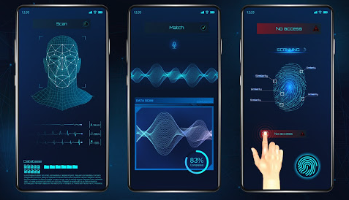
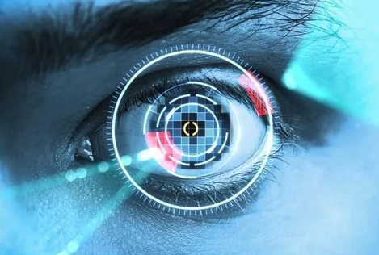
Will we eventually replace password managers?
1. Biometric Authentication:
Current State: Fingerprint, facial recognition, and voice recognition,retina scan are becoming commonplace in device authentication.
Future Possibility: Enhanced biometric systems that combine multiple biometric parameters for ultra-secure authentication.
2. Behavioral Biometrics using AI and ML:
Current State: Advanced AI and machine learning algorithms can help identify and prevent unauthorized access. Some systems track user behavior (such as typing speed, mouse movements, etc.) to create a user profile.
Future Possibility: Advanced behavioral biometrics that could identify and authenticate users seamlessly based on their unique usage patterns.
Notes:
let’s peek into the future and ask a question that's been on many minds: Will we ever say goodbye to password managers? It's like wondering if we’ll ever replace our trusty old keys with something more advanced.
Will password managers evolve to meet the challenges, or will they gracefully step aside for more advanced guardians of our digital lives? The answer is yes
As technology is advancing at exponential rate

Slide 53
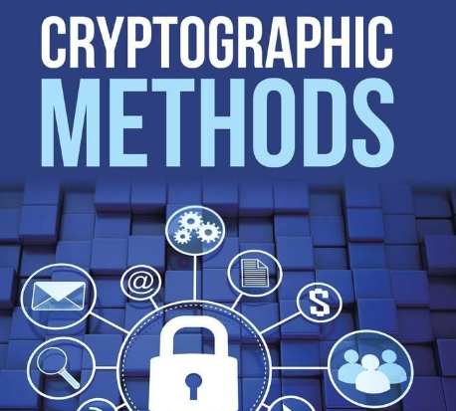
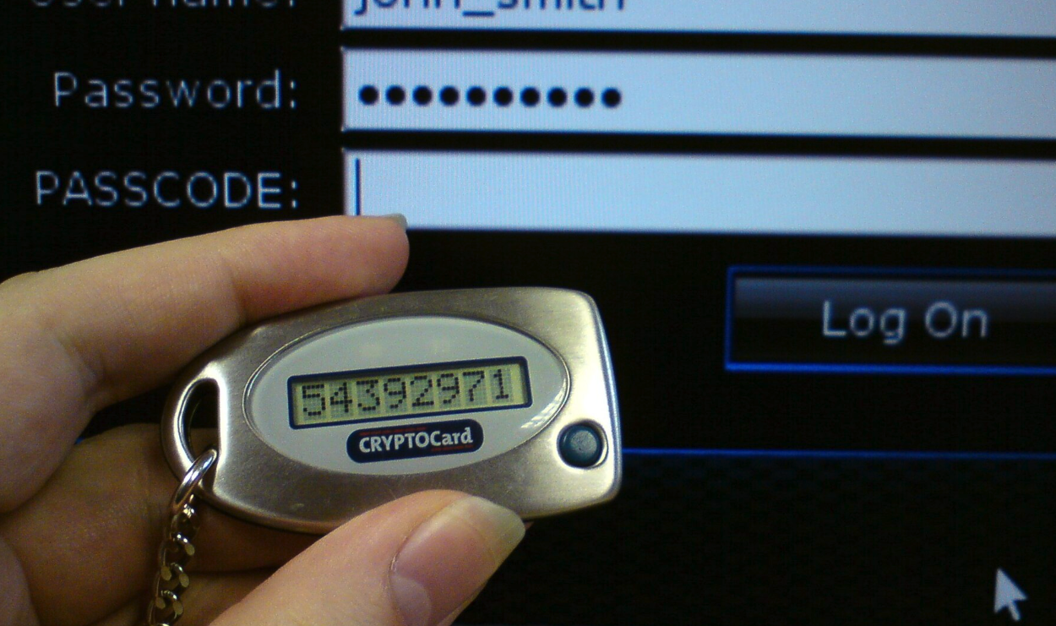
Will we eventually replace password manager ???
3. Quantum-Safe Cryptography:
Current State: Research into cryptographic methods that would be secure against quantum attacks.
Future Possibility: Implementation of quantum-resistant cryptographic algorithms in authentication processes.
4. Hardware Tokens:
Current State: Hardware tokens (like YubiKey, satellite key) provide an additional layer of security through physical devices.
Future Possibility: More advanced and user-friendly hardware tokens that could completely eliminate the need for remembering passwords.

Slide 54
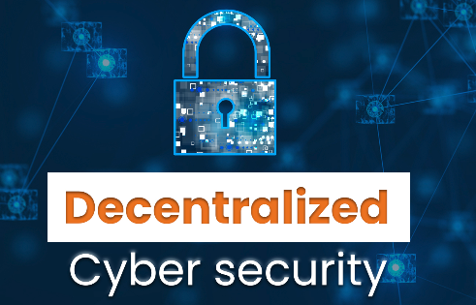
Will we eventually replace password manager ???
5. Decentralized Identity Management:
Current State: Blockchain technology is being utilized for decentralized identity management in some systems.
Future Possibility: A global, decentralized identity management system that provides secure and seamless authentication without centralized control.

Slide 55
Can password-FREE technology solve the problem?
Possession factors like one-time passwords, authentication app codes, or hardware tokens.
Biometrics, such as fingerprints, face recognition, retina scans, or heartbeats.
A special link sent via email that provides access to the user.
Notes:
Password-free technology is all about finding smarter, more convenient ways to secure our digital lives. It's like moving from a cumbersome old lock to a futuristic, seamless access system.

Slide 56
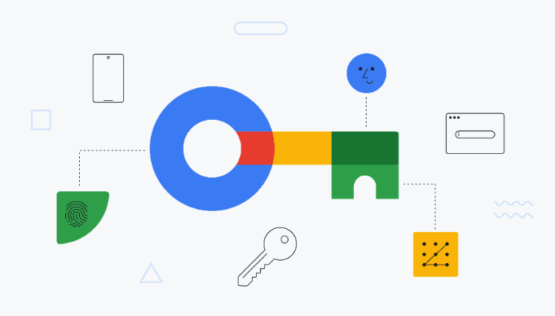
Is password less technology the answer?
Passkeys can replace traditional passwords with your device’s own authentication methods. That way, you can sigin to Gmail, PayPal, or iCloud just by activating Face ID on your iPhone, your Android phone’s fingerprint sensor.
Built on WebAuthn (or Web Authentication) tech, two different keys are generated when you create a passkey: one stored by the website or service where your account is and a private key stored on the device you use to verify your identity.
Google introduced passkeys, a product developed in collaboration with the FIDO Alliance.
In 2023, 1Password will unveil a password-free system compatible with iOS, Android, Windows, Mac, Chrome OS, and Linux devices. Users can generate concealed passkeys effortlessly through a browser extension, with each website having its unique pair stored securely.
Notes:
Passkeys, a revolutionary concept in the realm of authentication.
It’s like having a magical key that opens all your digital doors, without the fuss and complexity of traditional passwords.

Slide 57
specific points about
Google Passkeys:
Google Passkeys are a new, passwordless way to sign in to your Google Account and other online services.
Passkeys are created using your device's biometric authentication features, such as your fingerprint or face scan.
Passkeys are more secure and convenient than passwords, and they are not susceptible to phishing attacks or password breaches.
Google Passkeys are still under development, but they are already supported by a number of popular websites and apps.
Notes:
how do Passkeys work? Different passkeys are approaching
They're like your personal bodyguard, created using your device's biometric features—your fingerprint or face scan.
No more wrangling with those tricky passwords!
here's the scoop: Google Passkeys are still in the oven, but they're already earning support from various popular websites and apps. It's like the future of secure, hassle-free access is just around the corner.

Slide 58

references
https://aag-it.com/the-latest-cyber-crime-statistics/#:~:text=Headline%20Cyber%20Crime%20Statistics&text=1%20in%202%20American%20internet,the%20first%20half%20of%202022.
https://securityintelligence.com/articles/future-of-password-managers/
1Password. 2019. 1Password website. Accessed: 2019-02-22.
https://www.google.com/search?sca_esv=572214004&sxsrf=AM9HkKnyzbfxCLK8ZxP5_Q4VfxtUhi2StQ:1696954578005&q=sanskrit+shlokas
https://www.lastpass.com/solutions/enterprise-password-management?utm_source=google&utm_medium=cpc&utm_campaign=19885604562&utm_term=corporate%20password%20management%20system&utm_content=150217548169&sfdcid=7018c000001FDbw&gclid=Cj0KCQjw7JOpBhCfARIsAL3bobcFh7YBVm0VySW0KKQFfBLHa_1XEDPHhpHDDKDIrZGNyJtnytiGh6AaAgpCEALw_wcB
https://www.powershow.com/view4/4f104a-OGIzM/Password_Managers_powerpoint_ppt_presentation
https://cybersecurityventures.com/cybersecurity-almanac-2023/
https://www.wired.com/story/how-to-use-google-authenticator-app/
https://www.theverge.com/2023/9/20/23880714/1password-mobile-passkey-support-web-browser-extension-release-date

Slide 59


