Slide 1
WearSec: Towards Automated Security Evaluation of Wireless Wearable Devices
CSE 707 SEM
UPAD: Seminars
Wireless Networks Security
Sowmiya Murugiah
Dhayaneshwar Balusamy

Slide 2
AGENDA
Introduction
Wearable Devices
Potential Risks
Unique Approach to Device Security
Process Flow Of The Prototype
Choice of Hardware
Data Capture Bandwidth Issues
Lack of Open Source and Protocol Stack
Conclusion and Future Works

Slide 3
Introduction
Unveiling the realm of wireless wearables
Exploring their hardware and wireless vulnerabilities
Introducing an automated security evaluation prototype
Focusing on Bluetooth and Wi-Fi security
Join us on a journey to secure wearable tech!

Slide 4
Wearable Devices
Wearable devices are electronic gadgets that can be worn on the body as accessories or integrated into clothing and accessories.
These devices are designed to perform specific functions and provide various features to the wearer, typically through sensors and embedded technology.

Slide 5
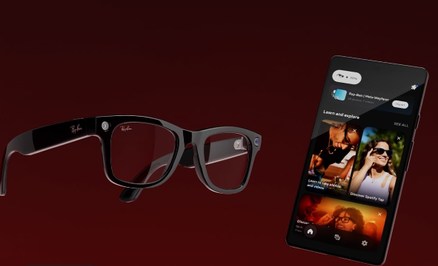
Ray-Ban Smart Glasses
Meta CEO Mark Zuckerberg introduced the latest innovation, Ray-Ban smart glasses, during the Meta Connect 2023 event.
These cutting-edge smart glasses promise to redefine how we interact with the world.
Let's dive into their features and capabilities in the following slides.

Slide 7
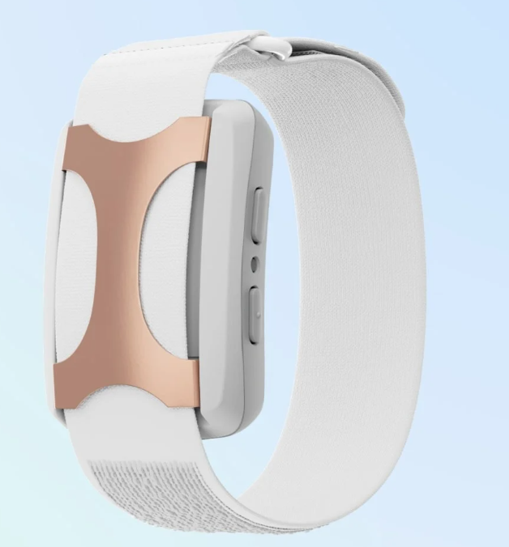
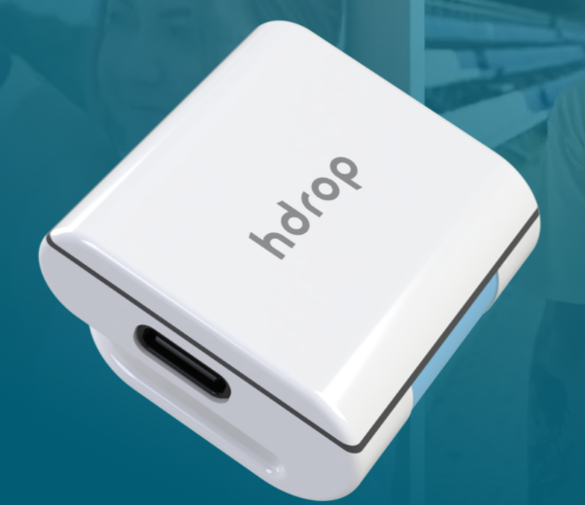
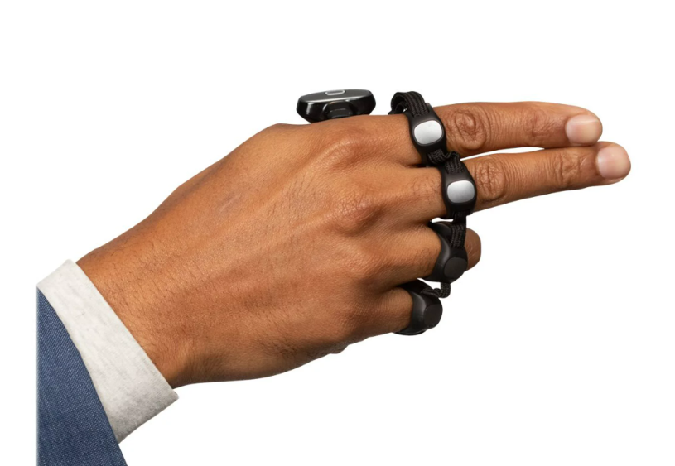
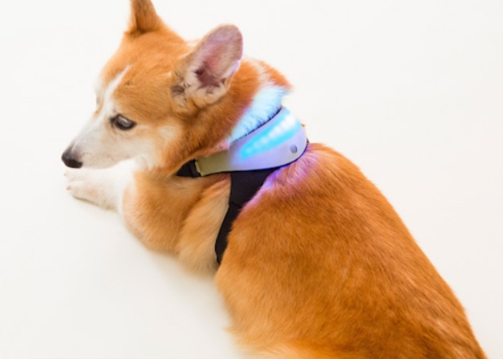
Apollo Wearables
hdrop
Tap Strap
Inupathy
The Apollo® wearable is designed to elevate your body's resilience to stress, offering a holistic approach to well-being.
HDROP simplifies the process of sweat testing for athletes. It's user-friendly, flexible, and cost-effective, making hydration monitoring more accessible than ever.
With the Tap Strap 2, you can seamlessly type, mouse, and control any digital environment.
Inupathy is a pioneering device that gives dog owners unprecedented insights into their pets' emotional and physical states.

Slide 8
Wearable Devices Growth
In just six years, from 2016 to 2022, the number of connected wearable devices in the world has seen an extraordinary increase. Starting at 325 million in 2016, this figure has surged to an astounding 1,105 million in 2022.
Percentage Increase: 240%
This remarkable growth represents a staggering 240% increase, signifying the rapid adoption and integration of wearable technology into our daily lives.

Slide 9
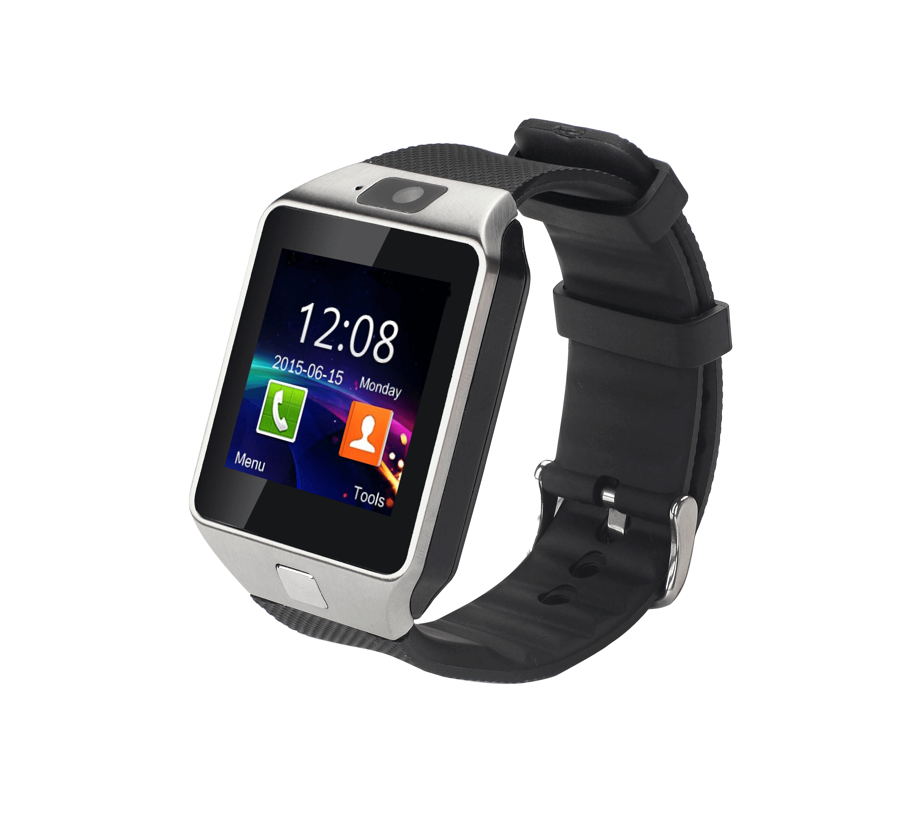
Uses

Slide 10
Potential Risks

Slide 11
Privacy and Security Risks of Wearable Devices
Privacy Concerns: Compromised wearable devices could expose sensitive personal information, making users vulnerable to privacy breaches.
Network Security: They may facilitate attacks on private networks, potentially leading to unauthorized access or data breaches.
Covert Account Takeover: Hackers could exploit vulnerabilities in wearables to gain unauthorized access to user accounts.
Targeted Attacks: Wearable devices may serve as entry points for both direct and indirect targeted cyberattacks.

Slide 12
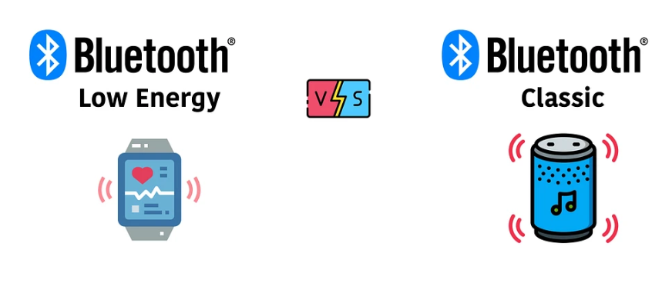
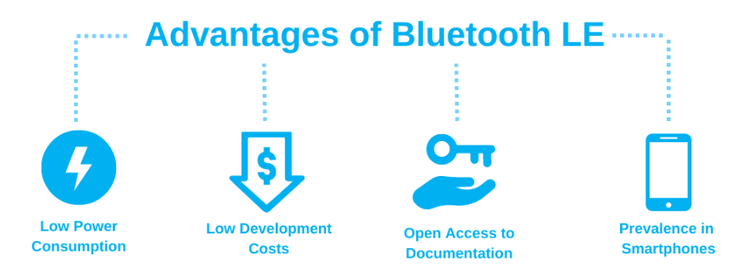
Wireless Communication Standards
Wearable devices have become increasingly reliant on wireless communication standards to interact with other devices and networks. The most common standards used include:
Bluetooth Classic (BT): This standard is widely employed for connecting wearables to smartphones and other devices. It enables data exchange over short distances.
Bluetooth Low Energy (BLE): BLE is energy-efficient and commonly used in fitness trackers and health monitors, allowing for continuous monitoring without significant battery drain.
WiFi: Wearables with WiFi capabilities can connect to local networks, facilitating data transfer and remote monitoring.

Slide 13
Contributions and Paper Structure
This paper offers valuable contributions in the field of wearable device security evaluation.
A) Automated Wireless Wearable Device Security Evaluation Prototype:
Conceptual design, with detailed functionality requirements.
A comprehensive patent description.
B) Overview of Prototype Technical Implementation:
Insights into the initial stage of technical implementation.
Paper Structure:
Section 2: Discusses related work on wireless device fingerprinting and security assessment.
Section 3: Describes the proposed system architecture, conceptual prototype, and considerations for automated security evaluation of wireless wearable devices.
Section 4: Covers the specific implementation stages, challenges faced during the first stage of prototype implementation, and solutions to overcome these issues.
Section 5: Engages in a discussion of future work related to this research.

Slide 14
A Unique Approach to Wearable Device Security
This paper offers valuable contributions in the field of wearable device security evaluation.
In the proposed paper, we encounter a novel strategy for enhancing the security of wearable devices, which deviates from the conventional automated fuzzing methods.
Device Detection and Fingerprinting
Vulnerability Identification

Slide 15
1. Device Detection and Fingerprinting
Device Fingerprinting Overview: Device fingerprinting is a technique to identify target devices by scrutinizing their distinctive features and hardware imperfections. This presentation explores this intricate process and its implications in the realm of security.
Fingerprinting Process Components:
The fingerprinting process encompasses two crucial components: feature extraction and classification.
Security Implications: Successful device fingerprinting may lead to serious security risks, particularly if the identified chipset has publicly known attack vectors, often accompanied by available exploitation proof-of-concept (PoC) code.

Slide 16
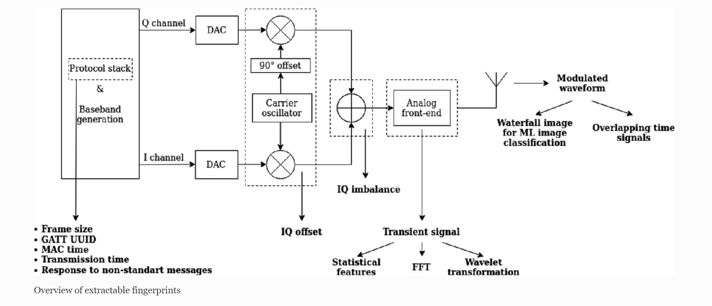

Slide 17
Vulnerability Identification
In this project, a dual-pronged approach is employed for vulnerability identification, ensuring a comprehensive security assessment of wearable devices.
1. Known Vulnerability Applicability:
The first direction revolves around the assessment of known and publicly released vulnerabilities.
This is achieved through a meticulous analysis of the Device-Under-Test (DUT) passive fingerprinting and the examination of intercepted communications.
By matching the device's characteristics and communication patterns, we ascertain the applicability of known vulnerabilities.
2. Active Unknown Vulnerability Detection:
The second direction represents a proactive stance. It involves the active initiation of attempts to trigger unknown vulnerabilities in the wearable device.
This is accomplished by employing black-box fuzz testing techniques.
The goal is to unearth potential vulnerabilities that may have remained concealed, enhancing the overall security posture of the device.

Slide 18
Prototype Concept Description: Automated Security Evaluation of Wearable Devices
3 Prototype Concept Description
Passive Fingerprinting for Device Identification:
Intercepting radio spectrum broadcasts from wearable devices.
Analyzing received data to identify the hardware chip manufacturer, model, and potentially the device itself based on unique data patterns and signatures.
Fingerprinting for Known Vulnerabilities:
Comparing collected fingerprint data with a comprehensive database containing known vulnerabilities specific to wireless wearable devices.
Active Interaction to Validate and Probe Vulnerabilities:
Validating identified vulnerabilities, particularly if there is a publicly disclosed exploit code.
Eliciting responses from devices to gather further fingerprinting data.
Performing automated vulnerability identification and probing using fuzz-testing approaches at the wireless protocol level.

Slide 19
Prototype Process Flow
Wireless DUT: Wearable devices being tested.
Wireless Sensors & HPD Modules:
Hardware designed to interact with radio frequencies used by wearable devices.
Supervises interactions, captures data, and provides side information.

Slide 20
Communication & Interface
Asynchronous Message Queuing:
Facilitates communication between abstraction layers.
DSL (Domain-Specific Language):
Provides a common interface for message formation based on wireless protocol specifications.
01010101110
10101010111
10111011100
01010101110
10101010111

Slide 21
Recording & User Scripts
Traffic Recording & Filtering:
Captures raw traffic and RF signal parameters for fingerprinting and evaluating outcomes.
User Scripts:
Highest-level entity that defines activities.
Communicates through the DSL API.

Slide 22
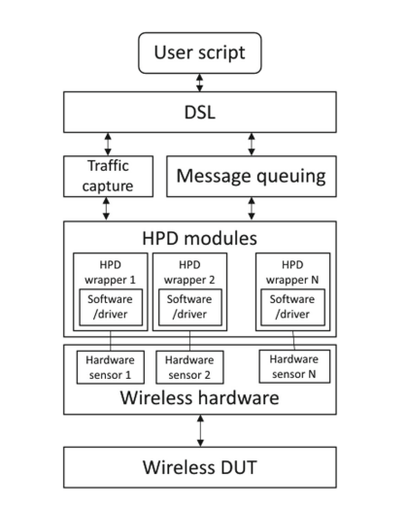
Operational Process Flow Of The Prototype

Slide 23
Stages of Development
Stage 0: Selection of wearable DUTs and prototype hardware.
Stage 1: Recording of wearable device communications.
Stage 2: Identification of communication patterns.
Stage 3: Dataset for machine-learning-assisted fingerprinting.
Stage 4: Actively probe and assess the devices.
Note: Discussion is limited to Stage 1. The concept has been submitted for patenting.

Slide 24
Choice of Hardware
Protocol-specific chips vs. Software-Defined Radio (SDR)
Protocol-specific chips:
Pre-fabricated for specific protocols.
Advantages: Straightforward communication, no need for custom implementations.
Limitations: Restricted functionalities, no deviations from protocol, can't gather signal nuances.

Slide 25
Choice of Hardware
Protocol-specific chips vs. Software-Defined Radio (SDR)
Software-Defined Radio (SDR):
Uses software for functions.
Advantages: Highly flexible, allows data collection in any manner and signal variations.
Focus on SDR due to its complexity.

Slide 26
Frequency Bandwidth Consideration
Recording Bandwidth: Capture all channels of Bluetooth and Bluetooth LE requires 80 MHz spectrum band.
Challenges: No affordable SDR devices provided the needed 80 MHz bandwidth.
Solution: Use multiple SDR devices simultaneously to achieve required bandwidth.

Slide 27
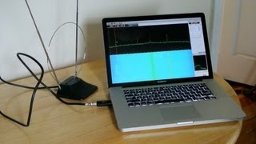

Slide 28
Choice of SDR Device
HackRF One by Great Scott Gadgets - popular hobbyist SDR device
Alternative SDR Device Options:
Three manufacturers met their budget and quality criteria:
- Ettus Research USRP B series
- Nuand BladeRF
- Lime Microsystems LimeSDR

Slide 29
Data Capture Bandwidth Issues
USB Connection Throughput
Discrepancy between data file size from recordings and the expected size based on recording time and sample size.
Disk Writing Speed
Required bandwidth exceeded their SSD capabilities - 640 MBps

Slide 30
Workstation Specifications:
CPU: Intel Xeon Silver 4208 (32) operating at 3.2 GHz.
RAM: 1 TB (highlighting their resolution to the disk writing speed issue).
HDD: 10 TB.
SSD: 512 GB.
Kernel: 5.15.0-25-generic.
OS: Ubuntu 22.04 LTS.

Slide 31
Interference by Surrounding Signals
Create clean recording of radio data stream without noise.
Faraday Cage Limitation - reflect internal signals
Electronic Anechoic Chamber - contains internal absorbers
Size Consideration: 1-meter external dimension
Optical Isolation: optically disconnected data lines
Power Supply Isolation: filtering power supply

Slide 33
Lack of Open Source, Instrumentable Low-Level Protocol Stack
Bluetooth's Complexity
comprises a multifaceted array of protocols
non-trivial to replicate correct behavior
Requirement for Protocol Modification
proprietary and closed source
pre-compiled firmware adhering to standard-compliant
Braktooth's Solution

Slide 34
Conclusions and Future Work
Feasibility of the Proposed Concept
Prototype Status
Value of Shared Experience
Future Work:
Recording and Publishing an RF Dataset
Automated Vulnerability Discovery

Slide 35
References
Blumbergs, B., Dobelis, Ē., Paikens, P., Nesenbergs, K., Solovjovs, K., Rušiņš, A. (2022). WearSec: Towards Automated Security Evaluation of Wireless Wearable Devices. In: Reiser, H.P., Kyas, M. (eds) Secure IT Systems. NordSec 2022. Lecture Notes in Computer Science, vol 13700. Springer, Cham. https://doi.org/10.1007/978-3-031-22295-5_17
Laricchia, F.: Number of connected wearable devices worldwide from 2016 to 2022. https://www.statista.com/statistics/487291/global-connected-wearable-devices/. Accessed 28 Aug 2022
Cilliers, L.: Wearable devices in healthcare: privacy and information security issues. Health Inf. Manag. J. 49(2-3), 150–156 (2020). https://doi.org/10.1177/1833358319851684. PMID: 31146589
https://www.youtube.com/watch?v=Li475b8-xQ0
https://www.youtube.com/watch?v=CJPjx2_UHyQ

