Slide 1
CSE 707 : Wireless Network Security Evil Never Sleeps: When Wireless Malware Stays On After Turning Off iPhones: WiSec 2022: Proceedings of the 15th ACM Conference on Security and Privacy in Wireless and Mobile Networkons
Jiska Classen, Alexander Heinrich, Robert Reith, Matthias Hollick Secure Mobile Networking Lab, TU Darmstadt
Shubhi Srivastava Ramya Pachhipulusu

Slide 2
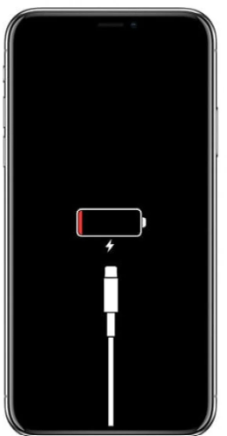
How secure is your iPhone even when it's turned off ??

Slide 3
Overview
From iOS 15 onwards most wireless chips remain active despite the phone being turned off.
Find My network can still locate the iPhone even after user-initiated shutdown.
Low battery triggers automatic shutdown and power reserve mode yet still users can access their credit cards, student passes, and other Wallet items and open their nearby locked cars.
Recent iPhones' Bluetooth, Near Field Communication (NFC), and Ultra-wideband (UWB) chips continue operating post power-off.
All three chips have direct access to the secure element.
Research conducted by the German Secure Mobile Networking Lab at the Technical University of Darmstadt.

Slide 4
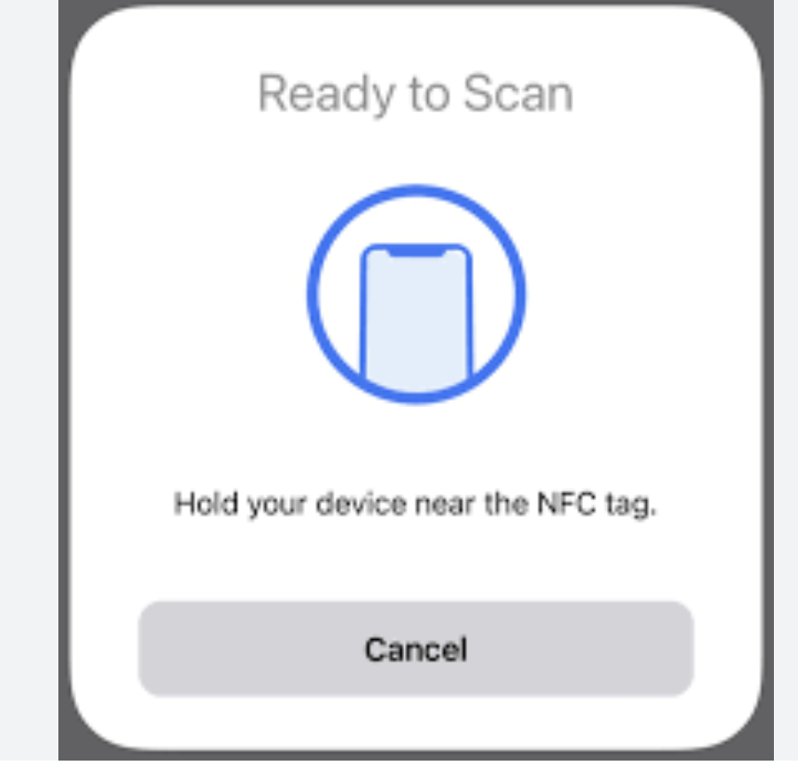
Terminology
Low Power Mode LPM : LPM is a mode which operates differently from the standard energy-saving mode. In LPM, the iPhone does not respond to screen taps or shaking, ensuring minimal power usage.LPM is triggered either by user shutdown or automatic activation during low battery levels. Despite reduced power consumption, it preserves crucial functionalities like Find My iPhone, allowing location tracking even in this power-efficient state.
NFC (Near Field Communication): NFC is a wireless communication technology that enables devices, including iPhones, to establish communication by bringing them close together. In iPhones, NFC facilitates functionalities like wireless payments and interactions with compatible devices.

Slide 5
Terminology
Ultra-Wideband (UWB): UWB is a short-range wireless communication technology that provides precise, high-bandwidth communication between devices.In iPhones, UWB technology enhances spatial awareness, enabling features like precise device location and interaction with nearby UWB-enabled devices.

Slide 6
LPM
LPM is activated during user-initiated shutdown or when the device shuts down automatically due to low battery.
In LPM, essential functions like the Find My network and Express Mode continue to operate.
Find My network enables users to locate their iPhones even when powered off.
Express Mode facilitates quick usage of selected cards and keys without additional user authentication.
Originally, NFC was the sole requirement. However, the Digital Car Key (DCK) 3.0 protocol now utilizes Bluetooth and UWB, enabling Express Mode even in power reserve. This ensures users don't get locked out of their vehicles or homes and can make payments seamlessly.

Slide 7
LPM
LPM involves the integration of various wireless chips, including Bluetooth, Near Field Communication (NFC), and Ultra-wideband (UWB).
These wireless chips are physically connected or "hardwired" to a critical component known as the Secure Element (SE), which is a secure storage area within the NFC chip.
Role of the Secure Element (SE): The Secure Element (SE) functions as a secure enclave within the NFC chip, safeguarding sensitive data such as digital keys, payment credentials, and other secure information.

Slide 8
NFC LOW-POWER MODE
How Does NFC Work ??
iOS implements secure wireless payment functionalities on an NFC chip equipped with a Secure Element (SE).
The SE, certified based on Common Criteria standards, operates on a JavaCard platform, executing specific applets such as Apple Pay, DCK, and third-party applets.
During setup, applets are personalized, ensuring additional security boundaries.
Sensitive data, like credit card information, is not stored on payment applets but is represented by a revocable identifier known only to the payment network.
Applets and their associated secrets are segregated within the SE, preventing them from leaving the secure enclave.
During wireless transactions, the SE within the NFC chip responds directly, bypassing the need to forward data to iOS.

Slide 9
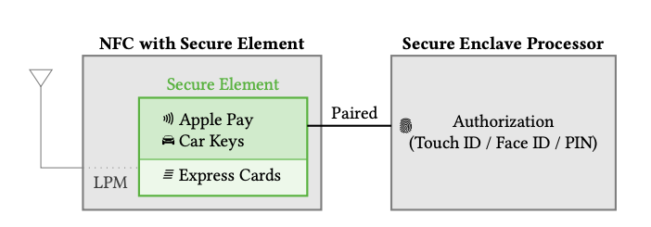
NFC Low Power Mode
Even if iOS or apps are compromised, credit card details and other essential keys cannot be stolen from the SE due to this direct communication method.
The SE is intricately connected to the Secure Enclave Processor (SEP), which validates payments by ensuring user authentication through Touch ID, Face ID, or a passcode.
Notably, the SEP does not store data within the SE but relies on a separate secure storage component, enhancing the overall security architecture.
The SE and SEP are paired in-factory, enabling encrypted and authenticated communication between these components, further bolstering the security of wireless transactions.

Slide 10
NFC Low Power Mode
Express Cards and Power Reserve
Wallet app enables the setup of specific NFC cards and keys for Express Mode, including credit, travel, and student cards.
Express Cards no longer require SEP authorization, allowing swift, iPhone-unlock-free payments.
NFC transactions can operate independently without SEP or iOS intervention, utilizing SE applets for secure functionality.
Extended Functionality in Power Reserve Mode:
iPhone shutdown doesn't affect NFC chip, which remains powered for up to 5 hours.
Users can continue using Express Cards for transit, credit, and car keys until iPhone recharge.
Display indicates active Express Cards, providing essential functionality even in power reserve mode.

Slide 11
BLUETOOTH AND UWB LPM
iOS 15 introduces Find My, an offline finding network utilizing Bluetooth Low Energy (BLE), and Digital Car Key (DCK) 3.0 support, utilizing Ultra-Wideband (UWB) for secure distance measurement.
These features enable Bluetooth and UWB chips to operate independently even when iOS is powered off
Find My Bluetooth Module Working Principle
Find My is an offline finding network that locates devices while they are not connected to the Internet. It works by having offline devices send Bluetooth advertisements, which are scanned for by devices with a network connection. These devices then report the lost device's location to the legitimate owner.

Slide 12
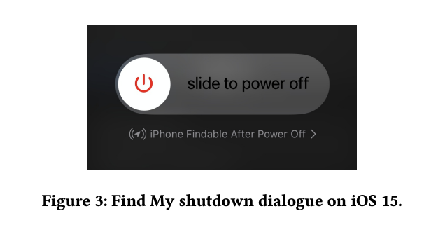
Find My Low Power Mode Setup
Find My can be enabled to work after power off. This setting can be changed manually or is enabled automatically in power reserve mode.
LPM support requires special Bluetooth firmware. Broadcom Bluetooth chips can be configured to interact with a host (like iOS) or run as a standalone app.
When entering LPM, the iOS Bluetooth stack is terminated and the Bluetooth chip is reset. Then, HCI commands configure Find My parameters and disable HCI. The firmware then starts a standalone Find My thread and advises the PMU to keep the Bluetooth chip on.
The Find My configuration HCI commands are flexible and allow setting multiple public keys for short and long rotation intervals. As of iOS 15.3, 96 short interval (15 min) and 0 long interval (24 h) keys are set. This means the standalone Bluetooth app can only send Find My advertisements for up to 24 h, or slightly more than 5 h in power reserve mode.

Slide 13
Digital Car Key 3.0 Bluetooth and UWB Modules
UWB as NFC Successor for Car Keys In addition to NFC cards, iOS also supports car keys. These digital car keys can have additional properties than regular car keys, such as being individualized per user or shared between iCloud users.
While having DCK support on iOS is convenient for users, it also adds new attack vectors to car theft. The main risk is on car manufacturers, as a compromised DCK or failures in its implementation can be used to steal a car. Unlike digital payments, physical car theft cannot be undone.
This risk motivated car manufacturers to move from DCK 2.0, which is based on NFC, to DCK 3.0. NFC is prone to relay attacks, which allow car access and theft while the user is not nearby.DCK 3.0 adds support for secure ranging based on UWB. While UWB has been shown to have flaws, it still provides better ranging security than NFC.

Slide 14
Digital Car Key 3.0 Bluetooth and UWB Modules
DCK 3.0 Working Principle. BLE is used to set up the initial connection and authentication between the iPhone and the car. UWB is then used for fine ranging, which allows the iPhone to determine its exact distance from the car. This is important for security, as it prevents attackers from using relay attacks to unlock the car from a distance.
The DCK 3.0 protocol is designed to be secure and reliable. The Secure Element (SE) on the iPhone is used to store and protect the secret key material used for authentication and ranging. The SE is also used to generate replies to the car without sharing them with iOS, which ensures that iOS cannot be compromised to unlock the car.

Slide 15
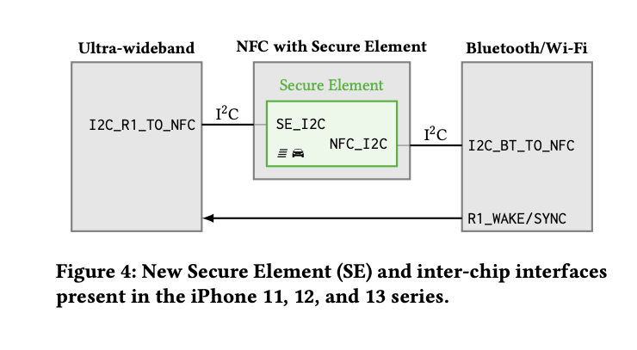

Slide 16
Digital Car Key 3.0 Bluetooth and UWB Modules
SIMPLE OVERVIEW The iPhone and the car exchange BLE messages to establish a connection and authenticate each other.
The iPhone uses UWB to measure its distance from the car.
The iPhone sends a message to the car with its distance and a one-time password (OTP).
The car verifies the OTP and unlocks the door if the distance is within a certain range.
DCK 3.0 is supported in power reserve mode, which means that you can still unlock your car even if your iPhone's battery is low. This is because the SE is powered by a separate battery.

Slide 17
LOW-POWER MODE SETUP
UWB Express Mode is enabled when the iPhone shuts down due to low battery and a car key is configured.
It is similar to NFC Express Mode, but uses UWB instead of NFC for secure ranging.
UWB Express Mode saves power on the UWB chip by putting it to sleep most of the time and only waking it up when needed.
When the UWB chip is needed, the Bluetooth chip sends a wake signal over a hardwired connection.
Timing between Bluetooth and UWB is synchronized to reduce active receiver times.
UWB Express Mode is a very secure way to unlock cars, as it uses both BLE and UWB to authenticate the user and measure the distance between the iPhone and the car.

Slide 18
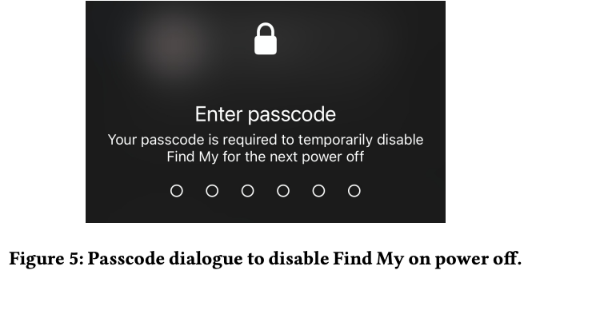
SECURITY ANALYSIS ( APPLICATION LAYER)
FIND MY Lack of User Awareness: Users are not informed about the limitations of Find My in Low-Power Mode (LPM). It stops sending advertisements earlier than expected, and users may assume their iPhone is findable for multiple days, leading to a false sense of security.
Advertisements Configuration: Only 96 advertisements are configured during user-initiated shutdown, broadcasted for 15 minutes each. After 24 hours, all advertisements are transmitted. Users are not aware of this configuration, and there's no explanation provided, causing potential misunderstandings about the device's findability duration.

Slide 19
SECURITY ANALYSIS ( APPLICATION LAYER)
Misleading Security Perception: The current shutdown dialogue suggests that Find My after power off is a robust security feature, but its limitations are not clearly communicated. Users might rely heavily on this feature, thinking it offers prolonged tracking capabilities, leading to a higher risk of permanent loss if the device is stolen.
Limited Active Period: Find My remains active for slightly more than 5 hours upon battery-low shutdown, similar to Express Mode. This limited duration is not documented, creating uncertainty about the time window for tracking the device before it transitions from power reserve to power off mode.
Possible Solutions: Extending the maximum time period could be achieved by configuring more advertisements, cycling advertisements only after 24 hours, or storing the master beacon key within a Secure Element (SE) applet. These measures could enhance the duration of Find My's active state, providing users with a longer window to locate their lost devices.

Slide 20
SECURITY ANALYSIS ( APPLICATION LAYER)
Advertisement Storage: Advertisements for the next 24 hours are stored locally on disk even if Find My is disabled during power off. These cached advertisements can be accessed via a Find My token decrypted from NVRAM storage after booting, regardless of previous power states, making tracking possible before the iPhone connects to the internet.
Limited Duration: Advertisements continue for 24 hours, after which the iPhone stops sending them. This fixed transmission time cannot be extended. Even if the iPhone has an internet connection after the first unlock, Find My might be disabled due to various conditions like Wi-Fi key availability or SIM card issues, providing a window for potential theft without detection.
Advertisement Accuracy: Advertisements in LPM show a standard deviation of 19 seconds in the 15-minute rotation windows. This variation could impact tracking accuracy, especially if LPM duration exceeds 24 hours. When advertisements fall outside the search window, the device becomes untraceable to Find My servers.

Slide 21
SECURITY ANALYSIS ( APPLICATION LAYER)
Express Cards Express Cards and Keys pose a risk if a user's credit card or car key is used without
authentication when the iPhone is stolen. Users need to enable Express Mode for
each item in the Wallet app, understanding the functionality and associated risks, including
limitations like shutdown after 5 hours, to ensure security awareness.

Slide 22
SECURITY ANALYSIS ( FIRMWARE LAYER)
Local Firmware Modification Firmware Modification: Attackers with system-level access can modify LPM-supported component firmware (NFC, UWB, Bluetooth) without kernel changes. This enables limited iPhone control even when powered off, ideal for persistent attacks on targets like journalists. LPM Chips: LPM supports NFC, UWB, and Bluetooth in iOS 15. NFC firmware is encrypted and signed for security. UWB firmware is signed but not encrypted, while Bluetooth lacks both. Bluetooth's lack of secure boot allows malware loading on iPhone 13 Bluetooth chips even when off.
Attack Approach: Attackers use existing drivers to enable LPM without altering kernel behavior. Modifying Bluetooth firmware exploits its missing secure boot, enabling malware execution in a powered-off state.

Slide 23
SECURITY ANALYSIS ( FIRMWARE LAYER)
REMOTE CODE EXECUTION Remote Code Execution (RCE): Attackers lacking system-level access might attempt over-the-air code execution on LPM-enabled chips. Historical vulnerabilities in iPhone Bluetooth chips suggest similar issues might exist in other wireless chips.
Attack Surface Reduction: Limiting wireless stack functionality, like in the Find My module, minimizes the attack surface. Find My transmits Bluetooth advertisements but does not receive data, reducing potential vulnerabilities. However, features like NFC Express Mode, Bluetooth, and UWB DCK 3.0 allow data exchange, expanding the attack surface. Apple mitigates risks by enabling these features on demand.

Slide 24
SECURITY ANALYSIS ( FIRMWARE LAYER)
Reconfiguring Firmware Options. Custom Commands and Advertisement Manipulation: Attackers with system-level access can send specific commands to chips, adjusting advertisement details. For instance, they could set unique ads matching their account's public key, allowing discreet device location.
Potential Future Threat: Currently not viable due to modifiable Bluetooth firmware. If future iPhone Bluetooth chips integrate secure boot features, this threat could become significant, especially if extended to devices like the Apple Watch.
Direct Secure Element Access via Firmware: LPM's introduction for features like car keys exposes an additional SE interface to iOS. This raises concerns about the trust model for sensitive data like car keys, potentially impacting overall security. Exact SE security standards remain uncertain due to undisclosed interface features and applet implementations.

Slide 25
SECURITY ANALYSIS ( HARDWARE LAYER)
Adversary Model: Assumes no hardware manipulation by attackers or legitimate users. Focuses on components that could be powered on while iPhone is off and potential applications attackers could build. Explores user detection capabilities of LPM applications.
Suitable Chips: Chips controlled by the Power Management Unit (PMU) could be active in LPM. Most iPhone chips are connected to PMU but must also interact with the Application Processor (AP) or Always-on Processor (AoP). Suitable chips for LPM must be battery-friendly, standalone, and able to interact with the user or external world.
Wireless Chips: Wi-Fi and cellular baseband chips, although connected to PMU, are not used for LPM applications. Display, buttons, and audio have specific connections: display shows a static screen, buttons can boot or reset iPhone, and audio is routed via the AoP, preventing hidden microphone creation in LPM.

Slide 26
SECURITY ANALYSIS ( HARDWARE LAYER)
Detection and Deactivation
Detection Challenges: Current iOS tools cannot detect LPM firmware running on chips. Additional hardware is necessary to monitor wireless transmissions during LPM.
Logging: LPM firmware supports logging, but these logs are inaccessible without jailbreaking, making it impossible for users to determine if LPM firmware was active or what actions it took.
Disabling LPM: LPM features are implemented in hardware; even if iOS removes LPM in the future, compromised systems could still activate these features. A physical switch, like those found in some Apple devices, could potentially disconnect the battery to permanently disable LPM.
Other Protections: Users concerned about being spied on by an iPhone in LPM could use a transmission monitoring device, although modern iPhones' complex design makes this challenging. Another option is placing the smartphone in a Faraday bag, although even small gaps can compromise its effectiveness due to signal leakage.

Slide 27
BLUETOOTH FIRMWARE MODIFICATION
Dumping and Loading Firmware
Complete firmware dump for analysis.
Utilized vendor-specific HCI commands for ROM data extraction.
Core Bluetooth framework limitations on chip access.
InternalBlue tool enabled command transmission and event interpretation.
Modified tool ensured Bluetooth daemon detachment for exclusive chip access.
Added support for newer PCIe driver, facilitating dumps of latest Bluetooth chips.
RAM analysis in different states for comprehensive firmware understanding.

Slide 28
BLUETOOTH FIRMWARE MODIFICATION
FIRMWARE PATCHING PROCESS Firmware patched temporarily in RAM using Broadcom's Patchram mechanism.
Patchram documented within the InternalBlue project.
Modification of 4-byte values in ROM to other 4-byte values.
Function calls in ROM overwritten with calls to RAM addresses, enabling patching.
RAM made writable and executable for patching purposes.
Legacy chips connected via UART, patching done using HCI commands with a max size of 255 bytes.
Newer PCIe interface introduced since iPhone Xs allowing one large .bin patch file transfer.

Slide 29
BLUETOOTH FIRMWARE MODIFICATION
Firmware Patch Image Upload:
Communication handled by Bluetooth daemon in iOS.
Bluetooth daemon calls BlueTool for low-level tasks without stack interference.
BlueTool can be instrumented via XPC calls, command line interface, or scripts.
Firmware patches loaded using specific command: power off device -D bcm -w /tmp/path/to/firmware.bin.
Enables application of firmware patches irrespective of iOS versions on jailbroken research iPhones.
iOS system logs indicate successful or unsuccessful firmware patch image loading.

Slide 30
BLUETOOTH FIRMWARE MODIFICATION
Firmware Patch Image Format:
RAM dumps used to identify address mappings of patches.
Arbitrary parts of patch files modified and tested for chip acceptance.
Patch format verified using Cyclic Redundancy Checks (CRCs), not signed by Broadcom.
Two Patchram areas in RAM containing writable and executable code regions.
Patch configuration data area in Type Length Value (TLV) format defines patch applications.
Contains patch name, hardware configurations, and 4-byte patch entry instructions.
Format similarity with WICED Studio 6.2 .hdf files, starting with the string "BRCMcfgS".
Patch entries start with byte sequence 0x0110, 15 bytes long, specifying ROM address and new instruction.

Slide 31
BLUETOOTH FIRMWARE MODIFICATION
Patch Analysis Tooling:
Developed tools to load and modify patch files for static reverse engineering.
Utilized Python and IDA Pro scripts for patch file extraction, reassembly, and parsing of patch configuration data.
Flexible applications, used historically for various Bluetooth modifications like enhancing BLE reliability and enabling ZigBee communication.
Malware Patch Example:
Demonstrated alteration of firmware during runtime despite security barriers.
Prevented direct observation and modification of communication between SE and Bluetooth chip.
Disabled HCI command via specific patch, showcasing its reactivation potential.
Modified firmware successfully on iPhone SE 2020 with iOS 14.8 and iPhone 12 with iOS 14.2.1, spanning three iPhone generations.

Slide 32
BLUETOOTH FIRMWARE MODIFICATION
Custom Bluetooth LPM Applications:
Explored potential attacks by manipulating LPM application thread.
Attacker could modify Find My advertisements, making the iPhone locatable for them.
Enabled addition of entirely new functionalities within the LPM framework.
Broadcom Bluetooth chips capable of running standalone applications without host connection, common in IoT devices.
In-Depth Analysis:
Conducted deep analysis of LPM firmware internals, including aspects like Find My advertisements, GATT service for DCK 3.0, and I2C connection to the SE.
Manually reverse-engineered symbols for iPhone 12 and 13 firmware, with a repository containing over 2000 function names published for reference.

Slide 33
REVERSE METHODS ENGINEERING
Dynamic Analysis Physical Device Requirement: Dynamic analysis mandates physical iOS devices due to emulator limitations.
Complex System Logs: Extensive and inconsistent iOS logs require careful interpretation.
Find My Advertisement Analysis:
Log Discrepancies: Find My advertisement disparities demand accurate assessment using a custom Python script.
Bluetooth Firmware Examination:
Limited Jailbreak Options: Specific features are backported for firmware analysis.
HCI Command Insight: Studying HCI commands reveals crucial Find My LPM configurations.
Memory Inspection: RAM dump analysis identifies functions using configuration values as timers or flags.

Slide 34
REVERSE METHODS ENGINEERING
Static analysis can be used to learn a lot about the hardware and software of iOS devices, even without having physical access to them. It can be used to:
Confirm that the SE is hardwired to UWB and Bluetooth.
Identify relevant binaries and kernel drivers.
Understand the interfaces’ protocols.
Uncover additional features and code paths.
Understand new feature integration in UWB firmware.

Slide 35
RELATED WORK
InternalBlue: Broadcom’s Bluetooth firmware was explored, but lacked support for the new firmware patch format and LPM features were not analayzed.Also, subjected Broadcom’s Bluetooth firmware to fuzzing tests.
UWB Chip: Apple’s UWB chip functionality was studied, including basic driver and firmware features, and investigated distance shortening attacks. The NFC chip in iPhones has not been reverse-engineered, but a similar NFC chip by NXP revealed a bootloader security issue.
NFC Chips: Security evaluations of NXP’s NFC chips, including SN100 and SN200 NFC chips, were conducted. No exploitable vulnerabilities were found in the SE component of the SN200 NFC chip or the full SN100 NFC chip. Additionally, the JavaCard Operating System on SN200 and SN210 chips was assessed.

Slide 36
RELATED WORK
Analysis of iOS Wireless Services:Investigated various wireless services on iOS devices, such as Find My, AirDrop, multiple Continuity services, and Magic Pairing. Additionally, assessed the security of iOS Bluetooth cellular baseband daemons using fuzzing techniques.
Inter-Chip Attacks and Privilege Escalation:Explored potential inter-chip privilege escalation attacks facilitated by the direct connection between SE and multiple wireless chips. Demonstrated practical attack enabling code execution in Wi-Fi via Bluetooth on recent iPhones.
Transmission Monitoring and Airplane Mode Bypass:Developed separate hardware-based device for monitoring wireless chips, attached to the mainboard of an iPhone 6. Airplane mode on smartphones under surveillance might not disable all wireless transmissions, necessitating external monitoring devices.
Considerations for LPM and UWB Support:Earlier smartphones (such as iPhone 6) analyzed by Huang and Snowden neither considered LPM nor supported Ultra-Wideband (UWB), highlighting the need for hardware upgrades to address these vulnerabilities in newer devices.

Slide 37
CONCLUSION
Current Low Power Mode (LPM) implementation in Apple iPhones is obscure and introduces new security threats. As it's tied to iPhone hardware, it cannot be removed via system updates, making its impact on the iOS security model long-lasting.
LPM features seem to be primarily designed for functionality without considering potential threats beyond intended applications.The "Find My" feature, even after device shutdown, transforms powered-down iPhones into tracking devices. The implementation within Bluetooth firmware lacks adequate security against manipulation. Attackers with system-level access could covertly alter tracking properties, posing significant risks.
Modern car key support necessitates Ultra-Wideband (UWB) in LPM. Bluetooth and UWB are hardwired to the Secure Element (SE), where car keys and sensitive data are stored. Given the manipulable nature of Bluetooth firmware, this exposes SE interfaces to iOS. However, SE is designed to protect secrets, assuming compromise at the iOS level.

Slide 38
CONCLUSION
To enhance security, the researchers recommend the addition of a hardware-based switch to disconnect the battery. This measure would mitigate some of the identified vulnerabilities in LPM applications and bolster overall security.
The research team is the first to investigate undocumented LPM features introduced in iOS 15, revealing various vulnerabilities not previously known.

Slide 39
TIPS
Use strong passwords and two-factor authentication: This will help to protect your devices from unauthorized access.
Keep your iOS device up to date: Apple releases security updates for iOS regularly. It's important to install these updates as soon as they are available.
Be careful about what networks you connect to: Avoid connecting to public Wi-Fi networks unless you are using a VPN.
Be careful about what apps you install: Only install apps from trusted sources.Read the privacy policy of any app before you install it: This will help you to understand what data the app collects and how it uses that data.
Be aware of the permissions that apps request: Don't grant apps more permissions than they need.
Keep your Bluetooth and AirDrop turned off when you're not using them: This will help to reduce the attack surface of your device.

Slide 40
REFERENCES
Journal reference:WiSec 2022: Proceedings of the 15th ACM Conference on Security and Privacy in Wireless and Mobile Networks ( https://arxiv.org/abs/2205.06114)
https://www.malwarebytes.com/blog/news/2022/05/how-iphones-can-run-malware-even-when-theyre-off https://blog.avast.com/iphone-low-power-mode-hack
https://vpnoverview.com/news/apple-iphones-low-power-mode-poses-cybersecurity-risk-study/
https://www.theregister.com/2022/05/19/apple-iphone-malware/
https://support.apple.com/guide/security/express-cards-with-power-reserve-sec90cd29d1f/web
https://support.apple.com/en-us/HT212788
https://support.apple.com/en-us/HT211234

Slide 41
THANK YOU

