Slide 1
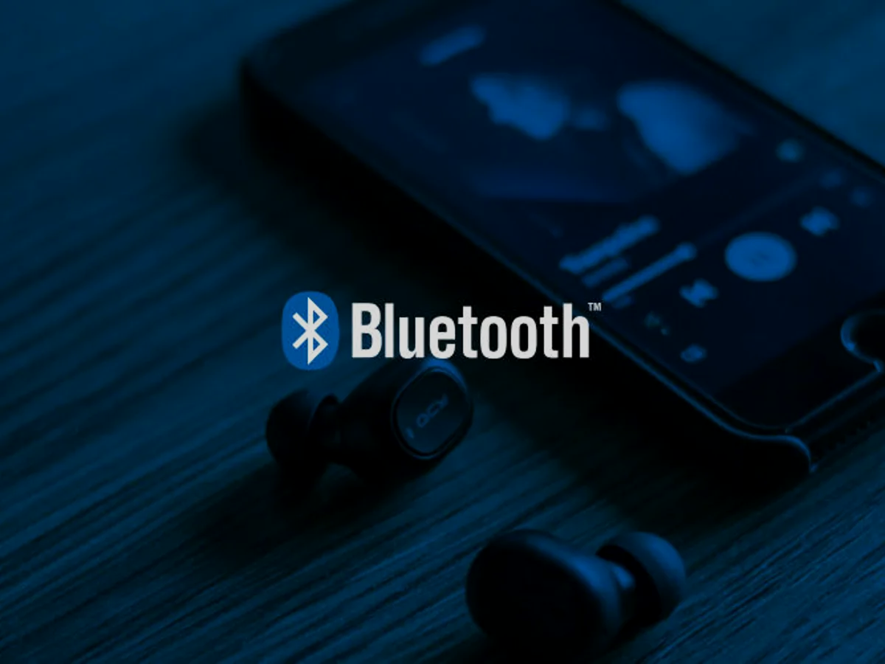
Security Vulnerabilities in Bluetooth Technology as Used in IoT
Angela M. Lonzetta , Peter Cope , Joseph Campbell , Bassam J. Mohd and Thaier Hayajneh
Under guidance of Professor Shambhu Upadhyaya
Presenters: Sagnik Mondal, Namrata Banerjee
CSE 707 Seminar-Advanced concept in Wireless Network Security

Slide 2
What is Bluetooth?
Bluetooth is a short-range wireless technology standard that is used for exchanging data between fixed and mobile devices over short distances and building personal area networks (PANs).
It was initially developed by the Swedish Company Ericsson in 1994.
While Bluetooth offers significant power efficiency, with a transmission power limited to 2.5 milliwatts, its range is relatively short, typically spanning between 10 to 15 meters at most.

Slide 3
How Bluetooth works?
Bluetooth operates in the ISM bands from 2.4 to 2.4835 GHz.
Bluetooth uses a technology called frequency-hopping spread spectrum to avoid interference by frequently changing the frequency at which data is transmitted.
The spectrum is divided into 79 channels with each channel being 1MHz. Bluetooth then divides the transmitted data into packets and transmit the packets using one of 79 channels mentioned above.
Bluetooth devices hops from one channel to another at a rate of 1600 times per second. This rapid hoping not only avoids interference but also enhance security and reliability of Bluetooth connections

Slide 4
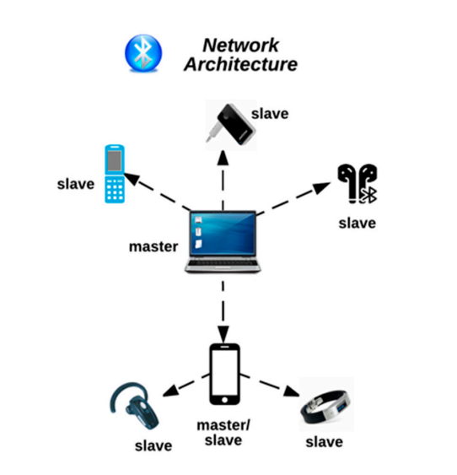
Piconet and Scatternet
A piconet is a spontaneous, ad hoc network that enables multiple Bluetooth devices to communicate with one another.
It consists of a master device and several slave devices.
At most, 7 slave devices can connect to a Master Device.
The Master Device takes charge of managing the communication within the piconet.
Slave devices need to relay information through the master device.
Sometimes, a slave Device in a piconet can be the Master Device in another piconet.
This group of 2 or more piconet is known as scatternet.

Slide 5
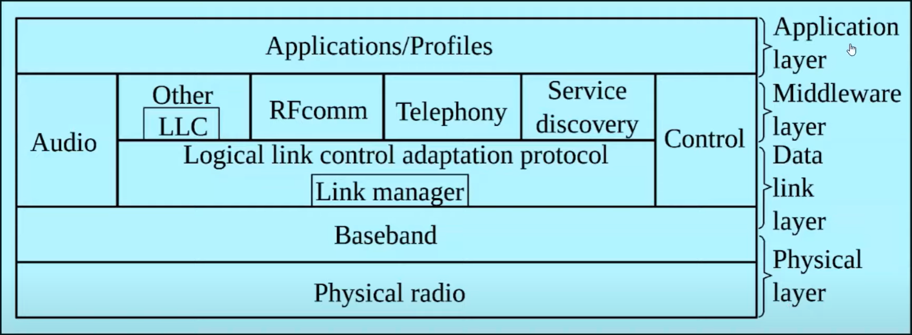
Protocol Stack
Bluetooth Protocol Stack is divided into 4 layers. Physical Layer, Data Link Layer, Middleware Layer and the Application Layer. They are discussed in detail below.
Physical radio (Physical Layer): This layer converts data into radio signals. It acts as
transceiver (transmitter and receiver).
Baseband (Data Link Layer): This layer establisher connection in a piconet
Link Manager(Data Link Layer): Once connection has been made, LM manages the established link. It also provides authentication and encryption processes.

Slide 6
Protocol Stack
L2CAP (Data Link Layer): Logical link control and adaptation protocol layer allows communication between upper layers and lower layers. It also does segmentation and multiplexing of data.
RFComm (Middleware Layer): Radio Frontend Component provide serial interface with WAP(Wireless Application Protocol) and OBEX(Object Exchange)
TCS (Middleware Layer): Telephony control protocol is used to provide telephony services like voice, fax, data etc.
SDP (Middleware Layer): The Service Discovery Protocol layer allows to discover the services available on a connected bluetooth device to enable seamless service integration.
Application Layer (Middleware Layer): At the top of the stack, the Application Layer provides an interface for users and applications to interact with Bluetooth technology and the connected devices.

Slide 7
Bluetooth Security Modes
All Bluetooth Devices operate in 1 of 4 defined access security modes.
Mode 1(Non secure mode): No security
Mode 2(Service Level): It can enforce authentication, confidentiality, and authorization
Mode 3(Link Level): Uses a secret key link to pair new devices.
Mode 4(Service Level with key exc): SHA-256 is used for hashing and AES CCM is used for encryption.

Slide 8
Bluetooth Trust Modes
The two modes of trust are Trusted Mode and Untrusted Mode
Trusted Mode means that a trusted device has established a fixed relationship with another device and has unrestricted access to all services.
Untrusted Mode means that untrusted device only has access to a restricted set of services. Although the device has passed authentication successfully, it does not have a fixed relationship with another device.

Slide 9
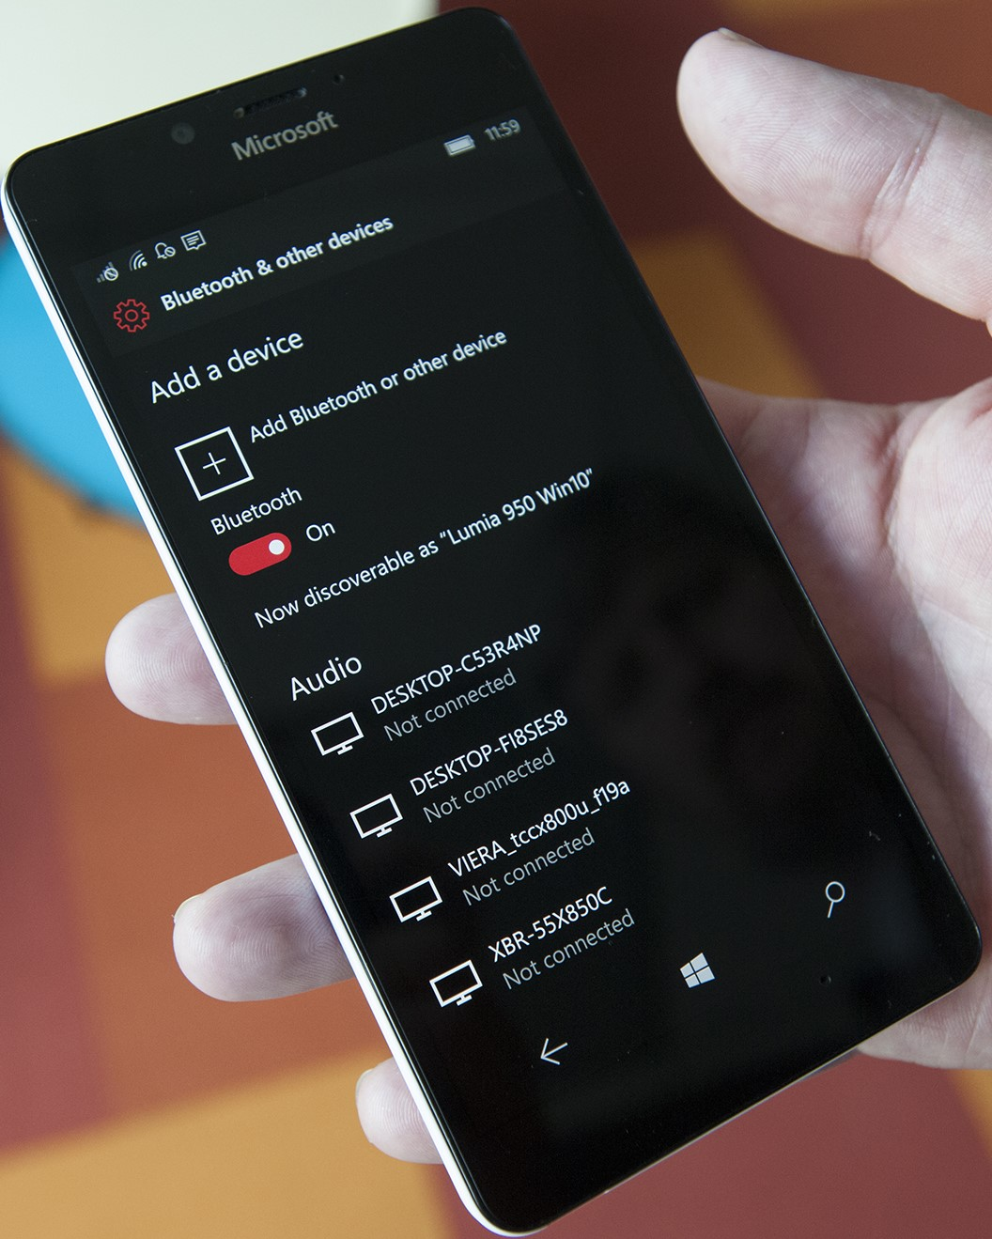
Bluetooth Discoverability
Discoverability mode in bluetooth devices seriously impact the device security.
When a device has its discoverable mode enabled, it becomes more vulnerable to security risks since they can be recognised by another bluetooth enabled device within the range of 10 metres.
In this mode, the device exchanges device name, class, list of services, and technical information.
In addition to that, every bluetooth device has a 48 bit Address similar to MAC Address, known as BD_ADDR which is manufacturer assigned address for hardware. It also serves as a unique id number.

Slide 10
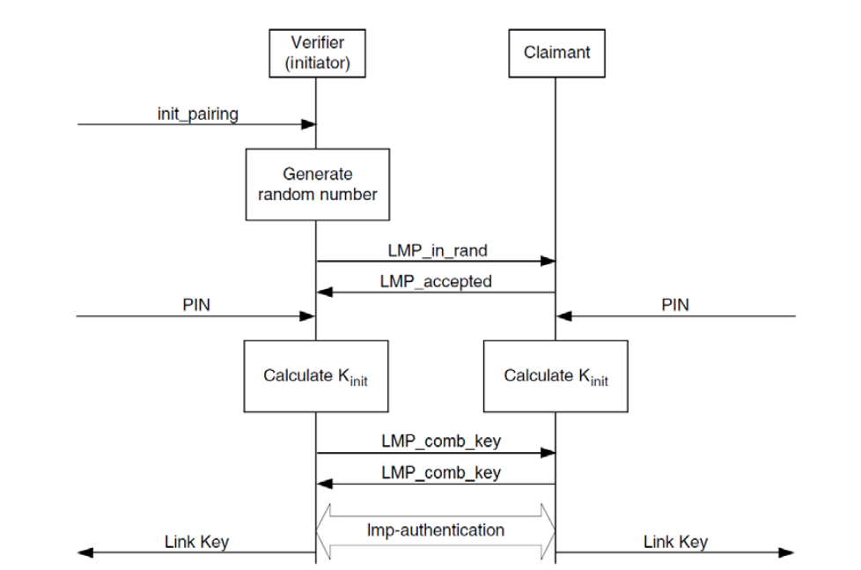
How does pairing occur ?
Link Key Generation with PIN
Link Key Generation with SSP
Authentication is performed by using challenge-response, based on BD_ADDR and a link key .
The link keys, once established, are kept by both devices to be used for future pairing

Slide 11
Built in Security Features
Adaptive Frequency Hopping: Frequency hopping in Bluetooth uses a 2.4 GHz ISM band with 79 channels to enable hops at 1600 hops per second. During the hopping, existing frequencies are excluded. The ability to frequency hop reduces both jamming and interference.
E0 Cipher Suite: The cipher generally has a key length of 128 bits and uses stream ciphering.
Undiscoverability: This prevents devices from responding to scanning attempts. A device’s 48-bit BD_ADDR address is also concealed.
Pairing: Pairing enables devices to communicate. A device’s BD_ADDR must be known for a pairing request to be made. The BD_ADDR is identified from knowledge of previous pairing or by scanning

Slide 12
Bluetooth version wise vulnerabilities
Bluetooth supports a wide range of device types, from older versions like Bluetooth 2.0 to more recent versions like Bluetooth 5. Each version has varying levels of security features. If you have a mix of devices with different security capabilities in your Bluetooth network, the security is only as strong as the weakest device in the network.
Example :
Pre Bluetooth v.1.2- Link keys, which are based on static unit keys, are used for pairing and can be reused
Connecting older versions with newer ones (v.2.1 and v.3 with v.4)
No user authentication, only device authentication

Slide 13
The Rise of IoT
The Internet of Things (IoT) has revolutionized the way we interact with technology. From smart homes to wearable devices, IoT has become an integral part of our lives.
Bluetooth Low Energy (BLE) is a Bluetooth variant designed for IoT applications.
Bluetooth offers interoperability across various IoT devices allowing them to work together seamlessly
Implementation of Bluetooth mesh

Slide 14
Bluetooth Attack Taxonomy
OBFUSCATION
SURVEILLANCE
RANGE EXTENSION
SNIFFING
MAN IN THE MIDDLE
UNAUTHORIZED DIRECT DATA ACCESS
DENIAL OF SERVICE
MALWARE
FUZZER

Slide 15
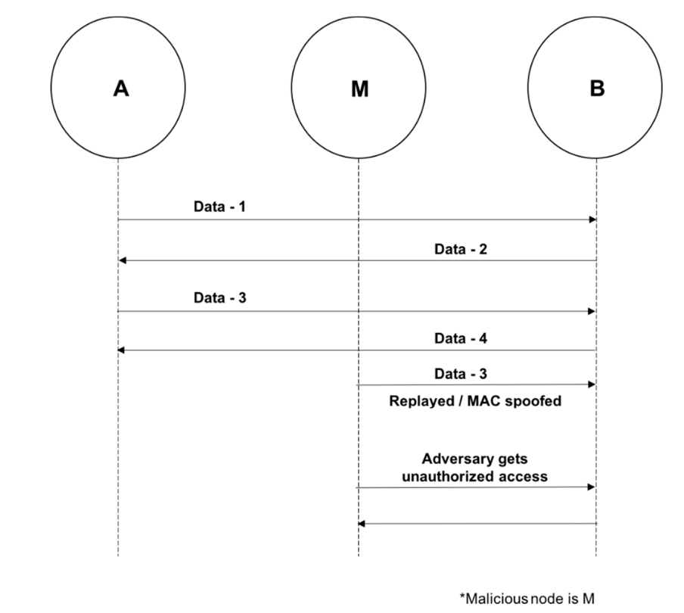
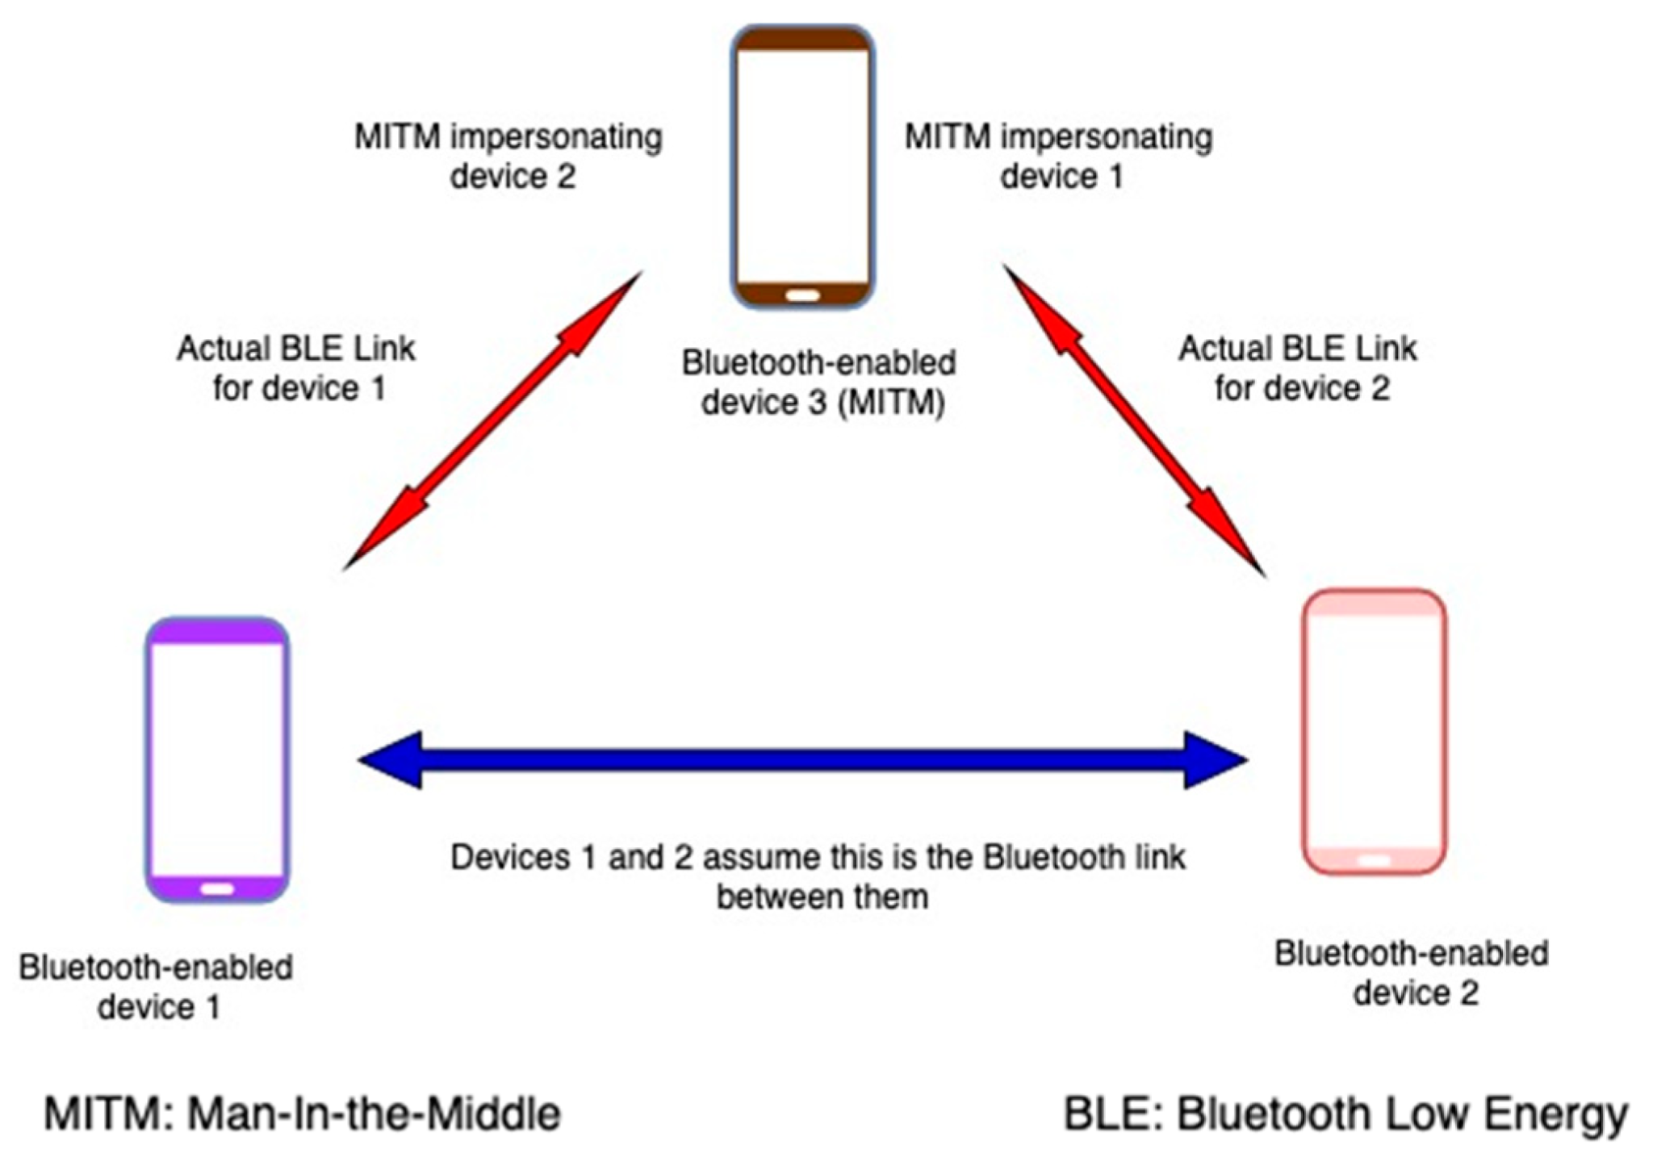
MAC Spoofing attack
Man in the middle attack
The attack occurs during piconet formation, before encryption is established when generating link keys.
Attackers can impersonate users, terminate connections, or intercept/modify data using specialized tools.
Takes place during pairing when devices exchange messages through an attacker.
This allows authentication without shared secret keys.
In a successful attack, users believe pairing is complete, but, in reality, the devices are paired with the attacker.

Slide 16
Pin cracking attack
Brute-Force BD_ADDR Attack
Relay / Reflection Attack
An attacker uses a frequency sniffer tool to collect the RAND and the BD_ADDR of the targeted device
A brute-force algorithm (E22 algorithm) is then used to test all possible permutations of the PIN with the data previously collected until the correct PIN is found
This attack is a scanning attack on the last three bytes of the BD_ADDR of a device , noting the first 3-bytes are public
The attacker is not looking for any undisclosed information during the attack. It simply authenticates the connection by reflecting/relaying device information.

Slide 17
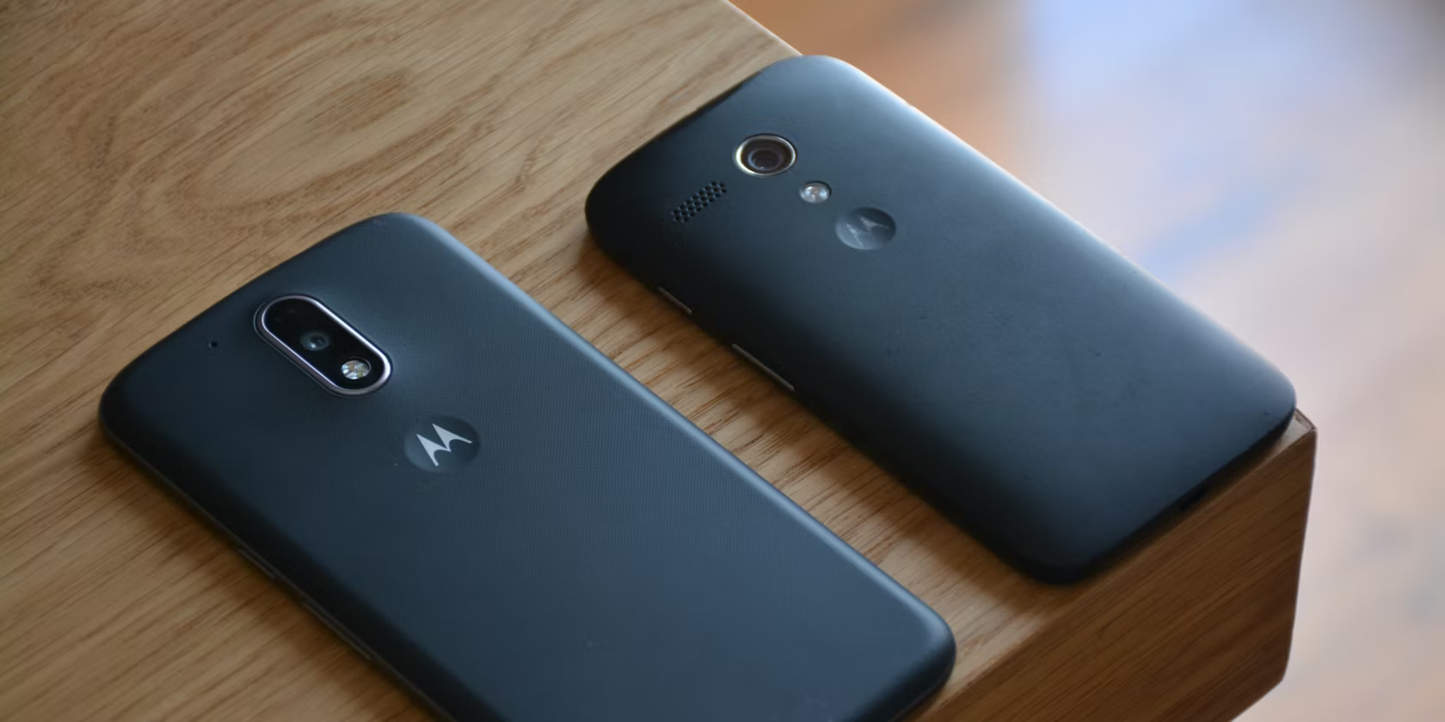
BlueJacking Attack
BlueSnarfing Attack
During a BlueJacking attack, the attacker sends unsolicited messages to a device to trick the user into using an access code
This enables the adversary to access files on the targeted device. The devices involved in the attack and the exact source of the message received need to be within a specific range, 10 m, for the attack to be successful
While it does not usually involve the alteration of data, it could make devices susceptible to other attacks
Involves hacking into a mobile phone and stealing data stored in its memory.
Exploits the OBEX File Transfer Protocol.
Enables the attacker to pair with the user's device and access data.
Example: ‘HELLOMOTO ATTACK’ in 2007

Slide 18
Car Whisperer Attack
Though surfaced in 2005, this attack is still prevalent and puts hackers in car seats.
Developed by Trinity group in Europe in order to demonstrate the limitations of Bluetooth systems
The Car Whisperer software is used to exploit the very short four-digit security key assigned by car manufacturers that come by default on Bluetooth radios in cars.To note car systems sometimes use the same key
Devices connect to vehicles by emulating a phone. After connecting, they can play sounds from the music systems in the vehicles and listen to the microphone

Slide 19
Blue-Borne Attack
The attack is conducted by exploiting a stack buffer overflow flaw
By targeting the processing of pending client L2CAP configuration responses, the attacker is able to hijack Bluetooth connections
This enables them to control a targeted device’s embedded content and functions. For the attack to be successful, only MAC and Bluetooth addresses are needed

Slide 20
BlueDump Attack
Fuzzing Attack
During the attack, the attacker spoofs the BD_ADDR of one of the devices to connect with the other during pairing, the target device sends an authentication request
The attacker responds with HCI_Link_Key_Request_Negative_Reply, this is a result of the attacker not having a link key. In some cases, the device targeted deletes its link key
It then goes into pairing mode
The attack occurs when the adversary attempts to cause a device to behave abnormally by sending malformed data packets and non-standard data to a device’s Bluetooth radio
The attacker then watches how the device reacts to the data packets being sent
If the device’s operations become sluggish or stop during these attacks, the attacker could infer that the protocol stack has vulnerabilities

Slide 21
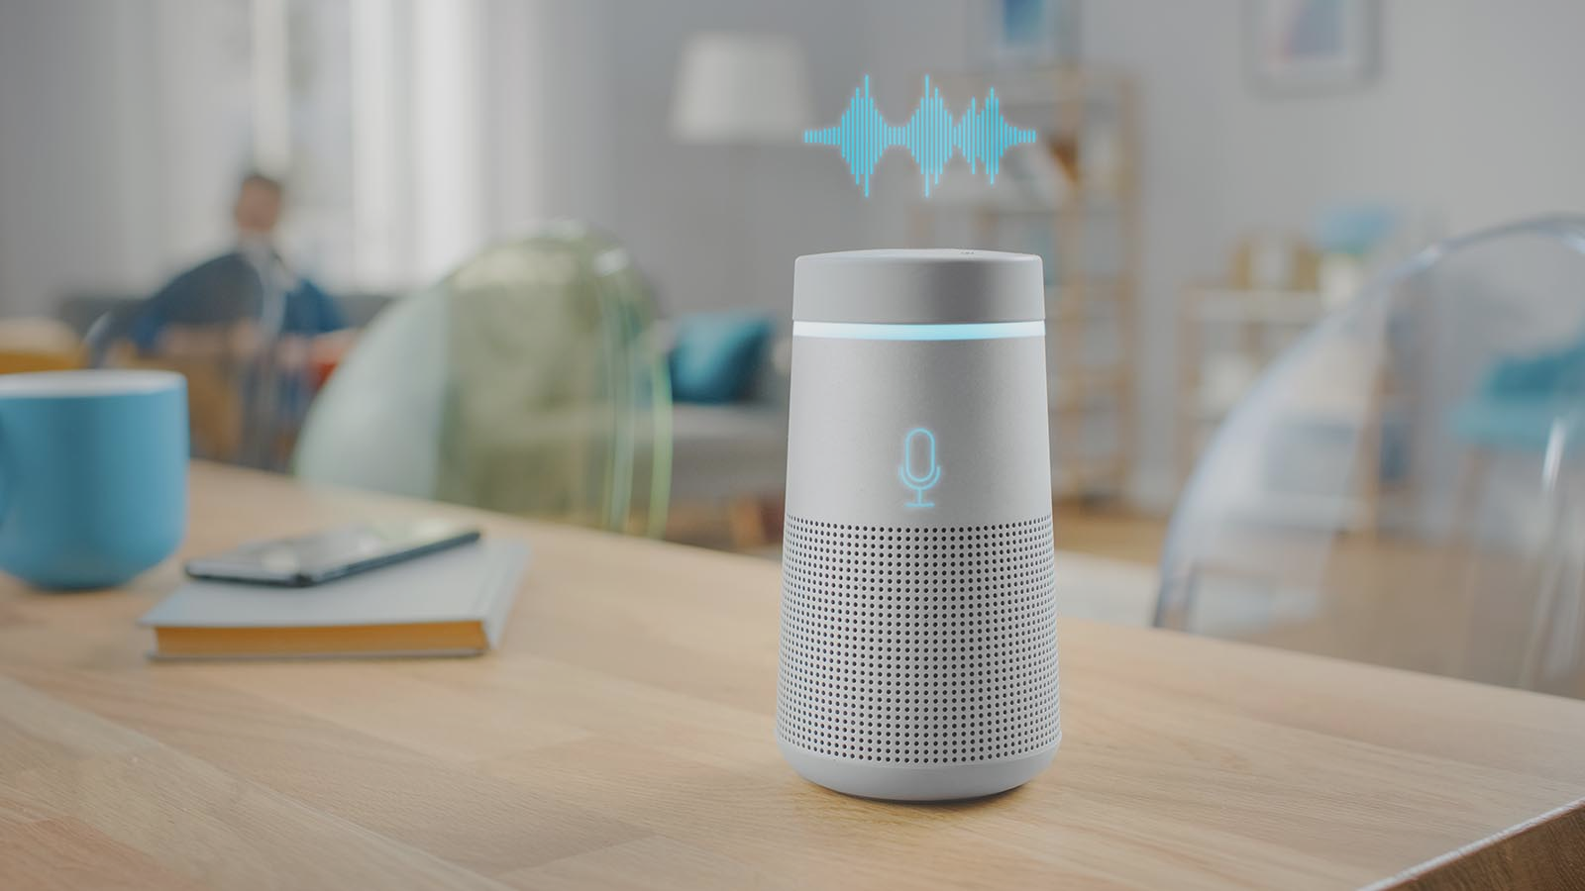
Attacks on personal assistant devices
BlueBorne attacks, which exploit vulnerabilities in the L2CAP, were conducted on the Amazon Echo and Google Home to demonstrate the vulnerabilities on these smarthome Bluetooth devices
Amazon Echo Vulnerabilities:
Remote code execution vulnerability in the Linux Kernel
Information disclosure flaw in the SDP server
Vulnerability depended on the device's operating system
Google Home Vulnerability:
Information disclosure vulnerability in Android's Bluetooth stack
Exposure could lead to a Denial of Service (DoS)
Don’t forget to update your devices!
Since bluetooth could not be disabled in these devices they were left vulnerable until new security patches were released by Amazon and Google.

Slide 22
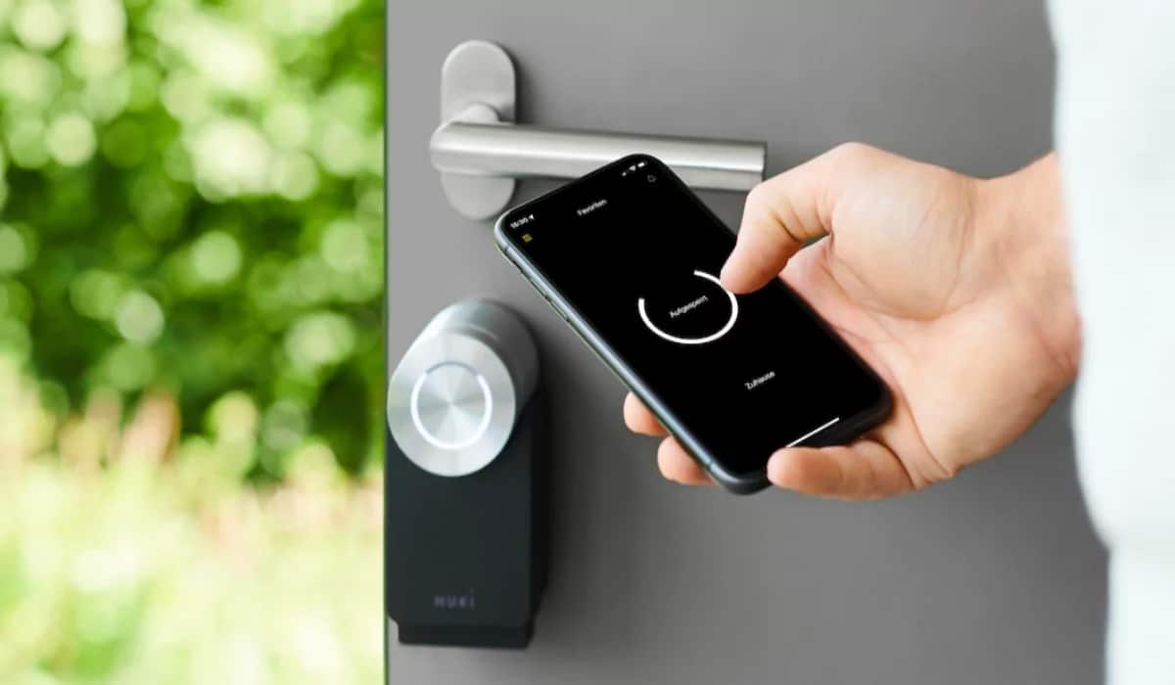
Bluetooth Smart Lock Hacks
Researchers Anthony Rose and Ben Ramsey tested 16 Bluetooth smart locks, successfully wirelessly hacking and opening 12 of them.
Vulnerabilities were not with Bluetooth Low Energy (BLE) protocol but in the way manufacturers implemented Bluetooth data communication with smartphone apps.
Vulnerability Types:
Link Manager Protocol/Link Layer Protocol vulnerabilities.
Some locks transmitted passwords in plaintext.
Others sent passwords twice, enabling attackers to alter them.
Some locks encrypted passwords, but attackers could unlock them with encrypted passwords.
Conducted Man-in-the-Middle attacks between the lock and the connected app.
Opened locks by changing a byte in proprietary encryption

Slide 23
A cute toy could bring a hacker into a home!
An 11-year-old boy, Reuben Paul, attended a cybersecurity conference at the World Forum in The Hague and performed a live hack exploiting vulnerabilities in his cloud-connected teddy bear
The exploit was performed by connecting the bear to Wi-Fi and Bluetooth, which enables the bear to transmit and receive messages.
Reuben used a Raspberry Pi that was connected to his computer to scan for Bluetooth-connected devices
Through the scan, he was able to download many device numbers, some of which belonged to devices of important executives attending the conference
By utilizing one of the numbers and the Python programming language, Paul was able to turn on the bear, turn on the bear’s lights, and even record a message from the audience
Mitigation: Building Security into hardware / Issuing patches

Slide 24
Back to more attacks…
DDoS - Denial of Service Attack
Disruption of services by making the machine/network unavailable
The attacks target the Physical Layer in the protocol stack or above
Ordinary Dos : By crashing the network or restart the system by sending packets to the targeted system
DDos -
Single attacker
Disable network/restrict access to a larger network
Namely BD_ADDR duplication, BlueSmack, BlueChop, NAK(Negative ack) uses continuous retransmission loop

Slide 25
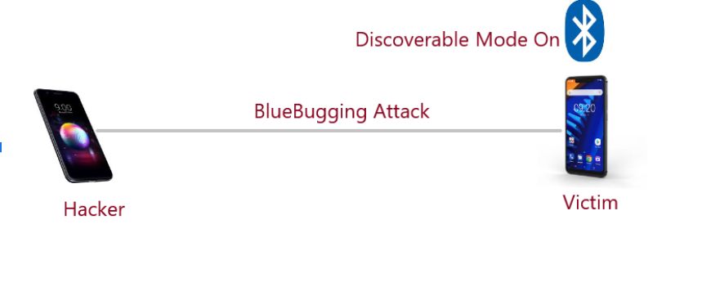
BlueBugging
BluePrinting
The attack occurs in the RFCOMM protocol. Physical connections are made via L2CAP + base band and it emulates serial RS-232 connections .
Installs a backdoor virus to exploit vulnerabilties
Unknown to the owner of target device the attacker then takes over the device by gaining access to the device’s set of “AT” commands, which are attention commands that send instructions to the module
Attacker now has privileges like owner and access to phone service and settings
The attack is carried out by combining the information that is revealed about a device like manufacturer, device model, and firmware version along with BD_ADDR already known

Slide 26
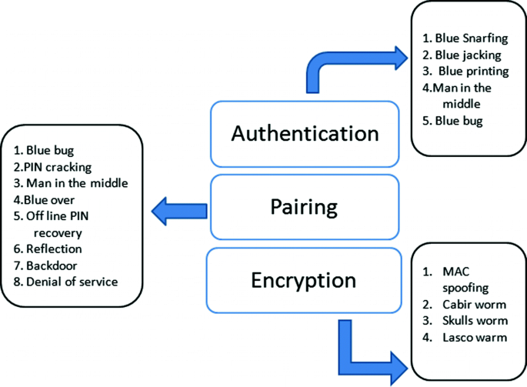
Worm Attacks on Bluetooth
The attacks occur when a malicious software or Trojan file sends itself to available Bluetooth devices
Mobile phones that use the Symbian series 60 interface platform are vulnerable to the attacks
For the attacks to be successful, the user must accept the worm. This causes the malware to install on the device
The worms are usually disguised in applications, which results in users unknowingly accepting them .Once installed, the software is the able to use the compromised device to search for and send itself to other available devices
Namely
Cabir Worms : replicates by using MMS and Bluetooth
Skulls Worms : poses as a Macromedia Flash player(SIS file)
Lasco Worms : from activation of velasco.sis file

Slide 27
Bluetooth Medical Hacks
According to a report in WIRED, security experts who studied at the Midwestern medical facility chain, over the course of two years found critical security vulnerabilities in medical devices
One finding allowed Bluetooth-enabled defibrillators to be manipulated to deliver random shocks to a patient’s heart or prevent a medically needed shock from occurring
Lack of authentication in the system
Usage if weak/hardcoded passwords
Hacks on Insulin Pumps and Companion App
Glucose monitors can be connected to companion smart apps on smartphones, which not only capture data, but also send alerts to patients
Man-in-the-Middle and eavesdropping attacks can be executed within close range
Data can be intercepted and decrypted/captured
Bluetooth’s Host Security protocols under attack
Mitigation: Updating the software and hardware

Slide 28
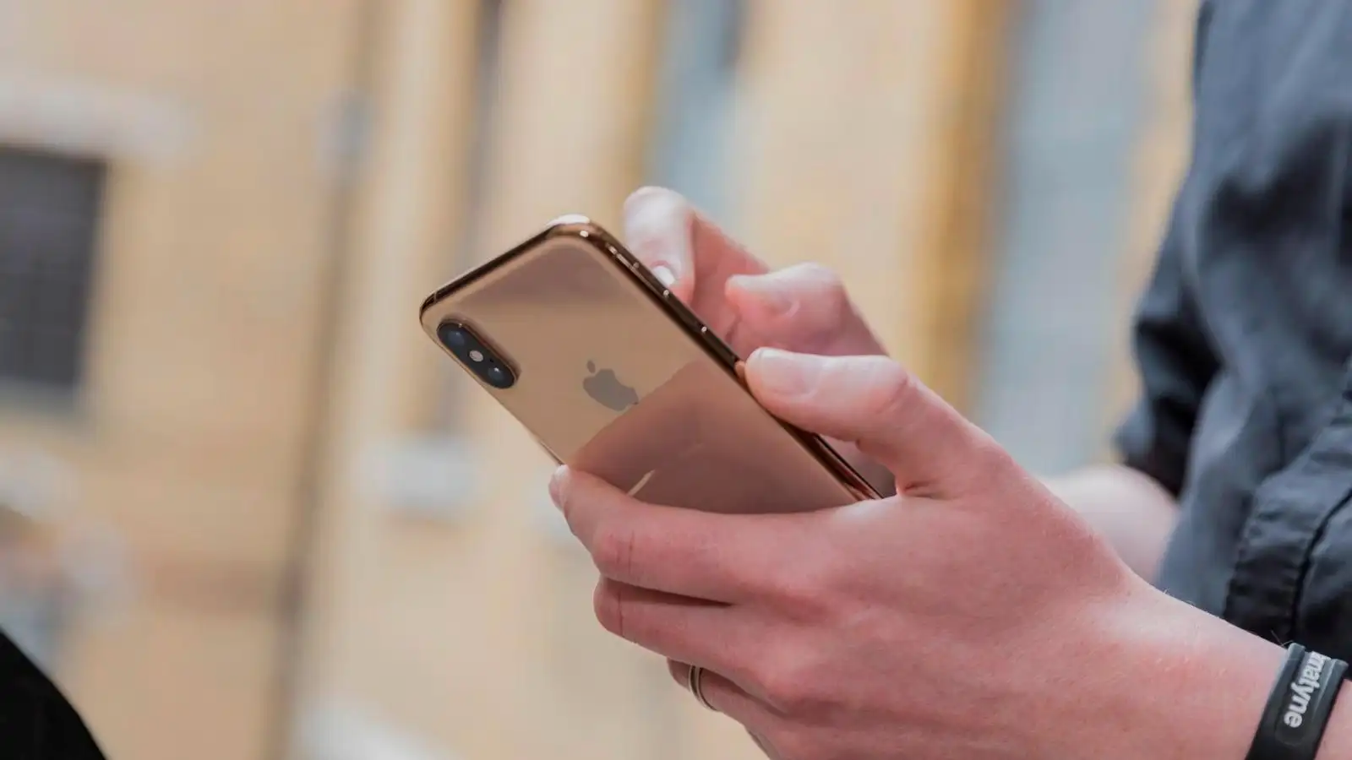
Smartphone Hacks on Bluetooth
Researchers conducted an experiment with the goal of learning how many devices they could infect with viruses in a public place using Bluetooth
They visited public places with a suitcase consisting of a computer that was equipped with a Bluetooth sniffing program
Able to detect more than 1400 devices in less than 23h
Captured 300 phone address books from
the roof of a Las vegas hotel on smartphones of bypassers standing in the below taxi stand
While experts advise to keep bluetooth off, some companies’ processes include turning the bluetooth on automatically when phones are turn on or after updates exposing customers to attack
Mitigation : It’s better to turn off the bluetooth when not in use

Slide 29
Camera Hacks on Bluetooth
In 2017, a mobile security and IoT hacker, Jason Doyle, identified three different vulnerabilities in Nest Cam Indoor, Nest Cam Outdoor, Dropcam Pro, and Dropcam security cameras that caused the camera’s feed to cut out . Each of the vulnerabilities were found in a specific firmware, which was version 5.2.1
Vulnerabilities exploited : Passing parameters to overflow Wi-Fi passwords and Wi-Fi SSIDs causing cameras to crash/reboot
Sending non-existent SSID resulting cameras to disconnect
These L2CAP vulnerabilities were exploited by attackers within Bluetooth range of the cameras.
Mitigation : Users should make sure they are updating their devices and running the latest updates to mitigate these types of vulnerabilities

Slide 30
Mitigation and Countermeasures
Device Firmware Upgrades:
Firmware upgrades are critical for addressing Bluetooth vulnerabilities, as they often include security patches.
However, these upgrades can only be provided by the device manufacturers, making it essential to stay updated with their offerings.
Enhancing User Awareness:
Educating users about secure Bluetooth practices is paramount.
This includes securing default settings, managing power levels to reduce exposure, and regularly updating and changing PIN codes for added protection.
Secure Device Configuration:
Ensuring that devices are set to undiscoverable mode when not in active use minimizes exposure to potential attackers.
Additionally, turning off Bluetooth in public areas and avoiding acceptance of connection requests from unknown sources are key steps in protecting against unauthorized access.

Slide 31
Mitigation and Countermeasures
Software and Driver Updates:
Keeping software and drivers up-to-date is crucial for patching known vulnerabilities and enhancing security.
It's equally important to avoid using older or unsupported Bluetooth versions that may lack critical security features.
Pairing Best Practices:
Devices should be paired in secure, non-public settings to prevent eavesdropping and unauthorized connections.
Utilizing Secure Simple Pairing (SSP) when pairing devices, when possible, can significantly enhance security. Additionally, promptly unpairing lost or stolen devices from previous connections is essential to prevent unauthorized access.
Broadcast Encryption:
Encrypting broadcasts lowers the risk of interception and ensures that sensitive information remains confidential.

Slide 32
Mitigation and Countermeasures
Data Transmission Security:
Using link encryption for all data transmissions safeguards the confidentiality and integrity of information.
Avoiding the use of the HID boot mode, which sends data in plaintext, and enabling encryption for multi-hop communication can help prevent eavesdropping and data interception. Implementing mutual authentication adds an extra layer of security to network-connected devices.
Key Size and Security Mode:
Utilizing the maximum encryption key size along with a minimum recommended key size (e.g., 128 bits) significantly bolsters resistance against brute-force attacks.
Implementing Security Mode 3 at the link level offers robust Bluetooth security and is highly recommended to enhance data protection.

Slide 33
Recommendations for Bluetooth Safety
Recommendations for Users:
Users should educate themselves on Bluetooth technology and do some research regarding the devices security features and capabilities before purchasing an IoT device.
User should visit manufacturer's website on a regular basis for any firmware updates or security patches to minimise the threat
Recommendations for Manufacturers:
Companies should prioritise security and apply security principles throughout development by leveraging threat models
Should stay updated on vulnerabilities and release patches and update firmwares promptly
Manufacturers must ensure that latest version of bluetooth is being used by the device
Documentation needs to be provided for users to increase their awareness on security of their devices.

Slide 34
Conclusion
This article comprehensively covered Bluetooth security, vulnerabilities, threats related to pairing, risk mitigation, real-life exploits in commercial products, and recommendations for securing Bluetooth communications.
Every individual should be responsible for securing their Bluetooth communications, as there is not one trusted, central party taking the necessary action.
Future work could extend this analysis to other wireless standards like WiFi and ZigBee and delve into power attacks on Bluetooth Low Energy (BLE) for low-energy applications.

Slide 35
Bibliography
Angela M. Lonzetta, Peter Cope, Joseph Campbell, Bassam J. Mohd and Thaier Hayajneh, Security Vulnerabilities in Bluetooth Technology as Used in IoT, Journal of Sensor and Actuator Networks, 2018.
https://www.ellisys.com/technology/een_bt07.pdf
https://www.govinfo.gov/content/pkg/GOVPUB-C13-c528fe2437b557e63cc73e6b431be093/pdf/GOVPUB-C13-c528fe2437b557e63cc73e6b431be093.pdf
https://en.wikipedia.org/wiki/Bluetooth
https://www.makeuseof.com/bluetooth-attacks/
https://electrek.co/2022/05/17/tesla-singled-out-bluetooth-hack-unlock-cars/
https://www.youtube.com/watch?v=eJKkEzeGuuo
https://youtu.be/1I1vxu5qIUM?si=FnHKPZQwWeU-5wDJ
https://youtu.be/cxP0Mdoz_Bo?si=FgheQp8Mm3FswWEp

Slide 36
Thank you!
Do you have any questions?

