Slide 1
CSE 707: Wireless Networks Security Secure Multipath Routing Protocol for Wireless Sensor Networks 27th International Conference on Distributed Computing Systems Workshops By Nidal Nasser and Yunfeng Chen Guided By Prof. Shambhu J. Upadhyaya presented by Rahul Kulkarni sai Vineeth arumalla

Slide 2
INTRODUCTION
Wireless Sensor Networks (WSN) applications require an energy-efficient and secure routing protocol that operates in an unattended, sometimes hostile environment.
Consuming low power is one important attribute of routing protocols for WSN. But a more useful metric for routing protocol performance is network lifetime.
Many protocols and algorithms, like DSR and AODV, have been proposed for traditional wireless ad hoc networks. But they are not well suited for sensor networks due to differences in network size, communication patterns, and node capacity.
Multipath routing protocols have been widely used in WSN to increase network lifetime and resistance to node failure but existing multipath routing protocols in WSN have three major weaknesses, including lack of security, energy depletion of nodes causing network partition and additional maintenance.
So, this paper introduced new routing protocol Secure and Energy Efficient Multipath Routing [SEER] protocol.

Slide 3
PROBLEM STATEMENT
Link-layer encryption and authentication, identity verification, bidirectional link verification, and authenticated broadcast can be used to protect sensor network routing protocols against external attacks, such as bogus routing information, Sybil attacks, HELLO floods, and acknowledgment spoofing.
However, Sinkhole attacks and wormholes pose challenges to secure routing protocol design and there are not effective countermeasures against these attacks that can be applied after the design of a protocol has completed.
This paper proposes a new routing protocol SEER: Secure and Energy-Efficient Multipath Routing protocol. SEER uses the principle similar to the Client/Server software architectures.
In this protocol base station handles route discovery, maintenance, and selection by periodically choosing a new path from multipath options, based on the current energy levels of nodes along each path.
Compared to other proposed routing protocols in WSN, SEER considers energy-efficiency and security simultaneously for the first time.

Slide 4
Secure and EnergyEfficient Multipath Routing Protocol
One issue with current protocols is their reliance on the lowest energy route for all communication which leads to energy depletion along that path and then network partition. To address this issue a new protocol, SEER was introduced which offers secure and energy-efficient multipath routing.
In SEER, the base station, not the source or destination, identifies and selects a multipath to the data source, changing the traditional route discovery approach
The base station continuously tracks node energy along the path, adjusting it as packets are sent and received. It uses this updated energy information to periodically choose a new path from the multipath options.
SEER enhances network lifetime by opting for multiple communication paths and also reduces the additional route maintenance. It serves as an efficient solution for securing and optimizing energy usage in WSN.

Slide 5
SEER Routing Protocol: Overview Assumptions
SEER adopts a Client/Server architecture, with base stations as servers and sensor nodes as thin clients.
SEER leverages the significant power advantage of base stations over common sensor nodes.
Base stations have robust processors, memory, AC power, and high-bandwidth communication links.
In this architecture, the base station handles tasks like data querying, control packet broadcasting, routing path selection and maintenance to work as an external network interfacing.
Sensor nodes focus on basic functions such as data sensing, packet forwarding and transmitting sensor data to the base station.
This division of roles optimizes energy consumption and enhances network efficiency in SEER.

Slide 6
SEER Routing Protocol: Assumptions
All the sensor nodes are static, i.e., mobility is not supported in SEER.
Energy consumption for each task is known for specific application.
All nodes have the same amount of energy available at the beginning of the Data Transmission phase, though it is the case that those nodes within one or two hops of the base station consume more energy during Topology Construction phase.
Each node consumes the same level of energy for transmitting and receiving one packet.
SEER has three phases:
Topology Construction
Data Transmission
Route Maintenance

Slide 7
1. Topology construction
Involves in establishing the relationships and connections between the sensor nodes and the base station.
This phase aims to determine how nodes are positioned, who their neighbors are, and how they are interconnected and helps ensure that data can be reliably and optimally transmitted between nodes and to the base station.
To initiate the topology construction, the base station first broadcasts a ND (Neighbors Discovery) message to the whole network, each node receiving this message does the following steps:
Records the address prev_hop from which the current node receives the message and stores it in the list neighbors_list in ascending order of message received time.
Changes the address prev_hop to the address of itself.
Checks if the broadcast message has been received by searching pkt_seq_num in the table received_pkts. If the message has already been received once, then drops this ND and does not rebroadcast it. Otherwise stores pkt_seq_num in table received_pkts and rebroadcasts the ND to its neighbors.

Slide 8
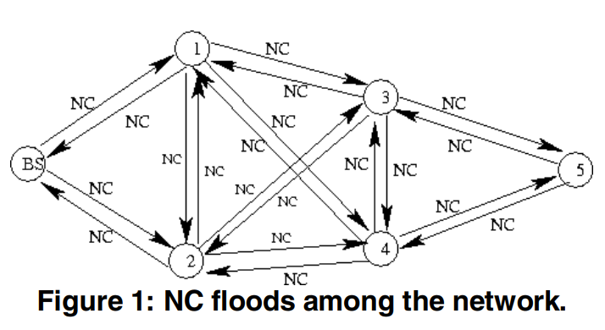
1. Topology construction
Sensor nodes learn about their neighbors by receiving and rebroadcasting ND, base station waits for sometime to ensure ND reaches all nodes in the network.
The base station broadcasts NC(Neighbors Collection) message to collect neighbor info from the previous broadcast. Nodes that receive NC perform the similar 3 steps as the previous ND was broadcasted and does this additional step where:
Time the timer send_ncr_timer_ to call after a random delay the function of brdcast_ncr that will broadcast the NCR message

Slide 9
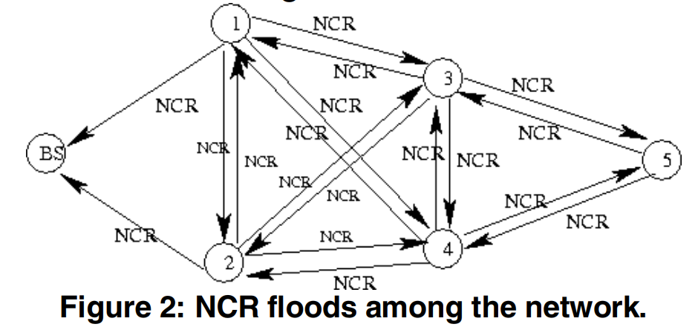
1. Topology construction
Sensor nodes on receiving the NC packet, replies a NCR (Neighbors Collection Reply) message to the base station by flooding.
In NCR, the source address is set to itself and the destination address is set to the base station. The NCR contains following information - The address of the node and list that has all addresses of its neighbors. Each node receiving this message does the similar 3 steps as the previous ND was broadcasted.

Slide 10
1. Topology construction
Once it receives information about the neighbors of all nodes, the base station gains a comprehensive understanding of the entire network's topology.
. The base station constructs a weighted directed graph using neighbor information.
Introduction of the "Weight" concept for path selection based on maximum node energy.
Edge weights in the graph represent available energy on the originating node.
Weight on edges decreases as nodes send and receive packets.
Figure 3 demonstrates the weighted subgraph derived from the network topology.
Edges originating from the base station (BS) have infinite weights, signifying its significantly higher energy compared to sensor nodes.

Slide 11
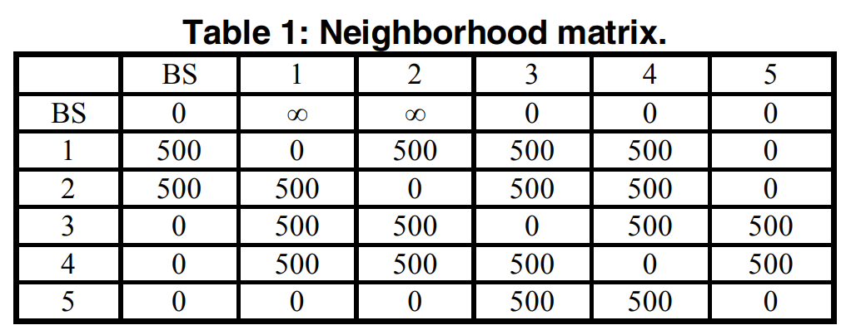
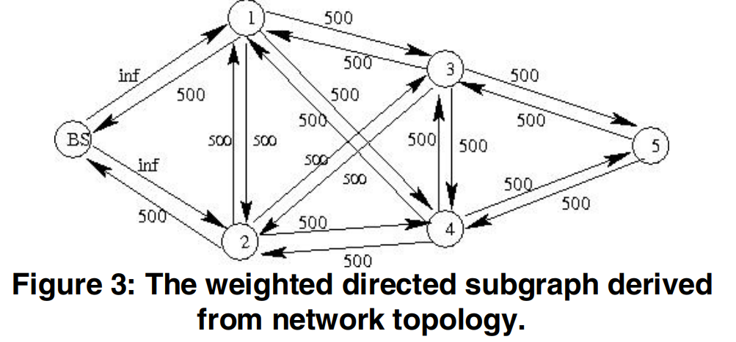
1. Topology construction
Weight = total power each node has / power for transmitting or receiving one packet.
For example, energy for sending a single bit of data is about 0.01 mW, the size of a packet is constant as 128 bytes, i.e., about 1,000 bits. So, the total energy for sending one packet is about: 1000 * 0.01 mW = 10 mW. suppose that each node starts with an initial energy of 5000 mW, then the weight can be calculated as 5000 mW / 10 mW = 500.
SEER protocol uses neighborhood matrix to represent the neighborhood relations between nodes. Table 1 shows the matrix corresponding to the weighted graph in Figure 3. Each row except the first row contains the neighbors information of a specific node

Slide 12
2. Data transmission
The base station broadcasts an enquiry DE (Data Enquiry).
Sensor nodes satisfy the enquiry response with a DER (Data Enquiry Reply) packet.
Sensor nodes that do not satisfy the enquiry rebroadcast DE.
The base station computes the shortest path within the weighted graph, typically selecting the path with the least energy consumption per node for sending one packet, often equating to the path with the fewest hops.
When there are more than two shortest paths, we select the path that has the maximal available energy on each sensor node.

Slide 13
2. Data transmission
Sensor Node:
Each node receiving the DE message:
Checks if it meets the inquiry's criteria.
If it does, it sends a DER message to the base station, including data length, with the next_hop set to the first node in its neighbors_list, ensuring proximity to the base station.
If not, the node rebroadcasts the DE and records the pkt_seq_num to prevent redundant DE broadcasts.
Nodes receiving the DER message forward it with the next_hop set to the first node in their neighbors_list and prev_hop set to themselves.
Base Station:
Base station receives DER and initiates shortest path calculation to the node that sent DER.
Base station leverages its knowledge of network topology to find these multipaths.
To determine the desired shortest path, SEER adapts the Breadth First Search (BFS) algorithm, traditionally used to find the shortest path from source to destination.
Modified BFS considers not only the shortest distance but also the energy left (edge weight) on each node.
If a node on the shortest path has insufficient energy, it is discarded, and the algorithm continues searching for the next shortest path.

Slide 14
2. Data transmission
Paths from the base station to different nodes traverse distinct nodes, allowing for individual energy limitations.
Energy limitation arrays are maintained for all nodes independently, optimizing sensor network utilization.
In Table 2, various paths from the base station to node 4 are listed based on the example in Figure 3.
The modified BFS algorithm finds the most energy-efficient routes, like routes 1 and 6, for data transmission.
Other routes with more available power are not used because they overlap with routes 1 or 6 and involve extra nodes, reducing power efficiency.
If a sensor on the path (e.g., BS->1->4) has insufficient energy, the base station runs the modified BFS to find an alternative path, e.g., BS->2->4.

Slide 15
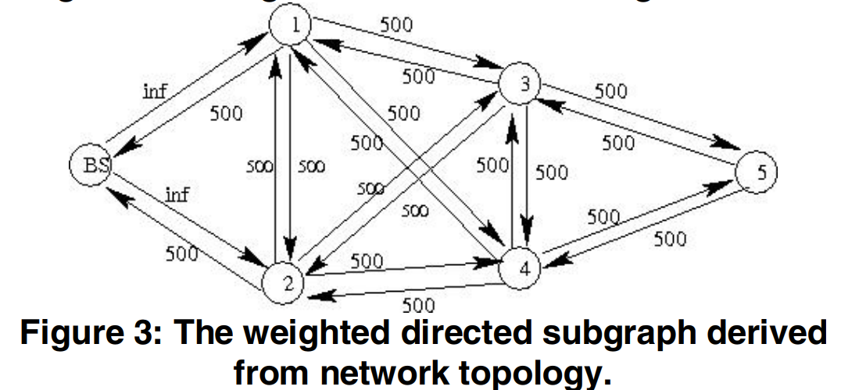
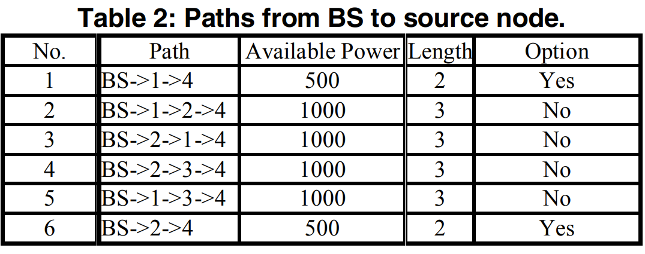
2. Data transmission
Upon finding a new path, the base station sends a Route Reply (RR) packet to node 4, specifying the selected route.
Node 4 acknowledges the RR and confirms the route for communication with the base station.
If the base station does not receive an ACK within a defined time, it considers the selected route invalid and initiates another BFS search for an alternative path.

Slide 16
3. Route maintenance
Route Maintenance phase aims to - avoid network partition problems and extend the network's lifespan.
So, MULTIPATH routes are employed to:
Distribute communication load across multiple routes between the source and destination.
Prevent the excessive energy consumption of nodes along a single route.
The base station remains the central server and control information source during Route Maintenance.
Energy levels of nodes on the path are reduced by one unit.
Periodic recalculation occurs after a set number of transmissions to select an alternative path.
The primary objective is to prevent energy exhaustion among nodes along a specific route.

Slide 17
Security Feature of SEER
Usually security can be enhanced with link layer encryption and authentication using a globally shared key.
SEER's security relies on unique routing path selection.
The base station chooses the route. This approach defends against attacks that manipulate routing protocols to attract traffic.
Specific attacks such as:
Wormhole
Sinkhole
Selective Forwarding, are addressed.

Slide 18
Defending wormhole and sinkhole attacks
Wormhole Attack:
What It Does: Deceives the network by creating a hidden, fast communication channel between two distant points in the network.
Objective: To make it seem like two far-apart nodes are neighbors, manipulating or intercepting their communication.
Challenges: Hard to detect because it operates outside the regular network communication.
Sinkhole Attack:
What It Does: Attracts network traffic to a specific node, often a compromised one, by advertising itself as the best route.
Objective: Intercept or manipulate data passing through the compromised node.
Challenges: Difficult to defend against in protocols relying on advertised information like hop counts etc.

Slide 19
Defending wormhole and sinkhole attacks
SEER's Defense Mechanisms:
Routing path selection is exclusively controlled by the base station, not the source or sink nodes.
The base station periodically reselects new paths based on current energy levels along multipath routes.
Adversarial attempts to manipulate routing have no impact on path selection, making it impossible to attract traffic through compromised nodes.
Even if compromised nodes temporarily exist on the routing path, their influence is short-lived, as the base station selects alternative paths, rendering further attacks ineffective.

Slide 20
Defending selective forwarding attacks
Selective Forwarding Attack:
What It Does: Malicious nodes choose which data packets to forward and which to discard.
Objective: Disrupt network communication and compromise its functionality by selectively blocking or forwarding packets.
Challenges: Detecting this attack is difficult as the attacker behaves like a regular node, making it hard to identify their malicious actions.
SEER's Defense Mechanisms:
SEER's routing path selection mechanism prevents sensor nodes from choosing or joining routing paths; all paths are uniquely chosen by the base station.
Each packet is assigned a unique sequence number, allowing detection if a compromised node selectively drops packets, as it will be identified by the next hop node.

Slide 21
Performance Evaluation – Setup Overview
Performance of protocol is done using dynamic simulation in Network Simulator “ns-2”.
Evaluation within a rectangular region measuring 150 m x 150 m.
Sensor nodes deployed in an ad hoc fashion.
Various sensor fields generated with different sizes.
Experiments cover six sensor field sizes, increasing in increments of 20 nodes.
All nodes are static with an initial energy of 100,000 mW.
Each node can send or receive 1,000 packets, with each communication consuming 100 mW.
Node transmission range is limited to 10 meters.

Slide 22
Performance Evaluation – Setup Overview
The base station requests data through broadcasted interests for specific data.
Source nodes send 500 packets each to the base station, with the base station broadcasting another interest upon receiving the last packet.
During simulations, the base station sends a total of 10 interests.
Performance comparison between SEER and Directed Diffusion protocols using metrics such as throughput, control overhead, and network lifetime.
Metrics compared under two conditions:
normal conditions
conditions with 20% of malicious nodes.

Slide 23
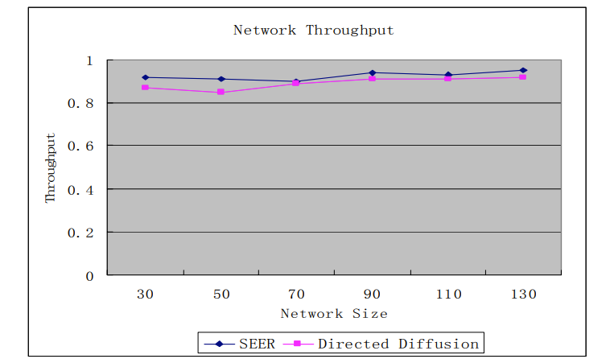
Performance Evaluation SEER and Directed Diffusion (Network Throughput) in Normal Condition
Figure shows high data delivery ratios for both SEER and Directed Diffusion.
Data delivery ratios increase as the number of nodes in the network grows.
Higher node density provides more sensor nodes for packet forwarding.
Both SEER and Directed Diffusion can select optimal paths from multiple choices.
Consequently, the difference in throughput between the two protocols is not significant.

Slide 24
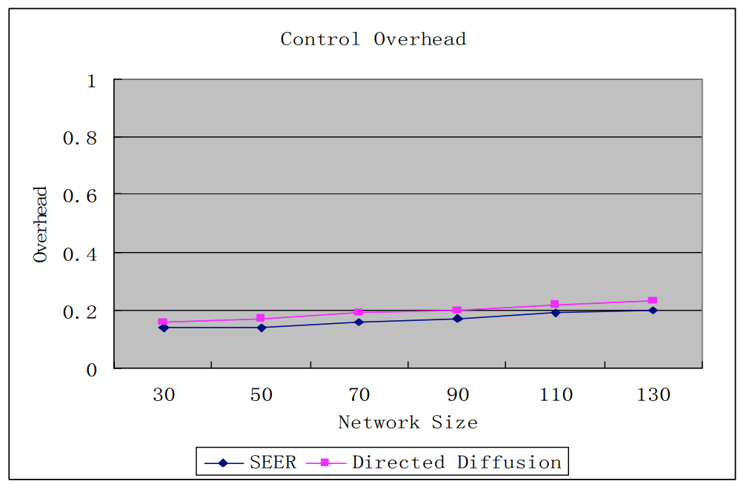
Performance Evaluation SEER and Directed Diffusion (Control Overhead) in Normal Condition
In the Topology Construction phase of SEER, control packets flood the entire network.
Increasing node density results in more neighbors for each node, leading to more control packet exchanges.
However, control packets transferred during the first phase of SEER remain constant for a fixed network size.
As data transmission increases within the sensor network, control overhead decreases, regardless of changing source nodes.

Slide 25
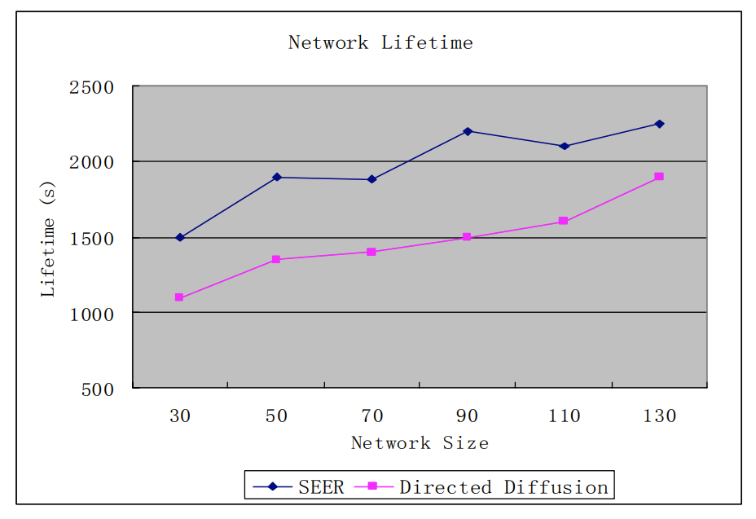
Performance Evaluation SEER and Directed Diffusion (Network Lifetime) in Normal Condition
SEER demonstrates a remarkable enhancement in network lifetime, with approximately 35% increase compared to Directed Diffusion.
Directed Diffusion consistently employs the same path for all communications between identical source and sink nodes, similar to many existing routing protocols.
So, this approach leads to nodes on the chosen path depleting their energy quickly, resulting in a shorter network lifetime.

Slide 26
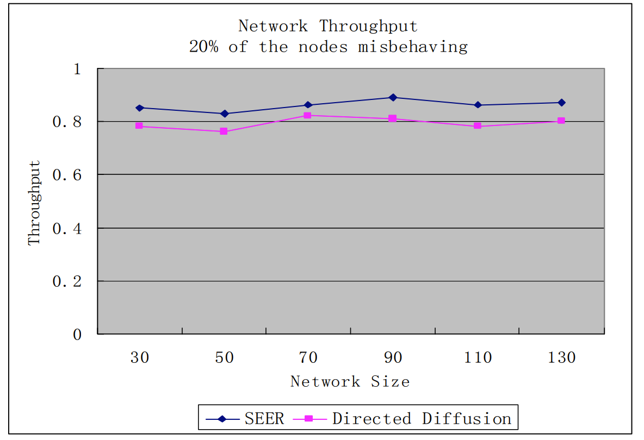
Performance Evaluation SEER and Directed Diffusion (Network Throughput) in 20% Malicious Condition
The network throughput does not exhibit a significant decrease in either protocol.
In the presence of malicious nodes obstructing the routing path by refusing to forward packets for the source, SEER can identify this behavior and react by selecting an alternative path.
Directed Diffusion also employs a similar mechanism to enhance its throughput when detecting malicious nodes.

Slide 27
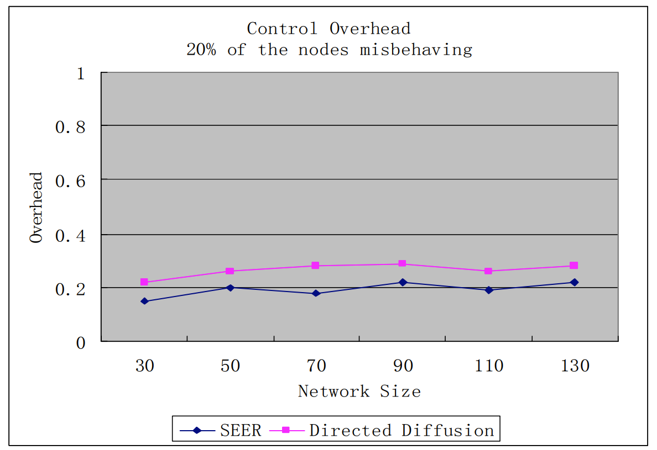
Performance Evaluation SEER and Directed Diffusion (Control Overhead) in 20% Malicious Condition
Control overhead, as illustrated in Figure 5(b), demonstrates different behaviors in the two protocols.
SEER experiences a relatively modest increase in control overhead, rising from 16% to 19%.
In contrast, Directed Diffusion witnesses a more substantial spike, with control overhead surging from 19% to 27%
SEER: Efficiently selects new paths during malicious node detection with minimal overhead.
Directed Diffusion: Faces complexity in handling misbehaving nodes, potentially requiring multiple floodings to identify new paths due to its reliance on local communication for path information.

Slide 28
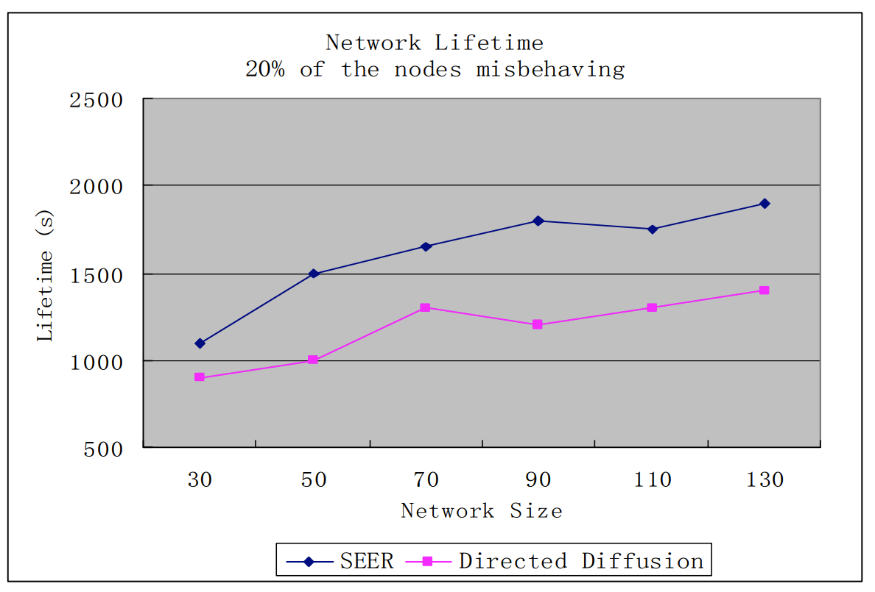
Performance Evaluation SEER and Directed Diffusion (Network Lifetime) in 20% Malicious Condition
Both protocols experience a notable decrease in network lifetime when malicious nodes are detected.
When misbehaving nodes are identified, both protocols select new paths, leading to the communication load being distributed among a limited number of available paths.
Despite the decrease, SEER outperforms Directed Diffusion with a 37% longer network lifetime due to its more even load distribution among multipath routes.

Slide 29
Conclusion
SEER is designed based on utilizing multipath concept. In general, SEER has following advantages compared to current routing protocols:
Mitigating the load of sensor nodes by transferring routing related tasks to the base station
Extending the lifetime of the whole network by using multipath to transfer data
Reducing the transmission delay through using the shortest and reliable path
Resistant to attacks that molest sensor networks by advertising high-quality route to BS.

Slide 30
SASC: Secure and Authentication-Based Sensor Cloud Architecture for Intelligent Internet of Things Khalid Haseeb, Ahmad Almogren, Ikram Ud Din, Naveed Islam and Ayman Altameem https://doi.org/10.3390/s20092468 Received: 18 February 2020 / Revised: 4 April 2020 / Accepted: 21 April 2020 / Published: 27 April 2020
Proposes a Secure Sensor Cloud Architecture (SASC) for IoT applications to improve network scalability with efficient data processing and security.
The proposed architecture comprises two main phases.
Firstly, network nodes are grouped using unsupervised machine learning and exploit weighted-based centroid vectors for the development of intelligent systems.
Secondly, the proposed architecture makes the use of sensor-cloud infrastructure for boundless storage and consistent service delivery.
Furthermore, the sensor-cloud infrastructure is protected against malicious nodes by using a mathematically unbreakable one-time password (OTP) encryption scheme to provide data security.
To evaluate the performance of the proposed architecture, different simulation experiments are conducted using Network Simulator (NS3)

Slide 31
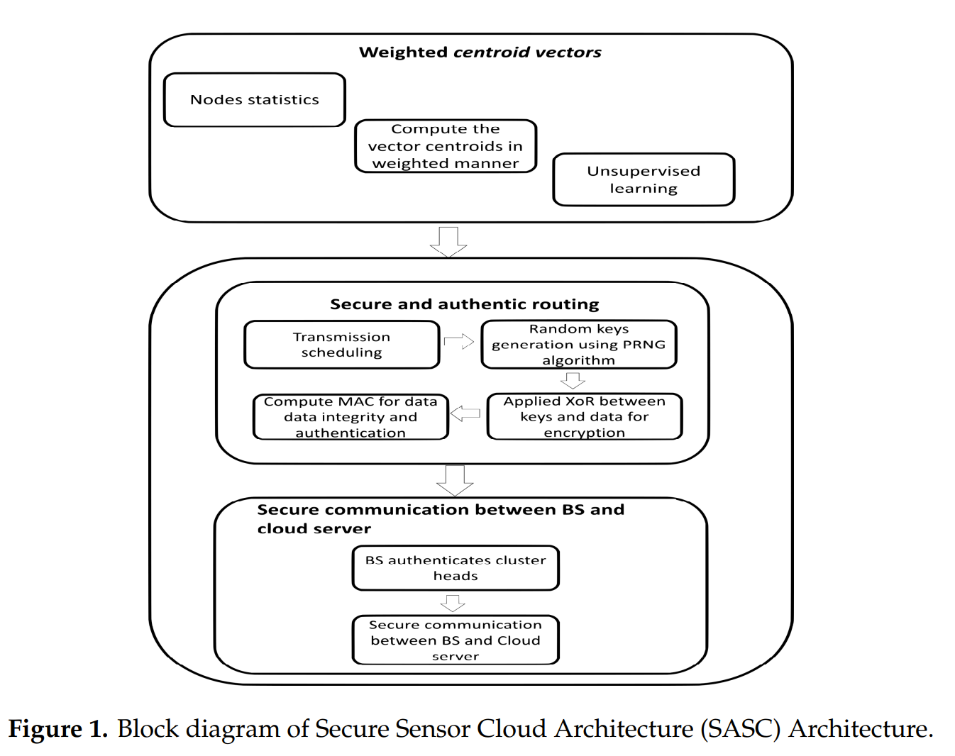
SASC: Secure and Authentication-Based Sensor Cloud Architecture for Intelligent Internet of Things Khalid Haseeb, Ahmad Almogren, Ikram Ud Din, Naveed Islam and Ayman Altameem https://doi.org/10.3390/s20092468 Received: 18 February 2020 / Revised: 4 April 2020 / Accepted: 21 April 2020 / Published: 27 April 2020

Slide 32
SASC: Secure and Authentication-Based Sensor Cloud Architecture
1. Cluster Formation Algorithm:
Divides network nodes into centroid-based regions.
Creates clusters based on node locality using distance and energy factors.
Self-organizes clusters with computed centroids, selecting cluster heads for data forwarding to the BS.
2. Cloud-Based Data Security Algorithm:
Stores sensed keys on the cloud for processing, reducing overhead, and enhancing network lifespan.
Implements lightweight security using OTP with XOR operation and random secret keys (PRNG).
Ensures data integrity and authentication with a message authentication code (MAC).

Slide 33
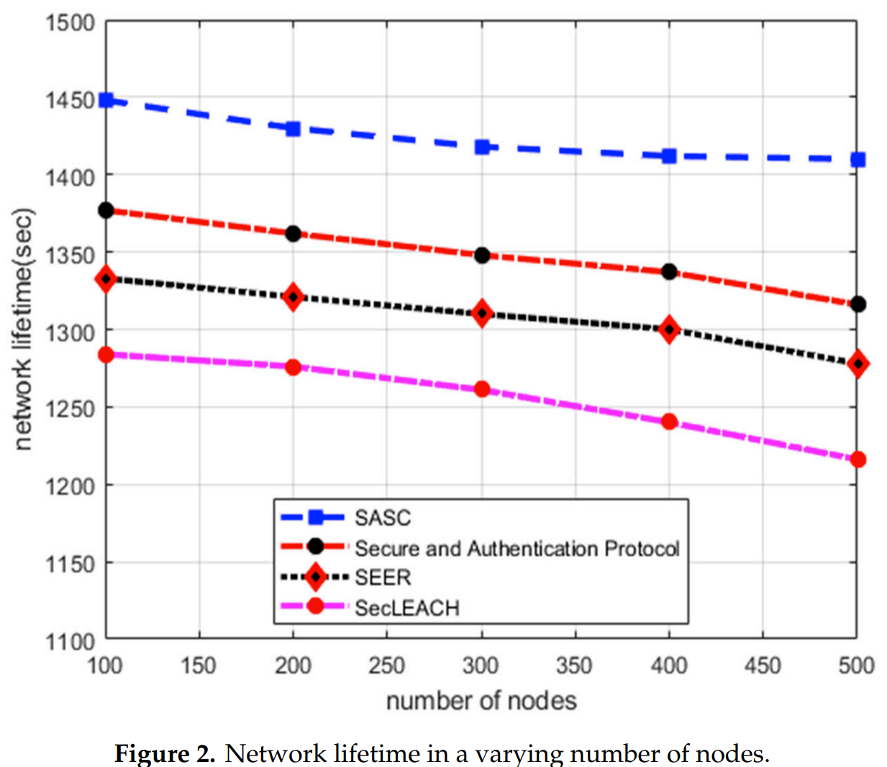
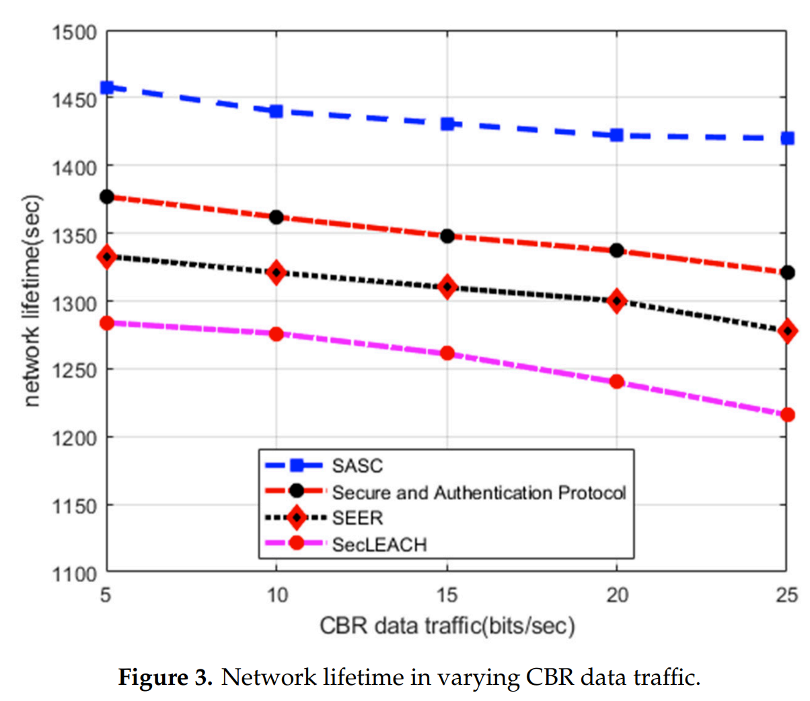
SASC: Secure and Authentication-Based Sensor Cloud Architecture Numerical Results:
Network Lifetime:
Figure 2: SASC improves network lifetime by 13% with varying node numbers.
Figure 3: SASC outperforms existing solutions by 12% under varying data traffic.
SASC's optimized cluster formation and reduced communication overhead enhance network lifetime.
Existing solutions may suffer from frequent data re-transmissions and route failures, especially under heavy network loads.

Slide 34
Secret Sharing-Based Energy-Aware and Multi-Hop Routing Protocol for IoT Based WSNs KHALID HASEEB, NAVEED ISLAM , AHMAD ALMOGREN, (Senior Member, IEEE), IKRAM UD DIN(Senior Member, IEEE), HISHAM N. ALMAJED , AND NADRA GUIZANI June 2019 DOI:10.1109/ACCESS.2019.2922971
Purpose: Provides a lightweight, secure, and energy-efficient multi-hop routing solution for constrained IoT-based wireless sensor networks (WSNs).
1.Network divided into inner and outer zones based on node locations, clusters generated within each zone based on node vicinity.
2.Utilizes an efficient secret sharing scheme for secure data transmission from cluster heads to the sink node.
3.Quantitative analysis of data links to minimize routing disturbances.
4. Results:
ESMR improves network lifetime by 38%.
Increases network throughput by 34%.
Reduces energy consumption by 34%.
Lowers average end-to-end delay by 28%.

Slide 35
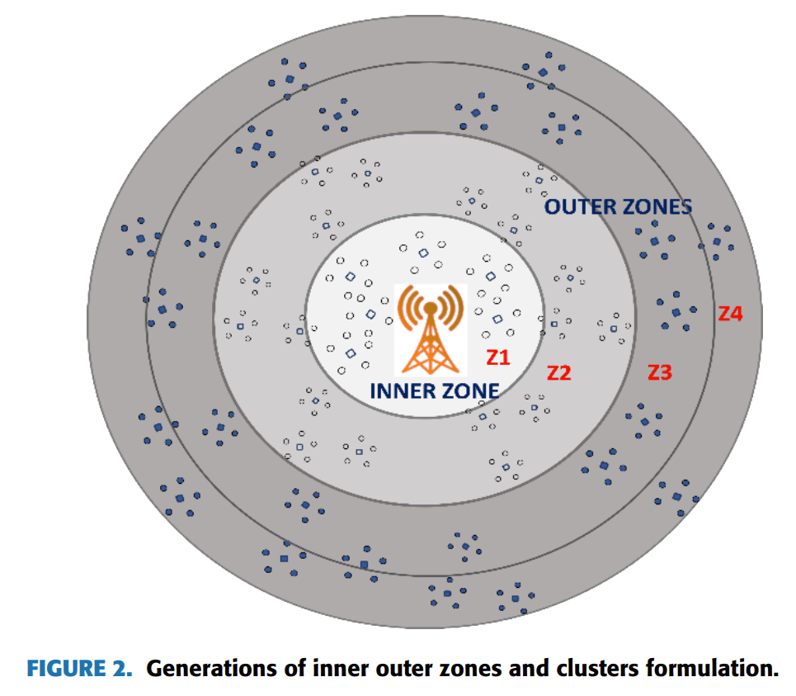
Secret Sharing-Based Energy-Aware and Multi-Hop Routing Protocol

Slide 36
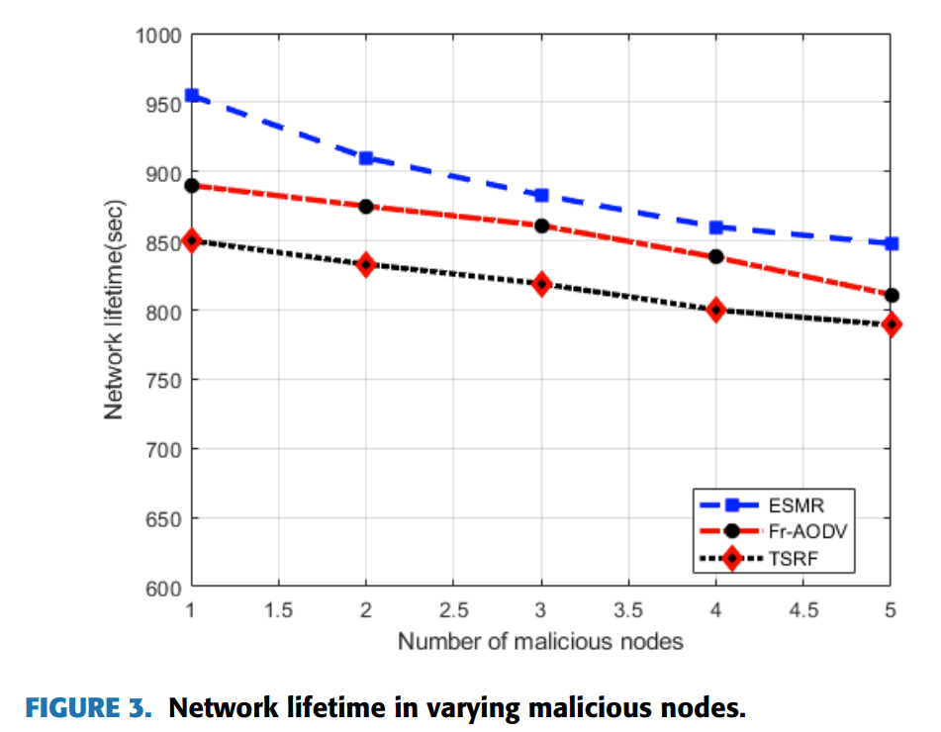
Secret Sharing-Based Energy-Aware and Multi-Hop Routing Protocol for IoT Based WSNs Numerical Results
Network Lifetime:
ESMR protocol increases the performance of network lifetime with an average of 38% as compared to other schemes.
This is done because it focusses on both energy efficiency and reliability of the network nodes.
Both FR-AODV and TSRF protocols select forwarders without considering network conditions and may lead to the early energy consumption.

Slide 37
References
Main Paper:
N. Nasser and Y. Chen, "Secure Multipath Routing Protocol for Wireless Sensor Networks," 27th International Conference on Distributed Computing Systems Workshops (ICDCSW'07), Toronto, ON, Canada, 2007, pp. 12-12, doi: 10.1109/ICDCSW.2007.72.
Reviewed Papers:
K. Haseeb, N. Islam, A. Almogren, I. Ud Din, H. N. Almajed and N. Guizani, "Secret Sharing-Based Energy-Aware and Multi-Hop Routing Protocol for IoT Based WSNs," in IEEE Access, vol. 7, pp. 79980-79988, 2019, doi: 10.1109/ACCESS.2019.2922971.
Haseeb, Khalid, Ahmad Almogren, Ikram Ud Din, Naveed Islam, and Ayman Altameem. 2020. "SASC: Secure and Authentication-Based Sensor Cloud Architecture for Intelligent Internet of Things" Sensors 20, no. 9: 2468. https://doi.org/10.3390/s20092468

Slide 38
Thank You!!

