Slide 1
Structural Attack against Graph Based Android Malware Detection
CSE 707: Wireless Networks Security
By: Kaifa Zhao, Hao Zhou, Yulin Zhu, Xian Zhan, Kai Zhou, Jianfeng Li, Le Yu, Wei Yuan, and Xiapu Luo
Under Guidance of Prof. Shambhu J. Upadhyaya
Presenters : Mehul Mittal, Rishab Aggarwal

Slide 2
Introduction to Android Malware Detection
Purpose and Types: Malware is software explicitly designed to disrupt, damage, or gain unauthorized access to computer systems. Spyware, Adware, Ransomware, Trojans are common types.
Impact on Android: The consequences of malware on Android devices highlight some high-profile cases of Android malware to illustrate the real-world impact.
Notes:
Android malware can range from spyware that monitors user actions and steals data, to adware that displays unwanted ads, and ransomware that locks devices or encrypts files, demanding a ransom for release. Spyware: Secretly monitors and collects personal information.
Adware: Automatically displays or downloads advertising material.
Ransomware: Blocks access to the device or files until a ransom is paid.
Trojans: Disguises itself as legitimate software to execute malicious functions.
such as personal and financial data breaches, reduced device performance, unauthorized use of resources, increased data consumption, and rapid battery depletion
Data Breaches: Unauthorized access to sensitive personal and financial information.
Performance Issues: Slowed down device operations and reduced lifespan.
Resource Exploitation: Increased data usage and battery drain, sometimes for botnet attacks or crypto-mining.

Slide 3
Exploitation Techniques
Modern malware on Android often involves:
Zero-Day Exploits: Taking advantage of unknown vulnerabilities in the OS or apps.
Rootkits: Gaining root access to take full control of the device.
Social Engineering: Tricking users into granting permissions or providing access.
Ransomware: Some malware encrypts user data and demands payment for the decryption key. This type of malware has become increasingly common and can be very profitable for cybercriminals.
Spyware: This type of malware is designed to spy on users' activities, capturing sensitive information like keystrokes, SMS messages, call logs, and location data.
SMS Trojans: These malware variants send SMS messages to premium-rate numbers from the infected device, often without the user's knowledge, resulting in unexpected charges on the user's mobile phone bill.

Slide 4
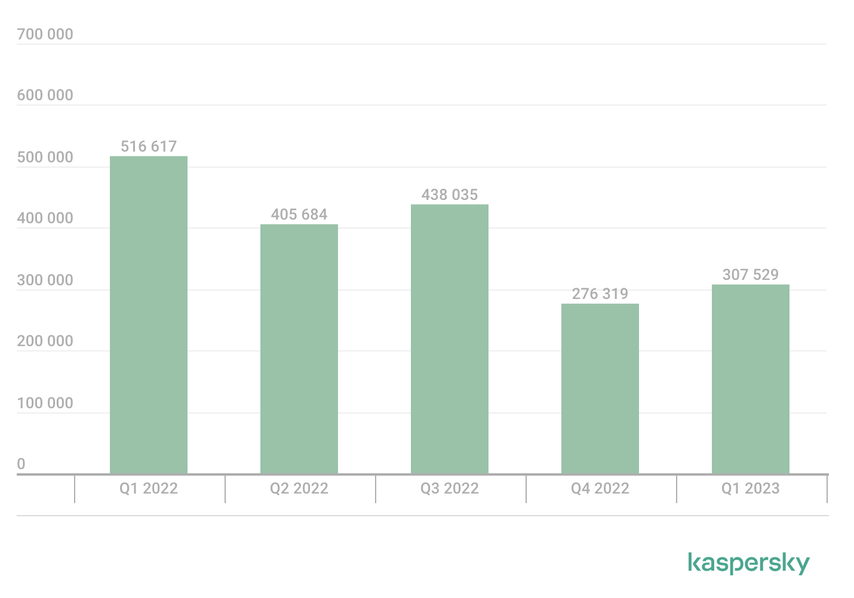
Number of detected malicious installation packages, Q1 2022–Q1 2023
According to Kaspersky Security Network, in Q1 2023:
4,948,522 mobile malware, adware and riskware attacks were blocked.
The most common threat to mobile devices was adware: 34.8% of all detected threats.
307,529 malicious installation packages were detected, of which:
57,601 packages were related to mobile banking Trojans
1767 packages were mobile ransomware Trojans

Slide 5
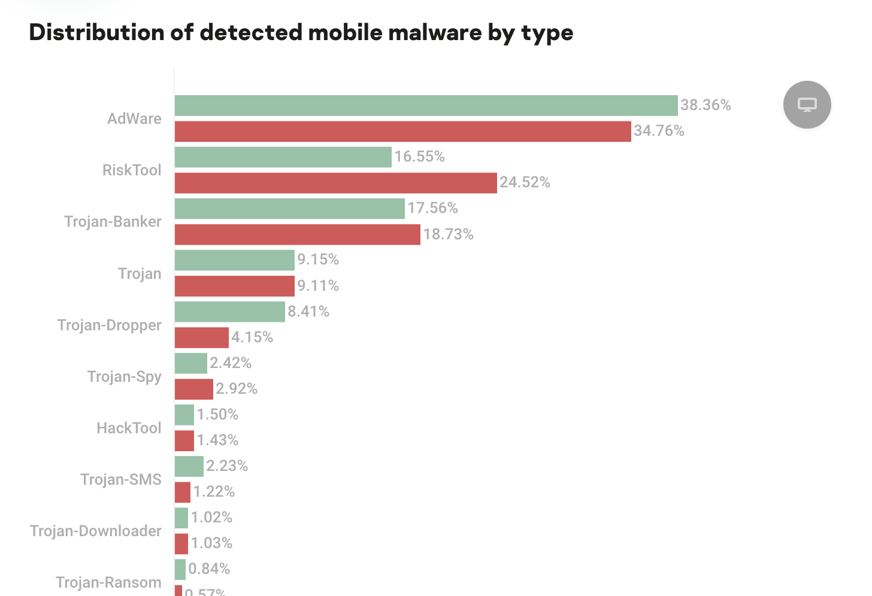
Types of malware with their percentages
Trojan-Dropper: 1%
Trojan-Spy: 2.92%
HackTool: 1.43%
Trojan-SMS: 2.23%
Trojan-Downloader: 1.02%
Trojan-Ransom, Backdoor, Monitor, and Other categories also appear to be listed with their respective percentages.
There's a reference to years 2022 and 2023, which may suggest a comparison or a timeline of malware detection statistics

Slide 6
Detection Techniques
Signature-Based Detection: Relies on identifying known malware signatures.
Behavioral-Based Detection: This technique analyzes the behavior of applications, flagging activities that are out of the ordinary.
Heuristic-Based Detection: They are used to identify new, unseen malware.
Machine Learning Approaches: Machine learning models are trained on large datasets containing examples of both benign and malicious apps.
Notes:
Signature-Based Detection: This method relies on identifying known malware signatures—a sequence of bytes or a pattern that uniquely identifies a specific malware strain. While effective against known threats, it struggles with new or evolving malware.
Behavioral-Based Detection: This technique analyzes the behavior of applications, flagging activities that are out of the ordinary, such as unexpected data transmissions, unusual access to contacts or messages, or hidden processes.
Heuristic-Based Detection: Heuristics are used to identify new, unseen malware. By examining code structures and behaviors for general characteristics of malware, heuristic scanners can detect suspicious activity without prior knowledge of the threat.
Machine Learning Approaches: Machine learning models are trained on large datasets containing examples of both benign and malicious apps. These models use pattern recognition to identify malware based on complex features extracted from the app's code, behavior, and other attributes.

Slide 7
The Importance of Structure in Malware Analysis
Significance of Structural Analysis in Malware Detection:
Code Structure
Execution Flow
Graph-Based Analysis Techniques:
Control Flow Graphs (CFGs).
Data Flow Analysis: This involves tracking the flow of data through the code.
Advantages of Structural Analysis:
Evasion Detection
Zero-Day Threat Identification
Machine Learning and Structural Analysis:
Feature Extraction
Pattern Recognition
Notes:
Understanding the importance of structure in malware analysis is crucial for developing robust detection systems, especially against sophisticated threats that specifically target Android devices
Significance of Structural Analysis in Malware Detection:
Code Structure: The structure of malware code offers insights into its potential capabilities and intentions. By analyzing the arrangement and flow of the code, detection systems can identify patterns indicative of malicious activity.
Execution Flow: Malware often has a distinct execution path that, when analyzed structurally, can reveal the underlying malicious process. Recognizing these patterns helps in preempting harmful actions before they occur.
Graph-Based Analysis Techniques:
Control Flow Graphs (CFGs): A CFG is a representation of all paths that might be traversed through a program during its execution. In malware analysis, CFGs are used to detect suspicious control structures that could indicate the presence of malware.
Data Flow Analysis: This involves tracking the flow of data through the code to identify anomalies such as unexpected data leakage or unauthorized data access that could signify malicious intent.
Advantages of Structural Analysis:
Evasion Detection: Malware authors frequently employ obfuscation techniques to hide their code's true purpose. Structural analysis can penetrate such obfuscation by focusing on the underlying control and data flow rather than superficial code characteristics.
Zero-Day Threat Identification: By understanding normal structural patterns, analysts can identify deviations that may represent new, previously unknown types of malware (zero-day threats).
Machine Learning and Structural Analysis:
Feature Extraction: Machine learning algorithms can analyze the structure of application binaries to extract features that are most indicative of malware. This can include graph-based features that describe the shape and connectivity of the code.
Pattern Recognition: Advanced machine learning models can learn from a large number of samples to recognize complex structural patterns that are characteristic of malicious software.

Slide 8
Background on Malware Detection Using FCGs:
What are Function Call Graphs (FCGs) ?
Malware Detection Tools: These tools extract features from FCGs that could indicate malicious behavior. These features might include the use of certain sensitive APIs (Application Programming Interfaces) that are commonly misused by malware
State-of-the-art Tools: The paragraph mentions that advanced malware detection tools analyze these FCGs to identify features indicative of malicious behavior. Features can include which APIs are called (sensitive APIs are more likely to be used by malware), how often they're called, and the relationships between them. Examples:
Malscan: Looks at the centrality of sensitive nodes in FCGs.
Mamadroid: Abstracts the nodes of FCGs into states.
Cai et al.: They employ graph neural networks.
Notes:
Function Call Graphs (FCGs): These are graphical representations of the calls (functions, methods, APIs) made within the software. Each node represents a function or API, and edges represent the calls between them.
FCGs: These graphs are a representation of a program where nodes correspond to functions in the code, and edges represent calls from one function to another.
Malware Detection Tools: These tools extract features from FCGs that could indicate malicious behavior. These features might include the use of certain sensitive APIs (Application Programming Interfaces) that are commonly misused by malware
State-of-the-art Tools: The paragraph mentions that advanced malware detection tools analyze these FCGs to identify features indicative of malicious behavior. Features can include which APIs are called (sensitive APIs are more likely to be used by malware), how often they're called, and the relationships between them.
Examples:
Malscan: It looks at the centrality of sensitive nodes in FCGs, which can indicate how crucial a particular API is within the graph. Central nodes might be more indicative of key malicious functionalities. These centralities are then used as features to train machine learning classifiers to detect malware.
Mamadroid: This tool abstracts the nodes of FCGs into states and uses the probability of transitioning between these states as features for detection.
Cai et al.: They employ graph neural networks, a sophisticated type of neural network tailored for graph data, to extract features from FCGs for malware detection.

Slide 9
Gap in the current research
Adversarial Attacks on FCG-based Detection:
Previous Studies:
Shows that it's possible to deceive FCG-based malware detection methods Adversarial samples are tweaked to evade detection while still performing malicious activities.
Feature Attacks New Focus:
Paper proposes a new method that targets the structure of the FCG itself—the nodes and edges—thus introducing what they call a "structural attack method."
Exploring Attack Surfaces: aims to explore vulnerabilities in the malware detection methods by altering the actual call structure within the FCG, potentially revealing new ways in which malware might evade detection.
Notes:
Function Call Graphs (FCGs): These are graphical representations of the calls (functions, methods, APIs) made within the software. Each node represents a function or API, and edges represent the calls between them.
FCGs: These graphs are a representation of a program where nodes correspond to functions in the code, and edges represent calls from one function to another.
Malware Detection Tools: These tools extract features from FCGs that could indicate malicious behavior. These features might include the use of certain sensitive APIs (Application Programming Interfaces) that are commonly misused by malware
State-of-the-art Tools: The paragraph mentions that advanced malware detection tools analyze these FCGs to identify features indicative of malicious behavior. Features can include which APIs are called (sensitive APIs are more likely to be used by malware), how often they're called, and the relationships between them.
Examples:
Malscan: It looks at the centrality of sensitive nodes in FCGs, which can indicate how crucial a particular API is within the graph. Central nodes might be more indicative of key malicious functionalities. These centralities are then used as features to train machine learning classifiers to detect malware.
Mamadroid: This tool abstracts the nodes of FCGs into states and uses the probability of transitioning between these states as features for detection.
Cai et al.: They employ graph neural networks, a sophisticated type of neural network tailored for graph data, to extract features from FCGs for malware detection.

Slide 10
Context and Challenges of Malware Detection:
Graph-based detection systems have become essential in identifying and understanding malware.
Scalability Issues:
Large-Scale Data
Dynamic Analysis Scalability
Evasion Techniques:
Code Obfuscation
Dynamic Code Execution:
Integration with Other Systems:
Interoperability: Integrating graph-based detection with other security systems and protocols can be complex, and lack of standardization can lead to compatibility issues.
Real-Time Analysis: Providing real-time analysis and protection using graph-based systems is challenging due to the time required for graph processing and analysis
Notes:
Graph-based detection systems have become essential in identifying and understanding malware. They represent the structural and behavioral patterns of applications as graphs, enabling sophisticated analyses.
Scalability Issues:
Large-Scale Data: The sheer volume of Android applications and the frequency of updates and new releases pose significant scalability challenges to graph-based detection systems. Processing and analyzing graphs for millions of apps is computationally intensive.
Dynamic Analysis Scalability: While static analysis can be more easily scaled, dynamic analysis requires the program to be executed, which is resource-intensive and less scalable.
Evasion Techniques:
Code Obfuscation: Malware authors often use obfuscation techniques to alter the appearance of their code while retaining its functionality, complicating graph generation and analysis.
Dynamic Code Execution: Some malware can execute code dynamically or download additional code during runtime, which may not be captured in the initial graph-based analysis.
Integration with Other Systems:
Interoperability: Integrating graph-based detection with other security systems and protocols can be complex, and lack of standardization can lead to compatibility issues.
Real-Time Analysis: Providing real-time analysis and protection using graph-based systems is challenging due to the time required for graph processing and analysis

Slide 11
Contd..
Adversarial Attacks:
Structural Attacks
Machine Learning Model Attacks
Feature Attacks vs. Problem-Space Attacks: Previous attacks added perturbations to feature vectors. Problem-space attacks, which aim to create real adversarial malware, have been limited to inserting non-functional methods or calls to avoid changing the software's behavior.
Inverse Feature-Mapping Problems: There is a challenge in translating changes in the feature space (abstract representation of program characteristics) back to the problem space (the actual code and its execution), and vice versa.

Slide 12
Malware Detection Models
Malscan: It utilizes centrality measures of sensitive nodes in a Function Call Graph (FCG) to detect malware. The centrality of these nodes is indicative of the sensitivity of the APIs involved, and a pre-trained classifier, such as kNN, is used to label the graph as malicious or benign.
Mamadroid: This model abstracts Android methods into different states based on the package or family name to handle API changes. It then uses the probabilities of calls between these states as features for malware detection, training classifiers like kNN on these features.
APIGraph: This model enhances Android Malware Detection (AMD) by aggregating APIs with similar semantics into clusters based on a relation graph derived from Android API documentation. It uses graph embedding algorithms to represent API features.

Slide 13
New type of attack
Addresses three key limitations of existing methods:
L1 - System-Specific Methods: The proposed attack doesn't rely on the specific feature extraction methods of the target AMD system, making it more general.
L2 - Limited Software Modification: The paper introduces four new software manipulation operations that go beyond inserting dead code, thus allowing more nuanced changes to the app's code without affecting its functionality.
L3 - Inconsistent Transformation Relation: The attack actions are designed with the characteristics of apps in mind, ensuring modifications in the graph correspond to actual app manipulations.
Heuristic Optimization Integrated Reinforcement Learning Attack (HRAT) Algorithm: The paper proposes the HRAT algorithm, which uses reinforcement learning to determine the type of action to take on the graph and to select the most effective nodes or edges to modify. This approach learns from the environment to bypass detection.

Slide 14
Conceptualizing HRAT: A Combined Approach
Theoretical Foundation of the HRAT Model:
Framework Foundations: System must learn to detect not only existing threats but also adapt to new, unseen adversarial strategies.
Optimization Problem: Goal is to maximize the detection rate of new and sophisticated malware while minimizing false positives and negatives.
Decision Making Process: The model uses a decision-making process based on Markov Decision Processes.
Reward Function: Incentivizes the RL agent to take actions that lead to better detection outcomes.
Integrating Heuristics with Reinforcement Learning:
Combination of Strengths: HRAT leverages the strengths of both to create a robust detection model.
Heuristics for Initial Guidance: Heuristic algorithms provide initial guidance to the RL agent, helping it to make better-informed decisions from the outset.
Reinforcement Learning for Adaptation: The RL component allows the system to learn from its interactions with the environment.
Notes:
ntegrating Heuristics with Reinforcement Learning:
Combination of Strengths: Heuristic methods excel at quickly identifying patterns based on predefined rules or experience, while reinforcement learning (RL) adapts to changing environments through feedback. HRAT leverages the strengths of both to create a robust detection model.
Heuristics for Initial Guidance: Heuristic algorithms provide initial guidance to the RL agent, helping it to make better-informed decisions from the outset. This can speed up the learning process by focusing on areas with a higher likelihood of success.
Reinforcement Learning for Adaptation: The RL component allows the system to learn from its interactions with the environment, which, in the context of malware detection, means it adapts to new malware strategies and evolves its detection capabilities over time.
Theoretical Foundation of the HRAT Model:
Framework Foundations: The HRAT model is grounded in the theory of adversarial machine learning, where the system must learn to detect not only existing threats but also adapt to new, unseen adversarial strategies.
Optimization Problem: HRAT is conceptualized as an optimization problem where the goal is to maximize the detection rate of new and sophisticated malware while minimizing false positives and negatives.
Decision Making Process: The model uses a decision-making process based on Markov Decision Processes (MDPs), where each state represents a potential configuration of a malware sample, and actions taken by the RL agent represent structural changes or heuristic rules applied to differentiate between benign and malicious apps.
Reward Function: A critical component is the reward function, which incentivizes the RL agent to take actions that lead to better detection outcomes. This function is carefully designed to balance immediate rewards against long-term strategic gains.

Slide 15
HRAT Methodology
Heuristic Optimization Techniques Employed:
Selection of Heuristics
Application of Heuristics
Optimization Process:
The Reinforcement Learning Algorithm in HRAT:
Model Framework
State Space
Action Space
Reward Function
Learning Process
Notes:
Heuristic Optimization Techniques Employed:
Selection of Heuristics: The methodology begins by selecting heuristic rules that can effectively guide the structural modifications of Android application code to bypass malware detection mechanisms. These rules are based on expert knowledge of how malware is typically detected.
Application of Heuristics: The chosen heuristics are then applied to the malware samples to make initial modifications. These modifications are designed to be subtle enough to avoid detection but significant enough to alter the graph-based representation of the application's code.
Optimization Process: Heuristic optimization involves iteratively refining the attack strategies by evaluating the effectiveness of each heuristic rule applied and adjusting accordingly. This optimization process aims to find the most effective combination of modifications that result in the highest likelihood of evading detection.
The Reinforcement Learning Algorithm in HRAT:
Model Framework: The reinforcement learning algorithm is structured around the concept of an agent that interacts with an environment. In this case, the agent is the attack model, and the environment is the malware detection system.
State Space: The state space encompasses all possible configurations of the application code, represented as graphs after modifications have been made.
Action Space: Actions correspond to the different types of structural changes that can be made to the malware's code graph, such as inserting, deleting, or modifying nodes and edges.
Reward Function: The reward function quantifies the success of each action based on whether the modified application evades detection. The algorithm seeks to maximize the cumulative reward, effectively learning the most efficient attack strategies over time.
Learning Process: Through a series of trials, the reinforcement learning algorithm fine-tunes the attack strategies, leveraging the heuristic optimization techniques to improve the learning efficiency.

Slide 16
Structural Attack Strategies and Tactics:
Analysis of Detection Algorithms: The methodology would analyze the algorithms for vulnerabilities that can be exploited.
Modification Tactics: Based on this analysis, specific tactics for modifying the structure of the malware’s code graph are developed. These might include adding decoy nodes to obscure the flow of execution or altering the relationships between nodes to mislead classification algorithms.
Evasion Techniques: The strategies also involve advanced evasion techniques that ensure the malware maintains its functional integrity while appearing benign to the detection system. This could involve mimicking the graph structures of benign apps or dispersing malicious functionality across the graph to avoid detection.
Notes:
Structural Attack Strategies and Tactics:
Analysis of Detection Algorithms: Understanding how graph-based malware detection algorithms work is crucial. The methodology would analyze the algorithms for vulnerabilities that can be exploited, such as over-reliance on certain graph features.
Modification Tactics: Based on this analysis, specific tactics for modifying the structure of the malware’s code graph are developed. These might include adding decoy nodes to obscure the flow of execution or altering the relationships between nodes to mislead classification algorithms.
Evasion Techniques: The strategies also involve advanced evasion techniques that ensure the malware maintains its functional integrity while appearing benign to the detection system. This could involve mimicking the graph structures of benign apps or dispersing malicious functionality across the graph to avoid detection.

Slide 17
Experimental Setup and Implementation
Data Preparation:
Malware Sample Collection: This involves gathering a comprehensive set of Android malware samples, possibly from public malware repositories or private collections.
Preprocessing: The samples must be preprocessed to ensure that they are in the correct format for analysis.
Labeling: Each malware sample must be accurately labeled to provide ground truth for the effectiveness of the attack model.
Dataset Splitting: The data is then divided into training, validation, and test sets, ensuring that there is a proper distribution of various types of malware across each set.
Environment Configuration:
Computational Resources: Allocation of sufficient computational resources is critical.
Security Measures: The experimental environment must be isolated and secure.
Parameter Setting: The parameters for the HRAT model need to be configured before training begins.
Notes:
to test the model effectively. Here's an elaboration on what this might involve, specifically for the HRAT model:
Data Preparation:
Malware Sample Collection: This involves gathering a comprehensive set of Android malware samples, possibly from public malware repositories or private collections.
Preprocessing: The samples must be preprocessed to ensure that they are in the correct format for analysis. This may include decompiling APK files to extract their Function Call Graphs (FCGs) or other relevant data structures.
Labeling: Each malware sample must be accurately labeled to provide ground truth for the effectiveness of the attack model. In the context of structural attacks, this would also involve labeling the structural features relevant to the attack.
Dataset Splitting: The data is then divided into training, validation, and test sets, ensuring that there is a proper distribution of various types of malware across each set.
Environment Configuration:
Computational Resources: Allocation of sufficient computational resources is critical. This includes setting up the necessary hardware (like GPUs for intensive computation) and software (such as machine learning frameworks and libraries).
Security Measures: Given the nature of working with malware, the experimental environment must be isolated and secure to prevent accidental release or execution of malicious code.
Parameter Setting: The parameters for the HRAT model, including learning rates, exploration-exploitation balance, and reward function specifics, need to be configured before training begins.

Slide 18
Workings of an Android App modifier (APPMOD) named HRAT
Purpose: HRAT (APPMOD) is a tool that automatically modifies Android apps to ensure two key principles: functional consistency and avoidance of detection by static analysis.
Implementation: The prototype is built on Soot, a framework that allows the translation of Android bytecode into an intermediate representation.
Modification Operations: HRAT supports four types of manipulations: adding function calls (edges), rewiring function calls, inserting methods (nodes), and deleting methods.
Constraints Determination: Not all methods are modifiable. Framework APIs, lifecycle methods, and methods introduced by FlowDroid (for analysis purposes) are unmodifiable.
Notes:
to test the model effectively. Here's an elaboration on what this might involve, specifically for the HRAT model:
Data Preparation:
Malware Sample Collection: This involves gathering a comprehensive set of Android malware samples, possibly from public malware repositories or private collections.
Preprocessing: The samples must be preprocessed to ensure that they are in the correct format for analysis. This may include decompiling APK files to extract their Function Call Graphs (FCGs) or other relevant data structures.
Labeling: Each malware sample must be accurately labeled to provide ground truth for the effectiveness of the attack model. In the context of structural attacks, this would also involve labeling the structural features relevant to the attack.
Dataset Splitting: The data is then divided into training, validation, and test sets, ensuring that there is a proper distribution of various types of malware across each set.
Environment Configuration:
Computational Resources: Allocation of sufficient computational resources is critical. This includes setting up the necessary hardware (like GPUs for intensive computation) and software (such as machine learning frameworks and libraries).
Security Measures: Given the nature of working with malware, the experimental environment must be isolated and secure to prevent accidental release or execution of malicious code.
Parameter Setting: The parameters for the HRAT model, including learning rates, exploration-exploitation balance, and reward function specifics, need to be configured before training begins.

Slide 19
Adding Function Calls
Objective: To manipulate the invocation of methods by adding a function call between a caller and a callee.
Implementation: An additional parameter, FLAG, is introduced to the callee method to distinguish between original and inserted calls. This FLAG is checked within the callee; if true, the callee returns a default value, maintaining functional consistency without executing its original code. If false, the callee operates normally.
Functionality: The method ensures that the added call does not alter the app's original functionality and prevents the new code from being classified as dead code by static analysis, which would otherwise be removed.
Notes:
Adding Function Calls
Objective: To manipulate the invocation of methods by adding a function call between a caller and a callee.
Implementation: An additional parameter, FLAG, is introduced to the callee method to distinguish between original and inserted calls. This FLAG is checked within the callee; if true, the callee returns a default value, maintaining functional consistency without executing its original code. If false, the callee operates normally.
Functionality: The method ensures that the added call does not alter the app's original functionality and prevents the new code from being classified as dead code by static analysis, which would otherwise be removed.

Slide 20
Rewiring Function Calls
Objective: To alter the flow of function calls by introducing an intermediate method (imm) and modifying the interaction between the caller and callee.
Implementation: This operation is performed in three steps:
Step a: Add a FLAG parameter to the intermediate method to control its behavior based on whether the invocation is original or inserted. If FLAG is true, imm invokes the callee; otherwise, it executes its original code.
Step b: Modify the caller's body to replace direct calls to the callee with calls to the intermediate method, setting FLAG appropriately to reflect the nature of the call.
Step c: Update all the invocations of the intermediate method to include the new parameter list and handle any changes in the return type. This ensures that existing calls to the intermediate method maintain their original behavior, even with the modified signature.
Notes:
Rewiring Function Calls
Objective: To alter the flow of function calls by introducing an intermediate method (imm) and modifying the interaction between the caller and callee.
Implementation: This operation is performed in three steps:
Step a: Add a FLAG parameter to the intermediate method to control its behavior based on whether the invocation is original or inserted. If FLAG is true, imm invokes the callee; otherwise, it executes its original code.
Step b: Modify the caller's body to replace direct calls to the callee with calls to the intermediate method, setting FLAG appropriately to reflect the nature of the call.
Step c: Update all the invocations of the intermediate method to include the new parameter list and handle any changes in the return type. This ensures that existing calls to the intermediate method maintain their original behavior, even with the modified signature.
Both operations are designed to modify the app's control flow graph subtly so that the functionality remains consistent, and the changes are not easily detected by static analysis tools used for app vetting or security checks

Slide 21
Inserting and Deleting Method
APPMOD can create a new method that performs simple mathematical operations and ensures that this method is invoked by an existing method (caller) within the app.
The operation of deleting a target method (tarMethod) from the app is handled carefully. APPMOD locates all the methods that call tarMethod and replaces the invocation statements with the body of tarMethod.
Notes:
APPMOD can create a new method that performs simple mathematical operations and ensures that this method is invoked by an existing method (caller) within the app.\
The process involves:
Creating local variables in the caller method that match the parameters and local variables of tarMethod.
Reassigning variables used in the invocation to match the new context.
Rewriting the statements from tarMethod using Soot’s APIs to ensure they are contextually appropriate for the caller.
If tarMethod has a return value, APPMOD replaces the return statement with an assignment statement.
Inserting goto statements to preserve the invocation logic, particularly when dealing with multiple return statements within tarMethod, to ensure that the program's flow is correctly managed after the method's deletion.
These operations are part of the sophisticated approach of APPMOD to modify Android apps in a way that is functionally consistent and avoids detection by static analysis tools, thus enabling the modification of the app's control flow graph without affecting its intended behavior.

Slide 22
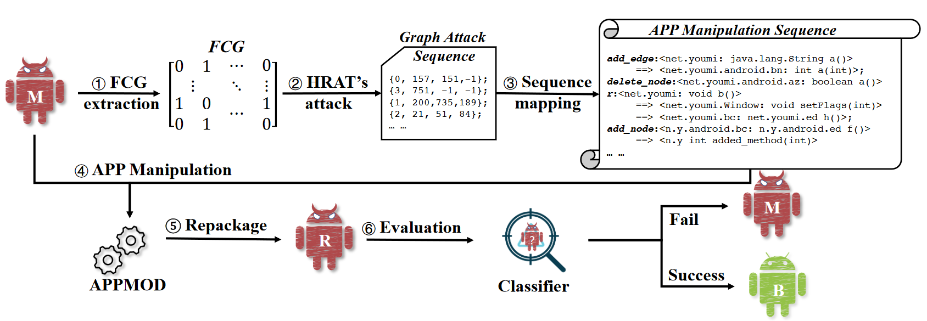
Evaluation
The figure sketches the attack flow of HRAT:
Given an App, HRAT first extracts its FCG
Generates a graph modification sequence (GMS)
Then, we convert a GMS to the manipulation sequence.
APP-MOD modifies the App according to the manipulation sequence
Repackage the app
Finally, evaluate whether target systems can detect the adversarial malware.
NOTE: HRAT modifications can fail to package, especially if the original code is obfuscated.
Notes:
The figure below sketches the attack flow of HRAT:
Given an App, HRAT first extracts its FCG
Generates a graph modification sequence (GMS) each item indicates a perturbation on the FCG’s nodes or edges. Then, we convert a GMS to the manipulation
sequence where each item denotes a manipulation on App ③. APP-
MOD modifies the App according to the manipulation sequence ④
and repackage it ⑤. Finally, we evaluate whether target systems
(i.e., Malscan, Mamadroid and APIGraph enhanced Malscan) can
detect the adversarial malware ⑥. We evaluate the performance of
HRAT by answering the following five research questions

Slide 23
Evaluation Criteria
The paper looks at five(5) research questions (RQs) to evaluate the performance of HRAT
RQ1: Effectiveness analysis. i.e., effectiveness of HRAT against the state-of-the-art AMD techniques
RQ2: Modification efficiency comparisons. i.e., the modification efficiency of HRAT compared to other attack methods
RQ3: Effectiveness of IMA. i.e., effectiveness of individual modification action (IMA)
RQ4: Resilience to code obfuscation. i.e., HRAT’s resilience to malware using obfuscation techniques
RQ5: Functional consistency assessment. i.e., does HRAT preserve functionality of the original app?
Notes:
We evaluate the performance of
HRAT by answering the following five research questions.
• RQ1: Effectiveness analysis. How effective is HRAT against the
state-of-the-art AMD techniques?
• RQ2: Modification efficiency comparisons. Compared with
other attack methods, how is the modification efficiency of HRAT?
• RQ3: Effectiveness of IMA. How effective is individual modifi-
cation action (IMA)?
• RQ4: Resilience to code obfuscation. How is the resilience of
HRAT to malware with different obfuscation techniques?
• RQ5: Functional consistency assessment. Do the adversarial
app generated by HRAT preserve the functionality as the original one?

Slide 24
Evaluation Criteria
Dataset:
Includes 11,613 benign Apps and 11,583 malicious Apps
Each sample has been detected by several antivirus systems in VirusTotal to determine their label.
Authors’ also used dataset from previous work* for evaluation of RQ4 and RQ5
Metrics:
Initialization ASR: The ratio of successful FCG-modified samples, to total samples
Relative ASR: The ratio of successful packaged apps, to successful FCG-modified samples
Absolute ASR: The ratio of apps that retain function and avoid AMD, to successful packaged apps
* S. Dong, M. Li, W. Diao, X Liu, J. Liu, Z. Li, F. Xu, K. Chen, X. Wang, and K. Zhang. Understanding android obfuscation techniques: A large-scale investigation in the wild. In International conference on security and privacy in communication systems, pages 172–192. Springer, 2018.
Notes:
• Initialization ASR (𝐼𝑛𝑖𝑡_𝐴𝑆𝑅) evaluates HRAT’s effectiveness on
feature space. Given 𝑁 malware samples, HRAT changes the FCGs
of 𝑁𝑔 malware samples with at most 500 modifications and make
them successfully escape the detection.The threshold (i.e., 500 mod-
ifications) selection can refer to RQ2. We found that nearly 100%
malware samples can escape detection within 500 manipulations
by HRAT. Note that not all modified FCGs can be repackaged due
to the anti-repackage protection [20].
• Relative ASR (𝑅𝑒𝑙𝑎_𝐴𝑆𝑅) reflects the rate of successful repackaged
malware. That is, among 𝑁𝑔 malware samples, 𝑁𝑝 samples can be
successfully repackaged into App files.
• Absolute ASR (𝐴𝑏𝑠_𝐴𝑆𝑅) evaluates HRAT’s effectiveness on prob-
lem space, i.e., whether the repackaged samples can evade the de-
tection and keep the functionality. Among 𝑁𝑝 repackaged malware
samples, 𝑁𝑠 samples run successfully and evade the detector.
𝐼𝑛𝑖𝑡_𝐴𝑆𝑅 = 𝑁𝑔/𝑁
𝑅𝑒𝑙𝑎_𝐴𝑆𝑅 = 𝑁𝑝 /𝑁𝑔
𝐴𝑏𝑠_𝐴𝑆𝑅 = 𝑁𝑠 /𝑁𝑝

Slide 25
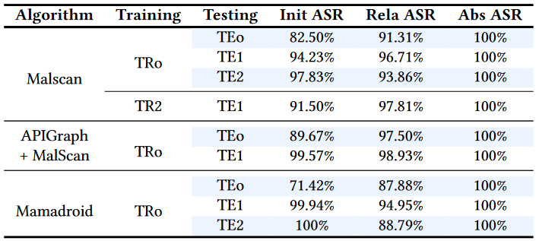
RQ1: Effectiveness Analysis
HRAT achieves up to 99.94% ASR within 500 modifications. Without restriction on the number of modifications, HRAT can achieve 100% ASR.
Three training and testing data sets were created and used for various different real-world use-cases:
TR0 and TE0 represents training and testing on same malware samples, representing up-to-date malware
TE1 and TE2 use newer samples than TR0, representing old malware detection models against newer samples
TR2 represents up-to-date samples to test older malware that HRAT may renew avoiding detection.
Notes:
Answer to RQ1: HRAT achieves up to 99.94% ASR within 500 mod-
ifications. Without restriction on the number of modifications,
HRAT can achieve 100% ASR of problem-space attack. We design three dataset [5]
settings for effectiveness analysis. In the first setting, the training
dateset (TRo) and the testing dataset (TEo) are collected during the
same period. In the second setting, the testing data (TE1 and TE2)
was collected after the training set. This setting emulates the situa-
tion that the malware detectors are trained with known malware
and use pre-trained classifiers to detect malware. In this case, since
there may be concept drift [53 ] in the malware samples, detectors
are suggested to re-train their classifiers to deal with new malware.
The third setting uses the latest malware to train the classifier (TR2)
and use older malware (TE1) for testing. In this setting, we aim at
evaluating whether our attack can renew outdated malware. We
use each training set to train target AMDs (i.e., Malscan, APIGraph
enhanced Malscan and Mamadroid). Given a malware in testing
sets, we use HRAT to modify it and then evaluate whether it can
evade target AMDs and record each ASR.

Slide 26
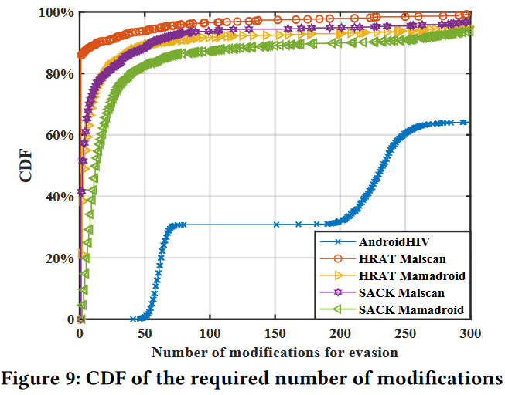
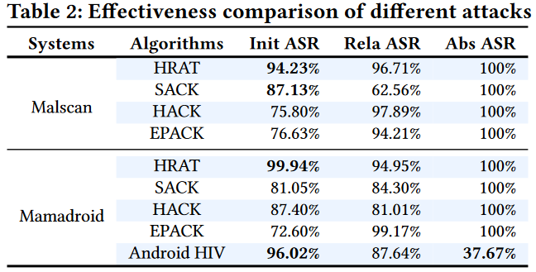
RQ2: Modification Efficiency Comparison
HRAT needs fewer number of modifications than other methods to let malicious Apps evade the detection.
HRAT was compared against other state-of-the-art AMD techniques:
Android HIV: state-of-the-art attack against Mamadroid (Android HIV not released to the public, implemented according to its paper by authors)
SACK: simulated annealing-based structural attack
HACK: hill-climbing-based structural attack
EPACK: evolutionary programming-based structural attack
Notes:
Answer to RQ2: HRAT needs fewer number of modifications than other methods to let malicious Apps evade the detection.
We compare the performance of HRAT and that of other
approaches. One is Android HIV [23 ], which is the state-of-the-art
attack against Mamadroid and also considers problem-space at-
tacks.Since Android HIV has not been released to the public, we
implement Android HIV by strictly following the description and
configuration in [ 23 ]. We also design attack strategies based on
evolutionary algorithms [54 ] (i.e., simulated annealing-based struc-
tural attack, SACK, hill-climbing-based structural attack, HACK,
and evolutionary programming-based structural attack, EPACK,
see Appendix E) as baseline algorithms for comparisons with rein-
forcement learning adopted by HRAT.

Slide 27
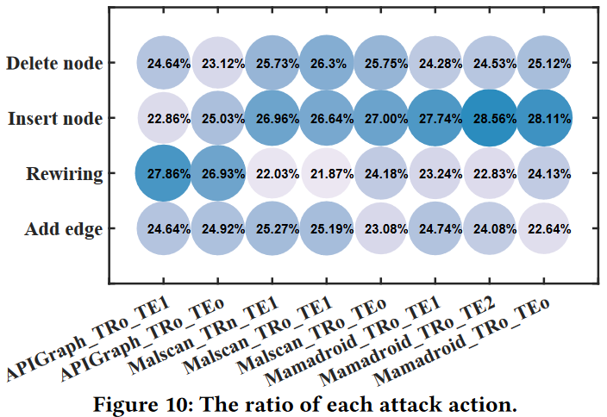
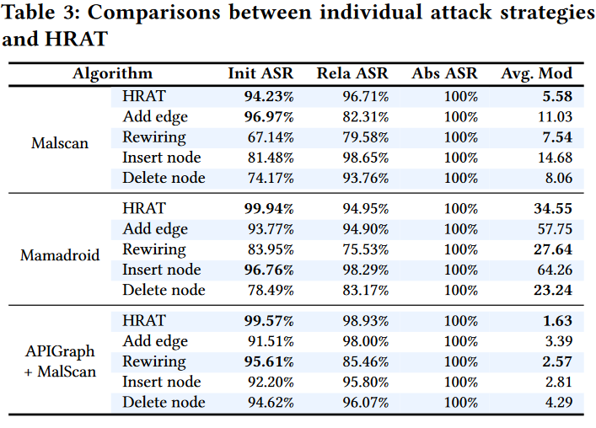
RQ3: Effectiveness of IMA
Individual attack actions are not always effective in attacking all AMDs. Combining multiple attack actions, HRAT is much more effective and modification efficient.
HRAT has a good mix of each action, it suggests that HRAT actively selects attack actions to achieve the trade-off between ASR and modification efficiency.
Furthermore, Effectiveness of HRAT on malware that fail to escape detection using individual actions was also evaluated, where results were between 37% - 99%.
Notes:
Answer to RQ2: HRAT needs fewer number of modifications than other methods to let malicious Apps evade the detection.
Ratio of individual actions. To evaluate the effectiveness of
individual manipulation action (IMA), we compute the ratio of each
attack action to all modifications applied to all adversarial Apps
that successfully evade the target systems (i.e., Mamadroid, Malscan
and APIGraph enhanced Malscan) under the aforementioned data
sets and configurations. For example, to obtain the ratio of insert
node in Malscan_TRo_TE1, we first count the number of insert node
(denoted as 𝑁𝑎𝑛 ) applied to those adversarial Apps and the total number of modifications (denoted as 𝑁𝑚 ) and then compute the
ratio as 𝑁𝑎𝑛 /𝑁𝑚
Additionally, ASR of individual actions was evaluated against IMA attacks.
Table 3 shows that using adding edges alone to attack
Malscan can achieve over 90% Init ASR but requires 11.03 average
modifications that is nearly double of the number of modifications
required by HRAT (5.58). As APIGraph clusters similar APIs into one class to en-
hance target AMD, perturbations on fewer APIs can let malware
escape the enhanced detector. In other words, when APIGraph en-
hances target systems, it also introduces new vulnerability. As all
IMAs follow our graph structure modifications, their performance
of problem-space attacks is the same as that of feature space attacks.
Regarding the effective ratio of HRAT over Apps that
fail to evade detection systems using individual attack actions. For
attacking Malscan, since adding nodes action achieves comparative
Init ASR with HRAT, the malware that fails to deceive Malscan
using adding nodes has overlapping with malware that fails to
evade the detection under HRAT’s modification, leading to 37.5%
effective ratio. For Mamadroid and enhanced detector, as HRAT
achieves nearly 100% Init ASR (Table 3), HRAT can also achieve
nearly 100% and around 90% effective ratio, respectively

Slide 28
RQ4: Resilience to Obfuscation Techniques
If an obfuscation technique neither affects the structure of FCGs nor impedes the static analysis and manipulation on Apps, it will not affect HRAT.
Dataset included malware from different families obfuscated by three different obfuscation techniques (i.e., identifier renaming, string encryption and reflection)
Identifier renaming has no effect on HRAT, as it does not affect the structure of FCGs.
For string encryption, malware may use encrypted string to replace original invocation statements, causing nodes and edges to be missed during HRAT’s modifications.
Reflection may make it difficult to conduct static analysis on Apps and thus some invocation relations may be missed.
Notes:
Answer to RQ2: HRAT needs fewer number of modifications than other methods to let malicious Apps evade the detection.
Ratio of individual actions. To evaluate the effectiveness of
individual manipulation action (IMA), we compute the ratio of each
attack action to all modifications applied to all adversarial Apps
that successfully evade the target systems (i.e., Mamadroid, Malscan
and APIGraph enhanced Malscan) under the aforementioned data
sets and configurations. For example, to obtain the ratio of insert
node in Malscan_TRo_TE1, we first count the number of insert node
(denoted as 𝑁𝑎𝑛 ) applied to those adversarial Apps and the total number of modifications (denoted as 𝑁𝑚 ) and then compute the
ratio as 𝑁𝑎𝑛 /𝑁𝑚
Additionally, ASR of individual actions was evaluated against IMA attacks.
Table 3 shows that using adding edges alone to attack
Malscan can achieve over 90% Init ASR but requires 11.03 average
modifications that is nearly double of the number of modifications
required by HRAT (5.58). As APIGraph clusters similar APIs into one class to en-
hance target AMD, perturbations on fewer APIs can let malware
escape the enhanced detector. In other words, when APIGraph en-
hances target systems, it also introduces new vulnerability. As all
IMAs follow our graph structure modifications, their performance
of problem-space attacks is the same as that of feature space attacks.
Regarding the effective ratio of HRAT over Apps that
fail to evade detection systems using individual attack actions. For
attacking Malscan, since adding nodes action achieves comparative
Init ASR with HRAT, the malware that fails to deceive Malscan
using adding nodes has overlapping with malware that fails to
evade the detection under HRAT’s modification, leading to 37.5%
effective ratio. For Mamadroid and enhanced detector, as HRAT
achieves nearly 100% Init ASR (Table 3), HRAT can also achieve
nearly 100% and around 90% effective ratio, respectively

Slide 29
RQ5: Functional Consistency Assessment
HRAT keeps functional consistency of the modified apps in most cases. It may break the functionalities of apps using obfuscation techniques that hinder the static analysis.
Static analysis assessment: The results show that the FCGs extracted from modified Apps are the same as the FCGs computed by the algorithm. Besides, the number of nodes and edges in the FCGs and extracted features from modified Apps are also the same as those calculated by HRAT.
Dynamic analysis assessment: The evaluation resulted in HRAT retaining the functionality, triggering methods during run-time for all the modified methods, however, reflection and obfuscation caused missed modification of obfuscated code, triggering app crashes.

Slide 30
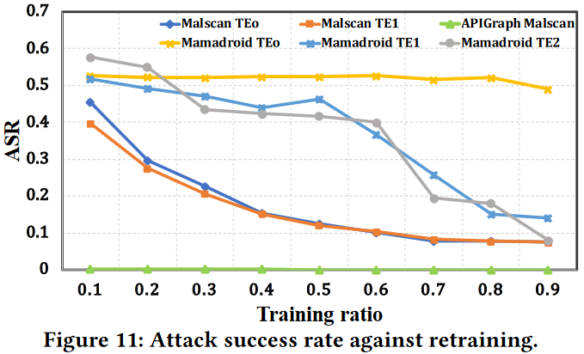
Defense against HRAT
Two potential approaches were evaluated for defending against HRAT which have been used to defend against adversarial attacks in other domains.
Adversarial retraining is regarded as one of the most effective defense methods against adversarial attacks. With the increase of training ratio, ASR drops accordingly. Thus, retraining would be an effective defense method against HRAT.
It is worth noting that Malscan enhanced by APIGraph only needs a small number of retraining samples to successfully detect adversarial Apps.
For ensemble learning, results show that it could be a promising defense strategy for Mamadroid. However, it is not always effective for Malscan. Therefore, different defense strategies should be adopted.

Slide 31
HRAT Limitations
HRAT’s optimization progress leads to high computational consumption, because given a new graph HRAT needs to calculate the gradient of each edge to select the influential nodes or edges.
Evaluation can be done on first using HRAT to attack one detection system and generate adversarial malware, and then check whether the generated malware can escape another detection system.
Since HRAT relies on static analysis, its attack may break APK’s dynamic features, such as reflection, dynamic class loading, etc.
We can add related methods into constraints and set them as unmodifiable to avoid modifying such dynamic features.
Moreover, HRAT could not handle heavily obfuscated malware, such as packaged apps, because static analysis may just access the Dex file of the shell rather than real functional Dex file.

Slide 32
Can it affect us today?
HRAT is aimed at modifying an app to reducing detectability of the features from AMD systems. Therefore, it is mainly useful for malware apps, providing another tool to hide their true nature. On the other hand, malware that modify benign apps (such as WhatsApp) will break their original packaging and signature, immediately flagging them as an untrusted app by most security software today.
HRAT can increase the difficulty in detecting the difference between a malicious app and a benign one. This indicates that if someone uploads a new app to an app store, it may not be detected as malware and might be made available to the public disguising itself, say, as an app helping you speed up your phone, undelete your chat messages, etc. to unsuspecting users.
Therefore, HRAT helps understand how malware apps can avoid detection on app stores. The research helps understand the changing landscape of security and allows for tech companies such as Google, Apple and Microsoft to develop better detection methods and prevent app stores from hosting nefarious apps.

Slide 33
Conclusion
The authors propose a novel structural attack against FCG-based Android malware detection systems.
By leveraging the correlation between FCG and software, the attack bridges the gap between feature-space attacks and problem-space attacks. Through interacting with target systems, their attack is more effective and modification efficient than heuristic methods.
Their extensive experiments demonstrate that combining multiple attack actions is more effective than applying single action.
Moreover, their methodology can also be applied to platforms other than Android.

Slide 34
References
Original Paper:
Zhao, K., Zhou, H., Zhu, Y., Zhan, X., Zhou, K., Li, J., Yu, L., Yuan, W., & Luo, X. (2021). Structural attack against graph based Android malware detection. Proceedings of the 2021 ACM SIGSAC Conference on Computer and Communications Security. https://doi.org/10.1145/3460120.3485387
Online References
Problem formulatin. (n.d.). Retrieved November 4, 2023, from https://sites.google.com/view/hrat/
Kivva, A. (2023, June 6). IT threat evolution Q1 2023. Mobile statistics. Securelist. Retrieved November 4, 2023, from https://securelist.com/it-threat-evolution-q1-2023-mobile-statistics/109893/
Application signing. (2023, September 25). Android Open Source Project. Retrieved November 4, 2023, from https://source.android.com/docs/security/features/apksigning

