Slide 1
CSE 707: Wireless Networks Security Intelligent Chain: Blockchain and Machine Learning based Intelligent Security Application for Internet of Vehicles (IoV) By Amritesh Kumar and Debasis Das, Indian Institute of Technology Jodhpur, India Guided By Prof. Shambhu J. Upadhyaya presented by Basireddy Ithihas Reddy Gandham Jayadhar

Slide 2
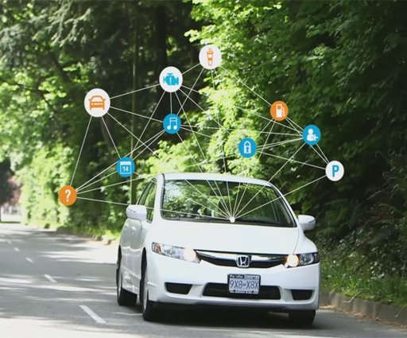
OVERVIEW
INTRODUCTION
PROBLEM STATEMENT
RESEARCH OBJECTIVE
EXPECTED OUTCOME
SIGNIFICANCE OF RESEARCH
LITERATURE REVIEW
METHODOLOGY
PERFORMANCE EVALUATION
POTENTIAL OF BLOCK CHAIN & MACHINE LEARNING IN IOV
CHALLENGES
CONCLUSION
FUTURE WORK
CONCLUSION STATEMENT
REFERENCES

Slide 3
INTRODUCTION
In the rapidly evolving landscape of the Internet of Things (IoT), the Internet of Vehicles (IoV) stands as a pivotal component, facilitating secure transmission and storage of real-time traffic accident information among IoV devices such as Vehicles, Road Side Units (RSU), and Edge Servers.
Despite the inherent advantages of IoV, challenges persist in achieving accurate traffic accident prediction and decentralized data storage, essential for ensuring a reliable IoV system.
To address these challenges, we introduce Intelligent Chain—an innovative solution that combines blockchain and machine learning within an edge server framework for IoV.
Intelligent Chain not only enables low-latency IoV device registration and secure communication of traffic accident information but also introduces novel decentralized trust and consensus procedures for blockchain-based storage.

Slide 4
INTRODUCTION
Leveraging LSTM recurrent neural networks, Intelligent Chain predicts localized area traffic accidents, with successful implementation demonstrated on the Raspberry Pi 4.
Experiment results showcase its exceptional 90% prediction accuracy on the Kaggle dataset, coupled with a reduction in transaction approval delay.
This research highlights Intelligent Chain's superiority over current state-of-the-art approaches in IoT, IoV, and Edge Server-based blockchain with machine learning technology, marking a significant advancement in the realm of IoV architectures.
So, this paper introduced new routing protocol Secure and Energy Efficient Multipath Routing [SEER] protocol.

Slide 5
PROBLEM STATEMENT
The Internet of Vehicles (IoV) presents a promising avenue for secure real-time transmission and storage of traffic accident information among IoV devices, including Vehicles, Road Side Units (RSU), and Edge Servers.
However, the current IoV landscape faces substantial challenges.
Despite the advantages of IoV, accurate traffic accident prediction and decentralized data storage remain elusive, leading to unintended losses and safety hazards.
Existing systems, particularly those structured around edge servers, fall short in addressing issues such as data immutability, decentralized storage, security, vehicle user privacy, and overall system security.
The integration of blockchain technology, specifically the Practical Byzantine Fault Tolerance (PBFT) model, lacks synchronization with machine learning models, exacerbating the severity of accidents, traffic congestion, and driver exhaustion.

Slide 6
RESEARCH OBJECTIVE
The primary objectives of this research are threefold:
Develop a solution that enhances the accuracy of traffic accident prediction in the IoV, leveraging the capabilities of blockchain and machine learning.
Establish a decentralized data storage mechanism within the IoV context to address security and privacy concerns, ensuring data integrity and user confidentiality.
Evaluate the effectiveness of Intelligent Chain in mitigating the identified challenges and compare its performance against existing approaches, providing insights into its potential impact on IoV systems.

Slide 7
EXPECTED OUTCOME
The successful implementation of Intelligent Chain is anticipated to signify a significant advancement in IoV architectures. By addressing the identified challenges, it aims to pave the way for a more secure, efficient, and reliable IoV system, thereby contributing to the evolution and optimization of the IoV landscape.

Slide 8
SIGNIFICANCE OF THE RESEARCH
The significance of the research, lies in the transformative potential of Intelligent Chain in addressing crucial challenges within Internet of Vehicles (IoV) systems. Here's an elaboration on the key aspects of the research's significance:
Improving Security and Reliability:
Security Enhancement: In the realm of IoV, ensuring the security of real-time data transmission and storage is paramount. Intelligent Chain proposes a blockchain-based solution, leveraging its inherent properties like data immutability and secure communication. By implementing a decentralized trust algorithm and consensus procedures, the research enhances the security infrastructure of IoV, making it more resistant to potential cyber threats.
Reliability Boost: Current IoV systems face challenges related to reliability, particularly in terms of decentralized data storage. Intelligent Chain offers a solution by utilizing blockchain technology, which provides a tamper-proof and distributed ledger. This approach contributes to the reliability of traffic accident information storage and retrieval, reducing the likelihood of data corruption or loss.

Slide 9
Efficiency Enhancement:
Transaction Approval Delay Reduction: The paper introduces Intelligent Chain as a solution that not only focuses on security but also aims to improve the efficiency of IoV systems. By incorporating machine learning models, particularly LSTM recurrent neural networks, the research enhances the accuracy of traffic accident prediction. Additionally, the implementation of novel decentralized trust and consensus algorithms reduces transaction approval delays, contributing to the overall efficiency of the system.
Edge Server Architecture: The choice of implementing an edge server structure in IoV is emphasized as a means to provide on-demand resource availability, massive data storage, and analysis closer to where data is generated. This approach minimizes latency and enhances the Quality of Service (QoS) in mobility support, contributing to the overall efficiency of the IoV system.

Slide 10
Addressing Critical Issues:
Data Immutability and Decentralized Storage: The research recognizes the limitations of existing IoV systems, including concerns about data immutability and centralized storage. By integrating blockchain, Intelligent Chain ensures that data once recorded cannot be altered, providing a transparent and immutable record of traffic accident information. Decentralized storage on the blockchain contributes to increased data availability and accessibility.
Privacy Concerns: The significance of the research extends to addressing privacy concerns inherent in IoV. By implementing decentralized trust mechanisms, Intelligent Chain strives to establish secure communication channels between IoV devices, preserving the privacy of users and their vehicular data.
Innovation through Integration:
Blockchain and Machine Learning Integration: Intelligent Chain's innovative approach lies in the integration of blockchain and machine learning. This amalgamation leverages the strengths of both technologies to create a synergistic solution. Blockchain ensures data integrity and security, while machine learning enhances predictive capabilities, leading to a comprehensive and innovative solution for IoV.
In summary, the research is significant as it proposes Intelligent Chain as a holistic solution to key challenges in IoV, offering improvements in security, efficiency, and reliability. The integration of blockchain and machine learning technologies positions Intelligent Chain as a pioneering approach with the potential to surpass current state-of-the-art IoV systems.

Slide 11
LITERATURE REVEIW CONSIDERED

Slide 12
LITERATURE REVIEW: IOV WITH BLOCK CHAIN BASED
The landscape of blockchain-based schemes for the Internet of Vehicles (IoV) reveals a diverse array of applications and limitations.
Li et al. seek to revolutionize IoV by eliminating centralized server communication, yet they grapple with intricate access control policies and compromised confidentiality.
Dorri et al.'s approach, leveraging clustering to manage public blockchains, falters in the realm of vehicular networks due to an inefficient two-layered communication architecture.
DSSCB innovatively deploys smart contracts for node control and data coin allocation but grapples with the computational intensity of validating messages using bilinear pairing.
Li et al.'s privacy-preserving incentive announcement network, though commendable, falls short by assigning identical rewards to all communications, demanding a delicate balance in keys and coins.
Jiang et al.'s model for sending vehicle blockchain data externally guides future networking but proves unreliable for cellular networks.

Slide 13
Chen et al.'s IoV, employing an iterative double auction method, maximizes societal benefit yet lacks synchronization mechanisms to resolve conflicts.
Kamal et al.'s connection fingerprint creation using wireless parameters and blockchain faces synchronization challenges between lightweight and heavyweight protocols.
Lin et al.'s Ethereum-based communication design, while secure, involves a burdensome two-signature verification process.
Sun et al.'s asymmetric inter-vehicle mutual authentication framework proves resilient to DoS attacks but demands an infinite repetition of game-based techniques against rational DoS attackers.
Hammi et al.'s bubbles of trust secure data integrity and availability but grapple with inter-bubble communication constraints.
Li et al.'s decentralized blockchain, boasting high confirmation speed and attack thwarting, falters by an inability to calculate a block's weight.
In summary, these IoV blockchain schemes, while promising in various aspects, face significant limitations that necessitate further refinement for widespread adoption.

Slide 14
LITERATURE REVEIW CONSIDERED

Slide 15
LITERATURE REVIEW: IOV WITH MACHINE LEARNING BASED SCHEME
The landscape of machine learning-based schemes for the Internet of Vehicles (IoV) is characterized by diverse applications and accompanying limitations.
Du et al.'s contribution stands out for its implementation of regression through a stacked Long Short-Term Memory (LSTM) model. However, a notable limitation arises from the lack of comprehensive analysis regarding the correlations and dependencies among different locations.
Zhao et al.'s approach employs a two-dimensional network with multiple memory units to address temporal-spatial correlation in the traffic system. Despite this, their work could be enhanced by incorporating variables such as travel time, traffic speed, and occupancy for a more nuanced analysis.

Slide 16
LITERATURE REVIEW: IOV WITH MACHINE LEARNING BASED SCHEME
Ping et al.'s scheme focuses on supporting the macroscopic relationship between driving behavior and fuel consumption, creating a model based on dynamic information. While commendable, the limitation lies in the commonality of fuel consumption analysis and the reliance on a relatively small scale of naturalistic driving data.
Tian et al.'s work introduces multi-party engagement of edge services to enhance system throughput, utilizing an aggregation strategy to ensure decision tree model accuracy and prevent data privacy leakage. However, challenges arise from the high communication overhead and an imbalance between privacy and efficiency considerations.
In summary, these machine learning-based IoV schemes present promising applications but must address specific limitations to reach their full potential and contribute effectively to the evolving landscape of intelligent vehicular systems.

Slide 17
REVIEW OF LITERATURE REVIEW
The review of relevant literature offers a comprehensive overview of the integration of blockchain and machine learning in the context of the Internet of Vehicles (IoV). The existing works in this domain have been summarized, showcasing the diverse applications adopted by researchers.
These applications range from blockchain-based schemes aimed at enhancing security and efficiency to machine learning-based schemes focusing on predictive modeling and data analysis within the IoV framework.
However, amidst these advancements, several gaps and limitations have been identified. These limitations serve as critical points of consideration for future research and development. For instance, issues such as complex access control policies, compromised confidentiality, inefficient communication architectures, and computational intensity in message validation have been highlighted in blockchain-based schemes.
In the realm of machine learning-based schemes, limitations include the lack of comprehensive analysis of correlations and dependencies, the need for enhancement through the inclusion of additional variables, reliance on commonality in data analysis, and challenges in balancing privacy and efficiency.

Slide 18
REVIEW OF LITERATURE REVIEW
Building upon these identified limitations, the framework for the current study can be established. The motivation behind the study lies in the necessity to address these gaps and push the boundaries of knowledge in IoV, paving the way for more robust and effective solutions.
The objectives of the study involve refining existing blockchain and machine learning integration approaches, developing novel methodologies, and enhancing the overall reliability, security, and efficiency of IoV systems.
The methodology include empirical studies, experimental validations, and the creation of new algorithms or frameworks.
In essence, this literature review not only provides a snapshot of the current state of research in IoV but also acts as a springboard for future investigations.

Slide 19
METHODOLOGY
RESEARCH DESIGN:
The research design for this study follows a systematic and interdisciplinary approach to investigate and implement the Intelligent Chain framework proposed by Amritesh Kumar and Debasis Das. It involves a combination of qualitative and quantitative methods to address the objectives of the study.
Qualitative Research: A comprehensive review of existing literature related to blockchain, machine learning, and their integration in the Internet of Vehicles (IoV) is conducted. This literature review informs the theoretical foundation and identifies gaps and challenges in the current research landscape.
Quantitative Research: The implementation and evaluation of the Intelligent Chain framework involve empirical studies and experiments. The research design includes the deployment of the Intelligent Chain on hardware platforms (Raspberry Pi 4 and NVIDIA Jetson Nano 2GB) simulating IoV devices and edge servers. Performance metrics such as transaction approval delay and prediction accuracy are quantitatively measured.

Slide 20
Mixed-Methods Approach: The research design integrates both qualitative and quantitative data to provide a comprehensive understanding of the strengths and limitations of the Intelligent Chain framework. This mixed-methods approach allows for a more robust exploration of the research questions.
Data Collection Methods:
Literature Review: The qualitative data collection involves a thorough review of relevant literature. Academic papers, articles, and conference proceedings related to blockchain, machine learning, and IoV are systematically analyzed to establish the theoretical foundation and identify gaps.
Empirical Studies: The quantitative data collection involves the implementation of the Intelligent Chain framework on Raspberry Pi 4 and NVIDIA Jetson Nano 2GB. Transaction approval delay and prediction accuracy data are collected through experiments and simulations.
Performance Metrics: Data on transaction approval delay is collected by measuring the time taken for transaction approval in the Intelligent Chain framework. Prediction accuracy data is obtained by evaluating the accuracy of traffic accident predictions using the LSTM model.

Slide 21
ANALAYSIS & INTERPRETATION OF DATA
Literature Analysis: The literature review involves the analysis of existing works to identify trends, challenges, and gaps. This analysis informs the development of the research framework and objectives.
Empirical Data Analysis: Quantitative data collected from the implementation of the Intelligent Chain is analyzed using statistical methods. This includes measuring transaction approval delay and evaluating prediction accuracy.

Slide 22
THE PROPOSED SYSTEM: INTELLIGENT CHAIN
The heart of the paper lies in introducing "Intelligent Chain," an efficient storage system designed for IoV. The system is divided into four distinct phases: registration, communication, storage, and prediction.
Registration:
The fundamental registration phase establishes legitimacy for both vehicles and RSUs. Through a secure infrastructure, the TLS protocol facilitates secure communication between vehicles/RSUs and the edge server. This phase aims to prevent undesired tasks and authenticate devices.
Communication:
With registration complete, IoV devices communicate over an open channel. This includes On-Board Units (OBUs) in vehicles, ensuring secure communication with other IoV devices. The communication process, involves various cryptographic functions and ensures secure interactions between devices.

Slide 23
THE PROPOSED SYSTEM: INTELLIGENT CHAIN
Storage:
The storage aspect of Intelligent Chain is discussed, highlighting the lightweight storage on vehicles and RSUs and the substantial information stored on the permissioned PBFT blockchain-based edge server. The Decentralized Trust and Consensus Process significantly contribute to securing traffic accident information.
Prediction:
Utilizing the power of recurrent neural networks (RNNs), specifically Long Short-Term Memory (LSTM) networks, Intelligent Chain predicts traffic accidents based on various parameters such as driver behavior, road conditions, and weather. This prediction process enhances the system's ability to anticipate future occurrences and provide relevant information to users.

Slide 24
INTELLIGENT CHAIN: REGISTRATION PHASE
The registration phase in Intelligent Chain serves as a pivotal and one-time process designed to establish the legitimacy of vehicles (Vi) and Roadside Units (RSUs) within the IoV ecosystem. This phase aims to prevent unauthorized activities and lay the foundation for secure communication.
Key Steps:
Secure Infrastructure:
The registration process occurs between Vehicle-to-Edge (V2E) and RSU-to-Edge (R2E) over a secure infrastructure, utilizing the Transport Layer Security (TLS) protocol. This ensures the confidentiality and integrity of the registration procedure.
Legitimacy and Prevention:
The primary objective is to grant legitimacy to vehicles and RSUs, preventing them from engaging in undesired tasks that may compromise the integrity of the IoV system.

Slide 25
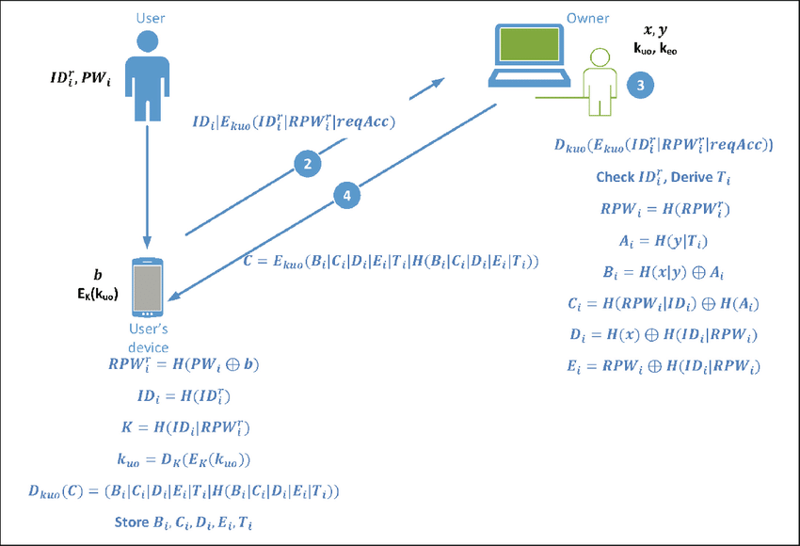
REGISTRATION PHASE
Key Components:
P UK (Public Key): Unique identifier for the public key of the vehicle or RSU.
SV (Secret Value): Confidential value associated with the entity.
Rid (Region ID): Identification of the region in which registration is taking place.
K (System Parameter): Essential parameter for the system's functioning.
V al (Communication Value): Value crucial for secure communication.
R (Random Nonce): Random value used for enhancing security.
REGISTRATION PROCESS

Slide 26
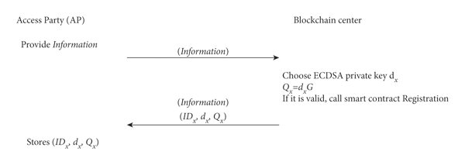
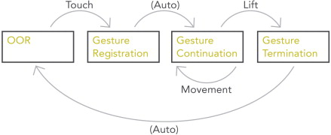
REGISTRATION PHASE
Broadcast K:
A key parameter is broadcasted to initiate the registration process, ensuring synchronization between the vehicle/RSU and the edge server.
Memory Storage:
Values such as Pi, Qi, Si, and Ti are stored in both the protected memory of the vehicle/RSU and the edge server's database. This stored information is later used for authentication during future interactions between IoV devices.
REGISTRATION PROCESS

Slide 27
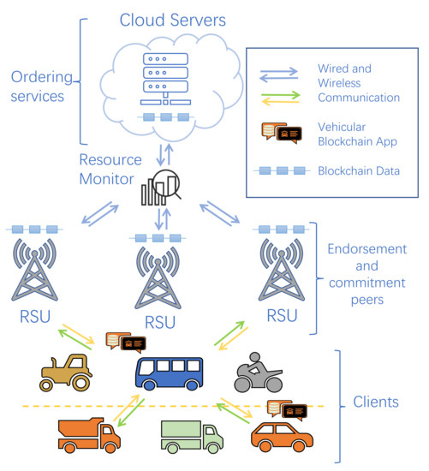
REGISTRATION PHASE
Authentication and Verification: When an IoV device receives a request or message from another IoV device in the future, the stored memory parameters (Pi, Qi, Si, Ti) are utilized for authentication and verification, ensuring the legitimacy of the communication.
The registration phase of Intelligent Chain establishes a secure foundation for IoV devices, preventing unauthorized activities and enabling authenticated communication. The use of cryptographic techniques and secure parameters enhances the overall integrity of the IoV ecosystem
REGISTRATION PROCESS

Slide 28
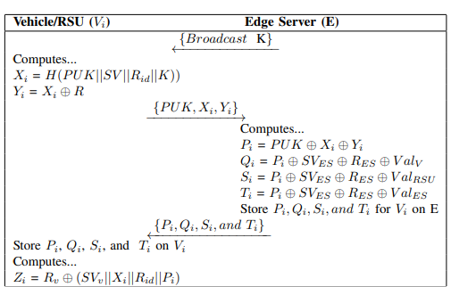
The provided diagram illustrates the intricate process of vehicle and RSU registration within the Intelligent Chain system. This registration phase is critical for ensuring the legitimacy and secure communication of IoV devices.
Computations at Vehicle/RSU and Edge Server:
Xi, Yi, Pi, Qi, Si, Ti: Computed values essential for the registration process, ensuring secure authentication and verification.
Xi Calculation: The computation of Xi involves hashing a concatenation of essential parameters, including the Public Key (PUK), Secret Value (SV), Region ID (Rid), and System Parameter (K). This cryptographic hash function (H) ensures a unique representation of the combined values.
Yi Calculation: Yi is derived by performing a bitwise XOR (⊕) operation between Xi and a random nonce R. This operation introduces an element of randomness and enhances the security of the registration process.
Vehicle/RSU Registration

Slide 29
Transmission to Edge Server : PUK, Xi, and Yi are then transmitted from the vehicle/RSU (Vi) to the edge server (E) over a secure channel. This transmission is crucial for the subsequent steps in the registration phase
Computation of Pi, Qi, Si, and Ti:
Pi Calculation:
The edge server (E) computes Pi by performing XOR operations involving PUK, Xi, and Yi. This process ensures the generation of a parameter essential for subsequent authentication.
Qi Calculation:
Qi is computed through a series of XOR operations involving Pi, Secret Value of Edge Server (SVES), Secret Value of RSU (RES), and Communication Value for Vehicle . This computation establishes secure communication parameters.
Si and Ti Calculations:
Si and Ti are computed similarly to Qi, involving XOR operations with specific parameters. These values contribute to the secure storage and subsequent authentication processes.

Slide 30
Storage of Parameters:
Storage on Edge Server (E):
The calculated Pi, Qi, Si, and Ti values are stored on the edge server (E). This stored information serves as a reference for future interactions with the vehicle/RSU.
Storage on Vehicle/RSU (Vi):
Simultaneously, the same set of Pi, Qi, Si, and Ti values are stored on the vehicle/RSU (Vi), securely preserving the registration parameters for authentication in subsequent communications.
Authentication through Zi: The final step involves the computation of Zi by performing XOR operations involving a random nonce Rv, Secret Value of the Vehicle (SVv), Xi, Rid, and Pi. This step ensures the creation of a secure parameter for authentication.
The registration phase, involves a series of cryptographic computations and secure transmissions between the vehicle/RSU and the edge server. The use of hash functions, XOR operations, and the secure storage of parameters establishes a robust foundation for subsequent secure communication within the Intelligent Chain system. This detailed analysis provides insights into the intricacies of the registration process, emphasizing its significance in ensuring the integrity and legitimacy of IoV devices.

Slide 31
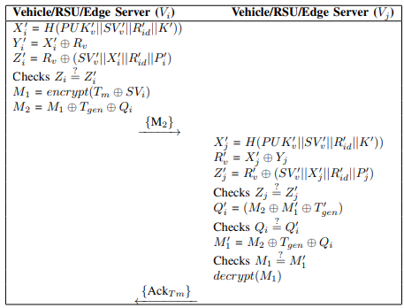
COMMUNICATION PROCESS IN INTELLIGENT CHAIN IOV SYSTEM
The communication phase in the Intelligent Chain Internet of Vehicles (IoV) system is a crucial aspect that facilitates the exchange of information between IoV devices, including vehicles (Vi), Roadside Units (RSUs), and edge servers. The communication process is designed to be secure, ensuring the authenticity of messages and preventing unauthorized access. Below is an elaboration of the steps involved in the communication mechanism:
Vehicle/ RSU/ Edge server to vehicle/ RSU/ Edge server communication

Slide 32
Below is an elaboration of the steps involved in the communication mechanism:
Self Authentication at Vehicle/RSU (Vi):
Calculation of X'ᵢ, Y'ᵢ, and Z'ᵢ:
Vi calculates cryptographic parameters X'ᵢ, Y'ᵢ, and Z'ᵢ using the hash function H and XOR operations involving various parameters such as public key (PUK), secret value (SV), region ID (Rid), and system parameter (K). These calculations ensure the integrity of the sender.
Self Authentication (Zi = Z'ᵢ):
Vi checks whether the calculated Z'ᵢ matches the expected Zi, providing a means for self-authentication. If the condition is true, Vi proceeds with the message communication process.
Vehicle/ RSU/ Edge server to vehicle/ RSU/ Edge server communication

Slide 33
COMMUNICATION PROCESS
Message Encryption and Modification:
Encrypting the Original Message (M1):
Vi encrypts the original text message (Tm) using elliptic curve cryptography with the secret value (SVv). The result is the encrypted message M1.
Message Modification (M2):
Vi modifies the encrypted message M1 by XORing it with the message generation time (Tgen) and the received value Qi from the edge server. For RSU and edge server, Si and Ti are used in this process. The modified message is denoted as M2.
Transmission and Reception:
Transmission from Vi to Vj (M2):
Vi transmits the modified message M2 to another IoV device, Vj, over the open communication channel.

Slide 34
Self Authentication at Vehicle/RSU (Vj):
Calculation of X'ⱼ, Y'ⱼ, and Z'ⱼ:
Vj calculates cryptographic parameters X'ⱼ, Y'ⱼ, and Z'ⱼ using the same process as Vi, ensuring consistency and authenticity.
Self Authentication (Zj = Z'ⱼ):
Vj checks whether the calculated Z'ⱼ matches the expected Zj for self-authentication. If the condition is true, Vj proceeds with the message communication process.
Information Retrieval and Verification:
Retrieving Q'ᵢ:
Vj retrieves Q'ᵢ from the modified message M2 through XOR and computational operations.
Comparing Q'ᵢ with Stored Qi:
Vj compares the retrieved Q'ᵢ with the value Qi stored on the edge server, verifying the integrity of the received information.

Slide 35
COMMUNICATION PROCESS
Decryption and Acknowledgment:
Decryption of M1 and Acknowledgment:
If the comparison is successful, Vj extracts the original message M1 and decrypts it using its private key. Vj then sends an acknowledgment (AckTm) back to Vi regarding the received message Tm.
The communication mechanism in the Intelligent Chain IoV system ensures secure and authenticated information exchange between vehicles, RSUs, and edge servers. The use of cryptographic calculations, encryption, and self-authentication steps enhances the overall security and reliability of the communication process within the Intelligent Chain framework.

Slide 36
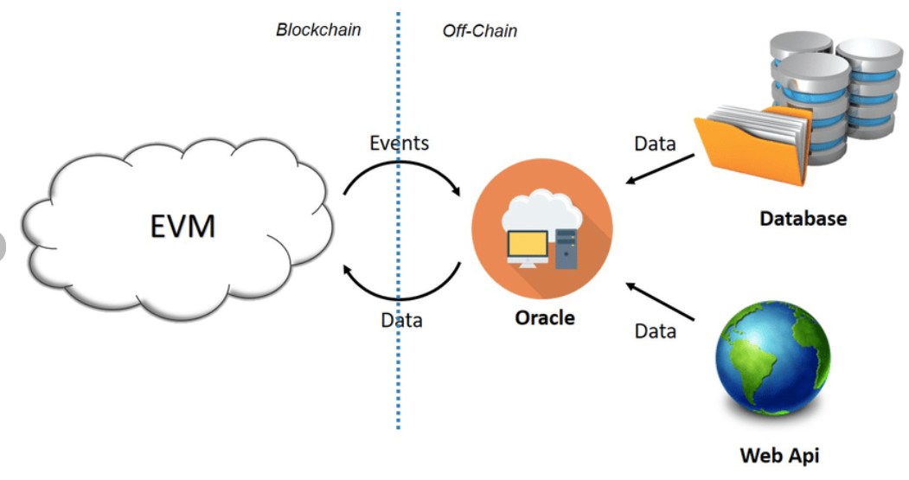
STORAGE PHASE: INTELLIGENT CHAIN’s TRAFFIC ACCIDENT INFORMATION STORAGE OPERATION’s
The storage operations of Intelligent Chain, focusing on traffic accident information, are discussed. The system employs a permissioned Practical Byzantine Fault Tolerance (PBFT) blockchain-based edge server for storing a vast volume of information. Key elements of this process include the Decentralized Trust and Consensus Process.
Lightweight Devices and Edge Servers:
Information Storage Hierarchy:
Vehicles (Vi) and Roadside Units (RSUs) store minimal information locally.
The primary storage repository is the permissioned PBFT blockchain-based edge server.
STORAGE PROCESS

Slide 37
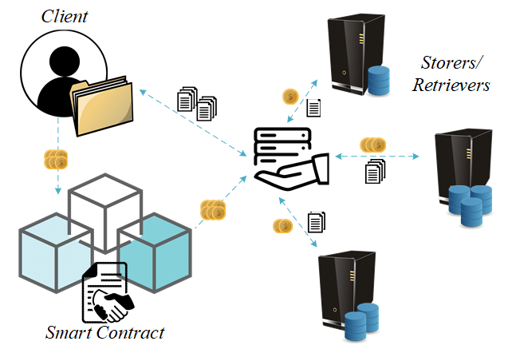
DECENTALIZED TRUST PROCESS: STORAGE PHASE
Primary and Secondary Edge Servers:
Intelligent Chain designates one edge server as primary and others as secondary in the Decentralized Trust Process.
The primary edge server transmits the block to all secondary edge servers for verification.
Trust Algorithm:
The decentralized trust algorithm assesses trust between the primary and secondary edge servers.
If the algorithm indicates "block validation is necessary," the secondary edge server performs block validation; otherwise, it does not.
STORAGE PROCESS

Slide 38
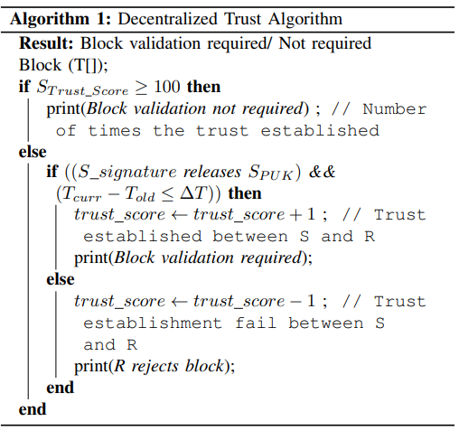
TRUST SCORE CALCULATION
Trust Score Criteria:
Trust score indicates the number of times trust has been established between the primary (S) and secondary (R) edge servers.
A score of 100 or more implies adequate trust.
Verification Time Optimization:
The trust algorithm considers the age of the block and reduces the trust score if trust is not established.
Reducing trust score shortens the total verification time at the secondary edge server.
The block is not verified if the trust score is larger than 100, optimizing the verification process.
ALGORITHM 1

Slide 39
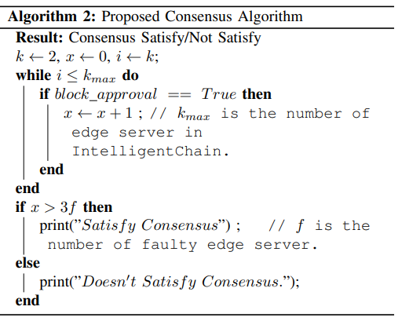
CONSENSUS PROCESS
Primary Edge Server's Consensus Algorithm:
Before adding a block to the PBFT blockchain-based edge server, the primary edge server implements a consensus algorithm.
The algorithm counts the number of secondary edge servers agreeing on the same block.
Consensus Criteria:
The consensus algorithm ensures that more than 3f (f being the number of faulty edge servers) secondary edge servers in the network agree on the same block for consensus satisfaction.
Valid blocks satisfying consensus are stored on the PBFT blockchain-based edge server.
ALGORITHM 2
Intelligent Chain's storage operations integrate the Decentralized Trust and Consensus Process to ensure secure and reliable storage of traffic accident information. The use of trust algorithms and consensus mechanisms enhances the system's robustness and optimizes the verification process for efficient information storage.

Slide 40
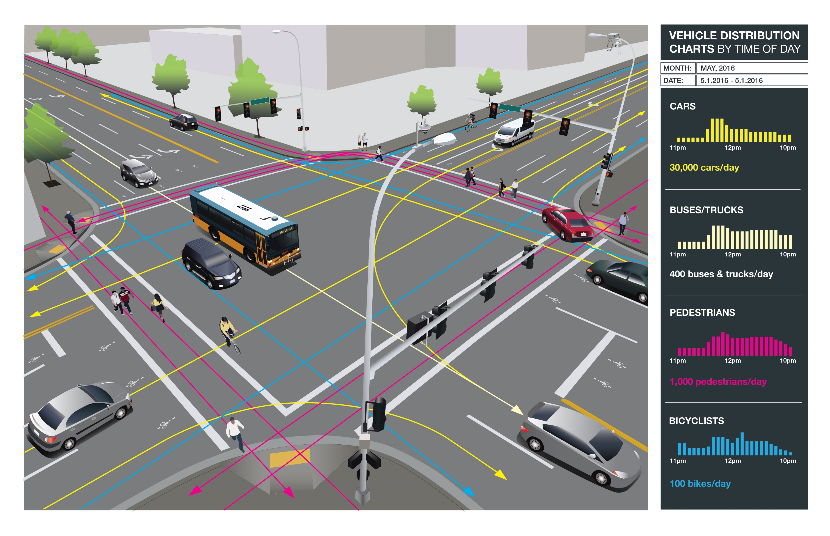
PREDICTION PHASE PROCESS: INTELLIGENT CHAIN’s TRAFFIC ACCIDENT FORECASTING WITH LSTM
The prediction phase of Intelligent Chain involves employing the Long Short-Term Memory (LSTM) network, a type of recurrent neural network (RNN), to anticipate traffic accident information. The LSTM network is particularly effective for training on large datasets and capturing sequence dependencies.
LSTM is a type of neural network designed to handle sequence dependence, making it suitable for predicting values based on historical data.
Intelligent Chain utilizes the LSTM network method, leveraging its capability to effectively learn from and adapt to extensive datasets.
PREDICTION PROCESS

Slide 41
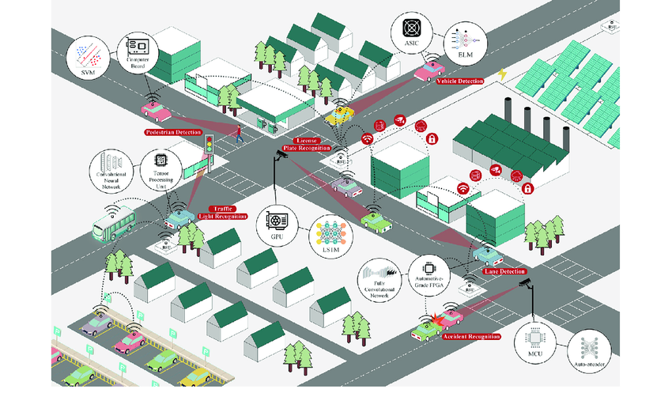
Factors Influencing Traffic Accident Prediction:
Driver behavior
Cyclist activity
Actions of other vehicle drivers
Pedestrian movements
Passenger involvement
Vehicle condition
Road condition
Weather condition
Presence of passengers
Lighting conditions
Civic body negligence
Stray animal presence
PREDICTION PROCESS

Slide 42
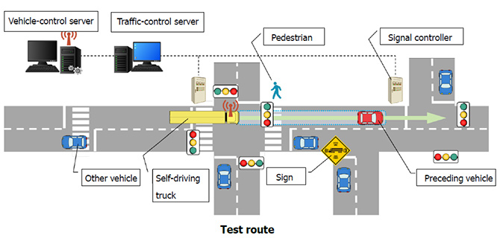
PREDICTION PHASE PROCESS
Prediction Based on Current State:
State-Dependent Prediction:
The LSTM network predicts outcomes based on the current state of the system, incorporating the diverse factors mentioned above.
User-Requested Predictions:
User Interaction:
When a driver requests traffic accident information for a specific destination area, the edge server processes the request.
Prediction Process:
The edge server utilizes the LSTM network to predict the chances of a traffic accident in the specified destination area based on the available dataset.
PREDICTION PROCESS

Slide 43
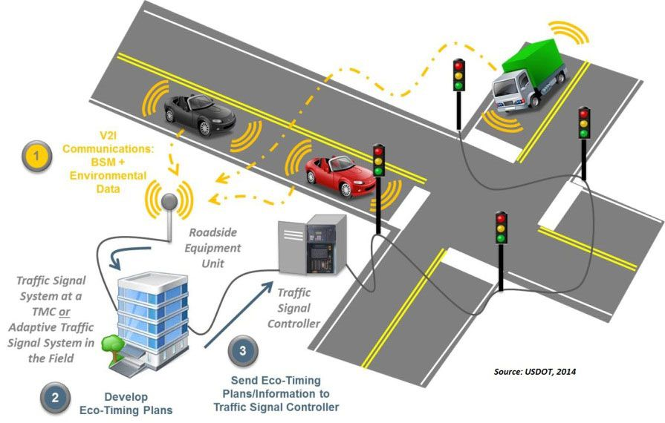
Communication with Drivers:
Communication Range Consideration:
If the destination area is not within the communication range of the edge server, it notifies the driver.
Nearest Location Details:
The edge server sends a message to the driver, requesting details of the nearest location to the specified destination.
Iterative Communication:
Communication continues iteratively until the driver receives accurate accident information for the specific destination area.
PREDICTION PROCESS
Intelligent Chain's prediction phase incorporates advanced machine learning techniques, specifically the LSTM network, to forecast traffic accident information. The system considers a broad spectrum of factors, providing a comprehensive prediction that enhances driver awareness and safety. The iterative communication process ensures that drivers receive accurate information, even for destinations beyond the immediate communication range.

Slide 44
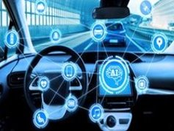
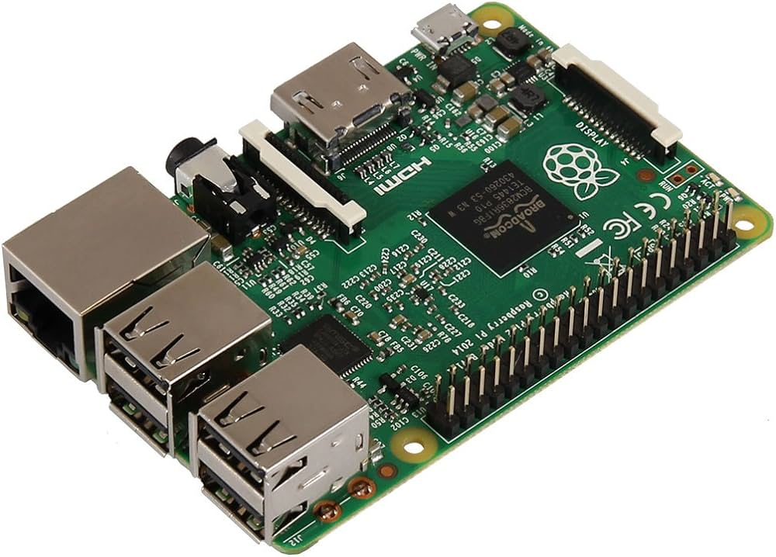
PERFORMANCE EVALUATION
Implementation Details:
Hardware Used: Intelligent Chain has been implemented and tested on two hardware platforms:
Raspberry Pi 4 (OBU and RSU)
NVIDIA Jetson Nano 2GB (Edge Server)
System Classification:
Raspberry Pi devices are designated as On-Board Units (OBU) and Roadside Units (RSU).
NVIDIA Jetson Nano serves as the Edge Server.
Software Configurations:
Spyder 4.1.5 Python IDE on Anaconda Navigator
Flask 0.12.2
Requests 2.18.4
Postman
Raspberry pi

Slide 45
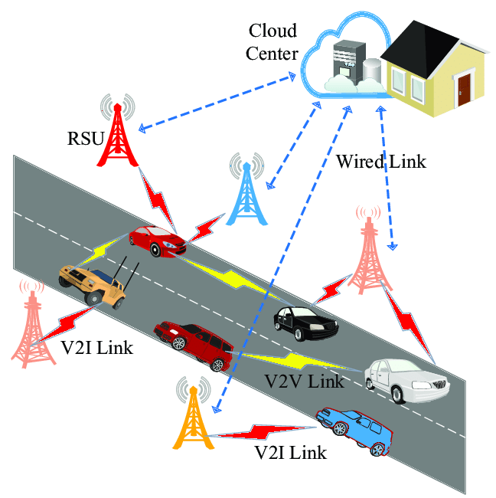
Blockchain Network:
Python programming is employed to build the blockchain network on the edge server.
Test Configuration:
Network Topology: The implementation involves creating a network with:
Four Edge Servers
Ten RSUs
Twenty Vehicles
Connectivity:
Each edge server is connected to 2-3 RSUs and several vehicles.
NVIDIA Jetson NANO
PREDICTION PROCESS

Slide 46
Performance Metrics:
Transaction Approval Delay:
The efficiency of Intelligent Chain is evaluated based on the delay in approving transactions within the network.
Accuracy of Prediction:
The accuracy of the prediction phase, particularly utilizing the LSTM network, is a critical metric for evaluating the system's performance.
Evaluation Process:
Transaction Approval Delay:
The delay in approving transactions is measured to assess the responsiveness of the Intelligent Chain network. Lower delays indicate faster transaction processing.
Accuracy of Prediction:
The accuracy of predictions made by the LSTM network is evaluated against actual occurrences, providing insights into the reliability of the Intelligent Chain's forecasting capabilities.

Slide 47
Platforms Tested:
Raspberry Pi 4:
Testing on Raspberry Pi simulates the performance of Intelligent Chain in OBU and RSU scenarios.
NVIDIA Jetson Nano 2GB:
Evaluation on NVIDIA Jetson Nano assesses the capabilities of the Intelligent Chain edge server.
The performance evaluation of Intelligent Chain on Raspberry Pi and NVIDIA Jetson Nano provides insights into its efficiency in transaction processing and the accuracy of traffic accident predictions. The results obtained from transaction approval delay and prediction accuracy metrics contribute to understanding the overall reliability and responsiveness of Intelligent Chain in the Internet of Vehicles (IoV) environment.

Slide 48
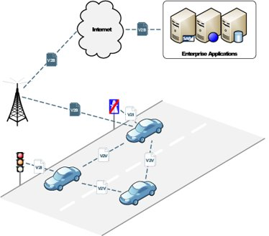
PREDICTION PHASE PROCESS : Transaction Approval Delay
Transaction approval delay refers to the time taken by Intelligent Chain to approve transactions after executing the trust algorithm.
Detailed Analysis:
Individual Operations Time:
Sign Verification: 7.184 ms
Trust Calculation: 7.184 ms
Hash Operation: 0.005 ms
Search Operation: 0.005 ms
Timestamp: 0.002 ms
Bi-linear Pair: 40.7423 ms
PREDICTION PROCESS

Slide 49
Transaction Approval Delay
Operations for Single Transaction Approval:
1 Sign Verification
1 Trust Calculation
1 Search Operation
1 Timestamp Operation
Total Time for Single Transaction Approval:
Maximum 14.375 ms (Sum of individual operation times)
ARDUINO UNO

Slide 50
Comparison with Other Schemes (Hundred Blocks, Each with Ten Transactions):
LSB (Min Execution Time): 2.8758s
LSB (Max Execution Time): 5.7516s
Li et al.: 14.372s, DSSCB: 88.6786s, BCPPA: 9.5787s, Li et al. (Decentralized): 2.10s, EAAP: 81.5146s
Sun et al. (V2V Authentication): 72s
Sun et al. (V2R Authentication): 28.746s
Intelligent Chain (Direct Case): 0.7184s
Intelligent Chain (Indirect Case): 1.4375s

Slide 51
Transaction Approval Delay
Intelligent Chain demonstrates significantly lower transaction approval delays compared to several well-known schemes.
The direct case (decentralized trust) and indirect case (decentralized trust + transaction verification) in Intelligent Chain show efficient transaction processing times.
The percentages in Intelligent Chain's case indicate the proportion of edge servers with no trust relationship between them.
Intelligent Chain excels in minimizing transaction approval delays, showcasing its efficiency in transaction processing within the Internet of Vehicles (IoV) environment. The comparison highlights Intelligent Chain's favorable performance against other schemes across various scenarios.

Slide 52
PERFORMANCE EVALUATION: Accuracy of Prediction Analysis
Dataset Source: Intelligent Chain utilizes a publicly available car-accident dataset from Kaggle.
Data Preparation:
Handling Missing Values:
Identify and handle missing values (marked as '-1' and Not a Number (NaN) in the dataset).
Data Splitting:
Split the data into training and testing datasets.
Prediction Task:
The prediction task involves predicting accident severity based on the prepared dataset.

Slide 53
Significance of Prediction:
The accuracy of accident severity prediction is crucial for recommending or not recommending a particular area for travel.
Accurate predictions aid in early establishment of emergency medical facilities in areas identified as high-risk for accidents.
The primary purpose of accurate accident severity prediction is to proactively address safety concerns, provide travel recommendations, and optimize emergency response.
By identifying accurate predictions, Intelligent Chain aims to contribute to saving lives and preventing future accidents through informed decision-making.
The accuracy of prediction in Intelligent Chain is essential for enhancing safety measures, guiding travel decisions, and facilitating timely emergency response. The utilization of real-world datasets and the focus on accident severity prediction underscore the practical impact of Intelligent Chain in the realm of Intelligent Transportation Systems.

Slide 54
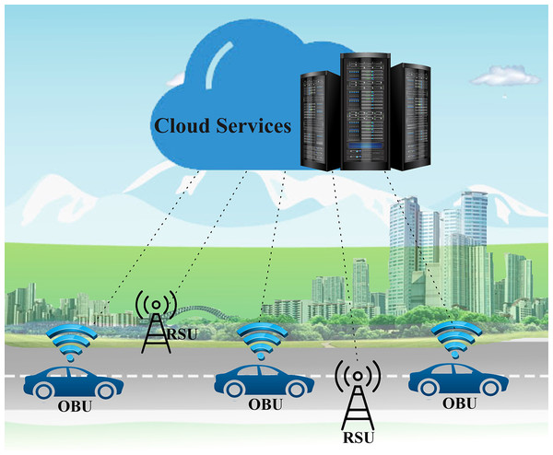
POTENTIAL OF BLOCK CHAIN & ML IN IOV
Enhanced Data Trading:
Blockchain facilitates secure and transparent data transactions.
Improved Traffic Predictions:
Integration of machine learning enables advanced predictive analytics.
Increased Security:
Blockchain's immutable ledger enhances data integrity and security.
INTERNET OF VEHICLES (IOV)

Slide 55
CHALLENGES
Complex Access Controls:
Balancing accessibility with security is a nuanced challenge.
Implementing fine-grained access controls to ensure data privacy while
Enabling necessary communication.
Computational Hurdles: Resource-intensive cryptographic operations in blockchain may pose computational challenges.
Privacy Concerns:
Preserving user privacy amidst extensive data sharing is a critical concern.
Implementation of privacy-preserving techniques, such as secure multiparty computation.

Slide 56
CONCLUSION
Intelligent Chain is a comprehensive system that leverages blockchain technology, machine learning (ML), and the Internet of Vehicles (IoV) for storing, predicting, and securing traffic accident information.
The architecture employs a Practical Byzantine Fault Tolerance (PBFT) blockchain-based system supported by decentralized trust and consensus mechanisms. This ensures efficient and secure storage of traffic accident information.
IoV device registration and secure communication protocols contribute to the overall security of Intelligent Chain. The registration process establishes legitimacy, preventing undesired activities.
Intelligent Chain utilizes recurrent neural networks with Long Short-Term Memory (LSTM) for predicting traffic accident information at specific locations. This predictive capability enhances proactive decision-making.
Results indicate that Intelligent Chain surpasses existing protocols in terms of transaction approval speed and prediction accuracy. The system demonstrates efficiency and effectiveness in handling traffic accident data.

Slide 57
FUTURE WORK
5G-Based Communication: This enhancement aims to withstand future attacks, enhance communication speed, and overall improve performance outcomes.
Hyperledger Fabric Implementation: This implementation focuses on ensuring data immutability, tamper-proof distributed storage, and increased resilience against potential threats.
Continuous Performance Optimization: This includes refining algorithms, improving hardware configurations, and exploring advanced ML techniques.
Extended Security Measures: This includes exploring encryption advancements, intrusion detection systems, and anomaly detection mechanisms.
Integration with Emerging Technologies: such as edge computing, quantum computing, and advanced encryption methodologies. This ensures that Intelligent Chain remains at the forefront of technological advancements

Slide 58
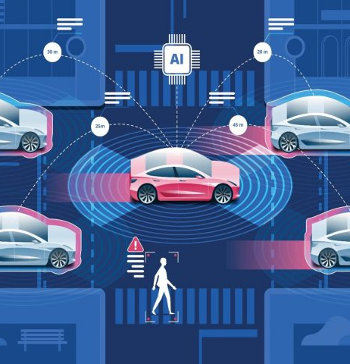
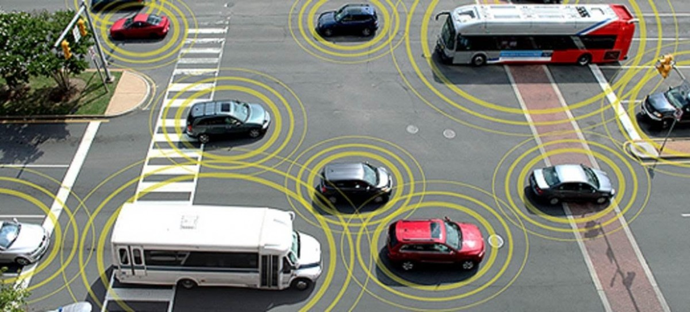
CONCLUSION STATEMENT
Intelligent Chain, with its current capabilities and future development plans, stands as a promising solution in the realm of Intelligent Transportation Systems. Its fusion of blockchain, machine learning, and secure communication protocols paves the way for safer, more efficient traffic management. Through continuous innovation and adaptation to evolving technologies, Intelligent Chain aims to contribute significantly to the future of connected and intelligent transportation.

Slide 59
REFERENCES
Main Paper:
Kumar, A., & Das, D. (2022, June). Intelligent Chain: Blockchain and Machine Learning based Intelligent Security Application for Internet of Vehicles (IoV). 2022 IEEE 95th Vehicular Technology Conference: (VTC2022-Spring). https://doi.org/10.1109/vtc2022-spring54318.2022.9860946
Reviewed Papers:
R. Li, T. Song, B. Mei, H. Li, X. Cheng and L. Sun, "Blockchain for Large-Scale Internet of Things Data Storage and Protection," in IEEE Transactions on Services Computing, vol. 12, no. 5, pp. 762-771, 1 Sept.-Oct. 2019, doi: 10.1109/TSC.2018.2853167.
C. Lin, D. He, X. Huang, N. Kumar and R. Choo ”BCPPA: A Blockchain-Based Conditional Privacy-Preserving Authentication Protocol for Vehicular Ad Hoc Networks,” IEEE Transactions on Intelligent Transportation Systems, VOL.8, IEEE 2020, Digital Object Identifier 10.1109/Access.2020.2998012.

Slide 60
Thank You!!

