Slide 2
ABSTRACT
In recent years, smartwatches have gained widespread popularity, with a continuous stream of apps designed to enhance convenience and promote user health.
The latest smartwatches are designed to operate independently of paired smartphones, necessitating the development of secure user authentication methods directly on the smartwatches.
Current authentication methods such as PINs, patterns, and even biometric information are criticized for their inconvenience and lack of high security, prompting the need for alternative approaches.
The proposed authentication method is based on a challenge-response scheme leveraging the unique interaction of vibrations with the physical structure of the human body.
This challenge involves random sequences of built-in vibration types in smartwatches.
This method utilizes default gyroscope and accelerometer sensors in smartwatches for measuring responses to vibrations.
It is claimed to be the first working model for commercial smartwatches with low specifications, and an equal error rate (EER) of 0.037 for user authentication.

Slide 3
1 INTRODUCTION
The need for a new type of biometrics-based authentication method for smartwatches, one that utilizes a challenge-response structure.
In this proposed authentication method, a verifier presents a challenge in the form of unpredictable stimuli, and the prover responds with a bodily reaction to the stimuli without revealing the secret used to generate the response.
The authentication method measures and analyzes the user's response to random vibrations from a smartwatch, taking advantage of the fact that vibrations interact differently with each person's unique body structure.
This approach is unique because it analyzes measurements from default sensors in a smartwatch with a low sampling frequency, and it generates vibrations using the default sensor of the smartwatch

Slide 4
1 INTRODUCTION
The method can independently authenticate smartwatch users without the need for a paired smartphone.
No Additional Devices required: It utilizes the built-in sensors of smartwatches, eliminating the need for additional devices, making it easy tat a low vibration frequency, making it suitable for current smartwatches with limited sensor capabilities.
User-Friendly Authentication: Users don't need to interact directly with the authentication process. Authentication occurs seamlessly when vibrations are generated by the smartwatch, and it has the potential for continuous authentication.

Slide 5
2 RELATED WORK
2.1 Biometrics-based Authentication
User authentication typically relies on three factors: knowledge, possession, and inherence. Biometric information falls under the inherence category, making it unique to each person.
Biometrics-based methods offer convenience, as they eliminate the risk of forgetting or losing authentication information, such as passwords or tokens.
Smartwatch manufacturers consider incorporating biometric information like fingerprints, faces or veins into their devices. However, this may increase the cost of smartwatches due to additional sensor requirements.
Static biometric authentication methods can be vulnerable to fake biometrics, such as 3D-printed fingerprints or wax hands showing veins.
Current smartwatches have the capability to measure ECG, voice, and user gestures using default sensors.

Slide 6
2 Contd..
2.1 Biometrics-based Authentication
Despite the availability of these default sensors, user authentication using ECG, voice, and gesture-based methods may still lack usability during the authentication process.
Examples include voice-based authentication, where users must speak into the smartwatch, and ECG-based authentication, which requires users to place their finger on the sensor, but can be vulnerable.
Gesture-based methods, such as Air sign, require users to perform specific gestures, which may have low usability.
Gait-based methods for smartwatch user authentication, where users only need to walk normally, offer usability advantages but may suffer from a high error rate, potentially frustrating users when authentication fails.

Slide 7
2 RELATED WORK
2.2 Analysis of Response to Vibrations
Other methods similar to the proposed one have also analyzed user responses to vibrations for authentication which includes Vibwrite, Velody and CNN-based method.
VibWrite: a two-factor authentication method where users draw a PIN or pattern on a vibrating panel. The response to vibrations depends on finger structure, and MFCC are used for feature extraction.
VELODY: a challenge-response structure using MFCC for feature extraction. VELODY generates vibrations at random frequencies and authenticates users based on their responses when placing their palm on the vibrating panel.
CNN-Based Method: Convolutional neural network (CNN) to analyze raw signals from vibration responses, eliminating the need for feature extraction.
Challenges for Smartwatches: Existing vibration-based authentication methods were designed for high-frequency vibrations and high sampling frequencies, making them unsuitable for modern smartwatches with default sensors.
Sensor Use in Proposed Method: The proposed method utilizes the built-in gyroscope and accelerometer sensors in smartwatches, which have a limited sampling frequency of 100Hz, to measure vibration responses.

Slide 8
3 Attack Model
The attacker aims to bypass authentication on a target smartwatch to access sensitive information and make unauthorized payments.
They know how the smartwatch authenticates its user and have information about the user's physical attributes (height, weight, body fat rate, skeletal muscle rate).
The attacker can physically access and steal the smartwatch but cannot modify its software or data.
They can trigger the smartwatch's authentication process through slight physical contact when it's locked. The device locks when not worn and requires re-authentication when put on again.
The attacker can obtain the target user's previous response signals to vibrations.
They cannot physically damage the smartwatch sensors or interfere with the initial vibration enrollment process.
There are two attack strategies: not-in-wear attacks (bypassing authentication when the smartwatch is not worn) and impersonation attacks (pretending to be the user).
Not-in-Wear Attacks: These involve leaving the smartwatch stationary and initiating the authentication process with a nudge.
Impersonation Attacks: These can be either by simulating the user’s response to vibrations or by having an assist with similar physical traits wear the smartwatch to pass authentication.

Slide 9
4 Challenge-Response (OUR) Method
A challenge-response system for smartwatch user authentication that operates independently without additional devices, using a unique method based on random vibration types.
Traditional static biometric authentication methods are susceptible to presentation attacks with fake biometrics, highlighting the need for a more dynamic method like the proposed vibration-based authentication.
Initially, users undergo a vibration enrollment process where their response to various vibration types is recorded using the smartwatch's built-in gyroscope and accelerometer sensors. This data is used to create a personalized verification model for each vibration type.
Each time authentication is requested, the smartwatch generates a vibration, and the user’s response is compared against the verification model to confirm identity.
This method offers a user-friendly and secure authentication process, leveraging the inherent capabilities of the smartwatch without relying on static biometric data, thus reducing the risk of biometric spoofing.

Slide 10
4.1 Vibration Generation and Measurement
The smartwatch has N different types of vibrations available for use.
For user authentication, five vibrations are randomly selected from these N types, with the possibility of choosing the same type more than once. This random sequence forms the "vibration challenge."
The smartwatch saves this sequence of selected vibration types for reference during the authentication process.
User Interaction: The smartwatch vibrates in the order of the vibration challenge, and the user's response to these vibrations is detected.
Response Analysis: The smartwatch uses its built-in gyroscope and accelerometer sensors to measure the user's response to the vibration challenge, known as the "vibration response." This response is then used to verify the user's identity.

Slide 11
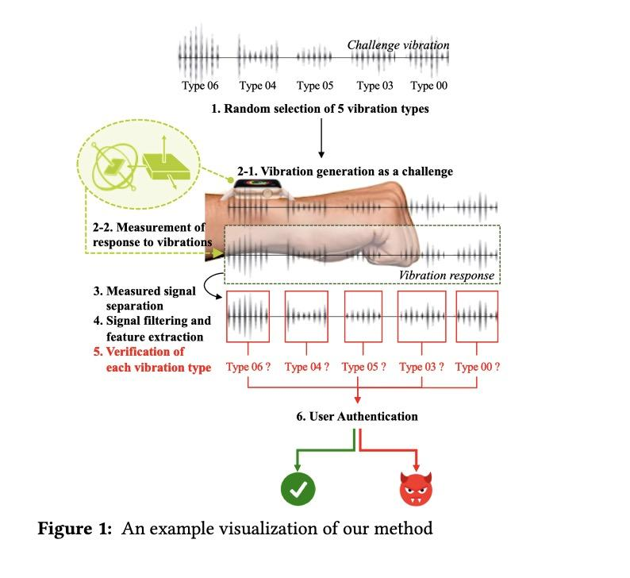
4.1 Contd..

Slide 12
4.2 Feature Extraction
Noise caused by user movements is filtered out from the response signals using a high pass filter set at 20Hz, as human movement typically falls within the 0Hz to 20Hz frequency range.
After filtering, various features are extracted from each response signal to accurately identify the user.
Each vibration response consists of six signals, three each from the gyroscope and accelerometer sensors, leading to a total of 756 features per response.
Low Sampling Frequency Adaptation: The method is designed to work effectively even with a low sampling frequency of 100Hz, typical of smartwatches.
Feature Evaluation: The effectiveness of these features is evaluated by observing how they cluster in scatter plots, indicating their association with individual participants.
Comparison with Other Methods: The method's feature scatter is compared to that of existing vibration-based methods using statistical features and MFCC at different sampling frequencies.

Slide 13
4.3 User Verification
Each response signal in the vibration response is verified through a model to confirm if it's from a legitimate user
For successful authentication, all five response signals must be validated as legitimate.
Authentication fails instantly if even one response signal is identified as invalid.
Multiple Verification Models: There is a total of N verification models for user authentication, corresponding to the number of vibration types N.
One-Class Classification: In smartwatch user authentication, a one-class classifier is used, which is designed to differentiate a valid user from invalid users based solely on valid response signals.
Challenge with Invalid Signals: There's a challenge in detecting invalid response signals during user authentication, as the one-class classifier is trained only with valid signals.
Combined Verification Model: To address this issue and enhance performance, a verification model combining both a multi-class classifier and a binary classifier is developed for more effective user authentication.

Slide 14
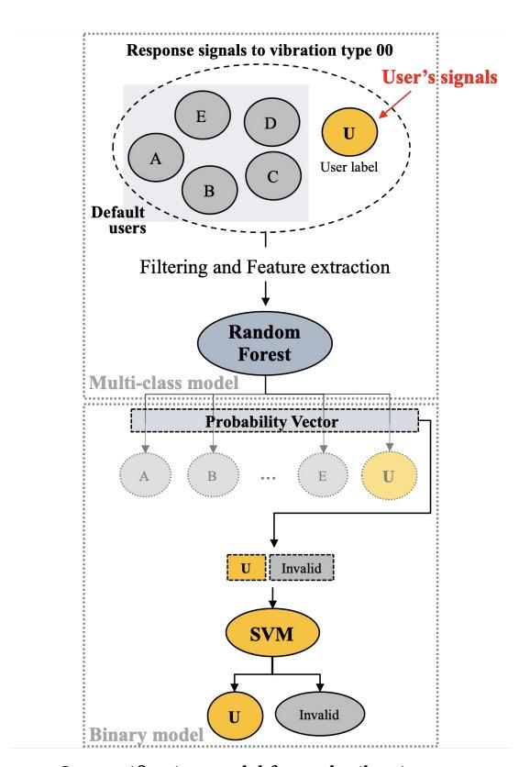
4.3 Contd…
The multi-class model classifies response signals from both default users and new users, treating each as separate classes within the model.
When response signals are input into the multi-class model, it calculates a probability vector that indicates the likelihood of the signal belonging to each user class.
The binary model's task is to ultimately determine if a response signal is valid or invalid for authentication purposes.
Probability vectors generated by the multi-class model are labeled as 'valid' for the new user's signals and 'invalid' for signals from default users, and these labels are used by the binary model for final classification.

Slide 15
5 EXPERIMENTAL SETUP
Device Used: Apple Watch Series 3 with standard bands in small and medium sizes, featuring nine default vibration types.
Vibration Selection: Eight out of nine vibrations types are used for the method, excluding the 'Click' type due to its low signal strength.
Software Tools: Custom application created using XCode for Apple devices, and Python for signal processing and model construction.
Sensor Capabilities: Built-in gyroscope and accelerometer sensors in the Apple Watch, with a maximum sampling frequency of 100Hz.
20 students from a graduate school, aged 20-30, participated, providing informed consent and receiving compensation.
Signal Measurement Process: 150 response signals per vibration type per participant were measured, with the last 30 signals used for testing and the rest for training and tuning the verification model.
Second Measurement Session: A follow-up session was conducted seven days later to measure additional 30 response signals per vibration type for each participant.

Slide 16
5 Contd
Adjustment for Wrist Movement: Smartwatches were randomly shifted on participants' wrists by 1cm to simulate real-world wearing conditions.
Participants varied in height, weight, body fat rates (BFR), skeletal muscle rates (SMR), age, and sex.
Five participants were set as default users; the remaining 15 were new users.
Verification Model Construction: Models for each vibration type were generated using response signals from both default and new users.
A total of 756 features were extracted from each response signal.
For each new user, the shape of data to train the multi-class model for each vibration type was 720 samples by 756 features.
Hyper-parameters like kernel type and regularization parameters were finely tuned using cross-validation and gridsearch.
Involved adjusting various parameters like the number of trees, depth, kernel types, and regularization parameters.
Continuous evaluation and hyper-parameter tuning were key to optimizing the performance of the verification models.

Slide 17
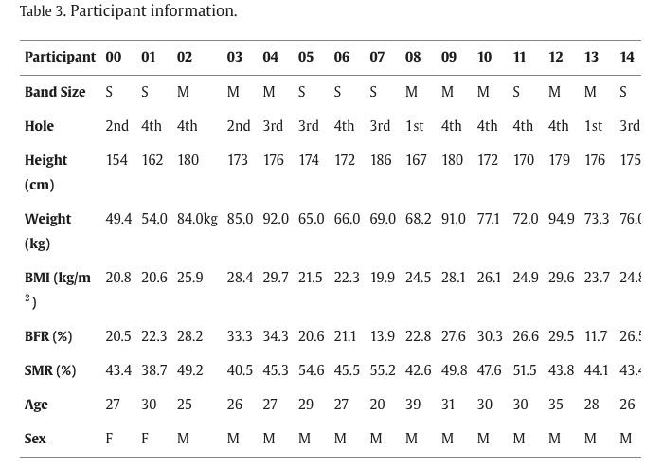
5 Demographic info students

Slide 18
6 EVALUATION
6.1 Performance Metrics
Evaluation Metric: The evaluation of the proposed method uses the Equal Error Rate (EER) as a performance metric.
EER Definition: The EER occurs when the False Negative Rate (FNR) and False Positive Rate (FPR) are equal.
FNR and FPR Definitions:
FNR (False Negative Rate): Measures the rate of false rejections and is used to evaluate usability. It's equal to 1 minus the True Positive Rate (TPR).
FPR (False Positive Rate): Measures the rate of false acceptances and is used to evaluate security.
User Authentication Success: In the proposed method, user authentication succeeds only if all five response signals constituting the vibration response signal are verified as valid by the verification models.
Overall TPR: The success rate of user authentication is determined by the overall True Positive Rate (TPR), which is the product of all TPRs in the verification models corresponding to the five selected vibration types.

Slide 19
6 EVALUATION
6.1 Performance Metrics
User Authentication Failure: If any of the five response signals is verified as invalid, user authentication immediately fails, and verification for the remaining signals is not performed.
Overall FNR: The failure rate of user authentication is calculated as 1 minus the overall TPR, and it is referred to as the overall False Negative Rate (FNR).
Success Rate of Attack: The success rate of an attack is determined by the overall False Positive Rate (FPR), which is the product of all FPRs in the verification models corresponding to the five selected vibration types.
Overall EER Calculation: The overall Equal Error Rate (EER) of the method is calculated using the overall False Negative Rate (FNR) and overall False Positive Rate (FPR).

Slide 20
6 EVALUATION
6.2 Distinguishability
Random Forest Classification: The study initially employed a random forest classification algorithm to determine if the features could differentiate between various vibration types and participants.
Vibration Type Differentiation: The features were tested for their ability to distinguish between eight different types of vibrations on a single participant. Results showed that the features achieved a minimum accuracy rate of 0.96 and a maximum rate of 1.00, indicating successful differentiation of vibration types with low error rates.
Participant Differentiation: Another test involved generating a fixed vibration type on different participants and measuring their response signals. The features were then used to distinguish between participants based on these response signals. The results showed a minimum accuracy rate of 0.95 and a maximum rate of 1.00 along the diagonal components, indicating that the features could successfully differentiate between participants when a fixed vibration type was used.
Successful Feature Performance: Overall, the study demonstrated that the extracted features were effective in distinguishing both different vibration types and different participants with high accuracy.
Confusion Matrix: The paper mentions the use of a confusion matrix to evaluate the classification results, providing a detailed breakdown of the accuracy rates for different scenarios.

Slide 21
6 EVALUATION
6.2 Distinguishability
Probability Vectors: The method utilizes probability vectors derived from response signals as intermediate values for the binary model.
Classification Test: To assess the effectiveness of probability vectors, a random forest classification algorithm was employed.
Vibration Type Differentiation: The results showed that probability vectors could effectively distinguish between eight different vibration types with a minimum accuracy rate of 0.96 and a maximum rate of 1.00, indicating low error rates.
Participant Differentiation: Similarly, the analysis demonstrated that probability vectors could differentiate between different participants when a fixed vibration type was given, achieving a minimum accuracy rate of 0.93 and a maximum rate of 1.00.
Effective Discrimination: In summary, probability vectors were found to be successful in distinguishing both different vibration types and different participants with high accuracy, as reflected in the confusion matrices provided.

Slide 22
6 EVALUATION
6.3 User Authentication
Response Signal Measurement: Vibrations were generated, and response signals were measured. A verification model was created for each vibration type.
FNR and FPR Analysis: The False Negative Rate (FNR) and False Positive Rate (FPR) were calculated for each verification model based on responses from participants (default users 00 to 04).
Stability Test: Response signals were also measured on different days to assess the stability of the method's features. FNR and FPR rates were compared between the first day and seven days later.
Threshold Determination: The method's overall FNR and overall FPR depend on a threshold value. The threshold was determined to be 0.8630, with corresponding FNR rates of 0.0137 for the first measurement and 0.0499 for the second measurement, when five default users were considered as participants
Shift of Smartwatch Location: User authentication performance was evaluated when the smartwatch's position shifted slightly on the wrist. Even with such shifts, the overall False Negative Rate (FNR) remained low, indicating the method's robustness.
Position and Direction of User's Hand: The method was tested for different hand and finger positions, wrist directions, and even when the hand was in a pocket. It demonstrated low overall FNRs regardless of these factors.

Slide 23
6 EVALUATION
6.3 User Authentication
Arbitrary Default Users: Performance was assessed when default users were randomly selected from participants. The method showed low overall Equal Error Rate (EER) for first-measured signals, indicating that random selection of default users did not affect the method.
Number of Default Users: User authentication performance was studied by varying the number of default users. The method exhibited lower EERs as the number of default users increased, maintaining competitive error rates.
Training Dataset Size: The size of the training dataset was examined as a trade-off between usability and accuracy. It was found that 90 response signals per vibration type were sufficient for generating verification models with low FNRs.
On the Prototype: An evaluation was conducted using a prototype with different vibration types and sensors. Features extracted from response signals could distinguish between vibration types with low error rates, and the method achieved an overall EER of 0.0296 with the prototype.

Slide 24
6 EVALUATION
6.4 Not-in-Wear Attack
Not-in-Wear Attack: The study examined a not-in-wear attack scenario where an attacker doesn't try to bypass user authentication but instead focuses on placing the smartwatch correctly and touching it lightly to restart the authentication process.
Response Signal Conditions: Response signals were measured under three conditions: i) in the air (no contact with any object), ii) on a solid wooden desk, and iii) on medium-density fiberboard (MDF).
success rate of not-in-wear attacks was assessed based on the measured response signals. The highest success rate of not-in-wear attacks, 0.0268, was achieved when the smartwatch was on MDF. This success rate could be reduced by requiring authentication only when the smartwatch is worn.

Slide 25
6 EVALUATION
6.4 Not-in-Wear Attack
Vulnerability of Participant 15: The 15 showed vulnerability to not-in-wear attacks targeting specific vibration types (01, 02, 03, 06, 07). The success rate for not-in-wear attacks on this participant was notably higher at 0.527.
Biometric Feature Recognition (BFR): The analysis of participant 15's BFR revealed that their physical wrist structure was not well-reflected in the vibration response signals. Their BFR was higher than that of other participants, indicating a lower chance of successful recognition based on their wrist structure.
Solution for Participant 15: To address the vulnerability of participant 15, a user authentication system could be constructed by randomly selecting seven vibration types from a subset of vibration types 00, 04, and 05, allowing for reduplication.

Slide 26
6 EVALUATION
6.4 Impersonation Attack
Impersonation Attack: The research conducted an impersonation attack to assess the method's resistance to attackers attempting to bypass authentication by using participants with similar physical characteristics to the target user.
Participant Pairs with Similar Physical Indicators: Three pairs of participants were selected for the evaluation, each with similar physical indicators. These indicators included height, weight, body fat rate (BFR), and skeletal muscle rate (SMR).
Table of Overall FPRs: Based on a predetermined threshold of 0.8630, the study presents a table (Table 5) illustrating the overall False Positive Rates (FPRs) for impersonation attacks. These FPRs are shown in relation to the similarity in physical indicators, such as height, weight, BFR, and SMR.

Slide 27
6 EVALUATION
6.4 Impersonation Attack
Low FPRs for Similar Physical Characteristics: The results indicate that the method maintains low overall FPRs even when attackers and target users share similar physical characteristics. On average, FPRs remain impressively low, suggesting the method's effectiveness in distinguishing between valid and invalid attempts at impersonation.
Specific Example: Notably, even in a specific example where two participants had similar BFRs and SMRs, the overall FPR remained low at 0.00047. This underscores the method's difficulty for attackers attempting to exploit similarities in physical composition to impersonate a target user.

Slide 28
6 EVALUATION
6.5 . Memory Overhead
The size of a verification model for each vibration type is approximately 10.88MB, including the multi-class model and binary model.Accordingly, the total size of our method is approximately 87.04MB.This memory size is similar to or smaller than applications normallyinstalled on smartwatches. For example, Apple Watch application Nike Run Club is approximately 181.5MB, which is larger than our method. Therefore, our method does not have high memory overhead and can be applied to current smartwatches.

Slide 29
7 DISCUSSION
7.1 Measurement Time for Model Generation
Measurement Time for Model Generation: The time required for measuring response signals is a critical factor affecting the duration of verification model generation in the method.
Efficient Measurement: It was demonstrated in the evaluation that approximately nine minutes are needed to efficiently measure response signals for each vibration type.
Smartwatch Band Changes: Users may need to change their smartwatch bands, similar to setting up a new smartwatch. Different types of smartwatch bands can affect the absorption, reflection, and propagation of vibrations differently.
Incremental Measurement: The method does not require all response signals to be measured at once. Instead, it can be spread out over time. This approach allows users to collect training data for model generation in a more manageable and convenient manner.
Data from ExtraSensory Dataset: Analysis of the ExtraSensory Dataset, which provides smartwatch accelerometer signals from 56 individuals during daily activities, revealed that people often have periods of around two minutes with no movement, making up approximately 12% of their total time.
User Expectation: Users can expect to dedicate a reasonable amount of time to collect training data for model generation, and this process can be spread out over a few hours to avoid continuous nine-minute measurement sessions.

Slide 30
7 DISCUSSION
7.2 Simulation Attack
Simulation Attacks: The evaluation considered simulation attacks against the method, where an attacker attempts to obtain previous vibration response signals of a target user and uses them to spoof the gyroscope and accelerometer sensors by injecting acoustic signals.
Difficulty in Acoustic Signal Injection: Prior research has shown that it is challenging for attackers to inject acoustic signals and precisely control all three axes of the gyroscope and accelerometer sensors to their desired values. Different sensors have varying vulnerabilities, and the resonant frequencies affecting each axis are different.
Robustness of the Method: Despite the difficulty of performing sophisticated attacks involving acoustic signal injection, the method is robust even against strong attackers who are capable of such attacks. This robustness is due to the method's authentication process, which involves five vibration types, each randomly selected from eight types, making it highly improbable for the attacker to predict all five vibration types.
Low Probability of Attack Success: The probability of a strong attacker successfully predicting all five vibration types is exceptionally low, estimated at 0.003%. This extremely low probability demonstrates the method's resilience against such attacks.

Slide 31
7 DISCUSSION
7.2 User Authentication on Moving Hands
Authentication Timing: The method for user authentication proposed in the paper does not require authentication during every instance of daily movements while wearing a smartwatch, such as walking or shaking hands. Instead, it is designed to be performed when users initially put the smartwatch on their wrist. Successful authentication at this point allows users to engage in various activities without the need for additional authentication, unless specific static activities, like processing a payment, are involved. The method's effectiveness is not significantly impacted by a user's movement.

Slide 32
7 DISCUSSION
7.2 Other Types of Smartwatches
Smartwatch Compatibility: The method is designed for user authentication using vibrations generated by commercial smartwatches. While the evaluations were conducted on the Apple Watch, the method does not rely on exclusive Apple Watch functions or require physical modification. It is expected to work on various smartwatch models from different companies that commonly have vibration sensors, gyroscope sensors, and accelerometer sensors with comparable specifications.
Compatibility Across Smartwatch Models: Smartwatches from different manufacturers typically include sensors such as vibration sensors, gyroscopes, and accelerometers. The method's evaluation used a prototype, indicating its potential applicability to smartwatches regardless of the specific model.

Slide 33
7 DISCUSSION
7.2 Other Types of Smartwatches
Physical Indicator Impersonation: The method was tested against impersonation attacks involving attackers with similar physical indicators (e.g., weight, height, body fat rate, skeletal muscle rate) as the target user. The results demonstrated the method's ability to distinguish between valid and invalid authentication attempts, even when attackers share multiple physical indicators with the target user.

Slide 34
8 CONCLUSION
Vibration-Based Authentication: The paper introduces a novel user authentication method for smartwatches based on vibrations. It adopts a challenge-response structure that operates without requiring user interaction.
Evaluation on Apple Watch: The method was thoroughly evaluated using the Apple Watch Series 3 and utilized default vibration patterns available on the device. No additional hardware or devices were needed for user authentication.
Impressive Performance: The method achieved a remarkably low Equal Error Rate (EER) of 0.0137 for initial measurements, showcasing its effectiveness in accurately authenticating users.
Robust Against Attacks: The proposed method demonstrated robustness against various attack scenarios, including not-in-wear attacks and impersonation attacks, particularly when attackers share physical characteristics with the target users.
Broad Applicability: The research suggests that this authentication approach is not limited to a specific smartwatch model but can be applied to a wide range of smartwatches available in the market.

Slide 35
8 References
[1] Apple iphone 5s fingerprint sensor hacked. https://www.cbc.ca/news/techno logy/apple-iphone-5s-fingerprint-sensor-hacked-1.1864995 [Online; accessed 2020-07-30].
[2] Apple watch series 3. https://www.apple.com/kr/apple-watch-series-3/ [Online; accessed 2020-07-30].
[3] Apple’s iphone faceID hacked in less than 120 seconds. https://www.forbes.com/ sites/daveywinder/2019/08/10/apples-iphone-faceid-hacked-in-less-tha n-120-seconds/#3d55683b21bc [Online; accessed 2020-07-30].
[5] Body fat rate. https://en.wikipedia.org/wiki/Body_fat_percentage [Online; accessed 2021-03-09].
[41] Davrondzhon Gafurov, Einar Snekkenes, and Patrick Bours. Spoof attacks on gait authentication system. IEEE Transactions on Information Forensics and Security, 2(3):491–502, 2007.
[48] Luka Knez, Janko Slavič, and Miha Boltežar. A sequential approach to the biodynamic modeling of a human finger. Shock and Vibration, 2017, 2017.
[67] Yue Zhao, Zhongtian Qiu, Yiqing Yang, Weiwei Li, and Mingming Fan. An empirical study of touch-based authentication methods on smartwatches. In Proceedings of the 2017 ACM International Symposium on Wearable Computers, pages 122–125, 2017

