Slide 1
CSE 707:
Solutions to Security & Privacy Issues in Mobile Social Networking
Paper by: Aaron Beach, Mike Gartrell, and Richard Han
Presented by: Jackey Wang, Nawar Khouri

Slide 2

Intro
Social media is becoming more and more common. However, these app were not created with security in mind. Social media apps require the user to expose their location and preferences in order to function and compromise the user’s privacy and security.

Slide 3

Focus
We will be focusing on security and privacy in location-area mobile social network (LAMSN) systems.
Many of these apps rely on people’s personal data such as location, relationships, preferences to function. These have consequences that are yet to be explored.
Will be focusing on WhozThat, and Serendipity which relies on users to be physically close to each other.
These systems have some major security and privacy concerns

Slide 4
Whozthat & Serendipity
WhozThat
Serendipity
A social media app that allows users/smart devices to see other people’s interests, relationships (By looking at their social media profiles), over Wi-Fi and Bluetooth [1]
You walk into a bar, WhozThat informs you that a certain person also enjoys football
A smart speaker sees your music preferences and changes its playlist accordingly
Uses Bluetooth to connect people that’re in the same location. Is able to matchmake people based on preferences (Also based on their existing social media profiles) to find people that are similar [2]
Using proximity to mobile devices, can infer the nature of people’s relationships
Able to differentiate people’s coworkers, and personal friends using time of day and mobile device location

Slide 5

Concerns
Three classes of privacy and security concerns
  Direct Anonymity Issues
  Indirect or K-anonymity Issues
  Eavesdropping, Spoofing, Replay and Wormhole
Notes:
3 privacy and security concerns are presented in the paper: direct anonymity, indirect or k-anonymity, and eavesdropping, spoofing, replay, and wormhole. The last one are grouped together since they basically fall under the same umbrella. We’ll see how later. These issues have been examined before in other context; however, we will talk about how they present their unique challenges to the context of mobile social network systems.

Slide 6
Identity Server
The identity server is a design for a system that provides solutions to the three classes of privacy and security problems.
The identity servers utilizes a novel approach using already established privacy and security technologies within the context of mobile social network systems.
More about the identity server later.

Slide 7

What Made it Possible?
There are four pillars what allowed mobile social networking to burgeon
Mobile Computing
  Majorly contributed to by apple with their Iphone and Ipod sales back in ‘09.
Social Networks
  It is reported by Facebook.com that the site has over 200 million active users, of which 100 million log on everyday.
Existing Mobile Social Network Applications
  Serendipity and WhozThat enabled context-aware applications by leveraging social network information from existing platforms like Facebook.
Privacy and Security

Slide 8
Security & Privacy Problems
Peer-to-Peer (P2P)
Client-Server
A system, with respect to applications such as WhozThat and SocialAware, that exchange users’ social network identifiers between devices using short-range wireless technology such as Bluetooth.
Utilizing P2P means there is no central server to communicate with, and that has its own benefits, such as no single point of failure.
A system, with respect to Brightkite and Loopt, that utilizes a centralized server for information about the current location of the device (via GPS).
Utilizing a centralized server would be significantly more secure because you can build more robust security measures on a server
Notes:
P2P: not secure
Client-server: not as efficient and quick as p2p

Slide 9

Direct Anonymity
Obviously, the methods of data transfer used in software such as WhozThat and Serendipity isn’t very secure. They both require access to the user’s personal information and link that data to the user.
Facebook generally requires users to give access to their information through Facebook’s API
In WhozThat and SocialAware (Built on WhozThat), one could use a Bluetooth device to snoop a user’s social network data, or eavesdrop on data sent over the connection

Slide 10
Direct Anonymity - Pt 2
Since SocialAware is P2P, one could track a user by tracking when they logged in, and each time another user or device detect that person’s social ID. With this information one could figure out that person’s schedule.

Slide 11
The Indirect or K-Anonymity Problem
Although the user does not provide identifiable information, certain aspects of the social network, such as preferences, may be used to map the information back to the user. For example, a user’s favorite movie list can be used to track down the user’s identity.
The K-Anonymity problem occurs when n pieces of information, or n sets of related information, can be used to track down the identity of a user. The challenge arises when deciding what information to use in such a way that the user's identity is not compromised

Slide 12
The Indirect or K-Anonymity Problem - Pt 2
One known K-Anonymity problem is the voter-health record problem, where individuals are able to identify associated medical health records through the use of voter records.
Notes:
However, this has been proven to be difficult to execute since records have to be unique because if 2 voter records are the same then it will be impossible to pinpoint their medical record.

Slide 13

Spoofing & Replay Attack
Once a person’s info has been intercepted in p2p networks, it can be used in a spoofing attack.
Spoofing - A hacker can pretend to be one of its victims by sending (replaying) the hacked ID to devices that request the user’s social network ID
  For example, a lock requires someone’s social network ID to open, the hacker intercepts the owner’s ID via Bluetooth since it’s not secure, replays it to the lock and is able to open it

Slide 14
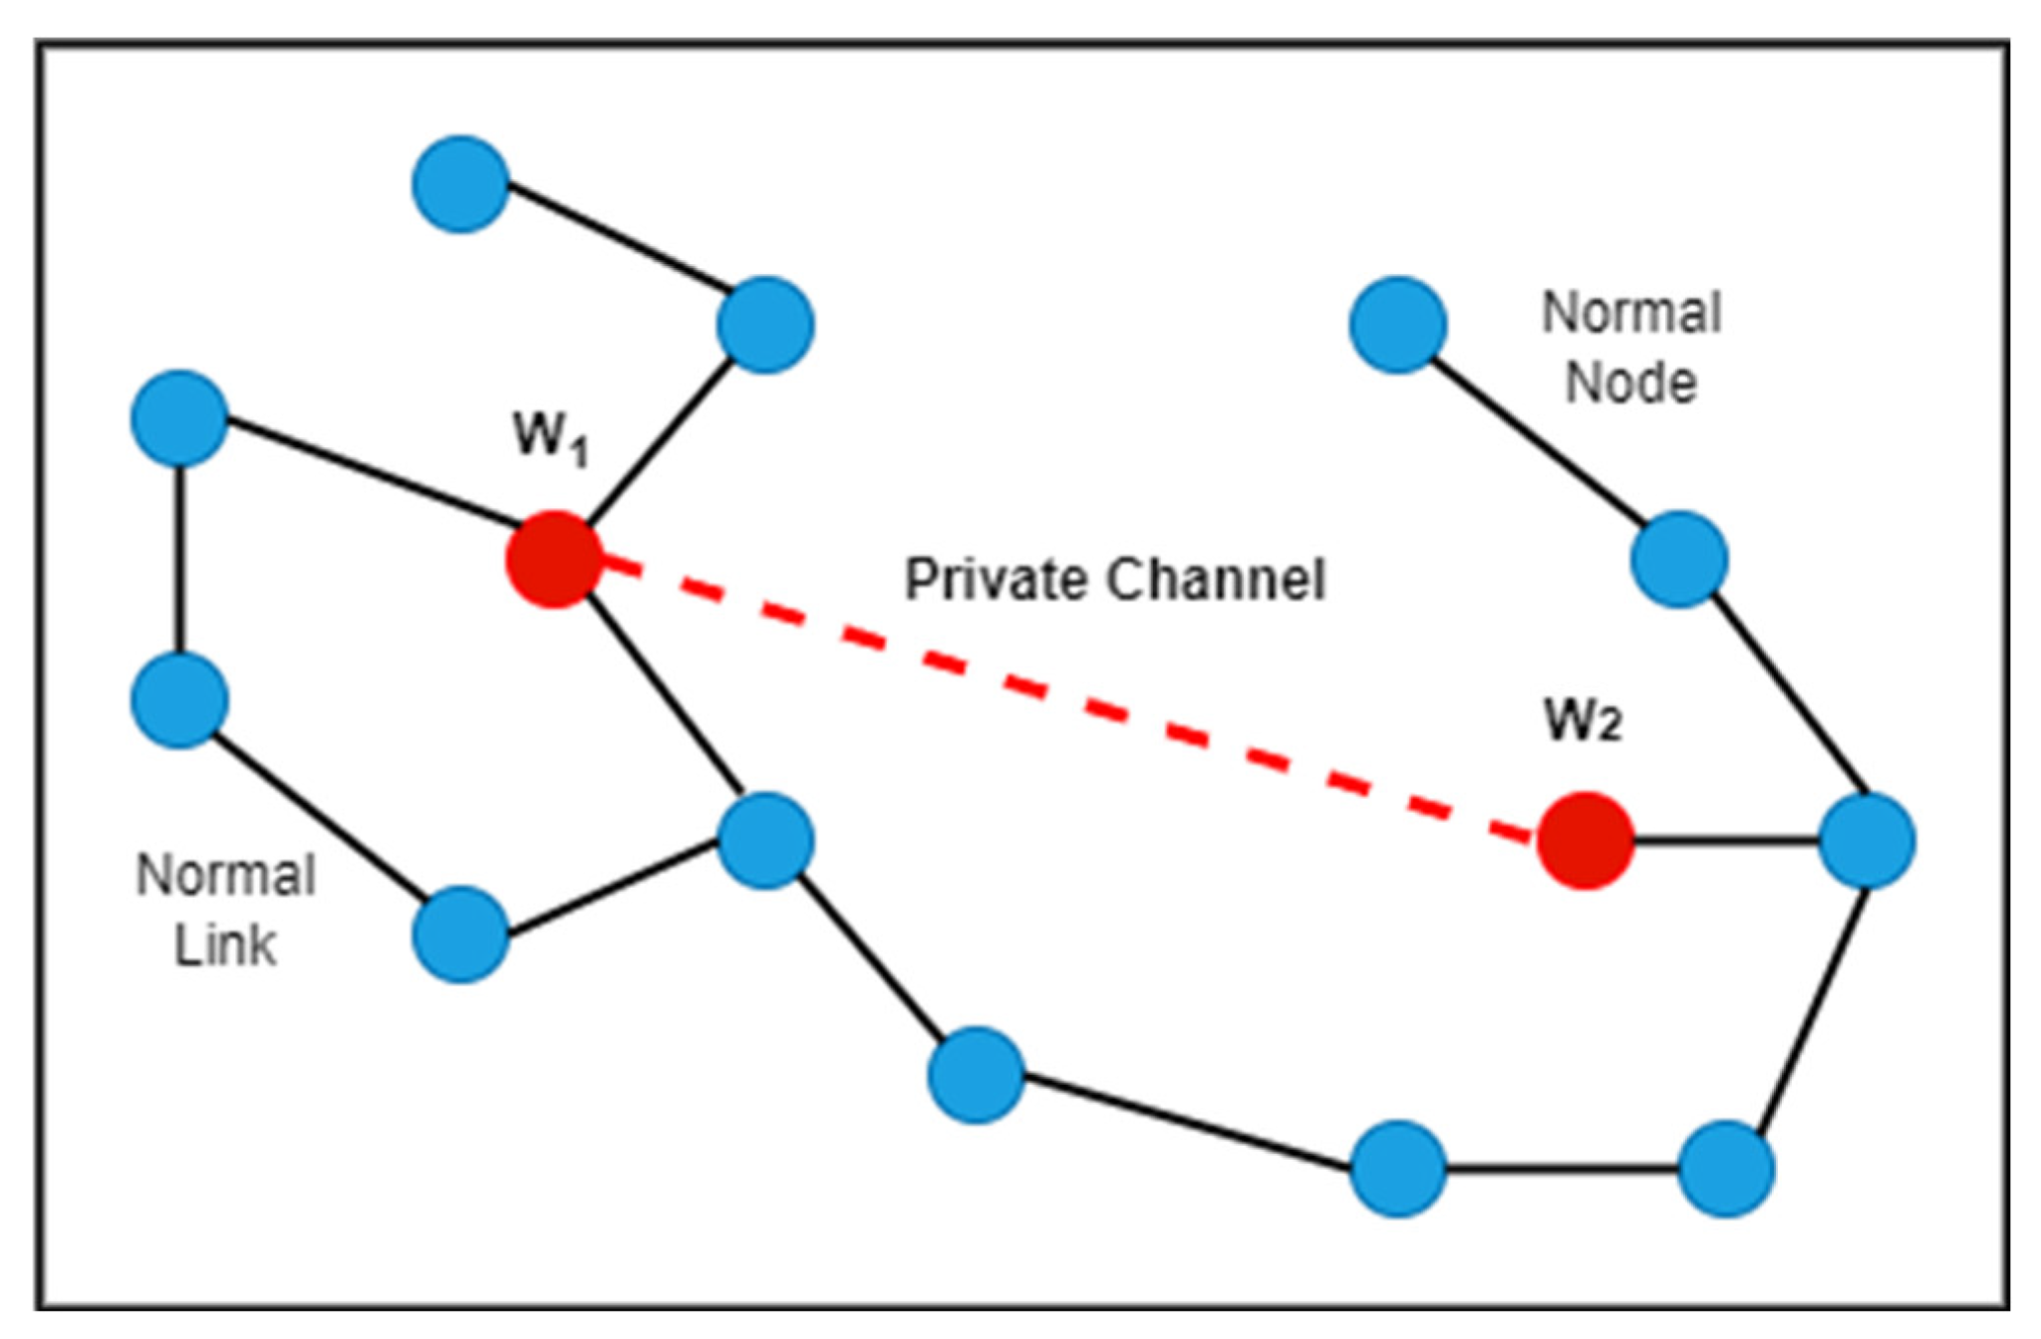
Wormhole Attack
Another type of replay attack.
Wireless transmissions are captured on one end of the network and replayed on another end
In software like WhozThat or SocialAware, a hacker could take a user’s ID and use their ID in a completely different location

Slide 15
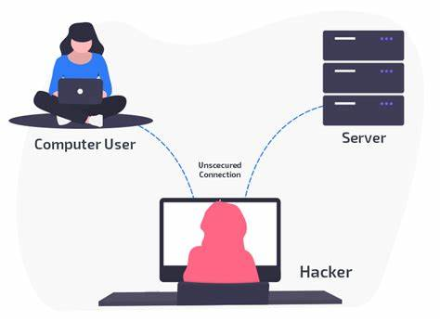
Eavesdropping
You don’t even need to intercept user IDs, you can simply just listen for their data over the wireless network.
Wait until a user transmits their data to a device. If that persons is connecting to Facebook using HTTP, instead of HTTP, all their information is in plaintext and can be completely clear for people to see.
Even if someone’s privacy settings didn’t allow for strangers to view their profile, it’s useless because all their information is still being transmitted via plaintext with HTTP

Slide 16

HTTPS
In reality all of the aforementioned attacks can be combated with HTTPS, and authentication.
If the user has a sufficiently strong username and password, it’s virtually impossible for a hacker to spoof the user’s ID.
However, it’s still not a good idea to just depend on HTTPS and strong passwords, so how do we solve these problems?

Slide 17
Security & Privacy Solutions
The previously mentioned Identity Server is a system designed to address the aforementioned security concerns. A few assumptions were made when designing the system:
A mobile device has a reliable internet connection.
A mobile device has short-range wireless capabilities, such as Bluetooth.
The mobile device uses a secure system location

Slide 18
Design of the Identity Server and Anonymous Identifier
To avoid using a user’s social network ID, which can present privacy and security concerns, the anonymous identifier (AID) is a nonce (a number used once in cryptographic communication) generated by the trusted server, called the Identity Server (IS). The process is as follows:
A user’s mobile device contacts the IS to obtain an AID before advertising its presence to other mobile devices.
The IS generates an AID for the mobile device using a cryptographic hash function and a salt value.
The IS associates the generated AID with the mobile device that requested it and returns it to the mobile device.
The mobile device (device A) shares its AID with other mobile devices and/or stationary devices (device B) by launching a Bluetooth AID-sharing service.
After a nearby mobile device or stationary device discovers this AID-sharing service on device A, device B establishes a connection to device A to obtain its AID.
After device B obtains the AID, device A contacts the IS to obtain a new AID for the next device.

Slide 19
Design of the Identity Server and Anonymous Identifier - Pt 2
After device B obtains device A’s AID, it can query the IS to obtain information about device A.
Once an AID has been used to obtain information, the IS removes the AID from the list of AIDs associated with its respective device.
The use of AIDs provides privacy features. Since mobile devices share only AIDs, a malicious user cannot use AIDs to map a user’s social network identity. The IS does not support the retrieval of personally identifiable information from a user’s network profile.

Slide 20
Implementation of the Identity Server
The IS was implemented using the Java Standard Edition (SE) 5.0 platform.
All IS services accessed by mobile and/or stationary devices are done via web services conforming to RESTful architecture.
Restlet, an open-source framework for Java, was used to develop the IS. All resources on the IS are exposed as separate URL-accessible resources via HTTP GET, POST, and PUT methods. The body of each HTTP request is encoded using JSON.
All traffic between the IS and other mobile/stationary devices is encrypted via HTTPS, and access to all resources is authenticated using HTTP basic access authentication.

Slide 21
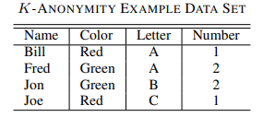
K-Anonymity Revisited
Consider this example.
If the set (Red, A, 1) is leaked by an application, the data could belong to Bill (Since it matches all of his information) or a combination of Fred & Joe (Fred has A, and Joe has Red and 1)
This means that k <= 2 because with the information the data could be linked back to Bill or the data is actually a combination of Fred and Joe’s

Slide 22
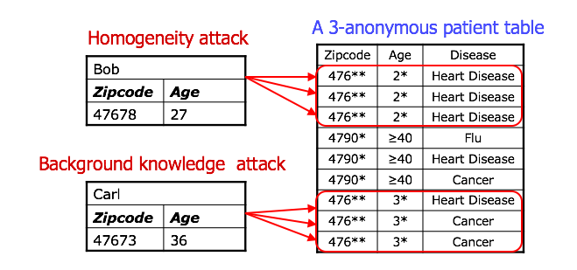
K-Anonymity Revisited - Pt 2
Let's say that another data set got leaked and it also included (Red, A, 1), but only Bill was present in that dataset, it’ll be very easy to link (Red, A, 1) to Bill.
However, if we have admissible sets (More users with the traits of Red or A or 1) it would be harder for malicious actors to make connections to Bill since those attributes wouldn’t be uniquely Bill’s at that point
Using the Quine-McCluskey algorithm guarantees that the datasets have K-anonymity for at least k = 20

Slide 23
Eavesdropping, Spoofing, Replay, and Wormhole Attacks
The use of AIDs prevents spoofing and replay attacks. Since AIDs are shared by the mobile device, a malicious user cannot spoof the social network identity of a different user.
Through the use of cryptographic functions and randomly salted values and continuously generating new AIDs upon requests as AIDS timeout or are consumed, replay attacks are prevented such that a malicious user cannot attempt to capture and reuse an already used AID.
Prior to a mobile device advertising its AID, it must inform the IS of its current location. It is assumed that all participating mobile devices use a secure position system. Such a system prevents location spoofing. Therefore, wormhole attacks are also prevented through the use of AID. A malicious user cannot intercept an AID that is being sent between two devices and retransmit it to a different location since the IS checks that the two devices are within a set distance of each other.
All network traffic is encrypted. Therefore, it provides protection against eavesdropping.

Slide 24
Trust Networks and Onion Routing
Through the use of peer-to-peer, it could be argued that it would be more private. However, this poses a major problem if the nodes are compromised.
These peer-to-peer networks could be made anonymous through onion routing, something that Tor utilizes. Several layers of encryption are decrypted at select routers along a virtual route. Thus, routing nodes cannot directly relate information at the destination to its source. If data is shared in this way, it would not be easy to identify the source.

Slide 25
Modern Day
Social media apps are even more prevalent today compared to 2009
More problems including data leakage, unauthorized access, cyberstalking, location privacy, etc
Location privacy is still an important issue today, and is even more prevalent now
Can now be countered with the use of AI
https://www.researchgate.net/publication/375513187_An_Overview_of_using_of_Artificial_Intelligence_in_Enhancing_Security_and_Privacy_in_Mobile_Social_Networks

Slide 26
Modern Day - Pt 2
Use machine learning to detect abnormalities in data access and predict threats based on analysis on location data
AI can be used in the development of smart privacy-preserving algorithms that can provide personalized and dynamic privacy settings based on user behavior and preferences
https://www.researchgate.net/publication/375513187_An_Overview_of_using_of_Artificial_Intelligence_in_Enhancing_Security_and_Privacy_in_Mobile_Social_Networks

Slide 27
Sources
Paper https://www.researchgate.net/publication/262333726_Solutions_to_Security_and_Privacy_Issues_in_Mobile_Social_Networking
[1] https://www.researchgate.net/publication/3283178_WhozThat_Evolving_an_ecosystem_for_context-aware_mobile_social_networks
[2] https://courses.cs.duke.edu/cps296.1/fall05/papers/serendipity.pdf
[3]https://www.researchgate.net/publication/375513187_An_Overview_of_using_of_Artificial_Intelligence_in_Enhancing_Security_and_Privacy_in_Mobile_Social_Networks

