Slide 1

EVIL NEVER SLEEPS:
WHEN WIRELESS MALWARE STAYS ON AFTER TURNING OFF iPHONES
Jiska Classen, Alexander Heinrich, Robert Reith, and Matthias Hollick
CSE 707 SEM
By Andrew Balotin and Raghavi Ayyathurai

Slide 2
Background

Slide 3
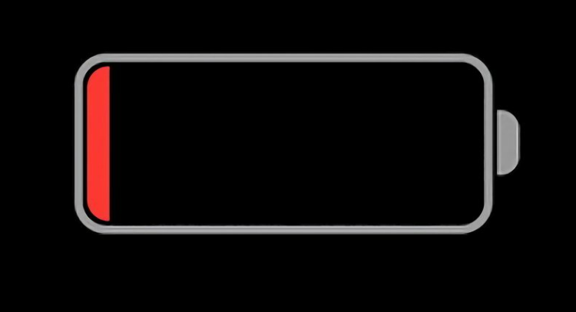
KEY TERMS
NFC (Near Field Communication) : Wireless technology that allows devices to exchange data over short distances.
UWB (Ultra-Wideband): Provides precise location tracking for features like digital car keys or finding lost devices.
Low-Power Mode (LPM) : A power-saving mode where Bluetooth, NFC, and UWB chips remain active.
Notes:
NFC uses induction coils to create radio waves and allow for data exchange over very short distances
UWB is a chip that uses super-fast signal pulses which avoids the interference from Wifi and Bluetooth. Provides precise tracking
Low power mode is different than the yellow low battery icon in the top right of your screen

Slide 4
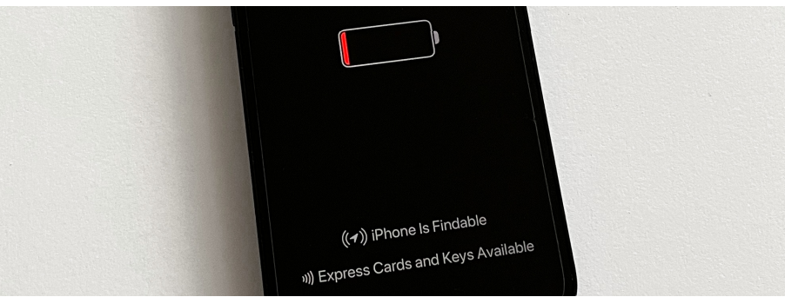
KEY TERMS (Cont.)
Express Mode: A feature that allows NFC-enabled services like payment cards to work without unlocking the iPhone, active even in Low-Power Mode.
Find My: A feature that broadcasts iPhone’s location even when powered off.
Bluetooth Low Energy (BLE) : A power-efficient Bluetooth protocol used in the Find My network for locating offline devices

Slide 5

INTRODUCTION
Wireless chips (Bluetooth, NFC, UWB) on iPhones continue operating in Low-Power Mode (LPM) even after the phone is switched off or when iOS shuts down due to low battery
In battery-low shutdown, Bluetooth-based Find My allows users to locate their iPhones even when they are turned off
Express Mode allows access to digital cards (student ID, transit, credit) and keys without unlocking the phone and is available in LPM
These cards and keys can still be used for up to 5 hours after the phone enters battery-low shutdown
Notes:
Wireless chips can run in a low power mode which is active even if the iphone is switched off. This mode can be activated when a user switched off their phone or if their phone shuts down due to low battery. If the battery is in low power mode then pressing the power button indicates low battery and the list of active LPM features appears (Go back to previous slide).
Express mode does not need any additional authentication
Cards and Keys can be used for up to 5 hours in this mode after the phone enters low power mode.

Slide 6
INTRODUCTION (Cont.)
Initially, NFC alone supported Express Mode, but the new Digital Car Key (DCK) 3.0 protocol now uses Bluetooth and UWB.
The bluetooth and UWB chips are hardwired to the Secure element (SE) in the NFC chip which stores secrets that are available in LPM.
Since this is hardware based and not software, wireless chips can no longer be trusted to be turned off after shutdown.
Notes:
This initially required the NFC to stay on for something like this but the new Digital Car Key 3.0 protocol now instead uses just Bluetooth and NFC, saving power.
LPM is implemented in hardware
The Power Management Unit (PMU) can turn chips on individually
The bluetooth and UWB chips are hardwired to the Secure element (SE) in the NFC chip which stores secrets that are available in LPM
Since this is hardware based and not software, wireless chips can no longer be trusted to be turned off after shutdown
LPM is significantly more stealthy than a fake power off since high power drainage from a fake power off would be noticeable
LPM is a relevant attack surface that has to be considered by high value targets or can be weaponized to build wireless malware operating on shutdown iphones

Slide 7
Research Focus: Analyzing Vulnerabilities in iOS Low-Power Mode
This paper explores the security analysis of new LPM features introduced in iOS 15:
It identifies flaws in the Find My LPM implementation, limiting the total advertisement time to 24 hours, even after a reboot.
It also identifies that the Bluetooth LPM firmware can be modified to run malware.

Slide 8
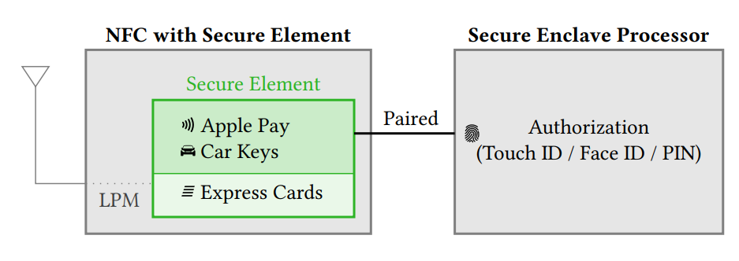
NFC LOW-POWER MODE
Documented by Apple
iOS implements secure wireless payments through an NFC chip with a Secure Element (SE).
The SE stores sensitive data (e.g., credit cards, digital car keys) and runs a JavaCard platform to manage secure transactions. It ensures applets are isolated from each other and remain protected even when iOS or other apps are compromised.
Data within the SE remains protected and is not accessible by iOS.
The Secure Enclave Processor (SEP) and SE are paired in-factory, enabling encrypted and authenticated communication between them. However, Express Mode can bypass the SEP to allow quicker access to cards and keys.
Notes:
iOS implements secure wireless payments on an NFC chip with a secure element (SE)
SE is certified based on Common Criteria and runs a JavaCard platform
Platform executes applets, apple pay, DCK, or third part applets
Applets are stored within the SE and do not leave
During a payment process the SE within the NFC replies directly without forwarding data to iOS
This prevents credit cards and keys from being stolen if iOS or apps are compromised
The SE is connected to the Secure Enclave Processor (SEP) which authorizes payments by forcing users to use TouchID, FaceID or passcode
These two are paired in factory and can communicate encrypted and authenticated
The wallet app allows to configure credit cards and keys for express mode, which do not require authentication from the SEP
This means that neither the SEP nor iOS are required to complete and NFC transaction and NFC can operate standalone using SE applets

Slide 10
BLUETOOTH AND UWB LPM
iOS 15 introduced two new LPM features:
The Find My network (Bluetooth-based).
Digital Car Key (DCK) 3.0 (UWB-based for secure distance measurement).
Both features are undocumented by Apple
Notes:
If both features were undocumented by Apple, how did the paper know about them

Slide 11
How was the Bluetooth and UWB LPM reverse Engineered?

Slide 12
Logging
On an active device logs can contain millions of messages within a couple of days
Logs can be searched
Naming of many features inside the log messages is often inconsistent
LPM is called wither LPEM or LEPM
DCK 3.0 is internally called Alisha
Often the logs are hard to reach
After combing through lots of logs there are hints that the UWB chip attempts to enter LPM on power off
Service checks if UWB Express is active on battery low shutdown

Slide 13
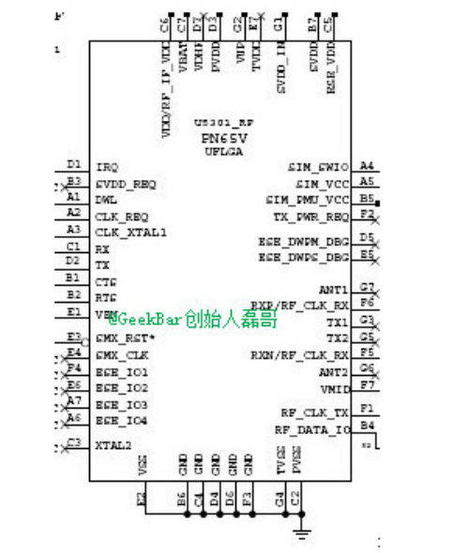
Hardware
Large online community that shares leaked smartphone schematics
Using these schematics it shows the SE is hardwired to the UWB and Bluetooth
Schematics also show trace connections between other chips to estimate threats by LPM
Also contains all the protocols for PCIe and I²C

Slide 14
Binaries
Analyzing different iOS versions allows for feature comparison across different software and hardware revisions
Recent iOS version have a Dynamically Loaded Library shared cache which contains a lot of proprietary functionality
Names in driver interfaces reveal hardware capabilities that are otherwise hard to reverse engineer

Slide 15
UWB Firmware
Analyzed the UWB firmware
Early versions of the iPhone 11 UWB firmware had lots of debug prints for communication with the SE
Lots of testing and logging was removed in later versions
Alisha, the nickname for the DCK 3.0 protocol started appearing in the iOS 14.3 firmware
LPM support for UWB was added in the same release

Slide 16
Find My and Bluetooth LPM Functionality

Slide 17

Find My LPM
An offline finding network using Bluetooth Low Energy (BLE). It helps locate iPhones and other Apple devices, even when not connected to the internet.
Offline devices regularly send Bluetooth Low Energy (BLE) advertisements, devices with a network connection can scan for these advertisements and then report lost devices to their legitimate owners.
Each device has a master beacon key that is synchronized with the user’s iCloud keychain.
BLE advertisements use rolling public/private key pairs that rotate every 15 minutes on iPhones to protect against device tracking and prevent linking keys to the device without proper access.
Notes:
Find My is an offline finding network that locates iPhones, airTags, and other Apple devices while they are not connected to the internet
Offline devices regularly send Bluetooth Low Energy (BLE) advertisements
Devices with a network connection can scan for these advertisements and then report lost devices to their legitimate owners
End to End is encrypted
Security guarantee is synced with a specific master key beacon and a users icloud keychain
Keychain is stored locally and access to its secret key requires round trip through the SEP
Based on master beacon key a rolling sequence of private/public key pairs is generated
Linking public keys in this sequence to each other requires knowledge of the master beacon key
Devices broadcasts the current public key as a BLE advertisement and a portion of the key sets the MAC address to a random value
Any internet connected device can observe the Find My BLE, encrypt it with the public key, and report it to apple
Location does not include the reporters identity
Public keys roll every 15 minutes on iPhones which limits smartphone tracking using BLE advertisements

Slide 18
Digital Car Key (DCK) LPM
DCK 3.0 uses both Bluetooth and Ultra-Wideband (UWB) technologies to enhance security and enable precise distance measurement for keyless entry.
Bluetooth is responsible for setting up the initial connection between the iPhone and the car.
The DCK system scans for BLE devices, runs a Generic Attribute (GATT) service for data exchange over BLE, and retrieves key material from the SE using I²C protocol.
In contrast to the Bluetooth chip, the UWB chip remains in sleep mode most of the time to conserve power.

Slide 19
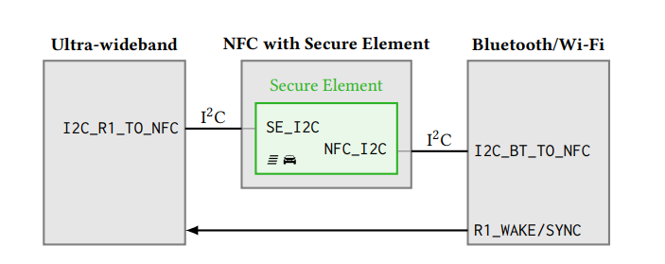
Notes:
Bluetooth retrieves key material from SE using i2c protocol
UWB is sleeping most of the time
When needed the Bluetooth chip sends a wake signal to the UWB chip
When active it only listens for a very limited time

Slide 20
Digital Car Key LPM (Cont.) :
Bluetooth sends a wake signal to the UWB chip when precise distance measurement is required. This power-efficient setup ensures that UWB is only active within a limited time window.
Ultra-Wideband (UWB) provides secure distance measurement, determining the exact range between the iPhone and the car.
UWB allows for precise localization, ensuring the car unlocks only when the iPhone is within a specific, close range, adding an additional layer of security.

Slide 21
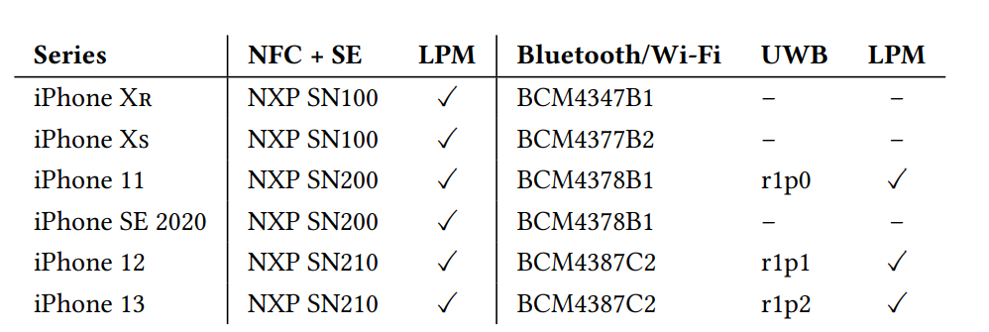
Devices that Support DCK 3.0

Slide 22
Security Analysis

Slide 23

Applications - Adversary Model
In the application layer, the adversary is assumed to have physical access to the iPhone and seeks to exploit vulnerabilities in Low-Power Mode (LPM) without manipulating the phone’s firmware or software.
The adversary's goal might be to disable Find My for theft or to exploit Express Cards and Keys to make unauthorized payments.

Slide 24
Security Flaws in Find My LPM:
The Find My feature is limited by LPM, where Bluetooth advertisements (used for locating lost devices) may stop broadcasting sooner than intended or fail to broadcast under certain conditions.
Users are not notified about these Find My limitations, leading to a false sense of security that their iPhone will remain locatable for longer periods.
The reduced broadcasting of Find My advertisements during LPM makes it easier for attackers to avoid detection and disable tracking.
When an iPhone is rebooted, it retrieves a Find My token from NVRAM storage, which persists through shutdowns and reboots, ensuring the continued use of Find My.

Slide 25
If the iPhone has an internet connection before the first unlock after reboot, it connects to Apple's servers to report the location. However, Wi-Fi keys are only available after the first unlock, and cellular connections may fail if there is a SIM PIN or the SIM card was removed.
Express Mode allows selected cards and keys (e.g., payment cards, car keys) to be used without authentication for up to 5 hours after the phone shuts down due to low battery.
This mode introduces a security risk if a stolen iPhone can still be used for payments or physical access (e.g., unlocking a car).

Slide 26
Firmware - Adversary Model
This section assumes an attacker with privileged firmware access, meaning they can send custom commands to the firmware, modify firmware images, or even gain code execution over-the-air.
This type of attack requires significant control, which is difficult but possible if there are vulnerabilities in the system.

Slide 27
Firmware Tampering:
Local Firmware Modification:
Attackers with system-level access can modify the firmware of components that support Low-Power Mode (LPM). This could allow attackers to maintain control of the iPhone even when the phone is powered off.
This type of control is valuable for persistent exploits targeting high-value individuals like journalists.
The iOS 15 LPM-supporting chips include NFC, UWB, and Bluetooth. Of these chips, the NFC chip is the most secure, as its firmware is both encrypted and signed. However, attempts to bypass its secure bootloader have been unsuccessful.
The Bluetooth firmware is the least secure, as it is neither signed nor encrypted, and lacks secure boot. This leaves the Bluetooth chip vulnerable to malware even when the phone is off.

Slide 28
Remote Code Execution:
Attackers who do not have system-level access can still attempt to remotely execute code on the LPM-enabled chips.
In the past, various vulnerabilities have been disclosed in Bluetooth chips used in iPhones.
Reconfiguring Firmware Options:
Even if firmware is protected, an attacker with system-level access could still send custom commands to manipulate the chips.
For example, they could alter the Bluetooth firmware to manipulate how Find My LPM works, such as modifying the advertisement intervals or inserting their public keys to track the device.

Slide 29
Implications:
If firmware is compromised, it exposes the Secure Element (SE) used for storing sensitive information (like car keys and payment data) to potential attacks.
The compromised Bluetooth firmware could allow attackers to access the SE and compromise the security of stored information, weakening trust in the SE’s protection.

Slide 30
Hardware - Adversary Model
The model assumes that neither the attackers nor the legitimate users manipulate the hardware.
The analysis focuses on which components could be stealthily powered on while the iPhone is off and the applications attackers might build using Low-Power Mode (LPM).

Slide 31
Suitable chips:
Many chips in an iPhone are controlled by the Power Management Unit (PMU), which could enable them to stay active in LPM.
However, the goal of LPM is to not significantly drain the battery, so only certain battery-friendly chips are suitable for LPM operation.
These chips must have a way to interact with the outside world or the user, such as wireless chips or buttons.
Most chips are also connected to the Application Processor (AP) or the Always-on Processor (AoP).
The AoP runs Apple’s RTKitOS, which is always active and waits for hardware events and triggers. The AP, which runs iOS, can go to sleep to save power.
Neither the AoP nor the AP should be running in LPM, as they consume too much power.
All wireless chips (e.g., Bluetooth, UWB) are connected to the PMU and could operate in LPM independently of iOS or the Application Processor.

Slide 32
Detection and Deactivation:
Detecting whether chips were running LPM firmware or disabling LPM entirely is not possible with current iOS on-board tools.
Additional monitoring hardware is needed to detect wireless transmissions in LPM.
Logging:
UWB chips have storage for crash logs, which are read out after system boot, while Bluetooth LPM firmware also supports logging. However, these logs are intended for iOS developers and cannot be accessed without jailbreaking the device.
Users cannot determine if LPM firmware was running or what actions it performed on a device without compromising the system.

Slide 33
Disabling LPM:
LPM support is implemented in hardware and cannot be removed through system updates.
A potential solution for privacy-conscious users would be a hardware switch to disconnect the battery, similar to how Apple disconnects the microphone on MacBooks when the lid is closed.
Other Protection Methods:
Users concerned about being spied on through LPM could install a transmission monitoring device to detect wireless communications, or use a Faraday bag to block transmissions, though small holes or gaps can lead to leakage.

Slide 34
Bluetooth Firmware Modification
Researchers use specialized tools to extract, analyze, and alter firmware, exposing weaknesses in firmware protection mechanisms.
They delve into the process of dumping and modifying the firmware of iPhone's wireless chips, particularly the Bluetooth chip, to uncover potential vulnerabilities.
The analysis highlights the security risks of firmware tampering, especially in Low-Power Mode (LPM).

Slide 35
Dumping and Loading Firmware
Firmware Dumps:
Broadcom Bluetooth chips store most of their firmware in Read-Only Memory (ROM).
To fully understand the firmware, researchers need to perform a complete dump, which includes the ROM.
The ROM is readable with a vendor-specific Host Controller Interface (HCI) command, supported by all Broadcom chips, including the ones in iPhone 13.
Apple's Core Bluetooth framework does not allow sending these HCI commands, but researchers bypass this on jailbroken iPhones using tools like InternalBlue.

Slide 36
Jailbreaking and InternalBlue:
The InternalBlue tool attaches itself to the Bluetooth subsystem to send HCI commands and interpret received events.
The initial version of InternalBlue only supported legacy chips connected via UART (Universal Asynchronous Receiver-Transmitter), but recent modifications allow support for newer chips with PCIe drivers.
Firmware Patching with Patchram:
Patchram is a method for temporarily patching the firmware in RAM.
Any 4-byte value in ROM can be mapped to another 4-byte value in RAM, allowing function calls in ROM to be replaced by calls to functions in RAM.
This process works because RAM is writable and executable.
Modern Broadcom chips have 256 Patchram slots, allowing multiple patches to be applied.

Slide 37
Legacy vs Modern Chips:
Legacy Bluetooth chips use UART for communication, which limits the patch size to a maximum of 255 bytes.
The newer chips, starting from the iPhone Xs and later, use PCIe for communication, allowing for the transfer of larger patch files in one go.
Patch Format:
The patch format used by newer chips involves transferring a large .bin patch file at once. This was reverse-engineered to allow custom patches to be installed on modern iPhones.

Slide 38
Firmware Patch Image Upload:
Most Bluetooth communication on iOS is handled by the Bluetooth daemon.
However, for low-level tasks, a tool called BlueTool is used to send HCI commands and load firmware patches.
BlueTool can be accessed via Cross-Process Communication (XPC) calls from other daemons or used interactively through a command line interface.

Slide 39
Analyzing and Modifying Firmware
Patch Analysis Tooling:
The researchers developed several tools to analyze and modify the Bluetooth firmware.
These include:
A Python script that can extract patch regions from firmware and reassemble patch files with correct Cyclic Redundancy Checks (CRCs).
An IDA Pro script that parses the patch configuration data.
Another IDA Pro script that identifies functions calling the abort handler.
These tools are flexible and have been used for multiple purposes, including increasing BLE reliability, enabling chips to send and receive ZigBee, and testing against security issues in the Bluetooth specification.

Slide 40
Firmware Modification:
Using the tools, researchers can load any patch file on top of an existing InternalBlue ROM dump for static reverse engineering.
The researchers modified existing patch files and loaded them onto running iOS devices to test whether the firmware can be modified and still function correctly.
This dynamic analysis helps identify potential issues or vulnerabilities within the Low-Power Mode (LPM) module.

Slide 41
Firmware Tampering Example:
An example of malware in firmware demonstrates how attackers could modify the Bluetooth firmware to observe or tamper with communication between the Secure Element (SE) and Bluetooth chip when using Digital Car Key (DCK) 3.0.
This is a significant security risk as it would allow attackers to access or manipulate sensitive data such as keys for digital car access.
Preventing Firmware Tampering:
Although firmware protection mechanisms exist, the Bluetooth chip on iPhones does not fully prevent tampering. The researchers were able to modify the firmware during runtime.
The patch they altered demonstrates that even though iOS has certain protections, they are not sufficient to stop advanced firmware modification attacks.

Slide 42
Research Summary and Implications
The current LPM implementation on iPhones presents new security threats, as LPM remains active even after shutdown, allowing wireless chips to stay operational.
While LPM increases user security in many cases, it also exposes potential risks, such as manipulating Bluetooth firmware to exploit the system.
The paper revealed undocumented LPM features in iOS 15, such as the ability for attackers to modify Bluetooth firmware to run malware.
The researchers recommend a hardware-based switch to disconnect the battery and provide greater privacy protection, especially for users at risk of surveillance.
The tools developed during the research, such as InternalBlue and Frankenstein, are available for public use and can aid in further analysis and security improvements.

Slide 43
References
[1] Classen, J., Heinrich, A., Reith, R., & Hollick, M. (2022). Evil Never Sleeps: When Wireless Malware Stays On After Turning Off iPhones. Proceedings of the 15th ACM Conference on Security and Privacy in Wireless and Mobile Networks (WiSec 2022)

