Slide 1

CSE707:
Emerging Security Threats and Countermeasures in IoT
Paper by: Zhi-Kai Zhang, Michael Cheng Yi Cho, Shiuhpyng Shieh.
Presented by: Jerry Mathew, Selwin Murzello

Slide 2
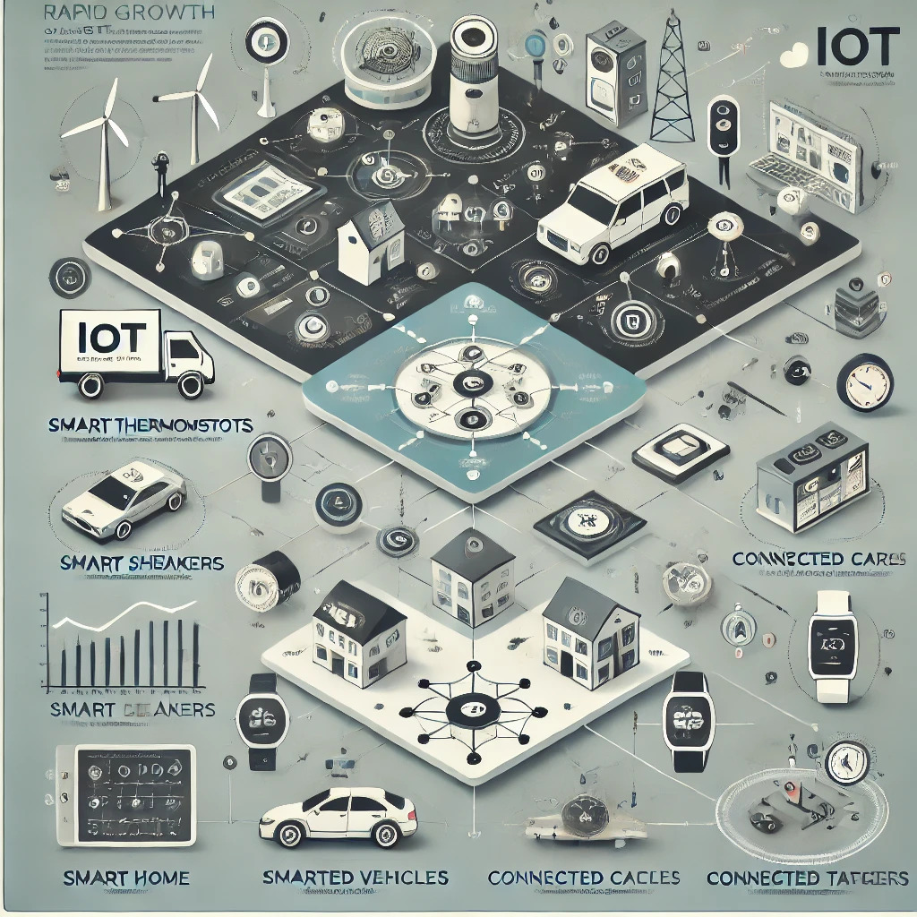
Introduction
Internet of Thing (IoT) is a self-configuring and adaptive complex network that interconnects uniquely identifiable “Things” to the Internet through the use of interoperable communication protocols.
The “Things”, sometimes referred to as devices or objects interchangeably, have sensing/actuation and potential programmability capability.
Information about the “Thing” can be collected from anywhere, at anytime, by anything.
Self-configuring and adaptive network:
IoT is characterized by its ability to configure itself and adapt to changing conditions.
This feature allows for the seamless integration of new devices and the ability to respond to environmental changes without manual intervention.
Interconnection of uniquely identifiable "Things":
In IoT, each device or object (referred to as "Things") has a unique identifier.
This allows for individual addressing and communication between devices, enabling precise data exchange and control.

Slide 3

Data sharing and processing:
A key aspect of IoT is the sharing of data between connected devices.
This shared data is processed into information that can serve as input for other devices or as reports for human consumption, enabling new services and applications.
Privacy and security concerns:
As IoT involves the exchange of sensitive and private information between devices, privacy becomes a major concern.
The paper highlights that with the growth of Big Data, the threat becomes even more severe, as attackers may obtain private information through raw data leaked by compromised objects.

Slide 4
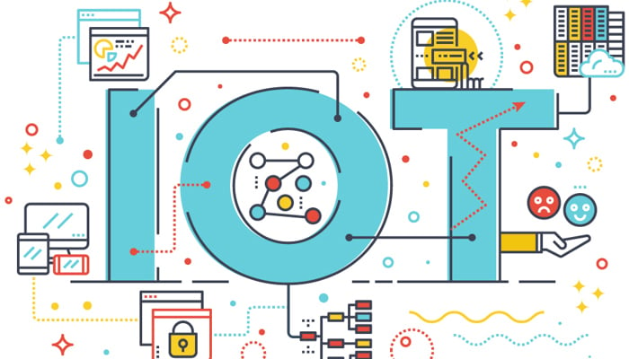
Navigating Security and Scalability Challenges in the Internet of Things (IoT) Ecosystem
The Main Concern: Scalability in IoT
Transparency and Reliability in IoT Security
Emerging Security Threats and the CIA Model

Slide 5

Research Focus and Objectives
Investigate emerging security threats specific to IoT
Examine privacy and security challenges in IoT communications
Analyze IoT communication scenarios and associated threats
Propose and evaluate authentication models for IoT

Slide 6
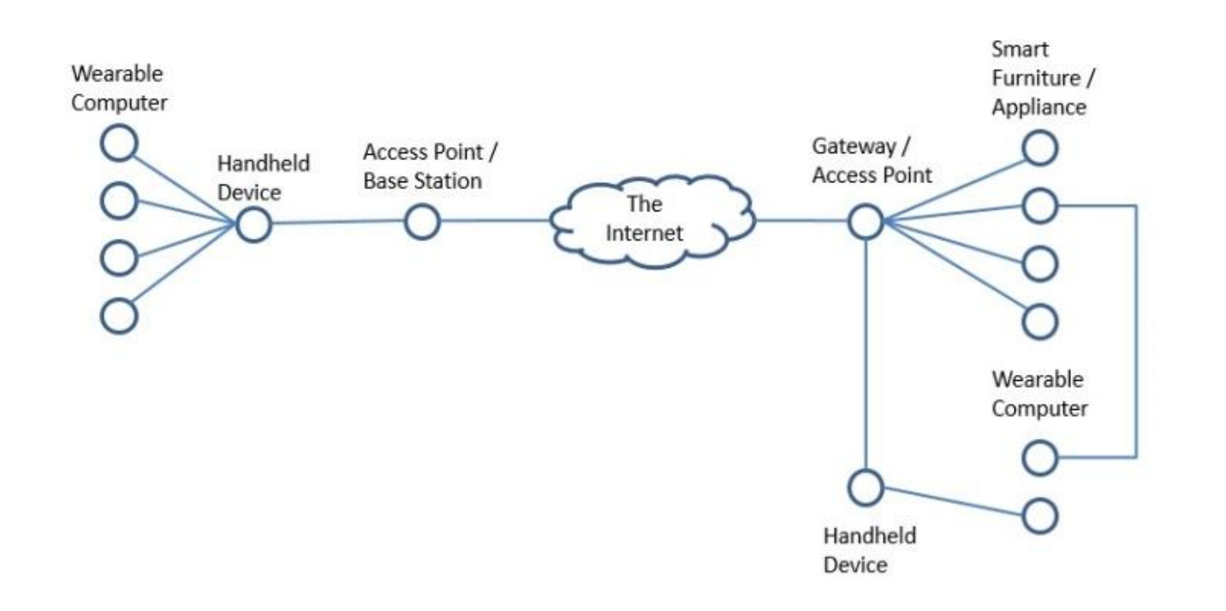
Naming, Identification and Authentication: I
Wearable gadgets take measurement and report it to mobile apps.
Two categories of information exchange according to the distance range: domestic and foreign.
Domestic communication is done locally without access to Internet while foreign communication relies on Internet.
Objects in IOT have limited resources, computing power and communication capability due to the nature of lightweight and portability.
To extend the communication range, a delegator is required to relay the data traffic also referred to as a gateway of communication.
Mobile phone is delegator for wearable devices while hotspot such as a wireless AP is suitable for home/office appliances.

Slide 7
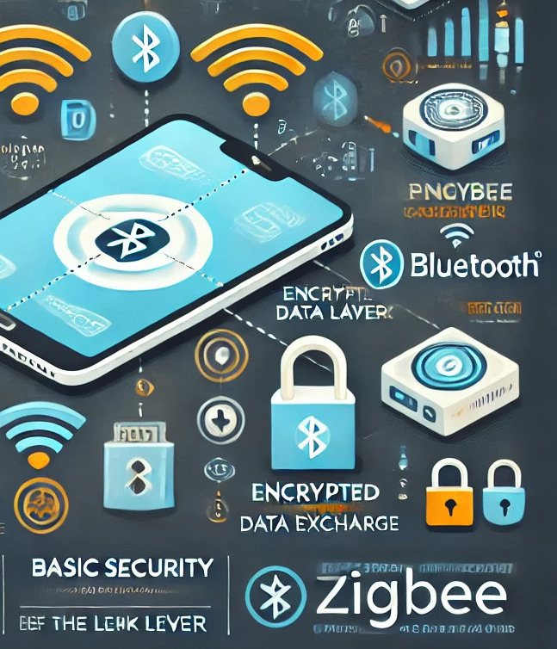
Naming, Identification and Authentication: II
Domestic communication needs short range wireless communication such as Bluetooth and Zigbee that rely on pairing objects prior to data exchange where password is required.
This accomplishes basic security in the link layer. Once the object is paired, encryption is applied when data has been exchanged wirelessly.
Massive scale of objects makes naming of the objects more complex.
Heterogeneity of the the objects and the network make conventional internet naming and identification inapplicable.
Uniquely naming the objects is one of the main challenges to be resolved before addressing object authentication.

Slide 8
Naming, Identification and Authentication: III
One proposal suggests DNS naming scheme can be the naming basis for IOT as ONS (Object Naming service) that can also be integrated into DNS as a sub-domain of DNS.
It proposes to leverage DNS to locate authoritative metadata and services with given Electronic Product Code (EPC), designed for the purpose of providing universal unique identity.
Future Internet Architecture Project proposed “Named Data Networking (NDN)” which moves the network architecture from host-centric to data-centric.
According to NDN, the identification and network routing are based on the name of the object instead of using conventional IP address.
Naming in NDN is in a hierarchical structure, and is applicable to hierarchical nature of the current computer network structures.
There are still many new challenges, such as efficiency, name validation, signing key management, object authentication, and other security issues.

Slide 9
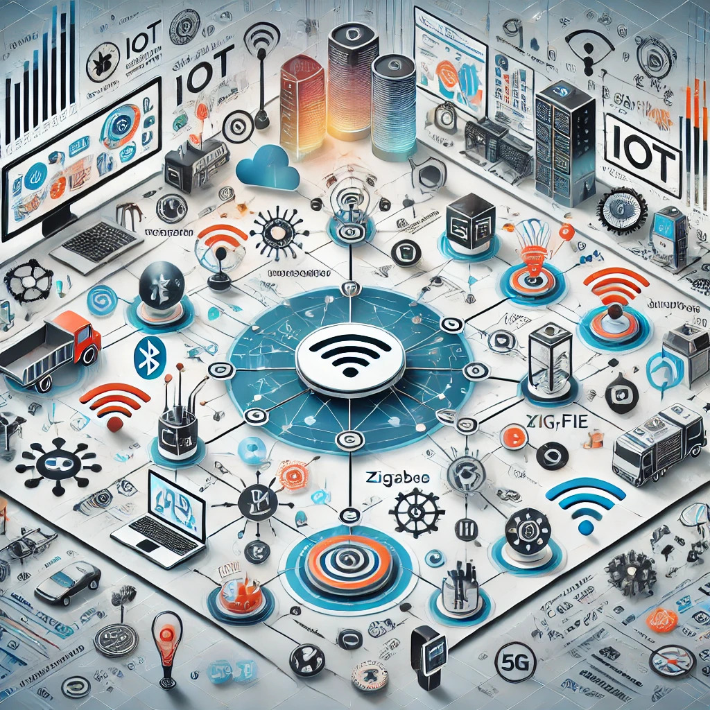
IOT COMMUNICATION SCENARIOS
Basic Communication Scenario
Extended Communication Scenario
Cloud Communication Scenario

Slide 10
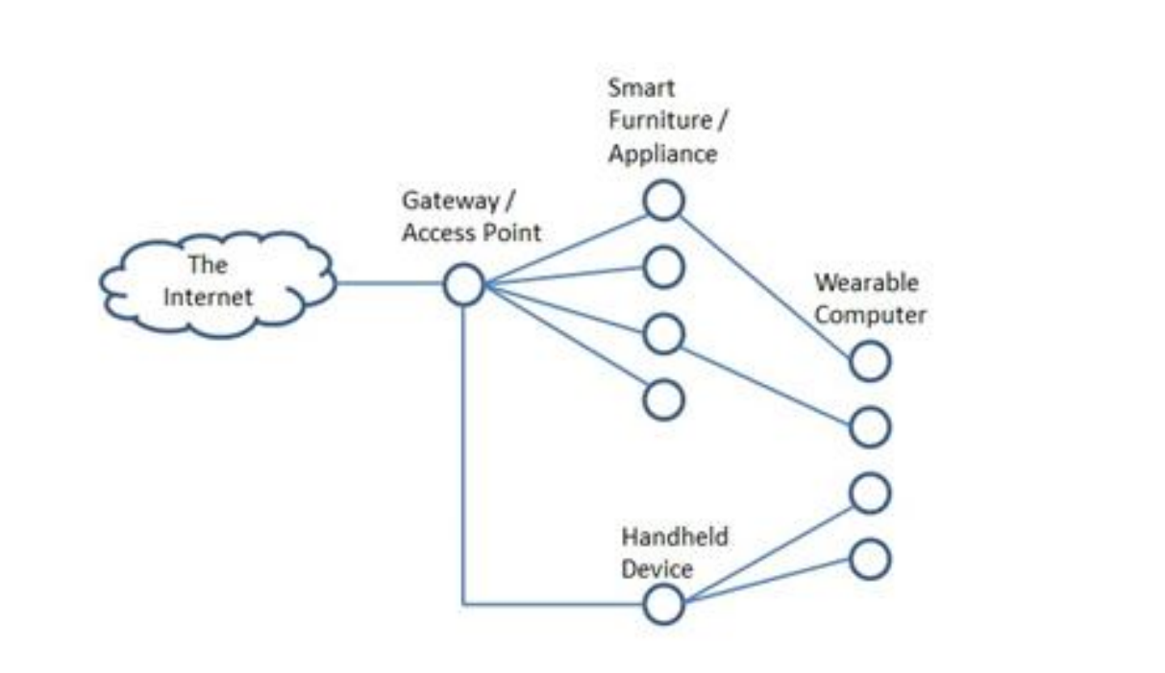
Basic Communication Scenario
Basic communication scenario is regarded as domestic communication where wearable devices, smart furniture, and smart appliance exchange data within a closed network environment, such as home or organization
For wearable devices that are incapable of making direct connection to an access point beyond the communication range, a delegator such as handheld device can play the role to relay data traffic to the access point so that the data can be transmitted to the destination.
This communication scenario takes place in a closed network often referred as local area network (LAN)
Challenges to Data Retrieval
Authentication and Authorization
Countermeasures for Eavesdropping

Slide 11
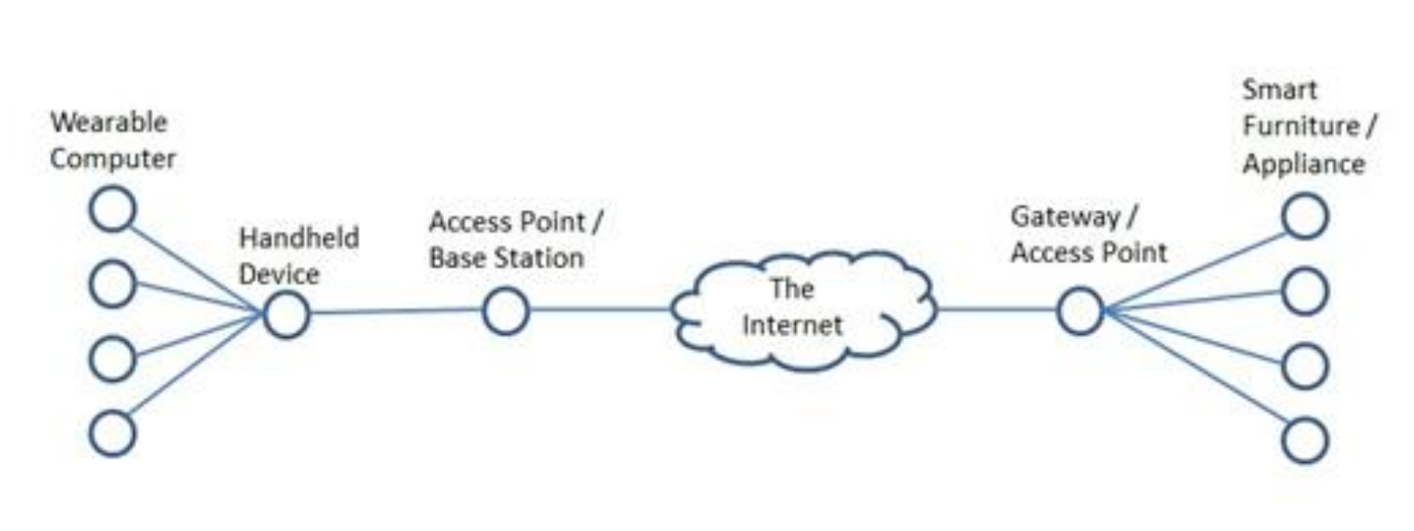
Extended Communication Scenario: I (Decentralized)
Public network (i.e. the Internet) is used to relay the exchanged data. Depending on the methods that data is exchanged and stored, network configurations can be divided into two types. Simple network configuration for external resource access where resource and data distribution are decentralized.
In this type of configuration, two gateways are employed to support communicate between the wearable devices and smart furniture/appliances.
A gateway supports the local area network, while the mobile handheld device supports data relay for mobile wearable devices.
As data exchanged, the two gateways handle data forwarding.

Slide 12
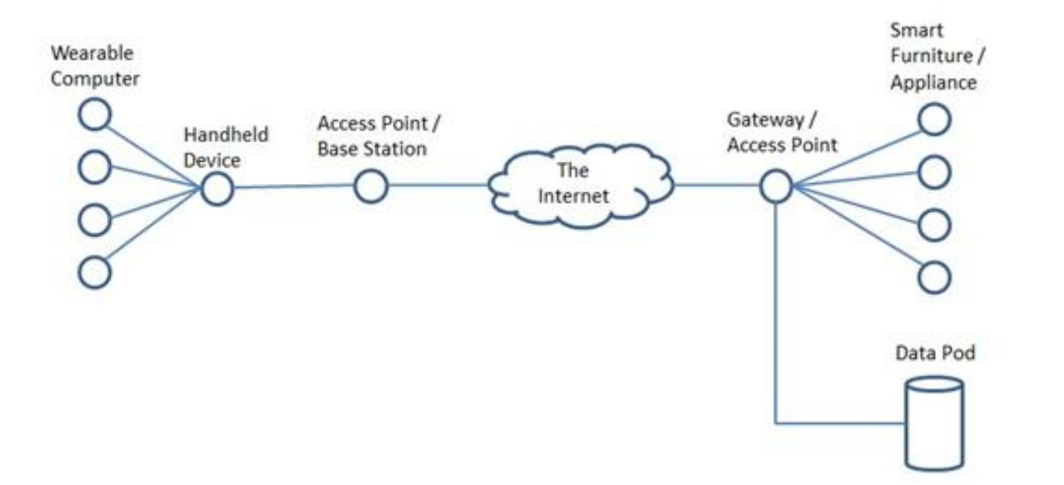
Extended Communication Scenario : II (Centralized)
Network configuration where resource and data are centralized. Although the two network configurations are alike, the actual communication takes place using different approaches.
In this approach, the data resource is centralized so that the objects do not communicate directly. All exchanged data is pushed and pulled from a central storage (i.e. the data pod).
Challenges to Data Retrieval
Authentication and authorization to use the LAN
Eavesdrop resistance over wireless networks
Integrity assurance when using the public network
Confidentiality assurance when using the public network

Slide 13
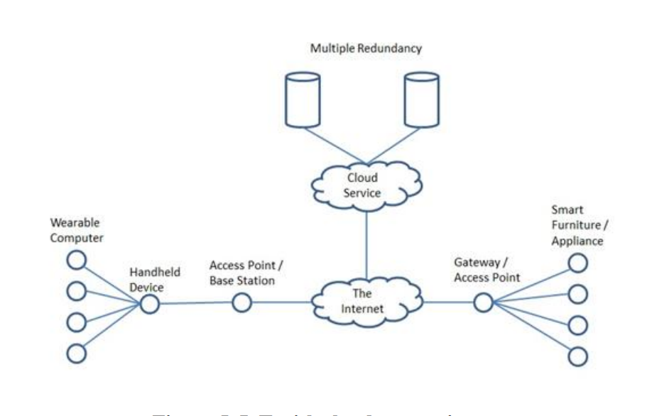
Cloud Communication Scenario
Here the vendors provide data storage service where data can be accessed from anywhere.
At the same time, data is replicated to prevent single point failure and ensure efficiency.
The pushed data in the cloud service can also be computed for analytical purpose or for personal service recommendations.
Unlike the aforementioned scenarios, the gateways of wearable devices, smart furniture, and smart appliances are only used to collect data for the cloud storage.
In this context, data authentication is still needed to avoid pollution while transmitting collected data over the Internet to the cloud
Authentication and authorization to use the LAN
Eavesdrop resistance over wireless networks
Confidentiality and integrity assurance over the Internet
Authentication and authorization for the cloud service
Confidentiality and integrity for the cloud storage

Slide 14


Authentication Model
Authentication models are introduced to cope with challenges incurred in various communication scenarios.
To authenticate communication between wearable devices and handheld devices, pairing mechanism is adopted when two objects are making connection.
At the pairing stage, a simple password or pre-shared key is supplied before initializing the communication.
When the data exchange begins, symmetric crypto systems are suitable for preventing eavesdropping over wireless communication.
For LAN communication, the conventional Wi-Fi protecting schemes are sufficient where a passphrase is used to authenticate the object to the network and prevent eavesdropping over wireless communication.
Authentic schemes for foreign communication where exchanged data is forwarded through internet:
A) Authentication by Gateway
B) Authentication by Security Token
C) Authentication by Trust Chain
D) Authentication by Global Trust Tree

Slide 15
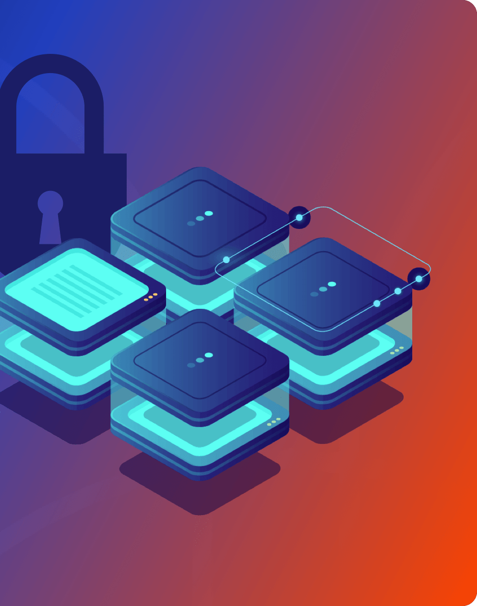
A) Authentication by Gateway
To communicate with a domestic peer, a foreign peer first needs to be authenticated by the domestic gateway.
Being authenticated, the subsequent exchanged data from the foreign peer is directed to the destination until the session is terminated.
This authentication process is repeated for each communication session whenever the communication parties exchange data via the Internet.
The authentication method can be as simple as ID password scheme or any other scheme as long as it provides the proof of authorized identity.

Slide 16
A) Authentication by Gateway II
Pros
The authentication method for foreign peers is independent of the authentication method for domestic peers.
Peer protection is centralized in the gateway. Since the gateway should be relatively powerful in terms of computation, the protection can be designed to be more complex to strengthen the security functionalities. On the other hand, the protection for the domestic peers can be designed to be lightweight. In this way, it is more applicable to the domestic peers that may have less computation power and requires less security functionalities.
Cons
Single point failure, such as compromised gateway, exposes all the peers to threats.
The gateway can be a bottleneck since it is in charge of authenticating network traffic from communicating peers. At the same time, the gateway is also the only ingress and egress point of public network traffic. Thus, network traffic congestion problem is inevitable.

Slide 17

B) Authentication by Security Token:
The gateway is responsible for initiating the authentication session when a foreign peer begins to exchange data with a domestic peer.
At initiation, the gateway will establish a security token with the communicating parties.
This security token may have a time-to-live or valid-period attribute to indicate security token validity by defining the time frame or the use count.
For all sessions in the valid time period, the communicating peers exchange data using the security token for authentication purpose.
Before the expiration of time-to-live or valid-period attribute, the gateway is free from succeeding authentication workload.

Slide 18
B) Authentication by Security Token: II
Pros
The load for succeeding authentication after initialization is removed from the gateway.
It is suitable for resource-constrained peers where token- based authentication is considered to be lightweight in computation.
Cons
Single point failure, such as compromised gateway, may expose peers to threats since the initial authentication
session is performed by the gateway.
The design of a scheme using security tokens can be difficult because both security requirements and resource
restriction of the peers must be taken into consideration simultaneously.

Slide 19
C) Authentication by Trust Chain
In this model, the trust relationship "peer A trusts peer B" is defined as follows. Peer A is convinced that the incoming data D is indeed from peer C, if peer B certifies that data D is from peer C.
Therefore, a trust graph is constructed as a connected and directed graph in which the successor of a directed edge trusts the predecessor.
The gateway is the predecessor of all the peers that are assigned to the domestic registration domain, and a public authority certifies the gateway.
If two communication peers belonging to different trust graphs need to authenticate each other, one or multiple edges should be added to concatenate the two trust graphs in a proper manner.
In this configuration, both peers can find particular predecessor which is trusted by itself and certifies the other peer.

Slide 20
C) Authentication by Trust Chain: II
Pros:
After the setup phase, there will be no further authentication workload on the gateway. Thus, this authentication model reduces the workload for authentication.
This model is based on trust chain. In practice, authentication standards of this model are designed to
provide better security functionalities compared to the basic authentication methods.
Instead of applying for a certificate for each domestic object, proprietary certificate authority is employed to reduce the cost of obtaining public certificates.
Cons:
This kind of authentication scheme is more complex, and may not be suitable for resource-constrained objects. A fair amount of computation power is required.
The authentication model uses similar methods for both domestic peers and foreign peers, which make it inflexible.
Single point of failure, such as a compromised gateway, may break the trust chain.

Slide 21
D) Authentication by Global Trust Tree
Unlike the authentication-by-trust-chain model, a global trust tree is used instead. All the peers are registered in the global trust tree.
As a result, all the peers can be authenticated globally. The gateways of the communicating peers do not take part in authentication.
Routing network traffic is their primary task. However, the communicating objects must be capable of performing data authentication, which may be problematic for some resource-constrained objects.
Therefore, it is more appropriate in this authentication model to centralize data retrieval over the public network or cloud computing communication environment to reduce the amount of data exchanged.
Currently no global trust trees are available. DNSSEC can be a potential candidate to construct one.

Slide 22
D) Authentication by Global Trust Tree: II
Pros:
Global trust graph is more reliable (in terms of management) comparing to the trust architecture using a private gateway. It can enforce strict rules to manage digital certificates.
The gateway does not intervene in authentication process, and thus can concentrate on network traffic forwarding tasks.
The underlying scheme is in general an international standard, which is more robust in achieving mutual authentication.
Cons:
Global trust graph is not available in the current Internet framework.
Constructing a global trust graph that includes all the objects in IoT is expensive and may be infeasible.
Even if a global trust graph is available, the registration fee will be high as a whole for all the domestic objects.

Slide 23
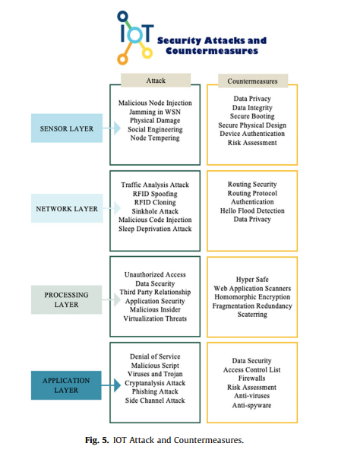
Security Countermeasure in IoT
Security tools of IoT In this section of the we will discuss the protection tools used in the Internet of Things.
M2MLabs mainspring: It is applied to build applications (M2M) such as remote monitoring or smart networks, and it is an open source application. Its capabilities extend to include device configuration and communication between device and application, it can verify data validity, store and recover lost data and rely on Java and Cassandra No SQL as a database
Flutter: Flutter is a basic processor that can be programmed, and it is designed for students and engineers, and it contains a wireless transmitter that may reach more than half a mile, and is characterized by ease of use.
Ssl/Tls: This protocol uses asymmetric encryption to achieve the necessary security for the data and can guarantee the verification of the client’s identity. Enhancing security using certificates may be smart locking by installing an authenticated server certificate and requiring client certificate and encryption.
Node-Red: It is a security tool that links the application programming indicator, IoT devices, and services provided using a browser-based flow editor

Slide 24
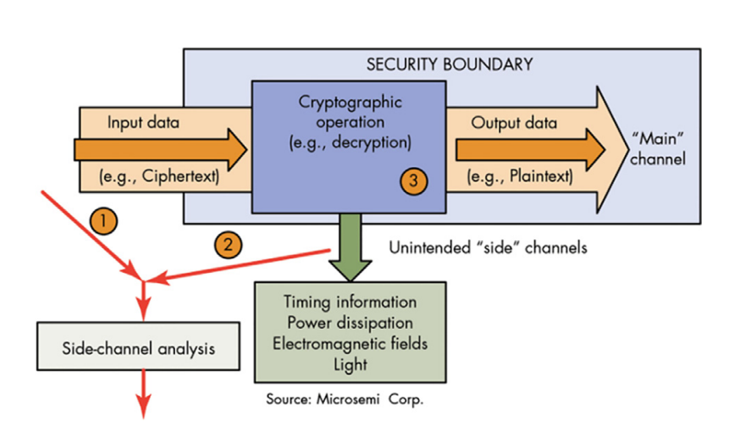
Internet of things safety techniques
Network security: The biggest challenge in the world of the Internet of things is securing networks due to their vulnerability to problems and because of the intricacy associated with them, the diversity of protocols used and standards of wired and wireless communication.
Authentication: Managing multiple users for a single device requires authentication, static passwords are not of the required security level and may be vulnerable to spoofing. Therefore, we need an authentication that gives strength to protection from infringements, such as digital certificates, two-factor authentication, and also biometrics.
Encryption: Due to the need to preserve data integrity and prevent hackers from intruding, we need here to use standard encryption algorithms and protocols, in addition to strong management of encryption keys, because in the case of poor management, this may reduce the overall safety of IoT devices.
Security-side-channel attacks: Indeed, even with sufficient encryption and verification, another danger is conceivable, to be specific, side-channel assaults. Such assaults center less around data move and more on how that data is being introduced. Side-channel assaults (SCAs) gather operational attributes—execution time, power shoppers, electromagnetic spread of the plan to recover keys, and deficiency inclusion.

Slide 25

CONCLUSION
The paper investigates emerging security threats and countermeasures in IoT, focusing on challenges related to sensitive and private information exchange between traveling objects and objects at home/organization
Emerging Security Threats:
  Focus on IoT-specific threats
  Challenges in protecting sensitive and private information
Key Issues for Secure Communication:
  Naming of IoT objects
  Identity management
  Authentication of IoT objects
Communication Scenarios:
  Various scenarios in IoT were examined
  Each scenario presents unique security challenges
Authentication Schemes:
  Several potential authentication schemes were evaluated
  Schemes are applicable to different IoT communication scenarios
Recent Work:
  The presentation talks about some recent security and countermeasures
  Focusing on addressing security concerns in IoT deployment

Slide 26
References
Zhang, Zhi-Kai, Michael Cheng Yi Cho, and Shiuhpyng Shieh. "Emerging security threats and countermeasures in IoT." Proceedings of the 10th ACM symposium on information, computer and communications security. 2015.(Presentation Paper)
A survey on security threats and countermeasures in IoT to achieve users confidentiality and reliability Kholoud Y. Najmi , Mohammed A. AlZain, Mehedi Masud , N.Z. Jhanjhi b , Jehad Al-Amri , Mohammed Baz.
R. H. Weber, “Internet of Things – New Security and Privacy Challenges,” in Computer Law & Security Review, vol. 26, issue 1, Jan 2010, pp. 23-30.
H. Chen, X. Jiao, and H. Li, “A Brief Introduction to IoT Gateway,” in IET International Conference on Communication Technology and Application (ICCTA 2011), Oct 2011, pp. 610-613.
C. M. Medaglia, and A. Serbanati, “An Overview of Privacy and Security Issues in the Internet of Things,” in the Internet of Things, Jan 2010, pp. 389-395.
R. Arends, et al., "DNS Security Introduction and Requirements," in IETF RFC4033, Mar 2005.

