Slide 1
Machine Learning-based Jamming Detection for IEEE 802.11: Design and Experimental Evaluation - Oscar Punal, Ismet Aktas, Gloria Abidin
CSE707 SEM – Wi-Fi Network Security
by Jack Dunfey and Josh Wajnryb

Slide 2
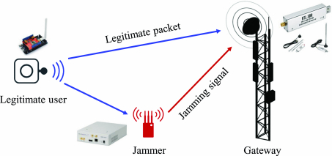
What is Jamming?
Jamming attacks consist of radio signals maliciously emitted to disrupt legitimate communication

Slide 3

Relevance
Current research: Jamming detection has been mainly studied for:
sensor networks (802.11 and 802.15.4 systems)
cellular networks
safety-critical applications
  vehicular ad-hoc networks (VANETs) in particular
The importance of jamming-aware communications is expected to increase in the future

Slide 4

Mitigation
Increasing the robustness of the legitimate signal
Migrating the communication to a different frequency band

Slide 5
Shortcomings of Mitigation-Based
Approach
Many of the proposed countermeasures cannot always be applied on already existing systems
In many cases, only alternative is to try to detect the jammer
Always: Detection requires knowledge of behavior under normal vs jammed conditions

Slide 6
Detecting-based
Approach
Manual Thresholding:
1. Choosing key metrics
2. Choosing an acceptable value range
3. Trigger some action when values are outside of the acceptable range

Slide 7
Why doesn't manual thresholding work?
Set based off of empirical observations: what if conditions change?
Must consider factors like:
Network congestion
Challenging wireless link conditions
What about more metrics?
Should increase accuracy
Complicates the problem of the manual threshold setting.
Notes:
Talk about:
In literature, only few experimentally-evaluated approaches for jamming detection have been proposed
Either do not address 802.11 communications or focus on very specific, and hence hardly generalizable, jamming attacks.

Slide 8
Pros of Machine Learning
Ease of use
(no manual tuning)
Higher accuracy and more generalizable

Slide 9

Metrics vs Helper Metrics
Metrics directly indicate jamming
Helper metrics can provide context to adjust weights of metrics

Slide 10
Good-link vs Bad-link Conditions
Good-link
Bad-link
High signal strength
Low noise levels
Low interference
High throughput
Low signal strength
Heavy noise levels
High interference
Low throughput
Notes:
Interference can come from neighboring networks

Slide 11
Constant vs Reactive Jammers

Slide 12
Constant Jammer
Sends signals as long as possible for as long as possible.
Due to hardware limitations, a truly constant signal is not possible
  Max single signal transmission: 2.7ms
  Min time between signals: 10μs (0.01 ms)
This will not impact the effectiveness of the jammer since 10μs is not fast enough for devices to establish a connection
  μs - equal to one millionth of a second

Slide 13
Reactive Jammer
Starts a transmission when energy on a channel is above a threshold.
This paper wanted a very sensitive jammer, but didn’t want false detections (e.g. reacting to neighboring networks)
  Chose -65dBm
Reaction delay of 12μs
This is fast enough to partially interfere the preamble of the 802.11 signal, which is known to increase the effectiveness of the attack

Slide 14
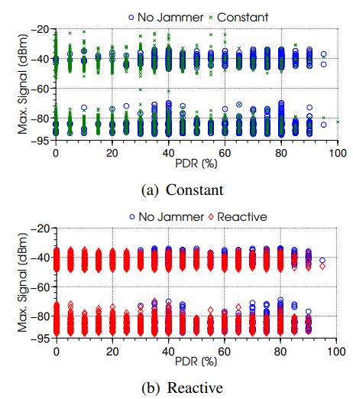
Jammer
Efficiency
Comparison
Notes:
LEARN ABOUT THIS SLIDE

Slide 15

What does a Jammer look like?

Slide 16
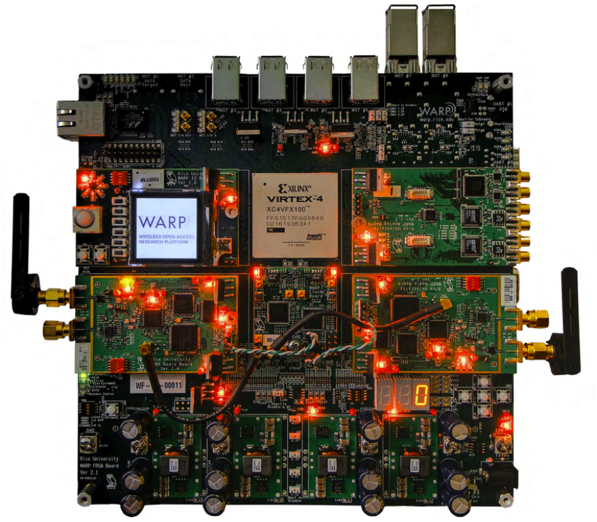
WARP Board Visual

Slide 17
Main Hardware Components of the WARP Board
Xilinx Virtex-II Pro Field Programmable Gate Arrays (FPGA) board
Multiple-Input Multiple-Output (MIMO)-capable radios
  MIMO-capable radios – Custom designed WARP radios that are capable of targeting both 2.4 GHz and 5 GHz Industry, Scientifc, and Medical (ISM) bands.
  Can have up to four radios on a single WARP
10/100 Ethernet port – Serves as the interface between the board and the wired internet.

Slide 18
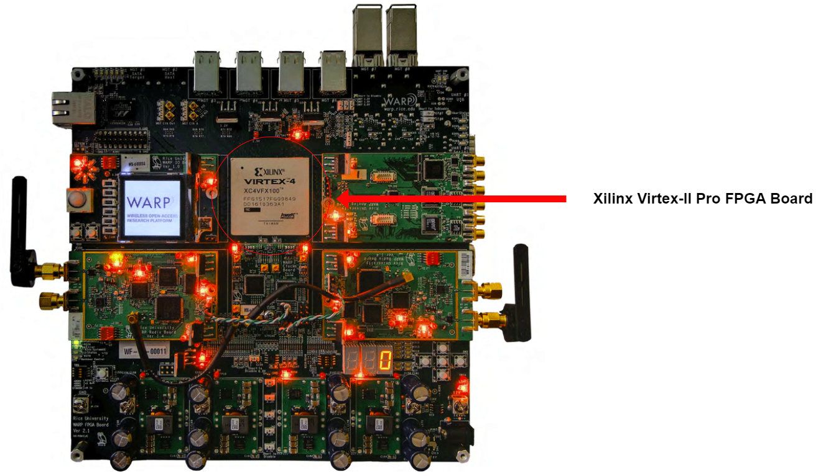

Slide 19
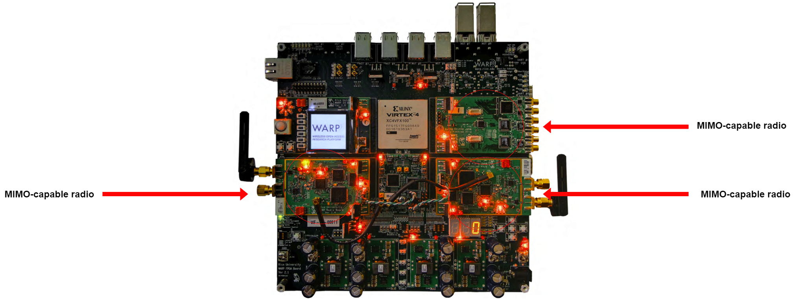

Slide 20
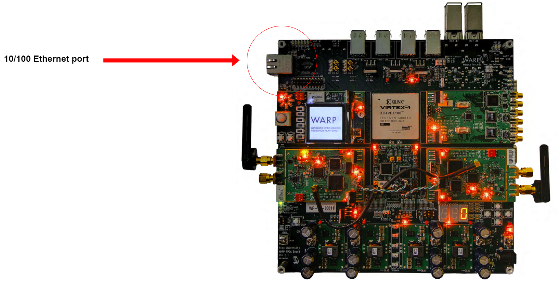

Slide 21

Indicators of Jamming

Slide 22
How are Indicators Selected
Metrics that are accessible via a common driver of commodity 802.11 network interface cards.
Metrics should work regardless of the type of traffic exchanged by the nodes. For instance, we discarded the number of frame retransmissions, since this metric requires the use of ACK frames that are not available in broadcast transmissions

Slide 23
Channel Metrics
Noise
Noise-level is the power measured on the channel during idle times of the transceiver
Channel Busy Ratio (CBR)
The channel is considered busy if the received power is above the clear channel assessment (CCA) threshold.
Notes:
As reactive jamming attacks are launched once the legitimate nodes have gained access to the medium, no impact is expected from this jammer on noise and CBR metric

Slide 24
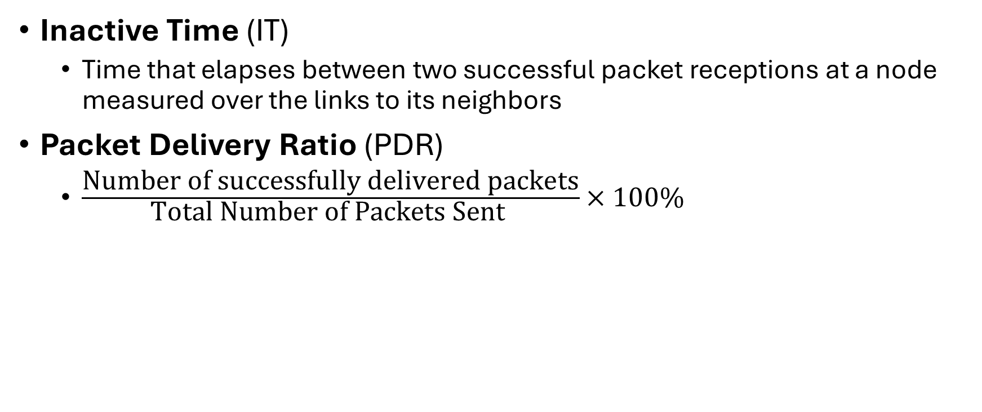
Performance Metrics
Inactive Time (IT)
  Time that elapses between two successful packet receptions at a node measured over the links to its neighbors
Packet Delivery Ratio (PDR)
  $\frac{\text{Number} \text{of} \text{successfully} \text{delivered} \text{packets}}{\text{Total} \text{Number} \text{of} \text{Packets} \text{Sent} }×100\%$
Notes:
This type of metrics can only be obtained if a connection is established between two or more stations. We identify Inactive Time (IT) and Packet Delivery Ratio (PDR) as suitable metrics

Slide 25
Signal Metrics
This metric is a helper metric that provides a useful context for the PDR and the Max IT metrics, although it is not explicitly affected by jamming.
For instance, a low received signal power is likely to result in a low PDR even if the jammer is silent. This knowledge is important to appropriately weigh the significance of PDR and Max IT accordingly.
In our experiments, instead of collecting a single signal metric (i.e., the average power), we have observed that the differentiation between minimum and maximum signal over all links is most valuable.
Notes:
Signal is the power measured upon arrival of a packet, but only passed to higher layers in case of successful reception.
useful context (e.g., link quality)

Slide 26
Overall Metrics Selected
Channel Metrics
Noise: the power measured on the channel during idle times of the transceiver.
Channel Busy Ratio (CBR): measures the time that the wireless channel has been sensed busy.
Performance
Inactive Time (IT): corresponds to the time that elapses between two consecutive successful packet receptions, including probing, beacons, and payload frames.
Packet Delivery Ratio (PDR): measures how many packets sent from a source reach their destination without loss or error.
Signal metrics
Deviation between minimum and maximum signal strength

Slide 27
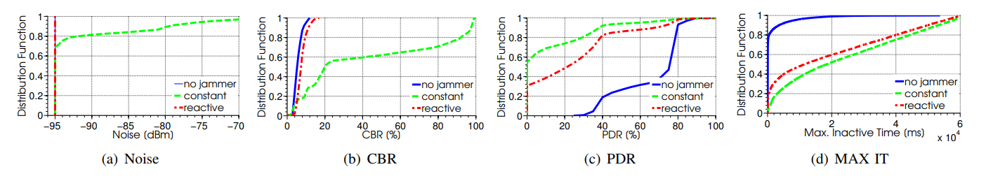
Behavior of Metrics under Various Conditions

Slide 28

Threshold Identification
and an introduction to CRAWLER

Slide 29
CRAWLER
An open-source software for Linux that allows cross-layer developers to express their monitoring and optimization requirements in an abstract and declarative way. Crawler provides many accessors to read and write system information ranging from TCP-IP to our metrics partially gathered directly from the WLAN devices.
Experimentation architecture for system monitoring and cross-layer-coordination that facilitates evaluation of applications and wireless protocols.
It alleviates the problem of complicated access to relevant system information by providing a unified interface for accessing application, protocol and system information.

Slide 30
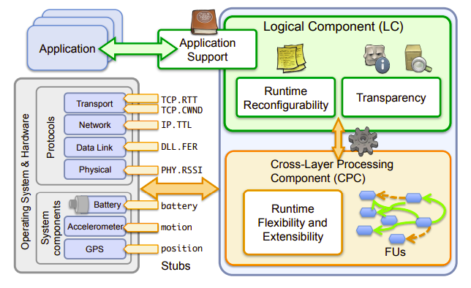
Conceptual View of CRAWLER’s Components

Slide 31

Phase 1: Data Collection

Slide 32
Integration With CRAWLER
Cross-Layer Component: Offer the flexibility to include and prepare diverse metrics from different protocol layers
  Reduce the complexity
    simplify the access to protocol and system information without requiring excessive effort and knowledge about system details
Information Exchange Component: The exchange of probing packets between nodes to measure the PDR

Slide 33

Phase 2: Application of ML on Collected Data

Slide 34
Machine Learning With CRAWLER
Before using machine learning for detecting the presence of a jammer, training data needs to be collected and provided to our machine learning component for learning.
The training data consists of multiple instances of the decision problem, which are themselves divided into input variables or features (i.e., the six selected metrics) and a corresponding output variable or class (i.e., a binary variable stating whether the jammer is active or not).
  Predicting and prediction probability of jamming

Slide 35
Description of Detection Approach
Design overview of detection approach consisting of three components:
  Metrics are accessed via CRAWLER and are provided to the machine learning component.
  Similarly does the information exchange component with the PDR metric.
  Based on the gathered data, the machine learning component decides on the presence of the jammer

Slide 36
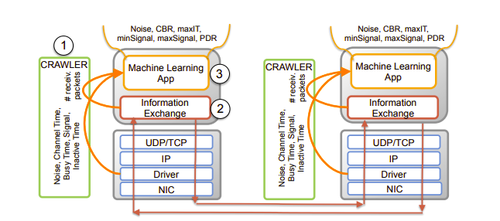
Design Overview of Detection Approach

Slide 37

Evaluation of Approach

Slide 38
Measurement Methodology
Conducted static indoor and mobile outdoor experiments.
Experimental settings consisted of three Linux PCs equipped with 802.11g Atheros WLAN card running the ath9k driver.
The three nodes (devices) were configured in ad-hoc mode and communicate on channel 11 in the 2.4 GHz band.
  Ad-hoc mode: a temporary LAN that doesn't require a router.
  Was not occupied by any other network during the conducted experiments.

Slide 39
More on Methodology Measurements...
For every chosen topology, multiple runs were conducted with a duration of 60 seconds.
The value of the binary output variable (the jammer activity) is introduced off-line once the measurement is finished.
A total of 27000 samples was collected
  9000 for each jammer
  9000 without the jammer
From the final training set, the results are selected 60% for learning and 40% for testing randomly
To minimize the impact of this selection, the learning algorithm is run 20 times considering different subset of samples at each iteration

Slide 40
Random Forest Learning Algorithm
Commonly-used machine learning algorithm that combines the output of multiple decision trees to reach a single result [3].
Decision trees start with a basic question ("should I surf?") and from there, you can ask a series of questions to determine an answer ("Is it a long period swell?" or "Is the wind blowing offshore")

Slide 41
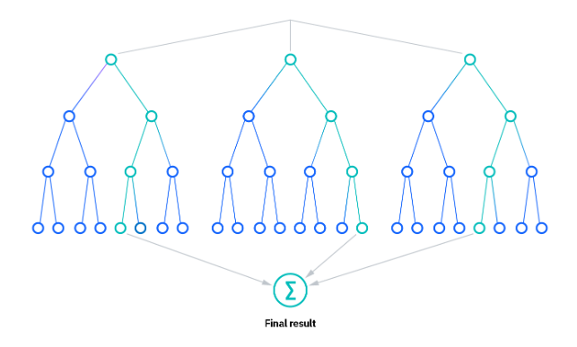
Random Forest Visual

Slide 42
Detection Accuracy
True Positive (TP) rate – the correct detection of existing jammer activity
True Negative (TN) rate – the correct identification that there is no jammer
Although a single metric could be used to some extent to detect a jammer, a holistic consideration of multiple metrics has proven to be a much more successful strategy for efficient jamming detection.

Slide 43
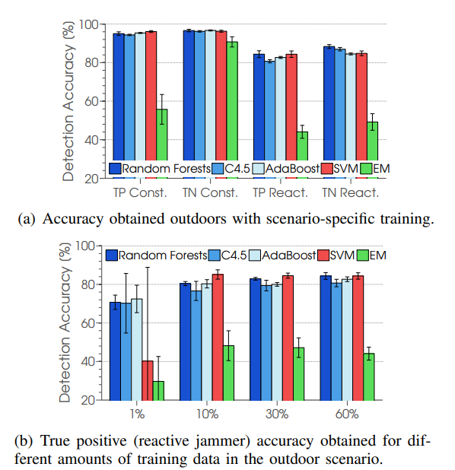
Why a Random Forest model?
Notes:
Highest accuracy amongst various models compared

Slide 44
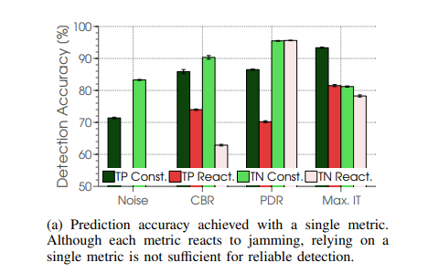
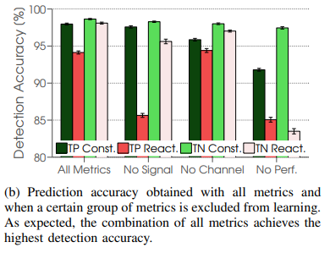
Detection Accuracy in the Indoor Scenario

Slide 45

Outdoor and Mobile Jamming Detection
The scenario is the following:
Two cards at the ends of a parking lot, while mobility was introduced by a third car moving back and forth between the static nodes at a maximal speed of 25 km/h.
The jammer was located close to one of the static nodes.
The wireless link between the static nodes was characterized (without jammer activity) by a low PDR of about 40% that dropped further due to the attenuation caused by the moving vehicle.
Notes:
Switching to Jack
Safety-critical communications in vehicular scenarios have tough reliability constraints and strict delivery deadlines.
Responsive and accurate jamming detection is important to initiate appropriate countermeasures.

Slide 46
Outdoor and Mobile Jamming Detection
Multiple runs of 60 seconds were conducted with a total of 4500 data samples
1500 for each jammer
1500 without jammer
Results show that the constant jammer can be detected with high reliability, while the accuracy for the reactive jammer is slightly above 80%.

Slide 47
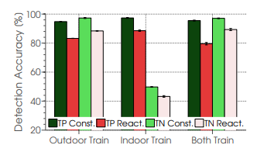
Indoor vs Outdoor Accuracies
Notes:
The indoor trained model does not adapt as well to new environments.
This is likely due to the fact that the outdoor trained model had to be more resilient in response to the ever-changing environment.

Slide 48
Impact of Concurrent 802.11 Traffic
Besides jamming, there are other sources of interference that can impact 802.11 communication.
The ability to evaluate jamming detection activity in the presence of intense traffic generated by a neighbor 802.11 network is critical in this context.
When combining training data samples from different scenarios, high TN and TP rate are obtained, which are comparable with the accuracy achieved by scenario-specific learning.

Slide 49
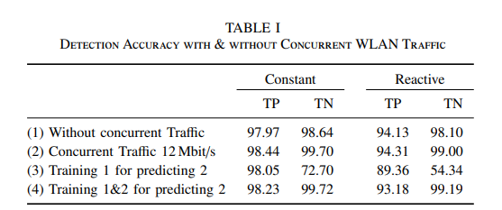

Slide 50
Exploiting Detection History
Every node in the study decides on the presence of a jammer using instantaneous information.
However, the predicted jammer probability features a certain degree of correlation when looking at time.
  A 10 second of a measurement in the outdoor scenario when the constant jammer was active.
The majority of the detection errors are isolated events (they are preceded and followed by correct detections) and that more than five consecutive detection errors rarely happen.
  Small fluctuations of the signal strength under bad-link connections are the main cause for isolated errors.
Notes:
Back to Josh

Slide 51
So how can we exploit detection?
The observations can be exploited for more efficient detection approaches by applying a moving average (mAvg) of a particular window size to account for past probabilities.
  Moving Average: a calculation that creates a series of averages from different selections of a data set
  For a window of size k, the values of k – 1 previous detection probabilities are stored and combined with the current probability.
A 10% higher detection accuracy is achieved with a windows of 3 seconds, as this size is able to efficiently intercept the isolated detection errors.
  Further increasing the windows sizes provides only a moderate gain and can degrade the accuracy as a result.

Slide 52
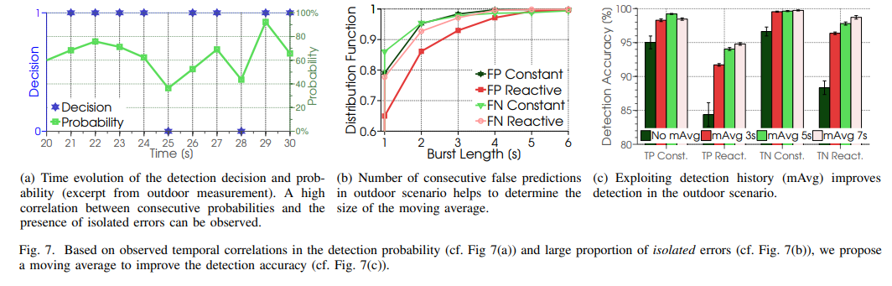
Proof of Exploiting Detection

Slide 53
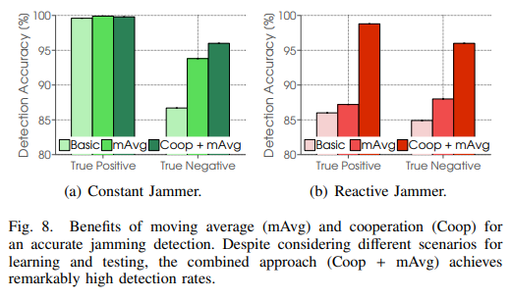
Moving Average Benefits With Both Jammers
Notes:
Coop = cooperative jamming detection (devices on the network running the code together share their thoughts about whether or not they are being jammed)
Used a naïve approach; assumed similar impact extent by jammer (didn’t use GPS – outside scope of paper)

Slide 54
Summary
A machine learning-based jamming detection approach for 802.11 networks that works with off-the-shelf hardware was presented.
Experiments were conducted in both indoor and mobile outdoor scenarios using good/bad-links with concurrent traffic from neighbor networks
  And for constant and reactive jammer types
Shown that exploiting the knowledge of past predictions in combination with cooperative jamming detection significantly improves the detection accuracy.
Compared different popular machine learning algorithms with respect to their accuracy and robustness.
  Out of scope for the paper's findings

Slide 55
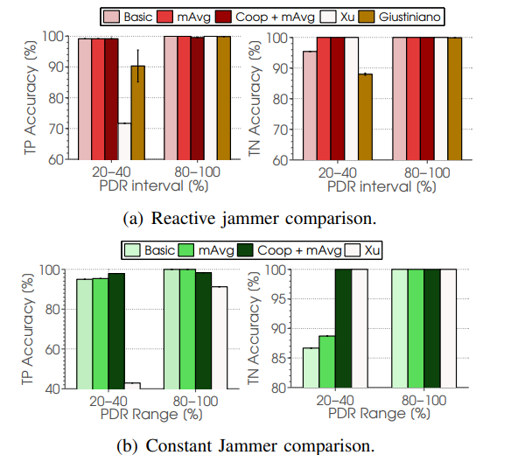
Contrast with Other Solutions

Slide 56
How have things changed…

Slide 57
Improvements since 2014^{[4]}
More advanced models: Deep Learning
Better handles complexity and adaptive jamming attacks
Federated learning used for decentralization
Real-time training and adaptation
Network simulations and adversarial training models allow for secure training and boosts resilience
Modern networks can now detect not only constant and reactive jamming but also intermittent and intelligent attacks that would have previously eluded simpler detection models.

Slide 58
References
[1] Oscar Punal, Ismet Akta, Caj-Julian Schnelke, Gloria Abidin, Klaus Wehrle and James Gross, "Machine Learning-based Jamming Detection for IEEE 802.11: Design and Experimental Evaluation", IEEE Conference on A World of Wireless, Mobile and Multimedia Networks (WoWMoM), 2014.
[2] I. Aktas, F. Schmidt, M. Alizai, T. Drüner, and K. Wehrle. CRAWLER: An Experimentation Platform for System Monitoring and Cross-LayerCoordination. In Proc. IEEE WoWMoM, 2012.
[3] https://www.ibm.com/topics/random-forest
[4] https://ar5iv.labs.arxiv.org/html/2004.06077

