Slide 1
CSE 707: Password Managers
Presented by: Jackey Wang, Nawar Khouri

Slide 2
“I don’t see why I would ever want to use it”: Analyzing the Usability of Popular Smartphone Password Managers
By: Sunyoung Seiler-Hwang, Patricia Arias-Cabarcos, Andrés Marín, Florina Almenares, Daniel Díaz-Sánchez, Christian Becker

Slide 3
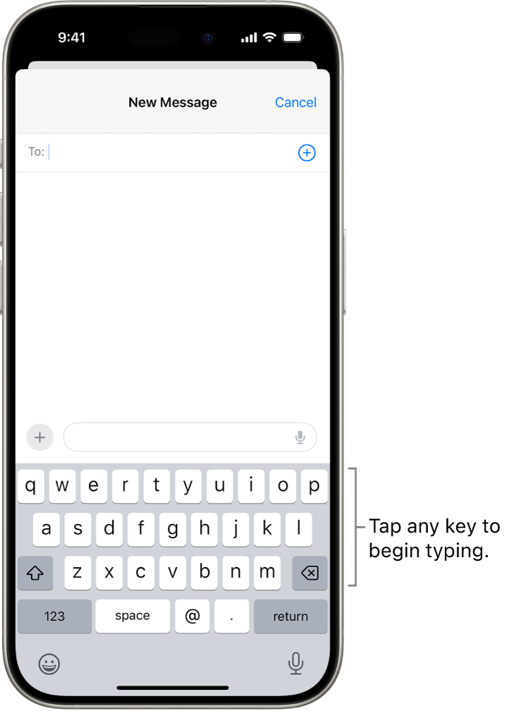
Background
Passwords are everywhere
Most popular form of authentication
Activities that used to be done on computers (Purchases, banking, etc) have now shifted to be done on smartphones.
These activities always require passwords, but interacting with mobile keyboards is very awkward. Many times they’re too small, have different layouts on different devices, need to be shifted to enter special characters, etc
The awkwardness leads to people picking weaker passwords so they have an easier time entering it, leading to weakened security

Slide 4
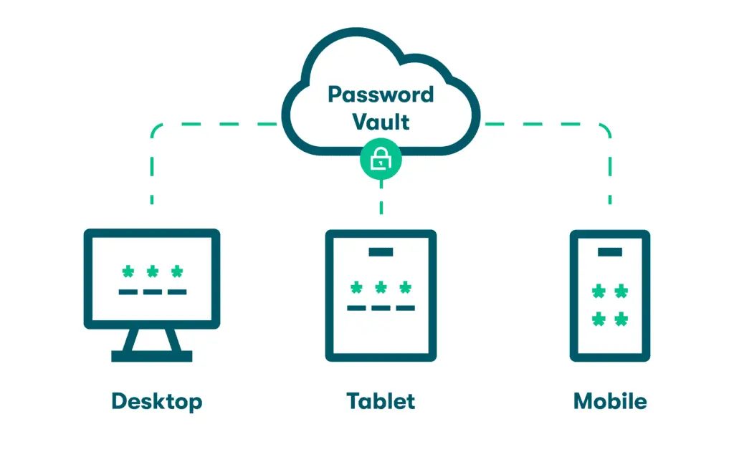
Background - 2
Password managers are tools that improve password usability
They work as wallets that stores all credentials, assisting users during the login process and helps with password creation
The only password the user would have to remember is the password manager’s password
Password managers are recommended by security experts and are proved to have a positive impact in the strength of the generated passwords
Around 16-17% of people have adopted PMs, but for mobile specifically it’s ~7%
Usability has been cited as a potential reason for low usage

Slide 5
Contributions
Empirical study to evaluate the usability of mobile password managers
Quantitative and qualitative evaluation of usability features
  Based on the PACMAD model
    Evaluates the usage the usability of mobile applications
  PMs are also quantitatively evaluated through the standard System Usability Scale
    Allows for objective comparison with other authentication alternatives
    Reported quantitative scores are average and barely acceptable

Slide 6
Contributions - 2
Recommendations for improving usability
  Identified key areas for improvement
  Integration with external applications
  Security, and user guidance and interaction
Findings
  Previous works identified lack of awareness as a big reason for the rejection of PMs
    Found that despite majority of participants knowing what a PM is, very few used one
    After trying a PM, half the users said they wanted to continue using one
  Need to increase usability to get people to use PMs
    According to SUS, when usability scores are above 80th percentile, users start to recommend the app to others

Slide 7




Usability
There hasn’t been any studies done on the usability of PMs
Chose 4 of the most popular PMs for Android and iOS
1password, Dashlane, Keeper, and LastPass were chosen based on their recommendations and number of downloads
These are evaluated qualitatively and quantitatively
Quantitative analysis done based on the System Usability Scale

Slide 8
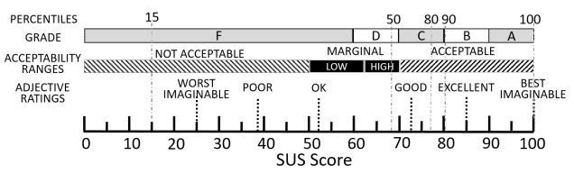
System Usability Scale
Usability Score
  Gives a usability score between 0-100 after asking participants to determine their agreement to a set of 10 statements
    Products with SUS scores above 70 are acceptable
    Products in the high 70s and above are exceptional
  Scores can also be given a grade from A-F
    0-59 F
    60-70 D
    71-80 C
    81-89 B
    90-100 A

Slide 9
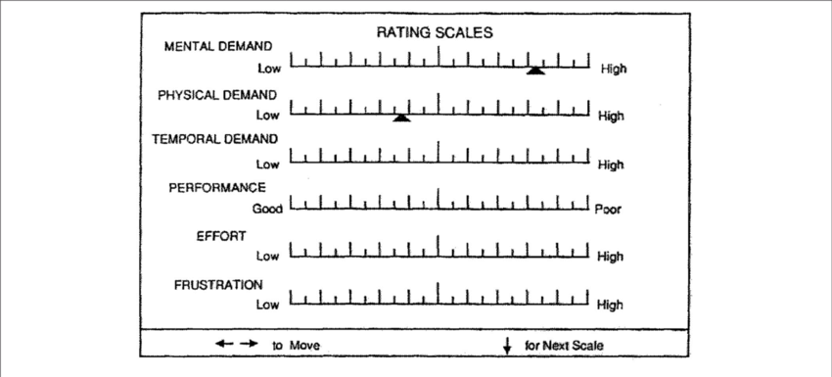
PACMAD
Combines significant attributes from different usability models to create a more comprehensive evaluation framework for mobile devices
Evaluates: Effectiveness, Efficiency, Satisfaction, Learnability, Memorability, Errors, and Cognitive Load
Efficiency is calculated through automated time measurements
Learnability is partially based on SUS questions
Cognitive Load is based on the NASA Task Load Index (TLX)
The rest are based on questionnaires

Slide 10
Structure
Pre-study questionnaire to gather demographic data and their knowledge of PMs
Brief description of what a PM is and install one of the four PMs
Perform predefined tasks. After each task participants respond to a questionnaire to measure usability and understand how they use PMs
Finally, do a post-study questionnaire to get the SUS scores they assigned to the PM

Slide 11
Tasks
Task 1: Initialization
  Install and register to the PM
Task 2: Account Migration
  Store an existing account on the PM
Task 3: Login
  Login with the account you just saved on the PM
Task 4: Account Creation and Usage
  Create a new account and save the account in the PM, and then login to the website
Task 5: Interaction with Native Apps
  Download the app version of the website chosen in Task 4 and login using the PM
Task 6: Password Change
  Change the password of the account in Task 4 using the password generator in the PM, then login
Task 7: Security Settings
  Change the security settings of the PM to reflect their preferences

Slide 12

Demographics
72.5% were male
26.25% were female
1.25% preferred not to answer
Ages were 18-45 years old
75% were younger than 35
8.75% had a high school degree
5% had technical training
56.25% had a college degree
8.75% had a graduate degree
95% came from the USA or India
71.25% preferred Android over iOS

Slide 13

Knowledge
83.75% claimed they knew about PMs
17.5% reported using one
Browser based PMs were mentioned 28.6% of the time
Third-party applications were mentioned 71.4% of the time
6.25% of the self-reported usage wasn’t accurate because the participants said that they couldn’t continue the test using the tested PM because their password was already stored by their browser on iPhone. This indicates that they had a misunderstanding about mobile PMs

Slide 14
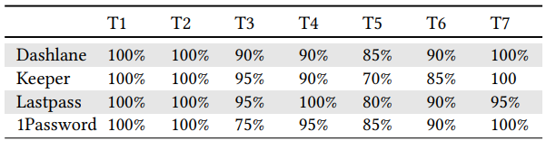
PACMAD Results
Effectiveness
  All four PMs had a 90% success on average for all tasks combined
  Task 5: Download the app version of the website chosen in Task 4 and login using the PM, had the lowest success rate
    Participants expected to be able directly use the autofill feature on the PM, but was required to grant system level permissions outside the application or be aware that autofill didn’t work on every app
Satisfaction
  Positives
    Effective: Liked the fact that you could autofill with the PM
    Simplicity: Responses such as “simple”, “straightforward”, etc
  Negatives
    Lack of guidance: Repeatedly complained that there were lack of instructions, tutorials, or help pages. Some had security concerns from a lack of understanding of PMs
    Lack of features: Had higher expectations of what a PM should be able to do. Expected that PMs should be able to save login details when a user logins or signs up, launch apps for login, update passwords automatically, enable users to use the password generator directly on the site while creating an account
    Mistrusts: Some didn’t like the concept of a PM. Worried that their passwords would be lost if they lost access to the PM. Some were concerned that it would be difficult to login to a new device that didn’t have the PM installed
    Performance: Experienced performance issues they found the PM less reliable

Slide 15
PACMAD Results - 2
Intention to continue using PMs
  Half of participants said they would continue using PMs
  Positive answers
    Liked the increased security and convenience
  Negative answers
    Usability issues. “Didn’t work as described”, too complicated, etc
    Didn’t find a use for it
    Already used another PM
Learnability
  Dashlane, Keeper, LastPass, 1Password <- Order of learnability
  1Password’s learnability was low enough to be statistically significant
  Top 3 are acceptable on the SUS scale while 1Password wasn’t

Slide 16
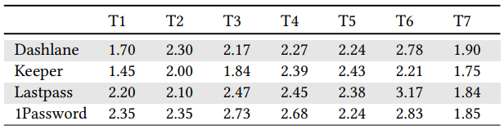
PACMAD Results - 3
Errors
  Success rates of tasks were generally high
  Specific tasks had some mistakes
    Autofill feature, password generation and update, and performance had some parts that were hard to understand
Cognitive Load
  Cognitive load is similar for all four PMs
  PMs are not very mentally demanding
  Tasks 1 & 7 (Installing and configuration of the app) were the least mentally demanding
  Task 6 (Changing password and logging in) is the most mentally demanding. This was also the most common source of errors

Slide 17
SUS Results
Dashlane (76.5) had the highest score followed by Keeper (71), LastPass (69) and 1Password (52.6)
Dashlane and Keeper are considered acceptable, LastPass is almost acceptable, and 1Password is almost unacceptable
Other authentication methods like voice, face, and gesture scored a 78, higher than all of the PMs

Slide 18
Observations
In-app Browser
  Asked participants about the browser they used to login to a website during Tasks 3 & 4 (Login, create account)
    First login 43% used the PM’s browser. Second login, only 18.75% used the PM’s browser
  Possible reasons could be that during Task 3 they were already in the PM, so it was quickest to use its browser, but afterward they either didn’t like the in-app browser or preferred their usual one
  The other 57% didn’t use the in-app browser. Could be because they weren’t aware of it
  Lack of integration in other browsers for features such as autofill and password gen can lead to a dissatisfaction in the PM since the user has to complete further steps

Slide 19
Observations - 2
Password Generation
  After completing Task 4, participants were asked if they’ve ever used automated password generation before
    Participants (28%) who did said it was easier than coming up with an original password, created safer password, or wanted to try it
    Those who didn’t said the PM either lacked awareness of the feature, didn’t care about it, or didn’t trust it
  New password generated were 1-5 characters more than their original passwords. This shows that PMs do have a positive effect on password strength
  Better integration of the password generator and increased awareness of it can lead to stronger passwords

Slide 20
Observations - 3
Preferred Features
  PMs are more than just a storage for passwords. Created a list of 8 options and told participants to pick 6 and rank them by preference
    Alerts about password breaches
    Automated login process using autofill
    Multi factor authentication
    Password generator
    Automated password updates
    Security analysis and feedback
    Password sharing
    Synchronization across devices
  Participants valued autofill over everything else. Password generator, and password updates were also popular. Password sharing was the least popular

Slide 21
Observations - 4
Security Settings
  In Task 7 told participants to configure the app to their liking and asked for their reasoning
    Most reasons can be reduced to
      Making the app more usable
      Making the app more secure
      Minimizing setup effort
  Those that wanted to make the app more usable preferred a fingerprint instead of a master password to ease of use, some disabled lock-on-exit feature, some disabled clear clipboard
  Those that wanted to make the app more secure hid passwords so that people weren’t able to peek
  Those who minimized setup effort left the settings alone because they were content with them

Slide 22
Recommendations
User Guidance and Interaction
  Participants frequently stated lack of guidance on how to use PM
    Lead to errors, unfulfilled expectations, and frustration
    Implement better tutorials, instructions, explanations, and help menus
    Many had to learn how to use the password generator by trial and error
    Most complaints reported when changing application settings as some didn’t know what some options meant
  Some also didn’t know if the task they completed was successful
    Need to implement better feedback to the user

Slide 23
Recommendations - 2
User Guidance and Interaction
  Users were also confused on what a master key was
  Overall, PMs need to:
    Educate users on how it works and why it’s secure
    The concept of a master password - what it is and why it’s important, and how to choose one
    Provide instructions on how to use the app
    Explain what options in the settings mean
  Guided support is important as one of the main problems facing PMs is the lack of trust

Slide 24
Recommendations - 3
User Guidance and Interaction
  Two important aspects for improving user interaction
    Performance: Users need PMs that offer an improved experience compared to simply entering in a password. When the PM works as intended users praised the PM
    Additional features: To improve usability and security it’s important to have additional features. Password generator, autofill, and device synchronization are crucial as that’s what users expect PMs to be capable of. Password updates, alerts for breaches, etc are also welcomed additions

Slide 25
Recommendations - 4
Integration
  Mobile development guidelines recommend apps to minimize text input
  Reflected in PACMAD and SUS. Users chose autofill as the most useful feature because it was easier than having to type or paste passwords.
  Autofill was also the most problematic feature as its integration with apps or browsers wasn’t good or nonexistent
  Recommend improving the interface between PMs and third parties. Requires effort from PM, OS, and third party developers.

Slide 26
Recommendations - 5
Security
  Mistrust was a strong reason for lack of PM adoption
  Better security and better communication about security can increase user trust
  Noticed that the requirements for the master password varied for PMs, some were very minimal
    Lead to some worry that weak passwords were getting accepted
  Recommended for PMs to enforce strong requirements for the master password
  Password strength feedback should be provided to get users to create stronger passwords
  Need to carefully balance convenience and security
  Default settings should be secure as some users trust in whatever the PM has configured

Slide 27
Conclusion
Study revealed that usability issues that were present on desktop/laptop PMs also applied to mobile PMs (Lack of guidance, lack of engagement, and poor integration with other applications and browsers
These issues negatively impact autofill and password generator, core features expected from PMs. This contributes negatively to user experience and security
In addition to the problems mentioned above, the new user experience needs to be improved with tutorials and other helpful resources to improve usability and trust

Slide 28
Paper
https://cse.buffalo.edu/~wenyaoxu/courses/fall2020/CSE741_Fall2020_Ref/Smartphone_Password.pdf

