Slide 1

CSE 707: Wireless Networks Security – Principles and Practices
Group 1:
Aayush Pandey
Kevin Prabhu

Slide 2

A Systematic Study of Physical Sensor Attack Hardness
Authors: Hyungsub Kim, Rwitam Bandyopadhyay, Muslum Ozgur Ozmen, Z. Berkay Celik, Antonio Bianchi, Yongdae Kim, Dongyan Xu
Institutions: Purdue University, KAIST
Published : 2024
Purpose: Introduce the focus on sensor security in robotic vehicles (RVs) and the new insights on attack hardness.

Slide 3
Table of Contents
1. Introduction – Importance of Sensor Security in RVs
2. Problem Statement and Motivation
3. Background on Robotic Vehicles and Sensors
4. Types of Physical Sensor Attacks
5. Current State of RV Security
6. Key Concept – Attack Hardness
7. RVPROBER Framework Overview
8.Methodology – Prerequisites for Sensor Attacks
9. Challenges in Quantifying Attack Hardness
10. Key Findings – Real-World Vulnerability of RVs
11. Impact of Prerequisites on Attack Success
12. Root Cause Analysis of Vulnerabilities
13. Attack Hardness – Prerequisite Analysis
14. Key Findings with RVPROBER
15. Real-World Vulnerability Analysis
16. Implications for RV Developers and Users
17. Recommendations for Countermeasures
18. Misconceptions About Sensor Attacks
19. Root Cause Analysis – In-Depth Findings
20. Generalization of Findings
21. Limitations of the Study
22. Future Work and Research Directions
23. Threats to Validity
24. Related Work
25. Summary and Key Takeaways
26. Conclusion and Q&A
Introduction
Key Concepts in Attack Modeling
Findings and Analysis
Implications and Recommendations

Slide 4

Paper Introduction

Slide 5
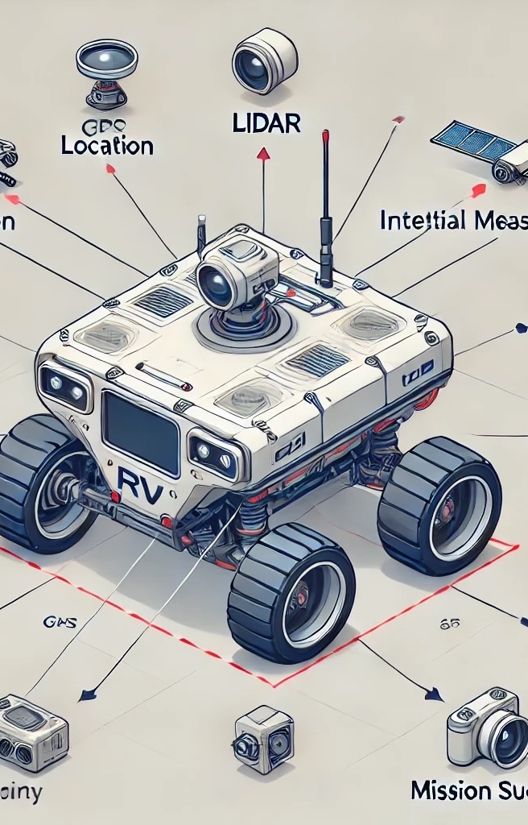
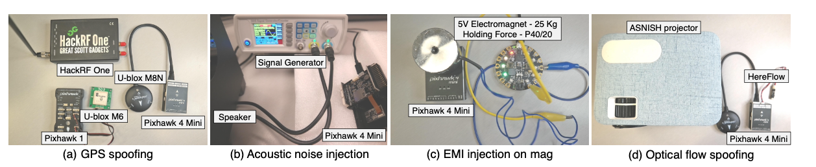
Introduction - Importance of Sensor Security in Robotic Vehicles (RVs)​
In robotic vehicles (RVs), sensors are the foundation of perception and decision-making, guiding navigation, collision avoidance, and operational safety.
Sensor Security: A Critical Aspect in Autonomous Vehicle Operations
Autonomous vehicles (e.g., drones, cars) rely on accurate sensor data to perform critical tasks.
Compromised sensors can lead to mission failures, physical harm, and security breaches.

Slide 6
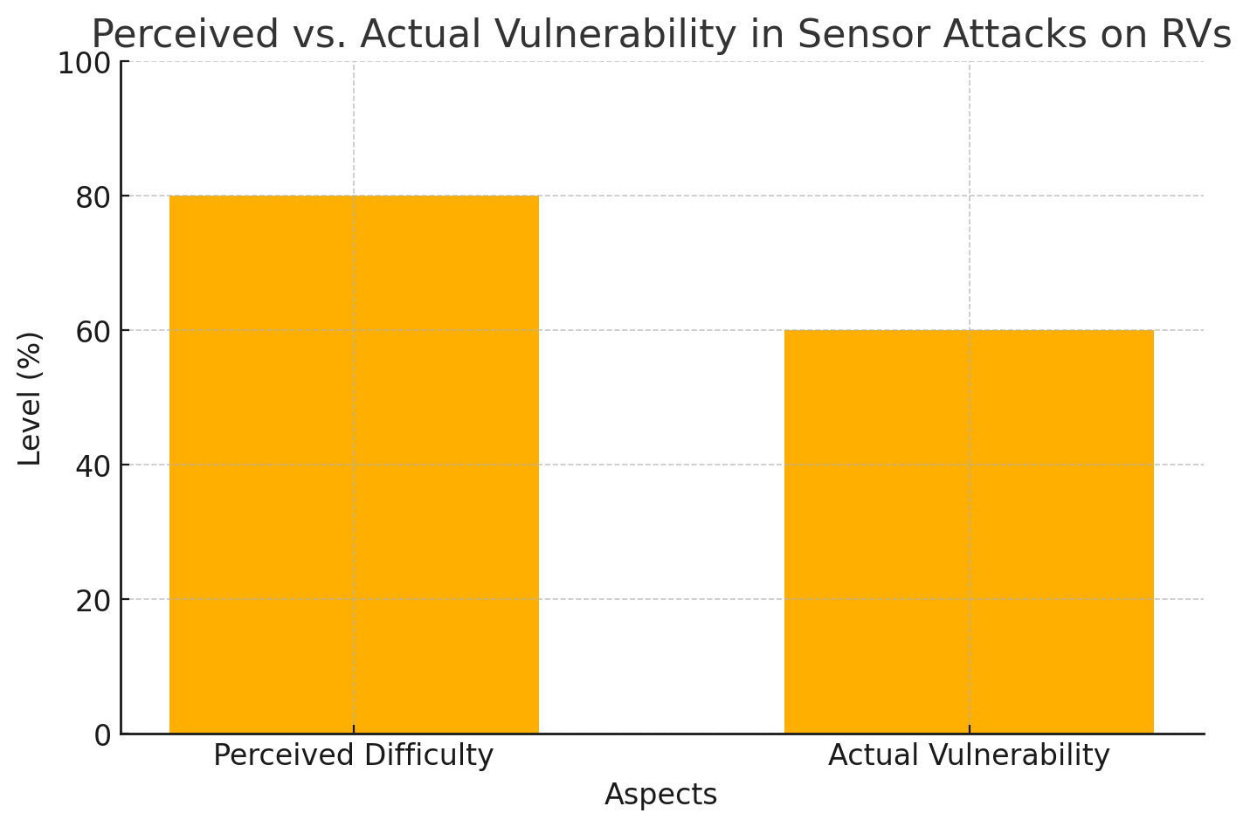
Problem Statement and Motivation
Summary of Contribution
Discovery of Attack Difficulty.
Attack Hardness Analysis Too
Root Cause Analysis.
Evaluation with Real-world Data.
Understanding the Risks and Feasibility of Physical Sensor Attacks
Misconception: Physical sensor attacks are often considered infeasible or too complex to implement.
Objective: This study aims to redefine the 'hardness' of such attacks by quantifying their difficulty.
Key Research Questions:
  What factors make sensor attacks feasible on real-world RVs?
  How can the difficulty of these attacks be systematically measured?
  What is the vulnerability level of actual RVs to these attacks?

Slide 7
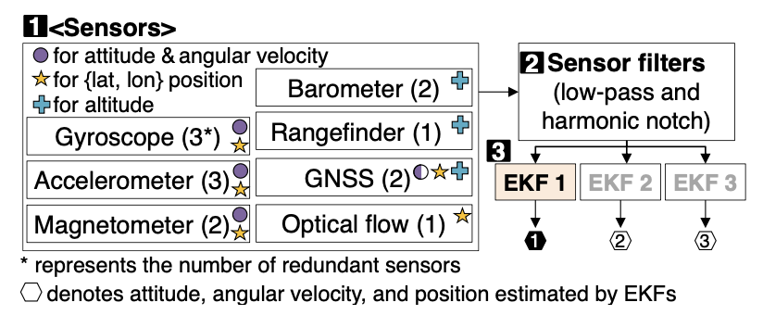
Background on Robotic Vehicles and Sensors
Understanding the Components and Functions of RV Sensors
Robotic Vehicles (RVs): Includes drones, rovers, and autonomous vehicles used for tasks like delivery, mapping, and monitoring.
Key Sensors:
  GPS: Provides precise location data to guide RVs in various terrains.
  IMUs (Inertial Measurement Units): Tracks motion and orientation, ensuring stable navigation.
  Cameras: Captures visual data for situational awareness and object detection.
  LiDAR: Uses light pulses to measure distances, creating a 3D map of the surroundings.
Sensor Fusion: Integrates data from multiple sensors to enhance reliability and accuracy.
Sensor fusion aims to improve the accuracy and reliability of estimating an RV’s physical states (e.g., position). It comprises three primary components: sensors, sensor filters, and sensor fusion algorithms (e.g., EKFs), as shown in Figure .
Illustration of different types of sensors , sensor filters and sensor fusion processes on RVs

Slide 8
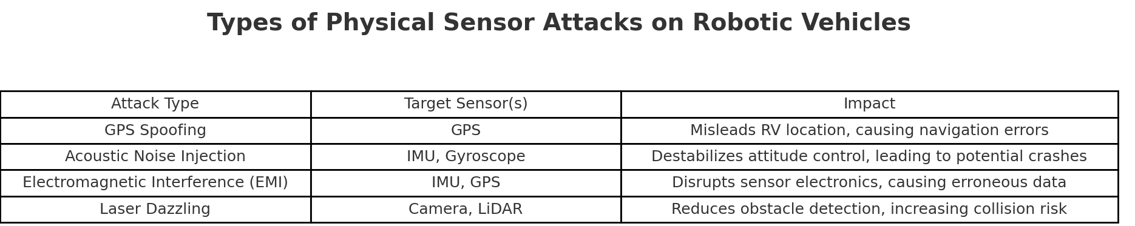
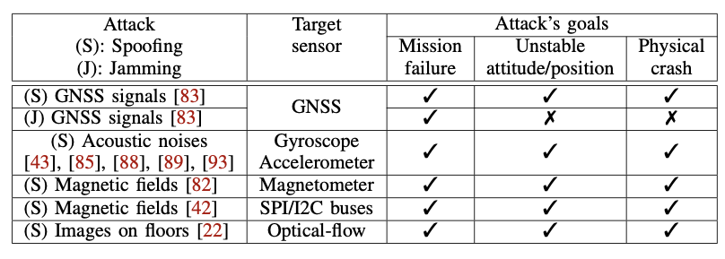
Types of Physical Sensor Attacks
GPS Spoofing:Sends false GPS signals to manipulate the RV’s location data, leading to misguidance.
Acoustic Noise Injection: Uses sound waves to interfere with sensors like gyroscopes, causing loss of stability.
Electromagnetic Interference: Disrupts sensor readings by introducing electromagnetic noise, affecting IMUs and other electronic sensors.
Light Injection Attacks: Targets cameras or optical sensors by flooding them with light, obscuring vision and data collection.
Physical sensor attacks and goals of an adversary

Slide 9
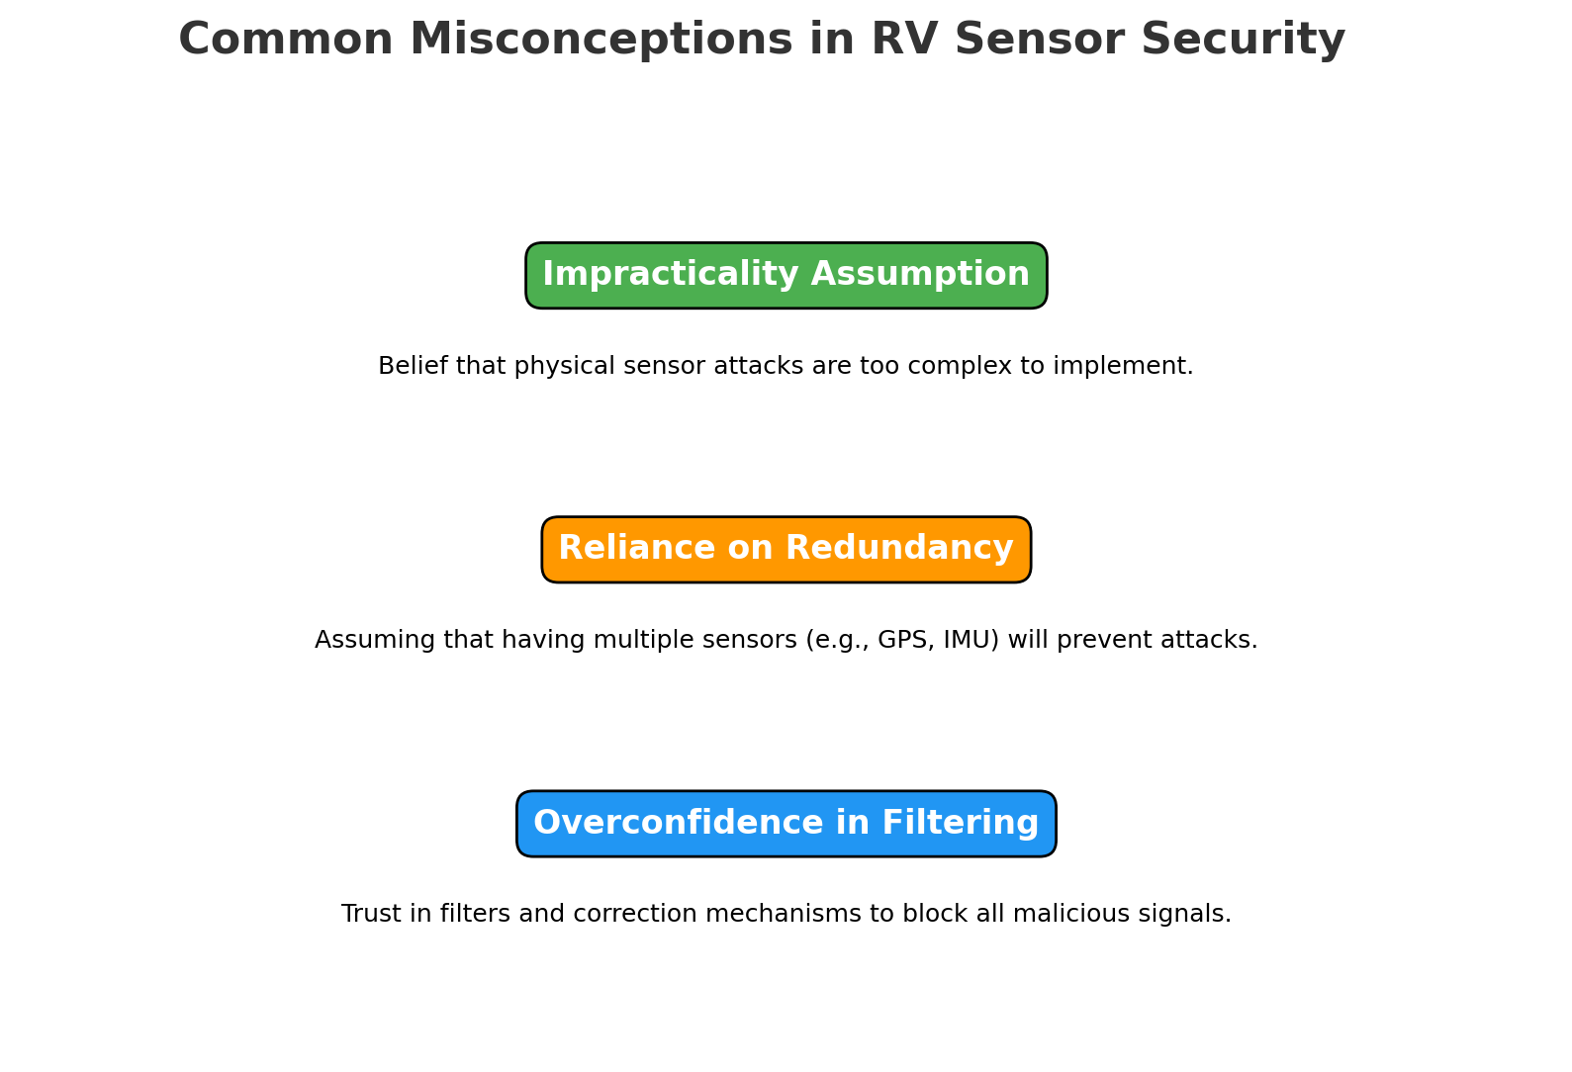
Current State of RV Security
Developer Misconceptions and Realities of RV Sensor Security
Misconception: Developers often believe that sensor redundancy and filtering make physical attacks impractical.
Reality: Under specific conditions, attackers can bypass these measures, posing risks to RV security.
Example: Even with redundant sensors, coordinated attacks can simultaneously affect multiple sensors, bypassing safety checks.

Slide 10
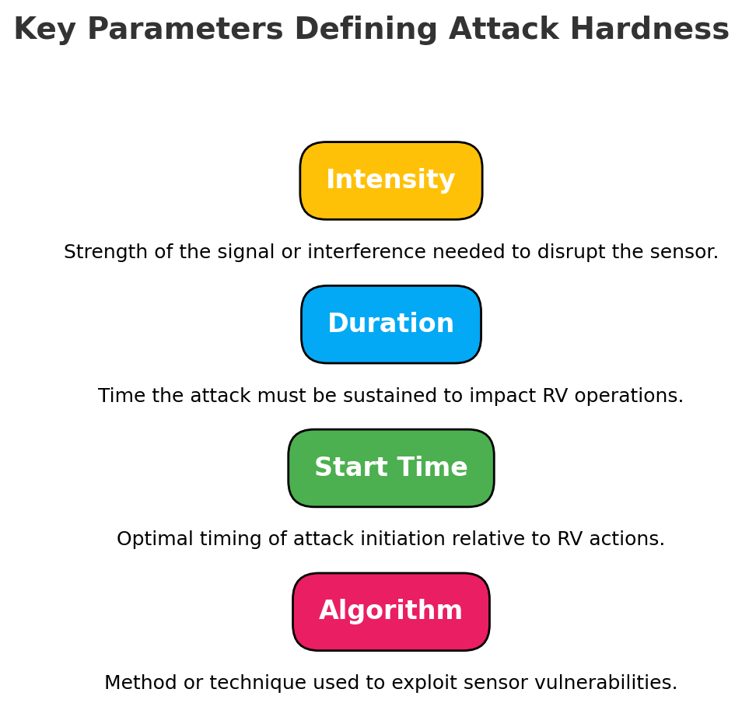
Key Concept: Attack Hardness
Defining the Difficulty of Executing Physical Sensor Attacks
Definition: Attack hardness measures how challenging it is to successfully execute a sensor attack on RVs.
Parameters Influencing Hardness:
  Intensity
  Duration
  Start Time
  Algorithm

Slide 11
RVPROBER Framework Overview
Framework for Identifying Attack Prerequisites and Quantifying Hardness
Purpose: RVPROBER is a framework developed to systematically identify prerequisites for sensor attacks and to measure attack hardness.
Key Process Steps:
Identify Prerequisites: Recognize specific conditions needed to execute each type of attack.
Analyze Difficulty: Assess the challenges associated with fulfilling these prerequisites.
Quantify Hardness: Determine overall attack hardness based on prerequisite complexity and attack parameters.

Slide 12
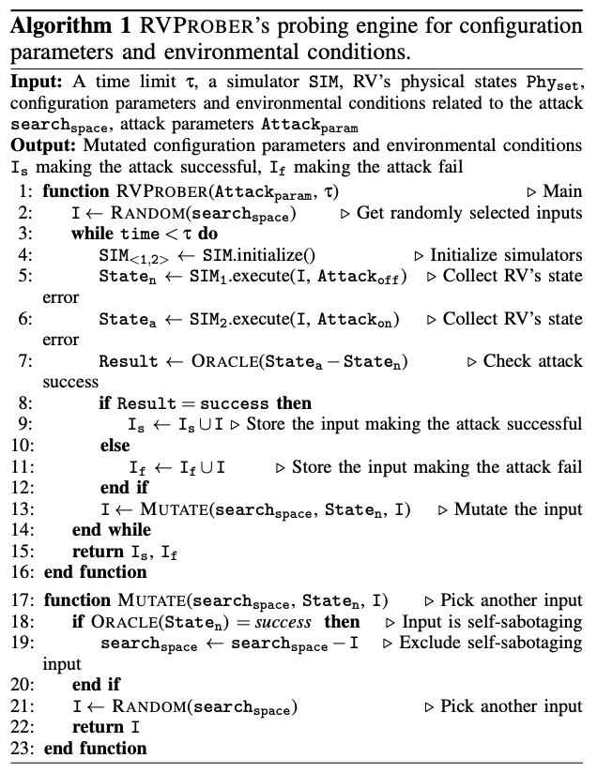
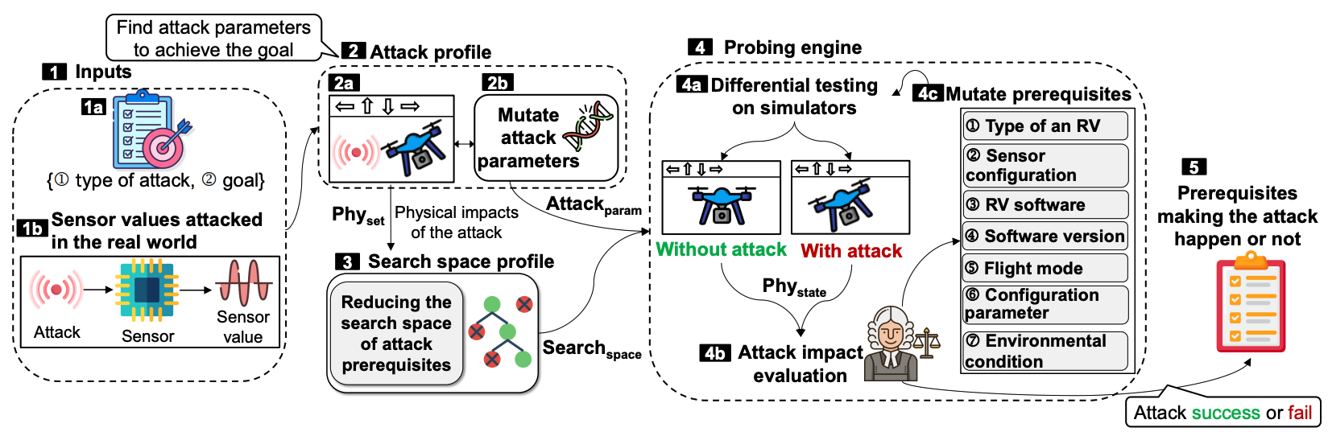
RVPROBER Framework Overview
1. Inputs (Attack Type)
2. Attack Profiling (Identifying physical states & Determining the appropriate attack parameters )
3. Search Space Profile
4. Attack Hardness Quantification ( Differential Testing & Attack Impact Evaluation )
5. Output (Difficulty Score)
RVPROBER takes, as input, a type of attack, its goal, and the sensor values compromised by the attack
Attack Parameters | Determining Attack Success Thresholds | Detailed Steps in Attack Profile |Mutating Attack Parameters
Reduces the high-dimensional search spaces of configuration parameters and environmental conditions as attack prerequisites
RVPROBER’s probing engine aims to achieve :
When RVPROBER identifies prerequisites that enable an attack in a simulated environment, those prerequisites are also required for conducting the attack successfully in the real world; and
When RVPROBER identifies prerequisites that disable an attack in a simulated environment, those prerequisites also make the attack fail in the real world.
Overview of RVPROBER’s workflow.

Slide 13

Key Concepts in Attack Modeling

Slide 14
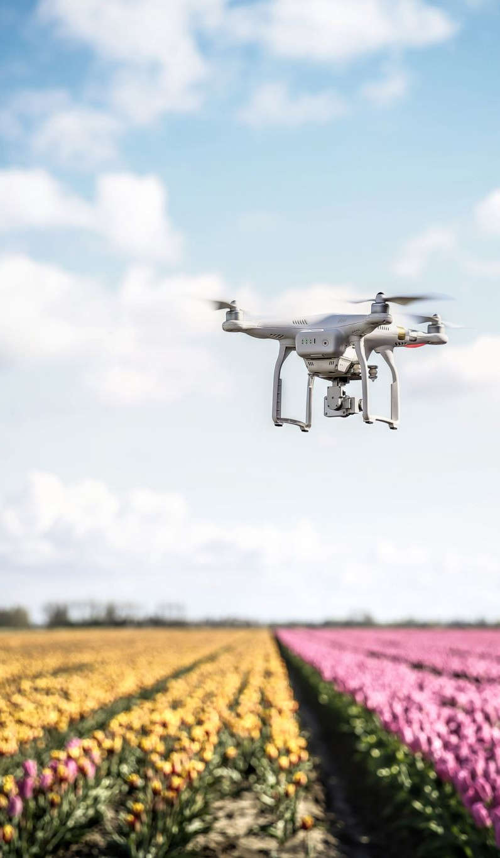
Methodology: Prerequisites for Sensor Attacks
Prerequisites Breakdown: The RVPROBER framework identifies seven key prerequisites that influence the success of sensor attacks on robotic vehicles.
These include:
RV Types: Certain RV types are more susceptible, depending on the environment (e.g., drones in air vs. rovers on land).
Sensor Configurations: Successful attacks often require the RV to have specific sensor configurations.
Software Versions: Different RV control software versions offer varying levels of resistance, especially with enhanced fail-safe logic in recent versions.
Flight Modes: Flight modes determine sensor use—e.g., “Loiter” mode leverages all sensors, making it more vulnerable.
Configuration Parameters: RVs may be configured with different sensor weights and filter settings.
Environmental Conditions: Prerequisites may include stable conditions like consistent GPS signals.
Attack Parameters: Parameters like intensity, timing, and duration impact the attack success rate.

Slide 15
Challenges in Quantifying Attack Hardness
Obstacles to Measuring Attack Feasibility Accurately
Environmental and Simulation Limitations:
The study faced environmental challenges, as real-world factors like signal interference and weather variability can impact the consistency of attacks. Simulated environments, while helpful, cannot replicate all real-world conditions, which may reduce result accuracy.
High-Dimensional Search Spaces:
With numerous variables, RVPROBER had to address expansive search spaces for various prerequisites. Using a binary search algorithm and dynamic analysis allowed for narrowing down relevant configurations.

Slide 16
Key Findings: Real-World Vulnerability of RVs
Identifying Vulnerabilities in Actual RV Configurations
Significant Real-World Vulnerability Rate: Analysis of 30,059 real-world RV logs revealed that around 57.08% of RVs are vulnerable to physical sensor attacks, underscoring the necessity of security improvements.
Misconceptions in Current RV Security: Despite these vulnerabilities, developers often assume that sensor redundancy is a sufficient countermeasure, overlooking coordinated interference and attack prerequisites.

Slide 17

Impact of Prerequisites on Attack Success
Analyzing How Prerequisites Influence Attack Outcomes
Prerequisite Fulfillment and Attack Success: The study observed that attacks are much more successful when prerequisites are met. For example, GPS spoofing requires conditions where legitimate signals can be overridden by the spoofed signal.
Defensive Strategy Insights: This data suggests that disrupting these prerequisites—like creating environments where sensor redundancy is more effective—could be a powerful defensive approach.

Slide 18

Root Cause Analysis of Vulnerabilities
Identifying Core Factors Behind Successful Sensor Attacks
Design Flaws and Lack of Redundancy: RV software often has weak fail-safe logic, insufficient data validation, and reliance on single sensors, making attacks like GPS spoofing more feasible.
Examples: Some RVs lack mechanisms to verify data consistency across multiple sensors, allowing a single compromised sensor to disrupt the entire system.

Slide 19
Attack Hardness – Prerequisite Analysis
Analyzing How Prerequisites Affect Attack Difficulty
Complexity of Prerequisites: Certain attacks are inherently harder to execute due to specific environmental conditions, precise sensor configurations, or multiple required disruptions (like interfering with IMUs across multiple frequencies).
Example: Acoustic noise injection attacks, for instance, require specific resonance frequencies for different sensors, making simultaneous disruption more difficult.

Slide 20
Key Findings with RVPROBER
RVPROBER's Effectiveness in Identifying Attack Prerequisites
RVPROBER’s Effectiveness: By automating the identification of prerequisites and enabling structured simulations, RVPROBER increased the number of successfully detected vulnerabilities from 6 to 11.
Practical Impact: RVPROBER highlights previously unidentified attack prerequisites, aiding developers in enhancing RV security by addressing these critical conditions proactively.

Slide 21

Findings and Analysis

Slide 22
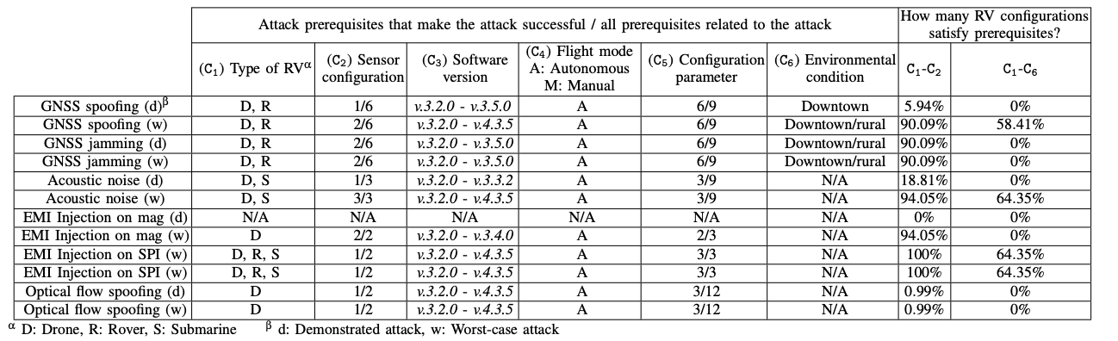
Summary of required prerequisites to achieve, as the attack’s goal, “Physical crash” in ArduPilot and how many real-world RV configurations satisfy the required prerequisites.
Real-World Vulnerability Analysis
Insights from Analysis of RV Logs and Vulnerability Trends
Analysis Scope: Over 30,000 RV logs were reviewed
Finding: Many real-world configurations frequently meet the prerequisites for sensor attacks, indicating potential security risks.
Implication: Need for ongoing assessment and adaptive security measures in RV design and deployment.
When the real-world RV configurations satisfy the “type of RVs” and “flight mode” prerequisites, a majority of the attacks can successfully achieve their goals | Quantified hardness of the attacks being consistent at around 61%
Only 0.64% of the actual users are vulnerable to the optical flow spoofing attacks.
Only “GNSS spoofing”, “acoustic noise”, and “EMI on SPI” attacks can make RVs physically crash.
24.7% of ArduPilot users are still not vulnerable to white-box attacks because they leverage manually-controlled flight modes. On the contrary, none of PX4 users are immune to white-box attacks due to design flaws

Slide 23
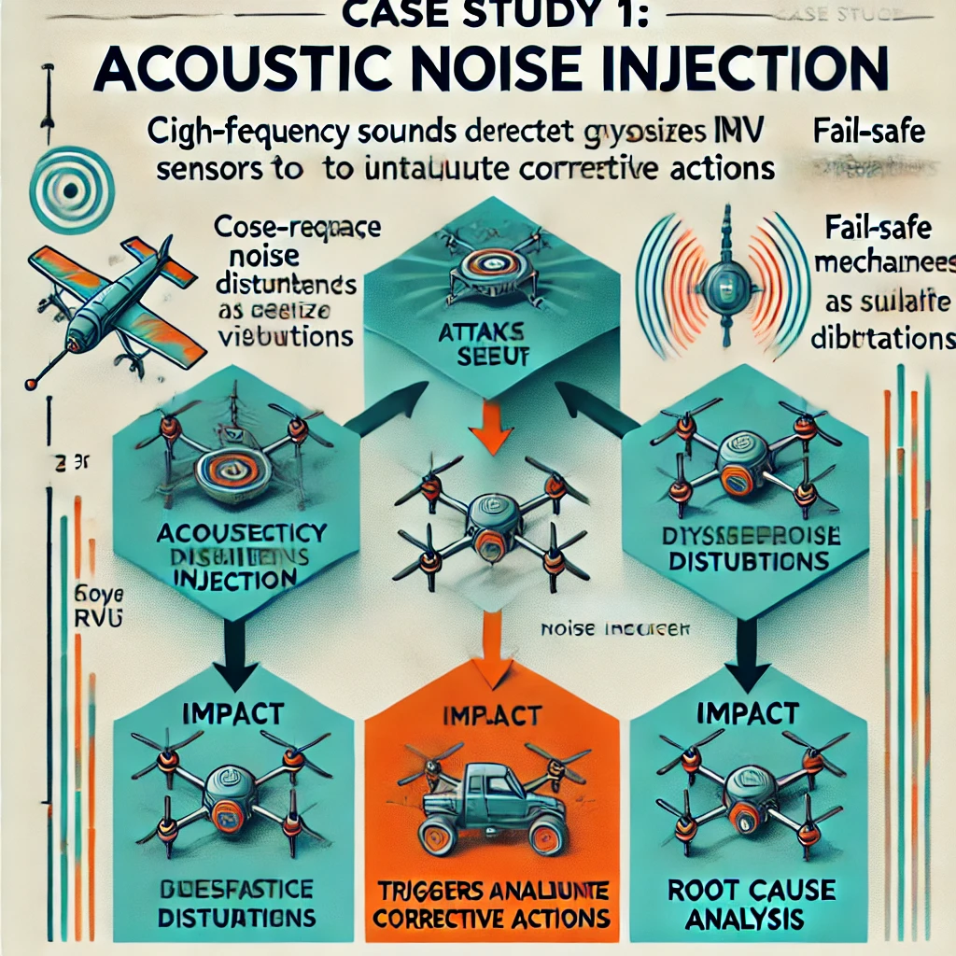
Case Studies – Acoustic Noise Injection and Electromagnetic Interference (EMI) Attacks
Case Study 1 – Acoustic Noise Injection
Attack Setup
Simulated using prerequisites identified by RVPROBER.
Impact
Noise injection destabilizes the RV’s gyroscope readings, causing attitude control issues.
Despite fail-safe logic, the RV crashes due to the system interpreting the noise as extreme vibrations.
Root Cause Analysis:
The fail-safe mechanisms misinterpret the acoustic noise as physical vibration, activating a less accurate complementary
ArduPilot and PX4 differ in response; ArduPilot misinterprets the noise as GPS signal disturbance, worsening stability, while PX4’s fail-safe triggers too late, failing to prevent the crash.
Key Prerequisites
Specific RV types vulnerable, such as drones with a single IMU.
Acoustic noise directed at IMUs within close range.

Slide 24
Case Study 2 – Electromagnetic Interference (EMI) Injection
Attack Setup
Performed on RVs with sensor configurations linked via SPI/I2C buses.
Impact
EMI injection corrupts sensor readings across all IMUs, resulting in loss of altitude and attitude control, causing a crash.
Root Cause Analysis:
Fail-safe logic in both PX4 and ArduPilot inadequately handles EMI. PX4’s response is delayed and insufficient, merely sending a warning to ground control or deploying a parachute too late.
Key Prerequisites
Specific configurations of sensors are required to ensure the EMI impacts crucial sensor data.
Proximity to electromagnetic generators positioned close to sensor hardware.
ArduPilot’s design flaw assumes at least one unaffected sensor, which fails when all sensors on the SPI/I2C buses are compromised.

Slide 25

Implications for RV Developers and Users
The high vulnerability of RVs to sensor attacks underscores the need for improved security practices among developers and heightened awareness among users.
Strengthen Fail-Safe Logic: Implementing robust logic that detects compromised sensor data to prevent mission failures.
1
Regular Software Updates: Ensuring continuous updates to maintain defense
2
Incorporate Attack Prerequisites into Design: Identifying and mitigating high-risk prerequisites in sensor system development.
3

Slide 26
Recommendations for Countermeasures
Based on the study’s findings, these countermeasures are recommended to reduce the risk of successful sensor attacks on RVs.
Enhanced Sensor Security: Implement advanced security protocols to protect sensors from external interference and manipulation.
Regular Patching and Updates: Continuously update firmware and software to protect against new vulnerabilities and attack methods.
Continuous Monitoring: Employ real-time monitoring systems to detect unusual behavior or potential breaches in sensor data integrity.

Slide 27

Misconceptions About Sensor Attacks
Belief in Impracticality: Many assume that physical sensor attacks are too difficult to execute, ignoring feasible attack methods.
Over-reliance on Redundancy: Developers often believe sensor redundancy can fully mitigate attacks, underestimating coordinated interference possibilities.
Misconception of Attack Detection: There is a common belief that all sensor attacks will trigger alerts, overlooking stealthy interference techniques.
Addressing Common Myths Around Sensor Security in RVs

Slide 28

Root Cause Analysis – In-Depth Findings
Detailed Exploration of Root Causes Behind Vulnerabilities
Design Flaws in Fail-Safe Logic: Current fail-safe mechanisms often trigger delayed or insufficient responses, leaving RVs vulnerable..
Weak Sensor Filtering Mechanisms: Lack of robust data filtering makes RVs susceptible to sensor spoofing and injection attacks.
Dependence on Single-Sensor Readings: Insufficient redundancy and verification across sensors create single points of failure.

Slide 29
Generalization of Findings
Performed a total of 33 real-world attacks: 11 GPS spoofing attacks, 10 acoustic noise injections, 10 EMI injections on magnetometers, and 2 optical flow spoofing attacks.
RVPROBER detected 11 successful attacks compared to 6 in a manual assessment by systematically analyzing prerequisites.
The RVPROBER framework was used to analyze seven key prerequisites that influence the success of sensor attacks on RVs.
Applicability: These findings are relevant beyond the specific RV platforms tested (e.g., ArduPilot, PX4).
Broader Impact: Other RV platforms ( Automotive| Defense | Logistics and Delivery )
Recommendation: Implementing security practices across different RV platforms for improved resilience.

Slide 30

Limitations of the Study
Acknowledging Constraints in Study Scope and Methodology
Focused RV Configurations: The study primarily examined specific RV configurations, potentially limiting the generalizability of findings.
Simulation Constraints: Simulations may not capture all real-world environmental variables, affecting result accuracy.
Limited Sensor Types: Not all sensor types were assessed, which may leave gaps in understanding attack susceptibility across varied sensors.

Slide 31

Implications and Recommendations

Slide 32

Future Work and Research Directions
Expanding RVPROBER Capabilities: Future directions include expanding RVPROBER to assess a broader range of sensor attack types, such as newer jamming techniques or attacks against alternative sensor technologies.
Broader Empirical Validation: Conducting real-world validation across a wider variety of RV platforms could help generalize findings. This includes testing on more proprietary or commercially available RVs beyond open-source platforms.
Developing Cost-Effective Security Solutions: Another key focus is creating scalable and cost-effective security measures that adapt to evolving RV technologies, with minimal impact on performance.

Slide 33
Threats to Validity
Limitations in Real-World Data Representation: Real-world RV logs may not capture the full range of possible RV configurations and operating conditions, which could impact the generalizability of the findings.
Simulation Constraints: Simulated environments don’t fully capture all real-world complexities, meaning some findings may vary under real conditions.
Sensor Variability: Different sensor models and configurations can affect attack outcomes, which means certain vulnerabilities may not apply universally across RVs.

Slide 34
Related Work
Overview of Key Studies on Sensor Attacks in Robotic Vehicles
Comparative Studies on Sensor Security: Previous studies have mostly focused on individual sensor vulnerabilities (e.g., GPS or gyroscope attacks) without a comprehensive framework like RVPROBER to quantify attack difficulty systematically.
Contributions Beyond Previous Research: The research contributes uniquely by offering an in-depth analysis of attack prerequisites and providing a structured approach for evaluating sensor attack feasibility, filling gaps left by prior studies.

Slide 35
Summary and Key Takeaways
Highlights of the Study and Contributions to RV Security
  Attack Hardness Analysis: Introduced a new framework to quantify sensor attack difficulty, focusing on how prerequisites affect attack success.
  RVPROBER Tool: The RVPROBER framework has enhanced the detection of vulnerabilities by identifying critical conditions for successful attacks.
  High Vulnerability Rates: Found that 57.08% of real-world RV configurations are vulnerable to sensor attacks, highlighting the importance of robust security.

Slide 36
Conclusion and Q&A
Final Thoughts on Advancing Sensor Security in Robotic Vehicles
Future-Ready RV Security: Emphasize the importance of continuous innovation in sensor security for RVs to keep pace with evolving threats.
Encouragement for Further Research: Future work will focus on developing scalable, adaptive security protocols that can protect RVs in diverse conditions.

Slide 37
Thank You

