Slide 1
Lecture 18
CSE 331
Oct 15, 2021

Slide 2

Please have a face mask on

Slide 3
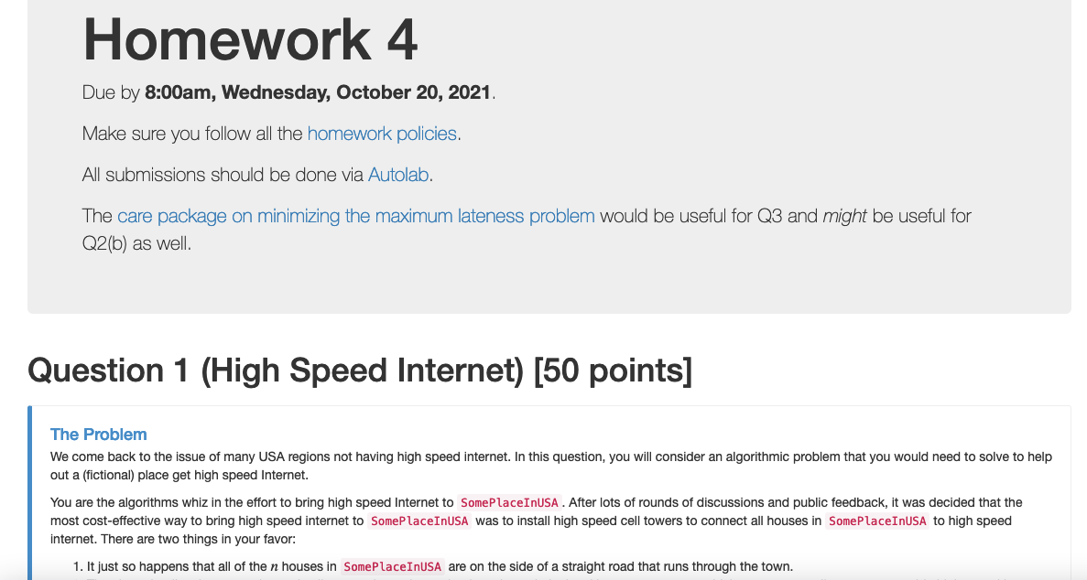
HW 4 is out
Probably the easiest HW

Slide 4
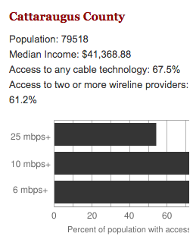
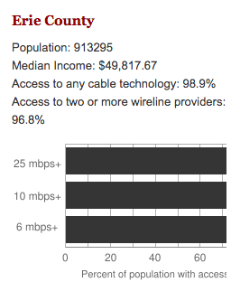
Make broadband more available
BOTH technical and societal issues
Say you are tasked to come up with the infrastructure

Slide 5
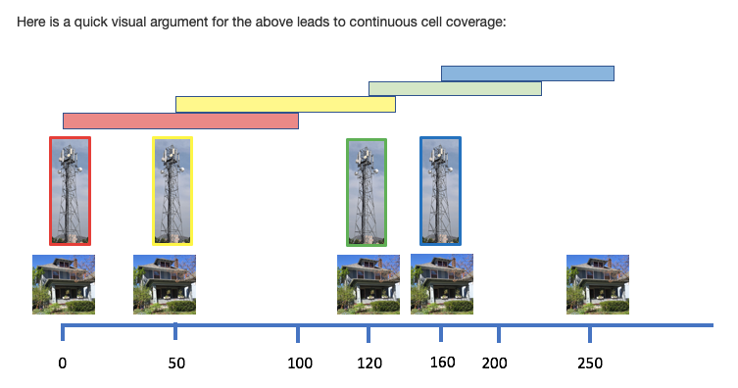
HW 4 Q1: How to lay down towers

Slide 6
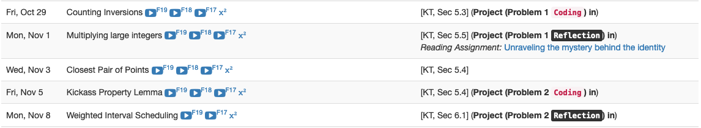
Project deadlines coming up

Slide 7
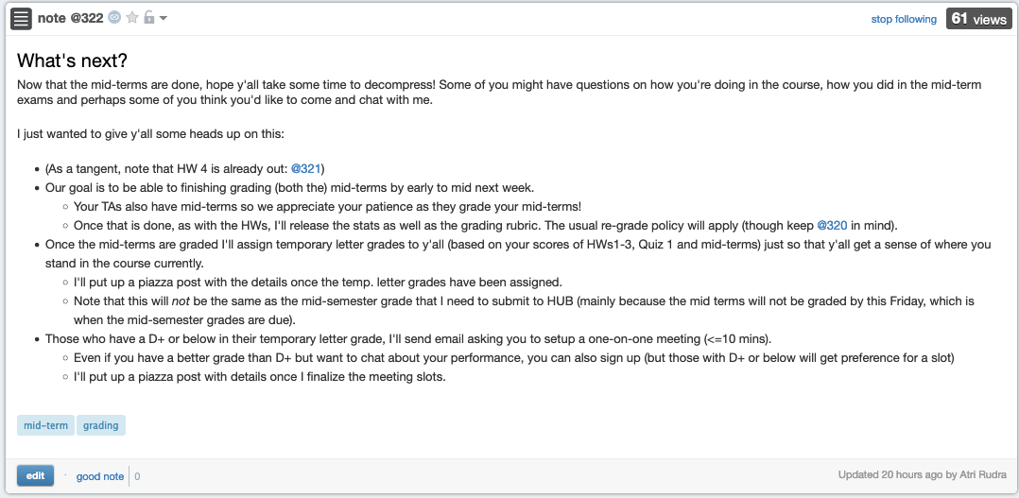
Some other stuff coming up

Slide 8
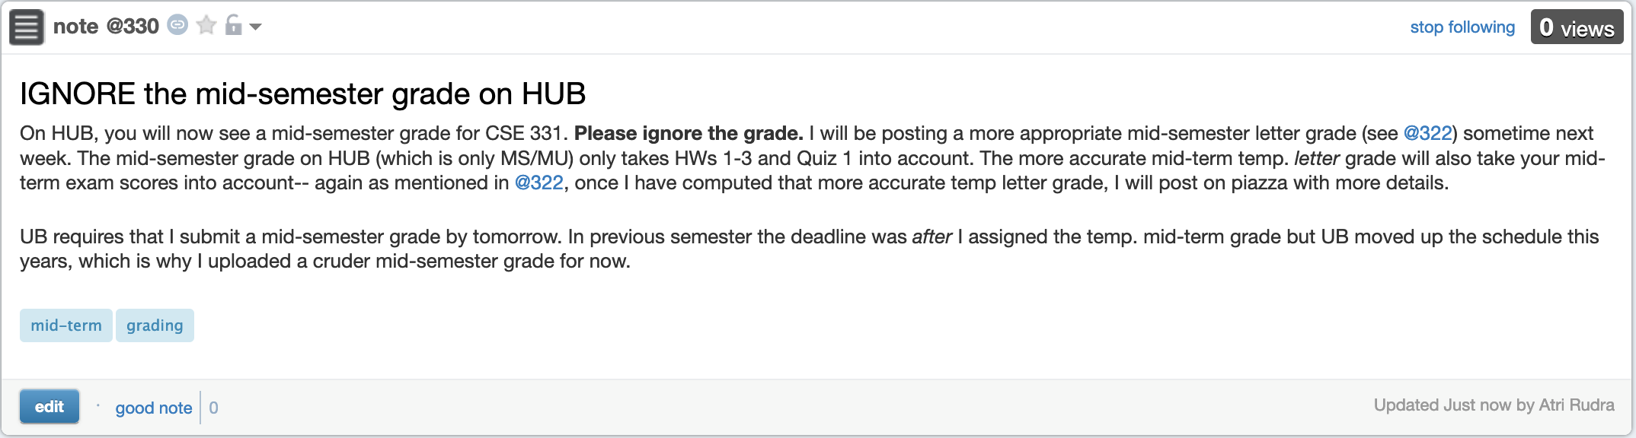
Mid-semester grade on HUB

Slide 9
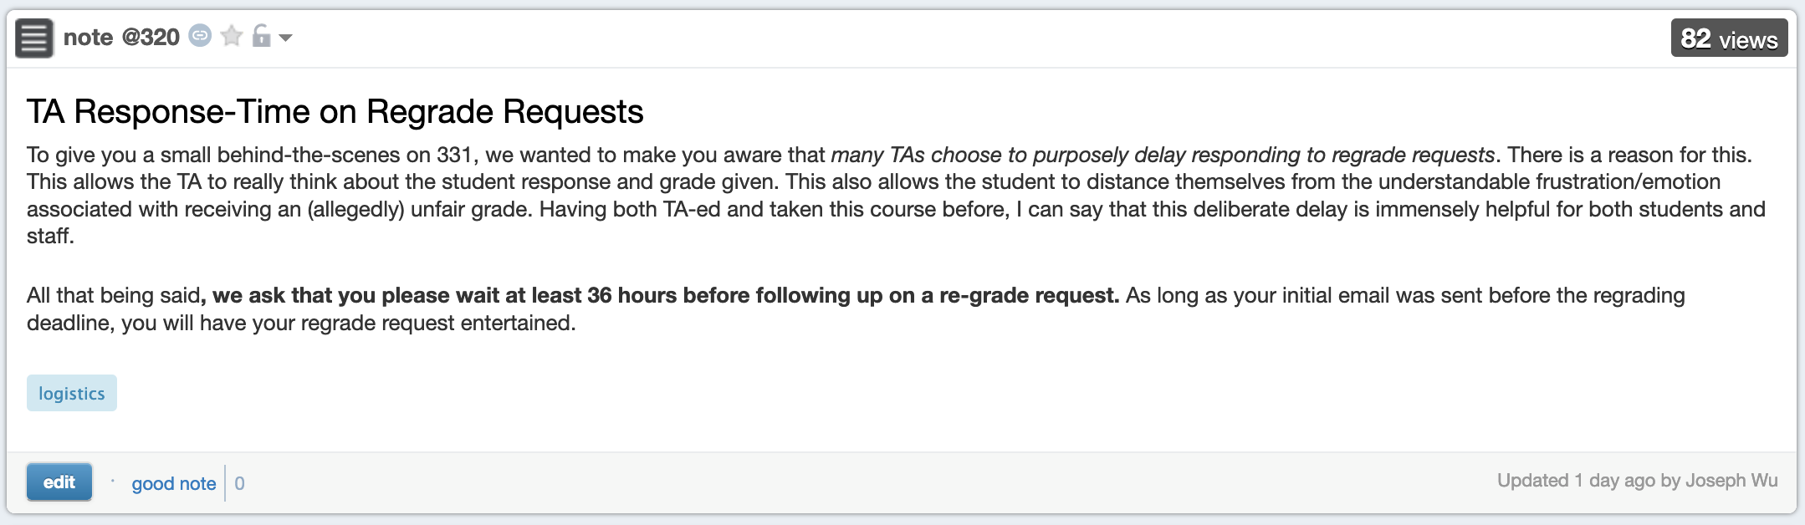
Note on re-grade requests

Slide 10

Questions?

Slide 11
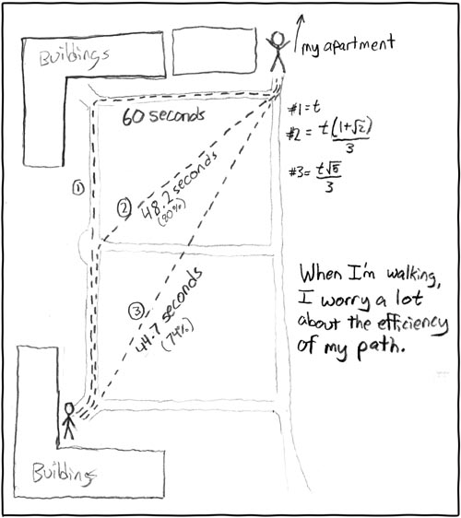
Shortest Path Problem
http://xkcd.com/85/

Slide 12

Another more important application
Is BGP a known acronym for you?
Routing uses shortest path algorithm

Slide 13
Shortest Path problem
s
100
Input: Directed graph G=(V,E)
Edge lengths, l_{e} for e in E
“start” vertex s in V
w
5
15
u
s
s
w
5
5
15
u
u
Output: Length of shortest paths from s to all nodes in V

Slide 14
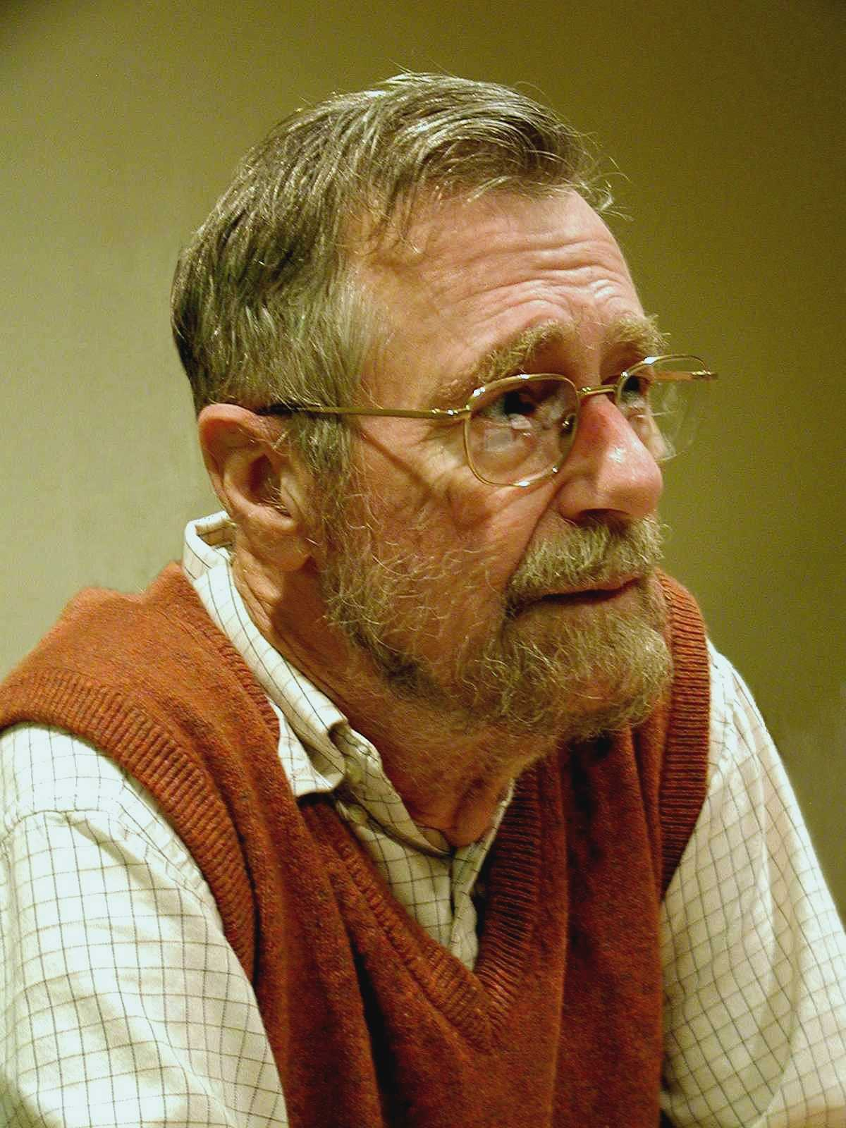
Dijkstra’s shortest path algorithm
E. W. Dijkstra (1930-2002)

Slide 15
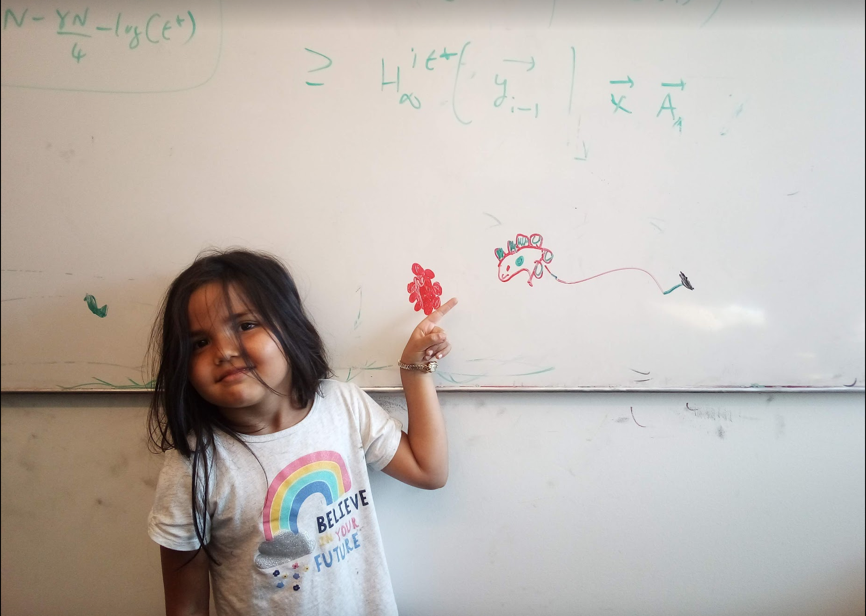
Questions/Comments?

Slide 16
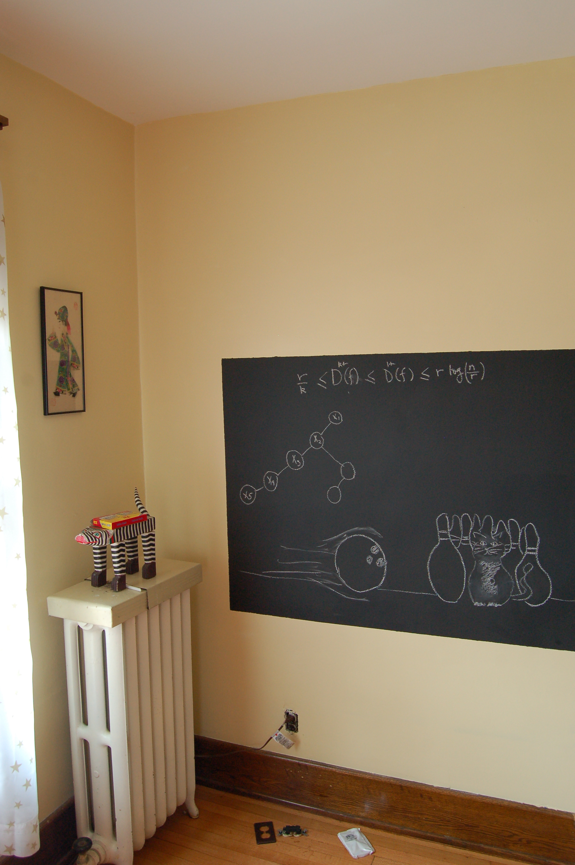
On to the board…

Slide 17
Towards Dijkstra’s algo: part ek
Determine d(t) one by one
s
d(s) = 0
u
x
y

Slide 18

Towards Dijkstra’s algo: part do
Determine d(t) one by one
Let u be a neighbor of s with smallest l_{(s,u)}
s
100
3
4
u
x
y
d(u) = l_{(s,u)}
Not making any claim on other vertices

Slide 19


Towards Dijkstra’s algo: part teen
Determine d(t) one by one
R
Assume we know d(v) for every v in R
s
u
x
y
Compute an upper bound d’(w) for every w not in R
d(w)
d(u) + l_{(u,w)}
w
d(w) d(x) + l_{(x,w)}
d’(w) = min _{e=(u,w) in E, u in R} d(u)+l_{e}
d(w) d(y) + l_{(y,w)}

