Slide 1
Lecture 34
CSE 331
Nov 22, 2021

Slide 2

Please have a face mask on

Slide 3
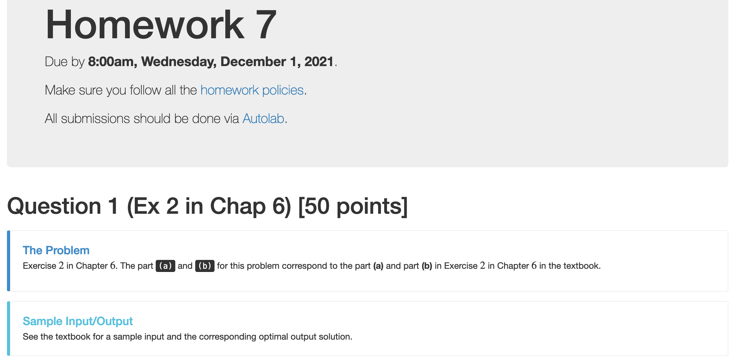
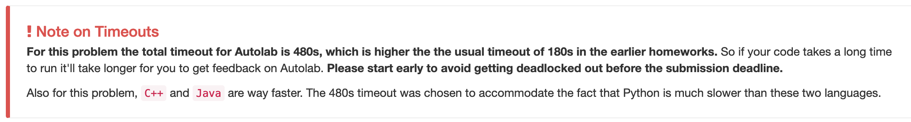
HW 7 reminders

Slide 4
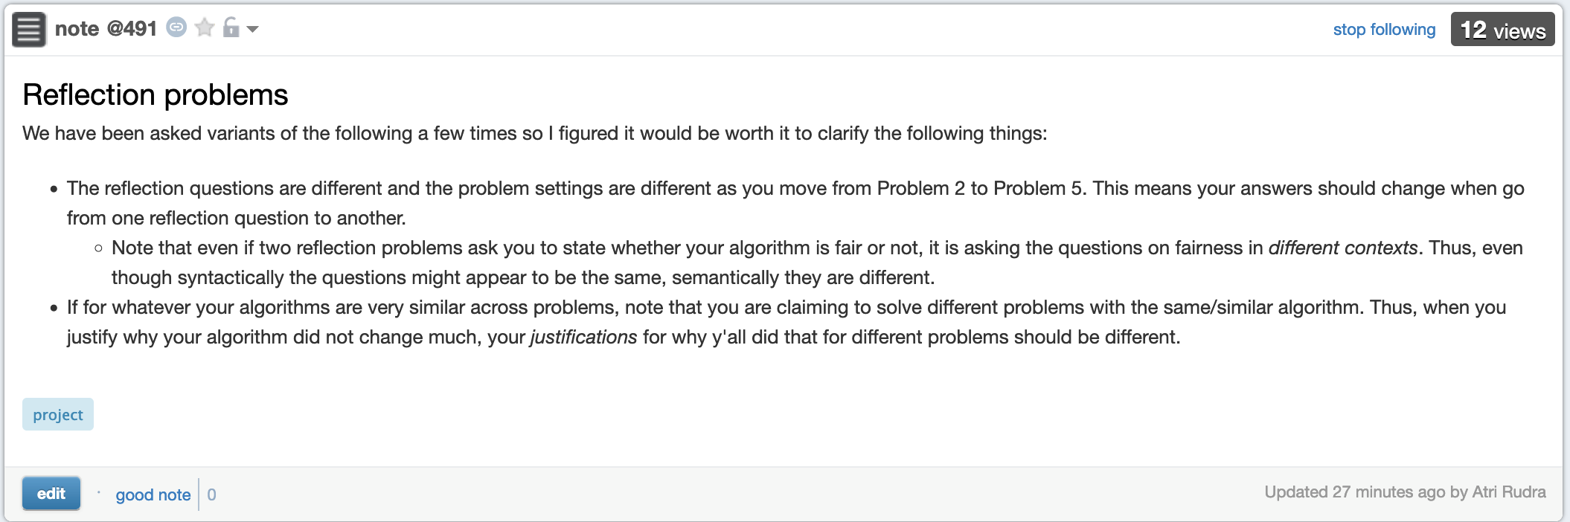
Reflection problems

Slide 5
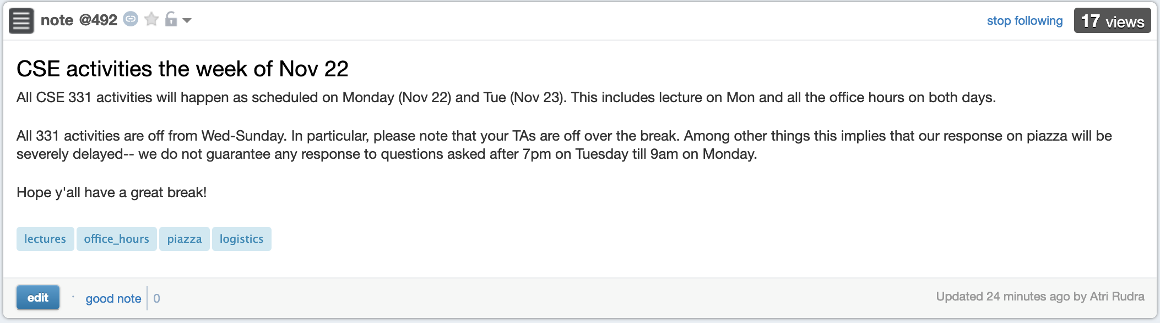
Rest of the week

Slide 6
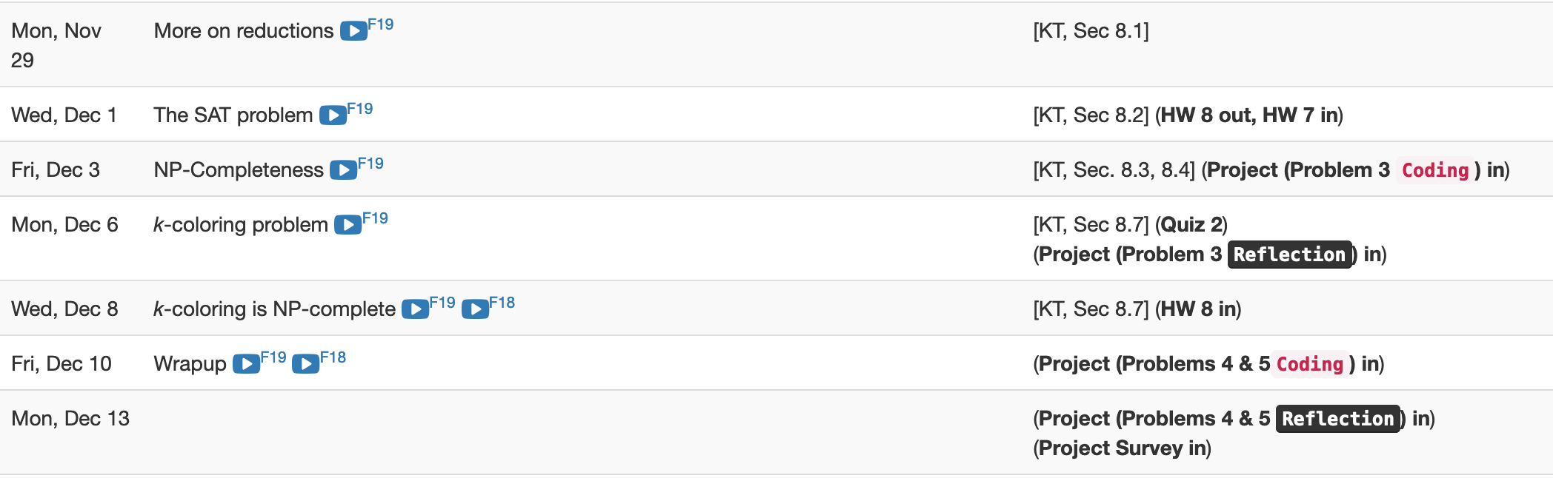
Last two weeks are packed

Slide 7

Questions?

Slide 8
Shortest Path Problem
Input: (Directed) Graph G=(V,E) and for every edge e has a cost c_{e} (can be <0)
t in V
Output: Shortest path from every s to t
Assume that G has no negative cycle
1
1
s
t
Shortest path has cost negative infinity
899
100
-1000

Slide 9
The recurrence
OPT(u,i) = shortest path from u to t with at most i edges
OPT(u,i) = min { OPT(u,i-1), min_{(u,w) in E} { c_{u,w} + OPT(w, i-1)} }

Slide 10
Some consequences
OPT(u,i) = cost of shortest path from u to t with at most i edges
OPT(u,i) = min { OPT(u, i-1), min_{(u,w) in E} { c_{u,w} + OPT(w,i-1)} }
OPT(u,n-1) is shortest path cost between u and t
Can compute the shortest path between s and t given all OPT(u,i) values

Slide 11
Bellman-Ford Algorithm
Runs in O(n(m+n)) time
Only needs O(n) additional space

Slide 12
Questions?

Slide 13
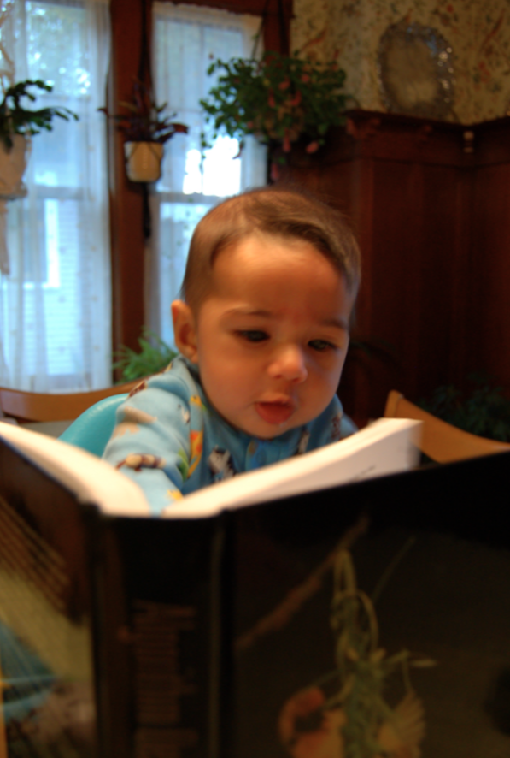
Reading Assignment
Sec 6.8 of [KT]

Slide 14
Longest path problem
Given G, does there exist a simple path of length n-1 ?

Slide 15

Longest vs Shortest Paths

Slide 16

Two sides of the “same” coin
Shortest Path problem
Can be solved by a polynomial time algorithm
Is there a longest path of length n-1?
Given a path can verify in polynomial time if the answer is yes

Slide 17
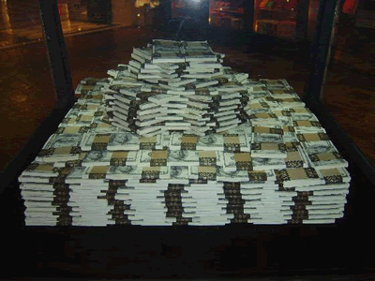
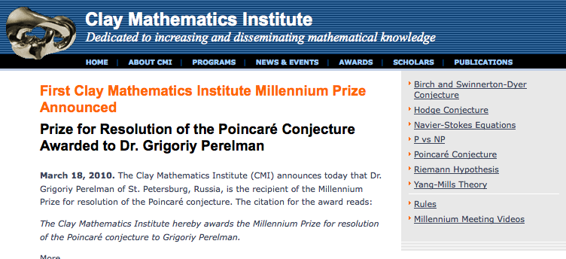
Poly time algo for longest path?

Slide 18
P vs NP question
P: problems that can be solved by poly time algorithms
Is P=NP?
NP: problems that have polynomial time verifiable witness to optimal solution
Alternate NP definition: Guess witness and verify!

Slide 19
Proving P ≠ NP
Pick any one problem in NP and show it cannot be solved in poly time
Pretty much all known proof techniques provably will not work

Slide 20
Proving P = NP
Will make cryptography collapse
Compute the encryption key!
Prove that all problems in NP can be solved by polynomial time algorithms
Solving any ONE problem in here in poly time will prove P=NP!
NP
NP-complete problems

Slide 21

A book on P vs. NP

Slide 22
Questions?

Slide 23

The course so far…
https://www.teepublic.com/sticker/1100935-obama-yes-we-can

Slide 24

The rest of the course…
Under certain assumptions,
https://www.madduckposters.com/products/megamind-no-you-cant?variant=13565168320556

Slide 25
No, you can’t– what does it mean?
NO algorithm will be able to solve a problem in polynomial time
Still for worst-case runtime

Slide 26
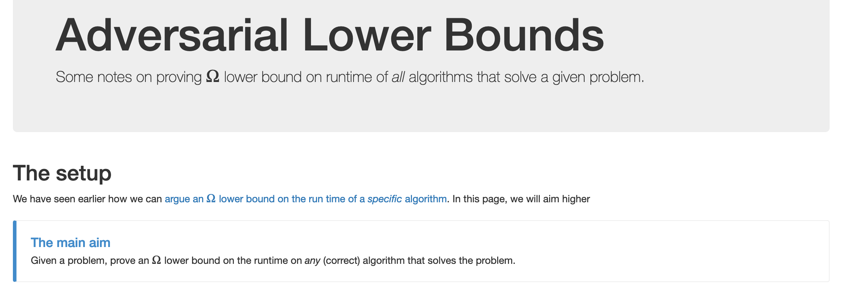
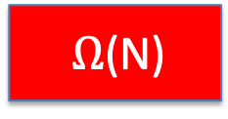
No, you can’t take- 1
What is the best lower bound you can prove?

Slide 27
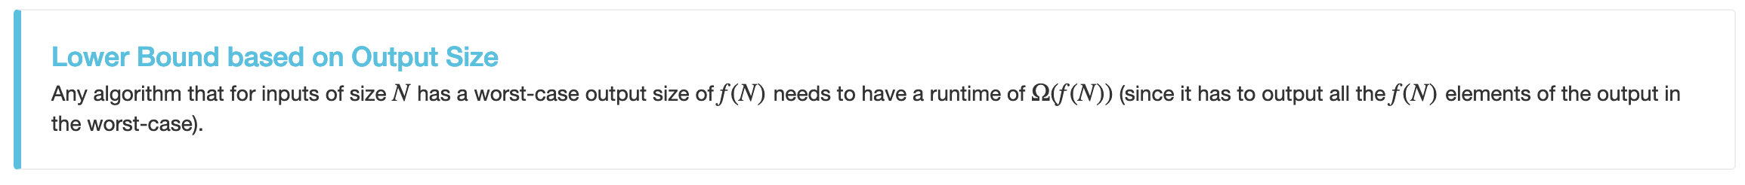
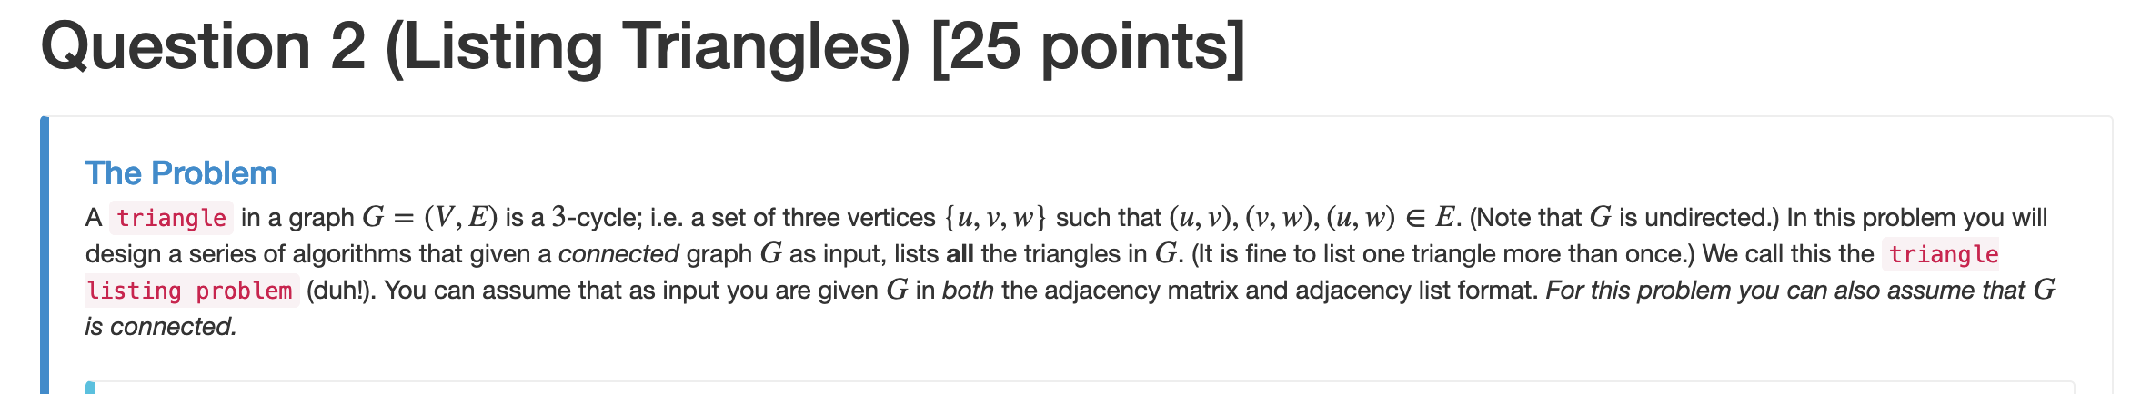
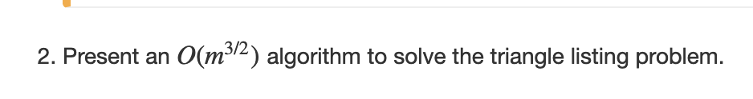
No, you can’t take- 2
Lower bounds based on output size
Exists graphs with m^{3/2} triangles

Slide 28
No, you can’t take- 2
Lower bounds based on output size
On input n, output 2^{n} many ones
Every algo takes (doubly) exponential time
But at heart problem is “trivial”
From now on, output size is always O(N) and could even be binary.

Slide 29
No, you can’t take -3
Argue that a given problem is AS HARD AS
a “known” hard problem
How can we argue something like this?
Reductions

Slide 30
So far: “Yes, we can” reductions
https://www.teepublic.com/sticker/1100935-obama-yes-we-can

Slide 31
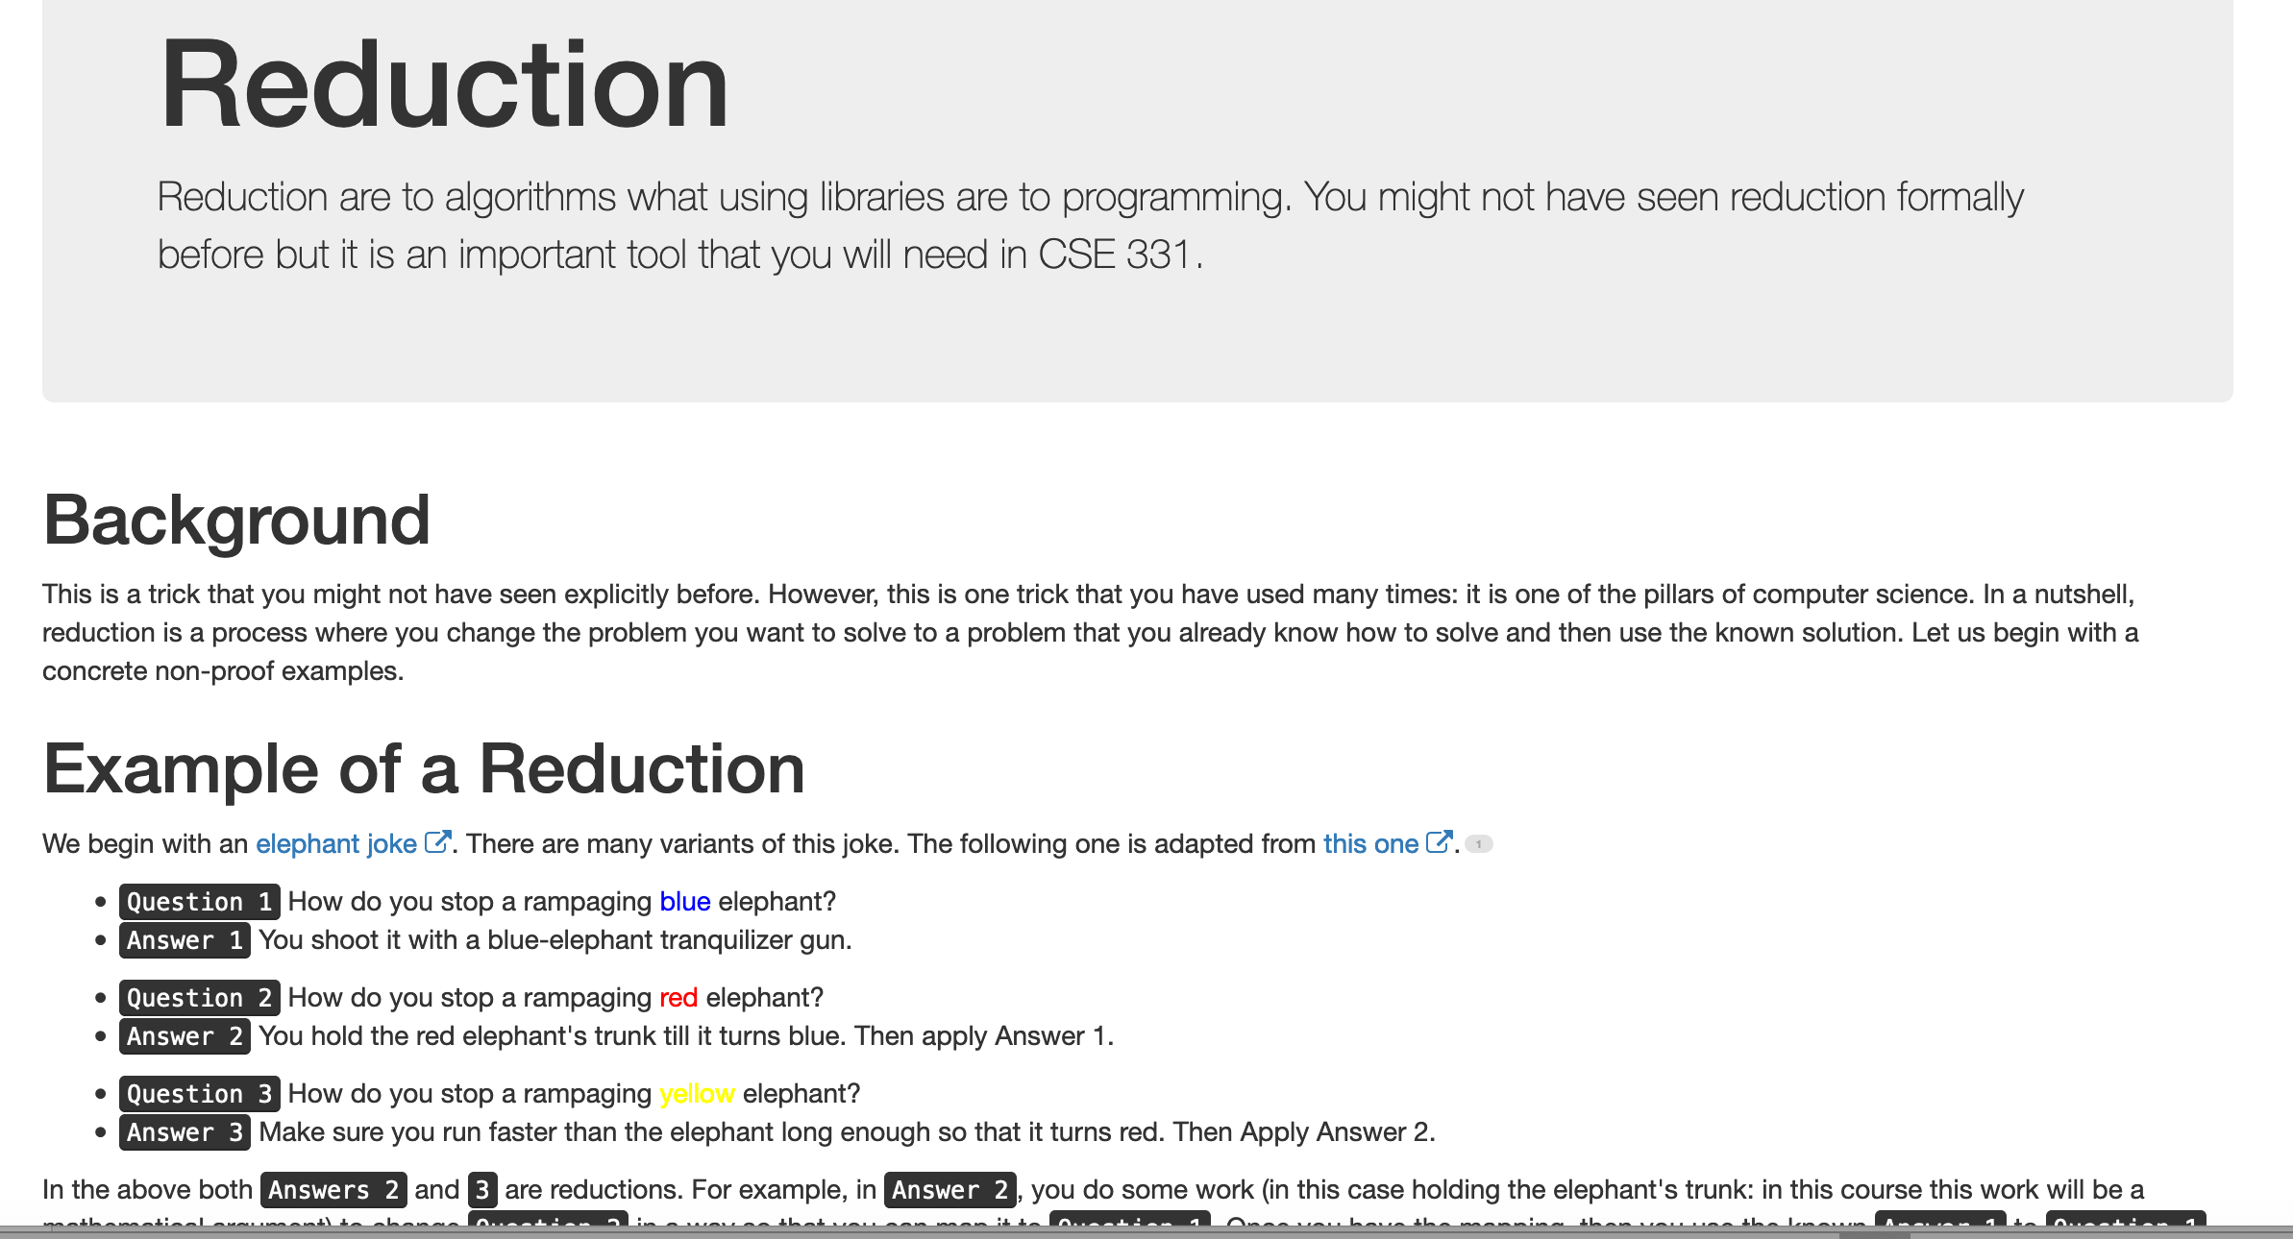
Reduce Y to X where X is “easy”

Slide 32
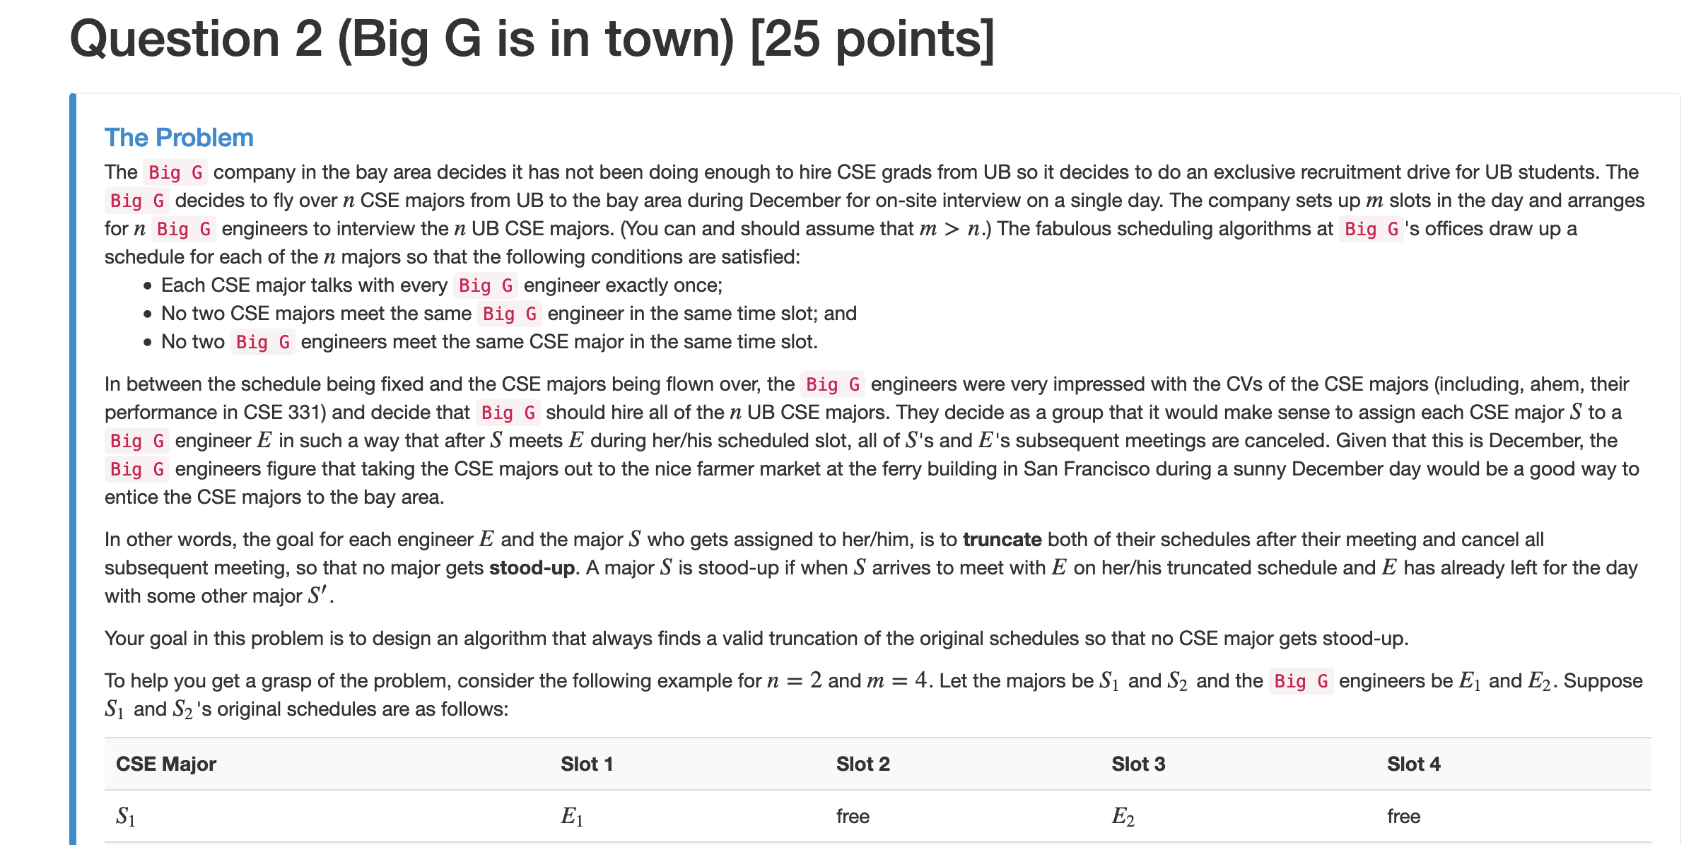
“Yes, we can” reductions (Example)

Slide 33


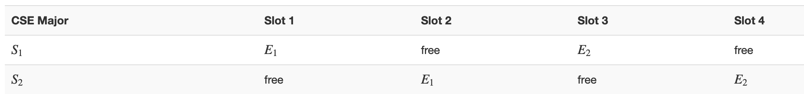
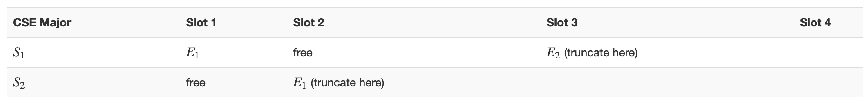




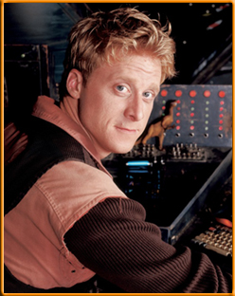

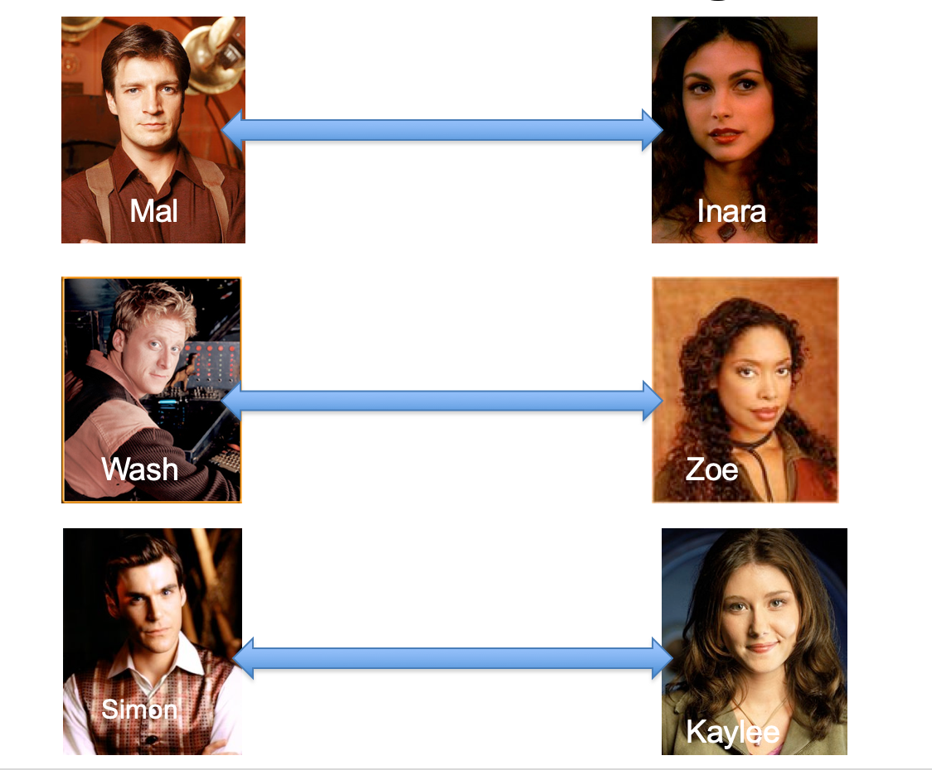
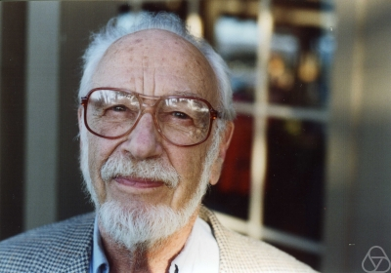
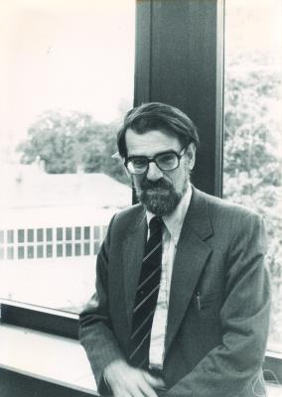
Overview of the reduction

Slide 34
Nothing special about GS algo
ANY algo for stable matching problem works!

Slide 35
Another observation
Poly time steps
ANY algo for stable matching problem works!

Slide 36
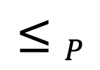
Poly time reductions
Poly time steps
ANY algo for stable matching problem works!

Slide 37


Poly time steps
Arbitrary Y instance
ANY algo for stable matching problem works!
Pre-process the input
Output for Y instance
All processing
is poly-time
Algo for X
Post-process the output

Slide 38


Poly time algo for X
Arbitrary Y instance
Poly time algo for Y
Pre-process the input
Output for Y instance
All processing
is poly-time
Algo for X
Post-process the output

Slide 39

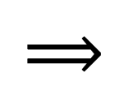
!B !A

Slide 40

No poly time algo for Y
Poly time algo for X
Arbitrary Y instance
No poly time algo for X
Poly time algo for Y
Pre-process the input
Output for Y instance
All processing
is poly-time
Algo for X
Post-process the output

