Slide 1
Lecture 40
CSE 331
Dec 10, 2021

Slide 2

Please have a face mask on

Slide 3
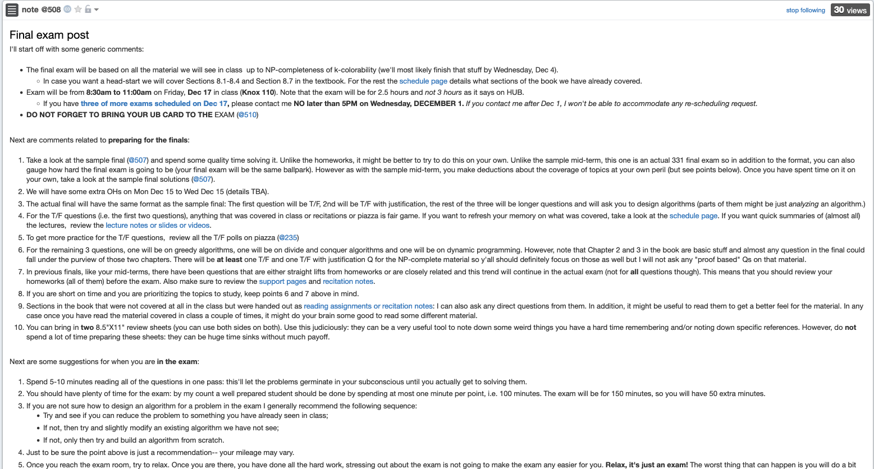
Final exam post

Slide 4
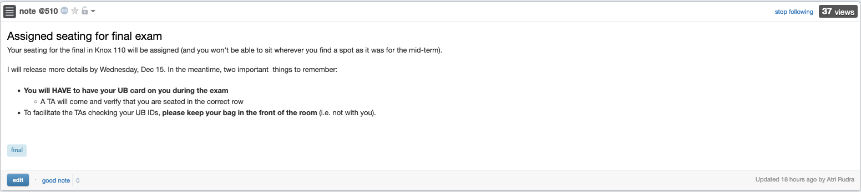
Bring your UB card to final

Slide 5
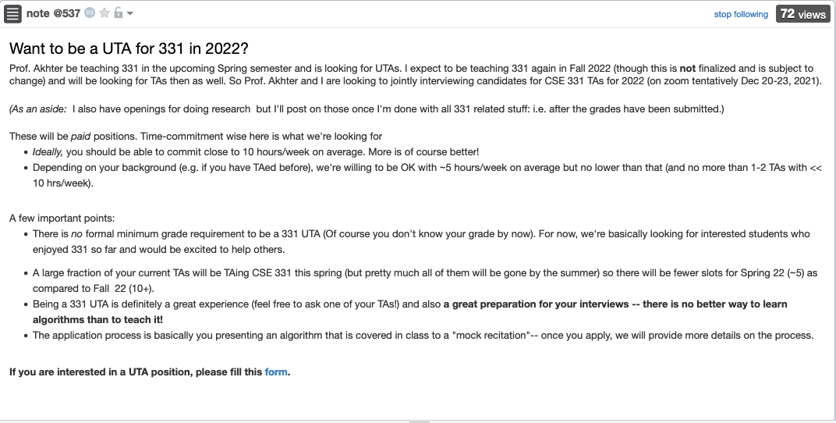
Interested in TAing CSE 331?

Slide 6
Extra OHs next Mon-Wed
Details by later today on piazza

Slide 7
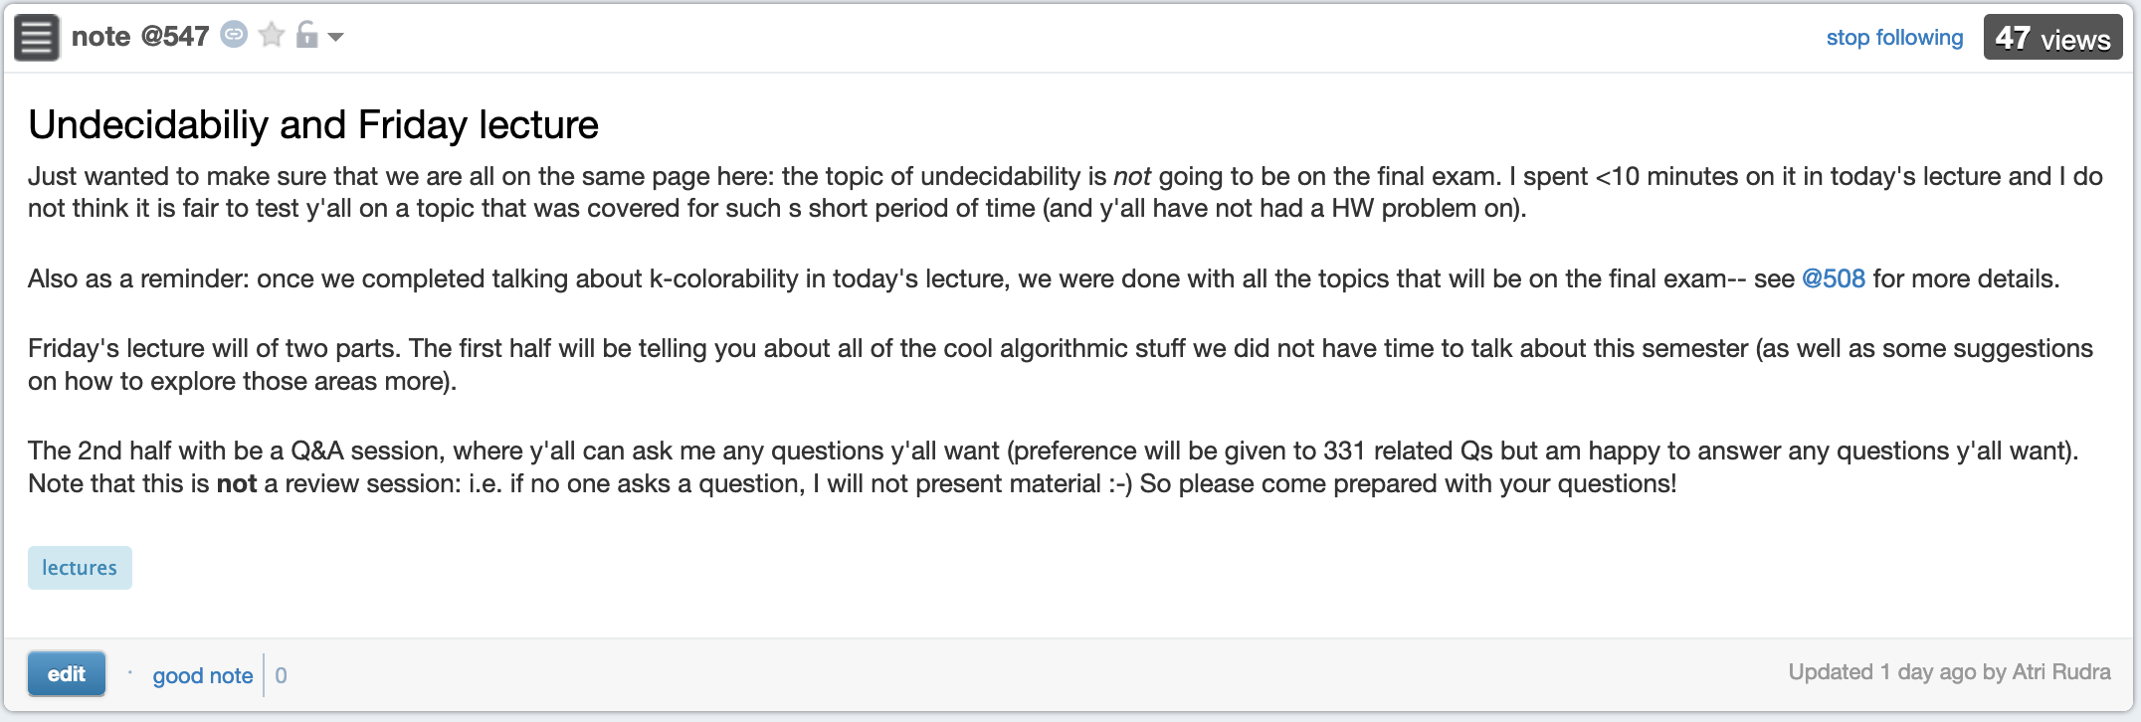
No undecidability on final

Slide 8
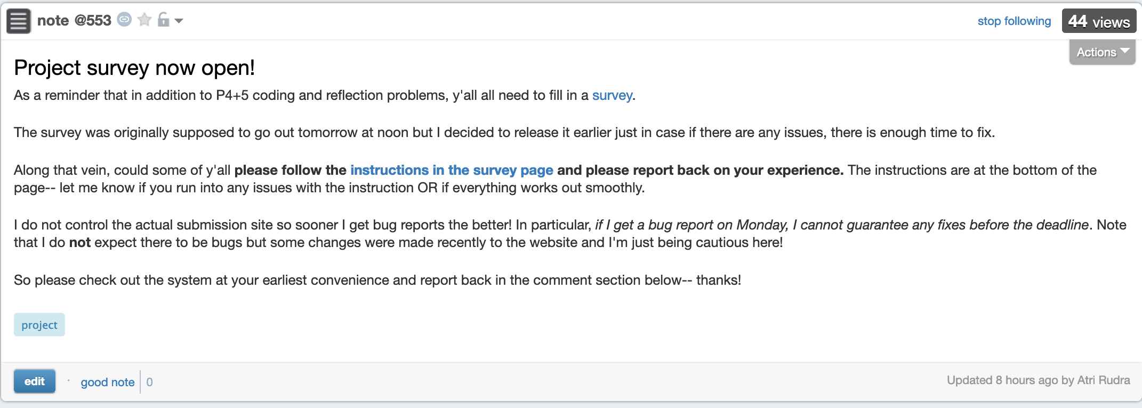
Project stuff still due

Slide 9
High level view of CSE 331
Problem Statement
Problem Definition
NP-completeness
Three general techniques
Algorithm
“Implementation”
Data Structures
Analysis
Correctness+Runtime Analysis

Slide 10

Now relax…

Slide 11
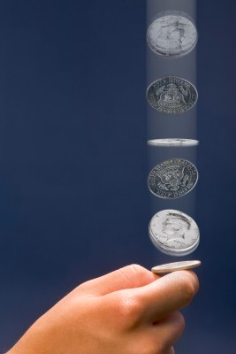
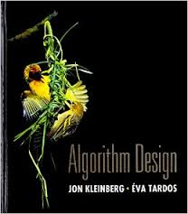
Randomized algorithms
What is different?
Algorithms can toss coins and make decisions
A Representative Problem
Hashing
http://calculator.mathcaptain.com/coin-toss-probability-calculator.html
Further Reading
CSE 432
Chapter 13 of the textbook

Slide 12
Approximation algorithms
Cool twist: NP-hardness of approximations!
What is different?
Algorithms can output a solution that is say 50% as good as the optimal
A Representative Problem
Vertex Cover
Further Reading
Chapter 12 of the textbook

Slide 13
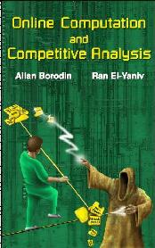
Online algorithms
What is different?
Algorithms have to make decisions before they see all the input
A Representative Problem
Secretary Problem
Further Reading

Slide 14
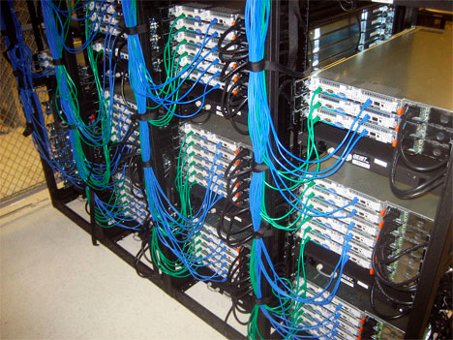
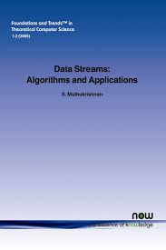
Data streaming algorithms
What is different?
https://www.flickr.com/photos/midom/2134991985/
One pass on the input with severely limited memory
A Representative Problem
Compute the top-10 source IP addresses
Further Reading

Slide 15
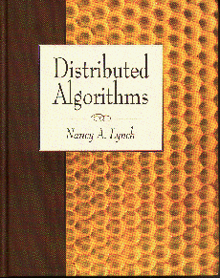
Distributed algorithms
What is different?
Input is distributed over a network
A Representative Problem
Consensus
Further Reading

Slide 16

Beyond-worst case analysis
What is different?
Analyze algorithms in a more instance specific way
A Representative Problem
Intersect two sorted sets
Further Reading
http://timroughgarden.org/f14/f14.html

Slide 17


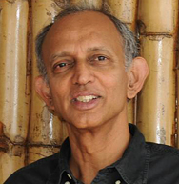
Algorithms for Data Science
What is different?
Algorithms for non-discrete inputs
A Representative Problem
Compute Eigenvalues
Further Reading
https://home.ttic.edu/~avrim/book.pdf

Slide 18
Algorithms and Society
What is different?
Measuring and correcting for harms caused by Algorithms
A Representative Problem
Bias in ML
CSE 410 in Spring 22: ML and Society

Slide 19
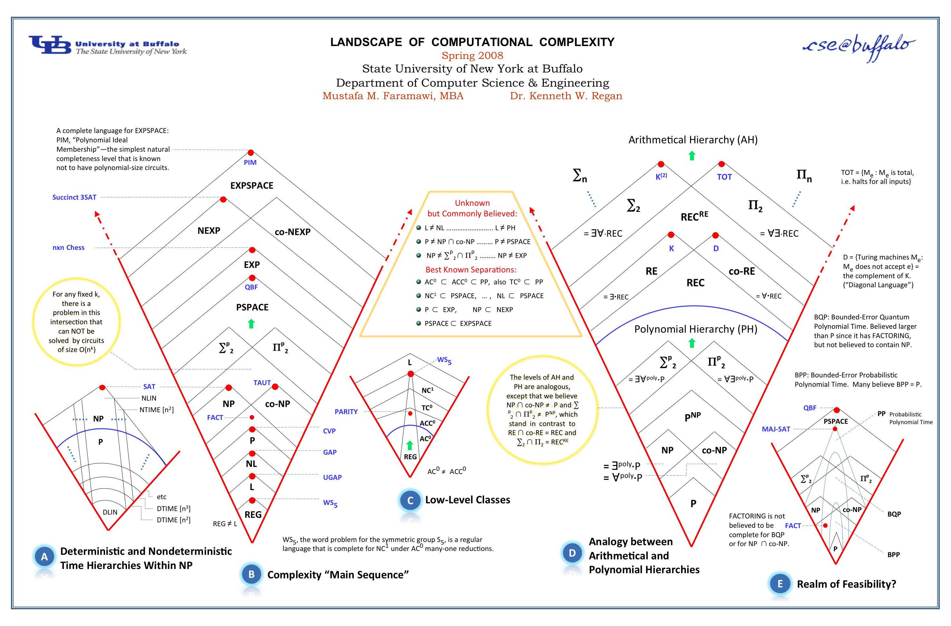
Anything > NP and < undecidability?

Slide 20
Q & A session

Slide 21


Whatever your impression of the 331
IT WAS
RIDING

Slide 22

Hopefully it was fun!

Slide 23

Thanks!
Except of course Project P4+5, survey and the final exam

