Slide 1
Lecture 12
CSE 331
Sep 26, 2022

Slide 2

If you need it, ask for help

Slide 3

Project groups due FRIDAY!
Deadline: Friday, Sep 30, 11:59pm

Slide 4
Upcoming quiz/exams
Quiz 1 Friday NEXT week
Mid-term 1 Monday in TWO weeks
Mid-term 2 Wed two days after Mid-term 1
Piazza post (+sample mid-terms) up by Thur. on preparing for mid-terms

Slide 5
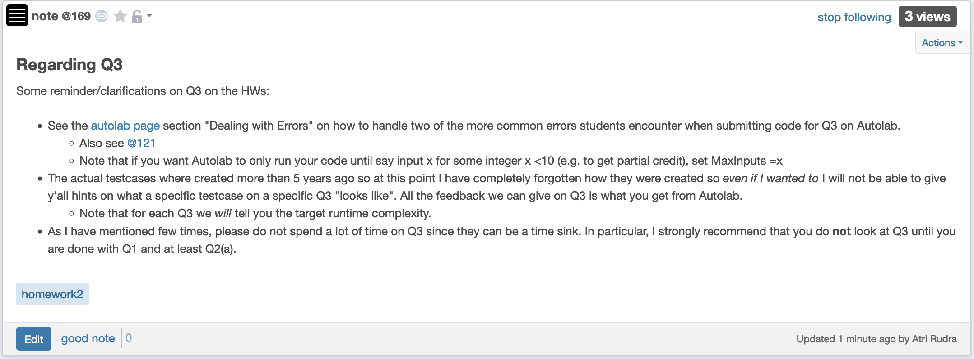
Clarifications on Q3

Slide 6

Questions?

Slide 7
Connectivity Problem
Input: Graph G = (V,E) and s in V
Output: All t connected to s in G
Connected component of s: CC(s)

Slide 8
Breadth First Search (BFS)
Build layers of vertices connected to s
L₀ = {s}
Assume L₀,..,L_{j} have been constructed
L_{j+1} set of vertices not chosen yet but are connected to L_{j}
Stop when new layer is empty

Slide 9
BFS Tree
BFS naturally defines a tree rooted at s
Add non-tree edges
L_{j} forms the jth “level” in the tree
u in L_{j+1} is child of v in L_{j} from which it was “discovered”
1
7
9
1
L₀
2
3
L₁
2
3
8
0
4
5
4
5
7
8
L₂
6
6
L₃

Slide 10
Two facts about BFS trees
All non-tree edges are in the same or consecutive layer
If u is in L_{i} then dist(s,u) = i

Slide 11

Questions/Comments?

Slide 12
Rest of today’s agenda
Computing Connected component

Slide 13
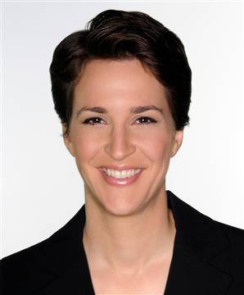









Computing Connected Component
Explore(s)
Start with R = {s}
While exists (u,w) edge w not in R and u in R
Add w to R
Output R* = R

Slide 14
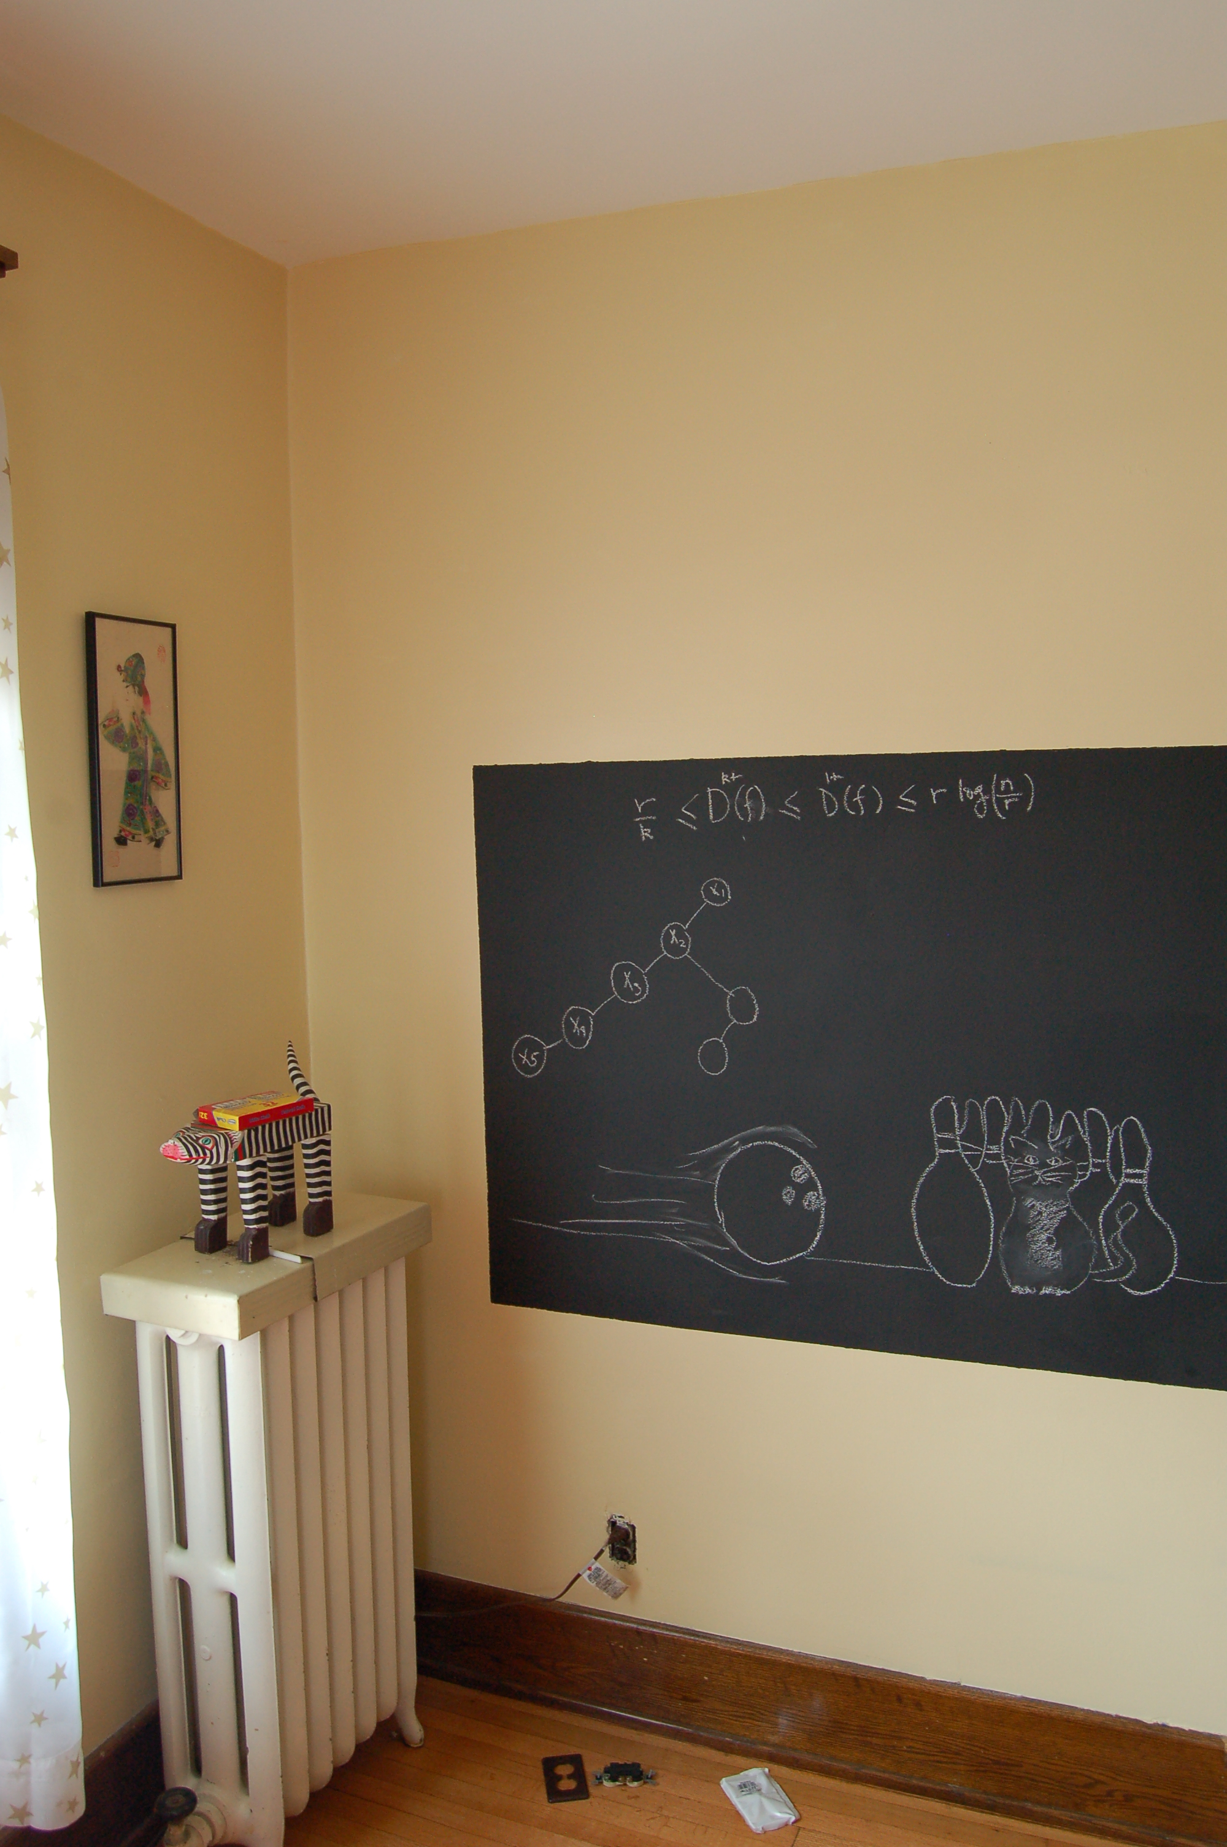
Argue correctness on the board…

Slide 15

BFS
all

Slide 16

Depth First Search (DFS)
http://xkcd.com/761/

Slide 17
DFS(u)
Mark u as explored and add u to R
For each edge (u,v)
If v is not explored then DFS(v)

Slide 18

Why is DFS a special case of Explore?

Slide 19
A DFS run
Every non-tree edge is between a node and its ancestor
1
DFS(u)
1
7
u is explored
2
2
3
For every unexplored
neighbor v of u
8
4
DFS(v)
4
5
5
DFS tree
6
6
3
8
7
Notes:
Note that the tree is arbitrary based on which neighbor was visited first.

Slide 20
Questions/Comments?

