Slide 1
Lecture 13
CSE 331
Sep 28, 2022

Slide 2

If you need it, ask for help

Slide 3
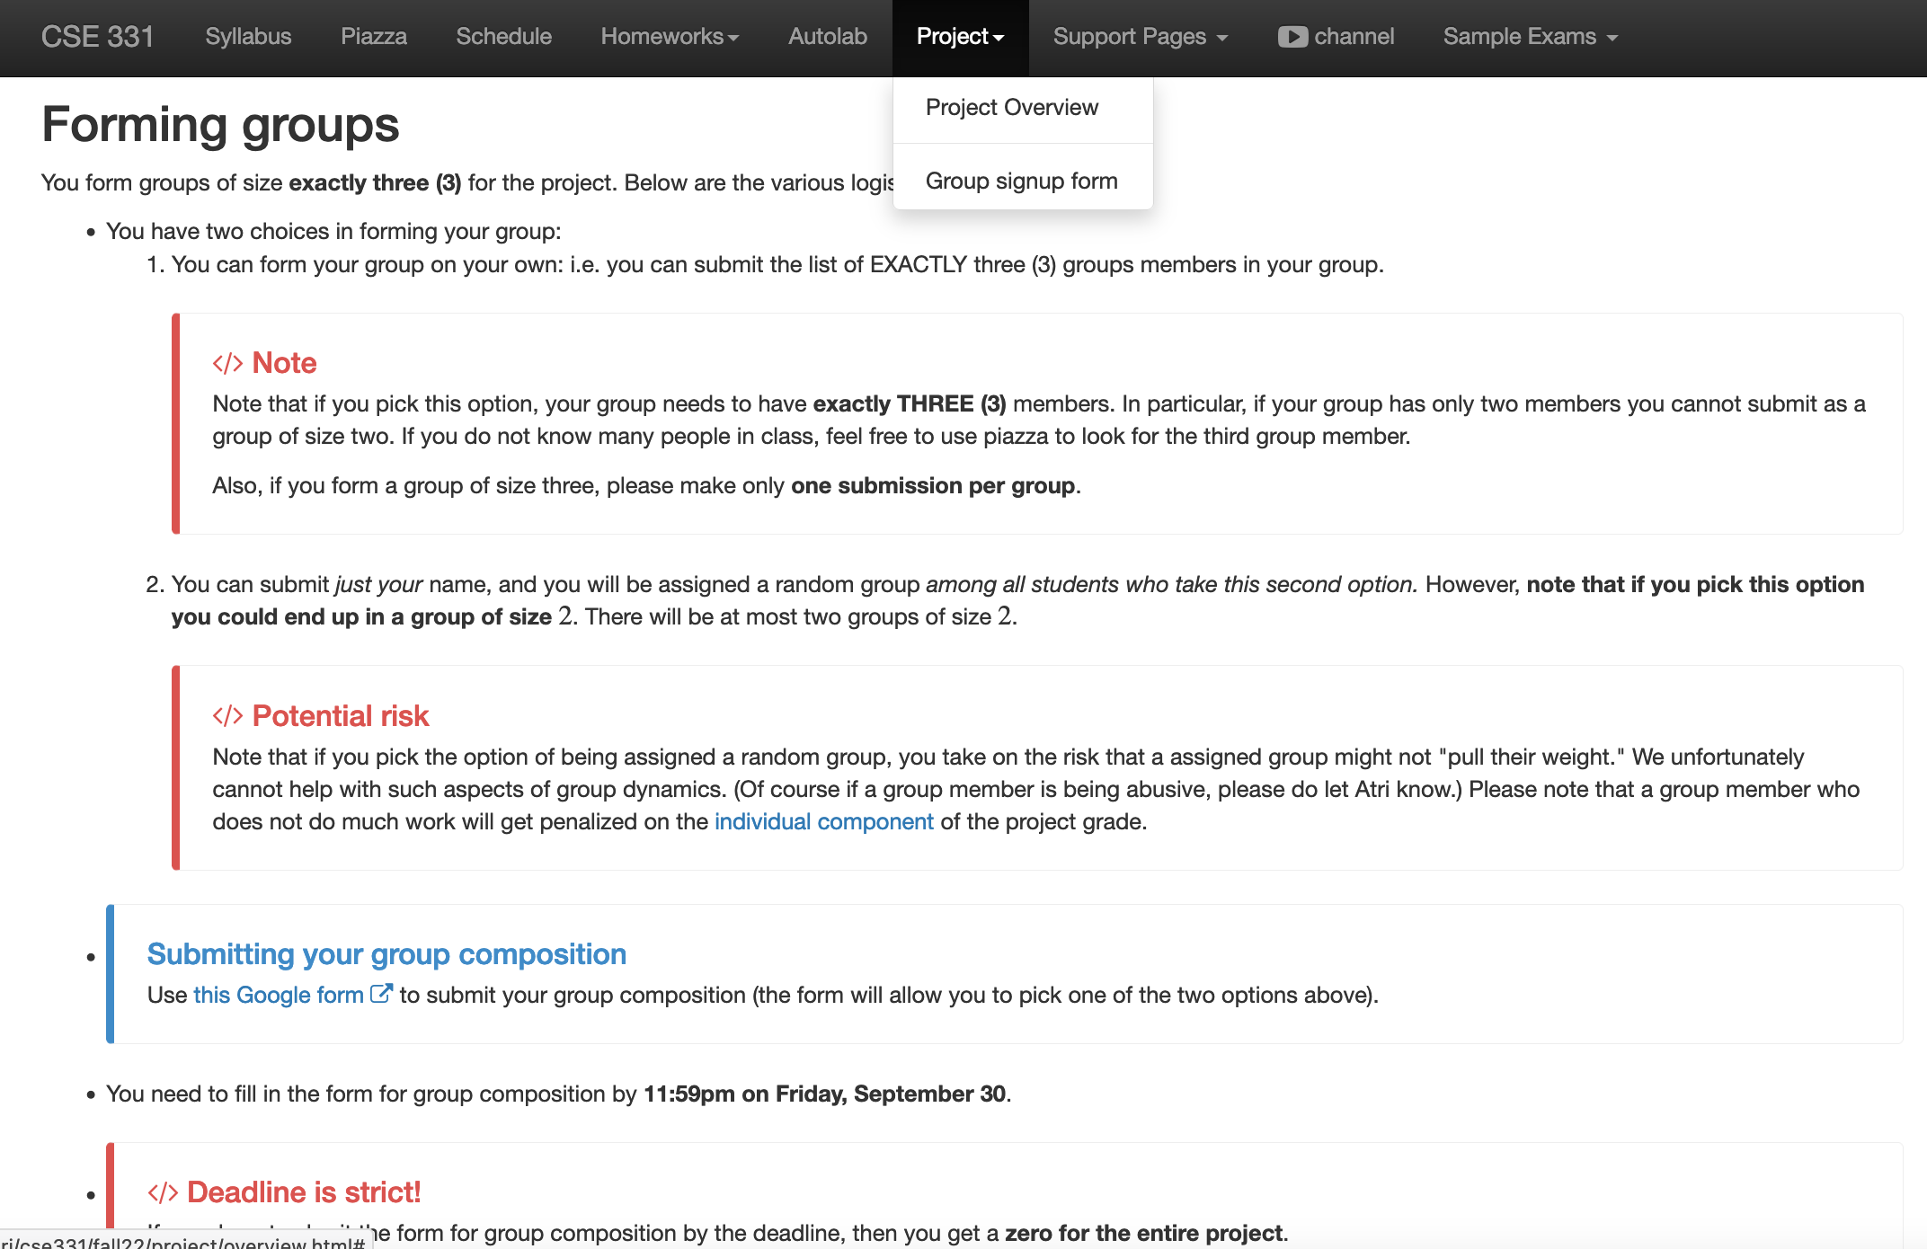
Project groups due FRIDAY!
Deadline: Friday, Sep 30, 11:59pm

Slide 4
Upcoming quiz/exams
Quiz 1 Friday NEXT week
Mid-term 1 Monday in TWO weeks
Mid-term 2 Wed two days after Mid-term 1
Piazza post up by tomorrow on preparing for mid-terms

Slide 5
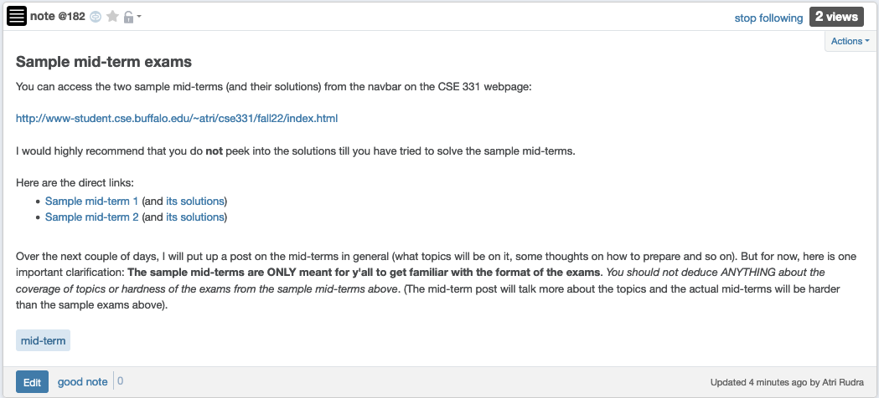
Sample mid-terms

Slide 6

Bit more on Quiz 1

Slide 7
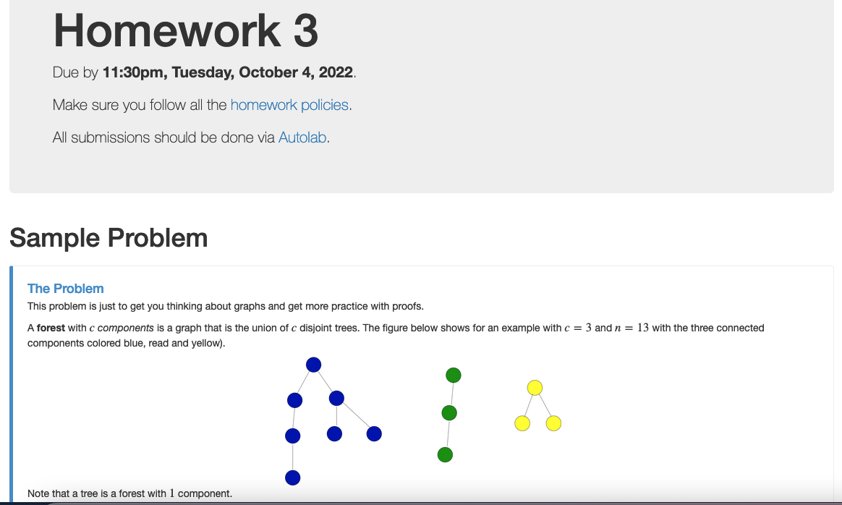
HW 3 out

Slide 8
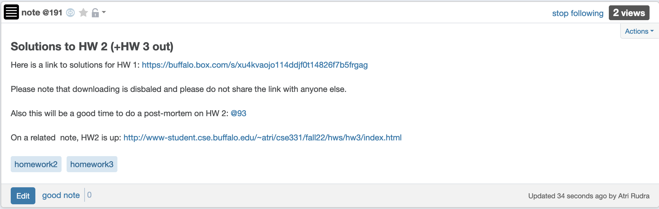
HW 2 solutions posted

Slide 9
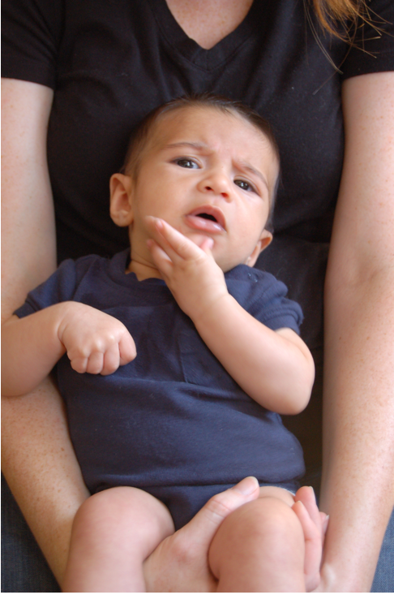
Questions?

Slide 10
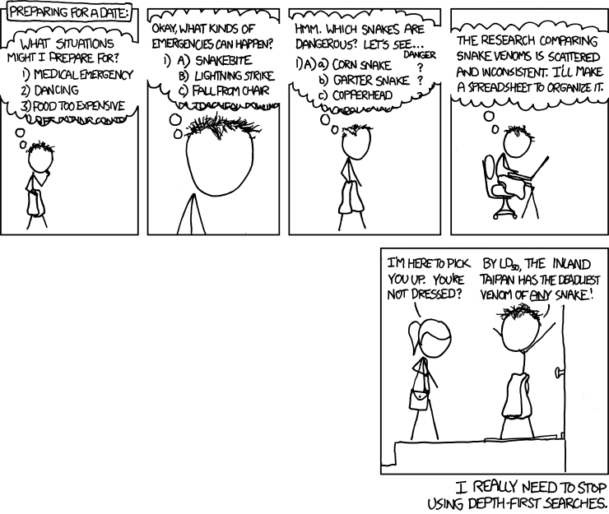
Depth First Search (DFS)
http://xkcd.com/761/

Slide 11
DFS(u)
Mark u as explored and add u to R
For each edge (u,v)
If v is not explored then DFS(v)

Slide 12
A DFS run
Every non-tree edge is between a node and its ancestor
1
DFS(u)
1
7
u is explored
2
2
3
For every unexplored
neighbor v of u
8
4
DFS(v)
4
5
5
DFS tree
6
6
3
8
7
Notes:
Note that the tree is arbitrary based on which neighbor was visited first.

Slide 13
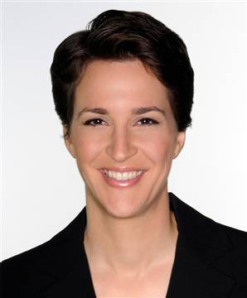









Connected components are disjoint
Either Connected components of s and t are the same or are disjoint
Algorithm to compute ALL the connected components?
Can run Explore instead of BFS
Run BFS on some node s. Then run BFS on t that is not connected to s

Slide 14
Computing all CCs
9
0
1
7
9
1
L₀
2
3
L₁
2
3
8
0
4
5
4
5
7
8
L₂
6
6
L₃

Slide 15

Questions/Comments?

Slide 16

Today’s agenda
Run-time analysis of BFS (DFS)

Slide 17

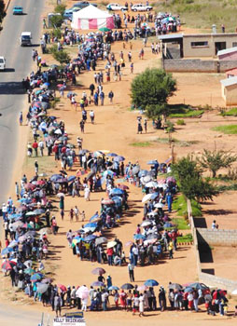
Stacks and Queues
Last in First out
First in First out
Notes:
We will need to keep track of visited nodes during our traversals.

Slide 18
But first…
How do we represent graphs?
Notes:
When using an algorithm to solve a problem, the runtime depends on how data is organized.

Slide 19
Graph representations
0
1
1
1
0
0
Better for sparse graphs and traversals
1
0
0
Adjacency matrix
Adjacency List
O(1)
(u,v) in E?
O(n) [ O(n_{v}) ]
O(n)
All neighbors of u?
O(n_{u})
O(n²)
Space?
O(m+n)

Slide 20
Questions/Comments?

Slide 21

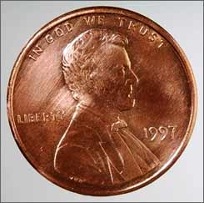
2m = Σ _{u in V} n_{u}
Rest of the graph
Give 2 pennies to each edge
Total # of pennies = 2m
n_{v}=3
u
n_{u}=4
v
Each edges gives one penny to its end points
# of pennies u receives = n_{u}

Slide 22
Breadth First Search (BFS)
Build layers of vertices connected to s
L₀ = {s}
Assume L₀,..,L_{j} have been constructed
L_{j+1} set of vertices not chosen yet but are connected to L_{j}
Stop when new layer is empty
Use CC[v] array
Use linked lists

Slide 23
Rest of Today’s agenda
Space complexity of Adjacency list representation
Quick run time analysis for BFS
Quick run time analysis for DFS (and Queue version of BFS)

