Slide 1
Lecture 14
CSE 331
Sep 30, 2022

Slide 2

If you need it, ask for help

Slide 3
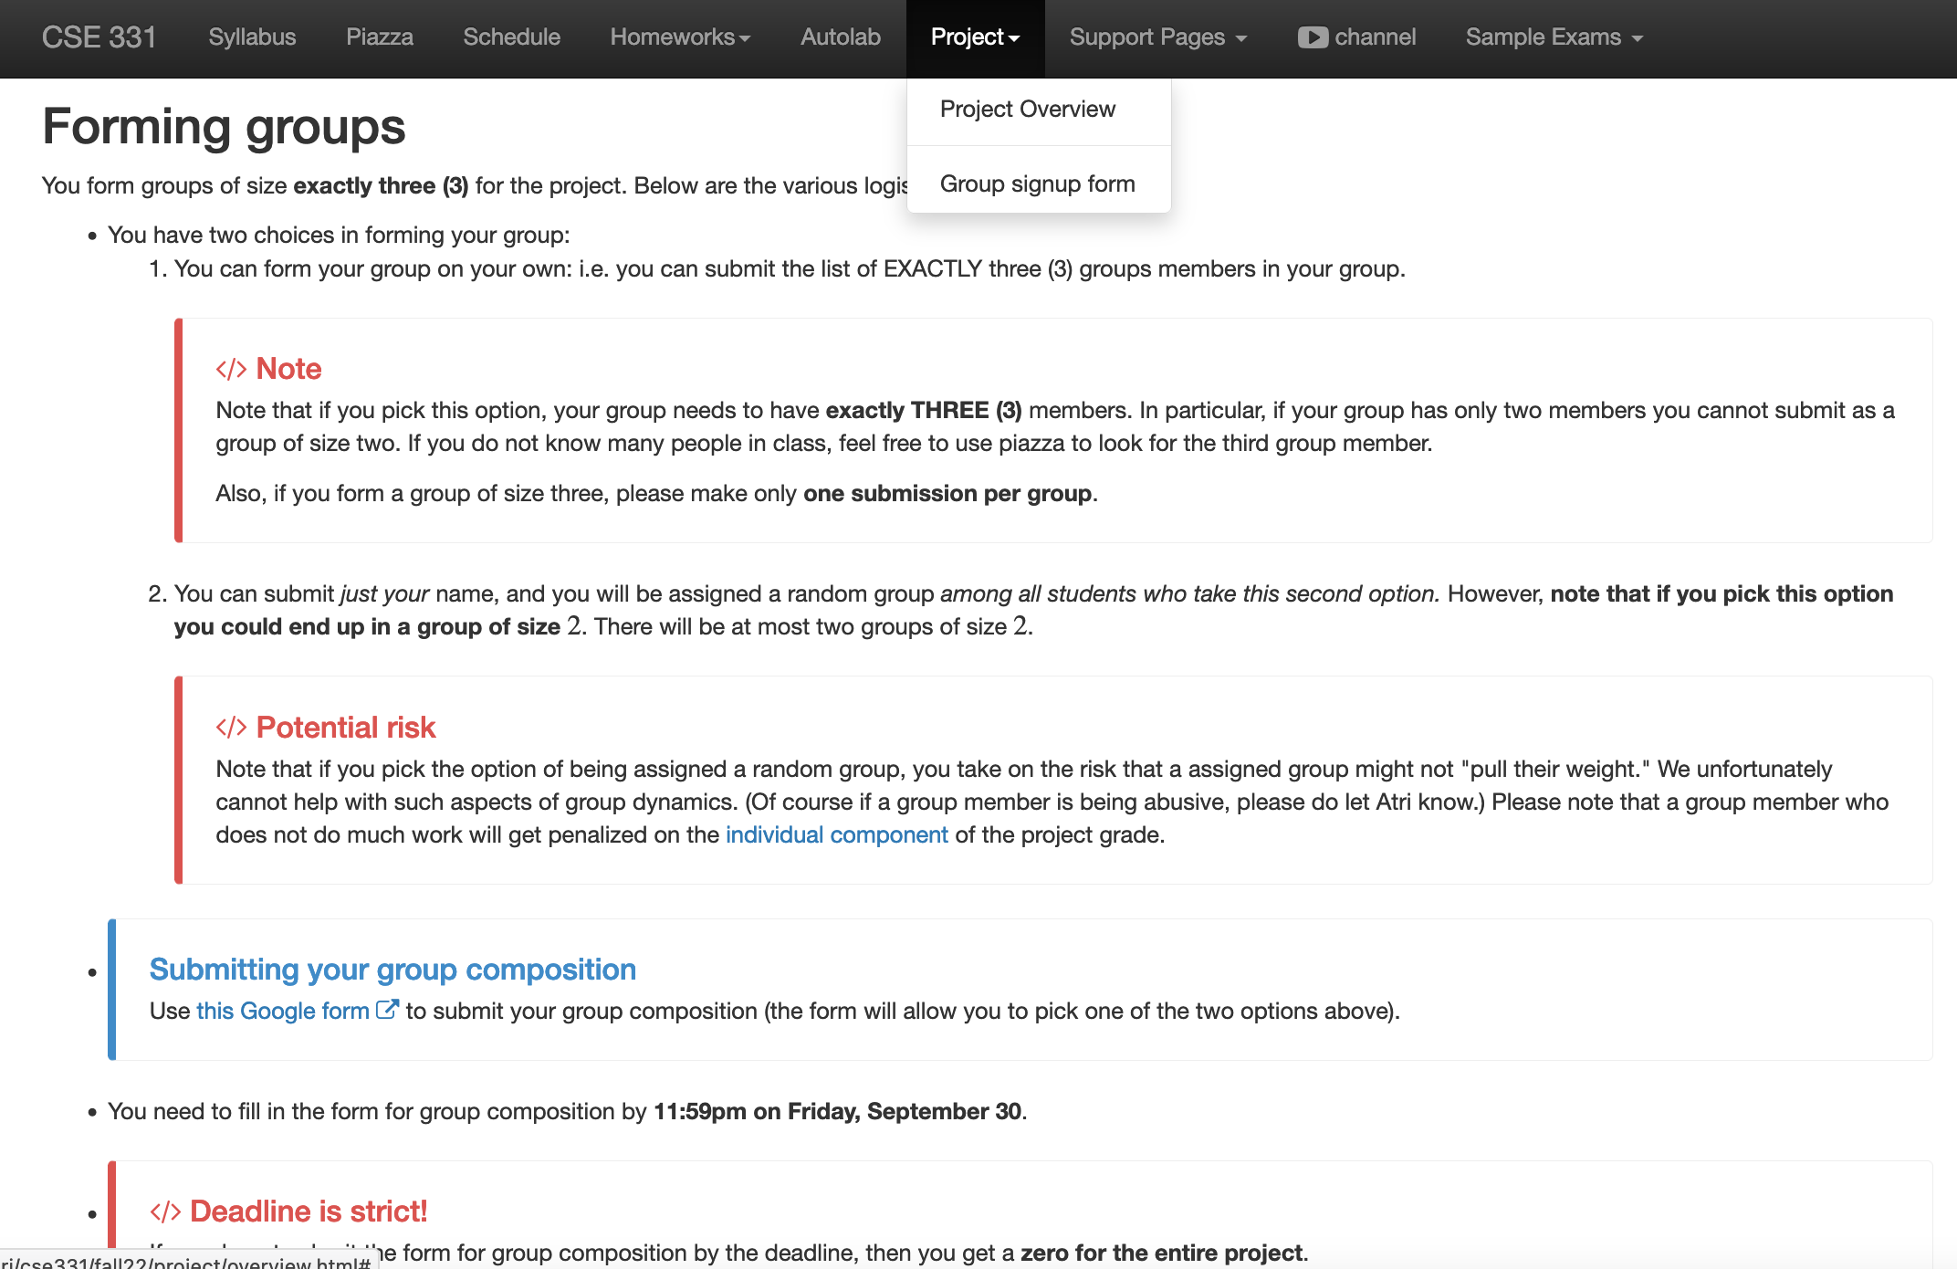
Project groups due TONIGHT!
Deadline: Friday, Sep 30, 11:59pm

Slide 4
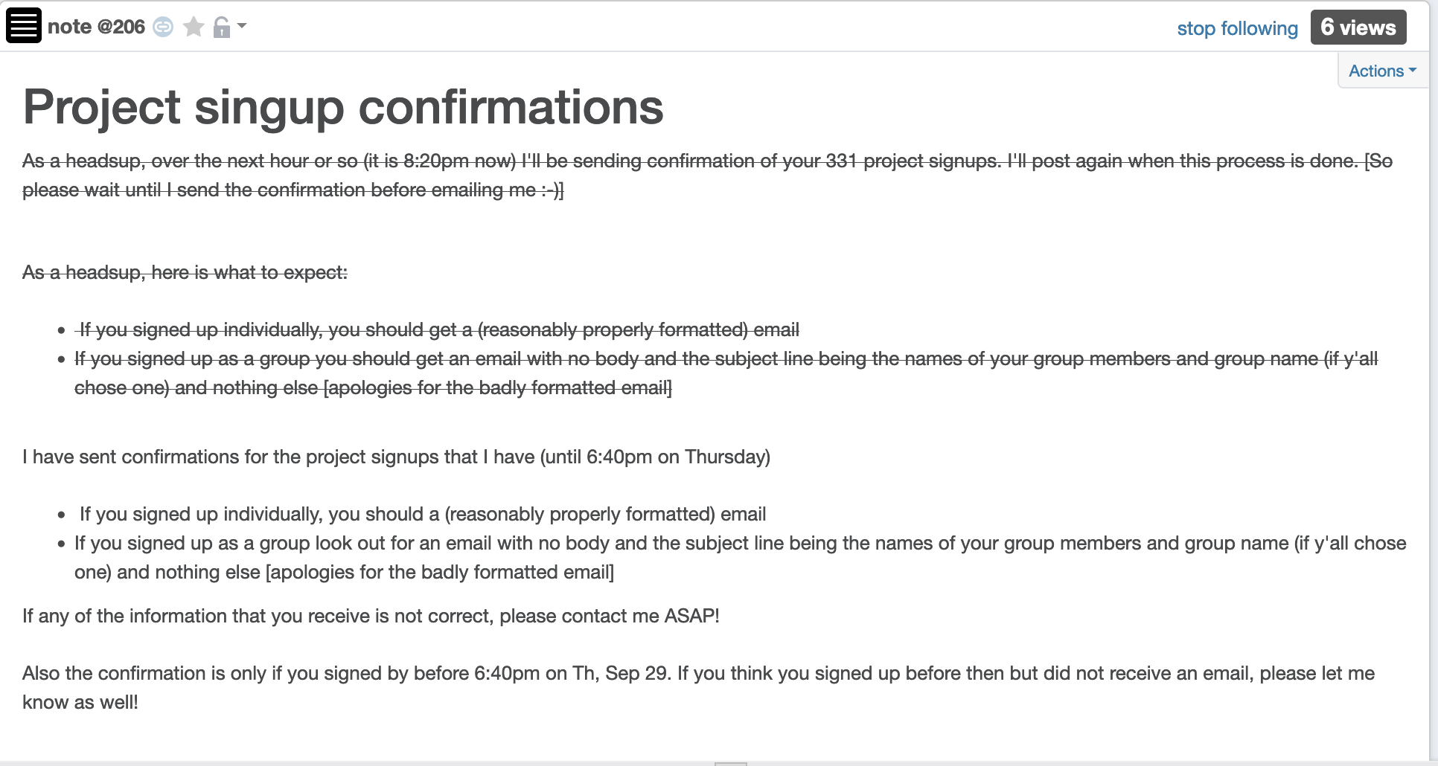
About ~25 have not signed up
No more confirmations until AFTER the deadline

Slide 5
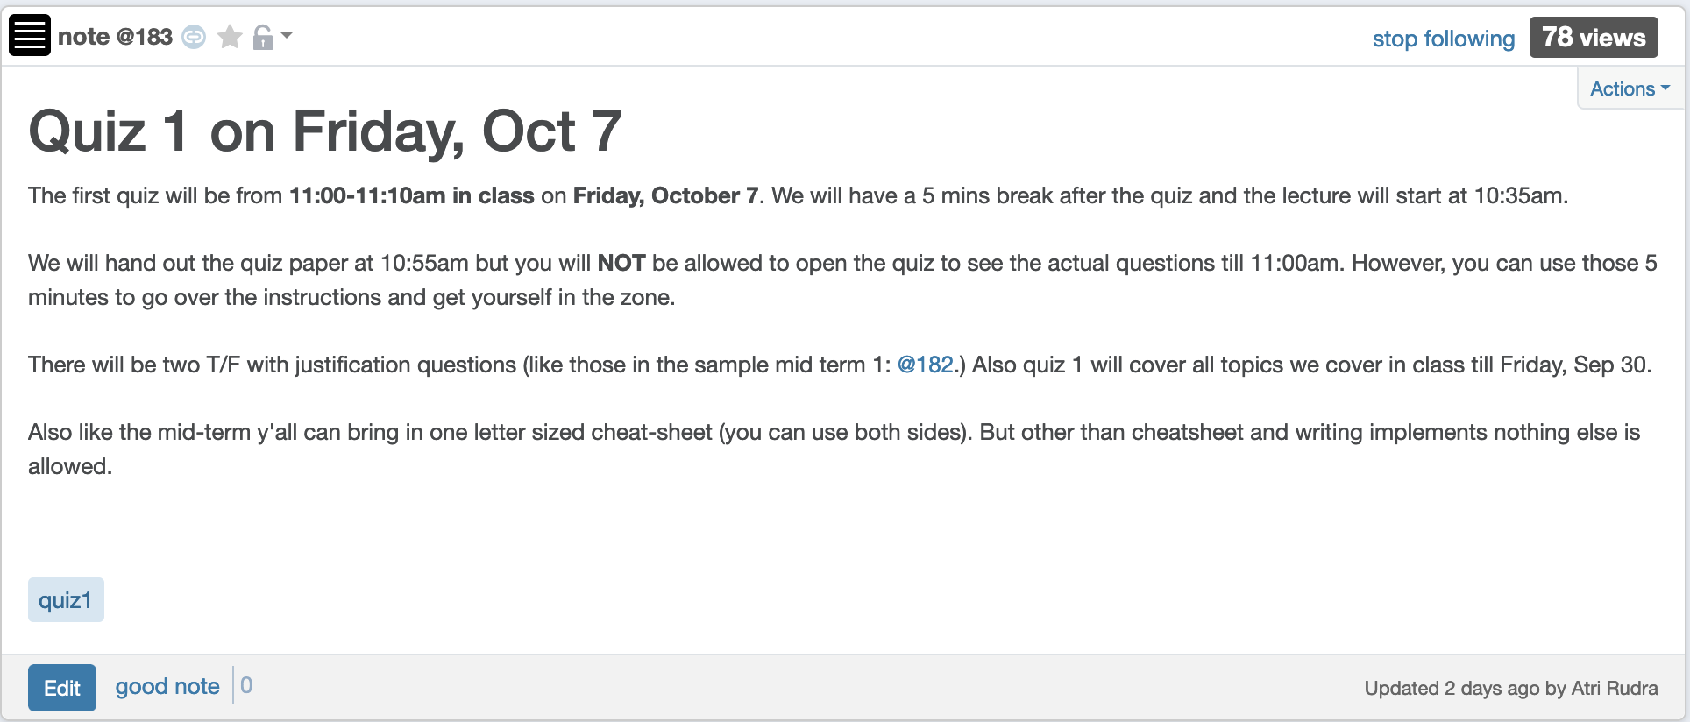
Quiz 1 in a week

Slide 6
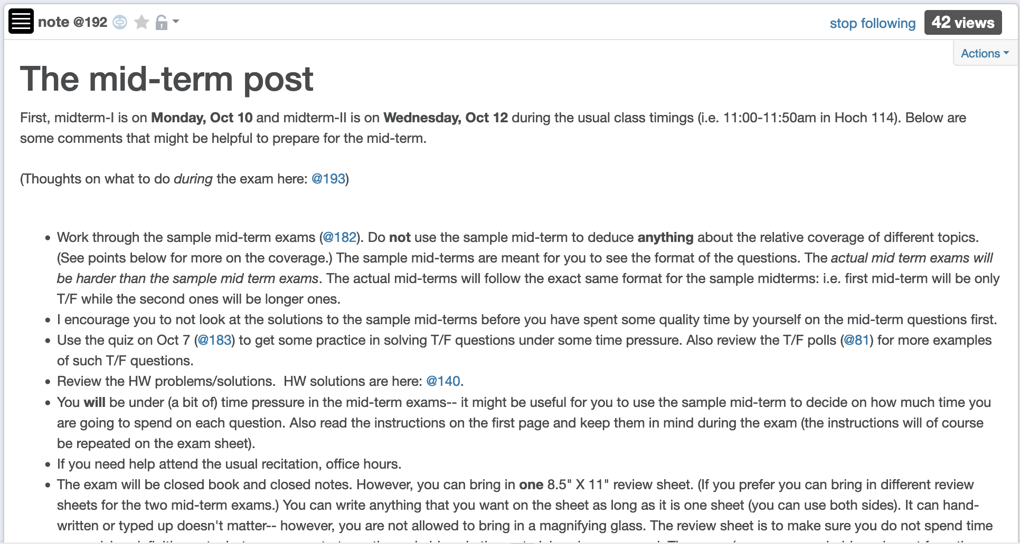
Mid-term post

Slide 7
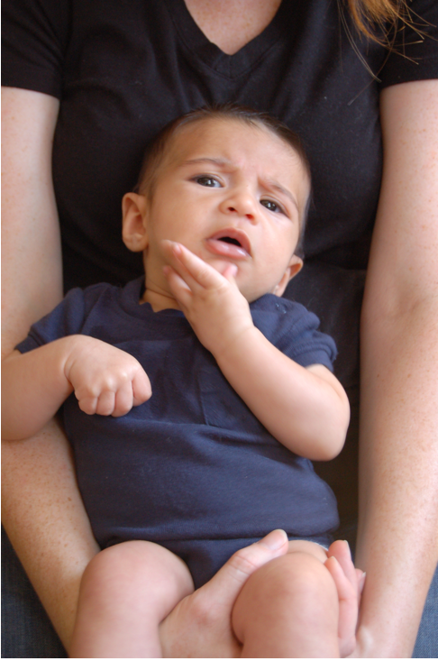
Questions?

Slide 8
Breadth First Search (BFS)
Build layers of vertices connected to s
L₀ = {s}
Assume L₀,..,L_{j} have been constructed
L_{j+1} set of vertices not chosen yet but are connected to L_{j}
Stop when new layer is empty
Use CC[v] array
Use linked lists

Slide 9
Rest of Today’s agenda
Quick run time analysis for BFS
Quick run time analysis for DFS (and Queue version of BFS)
Helping you schedule your activities for the day

Slide 10
O(m+n) BFS Implementation
Input graph as Adjacency list
BFS(s)
Array
CC[s] = T and CC[w] = F for every w≠ s
Set i = 0
Set L₀= {s}
While L_{i} is not empty
Linked List
L_{i+1} = Ø
For every u in L_{i}
For every edge (u,w)
Version in KT also computes a BFS tree
If CC[w] = F then
CC[w] = T
Add w to L_{i+1}
i++

Slide 11
All the layers as one
BFS(s)
All layers are considered in first-in-first-out order
CC[s] = T and CC[w] = F for every w≠ s
Set i = 0
Set L₀= {s}
While L_{i} is not empty
L_{i+1} = Ø
For every u in L_{i}
Can combine all layers into one queue: all the children of a node are added to the end of the queue
For every edge (u,w)
If CC[w] = F then
CC[w] = T
Add w to L_{i+1}
i++

Slide 12
An illustration
1
2
3
4
5
7
8
6
1
7
2
3
8
4
5
6

Slide 13
Queue O(m+n) implementation
BFS(s)
CC[s] = T and CC[w] = F for every w≠ s
O(n)
Intitialize Q= {s}
O(1)
While Q is not empty
Repeated at most once for each vertex u
Σ_{u} O(n_{u}) =
O(Σ_{u} n_{u}) =
O(m)
Delete the front element u in Q
For every edge (u,w)
Repeated n_{u} times
O(1)
If CC[w] = F then
O(n_{u})
CC[w] = T
O(1)
Add w to the back of Q

Slide 14
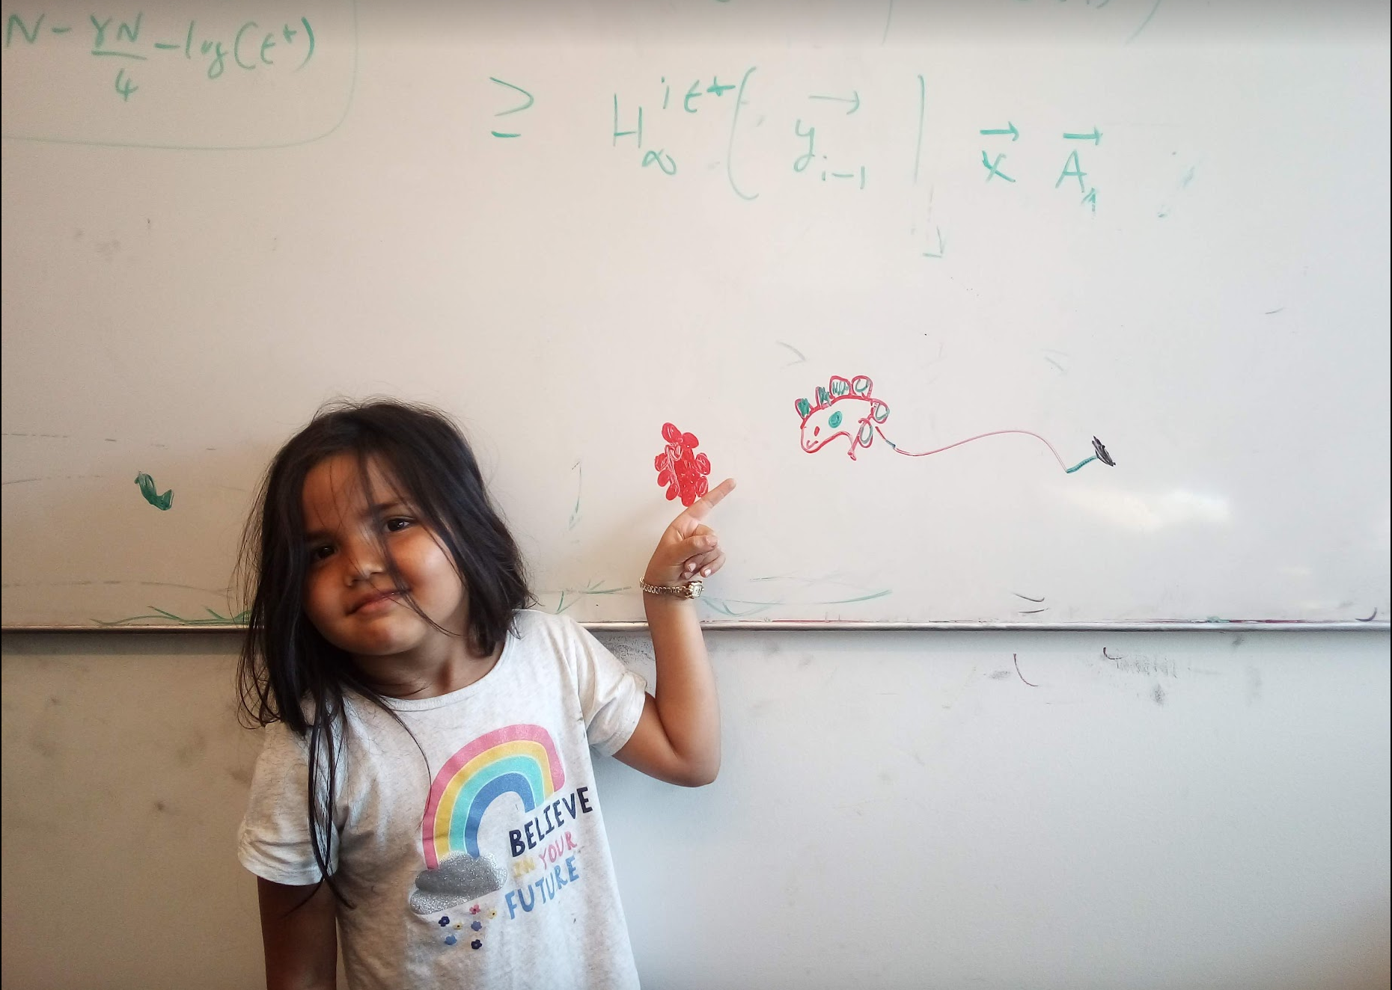
Questions/Comments?

Slide 15
Implementing DFS in O(m+n) time
Same as BFS except stack instead of a queue

Slide 16
A DFS run using an explicit stack
7
8
1
7
6
7
3
2
3
5
8
4
4
5
5
3
6
2
3
1

Slide 17
DFS stack implementation
DFS(s)
CC[s] = T and CC[w] = F for every w≠ s
Same
O(m+n) run time analysis as for BFS
Intitialize Ŝ = {s}
While Ŝ is not empty
Pop the top element u in Ŝ
If CC[u] = F then
CC[w] = T
For every edge (u,w)
Push w to the top of Ŝ

Slide 18
Questions/Comments?

Slide 19
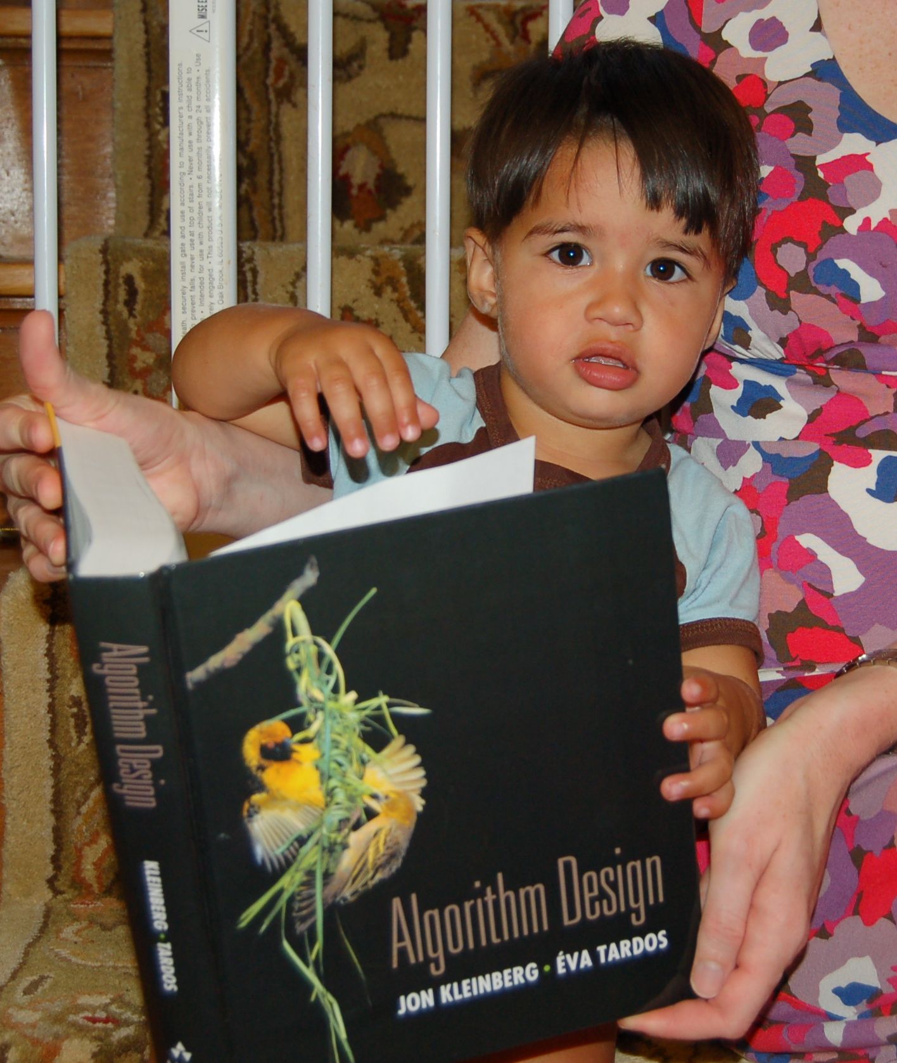
Reading Assignment
Sec 3.3, 3.4, 3.5 and 3.6 of [KT]

Slide 20


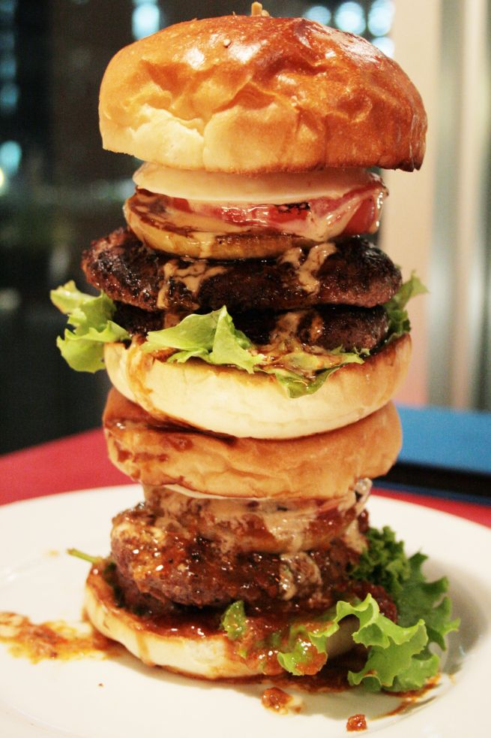
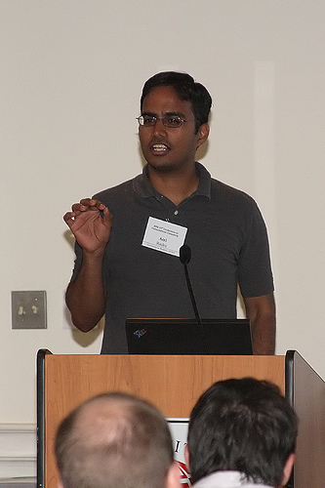
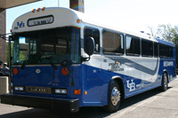
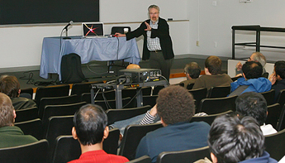
Directed graphs
Model asymmetric relationships
Precedence relationships
u needs to be done before w means (u,w) edge

Slide 21
Directed graphs
Adjacency matrix is not symmetric
Each vertex has two lists in Adj. list rep.

Slide 22
Directed Acyclic Graph (DAG)
No directed cycles
Precedence relationships are consistent

Slide 23
Topological Sorting of a DAG
Order the vertices so that all edges go “forward”

Slide 24

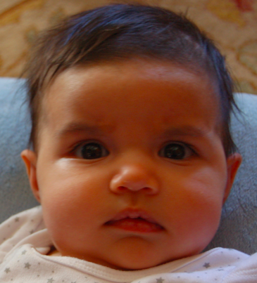
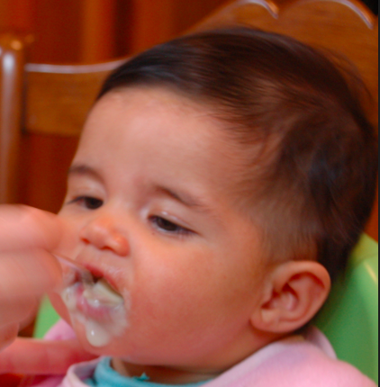

Probabilistic Graphical Models (PGMs)
http://ginaskokopelli.com/wp-content/uploads/2013/01/DiaperDealsLogo.jpg
D
E
H
f_{S|E}(s,e) = Pr[S=s|E=e]
S
S
E
f_{S|E}
Σ
1
1
0.8
φ (h) =
f_{H|D,S}(h,d,s) × f_{S|E}(s,e)
× f_{D|E}(d,e) × f_{E}(e)
1
0
0.3
d,s,e
0
1
0.2
0
0
0.7

Slide 25
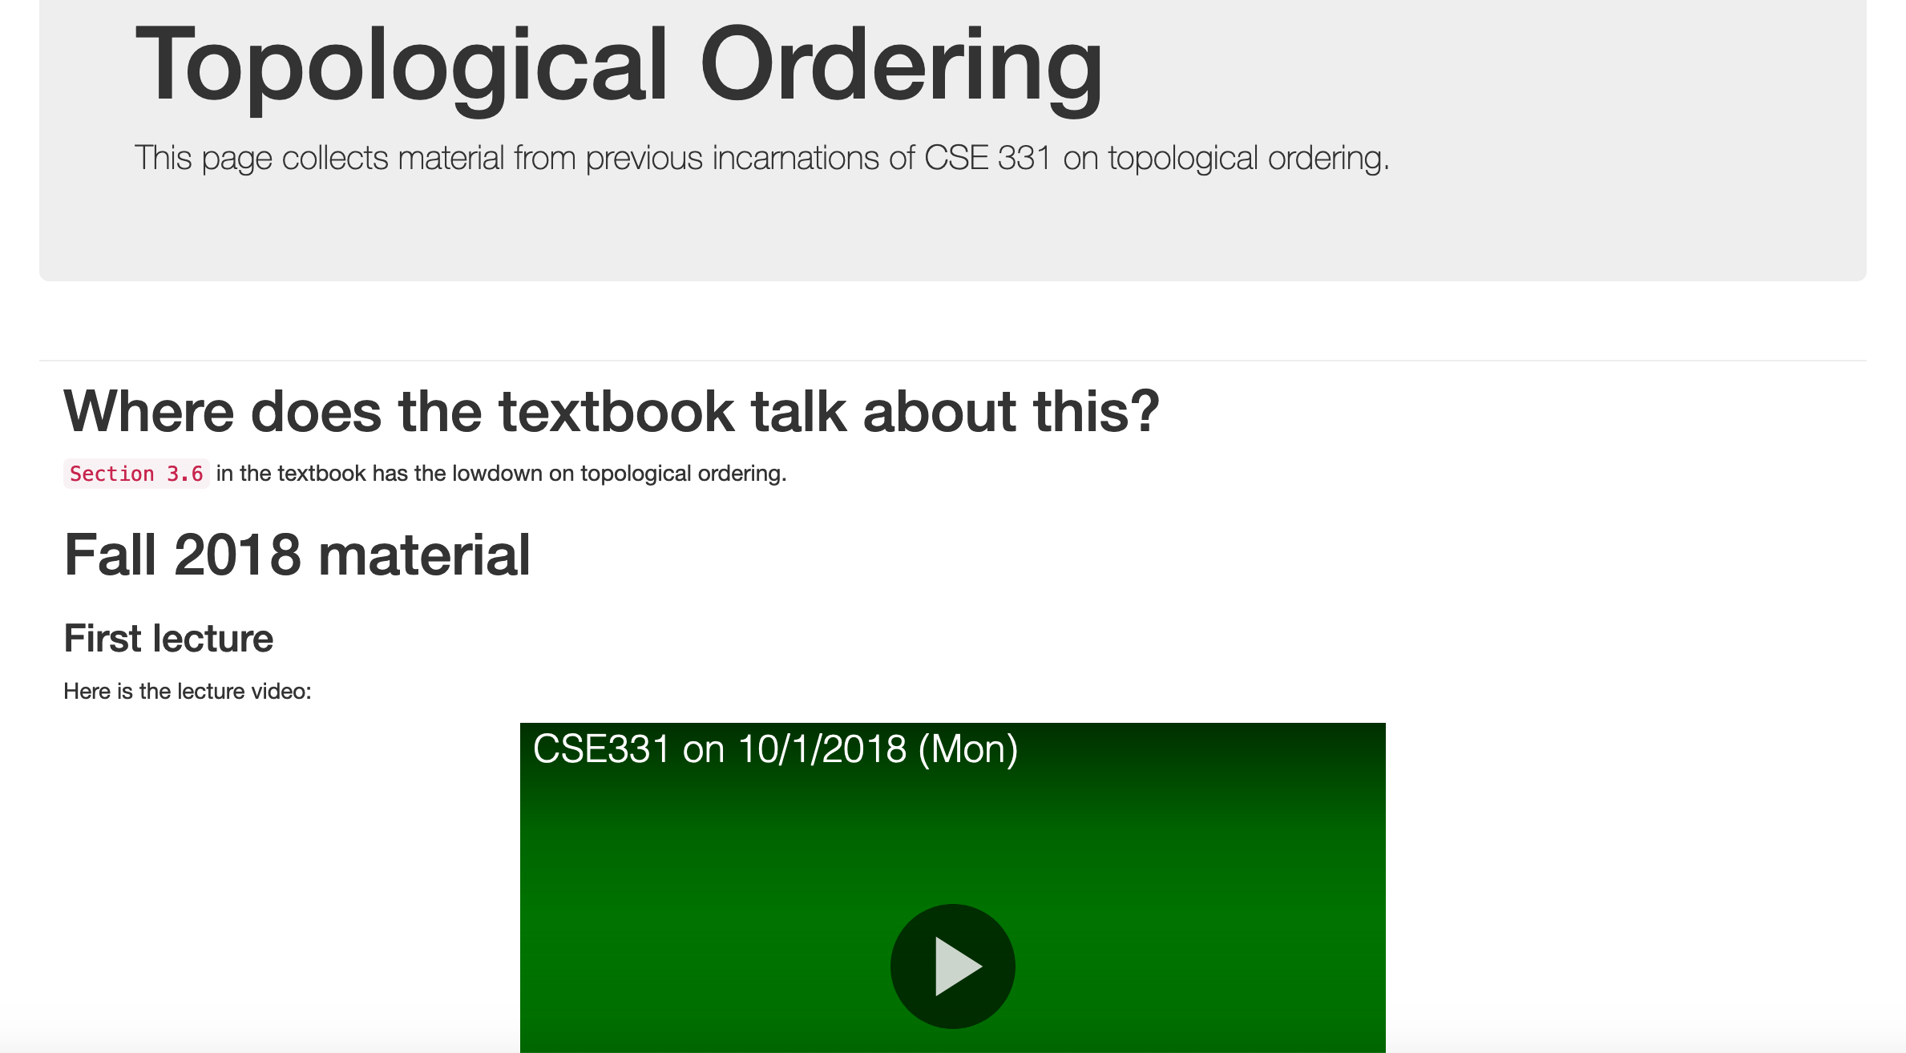
More details on Topological sort

Slide 26
Questions/Comments?

Slide 27
Mid-term material until here

