Slide 1
Lecture 15
CSE 331
Oct 3, 2022

Slide 2

If you need it, ask for help

Slide 3
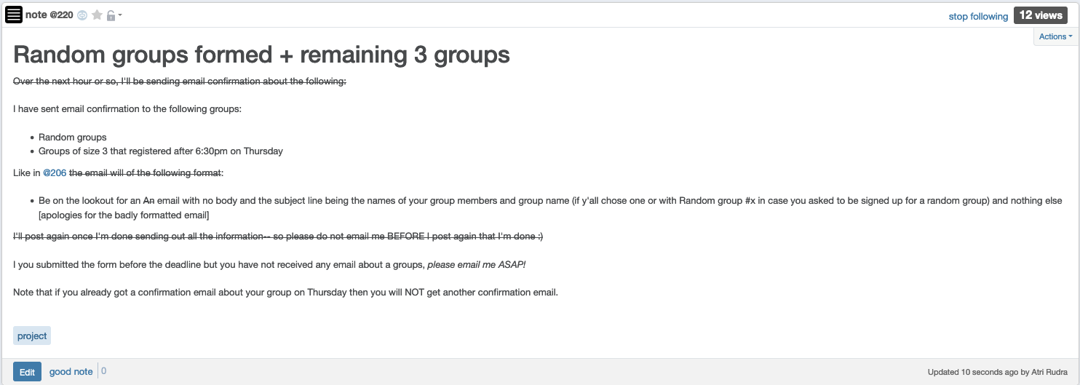
Project groups

Slide 4
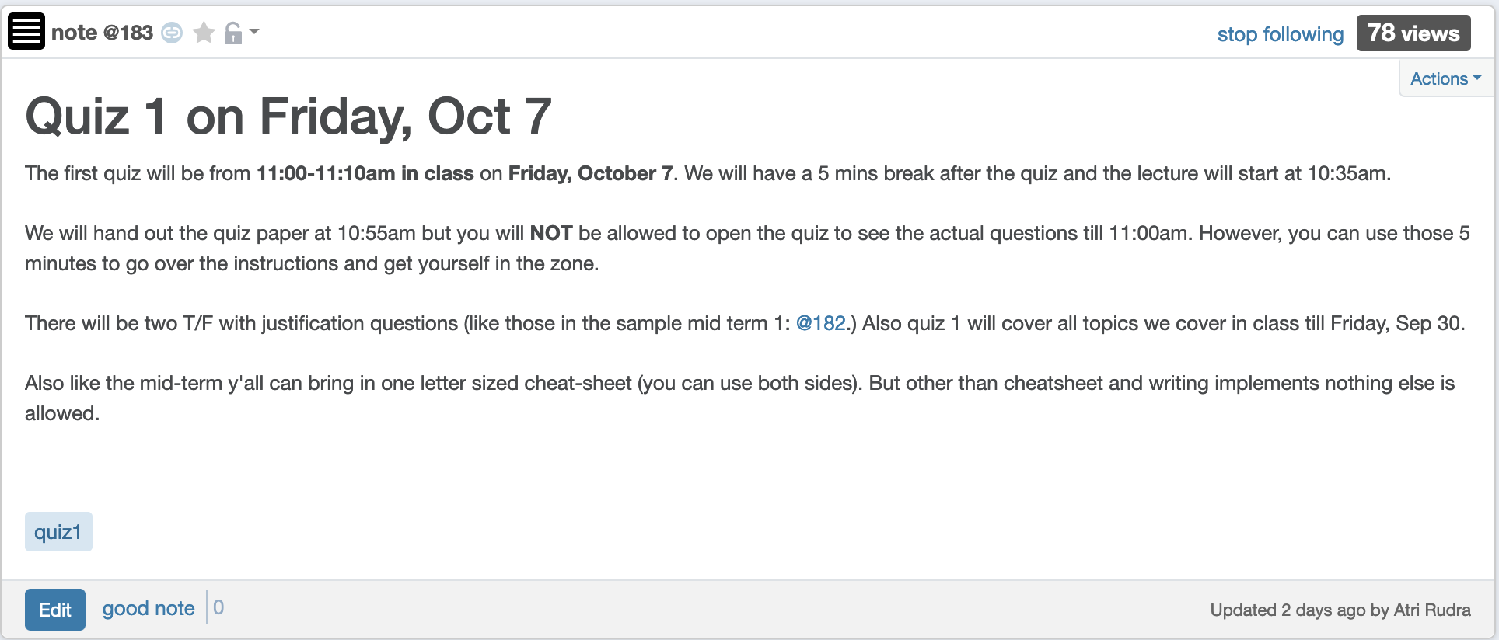
Quiz 1 this FRIDAY

Slide 5
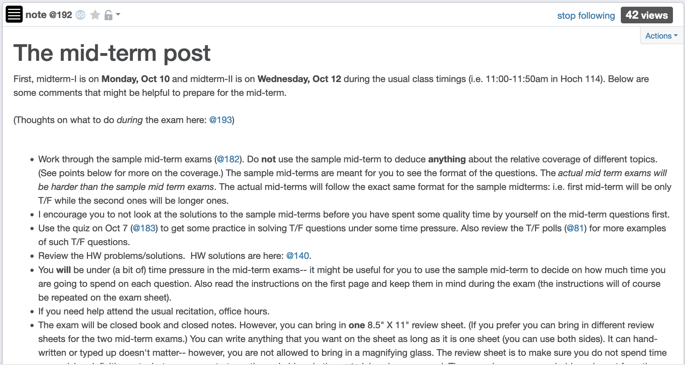
Mid-term post 1

Slide 6
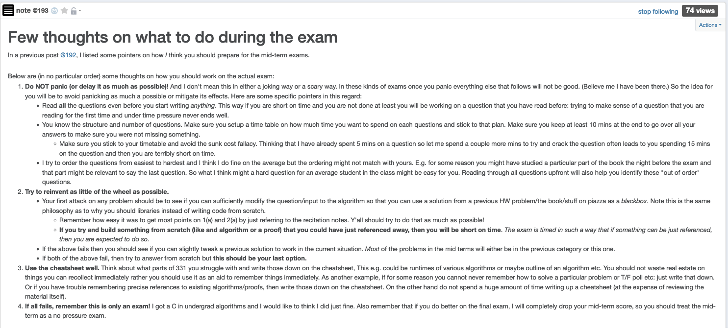
Mid-term post 2

Slide 7
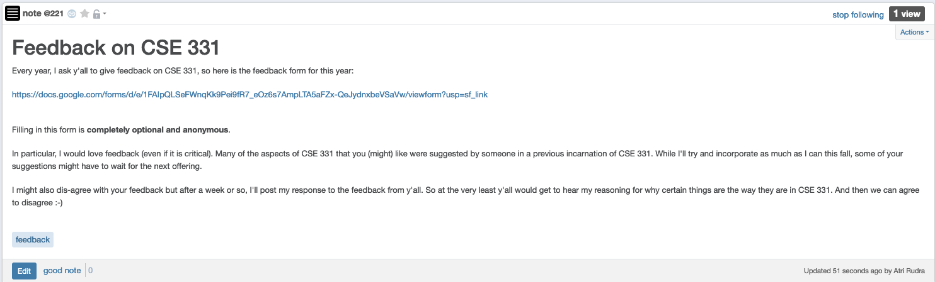
Feedback on CSE 331

Slide 8
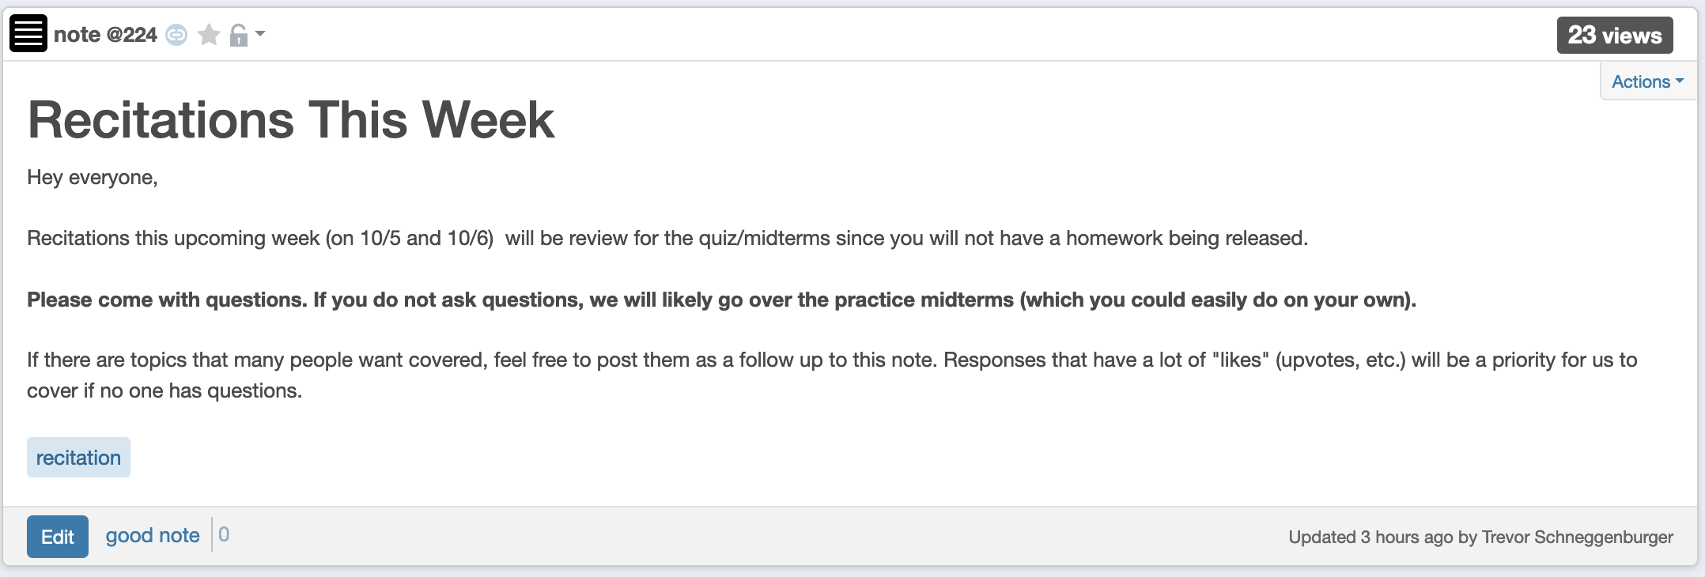
Recitation this week

Slide 9
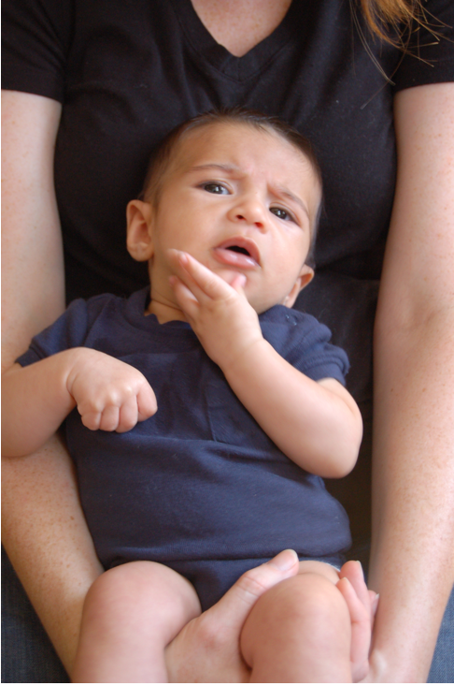
Questions?

Slide 10







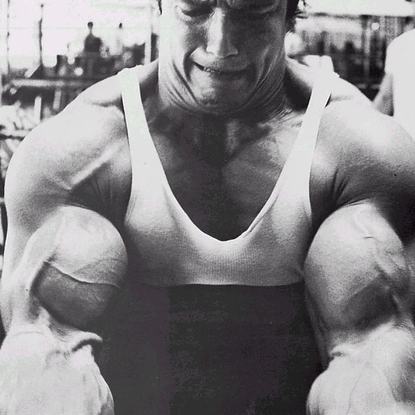
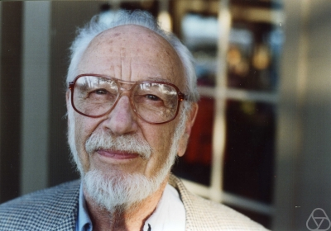
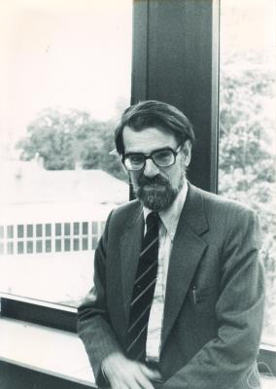
Main Steps in Algorithm Design
Problem Statement
Problem Definition
Algorithm
n!
“Implementation”
Data Structures
Analysis
Correctness+Runtime Analysis

Slide 11
Where do graphs fit in?
Problem Statement
A tool to define problems
Problem Definition
Algorithm
“Implementation”
Data Structures
Analysis
Correctness+Runtime Analysis

Slide 12
Rest of the course*
Problem Statement
Problem Definition
Three general techniques
Algorithm
“Implementation”
Data Structures
Analysis
Correctness+Runtime Analysis

Slide 13

Greedy algorithms
Build the final solution piece by piece
Being short sighted on each piece
Never undo a decision
Know when you see it

Slide 14

End of Semester blues
Can only do one thing at any day: what is the maximum number of tasks that you can do?
Write up a term paper
Party!
Exam study
331 homework
331 HW
Project
Friday
Saturday
Sunday
Monday
Tuesday

Slide 15
The optimal solution
Can only do one thing at any day: what is the maximum number of tasks that you can do?
Party!
Exam study
331 HW
Friday
Saturday
Sunday
Monday
Tuesday

Slide 16
Interval Scheduling Problem
Input: n intervals [s(i), f(i)) for 1≤ i ≤ n
{ s(i), … ,f(i)-1 }
Output: A schedule S of the n intervals
No two intervals in S conflict
|S| is maximized

Slide 17
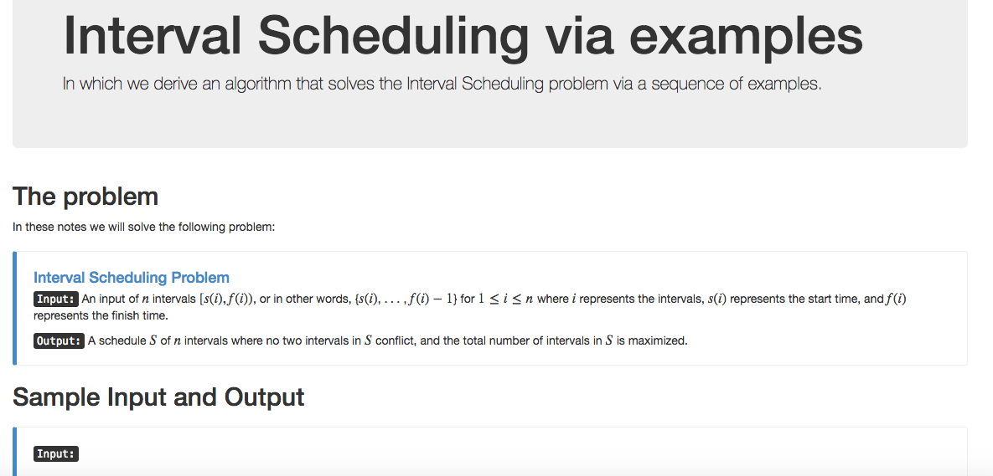
Algorithm with examples

Slide 18
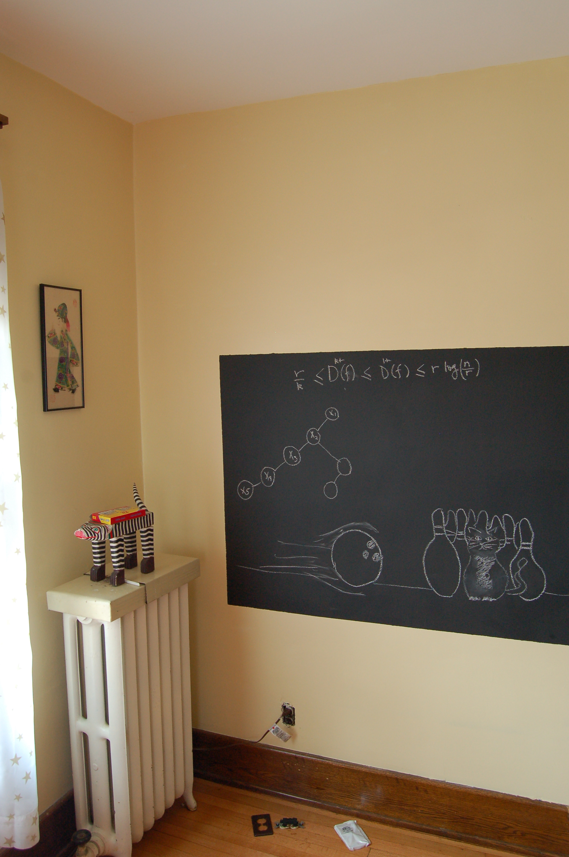
Re-define problem on the board…

Slide 19
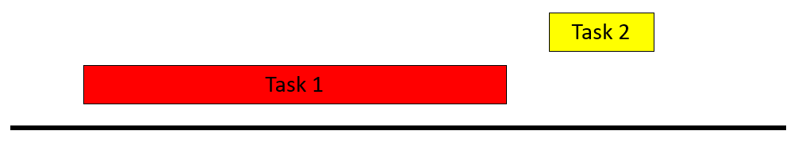
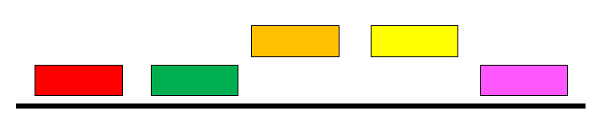
Example 1
No intervals overlap

Slide 20
Algorithm?
No intervals overlap
R: set of requests
Set S to be the empty set
While R is not empty
Choose i in R
Add i to S
Remove i from R
Return S*= S

Slide 21
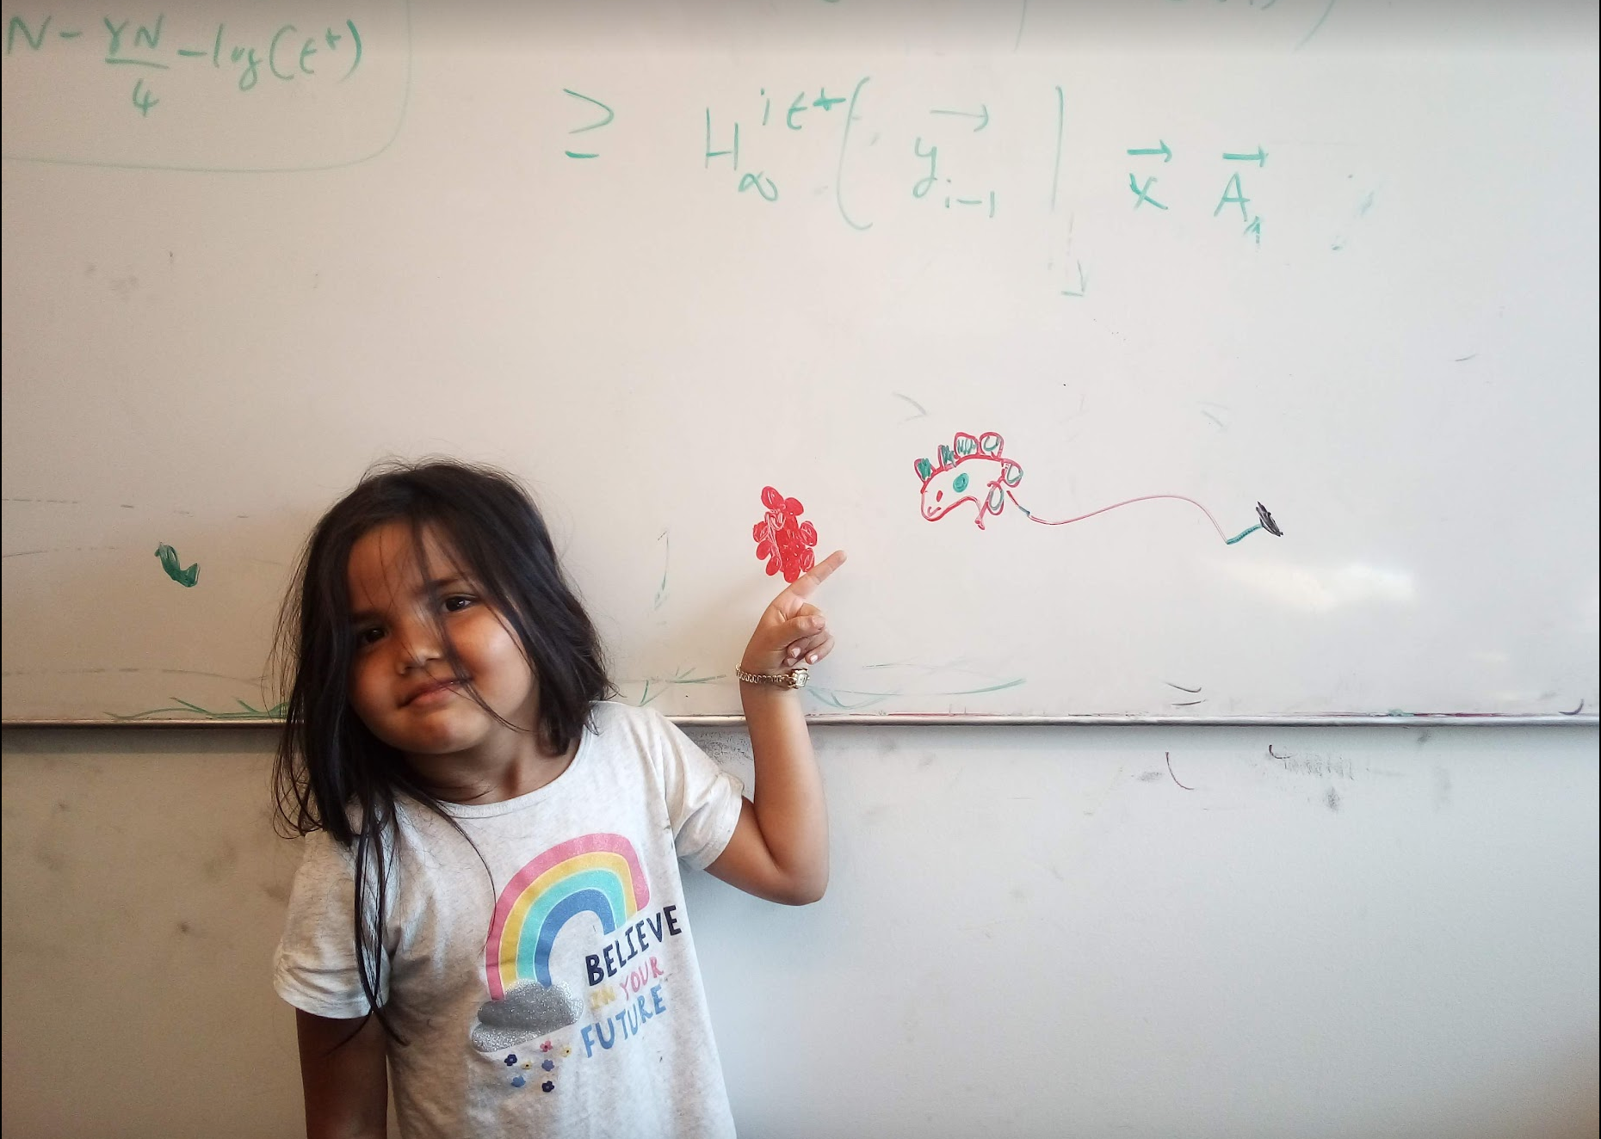
Questions/Comments?

Slide 22
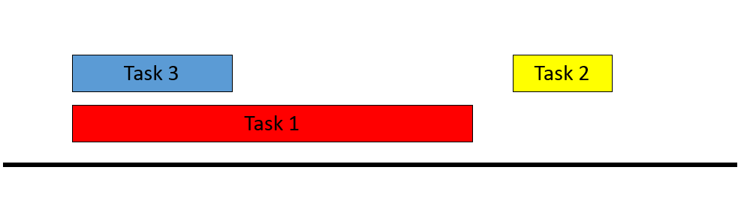
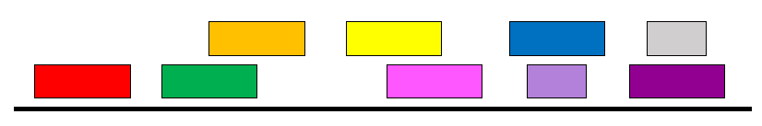
Example 2
At most one overlap/task

Slide 23
Algorithm?
At most one overlap
R: set of requests
Set S to be the empty set
While R is not empty
Choose i in R
Add i to S
Remove all tasks that conflict with i from R
Remove i from R
Return S*= S

Slide 24
Example 3
Task 4
Task 5
More than one conflict
Task 3
Task 2
Task 1
Set S to be the empty set
While R is not empty
Choose i in R
Add i to S
Remove all tasks that conflict with i from R
Return S*= S

Slide 25
Greedily solve your blues!
Arrange tasks in some order and iteratively pick non-overlapping tasks
Write up a term paper
Party!
Exam study
331 HW
Project
Saturday
Sunday
Monday
Tuesday
Wednesday

Slide 26
Making it more formal
Task 4
Task 5
More than one conflict
Task 3
Task 2
Task 1
Set S to be the empty set
Associate a value v(i) with task i
While R is not empty
Choose i in R
Choose i in R that minimizes v(i)
Add i to S
Remove all tasks that conflict with i from R
Return S*= S

Slide 27
Questions/Comments?

Slide 28
What is a good choice for v(i)?
Task 4
Task 5
More than one conflict
Task 3
Task 2
Task 1
Set S to be the empty set
Associate a value v(i) with task i
While R is not empty
Choose i in R that minimizes v(i)
Add i to S
Remove all tasks that conflict with i from R
Return S*= S

Slide 29
v(i) = f(i) – s(i)
Task 4
Task 5
Smallest duration first
Task 3
Task 2
Task 1
Set S to be the empty set
While R is not empty
Choose i in R that minimizes f(i) – s(i)
Add i to S
Remove all tasks that conflict with i from R
Return S*= S

Slide 30
v(i) = s(i)
Task 4
Task 5
Earliest time first?
Task 3
Task 2
Task 1
So are we done?
Set S to be the empty set
While R is not empty
Choose i in R that minimizes s(i)
Add i to S
Remove all tasks that conflict with i from R
Return S*= S

Slide 31
Not so fast….
Task 4
Task 5
Earliest time first?
Task 3
Task 2
Task 1
Task 6
Set S to be the empty set
While R is not empty
Choose i in R that minimizes s(i)
Add i to S
Remove all tasks that conflict with i from R
Return S*= S

Slide 32
Pick job with minimum conflicts
Task 4
Task 5
Task 3
Task 2
Task 1
Task 6
Set S to be the empty set
So are we done?
While R is not empty
Choose i in R that has smallest number of conflicts
Add i to S
Remove all tasks that conflict with i from R
Return S*= S

Slide 33
Questions/Comments?

Slide 34
Nope (but harder to show)
Set S to be the empty set
While R is not empty
Choose i in R that has smallest number of conflicts
Add i to S
Remove all tasks that conflict with i from R
Return S*= S

Slide 35
Task 7
Task 4
Task 5
Task 17
Task 18
Task 3
Task 2
Task 15
Task 16
Task 1
Task 12
Task 13
Task 14
Task 6
Task 8
Task 9
Task 10
Task 11
Set S to be the empty set
While R is not empty
Choose i in R that has smallest number of conflicts
Add i to S
Remove all tasks that conflict with i from R
Return S*= S

Slide 36
Algorithm?
Task 7
Task 4
Task 5
Task 17
Task 18
Task 3
Task 2
Task 15
Task 16
Task 1
Task 12
Task 13
Task 14
Task 6
Task 8
Task 9
Task 10
Task 11
Set S to be the empty set
While R is not empty
Choose i in R that minimizes v(i)
Add i to S
Remove all tasks that conflict with i from R
Return S*= S

Slide 37
Earliest finish time first
Task 7
Task 4
Task 5
Task 17
Task 18
Task 3
Task 2
Task 15
Task 16
Task 1
Task 12
Task 13
Task 14
Task 6
Task 8
Task 9
Task 10
Task 11
Set S to be the empty set
While R is not empty
Choose i in R that minimizes f(i)
Add i to S
Remove all tasks that conflict with i from R
Return S*= S

Slide 38
Find a counter-example?
Task 7
Task 4
Task 5
Task 17
Task 18
Task 3
Task 2
Task 15
Task 16
Task 1
Task 12
Task 13
Task 14
Task 6
Task 8
Task 9
Task 10
Task 11
It works!
Set S to be the empty set
While R is not empty
Choose i in R that minimizes f(i)
Add i to S
Remove all tasks that conflict with i from R
Return S*= S

Slide 39
Questions/Comments?

Slide 40
Today’s agenda
Prove the correctness of the algorithm

Slide 41
Final Algorithm
R: set of requests
Set S to be the empty set
While R is not empty
Choose i in R with the earliest finish time
Add i to S
Remove all requests that conflict with i from R
Return S*= S

Slide 42
Argue correctness on the board…

