Slide 1
Lecture 16
CSE 331
Oct 5, 2022

Slide 2
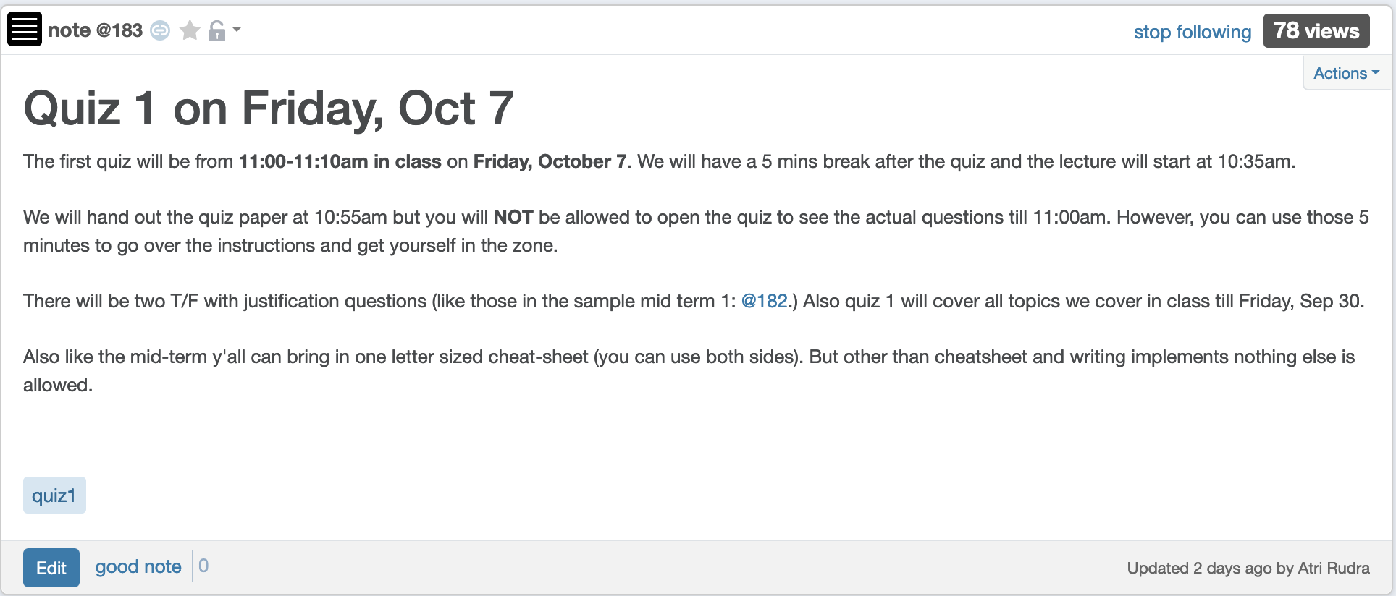
Quiz 1 this FRIDAY

Slide 3
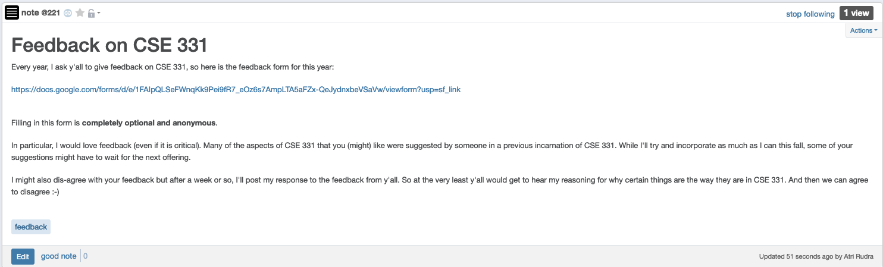
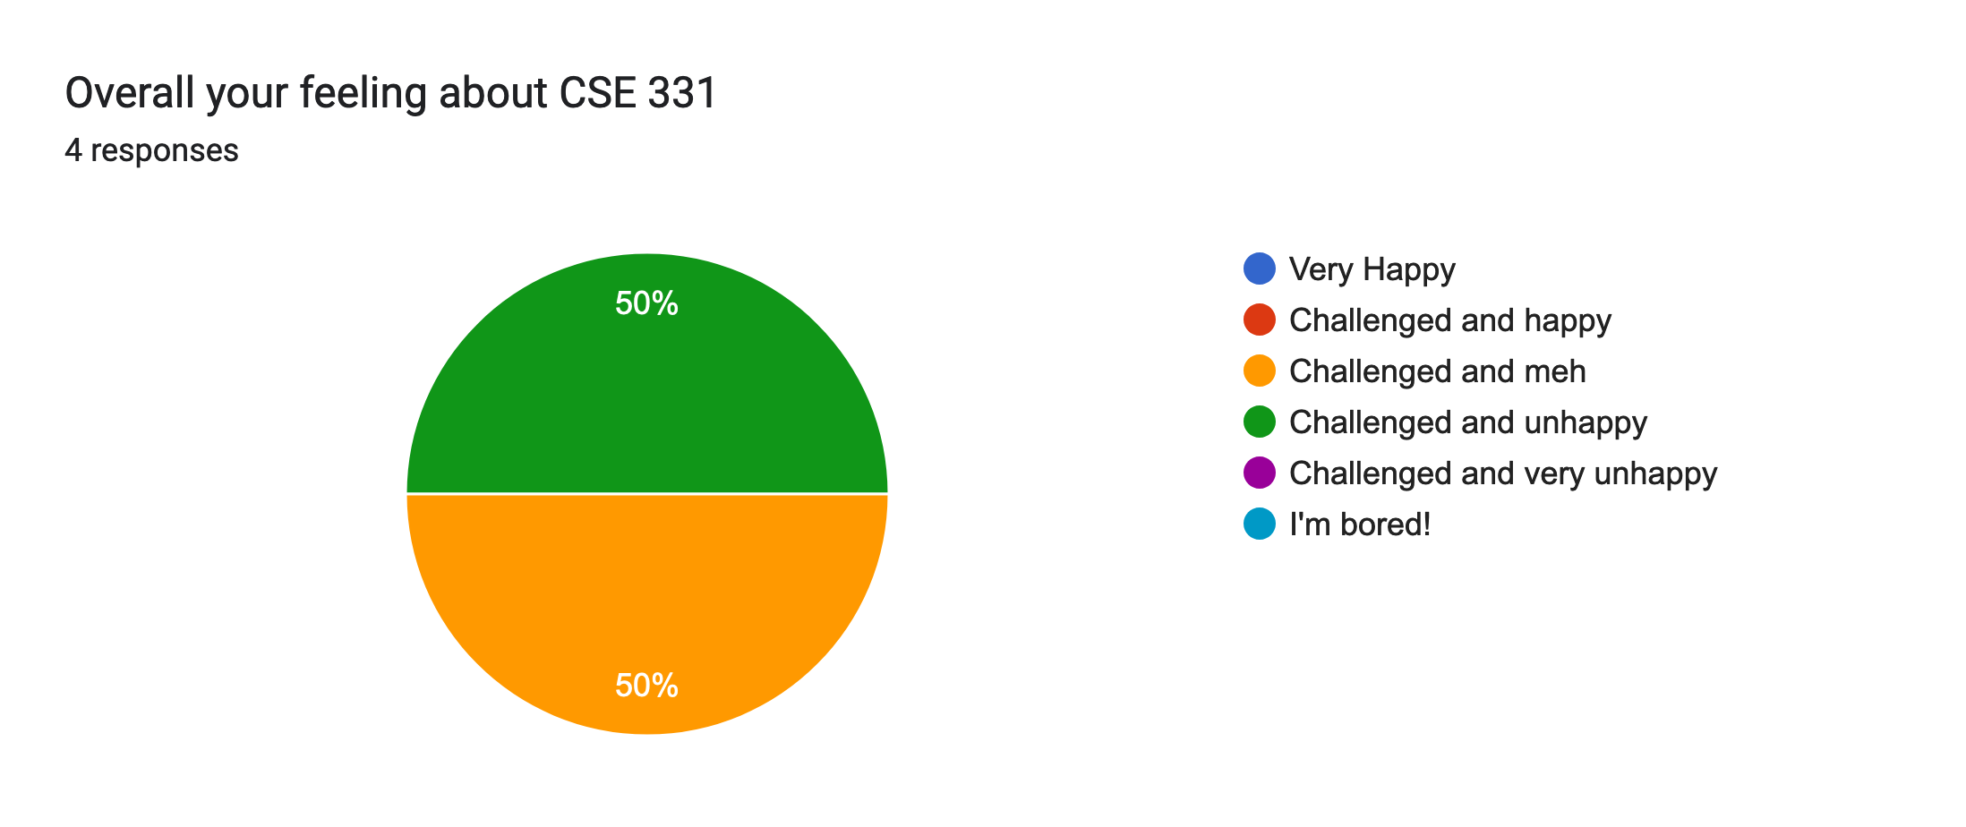
Please do fill in the feedback

Slide 4
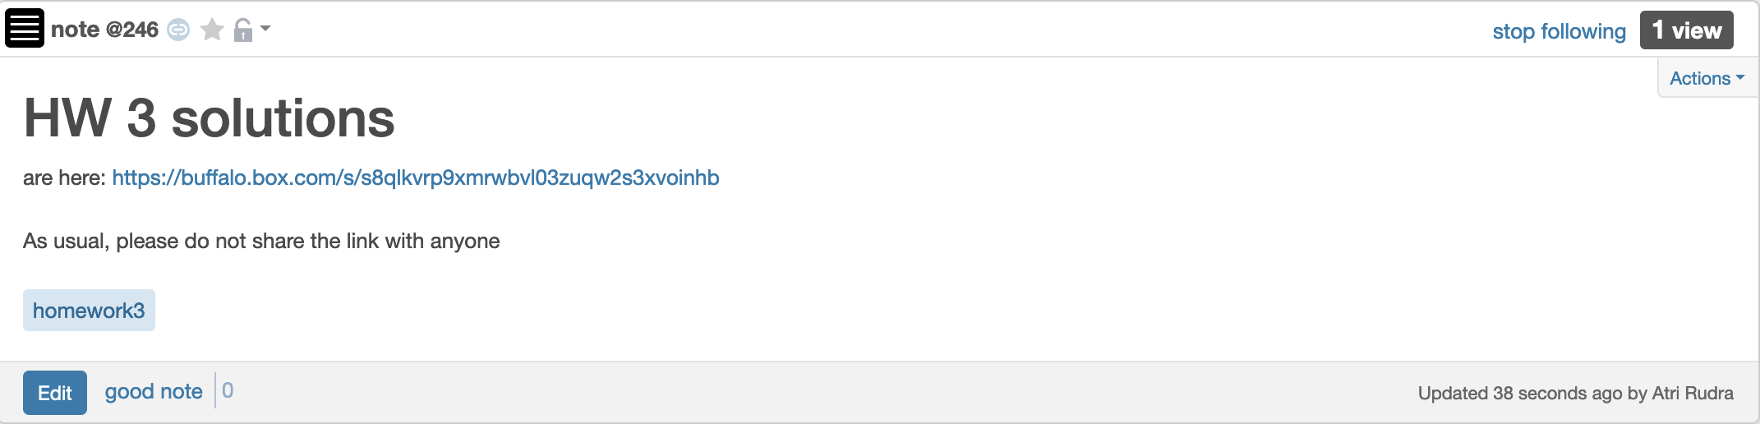
HW 3 solutions are out

Slide 5
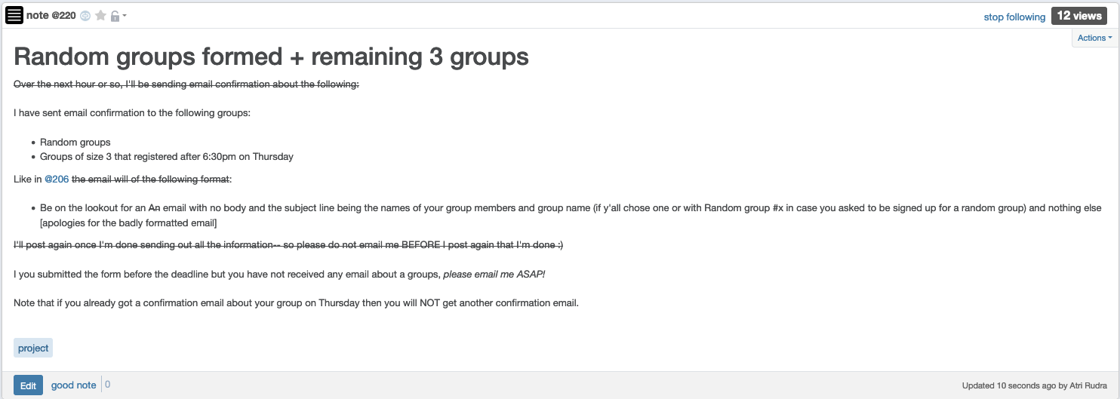
Project groups finalized

Slide 6
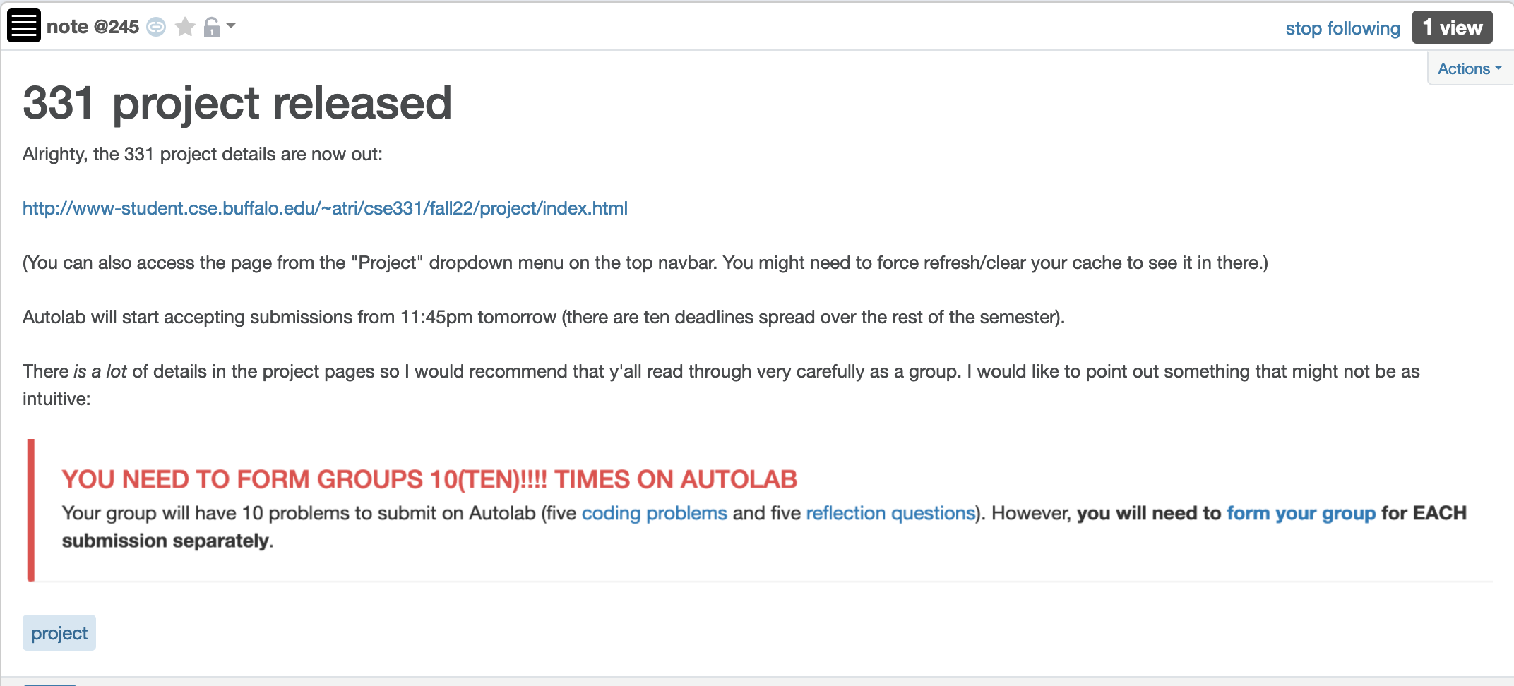
Project released

Slide 7
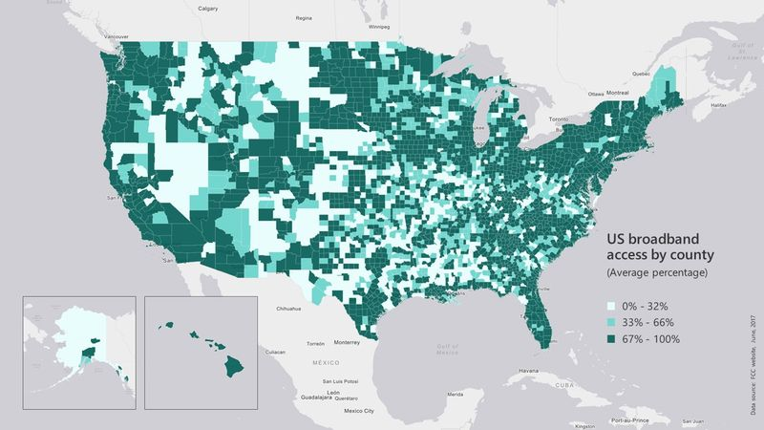
Broadband access
https://assets.bwbx.io/images/users/iqjWHBFdfxIU/iZSjibxE1KJs/v1/800x-1.jpg

Slide 8
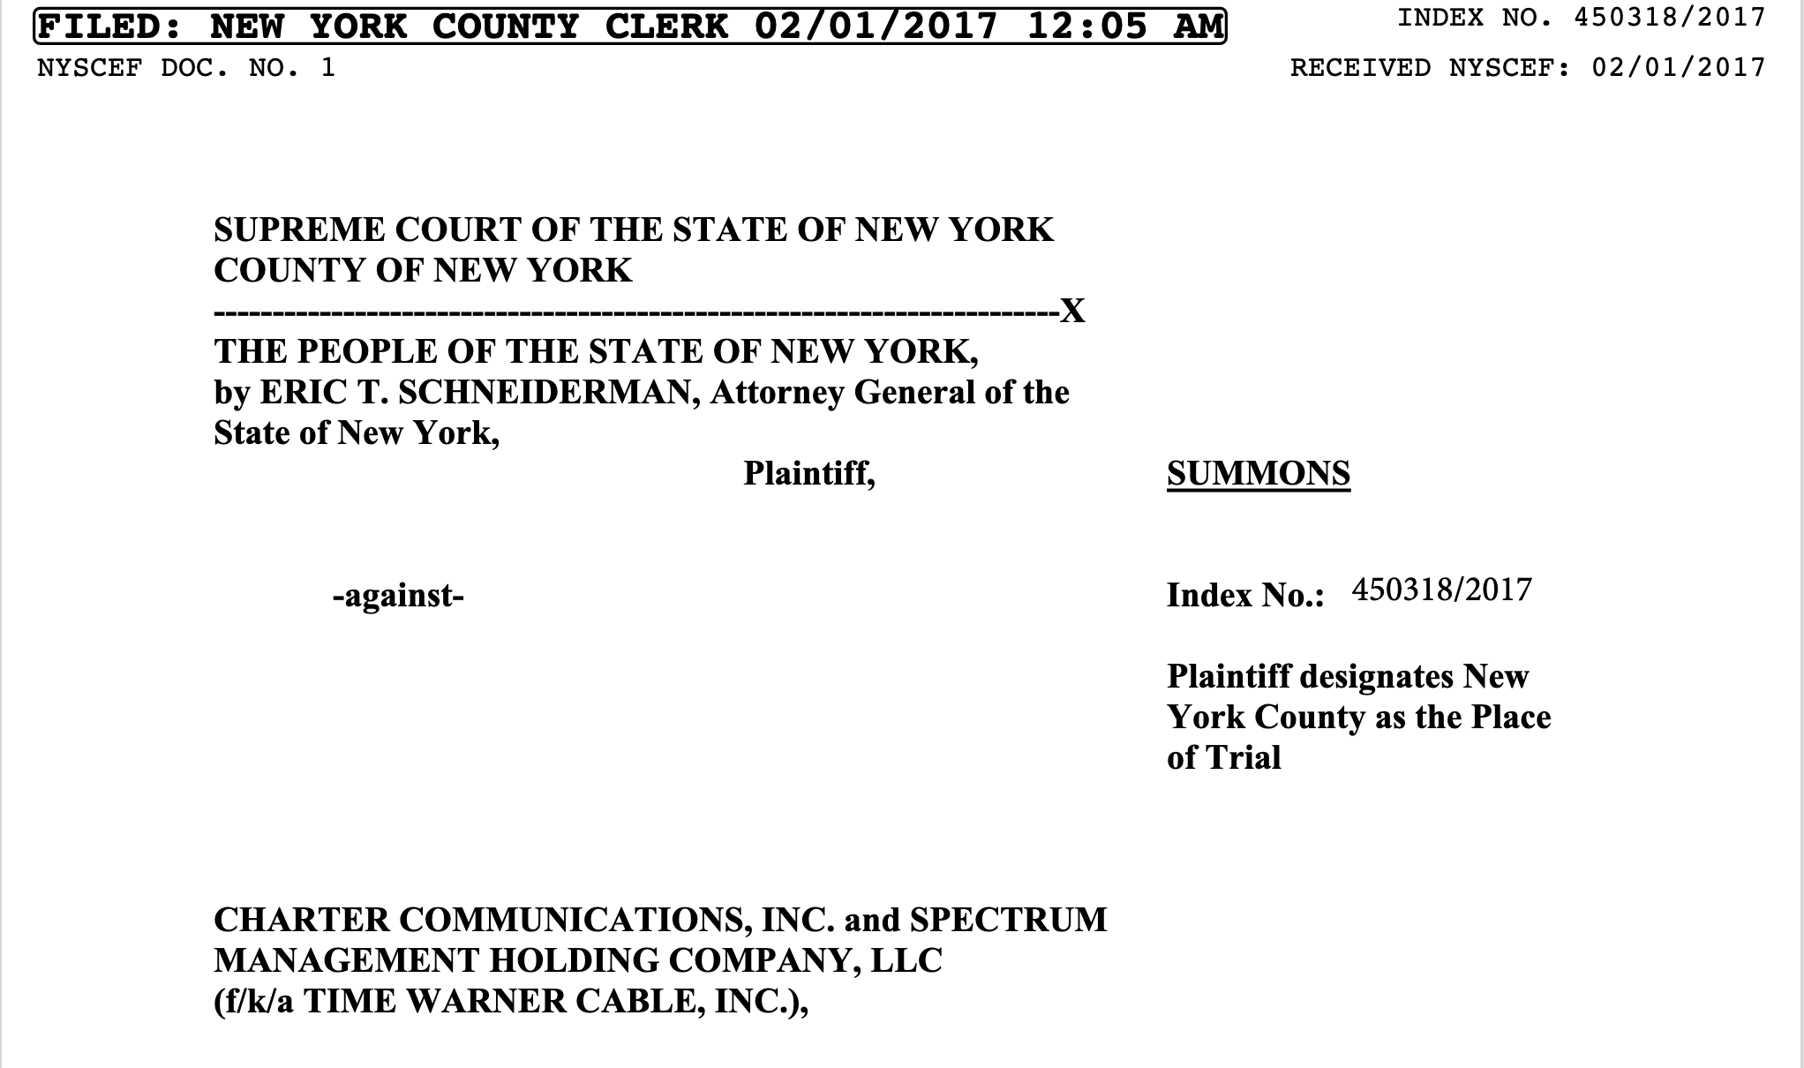
Lawsuit against Spectrum

Slide 9
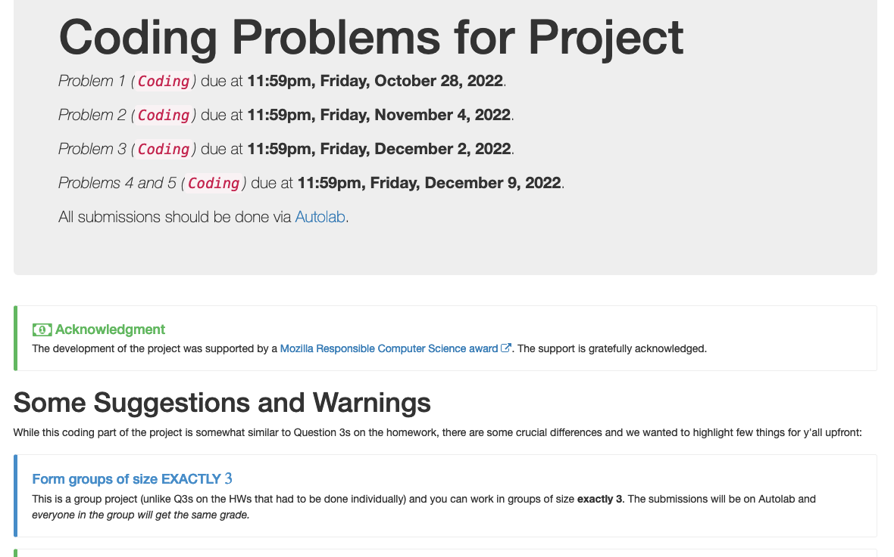
Five coding problems

Slide 10
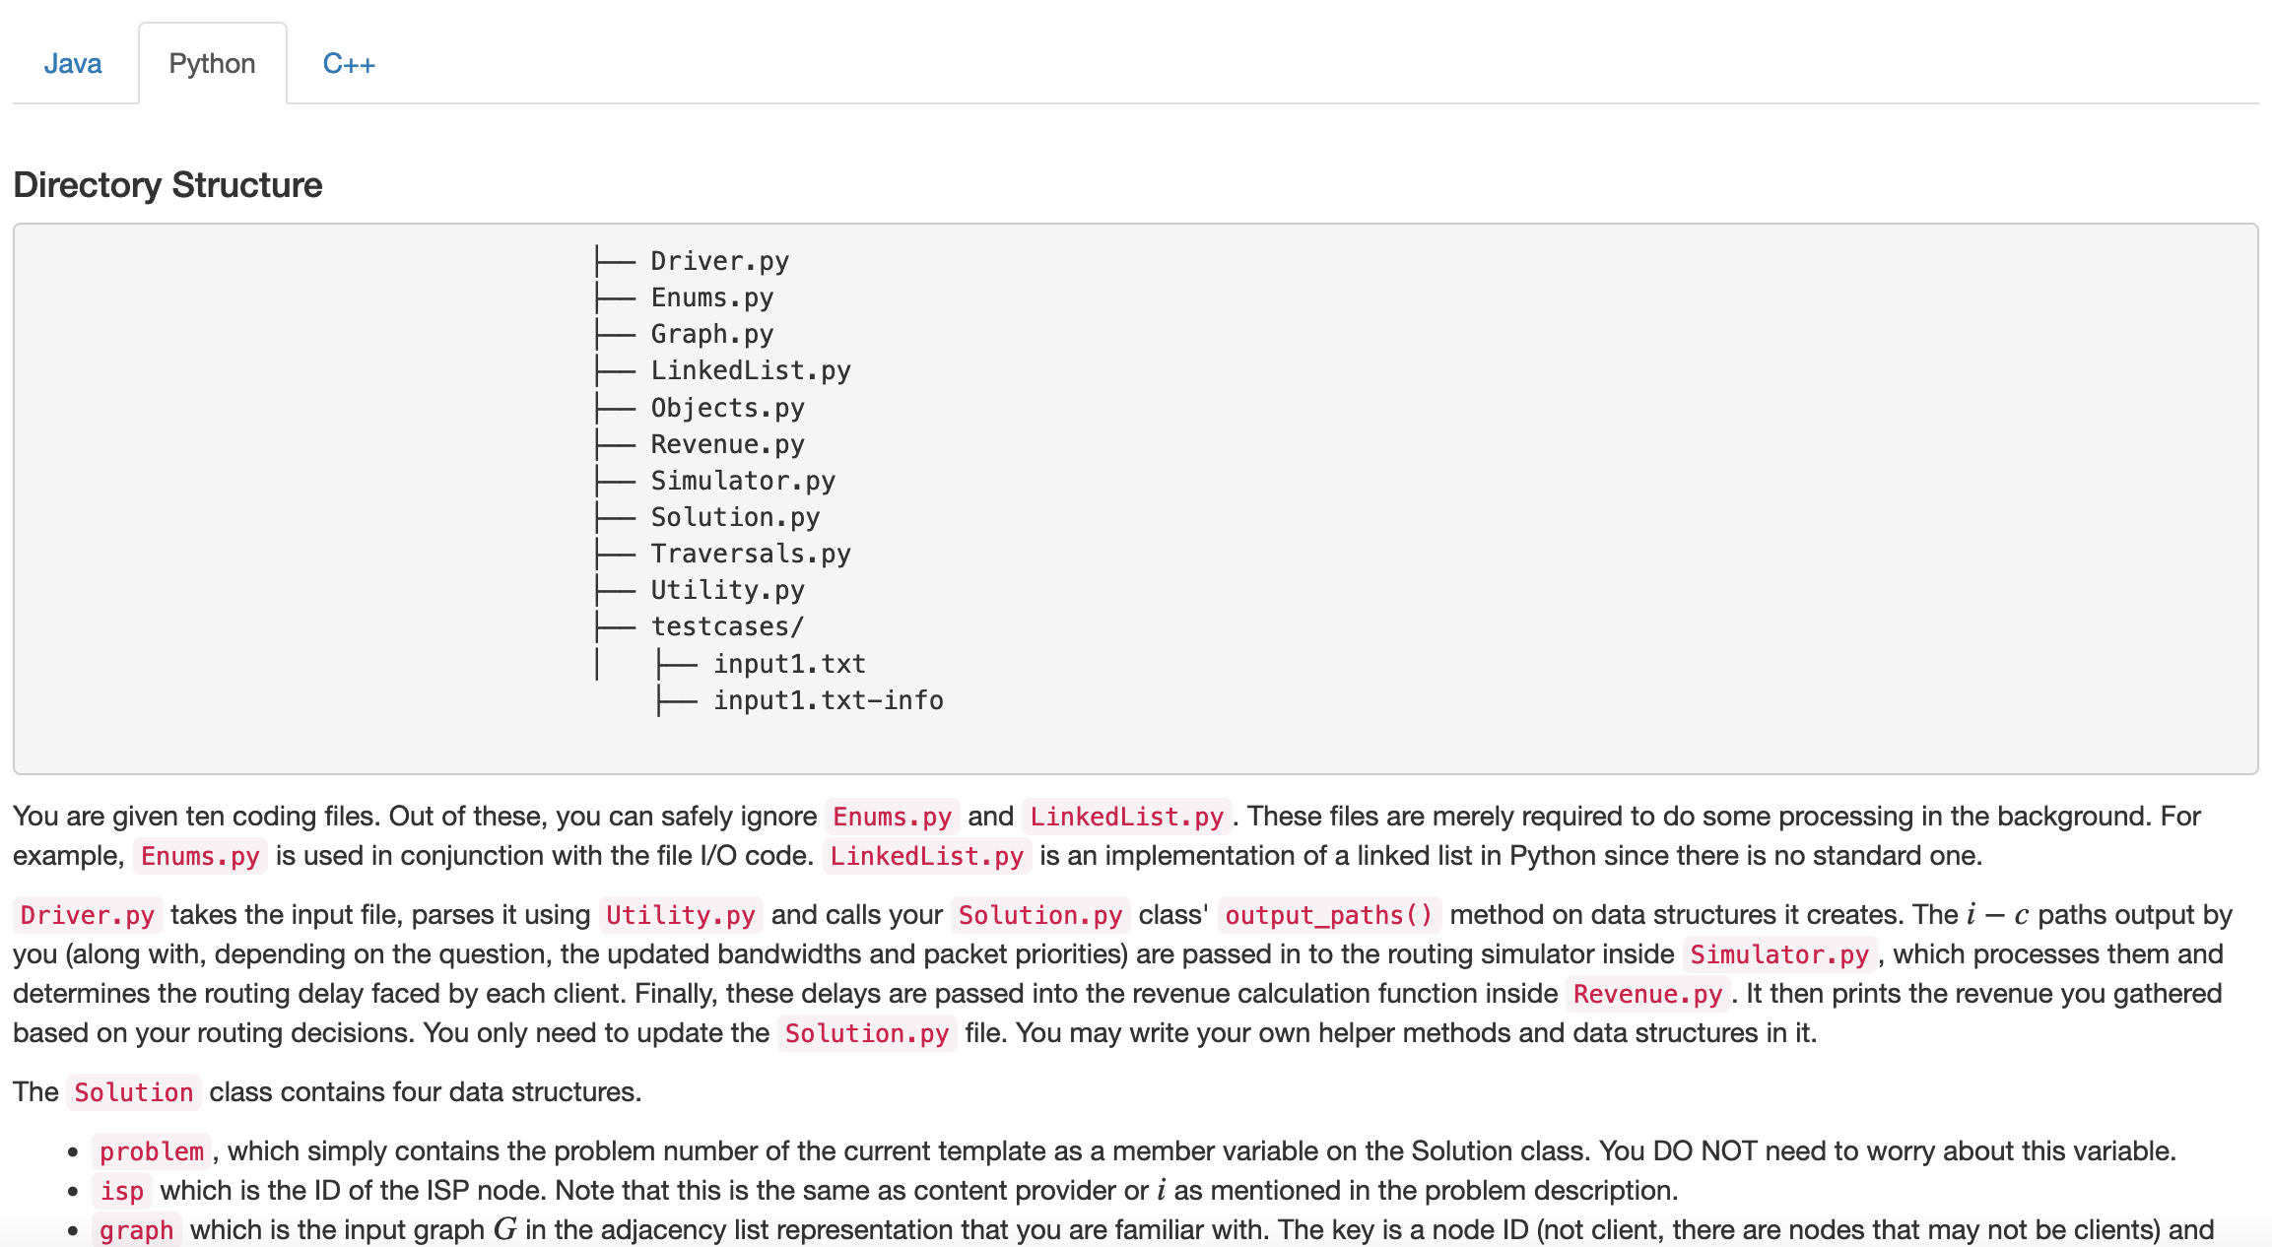
Each like a HW Q3
You can get full credit with code length along the lines of Q3 submissions!
More work to UNDERSTAND the problem

Slide 11
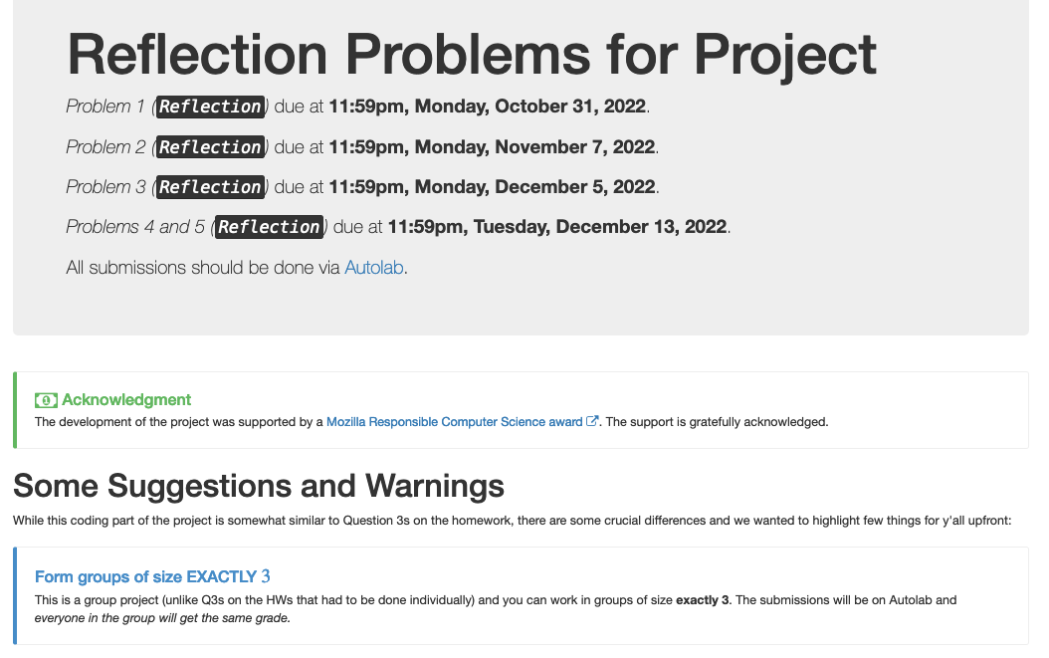
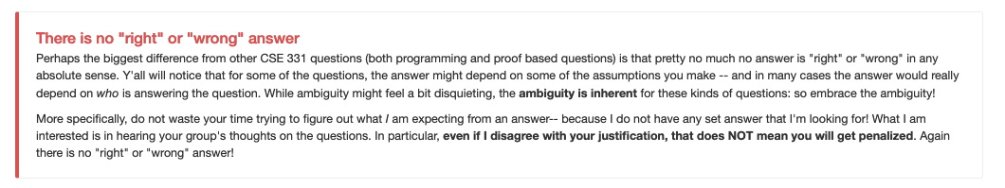
Five reflection problems

Slide 12
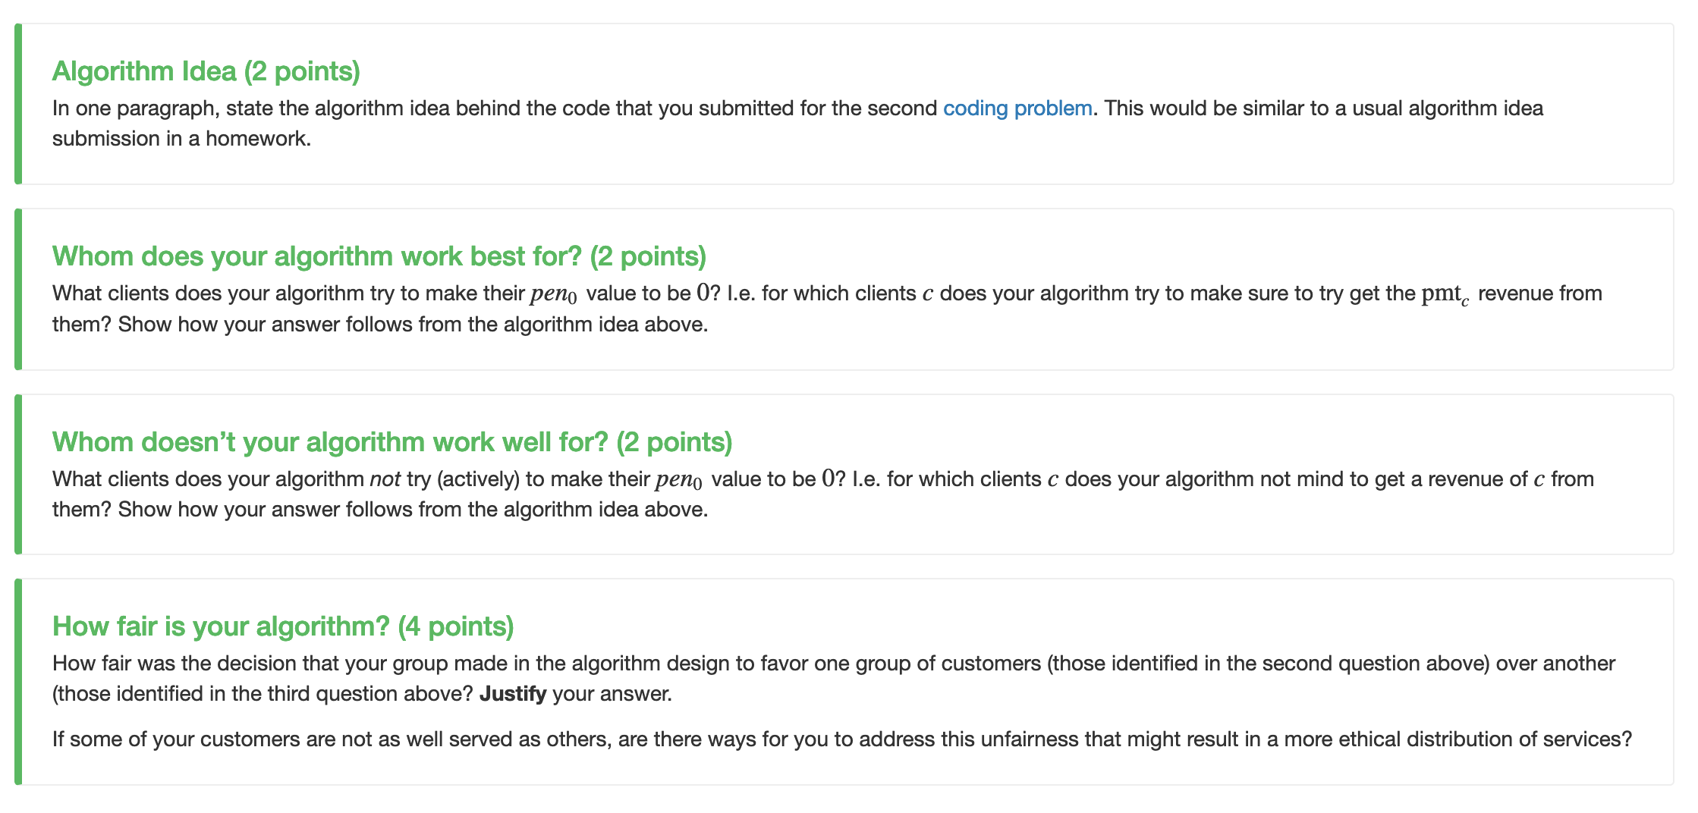
Reflect on your design choices

Slide 13
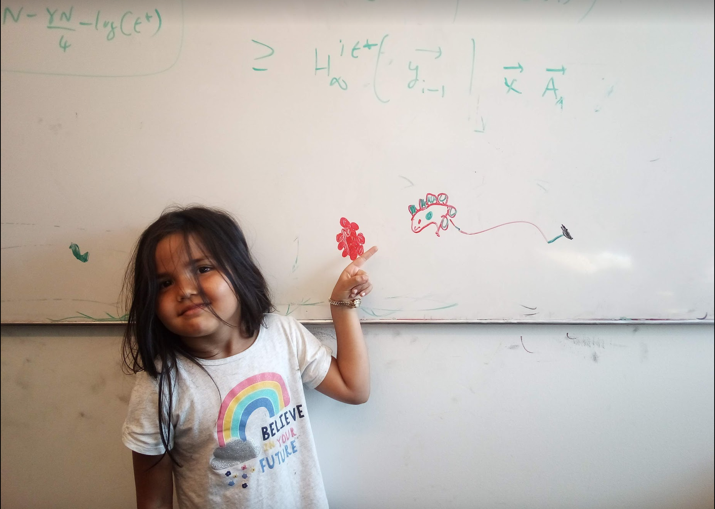
Questions/Comments?

Slide 14
Interval Scheduling Problem
Input: n intervals [s(i), f(i)) for 1≤ i ≤ n
Output: A schedule S of the n intervals
No two intervals in S conflict
|S| is maximized

Slide 15
Analyzing the algorithm
R: set of requests
S* has no conflicts
Set S to be the empty set
While R is not empty
Choose i in R with the earliest finish time
Add i to S
S* is an optimal solution
Remove all requests that conflict with i from R
Return S* = S

Slide 16
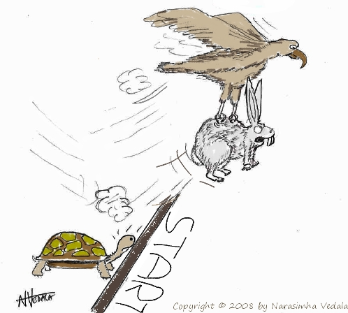
Greedy “stays ahead”
Greedy
OPT

Slide 17
Today’s agenda
Prove the correctness
Analyze run-time of the greedy algorithm

Slide 18
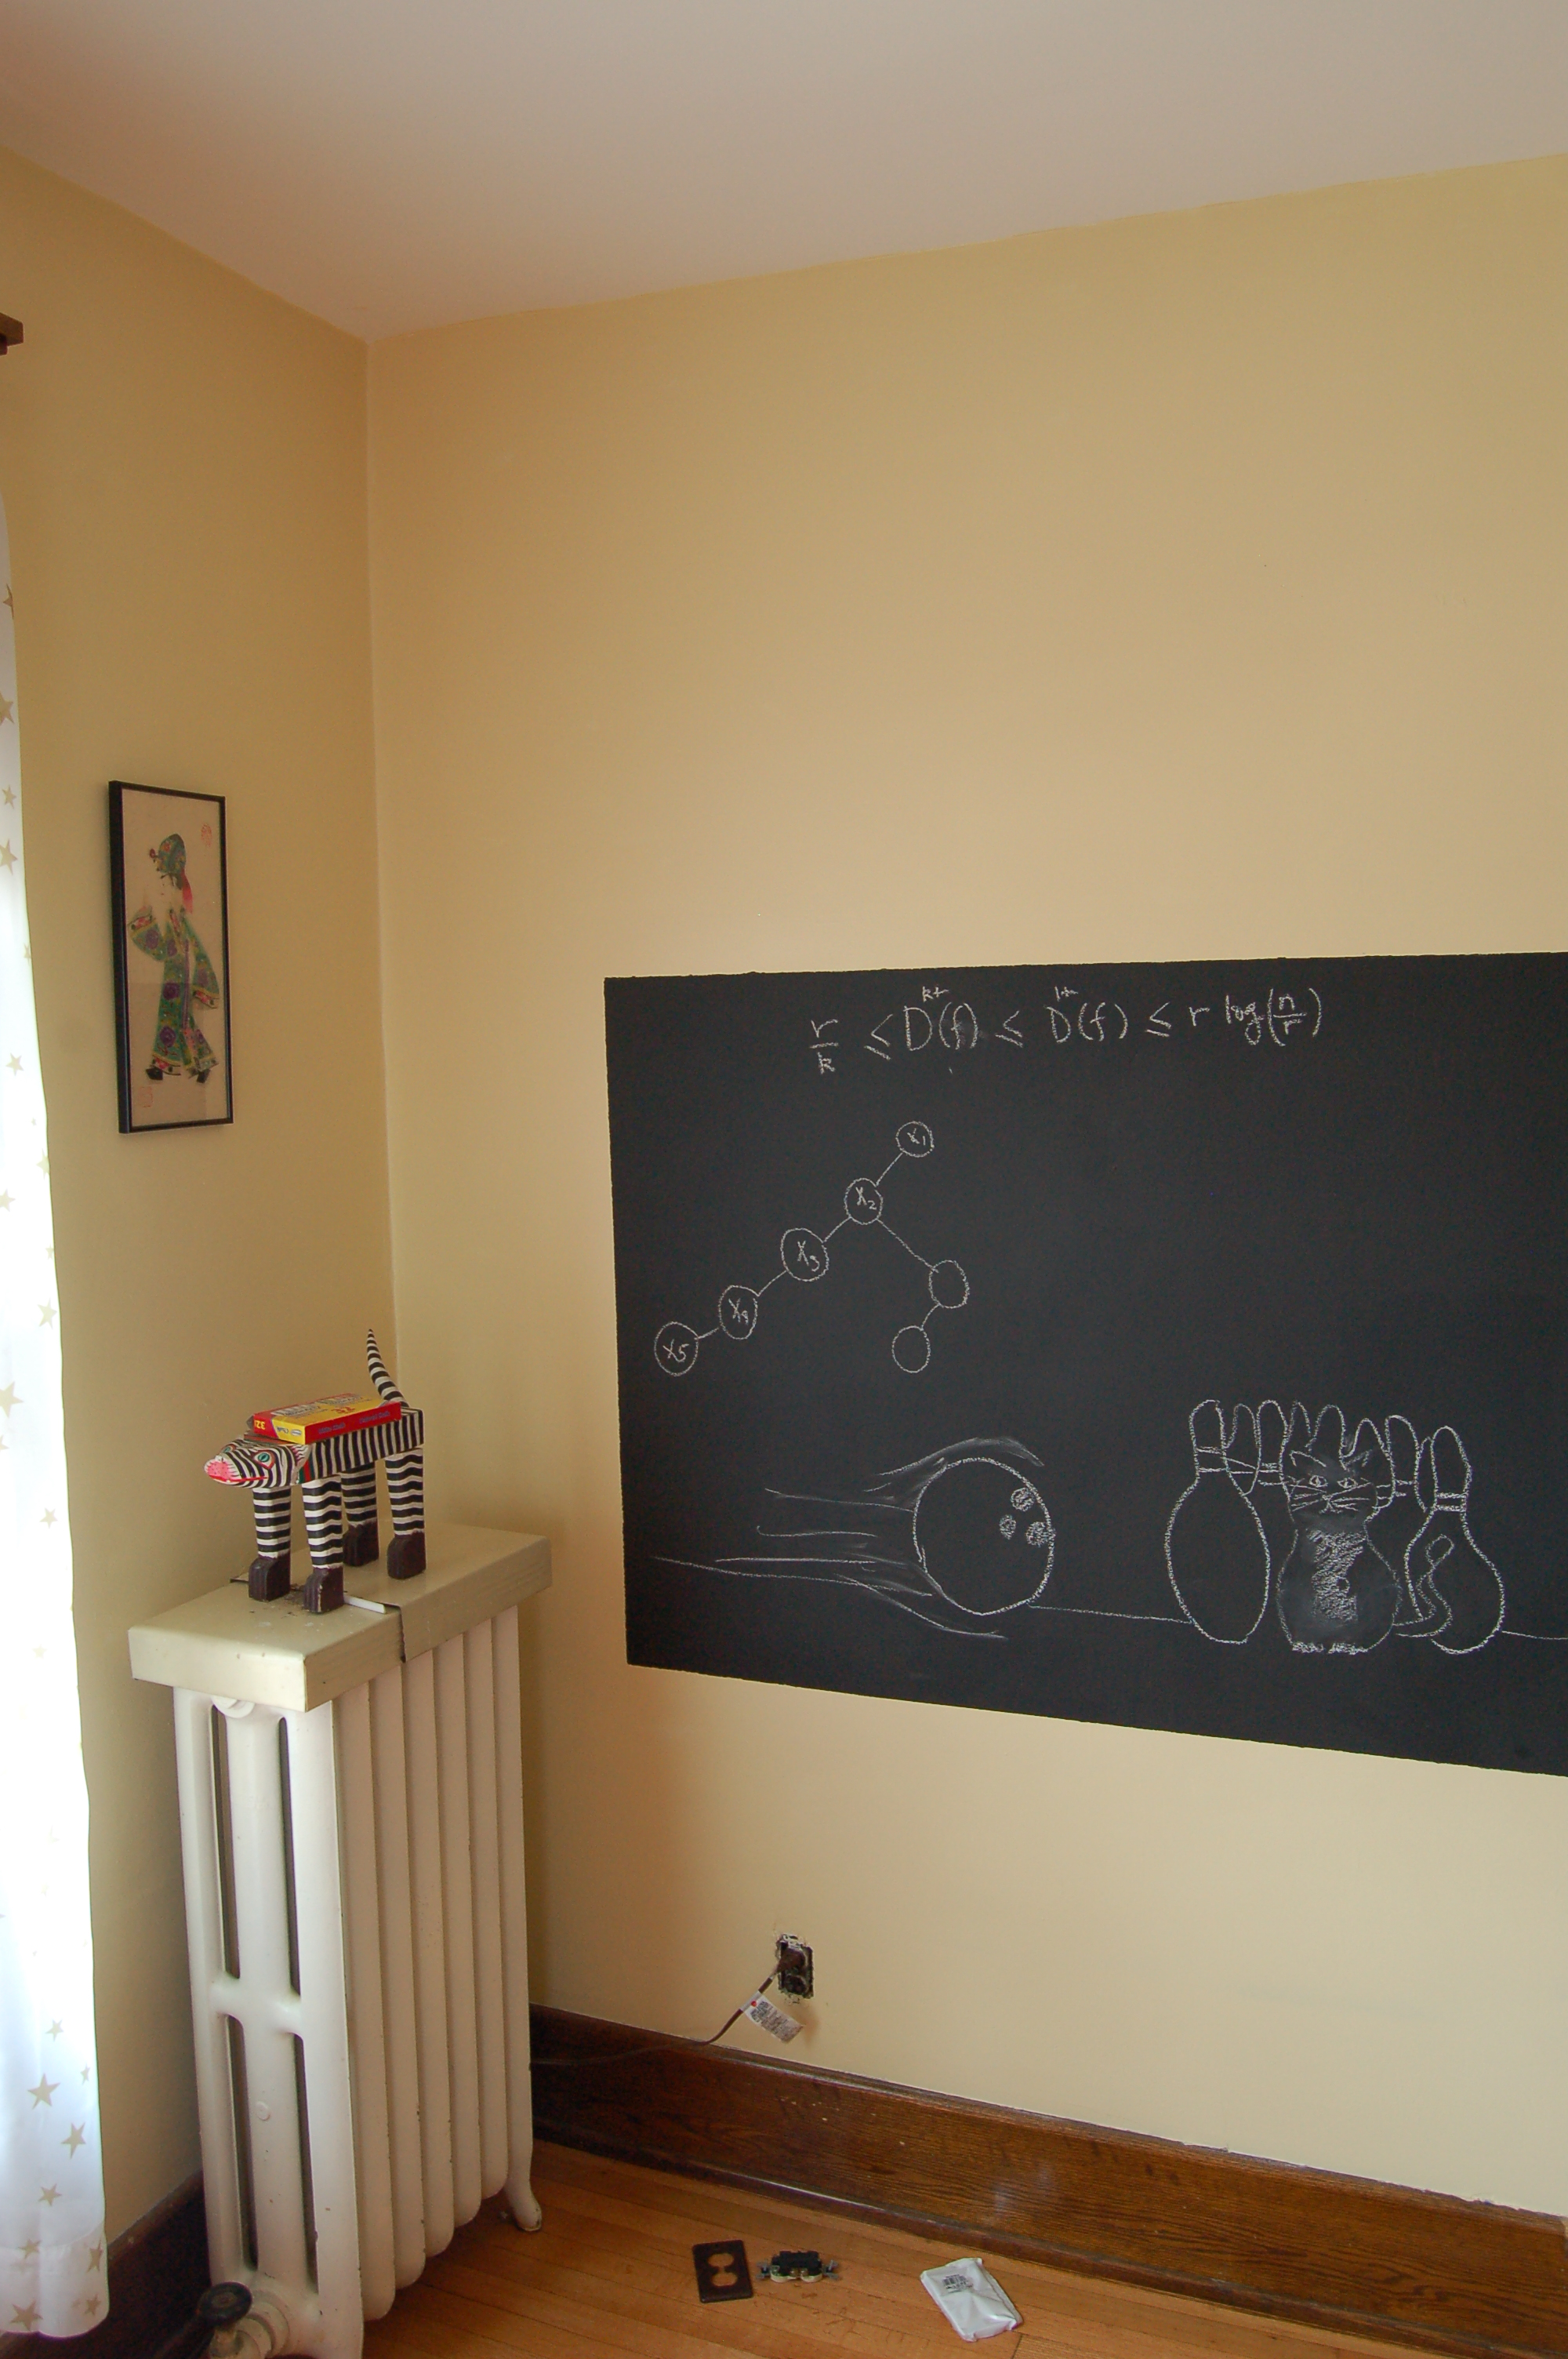
Argue correctness on the board…

