Slide 1
Lecture 19
CSE 331
Oct 17, 2022

Slide 2
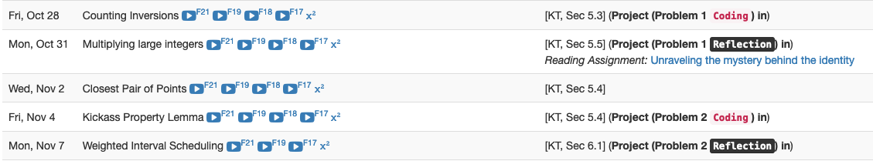
Project deadlines coming up

Slide 3
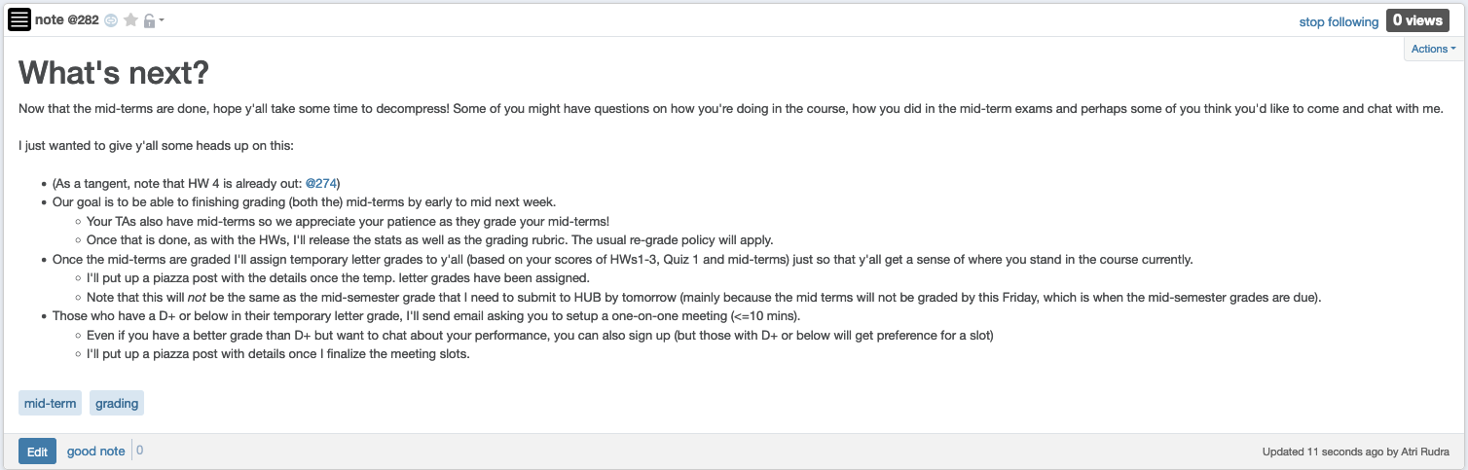
Some other stuff coming up

Slide 4
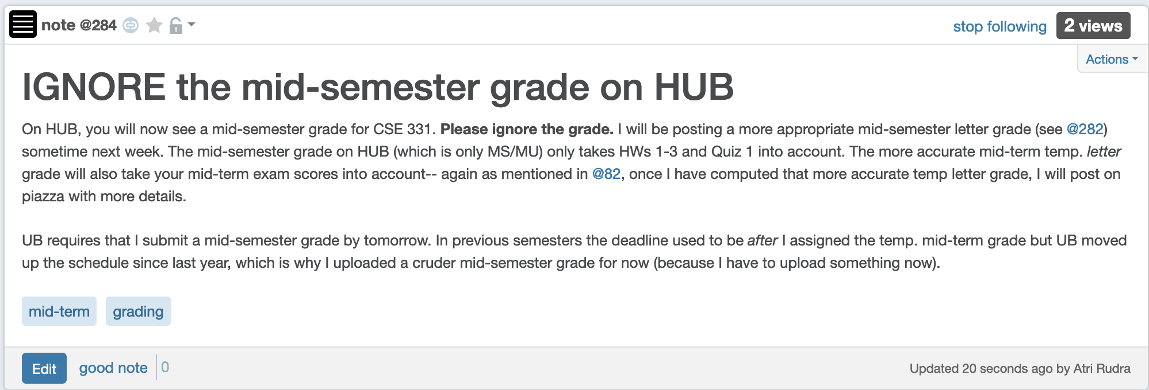
Ignore HUB mid-semester grade

Slide 5

Please pay attention to instructions

Slide 6

Overheard by a TA (in F19)..
I can't wait to be done with 331……
then I can have a normal life again

Slide 7

Questions?

Slide 8
Shortest Path problem
s
100
Input: Directed graph G=(V,E)
Edge lengths, l_{e} for e in E
“start” vertex s in V
w
5
15
u
s
s
w
5
5
15
u
u
Output: Length of shortest paths from s to all nodes in V

Slide 9
Towards Dijkstra’s algo: part ek
Determine d(t) one by one
s
d(s) = 0
u
x
y

Slide 10

Towards Dijkstra’s algo: part do
Determine d(t) one by one
Let u be a neighbor of s with smallest l_{(s,u)}
s
100
3
4
u
x
y
d(u) = l_{(s,u)}
Not making any claim on other vertices

Slide 11


Towards Dijkstra’s algo: part teen
Determine d(t) one by one
R
Assume we know d(v) for every v in R
s
u
x
y
Compute an upper bound d’(w) for every w not in R
d(w)
d(u) + l_{(u,w)}
w
d(w) d(x) + l_{(x,w)}
d’(w) = min _{e=(u,w) in E, u in R} d(u)+l_{e}
d(w) d(y) + l_{(y,w)}

Slide 12
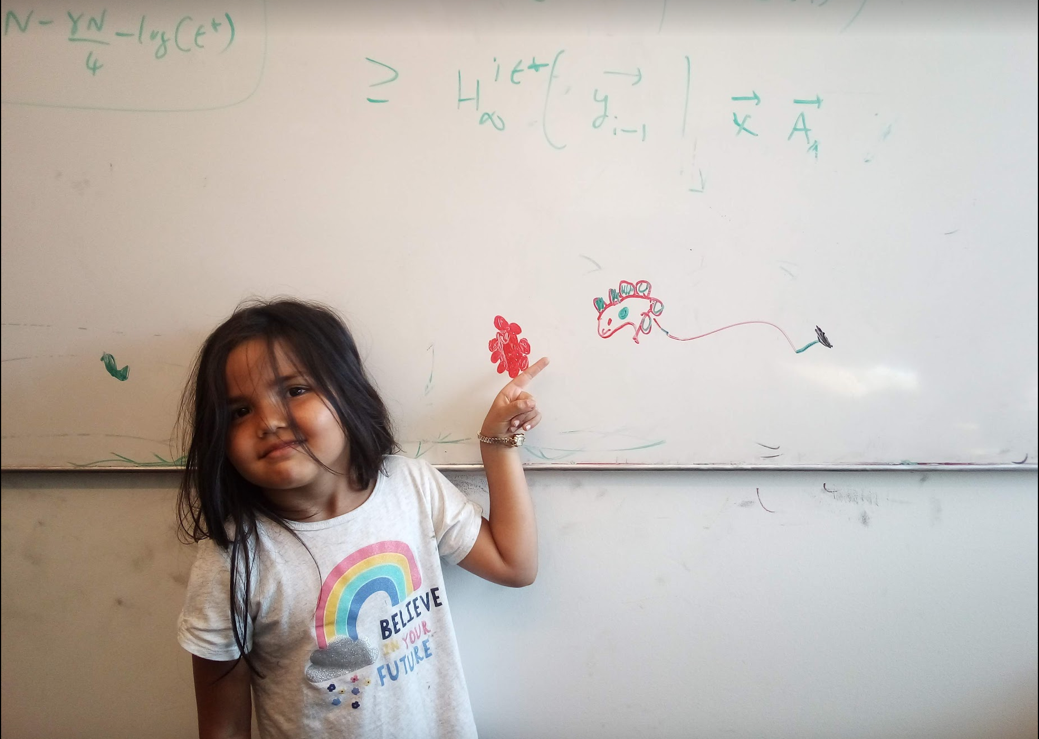
Questions/Comments?

Slide 13
Dijkstra’s shortest path algorithm
1
d’(w) = min _{e=(u,w) in E, u in R} d(u)+l_{e}
3
y
3
u
4
1
1
1
d(s) = 0
d(u) = 1
s
4
x
4
2
d(w) = 2
d(x) = 2
2
2
2
d(y) = 3
d(z) = 4
w
z
5
3
4
2
s
Input: Directed G=(V,E), l_{e} ≥ 0, s in V
u
w
R = {s}, d(s) =0
Shortest paths
While there is a x not in R with (u,x) in E, u in R
x
Pick w that minimizes d’(w)
Add w to R
y
z
d(w) = d’(w)

Slide 14
Questions/Comments?

Slide 15
Couple of remarks
The Dijkstra’s algo does not explicitly compute the shortest paths
Can maintain “shortest path tree” separately
Dijkstra’s algorithm does not work with negative weights
Left as an exercise

Slide 16
Rest of Today’s agenda
Prove the correctness of Dijkstra’s Algorithm

Slide 17
Dijkstra’s shortest path algorithm
d’(w) = min _{e=(u,w) in E, u in R} d(u)+l_{e}
P_{u} shortest s-u path in “Dijkstra tree”
Input: Directed G=(V,E), l_{e} ≥ 0, s in V
R = {s}, d(s) =0
While there is a x not in R with (u,x) in E, u in R
Pick w that minimizes d’(w)
Add w to R
d(w) = d’(w)
Lemma 1: At end of each iteration, if u in R, then P_{u} is a shortest s-u path
Lemma 2: If u is connected to s, then u in R at the end

Slide 18
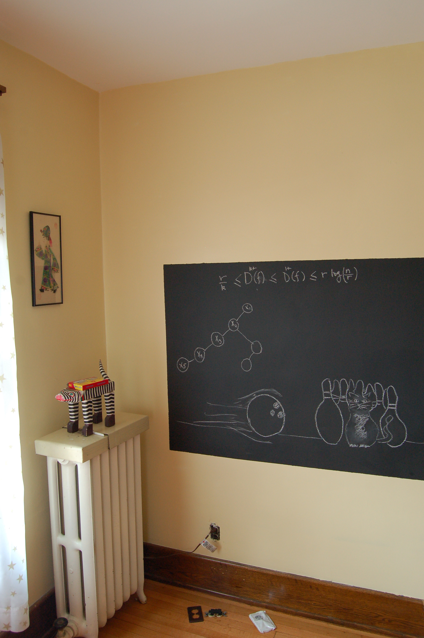
Proof idea of Lemma 1

Slide 19

Dijkstra’s shortest path algorithm
d’(w) = min _{e=(u,w) in E, u in R} d(u)+l_{e}
Input: Directed G=(V,E), l_{e} ≥ 0, s in V
R = {s}, d(s) =0
While there is a x not in R with (u,x) in E, u in R
At most n iterations
Pick w that minimizes d’(w)
Add w to R
d(w) = d’(w)
O((m+n)n) time bound is trivial
O((m+n) log n) time implementation with priority Q

Slide 20

Reading Assignment
Sec 4.4 of [KT]

